Slide 1
3.1) Sums of natural numbers

Slide 2
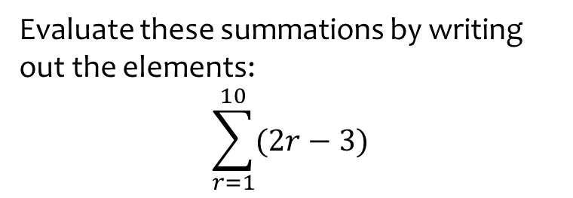
Worked example
Your turn
Evaluate these summations by writing out the elements:
$$\sum_{r=1}^{10}{(3r−2)}$$
$$\sum_{r=1}^{5}{(2−3r)}$$
Evaluate these summations by writing out the elements:
$$\sum_{r=1}^{10}{(2r−3)}$$
$$−1+1+3+5+7+9+11+13+15+17=80$$

Slide 3
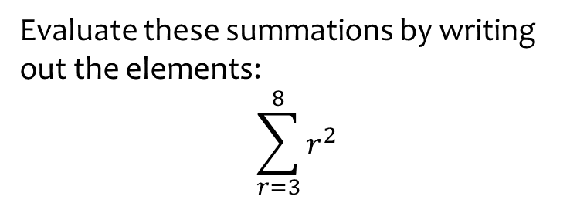
Worked example
Your turn
Evaluate these summations by writing out the elements:
$$\sum_{r=1}^{6}{r^{4}}$$
$$\sum_{r=2}^{7}{(r^{3})}$$
Evaluate these summations by writing out the elements:
$$\sum_{r=3}^{8}{r^{2}}$$
$$3^{2}+4^{2}+5^{2}+6^{2}+7^{2}+8^{2}=199$$

Slide 4

Worked example
Your turn
Evaluate:
$$\sum_{r=1}^{100}{r}$$
$$\sum_{r=20}^{50}{r}$$
Evaluate:
$$\sum_{r=21}^{50}{r}$$
$$1065$$

Slide 5
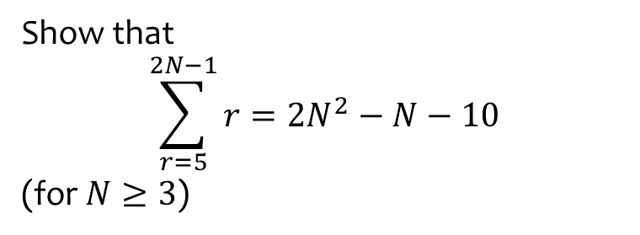
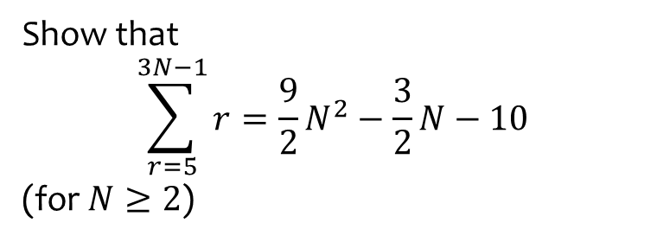
Worked example
Your turn
Show that
$$\sum_{r=5}^{3N−1}{r}=\frac{9}{2}N^{2}−\frac{3}{2}N−10$$
(for $N≥2$)
Show that
$$\sum_{r=5}^{2N−1}{r}=2N^{2}−N−10$$
(for $N≥3$)
Shown

Slide 6

Worked example
Your turn
Evaluate:
$$\sum_{r=1}^{100}{(3r−2)}$$
$$\sum_{r=1}^{50}{(2−3r)}$$
Evaluate
$$\sum_{r=1}^{100}{(2r−3)}$$
$$9800$$

Slide 7
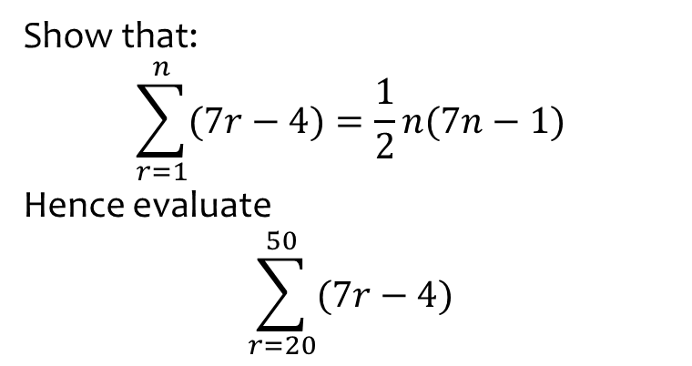
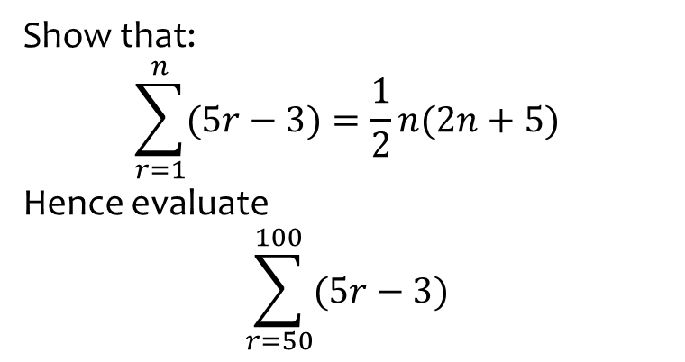
Worked example
Your turn
Show that:
$$\sum_{r=1}^{n}{(5r−3)}=\frac{1}{2}n(2n+5)$$
Hence evaluate
$$\sum_{r=50}^{100}{(5r−3)}$$
Show that:
$$\sum_{r=1}^{n}{(7r−4)}=\frac{1}{2}n(7n−1)$$
Hence evaluate
$$\sum_{r=20}^{50}{(7r−4)}$$
Shown
$$7471$$

Slide 8
Worked example
Your turn
Find the smallest value of $k$ for which
$$\sum_{r=1}^{k}{(6r−2)}>310$$
Find the smallest value of $k$ for which
$$\sum_{r=1}^{k}{(4r−5)}>4850$$
$$k=51$$

Slide 9
Worked example
Your turn
Given that
$$\sum_{r=1}^{n}{f(r)}={3n}^{2}+4n$$
deduce an expression for $f(r)$ in terms of $r$
Given that
$$\sum_{r=1}^{n}{f(r)}={2n}^{2}+5n$$
deduce an expression for $f(r)$ in terms of $r$
$$f\left(r\right)=4r+3$$

Slide 10
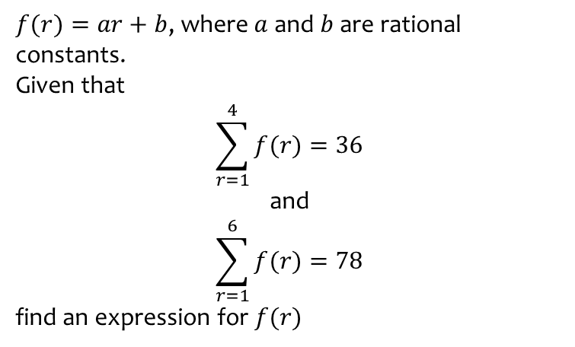
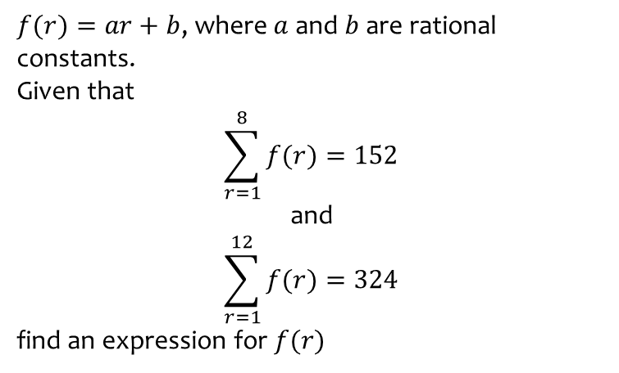
Worked example
Your turn
$f(r)=ar+b$, where $a$ and $b$ are rational constants.
Given that
$$\sum_{r=1}^{8}{f(r)}=152$$
and
$$\sum_{r=1}^{12}{f(r)}=324$$
find an expression for $f(r)$
$f(r)=ar+b$, where $a$ and $b$ are rational constants.
Given that
$$\sum_{r=1}^{4}{f(r)}=36$$
and
$$\sum_{r=1}^{6}{f(r)}=78$$
find an expression for $f(r)$
$$f\left(r\right)=4r−1$$

