Slide 1
Series
Twitter: @Owen134866
www.mathsfreeresourcelibrary.com

Slide 2
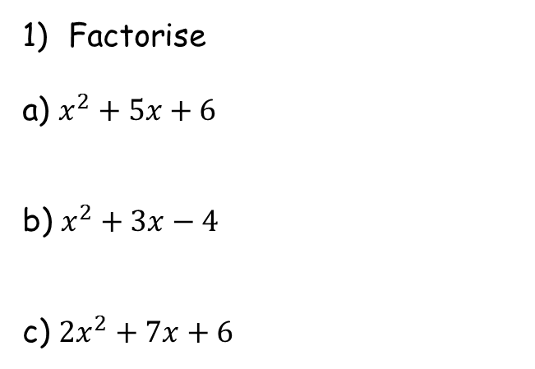
Prior Knowledge Check
Factorise
a) $x^{2}+5x+6$
b) $x^{2}+3x−4$
c) ${2x}^{2}+7x+6$
2) Simplify each of these by writing it as a product of two factors (brackets)
a) $\left(k+1\right)+\left(k+1\right)\left(k+2\right)$
b) $\frac{1}{2}{\left(k+1\right)}^{2}+k^{2}{\left(k+1\right)}^{2}$
c) $k^{2}\left(2k−1\right)+10k−5$
$$=(x+2)(x+3)$$
$$=(k+1)(k+3)$$
$$=(x+4)(x−1)$$
$$=\frac{1}{2}{\left(k+1\right)}^{2}(1+{2k}^{2})$$
$$=(2x+3)(x+2)$$
$$= (2k−1)(k^{2}+5)$$

Slide 3
Teachings for
Exercise 3A

Slide 4
Series
You can use the sigma notation to write the sum of a series clearly and concisely
The last value we put into the sequence formula (put in every integer in between as well!)
$$\sum_{r=1}^{3}{(10r−1)}$$
The sequence of numbers we are finding the sum of
The first value we put into the sequence formula
$$=9+19+29$$
$$=57$$
3A

Slide 5
Series
You can use the sigma notation to write the sum of a series clearly and concisely
The last value we put into the sequence formula (put in every integer in between as well!)
$$\sum_{r=2}^{5}{\left(r^{2}\right)}$$
The sequence of numbers we are finding the sum of
$$=4+9+16+25$$
The first value we put into the sequence formula
$$=54$$
3A

Slide 6
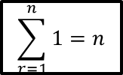
Series
$$\sum_{r=1}^{n}{1}=n$$
You can use the sigma notation to write the sum of a series clearly and concisely
To find the sum of a series of constant terms you can use the formula:
$$\sum_{r=1}^{n}{1}=n$$
This is essentially saying ‘the sum of $n$ 1s’ is equal to $n$
For example the sum of 1 + 1 + 1 = 3
The sum of 1 + 1 + 1 + 1 + 1 + 1 + 1 = 7
3A

Slide 7

Series
$$\sum_{r=1}^{n}{1}=n$$
$$\sum_{r=1}^{n}{r}=\frac{1}{2}n(n+1)$$
You can use the sigma notation to write the sum of a series clearly and concisely
To find the sum of the first n natural numbers (1, 2, 3, 4, 5…, n), you can use this formula:
$$\sum_{r=1}^{n}{r}=\frac{1}{2}n(n+1)$$
→ You will see how to prove this result in chapter 8!
This is essentially saying ‘the sum of $n$ natural numbers’ is equal to $\frac{1}{2}n(n+1)$
For example the sum of 1 + 2 + 3 + 4 + 5 = 15
$\frac{1}{2}\left(5\right)\left(5+1\right)=15$
3A

Slide 8

Series
$$\sum_{r=1}^{n}{1}=n$$
$$\sum_{r=1}^{n}{r}=\frac{1}{2}n(n+1)$$
$$\sum_{r=1}^{n}{r}=\frac{n(n+1)}{2}$$
You can use the sigma notation to write the sum of a series clearly and concisely
Calculate the sum of the series indicated below:
$$\sum_{r=1}^{n}{r}=\frac{1}{2}n\left(n+1\right)$$
We want the sum of the first 50 terms, so n = 50
$$\sum_{r=1}^{50}{r}=\frac{1}{2}(50)\left(50+1\right)$$
$$\sum_{r=1}^{50}{r}$$
Calculate
$$\sum_{r=1}^{50}{r}=1275$$
$$\frac{1}{2}n(n+1)$$
$$\frac{n(n+1)}{2}$$
It is fine (and sometimes easier) to use the formula in this form!
3A

Slide 9
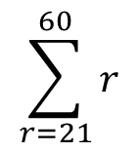
Series
$$\sum_{r=1}^{n}{1}=n$$
$$\sum_{r=1}^{n}{r}=\frac{1}{2}n(n+1)$$
$$\sum_{r=1}^{n}{r}=\frac{n(n+1)}{2}$$
The sum of the numbers from 21 to 60…
You can use the sigma notation to write the sum of a series clearly and concisely
Calculate the sum of the series indicated below:
0
10
20
30
40
50
60
-
$$\sum_{r=21}^{60}{r}$$
… Will be equal to the sum of the numbers from 1 to 60, subtract the numbers from 1 to 20…
The notation will look like this…
Notice the number here will always be one less than the one at the start!
$$\sum_{r=21}^{60}{r}$$
$$=\sum_{r=1}^{60}{r}$$
$$−\sum_{r=1}^{20}{r}$$
This is asking you to find the sum of the numbers from 21 to 60
Sum from 21 to 60
Sum from 1 to 60
Sum from 1 to 20
3A

Slide 10
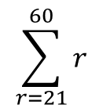
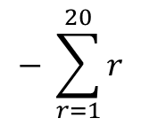
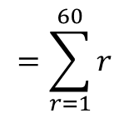
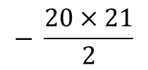
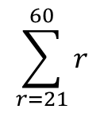
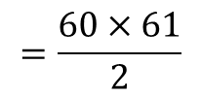
Series
$$\sum_{r=1}^{n}{1}=n$$
$$\sum_{r=1}^{n}{r}=\frac{1}{2}n(n+1)$$
$$\sum_{r=1}^{n}{r}=\frac{n(n+1)}{2}$$
You can use the sigma notation to write the sum of a series clearly and concisely
Calculate the sum of the series indicated below:
$$\sum_{r=21}^{60}{r}$$
$$=\sum_{r=1}^{60}{r}$$
$$− \sum_{r=1}^{20}{r}$$
Sub in values for each part
$$\sum_{r=21}^{60}{r}$$
$$\sum_{r=21}^{60}{r}$$
$$=\frac{60×61}{2}$$
$$− \frac{20×21}{2}$$
Calculate
$$=1620$$
This is asking you to find the sum of the numbers from 21 to 60
So the sum of the numbers from 21 to 60 is 1620!
3A

Slide 11
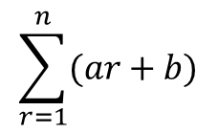


Series
$$\sum_{r=1}^{n}{1}=n$$
$$\sum_{r=1}^{n}{r}=\frac{1}{2}n(n+1)$$
$$\sum_{r=1}^{n}{r}=\frac{n(n+1)}{2}$$
You need to be able to split up parts of a sequence and sum them separately
You can split up series sums of the form:
into 2 separate ‘series sums’ as follows:
This allows you to then use the sum formulae for the sequence overall!
$$\sum_{r=1}^{n}{(ar+b)}$$
$$a\sum_{r=1}^{n}{r}$$
$$+ b\sum_{r=1}^{n}{1}$$
3A

Slide 12

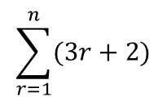
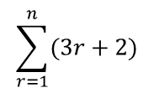



Series
$$\sum_{r=1}^{n}{1}=n$$
$$\sum_{r=1}^{n}{r}=\frac{1}{2}n(n+1)$$
$$\sum_{r=1}^{n}{r}=\frac{n(n+1)}{2}$$
You need to be able to split up parts of a sequence and sum them separately
Show that:
Can be written as:
$$\sum_{r=1}^{n}{(3r+2)}$$
If we wrote out the first few terms of this sequence…
$$\sum_{r=1}^{n}{(3r+2)}$$
$$=\left(3×1+2\right)$$
$$+ \left(3×2+2\right)$$
$$+ \left(3×3+2\right)$$
$$+ \left(3×4+2\right)………$$
This is equal to the sum of the multiplied terms, added to the sum of the 2s
$$=\left(3×1\right)$$
$$+ \left(3×2\right)$$
$$+ \left(3×3\right)$$
$$+ \left(3×4\right)$$
$$+ \left(2+2+2+2\right) ……$$
We can ‘factorise’ the 3 out of the multiplied terms and factorise a 2 from the added terms…
$$3\sum_{r=1}^{n}{r}$$
$$+ 2\sum_{r=1}^{n}{1}$$
$$=3×\left(1+2+3+4\right)………$$
$$+ 2\left(1+1+1+1\right)………$$
This is 3 multiplied by the sum of the first ‘n’ numbers represented by the formula ‘r’
This is 2 multiplied by ‘n’ 1s
$$3\sum_{r=1}^{n}{r}$$
$$+ 2\sum_{r=1}^{n}{1}$$
3A

Slide 13
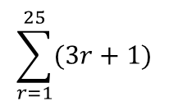
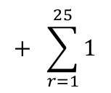
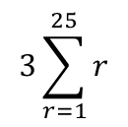
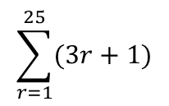
Series
$$\sum_{r=1}^{n}{1}=n$$
$$\sum_{r=1}^{n}{r}=\frac{1}{2}n(n+1)$$
$$\sum_{r=1}^{n}{r}=\frac{n(n+1)}{2}$$
$$\sum_{r=1}^{25}{(3r+1)}$$
You need to be able to split up parts of a sequence and sum them separately
Evaluate:
You need to split this up and sum the parts separately!
Split into two separate parts as you have seen
$$3\sum_{r=1}^{25}{r}$$
$$+ \sum_{r=1}^{25}{1}$$
$$\sum_{r=1}^{25}{(3r+1)}$$
Write the formulae for the sums. Remember the 3 at the start of the first one!
→ We will also have ‘n’ lots of 1
$$=\frac{3n(n+1)}{2}$$
$$+ n(1)$$
Sub in n = 25 (25 terms to add up)
$$=\frac{3(25)(25+1)}{2}$$
$$+ 25(1)$$
Calculate
$$=1000$$
So the first 25 terms of the sequence with the formula (3r + 1) will add up to 1000!
3A

Slide 14
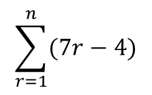
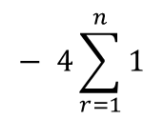
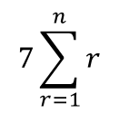
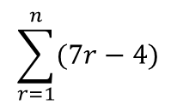
Series
$$\sum_{r=1}^{n}{1}=n$$
$$\sum_{r=1}^{n}{r}=\frac{1}{2}n(n+1)$$
$$\sum_{r=1}^{n}{r}=\frac{n(n+1)}{2}$$
$$\sum_{r=1}^{n}{(7r−4)}$$
You need to be able to split up parts of a sequence and sum them separately
Show that:
In this case you should proceed as normal, but use ‘n’ instead!
Split up as two separate sums
$$7\sum_{r=1}^{n}{r}$$
$$− 4\sum_{r=1}^{n}{1}$$
$$\sum_{r=1}^{n}{(7r−4)}$$
Remember the 7 on the first expression!
→ We also have n lots of 4
$$= \frac{n}{2}\left(7n−1\right)$$
$$=\frac{7n(n+1)}{2}$$
$$− 4n$$
Write ‘4n’ as fraction over 2 (for grouping)
$$=\frac{7n(n+1)}{2}$$
$$− \frac{8n}{2}$$
The sum of the first ‘n’ terms of this sequence
Is given by this formula, where ‘n’ is the number of terms
$$=\frac{7n\left(n+1\right)−8n}{2}$$
Group terms
Expand the bracket
$$=\frac{7n^{2}+7n−8n}{2}$$
$$=\frac{7n^{2}−n}{2}$$
Group terms
The two expressions are equivalent!
Factorise
$$=\frac{n(7n−1)}{2}$$
3A

Slide 15
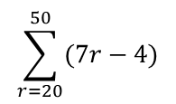
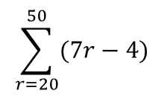
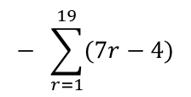
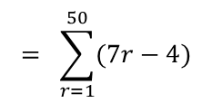
Series
$$\sum_{r=1}^{n}{1}=n$$
$$\sum_{r=1}^{n}{r}=\frac{1}{2}n(n+1)$$
$$\sum_{r=1}^{n}{r}=\frac{n(n+1)}{2}$$
Write as one sum subtract another
You need to be able to split up parts of a sequence and sum them separately
Show that:
Hence, calculate the value of:
Here, you can use the formula you’re given – remember that this will be the sum of the first 50 terms subtract the sum of the first 19!
$$\sum_{r=20}^{50}{(7r−4)}$$
$$= \sum_{r=1}^{50}{(7r−4)}$$
$$− \sum_{r=1}^{19}{(7r−4)}$$
Write the formula separately for each sum
$$=\frac{n(7n−1)}{2}$$
$$− \frac{n(7n−1)}{2}$$
Sub 50 into the first and 19 into the second
$$\sum_{r=1}^{n}{(7r−4)}$$
$$= \frac{n}{2}\left(7n−1\right)$$
$$=\frac{50(7(50)−1)}{2}$$
$$− \frac{19(7(19)−1)}{2}$$
Calculate each
$$=8725$$
$$− 1254$$
$$\sum_{r=20}^{50}{(7r−4)}$$
Calculate
$$=7471$$
3A

Slide 16
Teachings for
Exercise 3B

Slide 17




Series
$$\sum_{r=1}^{n}{1}=n$$
$$\sum_{r=1}^{n}{r}=\frac{1}{2}n(n+1)$$
$$\sum_{r=1}^{n}{r^{2}}=\frac{n(n+1)(2n+1)}{6}$$
$$\sum_{r=1}^{n}{r}=\frac{n(n+1)}{2}$$
$$\sum_{r=1}^{n}{r^{3}}=\frac{n^{2}}{4}{\left(n+1\right)}^{2}$$
You need to be able to calculate the sum of a sequence based on powers of 2 and 3
The sum of a sequence of squared numbers is given as follows:
And the formula for the sum of a sequence of cubes is:
You will see proofs for these in chapter 8!
$$\sum_{r=1}^{n}{r^{2}}$$
$$=\frac{n(n+1)(2n+1)}{6}$$
$$or \frac{n}{6}(n+1)(2n+1)$$
$$\sum_{r=1}^{n}{r^{3}}$$
$$=\frac{n^{2}{\left(n+1\right)}^{2}}{4}$$
$$or \frac{n^{2}}{4}{\left(n+1\right)}^{2}$$
3B

Slide 18
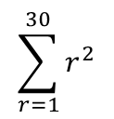
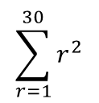
Series
$$\sum_{r=1}^{n}{1}=n$$
$$\sum_{r=1}^{n}{r}=\frac{1}{2}n(n+1)$$
$$\sum_{r=1}^{n}{r^{2}}=\frac{n(n+1)(2n+1)}{6}$$
$$\sum_{r=1}^{n}{r}=\frac{n(n+1)}{2}$$
$$\sum_{r=1}^{n}{r^{3}}=\frac{n^{2}}{4}{\left(n+1\right)}^{2}$$
$$\sum_{r=1}^{30}{r^{2}}$$
You need to be able to calculate the sum of a sequence based on powers of 2 and 3
Evaluate:
Write out the formula for a squared sequence
$$=\frac{n(n+1)(2n+1)}{6}$$
Sub in n = 30 as we want 30 terms
$$\sum_{r=1}^{30}{r^{2}}$$
$$=\frac{(30)(30+1)(2(30)+1)}{6}$$
Simplify the numerator (if necessary!)
$$=\frac{(30)(31)(61)}{6}$$
Calculate
$$=9455$$
3B
5D

Slide 19
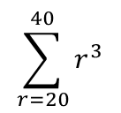
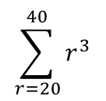
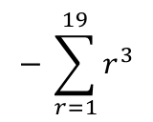
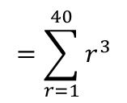
Series
$$\sum_{r=1}^{n}{1}=n$$
$$\sum_{r=1}^{n}{r}=\frac{1}{2}n(n+1)$$
$$\sum_{r=1}^{n}{r^{2}}=\frac{n(n+1)(2n+1)}{6}$$
$$\sum_{r=1}^{n}{r}=\frac{n(n+1)}{2}$$
$$\sum_{r=1}^{n}{r^{3}}=\frac{n^{2}}{4}{\left(n+1\right)}^{2}$$
Write it as one sum subtract another
You need to be able to calculate the sum of a sequence based on powers of 2 and 3
Evaluate:
Remember for this one you need the sum of the first 40 terms, subtract the first 19 terms!
$$\sum_{r=20}^{40}{r^{3}}$$
$$=\sum_{r=1}^{40}{r^{3}}$$
$$− \sum_{r=1}^{19}{r^{3}}$$
Write out the formula for the cubed sequence twice
$$\sum_{r=20}^{40}{r^{3}}$$
$$=\frac{n^{2}{\left(n+1\right)}^{2}}{4}$$
$$− \frac{n^{2}{\left(n+1\right)}^{2}}{4}$$
Sub in 40 for the first and 19 for the second
$$=\frac{{(40)}^{2}{\left(40+1\right)}^{2}}{4}$$
$$− \frac{{(19)}^{2}{\left(19+1\right)}^{2}}{4}$$
Calculate
$$=672400$$
$$− 36100$$
Finish the sum!
$$=636300$$
3B

Slide 20
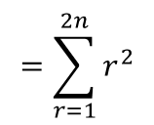
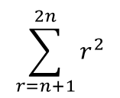
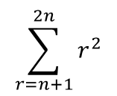
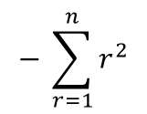
Series
$$\sum_{r=1}^{n}{1}=n$$
$$\sum_{r=1}^{n}{r}=\frac{1}{2}n(n+1)$$
$$\sum_{r=1}^{n}{r^{2}}=\frac{n(n+1)(2n+1)}{6}$$
$$\sum_{r=1}^{n}{r}=\frac{n(n+1)}{2}$$
$$\sum_{r=1}^{n}{r^{3}}=\frac{n^{2}}{4}{\left(n+1\right)}^{2}$$
$$\sum_{r=n+1}^{2n}{r^{2}}$$
$$=\sum_{r=1}^{2n}{r^{2}}$$
$$− \sum_{r=1}^{n}{r^{2}}$$
You need to be able to calculate the sum of a sequence based on powers of 2 and 3
Find:
This one is more algebraic but you still approach it the same way!
The first value we put in the sequence will be ‘n + 1’
The final value we put in will be ‘2n’
So we want the sum of the first ‘2n’ terms, subtract the first ‘n’ terms (same as if we were using numbers!)
Write out the formula twice
$$=\frac{n(n+1)(2n+1)}{6}$$
$$− \frac{n(n+1)(2n+1)}{6}$$
$$\sum_{r=n+1}^{2n}{r^{2}}$$
Sub ‘2n’ into the first and ‘n’ into the second
$$=\frac{2n(2n+1)(4n+1)}{6}$$
$$− \frac{n(n+1)(2n+1)}{6}$$
You can write this as one fraction
$$=\frac{2n\left(2n+1\right)\left(4n+1\right)−n(n+1)(2n+1)}{6}$$
This is the key step – you can factorise as n(2n+1) is common to both terms!
$$[$$
$$]$$
$$=$$
$$n(2n+1)$$
$$2\left(4n+1\right)$$
$$− (n+1)$$
$$6$$
Expand the terms in the square bracket
$$[$$
$$]$$
$$=$$
$$n(2n+1)$$
$$8n + 2$$
$$− n − 1$$
$$6$$
Simplify the square bracket (which can now be written as a ‘normal’ bracket!)
$$=$$
$$n(2n+1)$$
$$(7n +1)$$
$$6$$
The factorising step is crucial here – otherwise you will end up trying to factorise a cubic which can take a long time!
3B

Slide 21
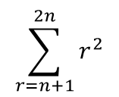
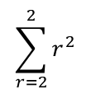
Series
$$\sum_{r=1}^{n}{1}=n$$
$$\sum_{r=1}^{n}{r}=\frac{1}{2}n(n+1)$$
$$\sum_{r=1}^{n}{r^{2}}=\frac{n(n+1)(2n+1)}{6}$$
$$\sum_{r=1}^{n}{r}=\frac{n(n+1)}{2}$$
$$\sum_{r=1}^{n}{r^{3}}=\frac{n^{2}}{4}{\left(n+1\right)}^{2}$$
$$\sum_{r=n+1}^{2n}{r^{2}=\frac{n(2n+1)(7n+1)}{6}}$$
You need to be able to calculate the sum of a sequence based on powers of 2 and 3
Find:
Verify that the result is correct for n = 1, 2 and 3
(This can show the formula is working, although in reality isn’t a proof in itself!)
If n = 1
$$\sum_{r=n+1}^{2n}{r^{2}}$$
$$\sum_{r=2}^{2}{r^{2}}$$
$$\frac{n(2n+1)(7n+1)}{6}$$
$$=\frac{n(2n+1)(7n+1)}{6}$$
$$=\frac{1(2+1)(7+1)}{6}$$
The first number we put in is 2, which is also the last number we put in
$$=\frac{24}{6}$$
Sequence →
$$4$$
$$=4$$
So the numbers in the sequence just add up to 4!
→ Let’s check the formula!
3B

Slide 22
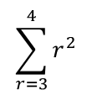
Series
$$\sum_{r=1}^{n}{1}=n$$
$$\sum_{r=1}^{n}{r}=\frac{1}{2}n(n+1)$$
$$\sum_{r=1}^{n}{r^{2}}=\frac{n(n+1)(2n+1)}{6}$$
$$\sum_{r=1}^{n}{r}=\frac{n(n+1)}{2}$$
$$\sum_{r=1}^{n}{r^{3}}=\frac{n^{2}}{4}{\left(n+1\right)}^{2}$$
$$\sum_{r=n+1}^{2n}{r^{2}=\frac{n(2n+1)(7n+1)}{6}}$$
You need to be able to calculate the sum of a sequence based on powers of 2 and 3
Find:
Verify that the result is correct for n = 1, 2 and 3
(This can show the formula is working, although in reality isn’t a proof in itself!)
If n = 2
$$\sum_{r=n+1}^{2n}{r^{2}}$$
$$\sum_{r=3}^{4}{r^{2}}$$
$$\frac{n(2n+1)(7n+1)}{6}$$
$$=\frac{n(2n+1)(7n+1)}{6}$$
$$=\frac{2(4+1)(14+1)}{6}$$
The first number we put in is 3, and the last number we put in in 4
$$=\frac{150}{6}$$
Sequence →
$$9, 16$$
$$=25$$
So the numbers in the sequence add up to 25
→ Let’s check the formula!
3B

Slide 23
Series
$$\sum_{r=1}^{n}{1}=n$$
$$\sum_{r=1}^{n}{r}=\frac{1}{2}n(n+1)$$
$$\sum_{r=1}^{n}{r^{2}}=\frac{n(n+1)(2n+1)}{6}$$
$$\sum_{r=1}^{n}{r}=\frac{n(n+1)}{2}$$
$$\sum_{r=1}^{n}{r^{3}}=\frac{n^{2}}{4}{\left(n+1\right)}^{2}$$
$$\sum_{r=n+1}^{2n}{r^{2}=\frac{n(2n+1)(7n+1)}{6}}$$
You need to be able to calculate the sum of a sequence based on powers of 2 and 3
Find:
Verify that the result is correct for n = 1, 2 and 3
(This can show the formula is working, although in reality isn’t a proof in itself!)
If n = 3
$$\sum_{r=n+1}^{2n}{r^{2}}$$
$$\sum_{r=4}^{6}{r^{2}}$$
$$\frac{n(2n+1)(7n+1)}{6}$$
$$=\frac{n(2n+1)(7n+1)}{6}$$
$$=\frac{3(6+1)(21+1)}{6}$$
The first number we put in is 4, and the last number we put in in 6
$$=\frac{462}{6}$$
Sequence →
$$16, 25, 36$$
$$=77$$
So the numbers in the sequence add up to 77
→ Let’s check the formula!
So the formula seems to be working fine!
3B

Slide 24
Series
$$\sum_{r=1}^{n}{1}=n$$
$$\sum_{r=1}^{n}{r}=\frac{1}{2}n(n+1)$$
$$\sum_{r=1}^{n}{r^{2}}=\frac{n(n+1)(2n+1)}{6}$$
$$\sum_{r=1}^{n}{r}=\frac{n(n+1)}{2}$$
$$\sum_{r=1}^{n}{r^{3}}=\frac{n^{2}}{4}{\left(n+1\right)}^{2}$$
You need to be able to use all you have learnt to calculate the sum of a more complex series, made up of several terms
Show that:
$$\sum_{r=1}^{n}{r^{2}+r−2}$$
Write as separate sums
$$\sum_{r=1}^{n}{r^{2}}$$
$$+ \sum_{r=1}^{n}{r}$$
$$− 2\sum_{r=1}^{n}{1}$$
Write the formula for each part in terms of n
$$\sum_{r=1}^{n}{r^{2}+r−2}=\frac{n}{3}(n+4)(n−1)$$
$$=\frac{n(n+1)(2n+1)}{6}$$
$$+ \frac{n(n+1)}{2}$$
$$− 2n$$
Write all with a common denominator
$$=\frac{n(n+1)(2n+1)}{6}$$
$$+ \frac{3n(n+1)}{6}$$
$$− \frac{12n}{6}$$
$$2n$$
$${(n}^{2}+ 3n−4)$$
Group up
$$=$$
$$6$$
$$=\frac{n\left(n+1\right)\left(2n+1\right)+3n\left(n+1\right)−12n}{6}$$
Divide numerator and denominator by 2
‘Clever factorisation’
$${(n}^{2}+ 3n−4)$$
$$[$$
$$]$$
$$n$$
$$n$$
$$=$$
$$=$$
$$(n+1)(2n+1)$$
$$+ 3(n+1)$$
$$− 12$$
$$3$$
$$6$$
Factorise!
$$]$$
Expand brackets
$$[$$
$$n$$
$$n$$
$${2n}^{2}+3n+1$$
$$=$$
$$(n+4)(n−1)$$
$$=$$
$$+ 3n+3$$
$$− 12$$
$$3$$
$$6$$
$$n$$
Group terms
$$=$$
$${(2n}^{2}+ 6n−8)$$
$$6$$
Take the factor 2 out of the bracket
$${(n}^{2}+ 3n−4)$$
$$=$$
$$2n$$
$$6$$
3B

Slide 25
Series
$$\sum_{r=1}^{n}{1}=n$$
$$\sum_{r=1}^{n}{r}=\frac{1}{2}n(n+1)$$
$$\sum_{r=1}^{n}{r^{2}}=\frac{n(n+1)(2n+1)}{6}$$
$$\sum_{r=1}^{n}{r}=\frac{n(n+1)}{2}$$
$$\sum_{r=1}^{n}{r^{3}}=\frac{n^{2}}{4}{\left(n+1\right)}^{2}$$
You need to be able to use all you have learnt to calculate the sum of a more complex series, made up of several terms
Show that:
Hence, calculate the sum of the series:
4 + 10 + 18 + 28 + 40 … … … + 418
$$\sum_{r=1}^{n}{r^{2}+r−2}$$
$$r=1$$
$${\left(1\right)}^{2}+\left(1\right)−2$$
$$=0$$
$$\sum_{r=1}^{n}{r^{2}+r−2}=\frac{n}{3}(n+4)(n−1)$$
$$r=2$$
$${\left(2\right)}^{2}+\left(2\right)−2$$
$$=4$$
$$r=3$$
$${\left(3\right)}^{2}+\left(3\right)−2$$
$$=10$$
$$r=4$$
$${\left(4\right)}^{2}+\left(4\right)−2$$
$$=18$$
$$r= ?$$
$$r^{2}+r−2$$
$$=418$$
You can see that this formula gives us the sequence we are trying to find the sum of!
(The 0 at the start will not affect the sum so can be ignored!)
We need to know how many terms there are, so have to find the value for r which gives a term with a value of 418…
3B

Slide 26
Series
$$\sum_{r=1}^{n}{1}=n$$
$$\sum_{r=1}^{n}{r}=\frac{1}{2}n(n+1)$$
$$\sum_{r=1}^{n}{r^{2}}=\frac{n(n+1)(2n+1)}{6}$$
$$\sum_{r=1}^{n}{r}=\frac{n(n+1)}{2}$$
$$\sum_{r=1}^{n}{r^{3}}=\frac{n^{2}}{4}{\left(n+1\right)}^{2}$$
You need to be able to use all you have learnt to calculate the sum of a more complex series, made up of several terms
Show that:
Hence, calculate the sum of the series:
4 + 10 + 18 + 28 + 40 … … … + 418
$$r^{2}+r−2=418$$
Subtract 418
$$r^{2}+r−420=0$$
Factorise
$$(r−20)(r+21)=0$$
$$\sum_{r=1}^{n}{r^{2}+r−2}=\frac{n}{3}(n+4)(n−1)$$
2 answers, only 1 is possible though!
$$r=20 or −21$$
So we are finding the sum of the first 20 terms of the sequence!
$$\sum_{r=1}^{20}{r^{2}+r−2}$$
We can use the formula we were given!
$$=\frac{n}{3}(n+4)(n−1)$$
Sub in n = 20
$$=\frac{20}{3}(20+4)(20−1)$$
Calculate
$$=3040$$
3B

Slide 27
Series
$$\sum_{r=1}^{n}{1}=n$$
$$\sum_{r=1}^{n}{r}=\frac{1}{2}n(n+1)$$
$$\sum_{r=1}^{n}{r^{2}}=\frac{n(n+1)(2n+1)}{6}$$
$$\sum_{r=1}^{n}{r}=\frac{n(n+1)}{2}$$
$$\sum_{r=1}^{n}{r^{3}}=\frac{n^{2}}{4}{\left(n+1\right)}^{2}$$
You need to be able to use all you have learnt to calculate the sum of a more complex series, made up of several terms
Find a formula for the sum of the series:
$$=\frac{2n^{2}{\left(n+1\right)}^{2}}{4}$$
$$+ \frac{5n(n+1)(2n+1)}{6}$$
$$− \frac{3n(n+1)}{2}$$
Write with the same denominator
$$=\frac{3n^{2}{\left(n+1\right)}^{2}}{6}$$
$$+ \frac{5n(n+1)(2n+1)}{6}$$
$$− \frac{9n(n+1)}{6}$$
$$\sum_{r=1}^{n}{r(r+3)(2r−1)}$$
Combine
$$=\frac{3n^{2}{\left(n+1\right)}^{2}+5n\left(n+1\right)\left(2n+1\right)−9n(n+1)}{6}$$
Expand the bracket
‘Clever factorisation’
$$[$$
$$]$$
$$\sum_{r=1}^{n}{r({2r}^{2}+5r−3)}$$
$$n(n+1)$$
$$3n(n+1)$$
$$+ 5(2n+1)$$
$$− 9$$
$$=$$
$$6$$
Expand the bracket again
Expand the inner brackets
$$[$$
$$]$$
$$n(n+1)$$
$$3n^{2}+3n$$
$$+ 10n+5$$
$$− 9$$
$$\sum_{r=1}^{n}{{2r}^{3}+{5r}^{2}−3r}$$
$$=$$
$$6$$
Simplify (you should also factorise if possible)
Write as 3 separate sums
$$=\frac{ n(n+1)(3n^{2}+13n−4)}{6}$$
$$2\sum_{r=1}^{n}{r^{3}}$$
$$+ 5\sum_{r=1}^{n}{r^{2}}$$
$$− 3\sum_{r=1}^{n}{r}$$
Write using the formulae above. Remember to include the coefficients!
$$=\frac{2n^{2}{\left(n+1\right)}^{2}}{4}$$
$$+ \frac{5n(n+1)(2n+1)}{6}$$
$$− \frac{3n(n+1)}{2}$$
3B

Slide 28
Series
$$\sum_{r=1}^{n}{1}=n$$
$$\sum_{r=1}^{n}{r}=\frac{1}{2}n(n+1)$$
$$\sum_{r=1}^{n}{r^{2}}=\frac{n(n+1)(2n+1)}{6}$$
$$\sum_{r=1}^{n}{r}=\frac{n(n+1)}{2}$$
$$\sum_{r=1}^{n}{r^{3}}=\frac{n^{2}}{4}{\left(n+1\right)}^{2}$$
You need to be able to use all you have learnt to calculate the sum of a more complex series, made up of several terms
Find a formula for the sum of the series:
Hence, calculate the following:
Write as one sum subtract another
$$\sum_{r=11}^{40}{r(r+3)(2r−1)}$$
$$=\sum_{r=1}^{40}{r(r+3)(2r−1)}$$
$$−\sum_{r=1}^{10}{r(r+3)(2r−1)}$$
$$\sum_{r=1}^{n}{r(r+3)(2r−1)}$$
Write the formulae out twice, one for each sum!
$$=\frac{ n(n+1)(3n^{2}+13n−4)}{6}$$
$$− \frac{ n(n+1)(3n^{2}+13n−4)}{6}$$
$$=\frac{ n(n+1)(3n^{2}+13n−4)}{6}$$
Sub in 40 and 10
$$=\frac{ 40(41)(5316)}{6}$$
$$− \frac{ 10(11)(426)}{6}$$
Calculate!
$$=1,445,230$$
$$\sum_{r=11}^{40}{r(r+3)(2r−1)}$$
3B

Slide 29
Series
$$\sum_{r=1}^{n}{1}=n$$
$$\sum_{r=1}^{n}{r}=\frac{1}{2}n(n+1)$$
$$\sum_{r=1}^{n}{r^{2}}=\frac{n(n+1)(2n+1)}{6}$$
$$\sum_{r=1}^{n}{r}=\frac{n(n+1)}{2}$$
$$\sum_{r=1}^{n}{r^{3}}=\frac{n^{2}}{4}{\left(n+1\right)}^{2}$$
The formula for squareds and cubes are given on the exam!
3B

