Slide 1
3) Methods in calculus
3.1) Improper integrals
3.2) The mean value of a function
3.3) Differentiating inverse trigonometric functions
3.4) Integrating with inverse trigonometric functions
3.5) Integrating using partial fractions

Slide 2
3.1) Improper integrals
Chapter CONTENTS

Slide 3
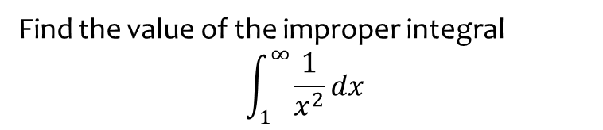
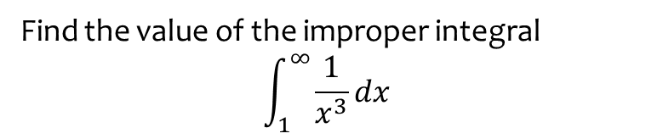
Worked example
Your turn
Find the value of the improper integral
$$\int_{1}^{∞}{\frac{1}{x^{3}}}dx$$
Find the value of the improper integral
$$\int_{1}^{∞}{\frac{1}{x^{2}}}dx$$
$$1$$

Slide 4
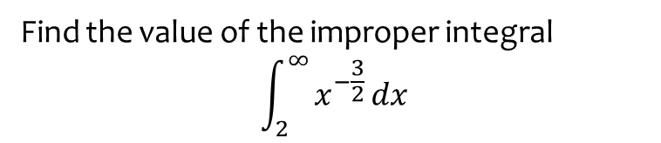
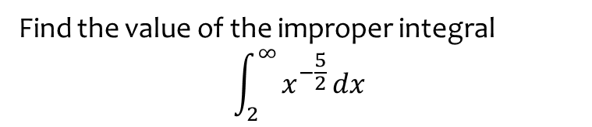
Worked example
Your turn
Find the value of the improper integral
$$\int_{2}^{∞}{x^{−\frac{5}{2}}}dx$$
Find the value of the improper integral
$$\int_{2}^{∞}{x^{−\frac{3}{2}}}dx$$
$$\sqrt{2}$$

Slide 5
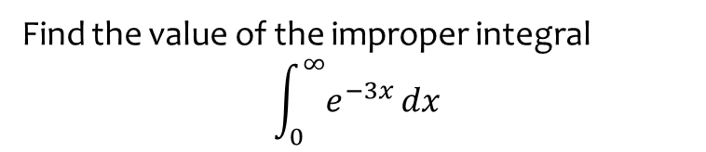
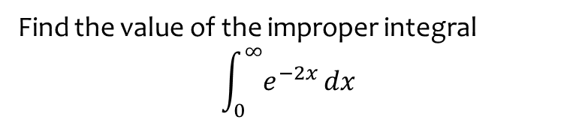

Worked example
Your turn
Find the value of the improper integral
$$\int_{0}^{∞}{e^{−2x}}dx$$
Find the value of the improper integral
$$\int_{0}^{∞}{e^{−3x}}dx$$
$$\frac{1}{3}$$

Slide 6
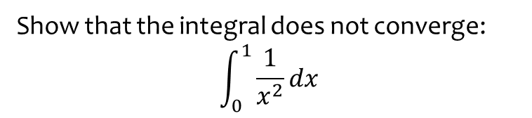
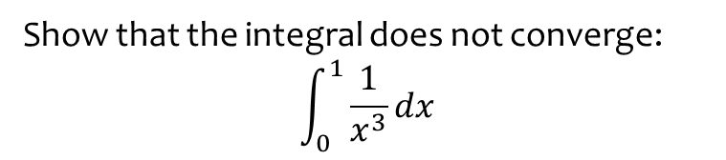
Worked example
Your turn
Show that the integral does not converge:
$$\int_{0}^{1}{\frac{1}{x^{3}}}dx$$
Show that the integral does not converge:
$$\int_{0}^{1}{\frac{1}{x^{2}}}dx$$
Shown

Slide 7
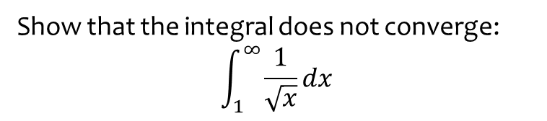
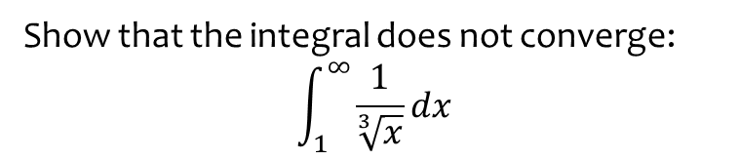
Worked example
Your turn
Show that the integral does not converge:
$$\int_{1}^{∞}{\frac{1}{\sqrt[3]{x}}}dx$$
Show that the integral does not converge:
$$\int_{1}^{∞}{\frac{1}{\sqrt{x}}}dx$$
Shown

Slide 8
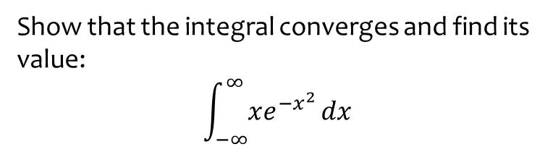
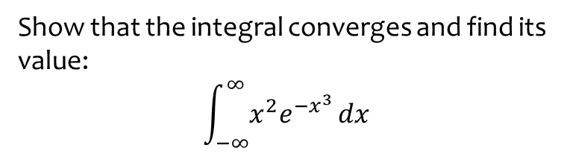
Worked example
Your turn
Show that the integral converges and find its value:
$$\int_{−∞}^{∞}{x^{2}e^{−x^{3}}}dx$$
Show that the integral converges and find its value:
$$\int_{−∞}^{∞}{xe^{−x^{2}}}dx$$
$$0$$

Slide 9
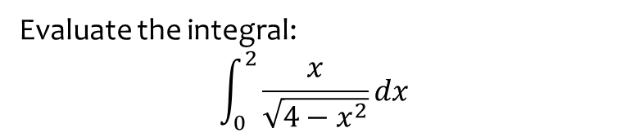
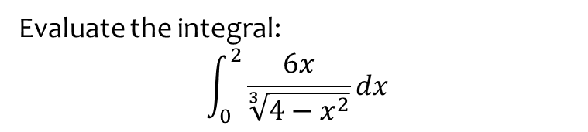
Worked example
Your turn
Evaluate the integral:
$$\int_{0}^{2}{\frac{6x}{\sqrt[3]{4−x^{2}}}}dx$$
Evaluate the integral:
$$\int_{0}^{2}{\frac{x}{\sqrt{4−x^{2}}}}dx$$
$$2$$

Slide 10
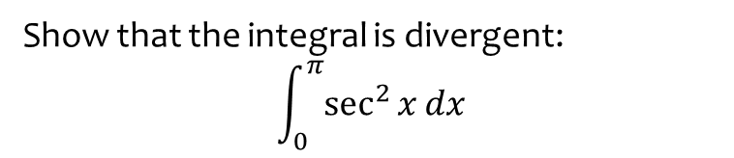
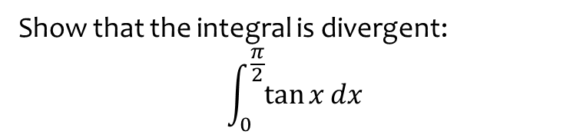
Worked example
Your turn
Show that the integral is divergent:
$$\int_{0}^{\frac{π}{2}}{\tan{x}}dx$$
Show that the integral is divergent:
$$\int_{0}^{π}{\sec^{2}{x}}dx$$
Shown

Slide 11
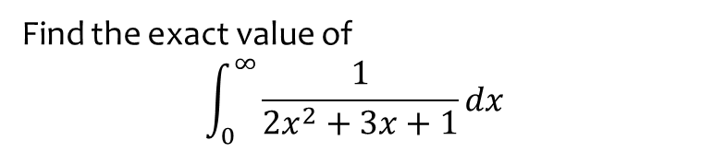
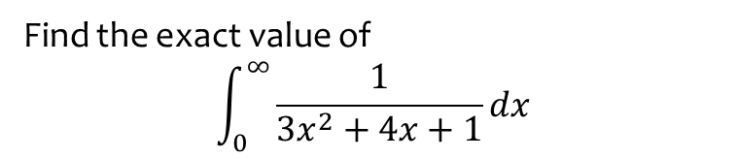
Worked example
Your turn
Find the exact value of
$$\int_{0}^{∞}{\frac{1}{3x^{2}+4x+1}}dx$$
Find the exact value of
$$\int_{0}^{∞}{\frac{1}{2x^{2}+3x+1}}dx$$
$$\ln{2}$$

Slide 12
3.2) The mean value of a function
Chapter CONTENTS

Slide 13
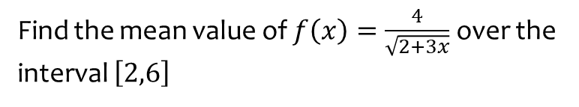
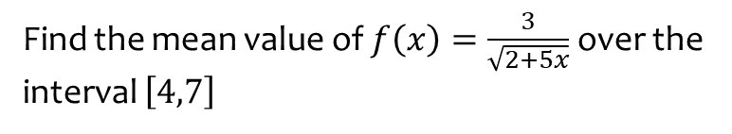

Worked example
Your turn
Find the mean value of $f\left(x\right)=\frac{3}{\sqrt{2+5x}}$ over the interval $\left[4,7\right]$
Find the mean value of $f\left(x\right)=\frac{4}{\sqrt{2+3x}}$ over the interval $\left[2,6\right]$
$$\frac{4}{3}\left(\sqrt{5}−\sqrt{2}\right)$$

Slide 14
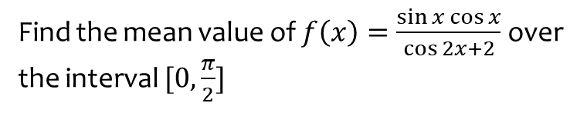
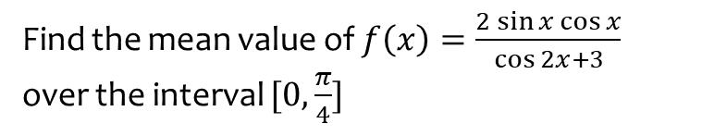

Worked example
Your turn
Find the mean value of $f\left(x\right)=\frac{2\sin{x}\cos{x}}{\cos{2x}+3}$ over the interval $[0,\frac{π}{4}]$
Find the mean value of $f\left(x\right)=\frac{\sin{x}\cos{x}}{\cos{2x}+2}$ over the interval $[0,\frac{π}{2}]$
$$\frac{\ln{3}}{2π}$$

Slide 15
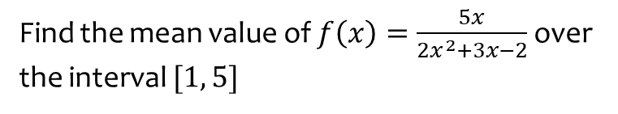
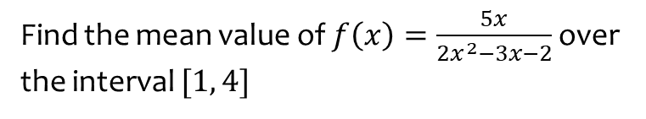

Worked example
Your turn
Find the mean value of $f\left(x\right)=\frac{5x}{2x^{2}−3x−2}$over the interval $[1, 4]$
Find the mean value of $f\left(x\right)=\frac{5x}{2x^{2}+3x−2}$over the interval $[1, 5]$
$$\frac{1}{4}\ln{\frac{49}{3}}$$

Slide 16
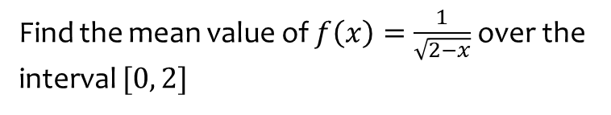
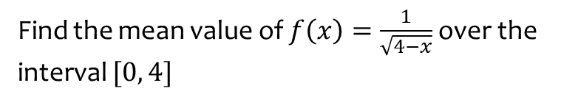
Worked example
Your turn
Find the mean value of $f\left(x\right)=\frac{1}{\sqrt{4−x}}$over the interval $[0, 4]$
Find the mean value of $f\left(x\right)=\frac{1}{\sqrt{2−x}}$over the interval $[0, 2]$
$$\sqrt{2}$$

Slide 17
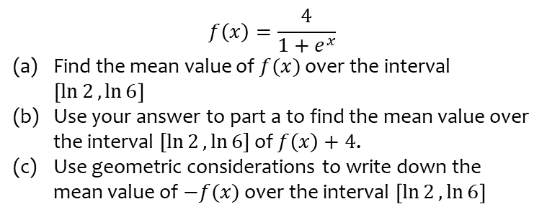
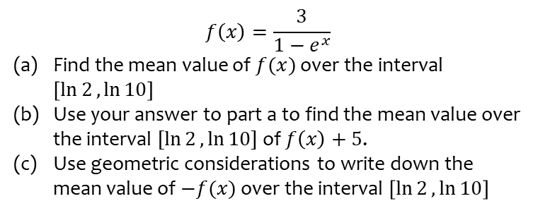
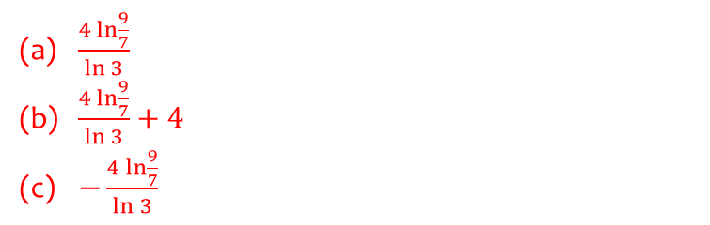
Worked example
Your turn
$$f\left(x\right)=\frac{3}{1−e^{x}}$$
Find the mean value of $f(x)$ over the interval $\left[\ln{2},\ln{10}\right]$
Use your answer to part a to find the mean value over the interval $[\ln{2},\ln{10}]$ of $f\left(x\right)+5$.
Use geometric considerations to write down the mean value of $−f(x)$ over the interval $\left[\ln{2},\ln{10}\right]$
$$f\left(x\right)=\frac{4}{1+e^{x}}$$
Find the mean value of $f(x)$ over the interval $\left[\ln{2},\ln{6}\right]$
Use your answer to part a to find the mean value over the interval $[\ln{2},\ln{6}]$ of $f\left(x\right)+4$.
Use geometric considerations to write down the mean value of $−f(x)$ over the interval $\left[\ln{2},\ln{6}\right]$
$\frac{4\ln{\frac{9}{7}}}{\ln{3}}$
$\frac{4\ln{\frac{9}{7}}}{\ln{3}}+4$
$−\frac{4\ln{\frac{9}{7}}}{\ln{3}}$

Slide 18
3.3) Differentiating inverse trigonometric functions
Chapter CONTENTS

Slide 19



Worked example
Your turn
Find:
$$\frac{d}{dx}(\arcsin{x})$$
$$\frac{d}{dx}(\arctan{x})$$
Find:
$$\frac{d}{dx}(\arccos{x})$$
$$−\frac{1}{\sqrt{1−x^{2}}}$$

Slide 20



Worked example
Your turn
Find:
$$\frac{d}{dx}(\arccos{x^{4}})$$
$$\frac{d}{dx}(\arctan{2x^{3}})$$
Find:
$$\frac{d}{dx}(\arcsin{x^{2}})$$
$$\frac{2x}{\sqrt{1−x^{4}}}$$

Slide 21



Worked example
Your turn
Find:
$$\frac{d}{dx}(\operatorname{arcsec}{3x})$$
Find:
$$\frac{d}{dx}(\operatorname{arcsec}{2x})$$
$$\frac{1}{x \sqrt{4x^{2}−1}}$$

Slide 22



Worked example
Your turn
Given that $y=\arctan\left(\frac{1+x}{1−x}\right)$, find $\frac{dy}{dx}$
Given that $y=\arctan\left(\frac{1−x}{1+x}\right)$, find $\frac{dy}{dx}$
$$−\frac{1}{1+x^{2}}$$

Slide 23
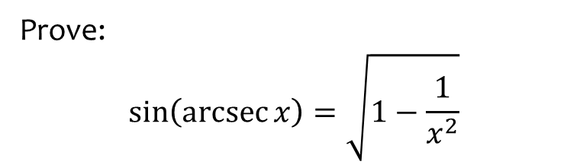
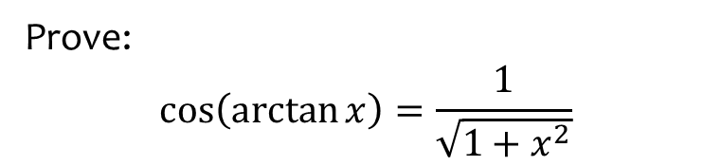
Worked example
Your turn
Prove:
$$\cos\left(\arctan{x}\right)=\frac{1}{\sqrt{1+x^{2}}}$$
Prove:
$$\sin\left(\operatorname{arcsec}{x}\right)=\sqrt{1−\frac{1}{x^{2}}}$$
Proof

Slide 24
3.4) Integrating with inverse trigonometric functions
Chapter CONTENTS

Slide 25
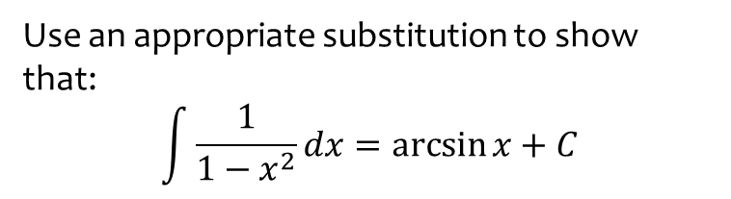

Worked example
Your turn
Use an appropriate substitution to show that:
$$\int{\frac{1}{1+x^{2}}dx}=\arctan{x}+C$$
$$\int{\frac{−1}{\sqrt{1−x^{2}}}dx}=\arccos{x}+C$$
Use an appropriate substitution to show that:
$$\int{\frac{1}{1−x^{2}}dx}=\arcsin{x}+C$$
Proof

Slide 26
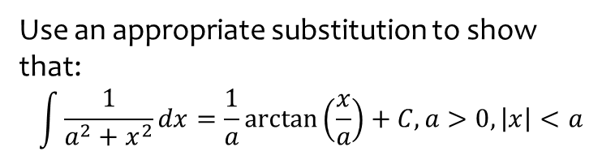
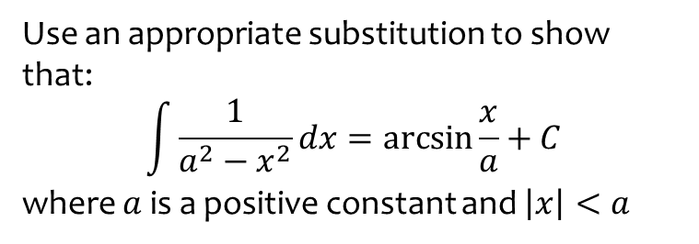
Worked example
Your turn
Use an appropriate substitution to show that:
$$\int{\frac{1}{a^{2}−x^{2}}dx}=\arcsin{\frac{x}{a}}+C$$
where $a$ is a positive constant and $\left|x\right|<a$
Use an appropriate substitution to show that:
$$\int{\frac{1}{a^{2}+x^{2}}dx}=\frac{1}{a}\arctan\left(\frac{x}{a}\right)+C, a>0, \left|x\right|<a$$
Proof

Slide 27



Worked example
Your turn
Find:
$$\int{\frac{3}{2+x^{2}}dx}$$
Find:
$$\int{\frac{4}{5+x^{2}}dx}$$
$$\frac{4}{\sqrt{5}}\arctan\left(\frac{x}{\sqrt{5}}\right)+c$$

Slide 28



Worked example
Your turn
Find:
$$\int{\frac{1}{49+16x^{2}}dx}$$
Find:
$$\int{\frac{1}{25+9x^{2}}dx}$$
$$\frac{1}{15}\arctan\left(\frac{3x}{5}\right)+c$$

Slide 29



Worked example
Your turn
Find:
$$\int_{−1}^{2}{\frac{1}{\sqrt{21−3x^{2}}}}dx$$
Find:
$$\int_{−\frac{\sqrt{3}}{4}}^{\frac{\sqrt{3}}{4}}{\frac{1}{\sqrt{3−4x^{2}}}}dx$$
$$\frac{π}{6}$$

Slide 30



Worked example
Your turn
Find:
$$\int{\frac{x+9}{\sqrt{1−9x^{2}}}dx}$$
Find:
$$\int{\frac{x+4}{\sqrt{1−4x^{2}}}dx}$$
$$\frac{1}{4}\sqrt{1−4x^{2}}+2\arcsin{2x}+c$$

Slide 31



Worked example
Your turn
Find:
$$\int{\frac{6x−5}{3+x^{2}}dx}$$
Find:
$$\int{\frac{8x−3}{4+x^{2}}dx}$$
$$4\ln{(4+x^{2})}−\frac{3}{2}\arctan\left(\frac{x}{2}\right)+c$$

Slide 32


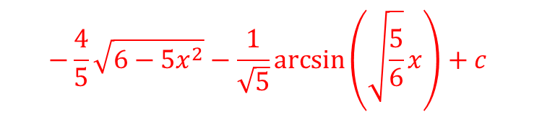
Worked example
Your turn
Find:
$$\int{\frac{3x−1}{\sqrt{5−4x^{2}}}dx}$$
Find:
$$\int{\frac{4x−1}{\sqrt{6−5x^{2}}}dx}$$
$$−\frac{4}{5}\sqrt{6−5x^{2}}−\frac{1}{\sqrt{5}}\arcsin\left(\sqrt{\frac{5}{6}}x\right)+c$$

Slide 33
3.5) Integrating using partial fractions
Chapter CONTENTS

Slide 34


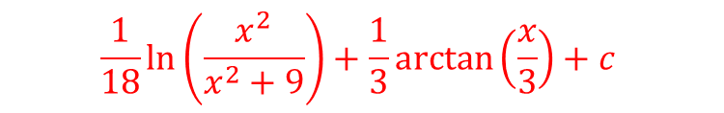
Worked example
Your turn
Find:
$$\int{\frac{1+x}{x^{3}+16x}}dx$$
Find:
$$\int{\frac{1+x}{x^{3}+9x}}dx$$
$$\frac{1}{18}\ln\left(\frac{x^{2}}{x^{2}+9}\right)+\frac{1}{3}\arctan\left(\frac{x}{3}\right)+c$$

Slide 35



Worked example
Your turn
Find:
$$\int{\frac{3x−x^{2}}{\left(x^{2}+9\right)\left(x+3\right)}} dx$$
Find:
$$\int{\frac{x^{2}−3x}{\left(x^{2}+6\right)\left(x+2\right)}} dx$$
$$\ln{|x+2|}−\frac{3}{\sqrt{2}}\arctan\left(\frac{x}{\sqrt{6}}\right)+c$$

Slide 36



Worked example
Your turn
Find:
$$\int{\frac{x^{4}+x}{x^{4}+7x^{2}+12}} dx$$
Find:
$$\int{\frac{x^{4}+x}{x^{4}+5x^{2}+6}} dx$$
$$x+\frac{1}{2}\ln\left|\frac{x^{2}+2}{x^{2}+3}\right|+2\sqrt{2}\arctan\left(\frac{x}{\sqrt{2}}\right)−3\sqrt{3}\arctan\left(\frac{x}{\sqrt{3}}\right)+c$$

Slide 37

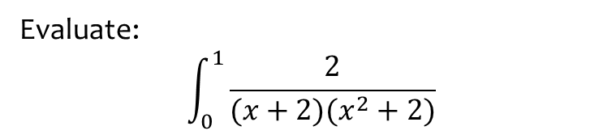

Worked example
Your turn
Evaluate:
$$\int_{0}^{1}{\frac{2}{(x+2)(x^{2}+2)}}$$
Find:
$$\int_{0}^{1}{\frac{2}{(x+1)(x^{2}+1)}}$$
$$\frac{1}{4}\left(π+2\ln{2}\right)$$

Slide 38


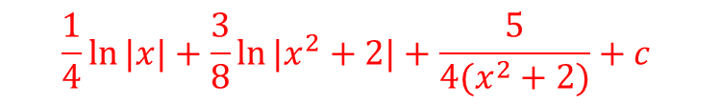
Worked example
Your turn
Find:
$$\int{\frac{x^{4}+1}{x{\left(x^{2}+3\right)}^{2}}} dx$$
Find:
$$\int{\frac{x^{4}+1}{x{\left(x^{2}+2\right)}^{2}}} dx$$
$$\frac{1}{4}\ln{|x|}+\frac{3}{8}\ln{|x^{2}+2|}+\frac{5}{4(x^{2}+2)}+c$$

Slide 39



Worked example
Your turn
Find:
$$\int{\frac{1}{3x^{2}+6x+7}} dx$$
Find:
$$\int{\frac{1}{2x^{2}+4x+11}} dx$$
$$\frac{1}{3\sqrt{2}}\arctan\left(\frac{\sqrt{2}\left(x+1\right)}{3}\right)+c$$

