Slide 1
2D Area & Perimeter
2D Area & Perimeter
June 2017 2H Q21
SAM
2H Q9
Spec 1
3H Q5
Nov 2017 1H Q23
SAM
3H Q1
Spec 2
1H Q2
May 2018 1H Q8
Spec 1
1H Q4
Spec 2
1H Q18
June 2018 3H Q3
Spec 1
2H Q19
Spec 2
3H Q7
Nov 2018 2H Q5
May 2019 1H Q7

Slide 2
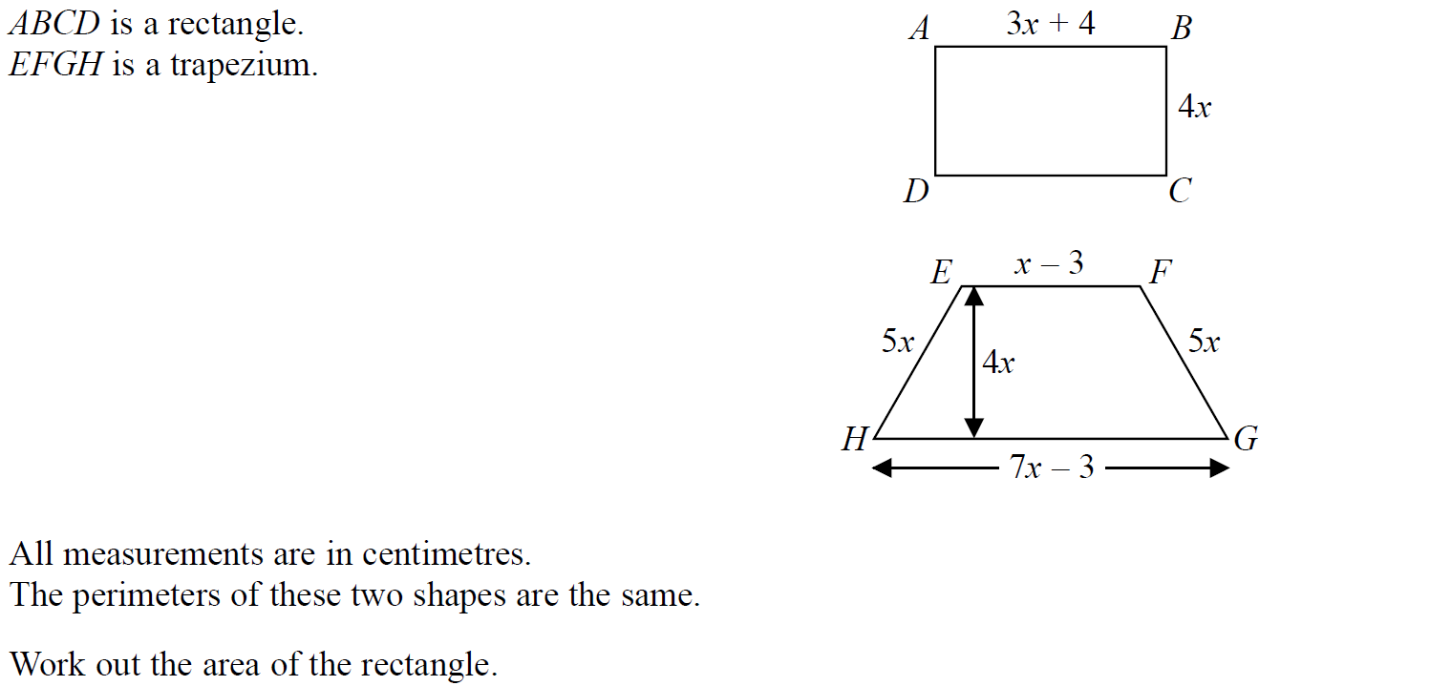
2D Area & Perimeter
SAM 2H Q9

Slide 3
2D Area & Perimeter
SAM 2H Q9
A

Slide 4
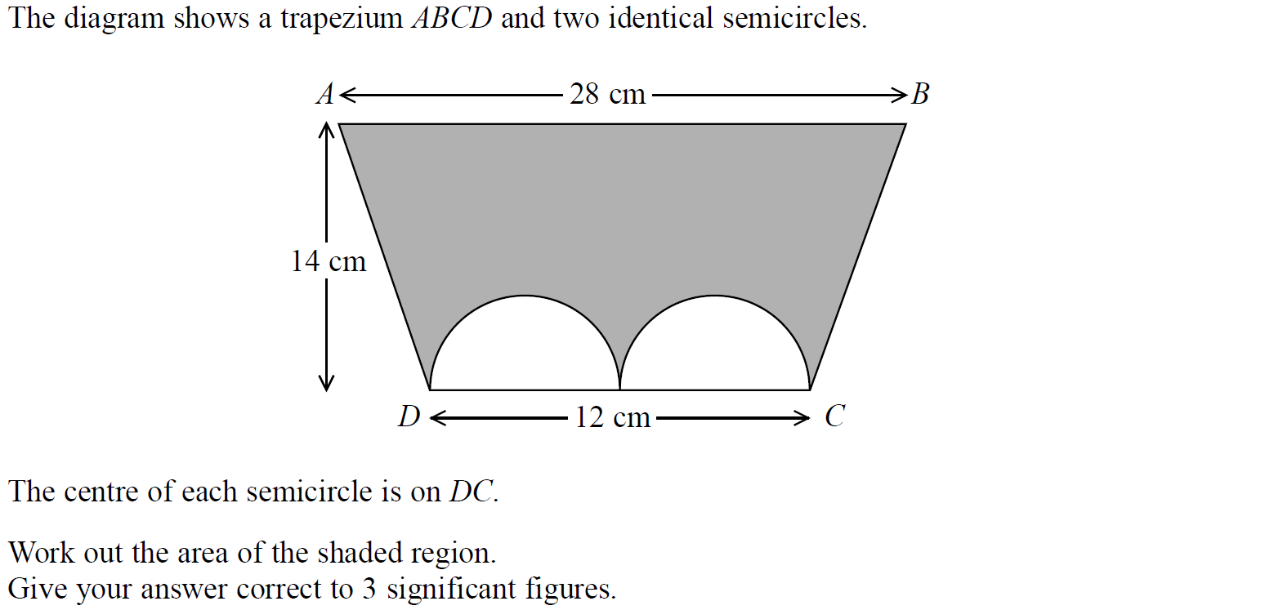
2D Area & Perimeter
SAM 3H Q1

Slide 5
2D Area & Perimeter
SAM 3H Q1
A

Slide 6
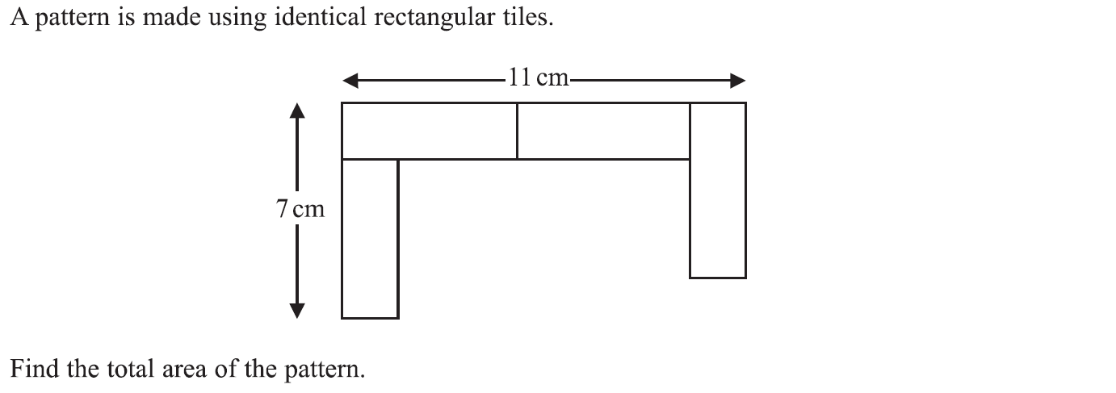
2D Area & Perimeter
Specimen Set 1 1H Q4

Slide 7
2D Area & Perimeter
Specimen Set 1 1H Q4
A

Slide 8
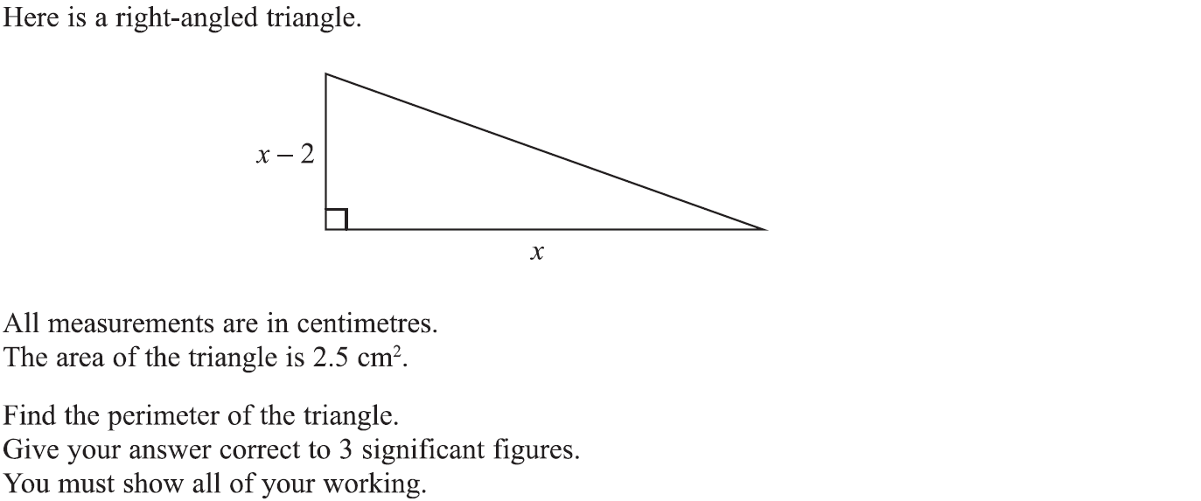
2D Area & Perimeter
Specimen Set 1 2H Q19

Slide 9
2D Area & Perimeter
Specimen Set 1 2H Q19
A

Slide 10
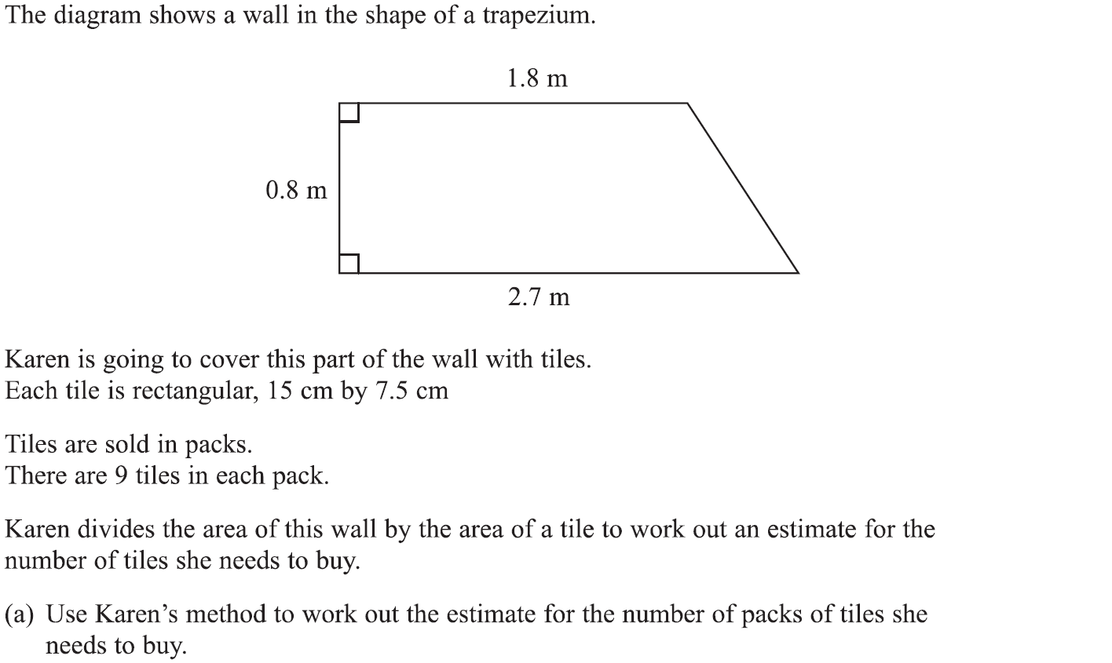
2D Area & Perimeter
Specimen Set 1 3H Q5

Slide 11
2D Area & Perimeter
Specimen Set 1 3H Q5
A
B

Slide 12
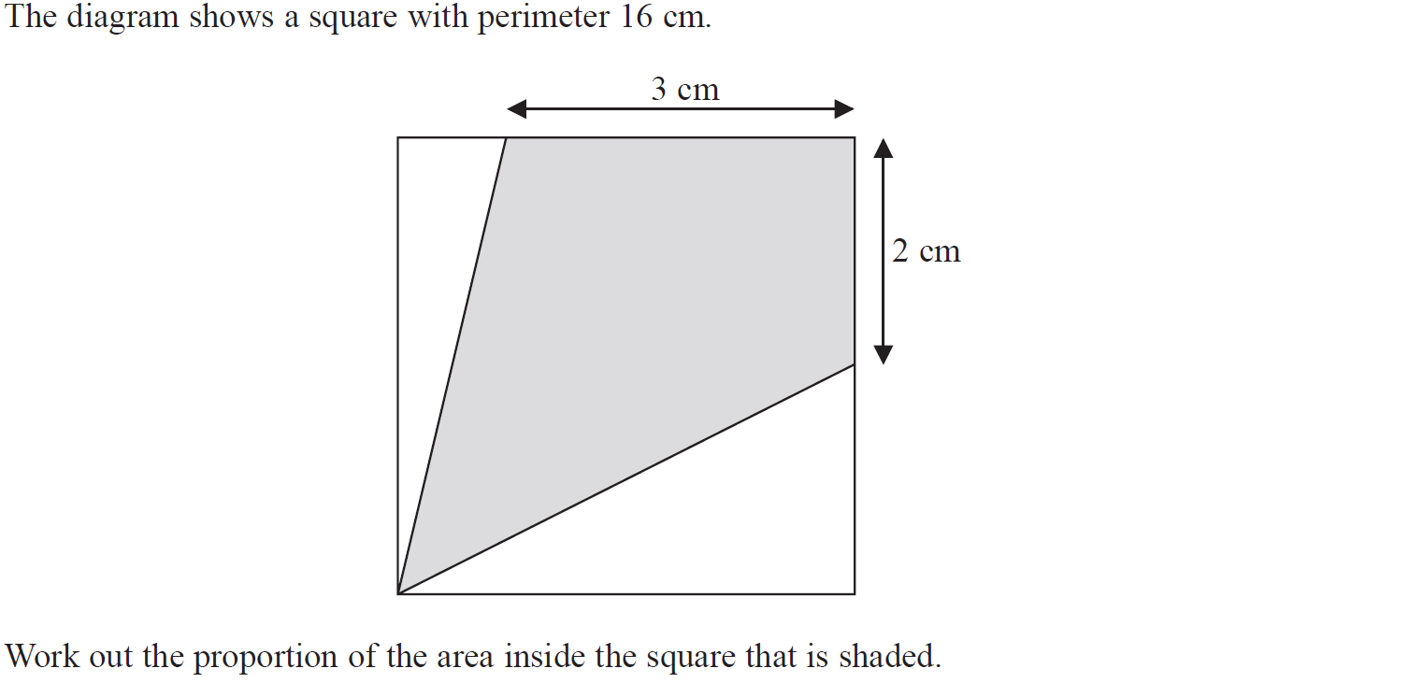
2D Area & Perimeter
Specimen Set 2 1H Q2

Slide 13
2D Area & Perimeter
Specimen Set 2 1H Q2
A

Slide 14
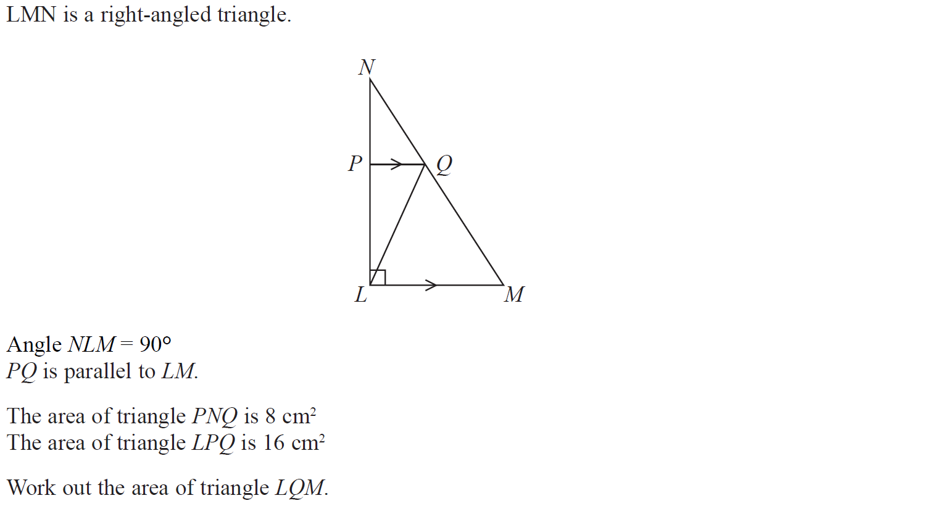
2D Area & Perimeter
Specimen Set 2 1H Q18

Slide 15
2D Area & Perimeter
Specimen Set 2 1H Q18
A

Slide 16
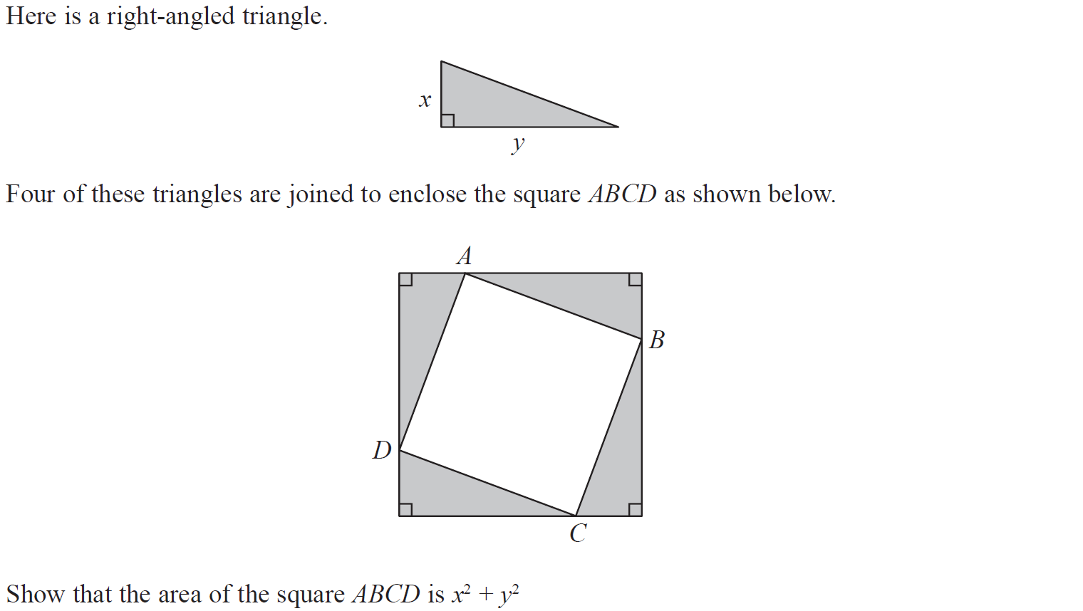
2D Area & Perimeter
Specimen Set 2 3H Q7

Slide 17
2D Area & Perimeter
Specimen Set 2 3H Q7
A

Slide 18
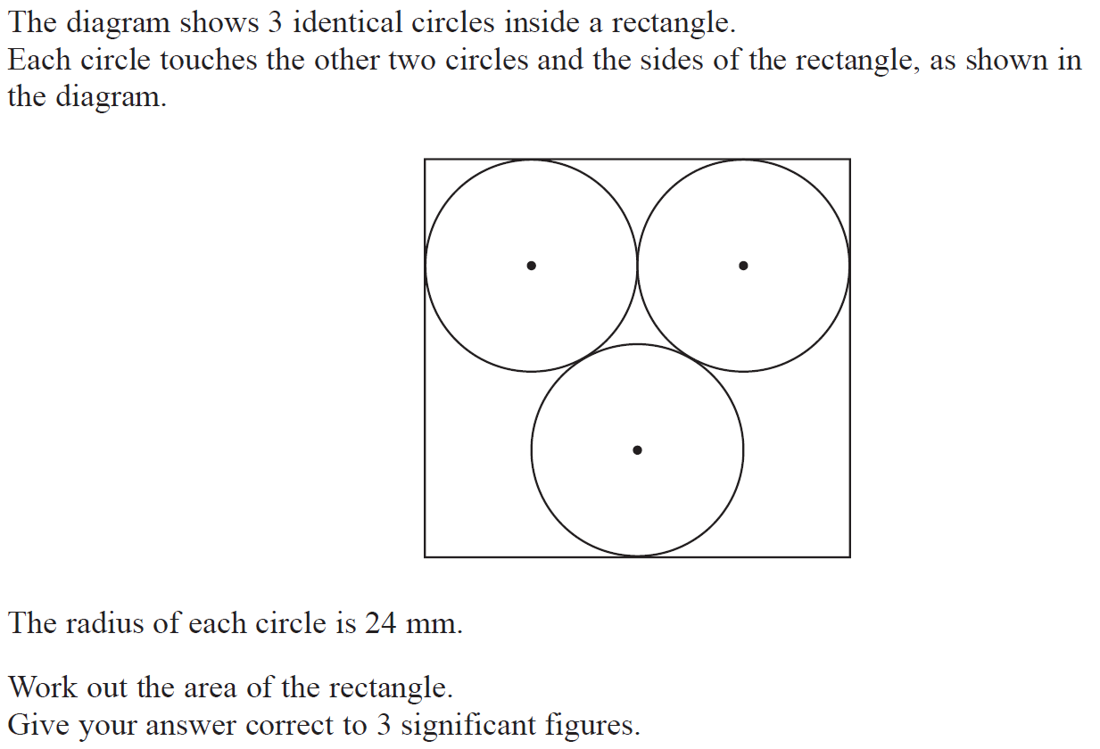
2D Area & Perimeter
June 2017 2H Q21

Slide 19
2D Area & Perimeter
June 2017 2H Q21
A

Slide 20
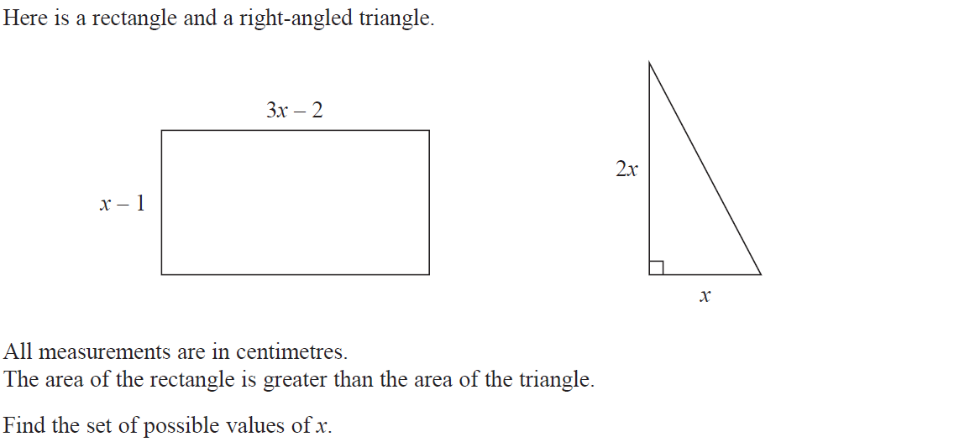
2D Area & Perimeter
Nov 2017 1H Q23

Slide 21
2D Area & Perimeter
Nov 2017 1H Q23
A

Slide 22
2D Area & Perimeter
May 2018 1H Q8

Slide 23
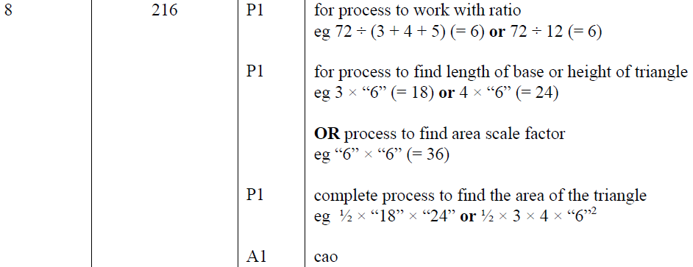
2D Area & Perimeter
May 2018 1H Q8
A

Slide 24
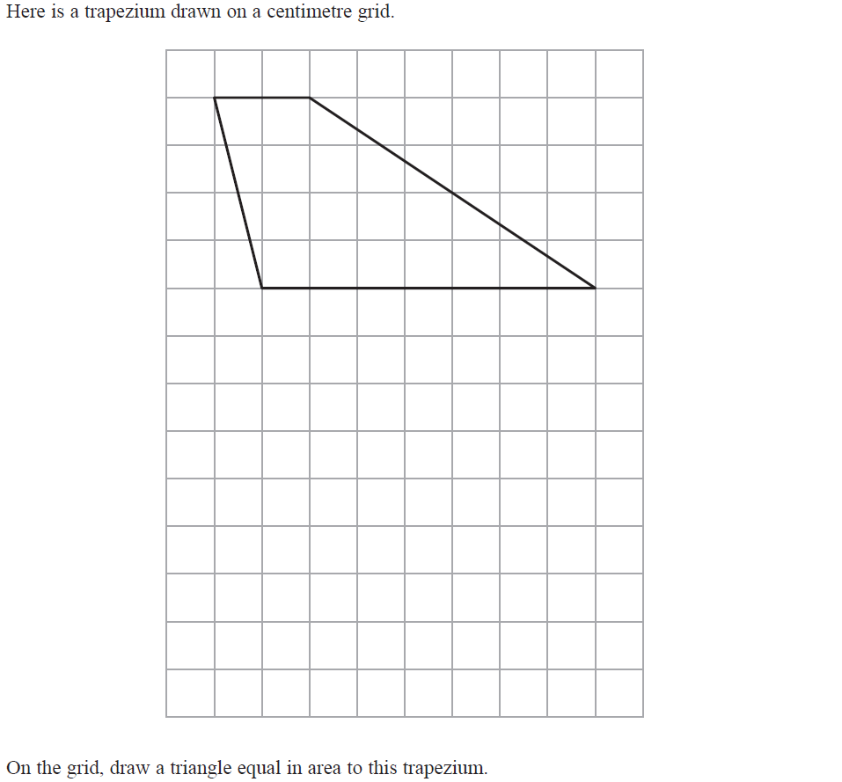
2D Area & Perimeter
June 2018 3H Q3

Slide 25
2D Area & Perimeter
June 2018 3H Q3
A

Slide 26
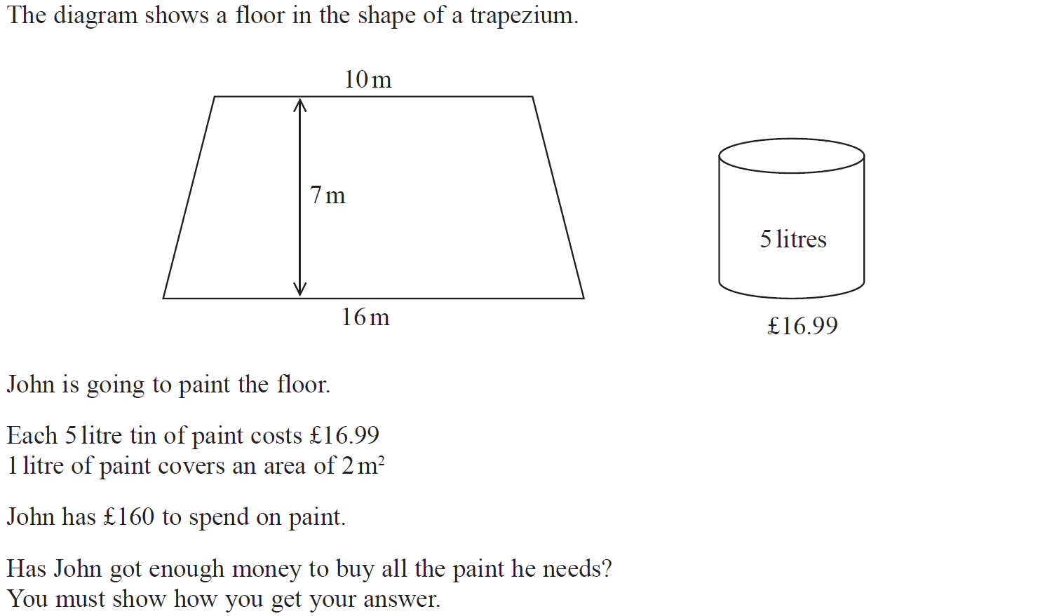
2D Area & Perimeter
Nov 2018 2H Q5

Slide 27
2D Area & Perimeter
Nov 2018 2H Q5
A

Slide 28
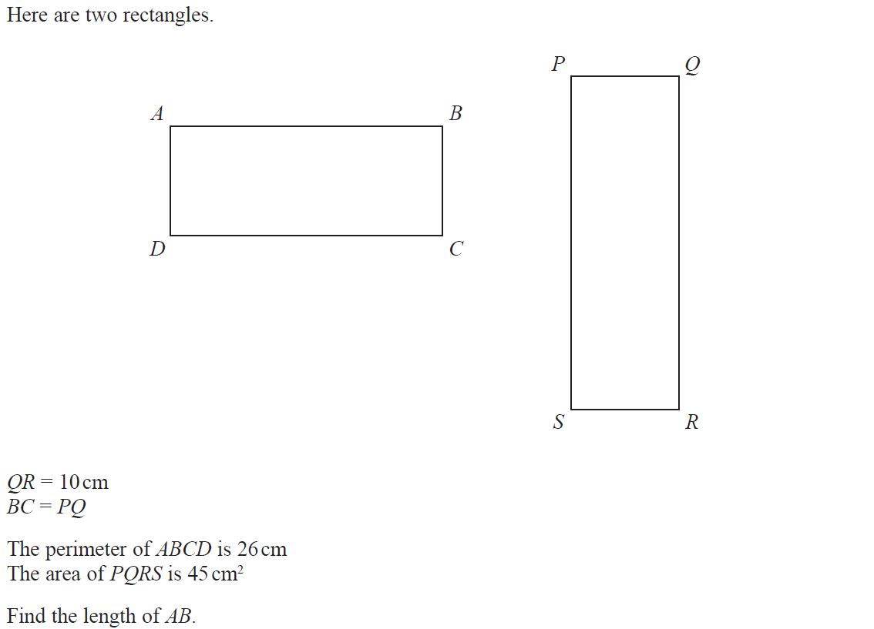
2D Area & Perimeter
May 2019 1H Q7

Slide 29
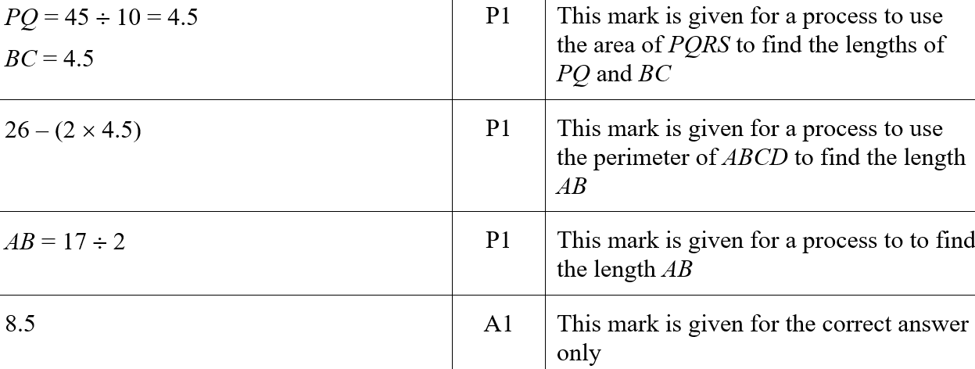
2D Area & Perimeter
May 2019 1H Q7
A
A SF

