Slide 1
2D Area & Perimeter
2D Area & Perimeter
Nov 2017 2H Q6
June 2018 2H Q7
Nov 2018 3H Q12

Slide 2
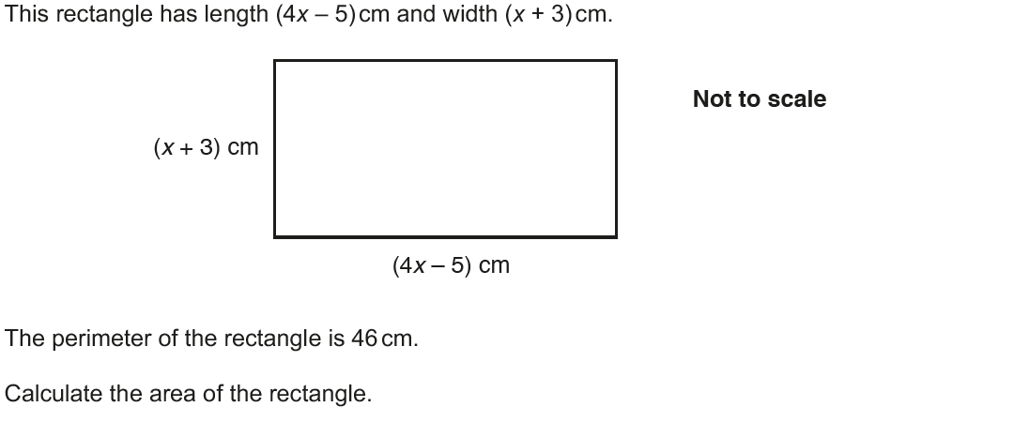
2D Area & Perimeter
Nov 2017 2H Q6

Slide 3
2D Area & Perimeter
Nov 2017 2H Q6
A

Slide 4
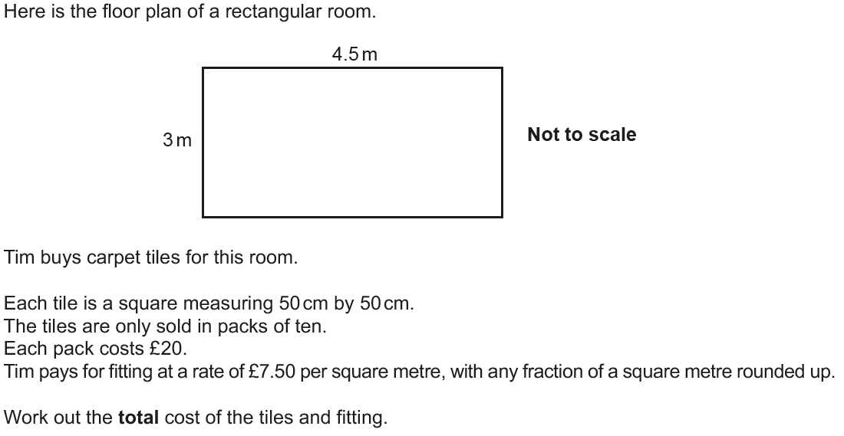
2D Area & Perimeter
June 2018 2H Q7

Slide 5
2D Area & Perimeter
June 2018 2H Q7
A

Slide 6
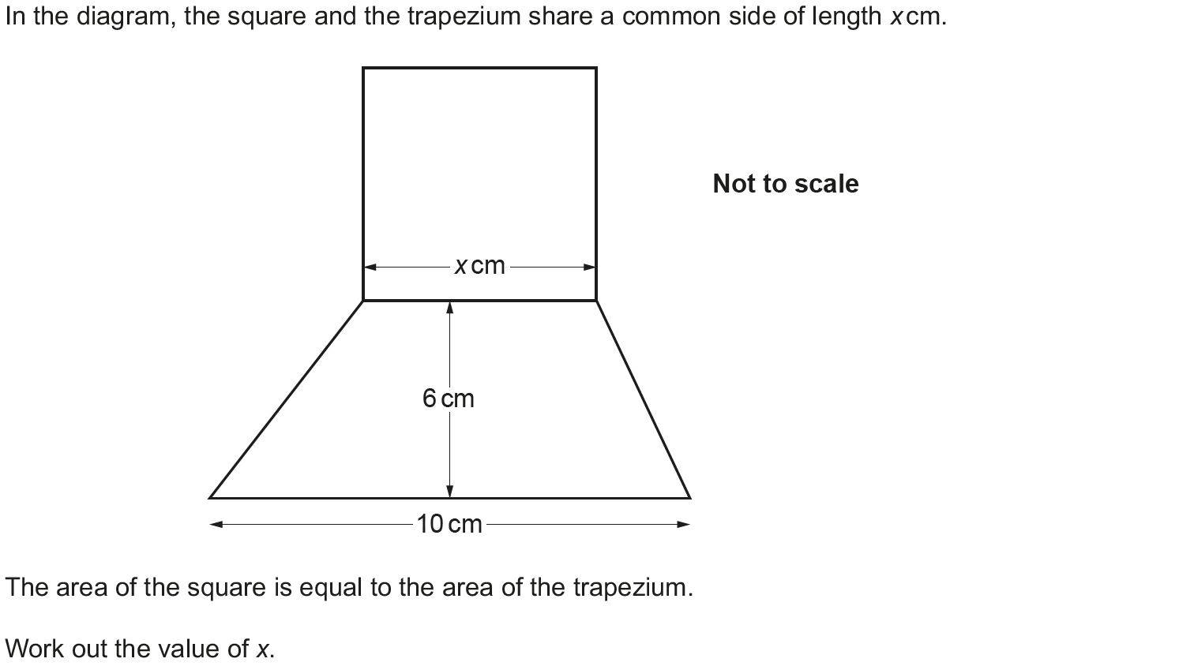
2D Area & Perimeter
Nov 2018 3H Q12

Slide 7
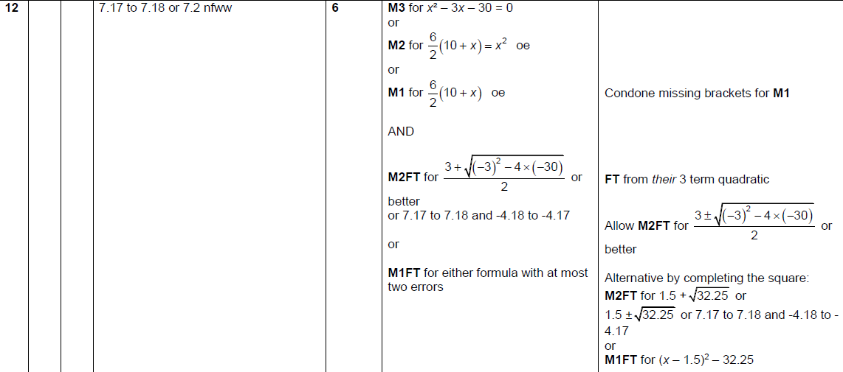
2D Area & Perimeter
Nov 2018 3H Q12
A

