Slide 1
2.5) Regions in the Argand diagram

Slide 2
Worked example
Your turn
On an Argand diagram, shade the region for which
$$\left|z−3+5i\right|≤4$$
On an Argand diagram, shade the region for which
$$\left|z+3−5i\right|≤2$$
Inside of solid-lined circle, centre $(3, −5)$, radius $2$

Slide 3
Worked example
Your turn
On an Argand diagram, shade the region for which
$$2≤\left|z−3+5i\right|≤4$$
$$2<\left|z−3−5i\right|≤4$$
On an Argand diagram, shade the region for which
$$2≤\left|z+3−5i\right|<4$$
Region enclosed between two circles.
One solid-lined circle centred $(−3, 5)$ radius $2$
One dotted-lined circle centred $(−3, 5)$ radius $4$

Slide 4
Worked example
Your turn
On an Argand diagram, shade the region for which
$$\left|z−3\right|<|z−5|$$
$$\left|z−3i\right|>|z+5|$$
On an Argand diagram, shade the region for which
$$\left|z+3\right|<|z−5i|$$
Dotted line perpendicular bisector of $(−3, 0)$ and $(0, 5)$. Shaded below the line

Slide 5
Worked example
Your turn
On an Argand diagram, shade the region for which
$$\left\{z∈ℂ:\left|z−4\right|≤\left|z−8−6i\right|\right\}∩$$
$$\left\{z∈ℂ:0≤\arg\left(z−2−4i\right)≤\frac{π}{4}\right\}$$
On an Argand diagram, shade the region for which
$$\left\{z∈ℂ:\left|z−2\right|≤\left|z−6−8i\right|\right\}∩$$
$$\left\{z∈ℂ:0≤\arg\left(z−4−2i\right)≤\frac{π}{2}\right\}$$
Shaded region in first quadrant enclosed by half lines $x=4$ and $y=2$ both extending from $(4, 2)$ and perpendicular bisector of $(2, 0)$ and $(6, 8)$ $y=−\frac{1}{2}x+6$

Slide 6
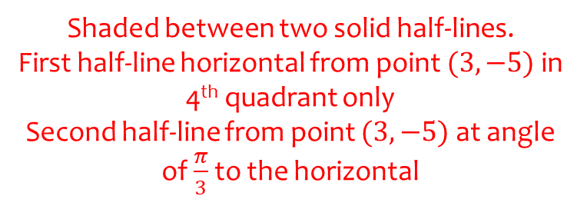
Worked example
Your turn
On an Argand diagram, shade the region for which
$$0≤\arg\left(z−3−5i\right)≤\frac{π}{4}$$
$$\arg\left(z−3+5i\right)>\frac{π}{2}$$
On an Argand diagram, shade the region for which
$$0≤\arg\left(z+3−5i\right)≤\frac{π}{3}$$
Shaded between two solid half-lines.
First half-line horizontal from point $(3, −5)$ in 4th quadrant only
Second half-line from point $(3, −5)$ at angle of $\frac{π}{3}$ to the horizontal

