Slide 1
2.4) Loci in the Argand diagram

Slide 2
Worked example
Your turn
Sketch the locus of points represented by
$$\left|z\right|=3$$
$$\left|z\right|=4$$
Sketch the locus of points represented by
$$\left|z\right|=5$$
Circle centre $(0, 0)$ radius $5$
Cartesian equation: $x^{2}+y^{2}=25$

Slide 3
Worked example
Your turn
Sketch the locus of points represented by
$$\left|z+3−5i\right|=2$$
and find its Cartesian equation
Sketch the locus of points represented by
$$\left|z−3+5i\right|=4$$
and find its Cartesian equation
Draw the locus of points that satisfy:
$$\left|z−5−3i\right|=6$$
and find its Cartesian equation
Circle centre $(5, 3)$ radius $6$
$${\left(x−5\right)}^{2}+{\left(y−3\right)}^{2}=36$$

Slide 4
Worked example
Your turn
Sketch the locus of points represented by
$$\left|3−z\right|=5$$
and find its Cartesian equation
Sketch the locus of points represented by
$$\left|2i−z\right|=4$$
and find its Cartesian equation
Sketch the locus of points represented by
$$\left|2−3i−z\right|=2$$
and find its Cartesian equation
Draw the locus of points that satisfy:
$$\left|3−2i−z\right|=3$$
and find its Cartesian equation
Circle centre $(3, −2)$ radius $3$
$${\left(x−2\right)}^{2}+{\left(y+2\right)}^{2}=9$$

Slide 5
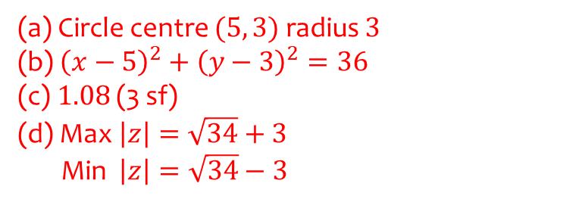
Worked example
Your turn
A complex number $z$ is represented by the point $P$. Given that $\left|z−3+5i\right|=2$
Sketch the locus of $P$
Find the Cartesian equation of the locus.
Find the maximum value of $\arg{z}$ in the interval $\left(−π,π\right)$
Find the minimum and maximum values of $|z|$
A complex number $z$ is represented by the point $P$. Given that $\left|z−5−3i\right|=3$
Sketch the locus of $P$
Find the Cartesian equation of the locus.
Find the maximum value of $\arg{z}$ in the interval $\left(−π,π\right)$
Find the minimum and maximum values of $|z|$
(a) Circle centre $(5, 3)$ radius $3$
(b) ${\left(x−5\right)}^{2}+{\left(y−3\right)}^{2}=36$
(c) $1.08$ (3 sf)
(d) Max $\left|z\right|=\sqrt{34}+3$
Min $\left|z\right|=\sqrt{34}−3$

Slide 6
Worked example
Your turn
Sketch the locus of points represented by
$$\left|z\right|=\left|z+4i\right|$$
and find its Cartesian equation
Sketch the locus of points represented by
$$\left|z\right|=\left|z−5\right|$$
and find its Cartesian equation
Sketch the locus of points represented by
$$\left|z\right|=\left|z−6i\right|$$
and find its Cartesian equation
Perpendicular bisector of $\left(0, 0\right)$ and $(0, 6)$
$$y=3$$

Slide 7
Worked example
Your turn
Sketch the locus of points represented by
$$\left|z−3i\right|=|z+1|$$
and find its Cartesian equation
Sketch the locus of points represented by
$$\left|z−3\right|=|z+i|$$
and find its Cartesian equation
Perpendicular bisector of $(3, 0)$ and $(0, −1)$
$$y=−3x+4$$

Slide 8
Worked example
Your turn
Find the Cartesian equation of the locus of $z$ if $\left|z−3i\right|=|z+1|$ and sketch the locus of $z$ on an Argand diagram.
Hence, find the least possible value of $|z|$.
Find the Cartesian equation of the locus of $z$ if $\left|z−3\right|=|z+i|$, and sketch the locus of $z$ on an Argand diagram.
Hence, find the least possible value of $|z|$.
$$\frac{2\sqrt{10}}{5}$$

Slide 9
Worked example
Your turn
Given that the complex number $z$ satisfies the equation $\left|z−8+6i\right|=5$, find the minimum value of $|z|$ and the maximum.
Given that the complex number $z$ satisfies the equation $\left|z−12−5i\right|=3$, find the minimum value of $|z|$ and the maximum.
Minimum $=10$
Maximum $=16$

Slide 10
Worked example
Your turn
Sketch the locus of points represented by
$$\arg\left(z\right)=\frac{π}{4}$$
and find its Cartesian equation
Sketch the locus of points represented by
$$\arg\left(z\right)=\frac{π}{3}$$
and find its Cartesian equation
Sketch the locus of points represented by
$$\arg\left(z\right)=\frac{π}{6}$$
and find its Cartesian equation
Half-line from origin $(0, 0)$
$$y=\frac{1}{\sqrt{3}}x, x>0,y>0$$

Slide 11
Worked example
Your turn
Sketch the locus of points represented by
$$\arg\left(z−2+3i\right)=\frac{π}{4}$$
and find its Cartesian equation
Sketch the locus of points represented by
$$\arg\left(z+3+2i\right)=\frac{3π}{4}$$
and find its Cartesian equation
Half-line from $\left(−3, −2\right)$
$$y=−x−5, x<−3,y>−2$$

Slide 12
Worked example
Your turn
Find the complex number $z$ which satisfies both $\left|z+3−2i\right|=50$ and
$\arg\left(z+3−2i\right)=\frac{π}{4}$
Find the complex number $z$ which satisfies both $\left|z+3+2i\right|=10$ and
$\arg\left(z+3+2i\right)=\frac{3π}{4}$
$$z=\left(−3−5\sqrt{2}\right)+i(−2+5\sqrt{2})$$

Slide 13
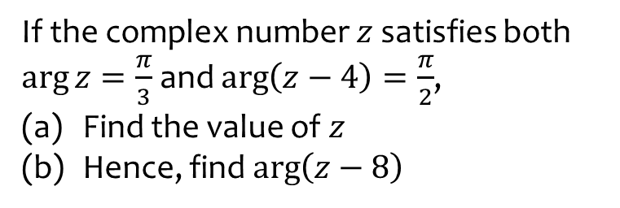
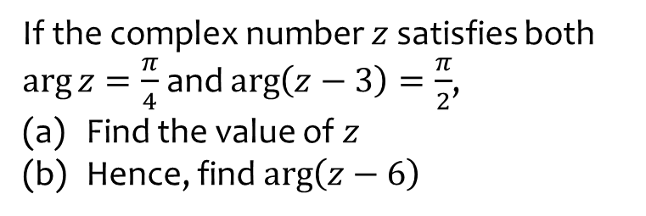
Worked example
Your turn
If the complex number $z$ satisfies both $\arg{z}=\frac{π}{4}$ and $\arg\left(z−3\right)=\frac{π}{2}$,
Find the value of $z$
Hence, find $\arg\left(z−6\right)$
If the complex number $z$ satisfies both $\arg{z}=\frac{π}{3}$ and $\arg\left(z−4\right)=\frac{π}{2}$,
Find the value of $z$
Hence, find $\arg\left(z−8\right)$
(a) $z=4+4\sqrt{3}i$
(b) $\frac{2π}{3}$

Slide 14
Worked example
Your turn
Given $\left|z+4−8i\right|=3$, show that the maximum value of $arg⁡(z+12−5i)$ in the interval $(−π, π)$ is $2\arcsin\left(\frac{3}{\sqrt{73}}\right)$
Given $\left|z+8−4i\right|=2$, show that the maximum value of $arg⁡(z+15−2i)$ in the interval $(−π, π)$ is $2\arcsin\left(\frac{2}{\sqrt{53}}\right)$
Shown

