Slide 1
2D Area & Perimeter
2D Area & Perimeter
June 2017 3H Q26
Nov 2017 2H Q19
Nov 2017 1H Q10
May 2018 1H Q11
1 Marker
Nov 2017 1H Q21
Nov 2018 2H Q10
Nov 2017 2H Q17

Slide 2
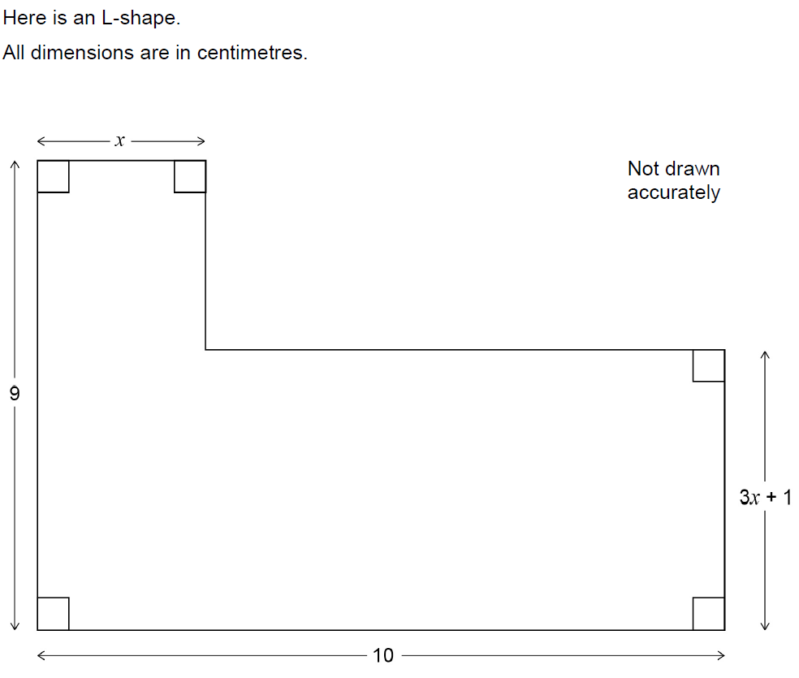
2D Area & Perimeter
June 2017 3H Q26

Slide 3
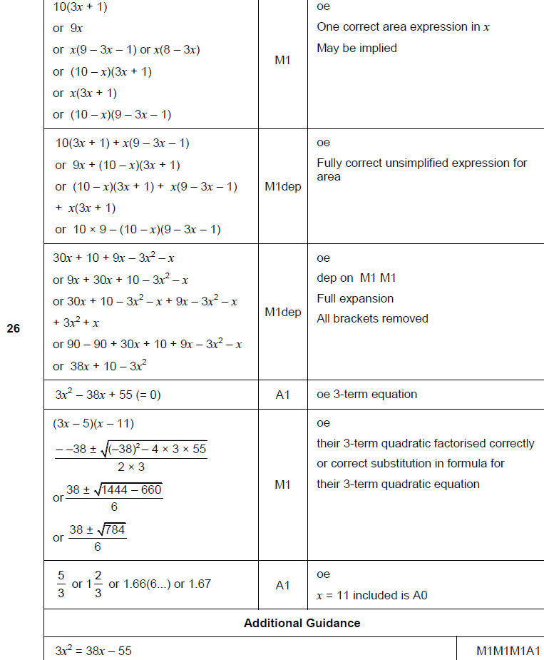
2D Area & Perimeter
June 2017 3H Q26
A

Slide 4
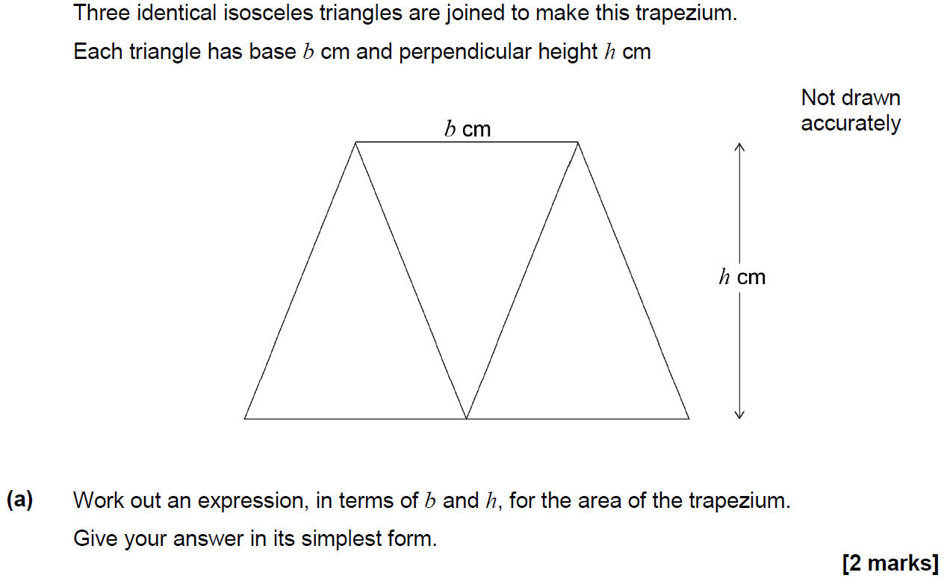
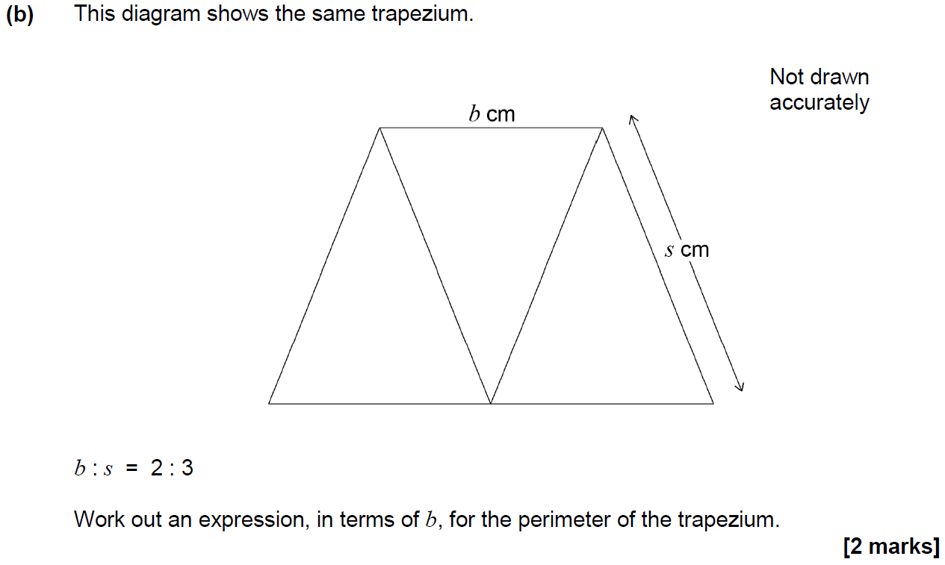
2D Area & Perimeter
Nov 2017 1H Q10

Slide 5
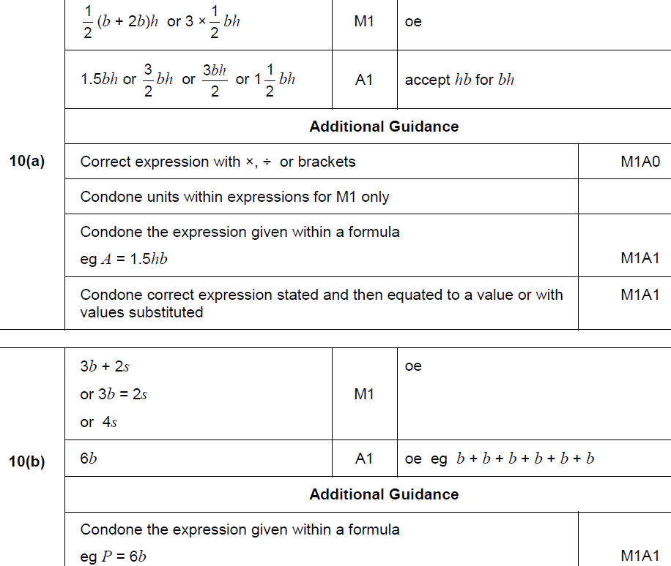
2D Area & Perimeter
Nov 2017 1H Q10
A
B

Slide 6
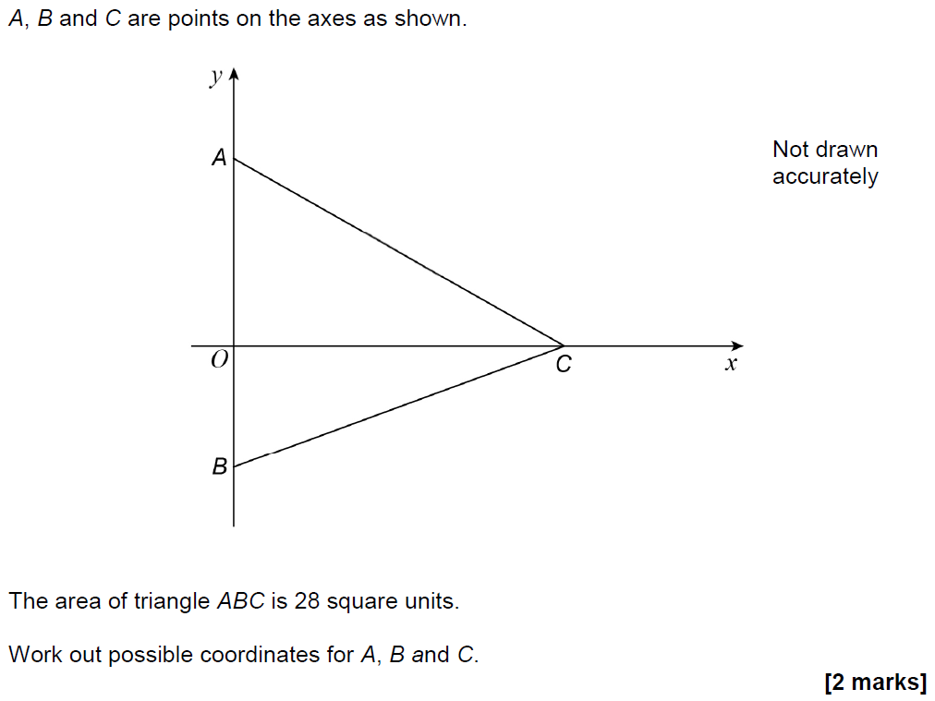
2D Area & Perimeter
Nov 2017 1H Q21

Slide 7
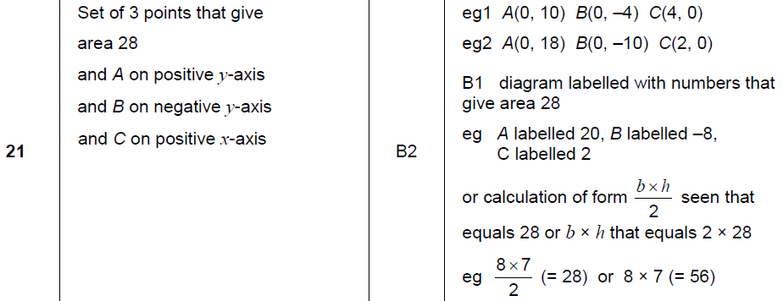
2D Area & Perimeter
Nov 2017 1H Q21
A

Slide 8
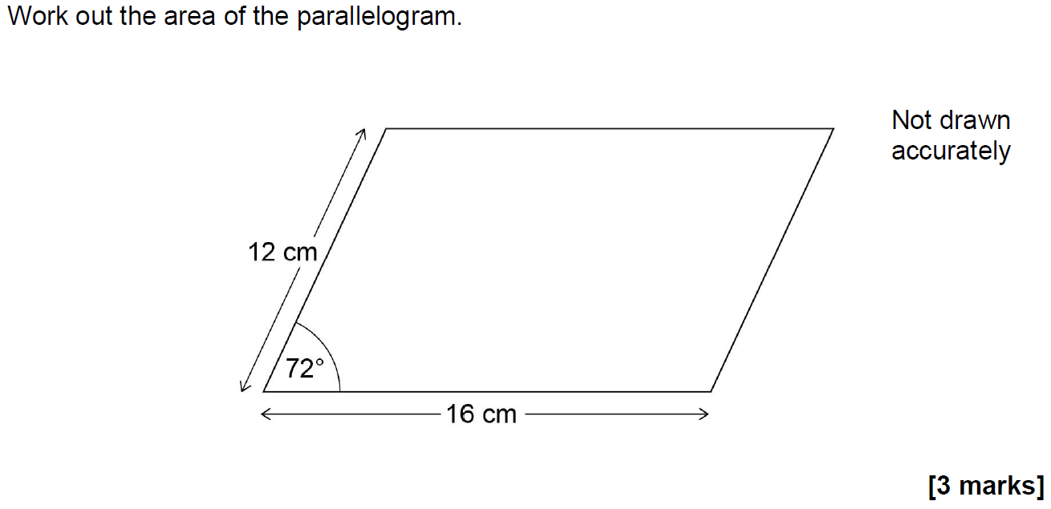
2D Area & Perimeter
Nov 2017 2H Q17

Slide 9
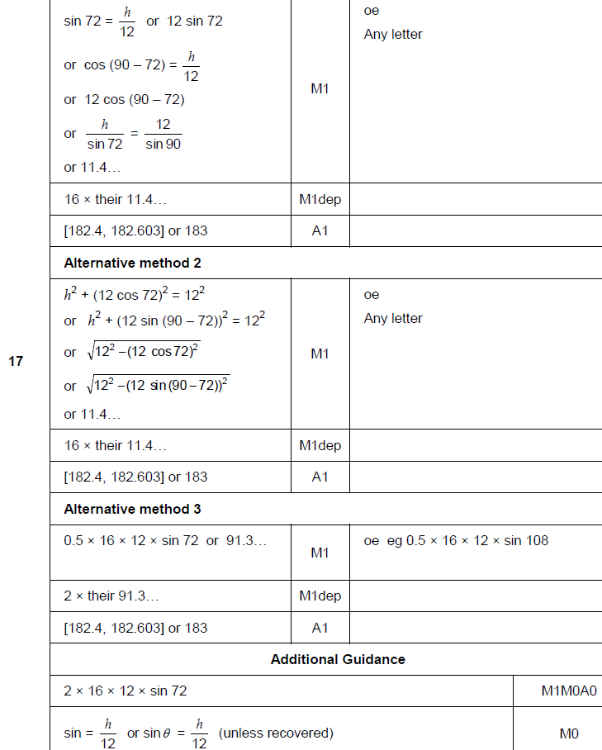
2D Area & Perimeter
Nov 2017 2H Q17
A

Slide 10
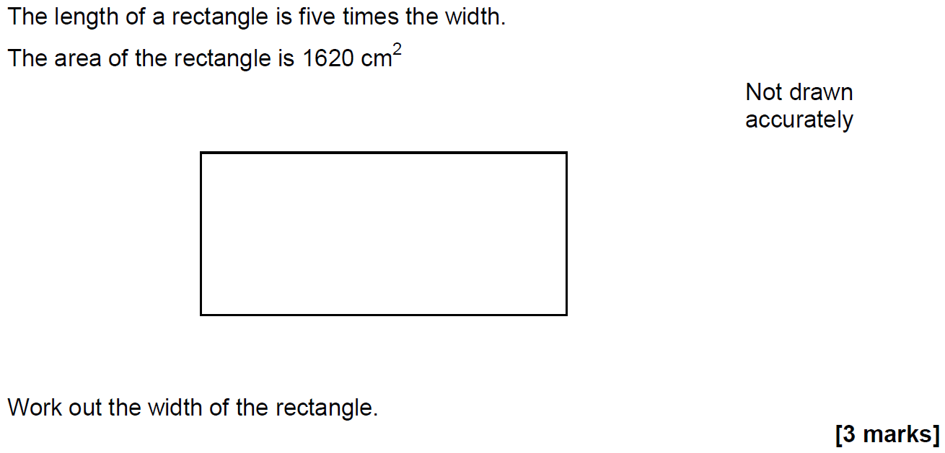
2D Area & Perimeter
Nov 2017 2H Q19

Slide 11
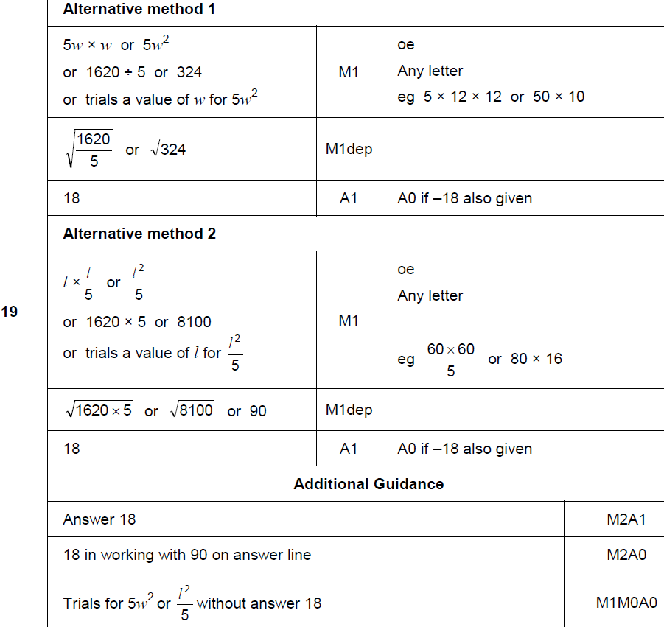
2D Area & Perimeter
Nov 2017 2H Q19
A

Slide 12
2D Area & Perimeter
May 2018 1H Q11

Slide 13
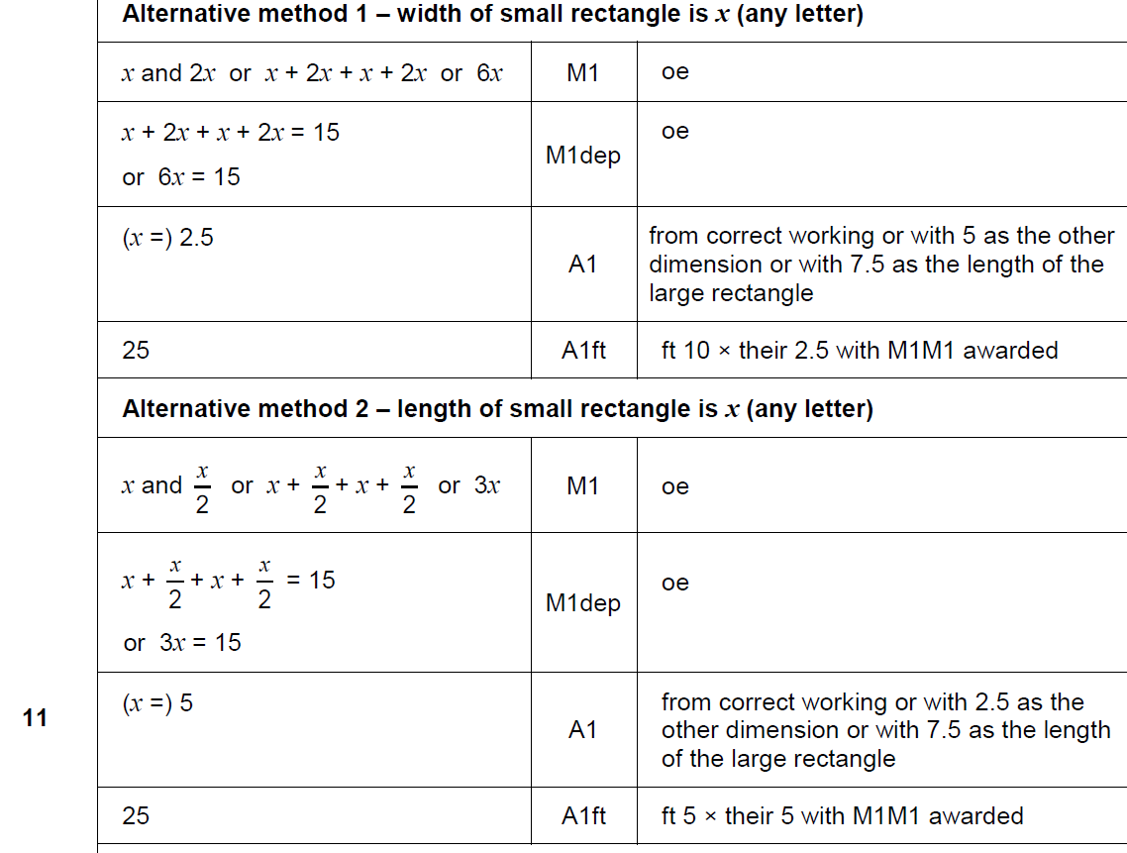
2D Area & Perimeter
May 2018 1H Q11
A

Slide 14
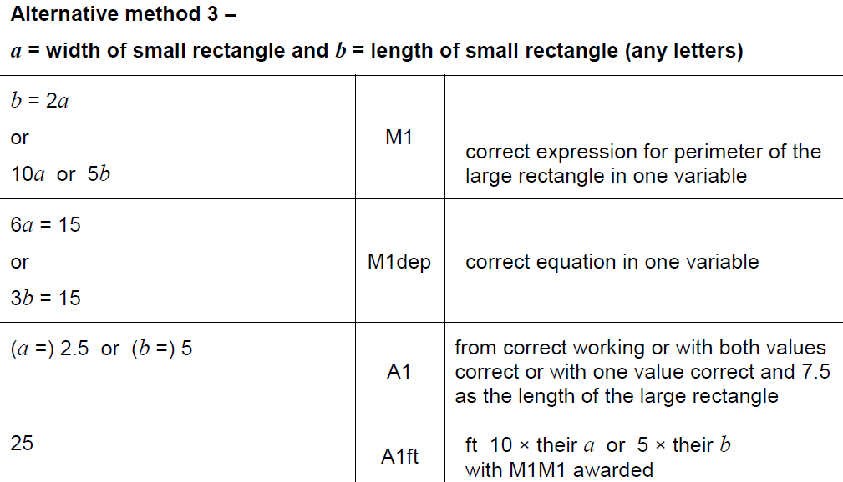
2D Area & Perimeter
May 2018 1H Q11
A Alternative 2

Slide 15
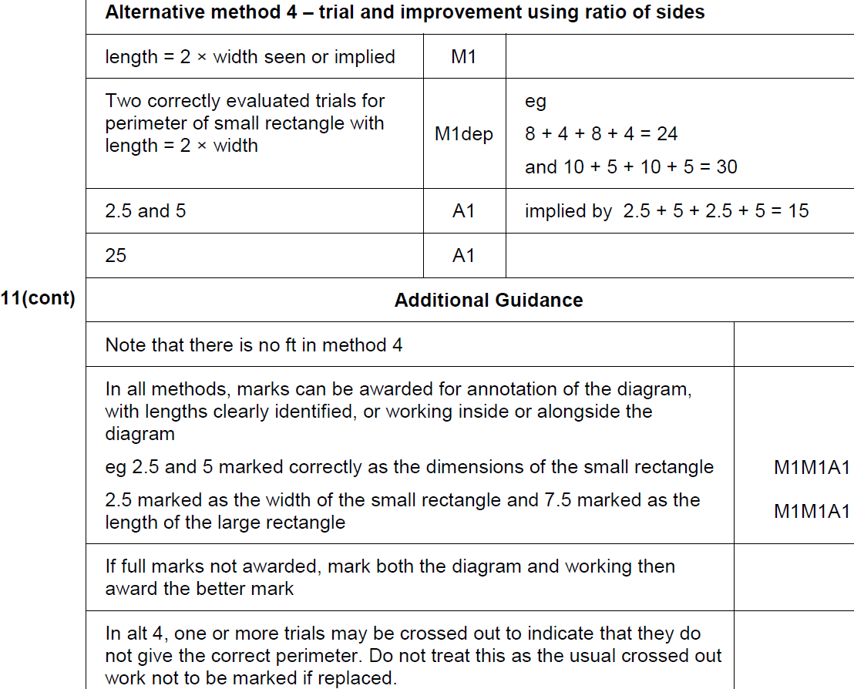
2D Area & Perimeter
May 2018 1H Q11
A Alternative 2 & notes

Slide 16
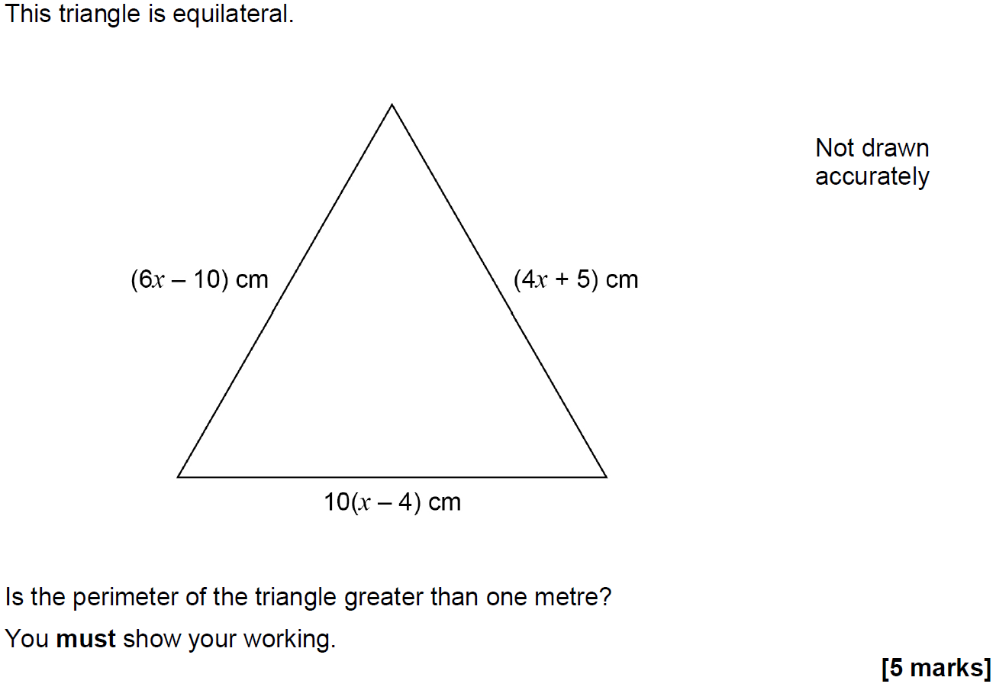
2D Area & Perimeter
Nov 2018 2H Q10

Slide 17
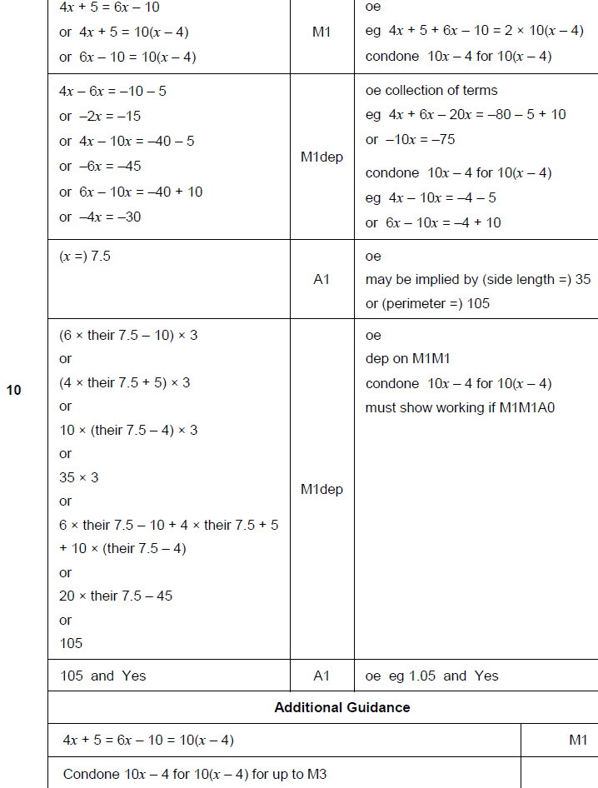
2D Area & Perimeter
Nov 2018 2H Q10
A

