Slide 1
2D Area & Perimeter
2D Area & Perimeter
Old Spec Q’s
May 2018
1HR Q1
Jan 2019
1H Q8
Jan 2019
2H Q5
Jan 2019
2H Q15
June 2019
2H Q12
Perimeter

Slide 2
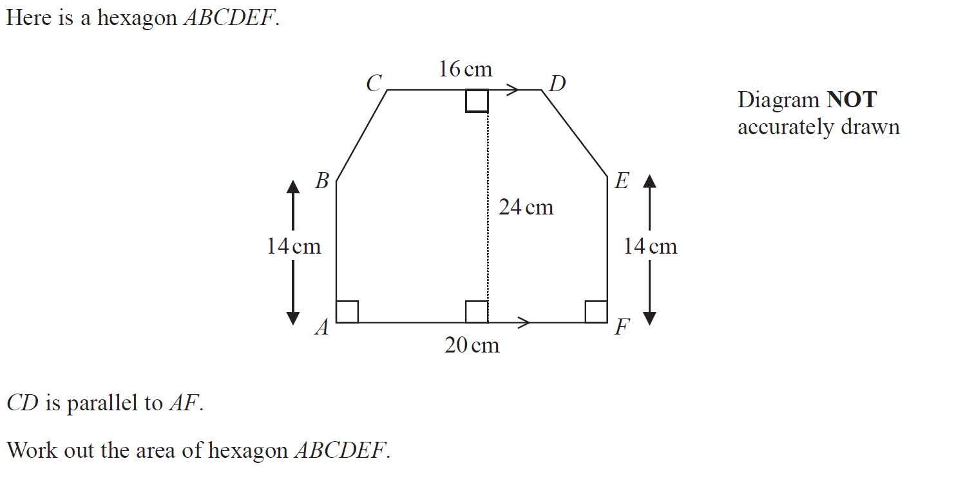
2D Area & Perimeter
May 2018 1HR Q1

Slide 3
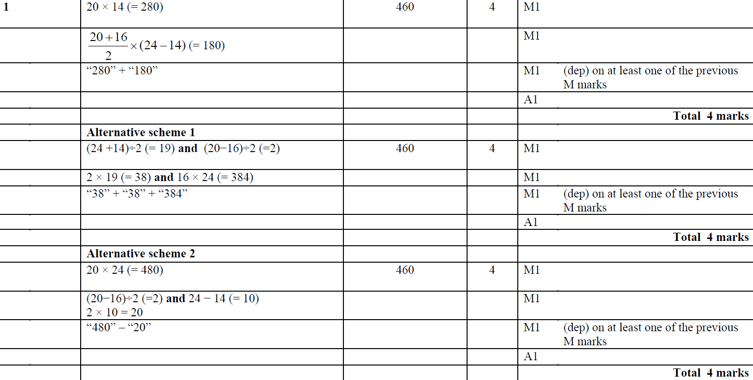
2D Area & Perimeter
May 2018 1HR Q1
A

Slide 4
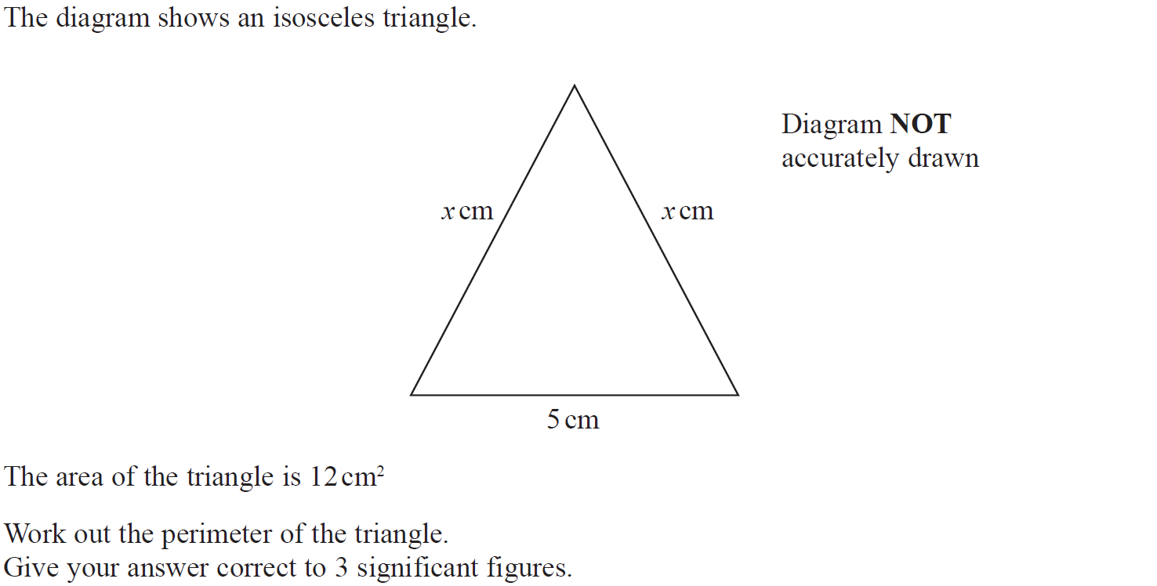
2D Area & Perimeter
Jan 2019 1H Q8

Slide 5
2D Area & Perimeter
Jan 2019 1H Q8
A

Slide 6
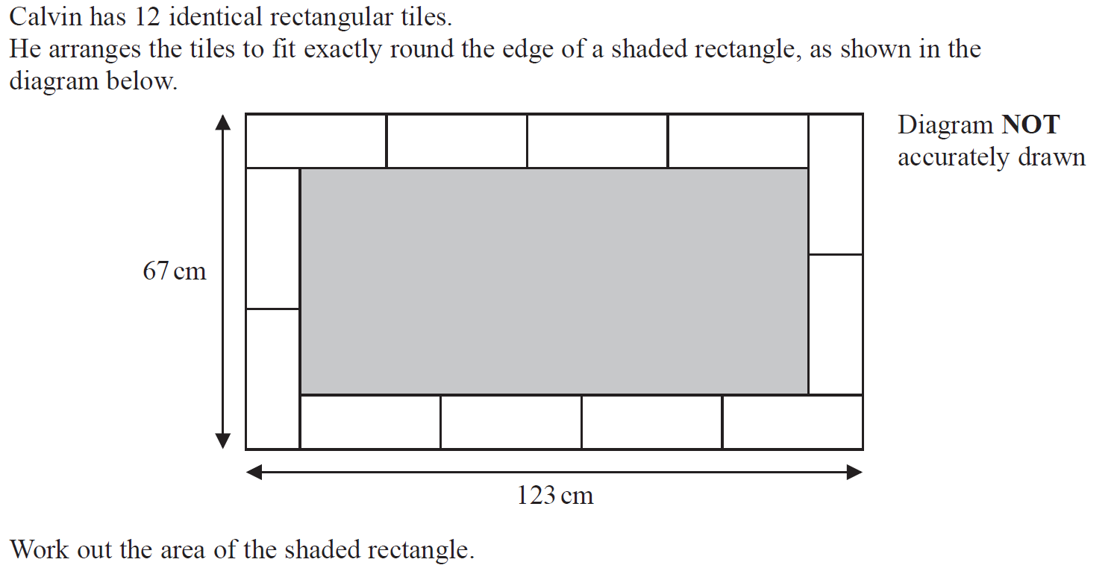
2D Area & Perimeter
Jan 2019 2H Q5

Slide 7
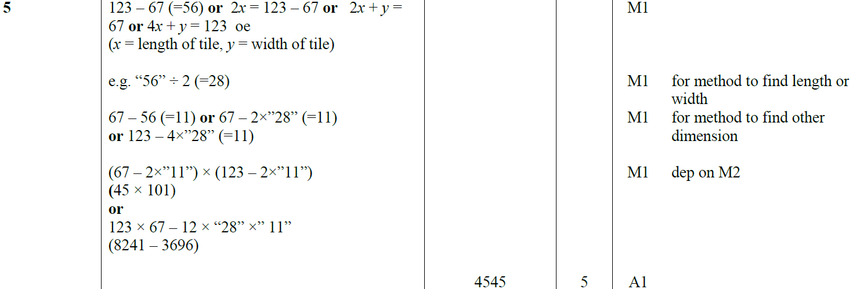
2D Area & Perimeter
Jan 2019 2H Q5
A

Slide 8
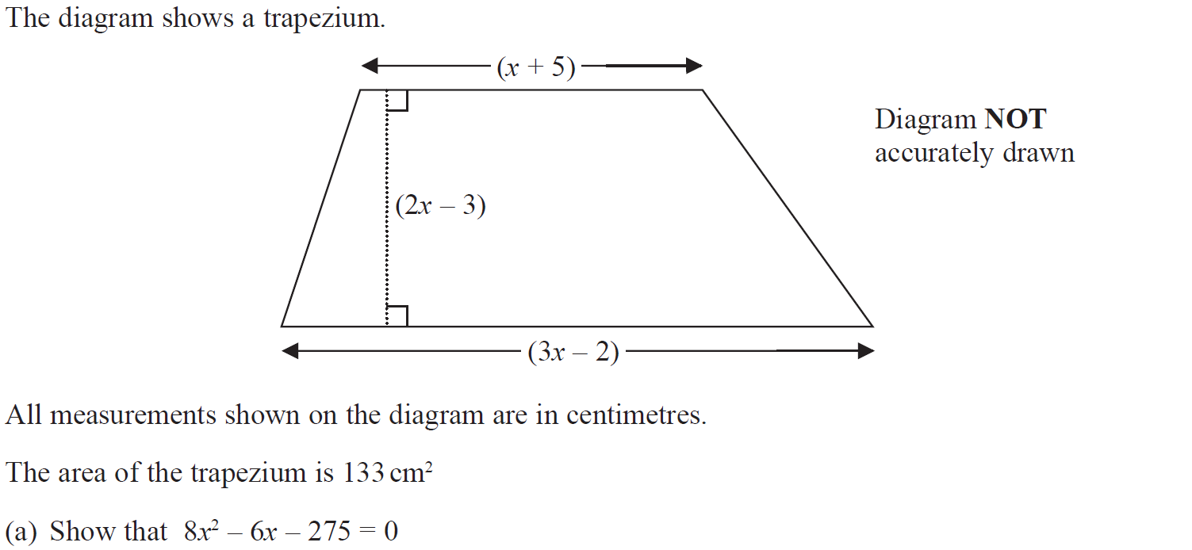
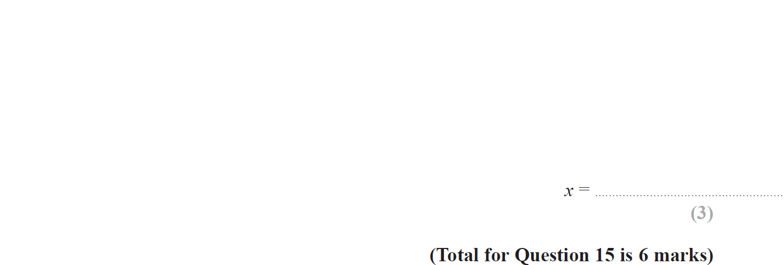
2D Area & Perimeter
Jan 2019 2H Q15

Slide 9
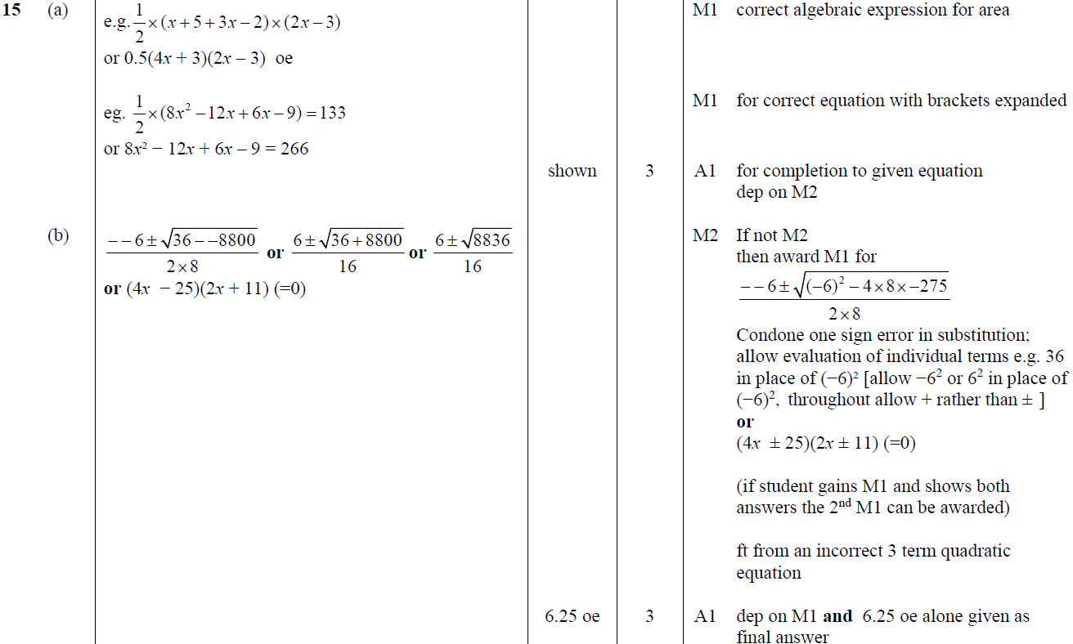
2D Area & Perimeter
Jan 2019 2H Q15
A
B

Slide 10
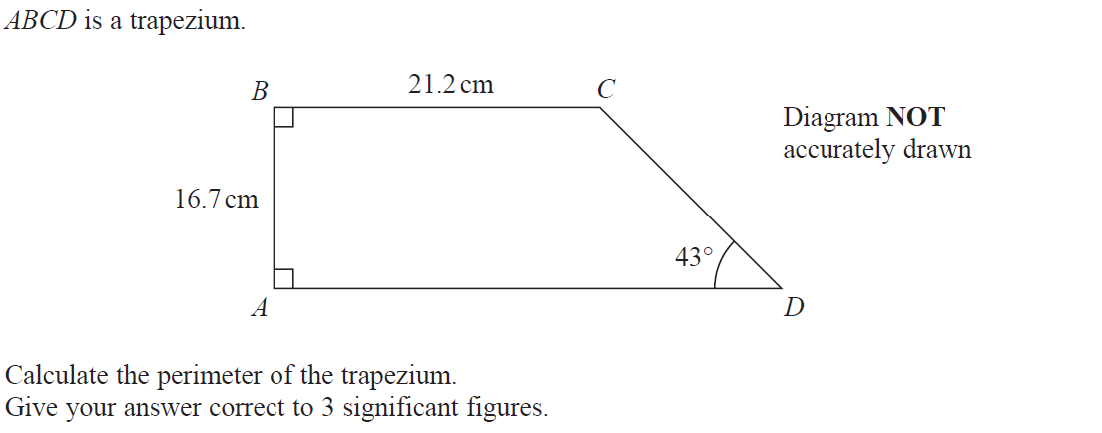
2D Area & Perimeter
June 2019 2H Q12

Slide 11
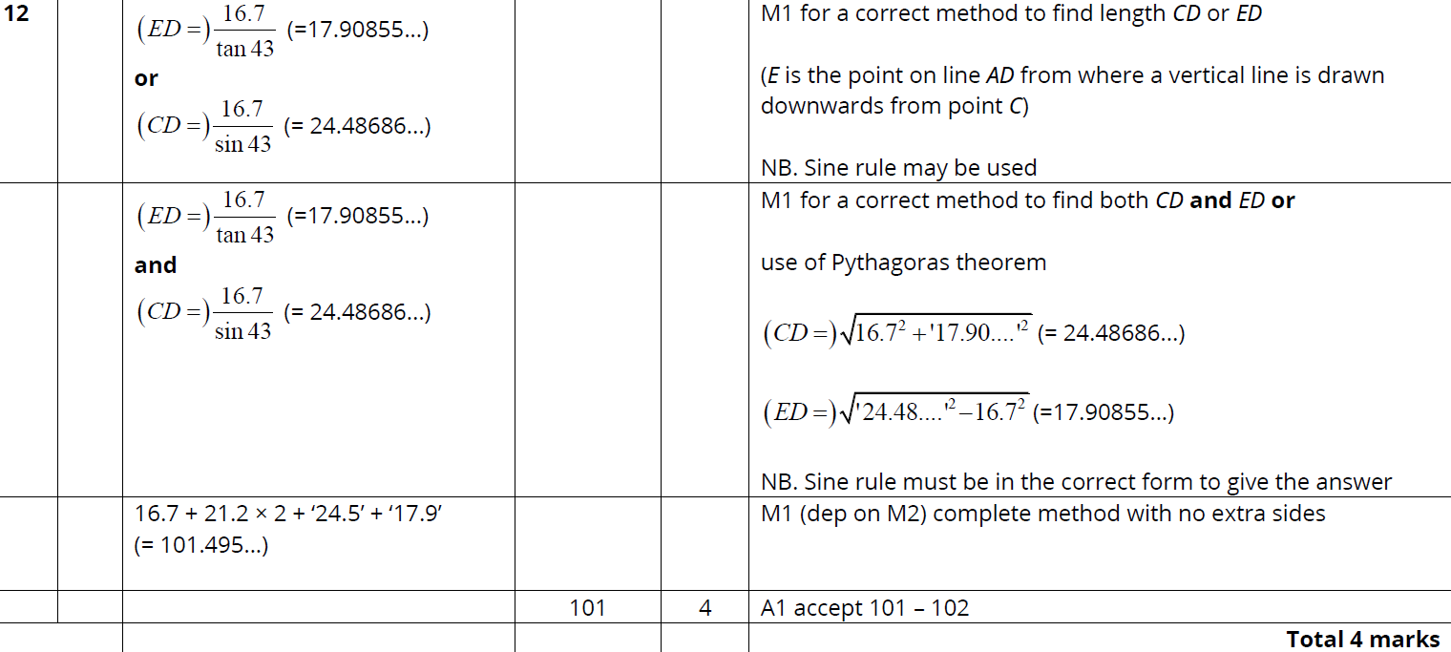
2D Area & Perimeter
June 2019 2H Q12
A

Slide 12
2D Area & Perimeter
2D Area & Perimeter
New Spec Q’s
May 2004
3H Q3
May 2007
4H Q1
Jan 2012 3H Q14
May 2013 3H Q19
May 2014 4HR Q16
June 2016 4HR Q11
June 2018 4HR Q19
May 2004
4H Q13
May 2007
4H Q5
Jan 2012 3H Q21
May 2013 4HR Q22
Jan 2015 3H Q4
June 2017 4H Q15
Nov 2004
4H Q3
Nov 2007
3H Q3
Jan 2012 4H Q9
Jan 2014 3H Q15
Jan 2015 4H Q8
Jan 2018 4H Q11
May 2005
3H Q17
Nov 2007
4H Q25
May 2012 3H Q7
Jan 2014 4H Q15
Jan 2015 4H Q17
Jan 2018 3HR Q5
May 2005
4H Q14
May 2008
3H Q22
Jan 2013 3H Q2
Jan 2014 4H Q18
Jan 2015 4HR Q7
Jan 2018 4HR Q2
May 2006
3H Q8
Nov 2008
4H Q3
Jan 2013 3H Q19
May 2014 3H Q14
May 2015 3HR Q11
Jan 2018 4HR Q18
May 2006
4H Q9
June 2011 3H Q21
Jan 2013 4H Q7
May 2014 3H Q18
Jan 2016 4HR Q5
June 2018 4H Q2
Nov 2006
3H Q9
June 2011 4H Q6
May 2013 3H Q5
May 2014 3HR Q13
May 2016 3H Q17
May 2018 3HR Q7
Perimeter

Slide 13
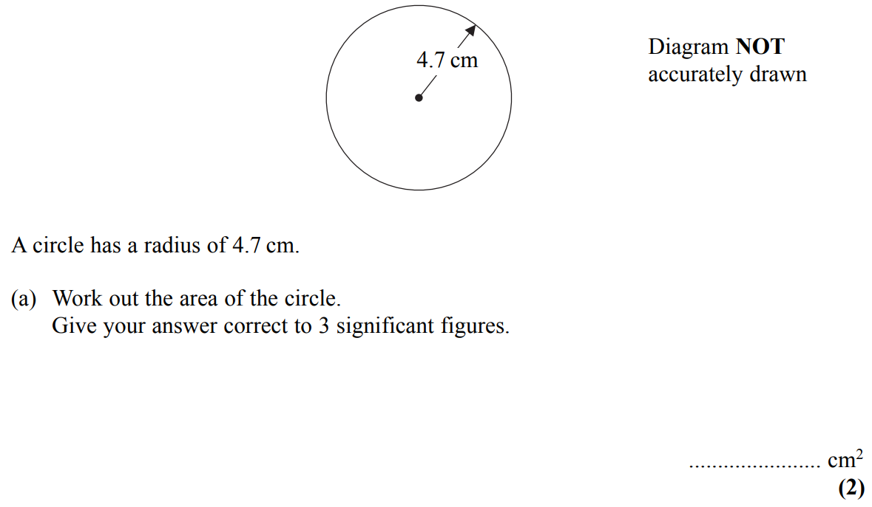
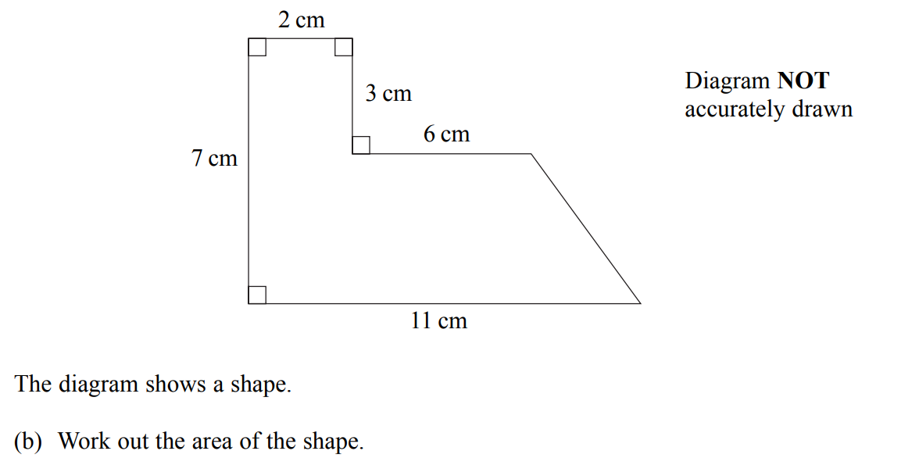
2D Area & Perimeter
May 2004 3H Q3

Slide 14
2D Area & Perimeter
May 2004 3H Q3
A
B

Slide 15
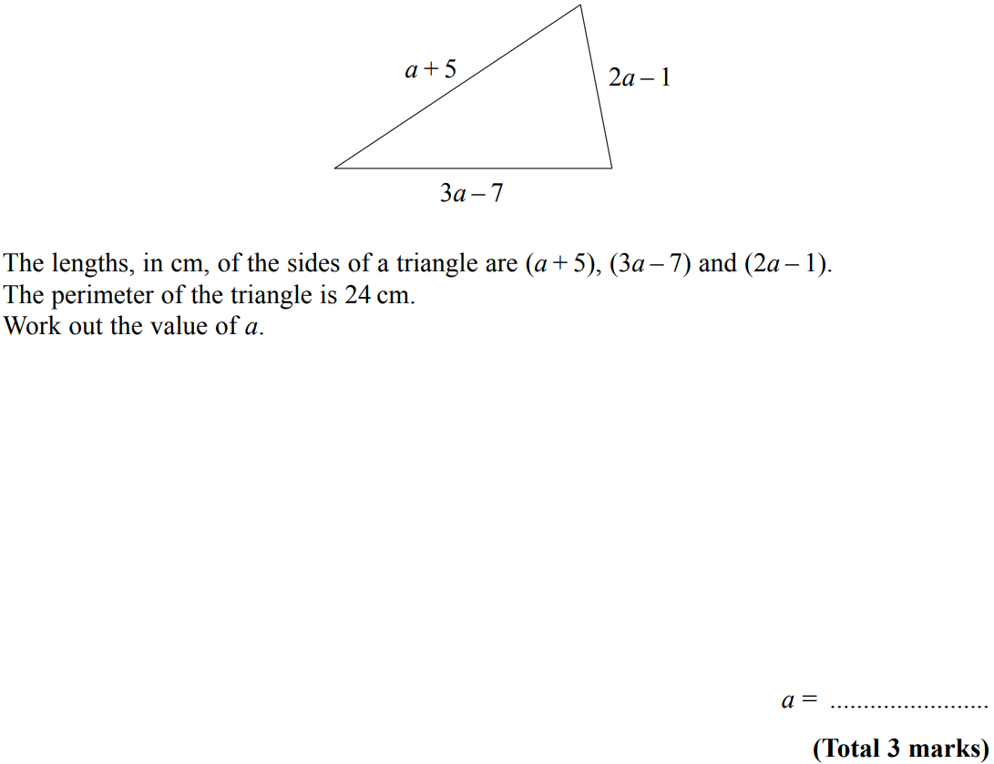
2D Area & Perimeter
May 2004 4H Q13

Slide 16
2D Area & Perimeter
May 2004 4H Q13
A

Slide 17
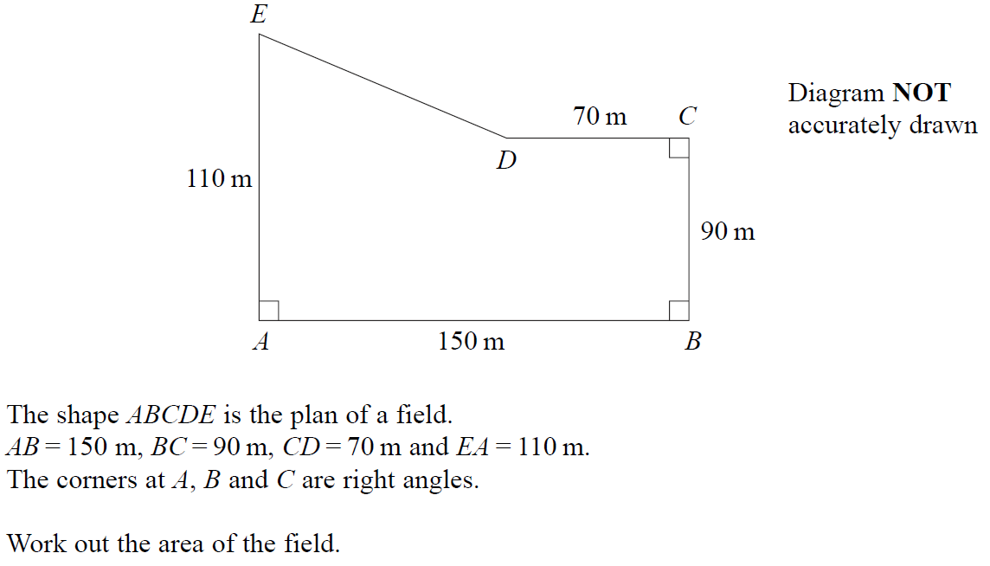
2D Area & Perimeter
Nov 2004 4H Q3

Slide 18
2D Area & Perimeter
Nov 2004 4H Q3
A

Slide 19
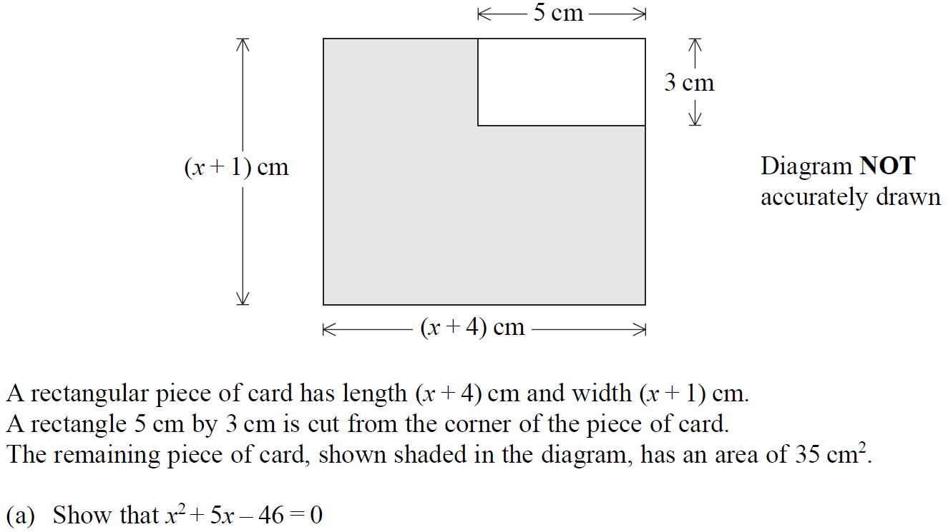
2D Area & Perimeter
May 2005 3H Q17

Slide 20
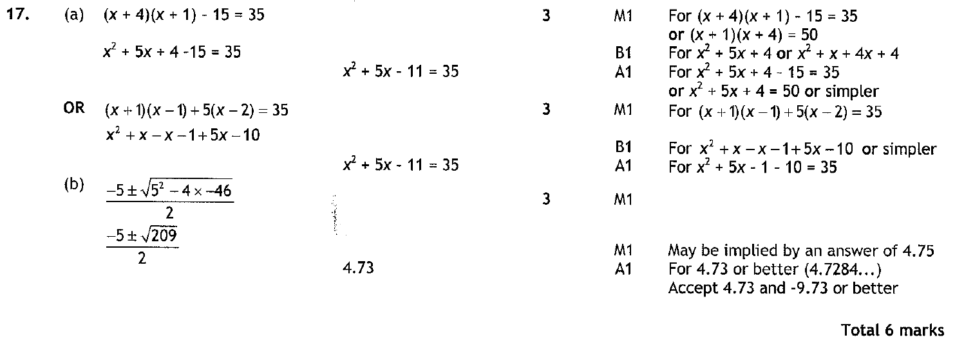
2D Area & Perimeter
May 2005 3H Q17
A
B

Slide 21
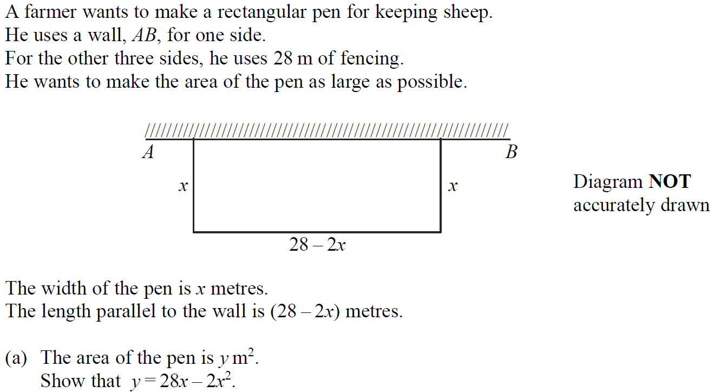
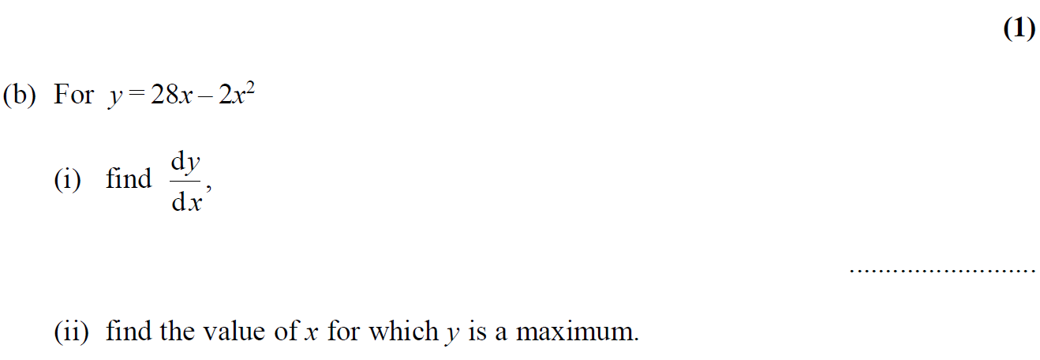
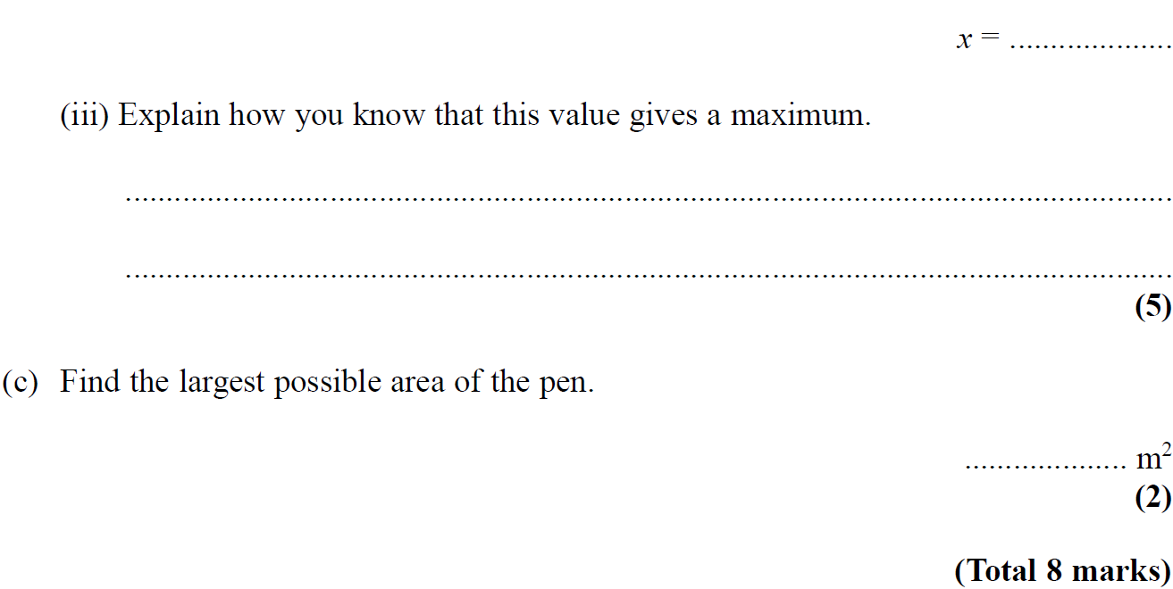
2D Area & Perimeter
May 2005 4H Q14

Slide 22
2D Area & Perimeter
May 2005 4H Q14
A
B (i)
B (ii)
B (iii)
C

Slide 23
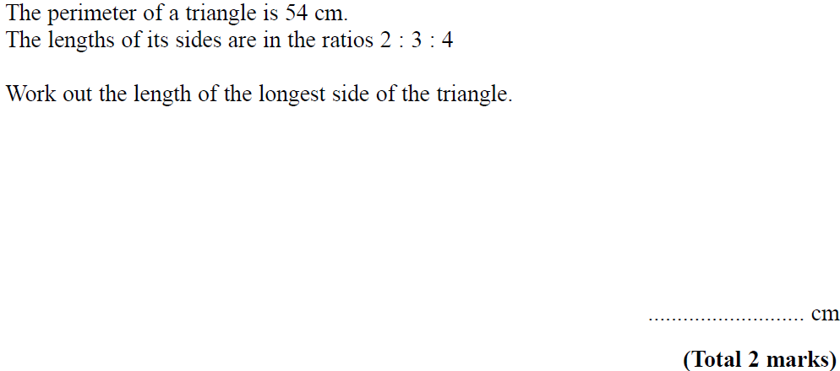
2D Area & Perimeter
May 2006 3H Q8

Slide 24
2D Area & Perimeter
May 2006 3H Q8
A

Slide 25
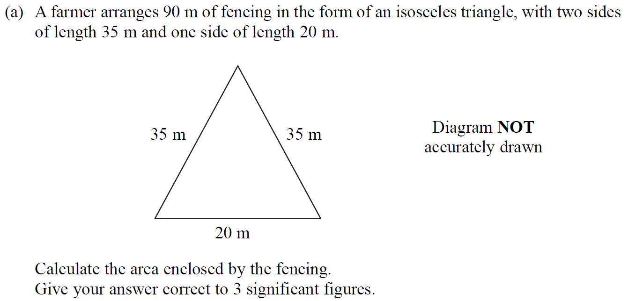
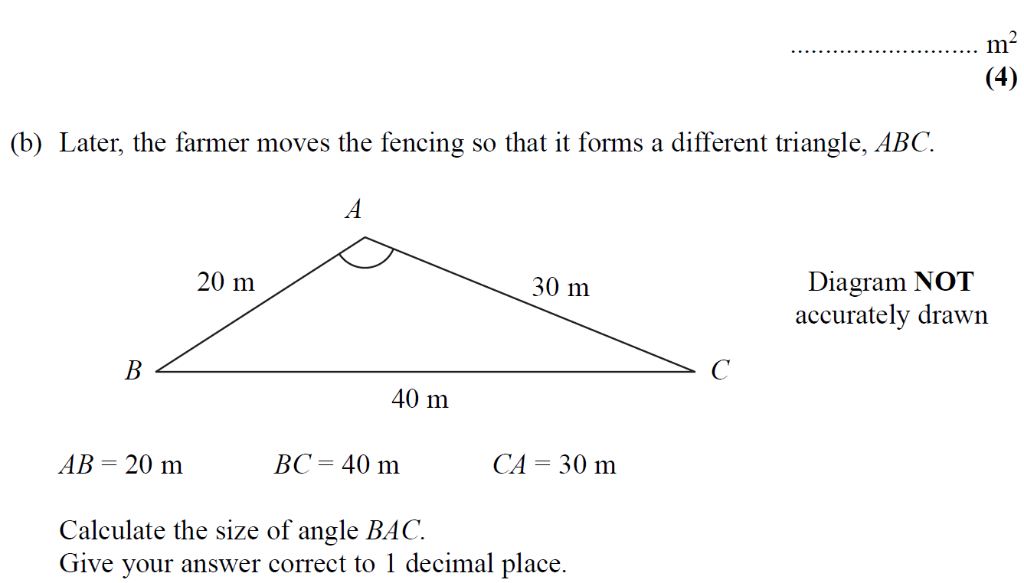
2D Area & Perimeter
May 2006 4H Q9

Slide 26
2D Area & Perimeter
May 2006 4H Q9
A
B

Slide 27
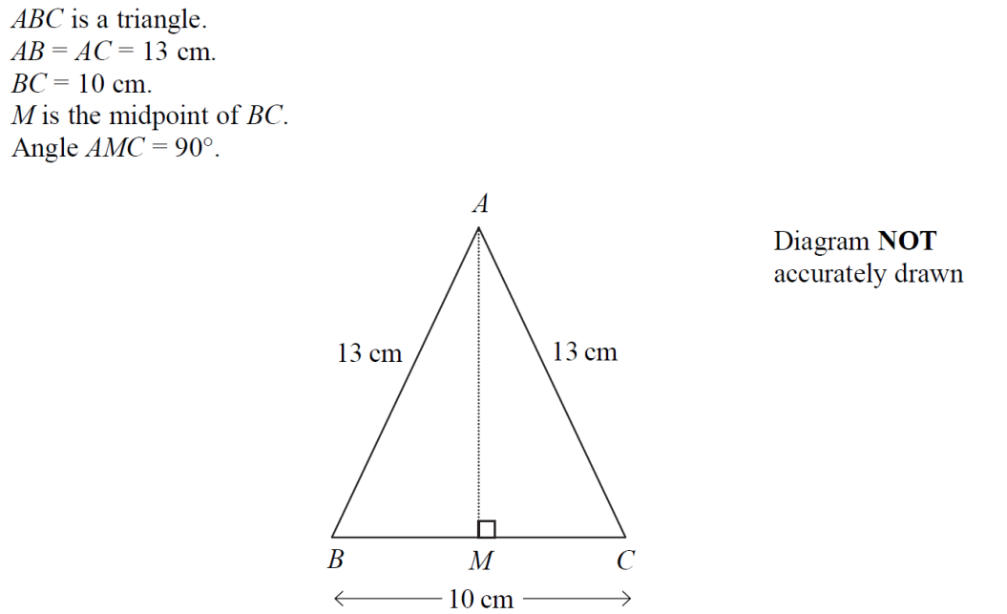
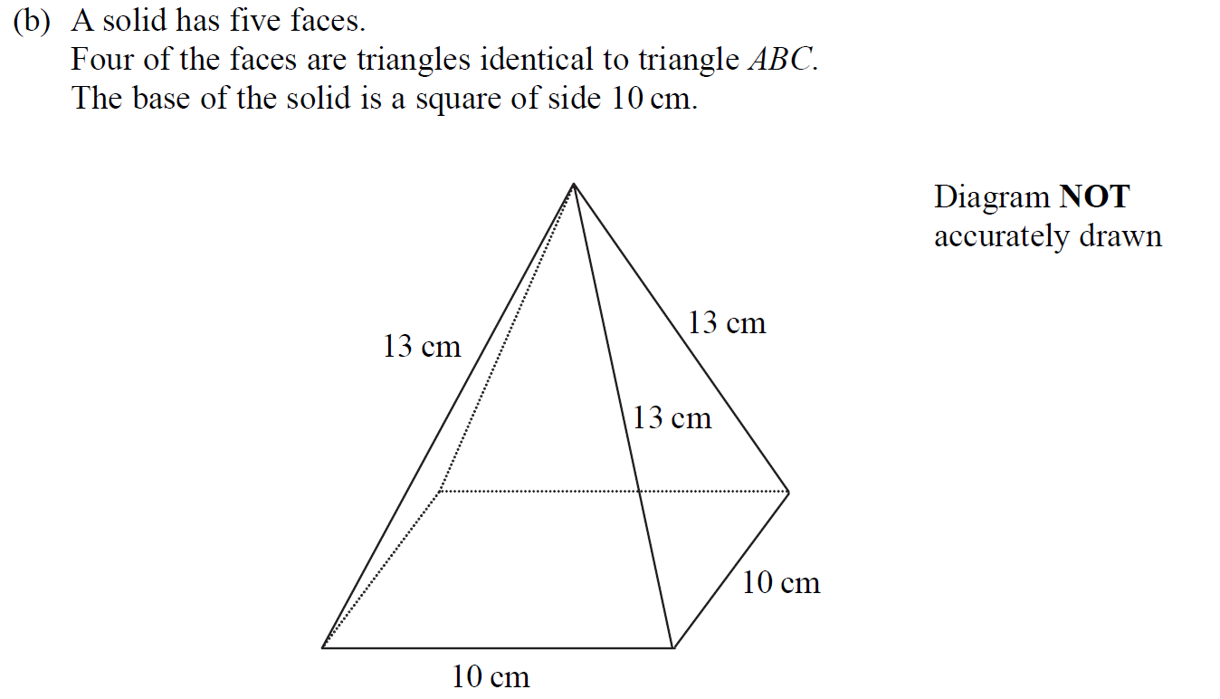
2D Area & Perimeter
Nov 2006 3H Q9

Slide 28
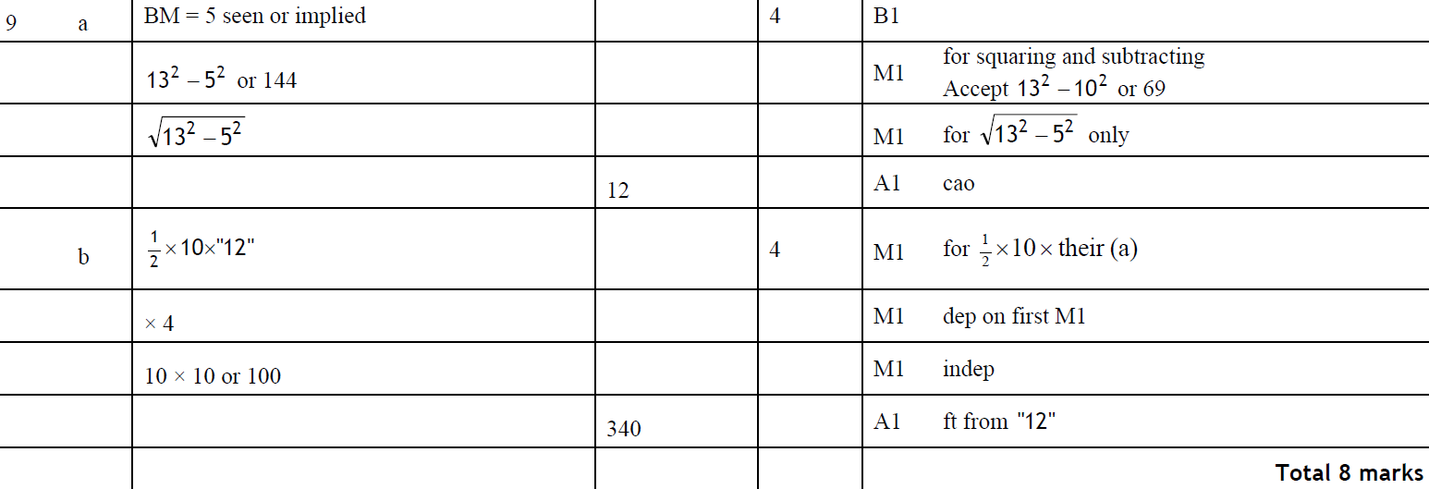
2D Area & Perimeter
Nov 2006 3H Q9
A
B

Slide 29
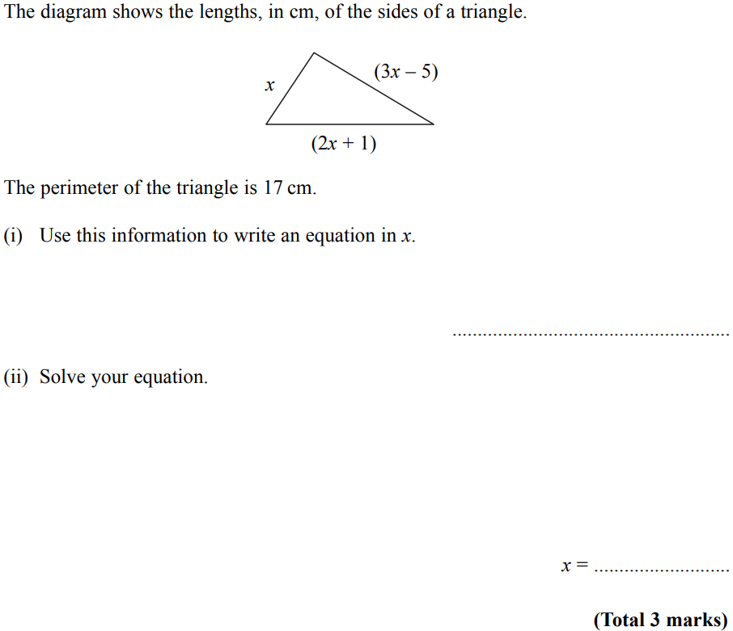
2D Area & Perimeter
May 2007 4H Q1

Slide 30
2D Area & Perimeter
May 2007 4H Q1
A

Slide 31
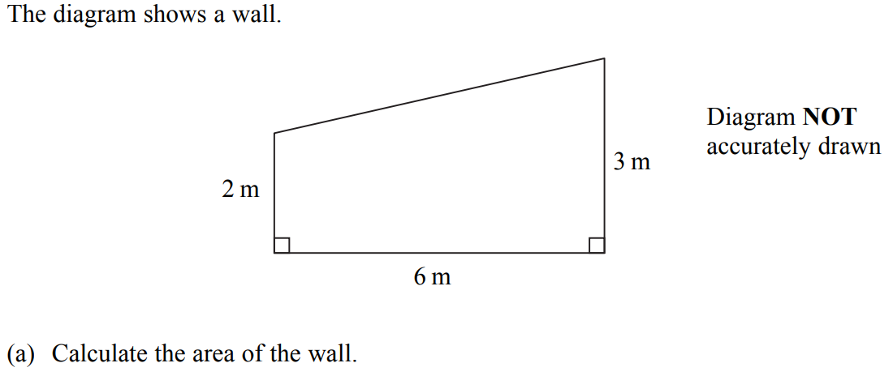
2D Area & Perimeter
May 2007 4H Q5

Slide 32
2D Area & Perimeter
May 2007 4H Q5
A

Slide 33
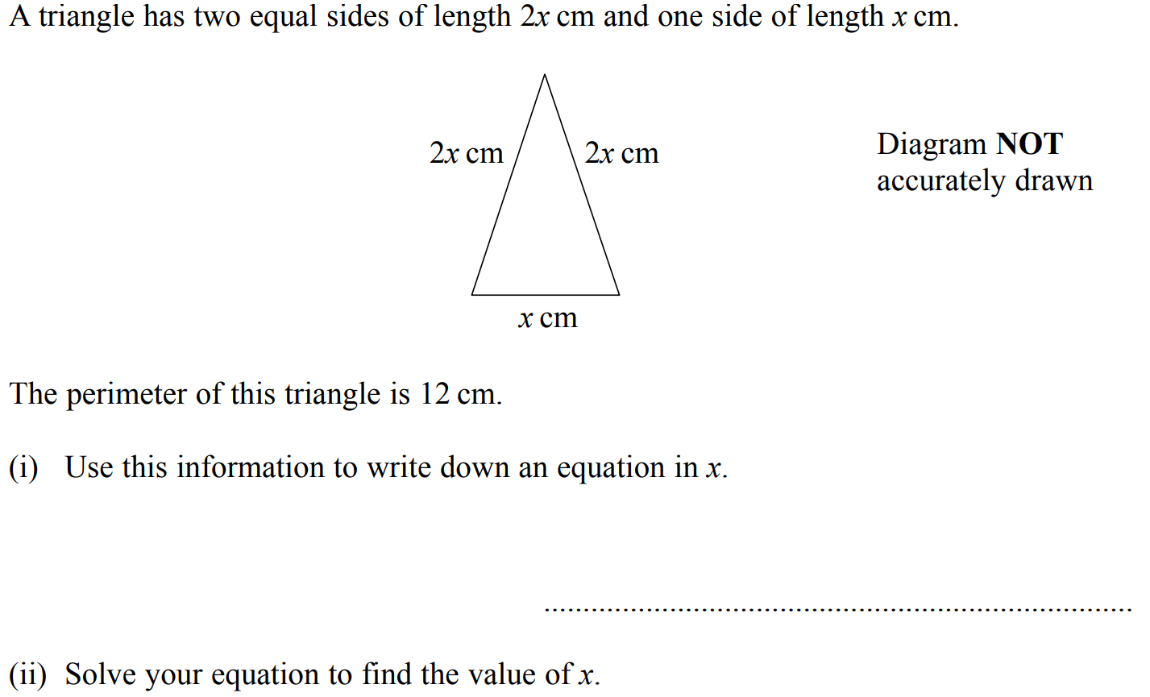
2D Area & Perimeter
Nov 2007 3H Q3

Slide 34
2D Area & Perimeter
Nov 2007 3H Q3
(i)
(ii)

Slide 35
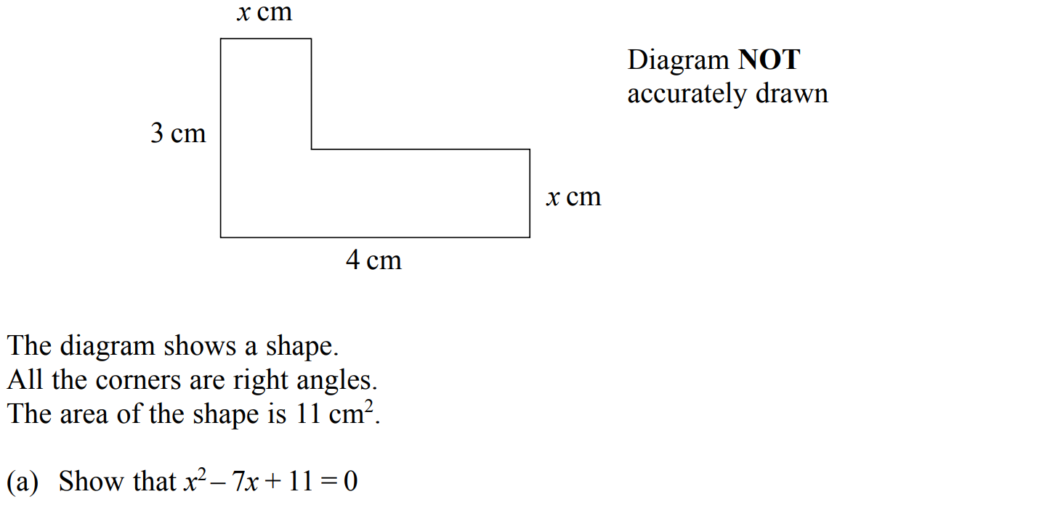
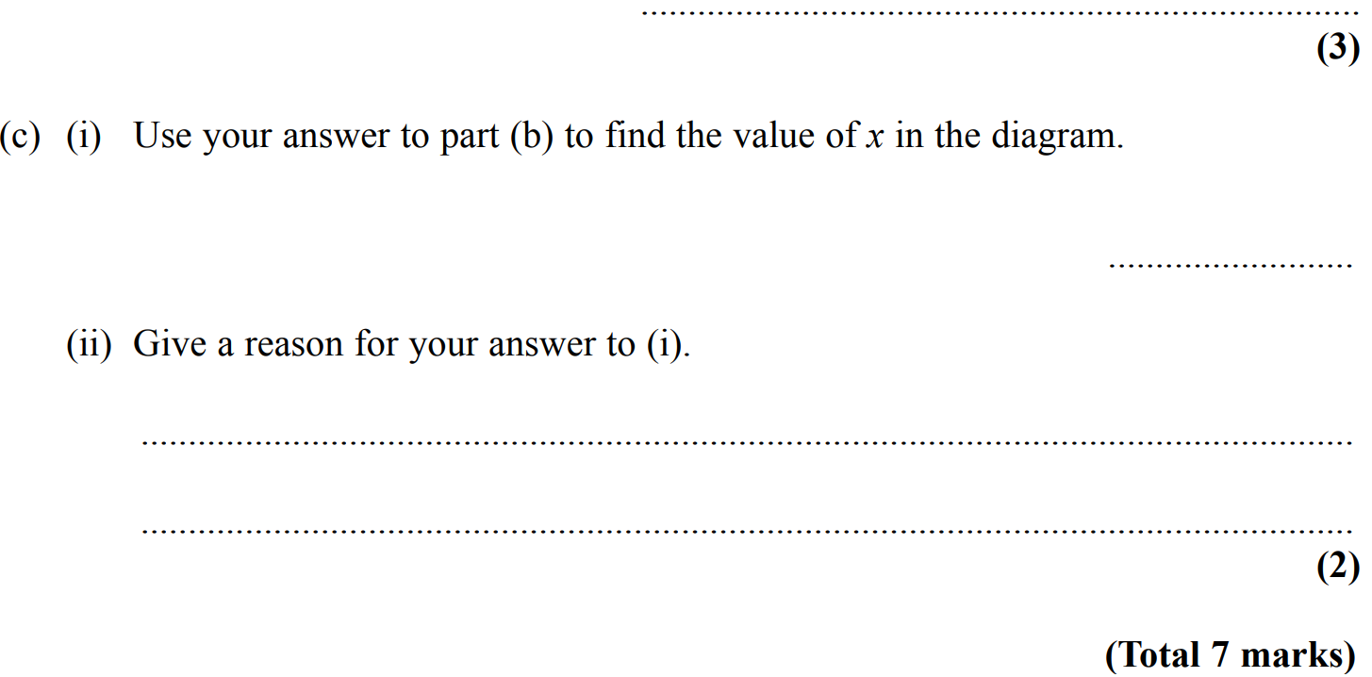
2D Area & Perimeter
Nov 2007 4H Q25

Slide 36
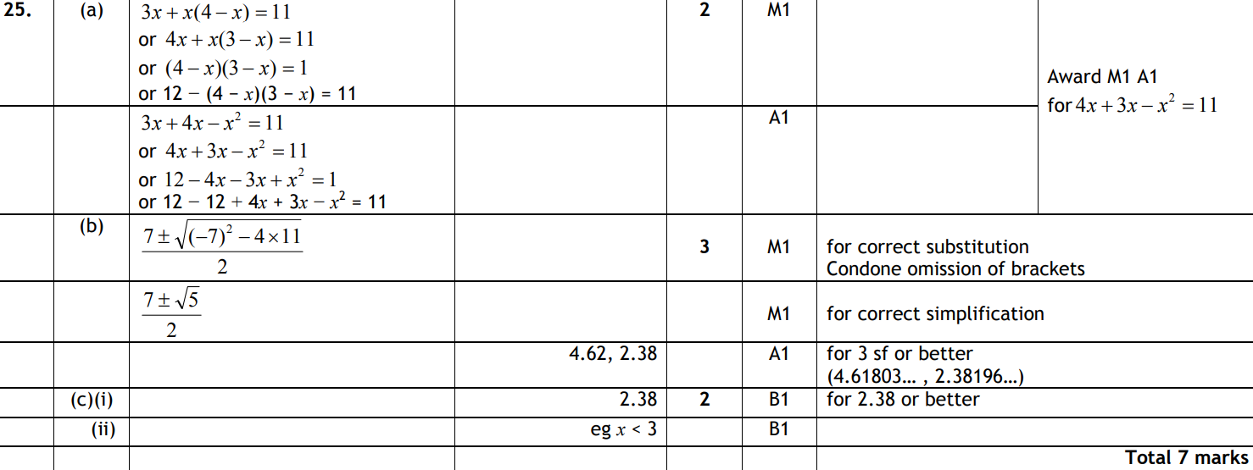
2D Area & Perimeter
Nov 2007 4H Q25
A
B
C (i)
C (ii)

Slide 37
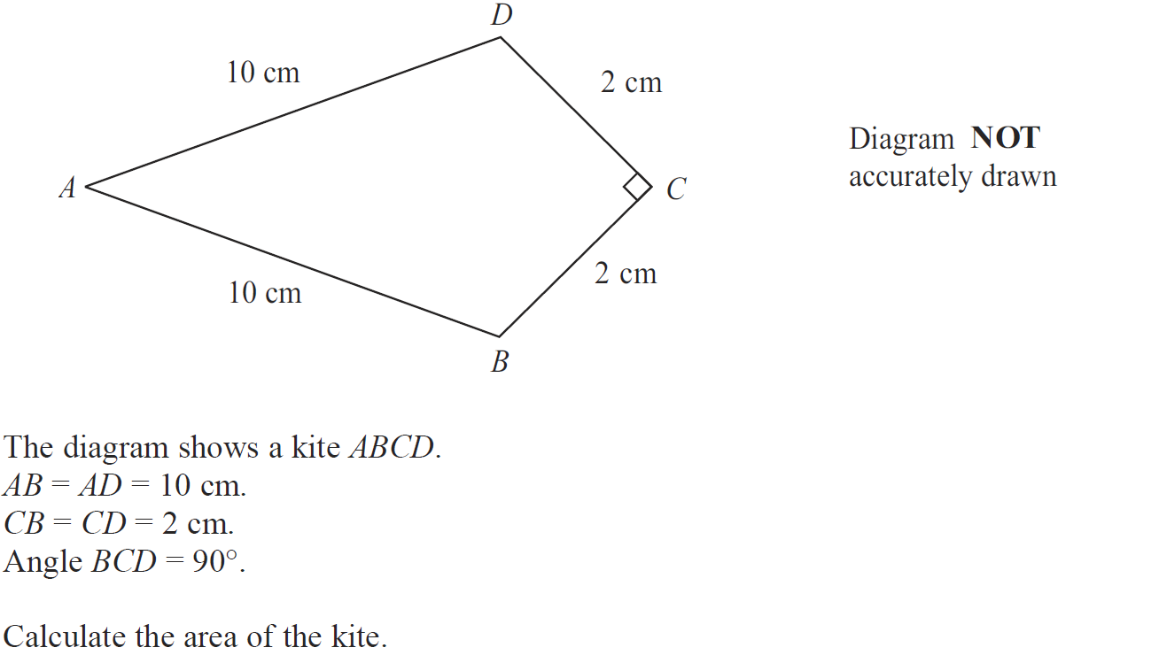
2D Area & Perimeter
May 2008 3H Q22

Slide 38
2D Area & Perimeter
May 2008 3H Q22
A

Slide 39
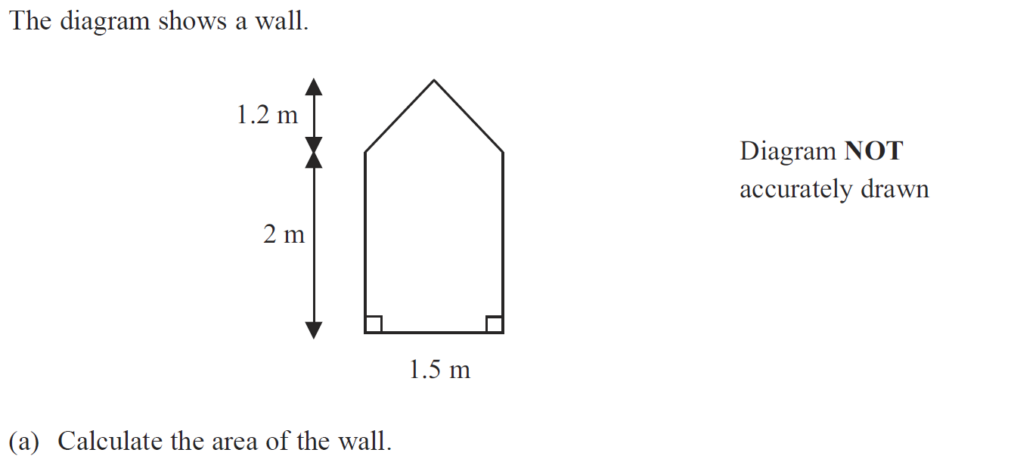
2D Area & Perimeter
Nov 2008 4H Q3

Slide 40
2D Area & Perimeter
Nov 2008 4H Q3
A
B

Slide 41
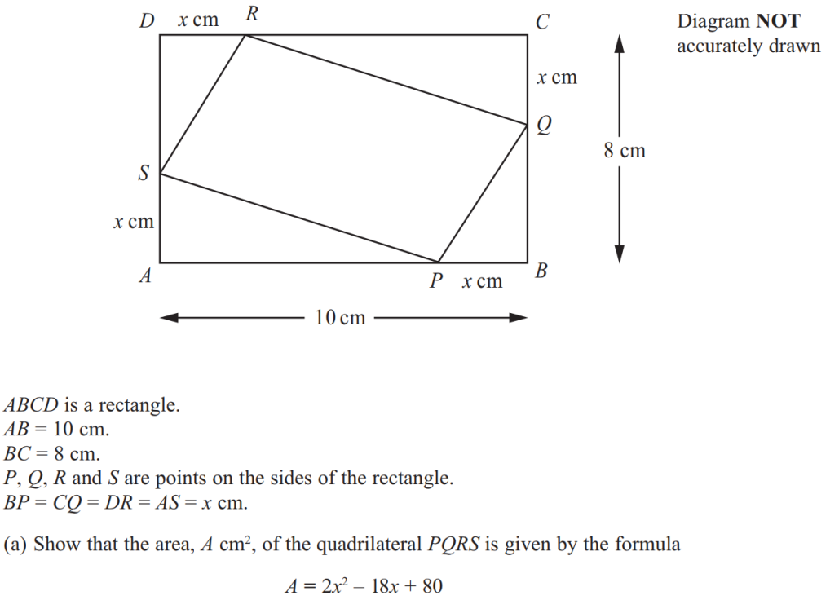
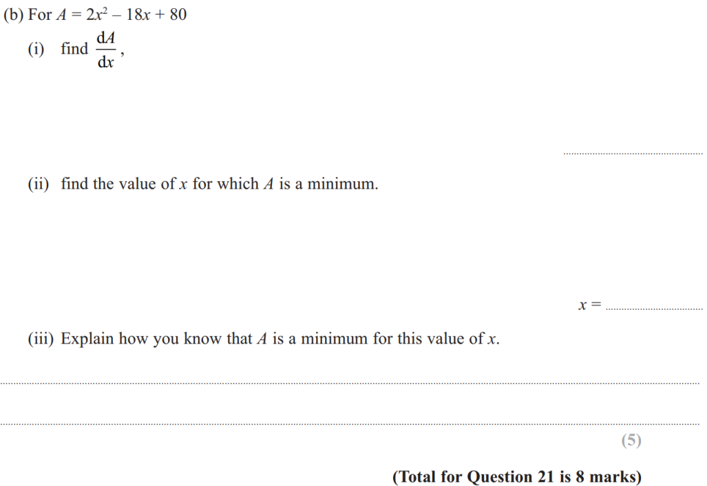
2D Area & Perimeter
June 2011 3H Q21

Slide 42
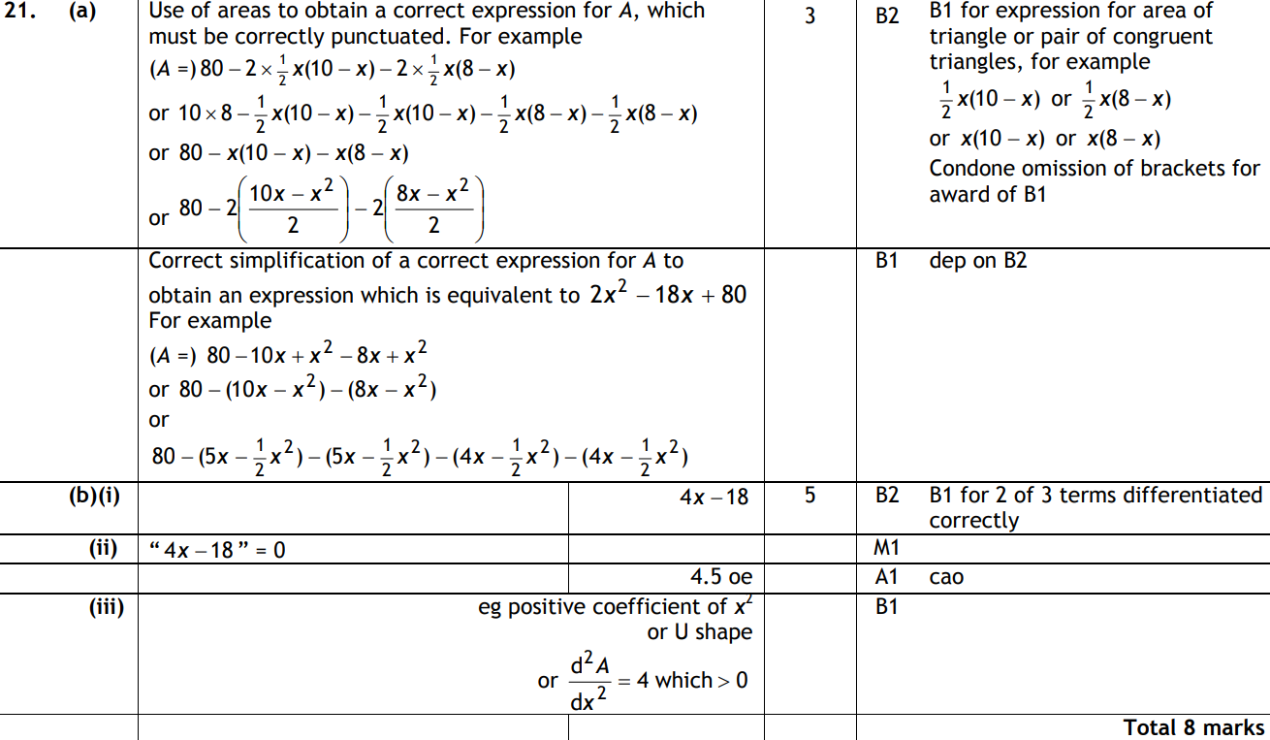
2D Area & Perimeter
June 2011 3H Q21
A
B (i)
B (ii)
B (iii)

Slide 43
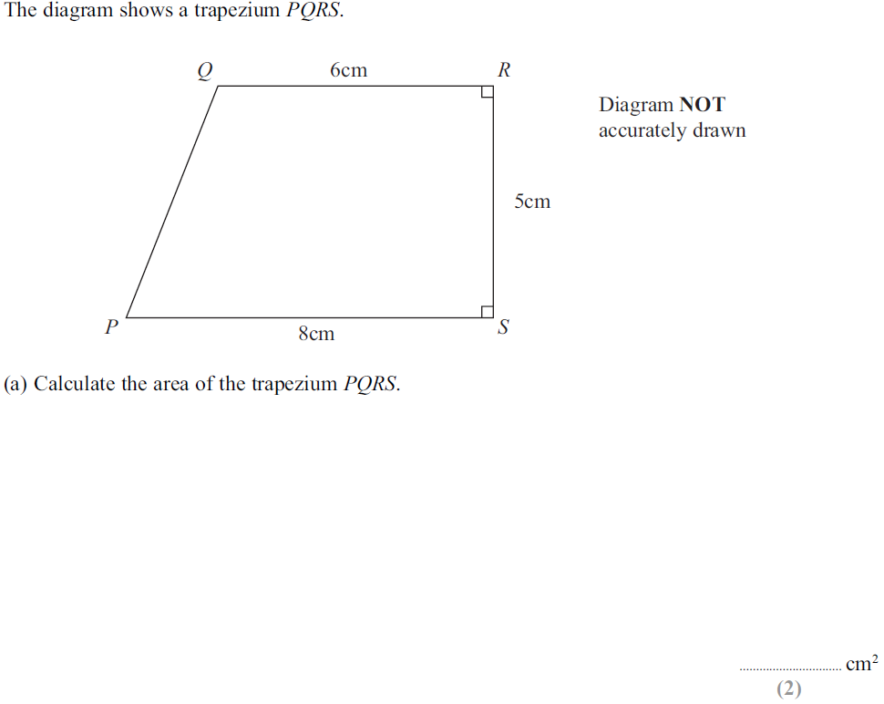
2D Area & Perimeter
June 2011 4H Q6

Slide 44
2D Area & Perimeter
June 2011 4H Q6
A
B

Slide 45
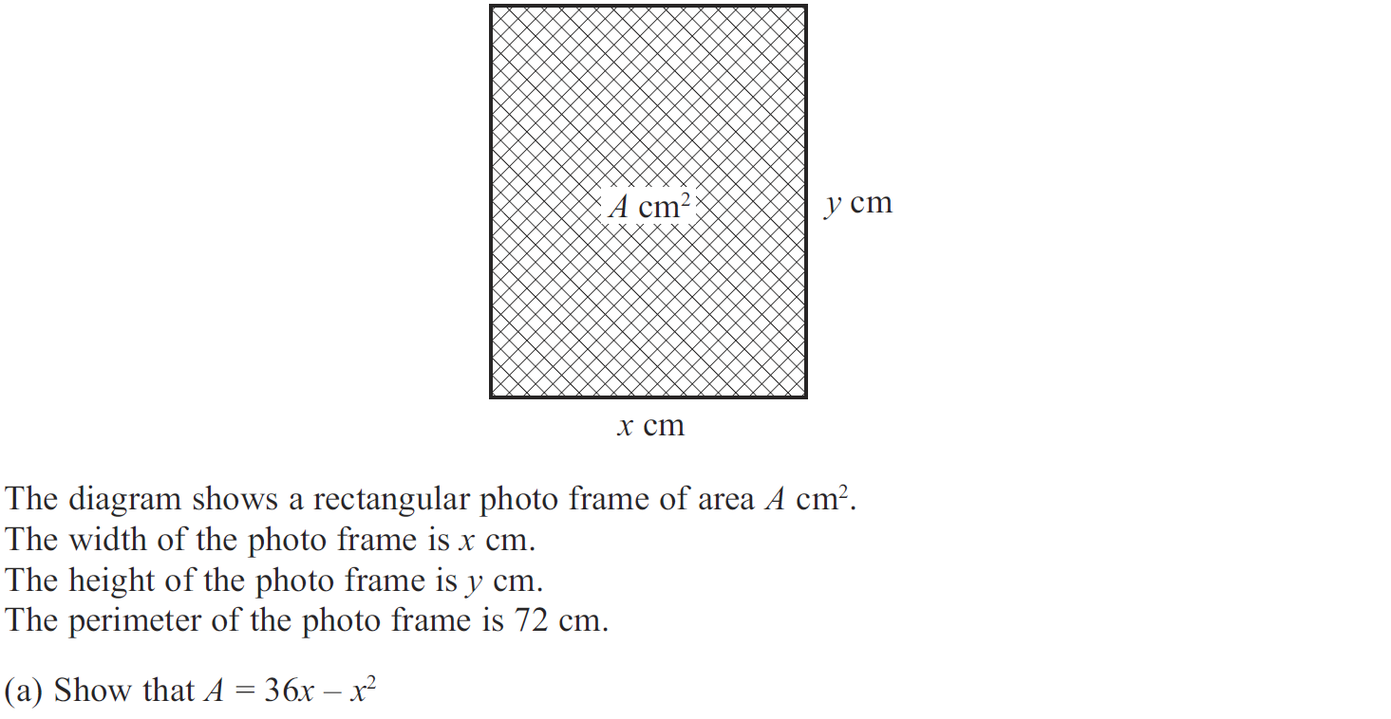
2D Area & Perimeter
Jan 2012 3H Q14

Slide 46
2D Area & Perimeter
Jan 2012 3H Q14
A
B
C

Slide 47
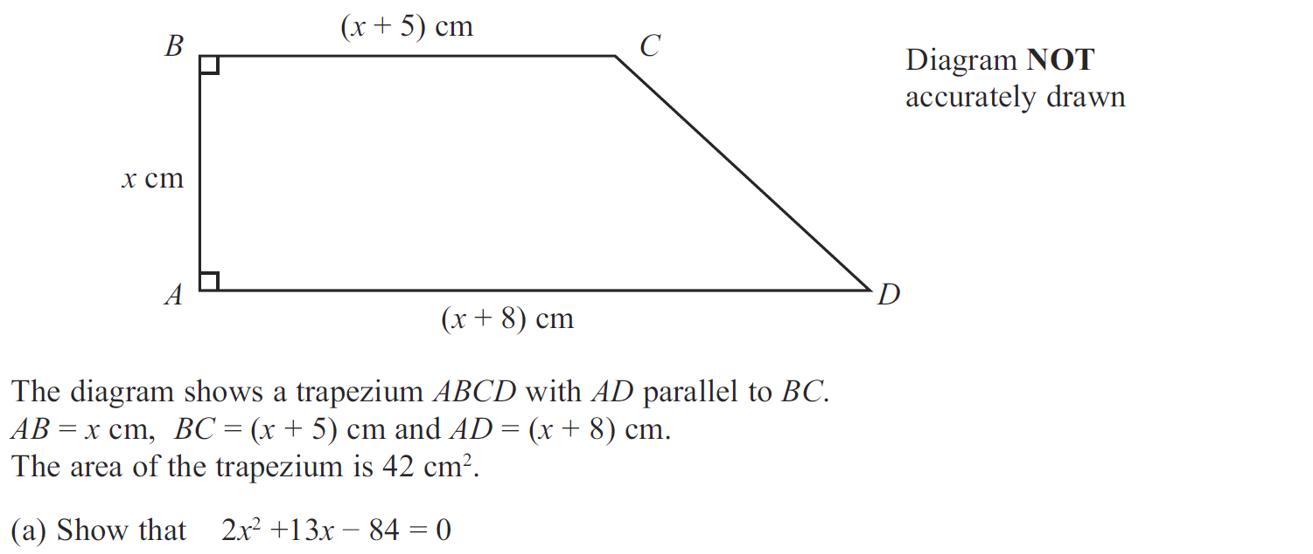
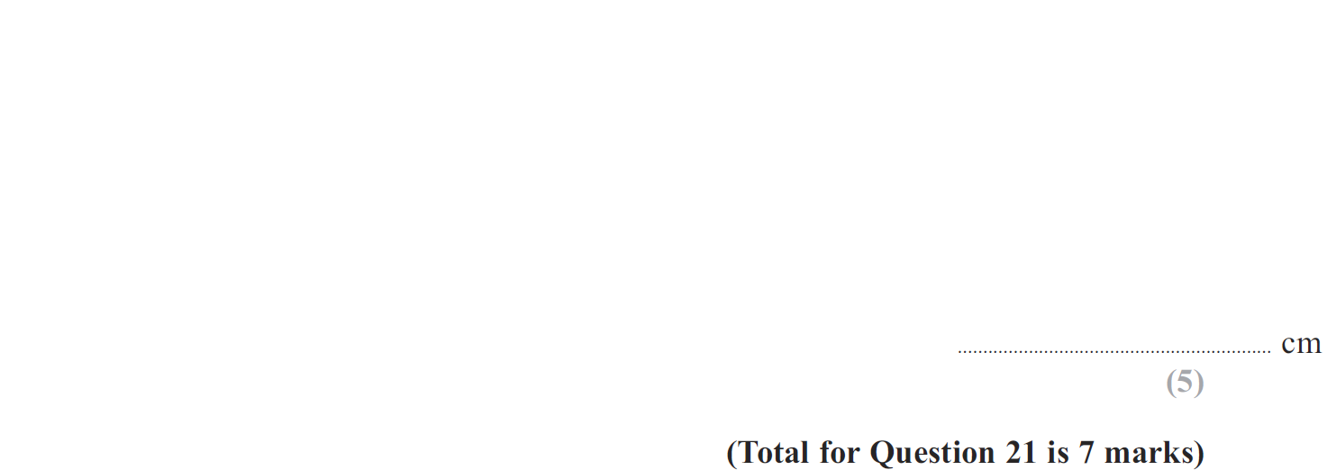
2D Area & Perimeter
Jan 2012 3H Q21

Slide 48
2D Area & Perimeter
Jan 2012 3H Q21
A
B

Slide 49
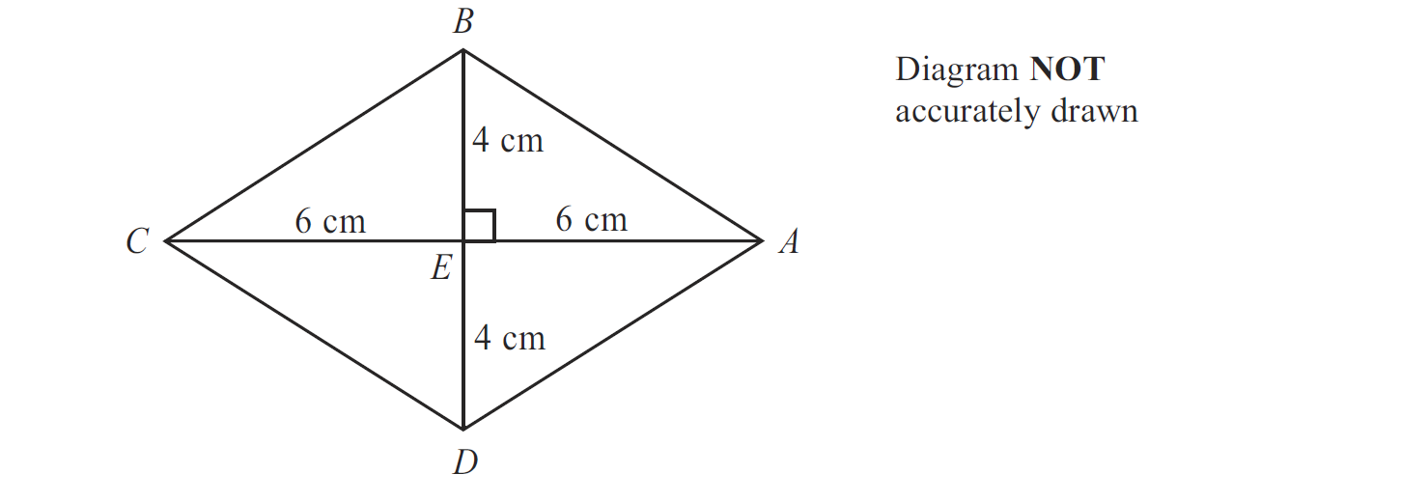
2D Area & Perimeter
Jan 2012 4H Q9

Slide 50
2D Area & Perimeter
Jan 2012 4H Q9
A
B

Slide 51
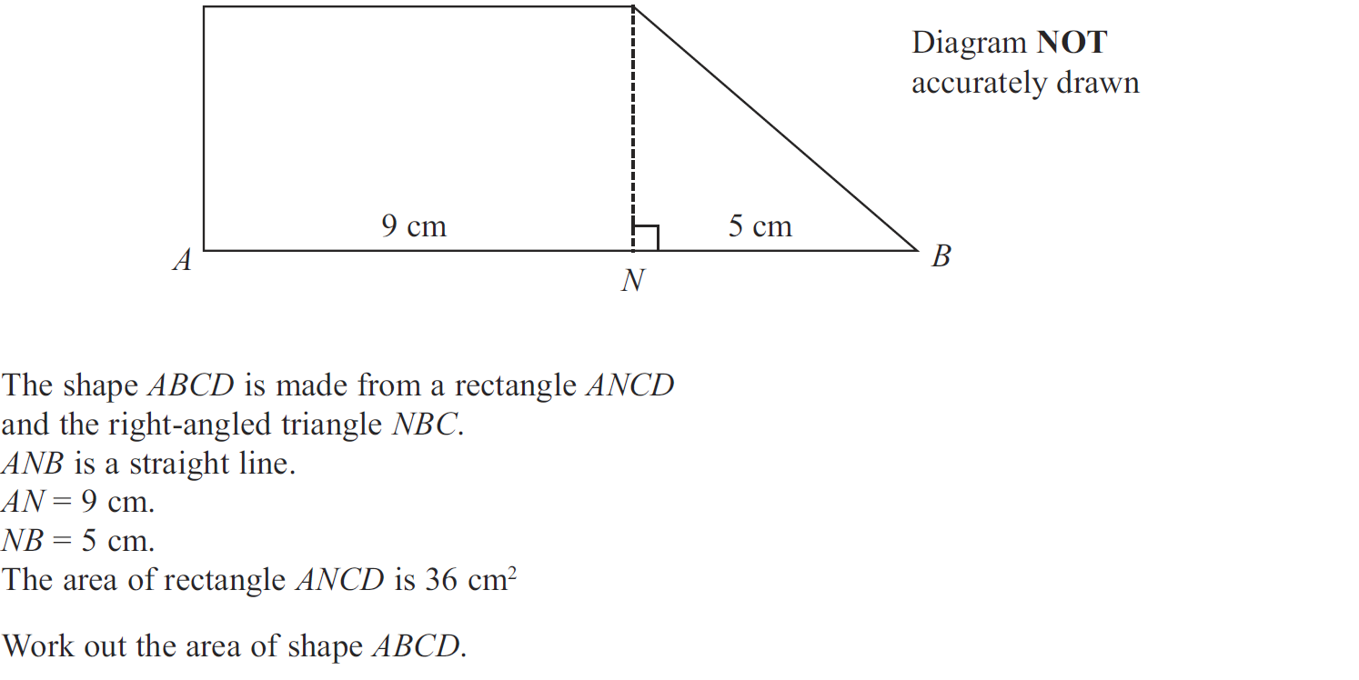
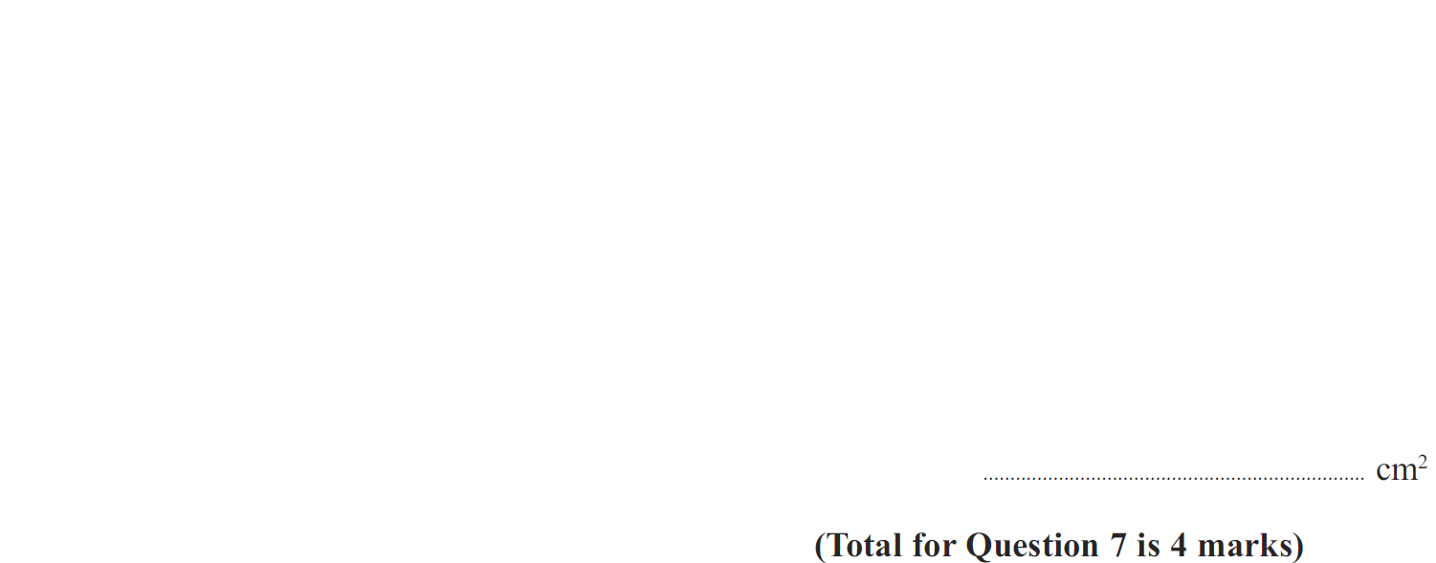
2D Area & Perimeter
May 2012 3H Q7

Slide 52
2D Area & Perimeter
May 2012 3H Q7
A

Slide 53
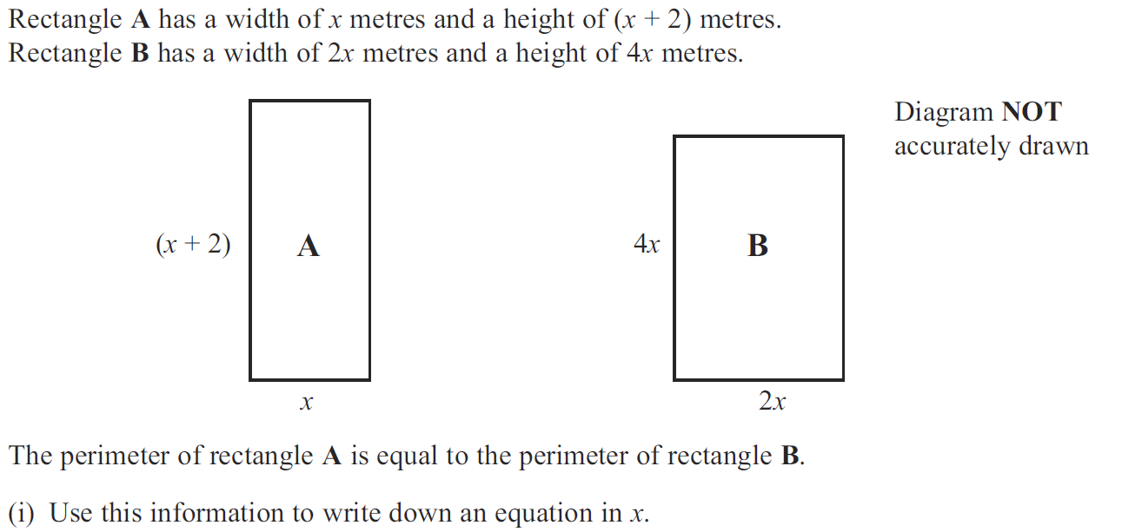
2D Area & Perimeter
Jan 2013 3H Q2

Slide 54
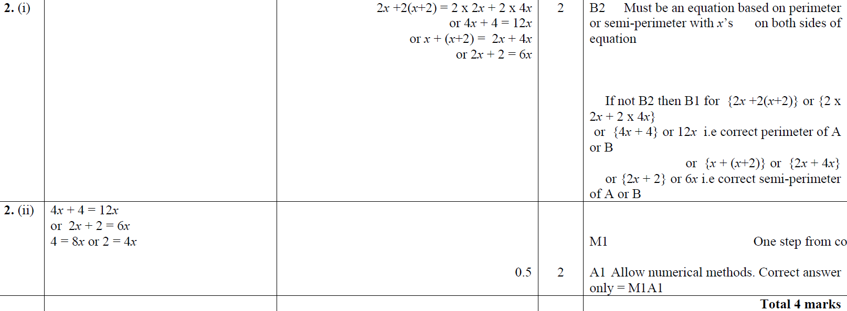
2D Area & Perimeter
Jan 2013 3H Q2
(i)
(ii)

Slide 55
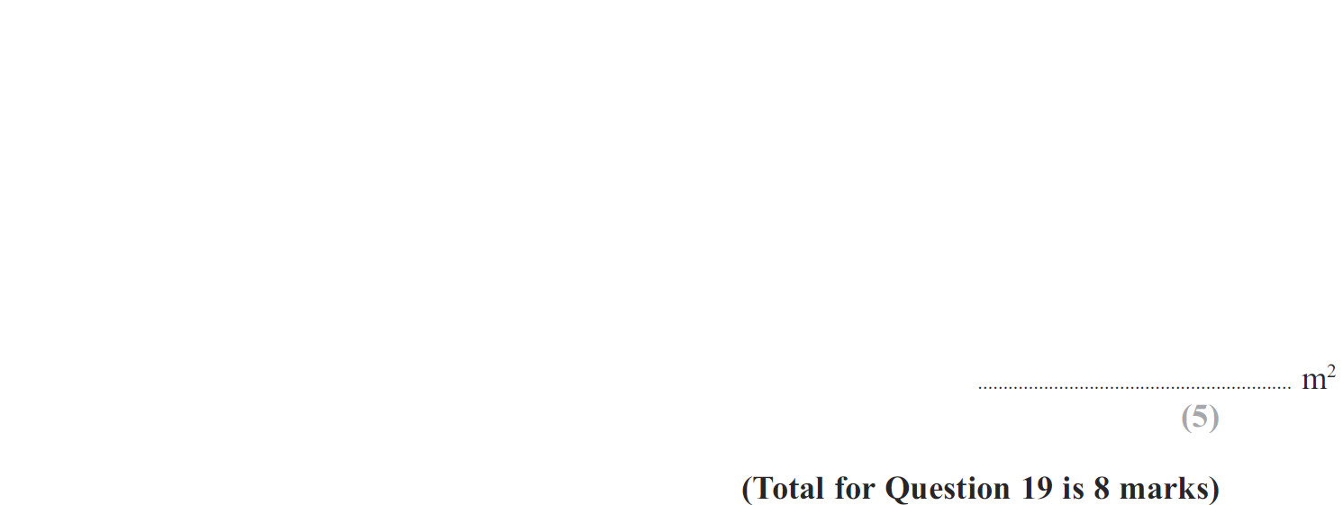
2D Area & Perimeter
Jan 2013 3H Q19

Slide 56
2D Area & Perimeter
Jan 2013 3H Q19
A
B

Slide 57
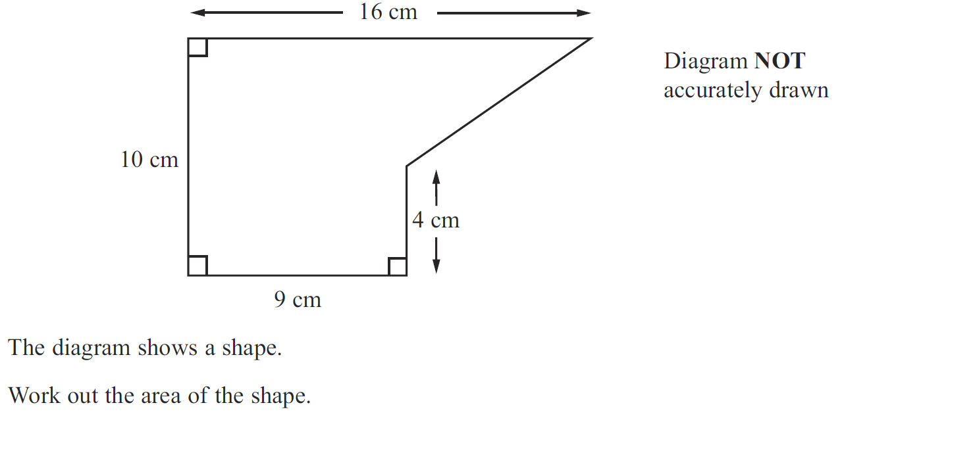
2D Area & Perimeter
Jan 2013 4H Q7

Slide 58
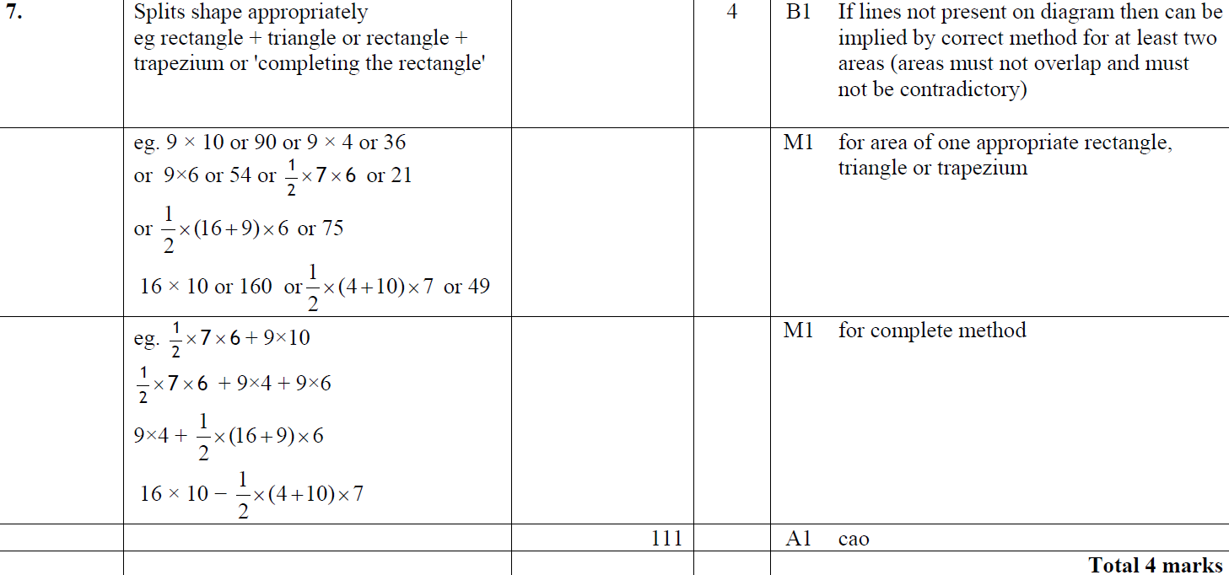
2D Area & Perimeter
Jan 2013 4H Q7
A

Slide 59
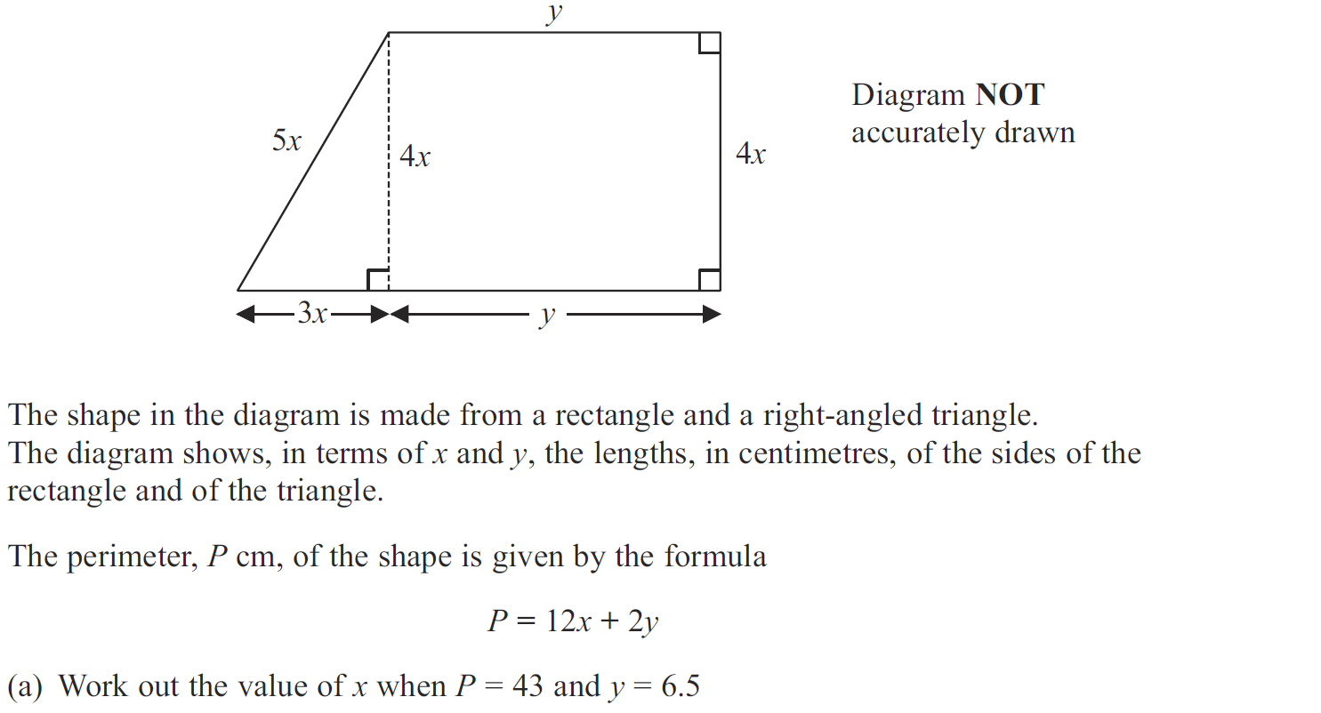
2D Area & Perimeter
May 2013 3H Q5

Slide 60
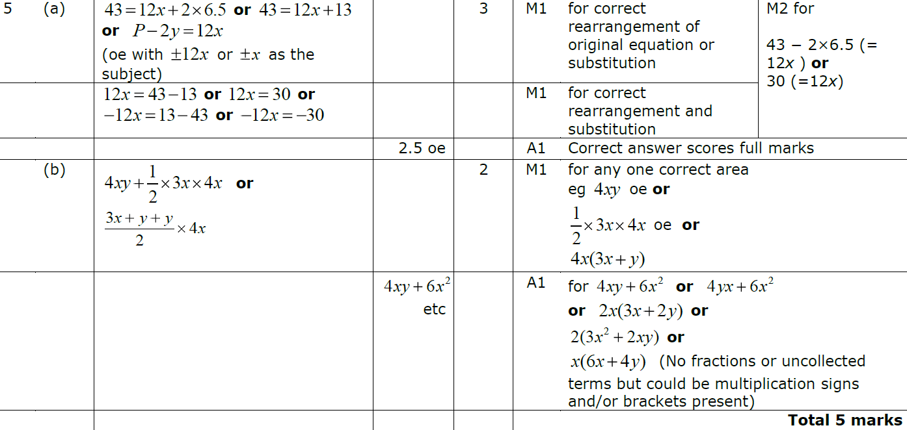
2D Area & Perimeter
May 2013 3H Q5
A
B

Slide 61
2D Area & Perimeter
May 2013 3H Q19

Slide 62
2D Area & Perimeter
May 2013 3H Q19
A
B

Slide 63
2D Area & Perimeter
May 2013 4HR Q22

Slide 64
2D Area & Perimeter
May 2013 4HR Q22
A

Slide 65
2D Area & Perimeter
Jan 2014 3H Q15

Slide 66
2D Area & Perimeter
Jan 2014 3H Q15
A

Slide 67
2D Area & Perimeter
Jan 2014 4H Q15

Slide 68
2D Area & Perimeter
Jan 2014 4H Q15
A (i)
A (ii)
B
C

Slide 69
2D Area & Perimeter
Jan 2014 4H Q18

Slide 70
2D Area & Perimeter
Jan 2014 4H Q18
A
B

Slide 71
2D Area & Perimeter
May 2014 3H Q14

Slide 72
2D Area & Perimeter
May 2014 3H Q14
A (i)
A (ii)
B
C

Slide 73
2D Area & Perimeter
May 2014 3H Q18

Slide 74
2D Area & Perimeter
May 2014 3H Q18
A

Slide 75
2D Area & Perimeter
May 2014 3HR Q3

Slide 76
2D Area & Perimeter
May 2014 3HR Q3
A
B

Slide 77
2D Area & Perimeter
May 2014 4HR Q16

Slide 78
2D Area & Perimeter
May 2014 4HR Q16
A
B
C
B Alternative

Slide 79
2D Area & Perimeter
Jan 2015 3H Q4

Slide 80
2D Area & Perimeter
Jan 2015 3H Q4
A

Slide 81
2D Area & Perimeter
Jan 2015 4H Q8

Slide 82
2D Area & Perimeter
Jan 2015 4H Q8
A

Slide 83
2D Area & Perimeter
Jan 2015 4H Q17

Slide 84
2D Area & Perimeter
Jan 2015 4H Q17
A
B

Slide 85
2D Area & Perimeter
Jan 2015 4HR Q7

Slide 86
2D Area & Perimeter
Jan 2015 4HR Q7
A
B

Slide 87
2D Area & Perimeter
May 2015 3HR Q11

Slide 88
2D Area & Perimeter
May 2015 3HR Q11
(i)
(ii)

Slide 89
2D Area & Perimeter
Jan 2016 4HR Q5

Slide 90
2D Area & Perimeter
Jan 2016 4HR Q5
A

Slide 91
2D Area & Perimeter
May 2016 3H Q17

Slide 92
2D Area & Perimeter
May 2016 3H Q17
(i)
(ii)

Slide 93
2D Area & Perimeter
June 2016 4HR Q11

Slide 94
2D Area & Perimeter
June 2016 4HR Q11
A

Slide 95
2D Area & Perimeter
June 2017 4H Q15

Slide 96
2D Area & Perimeter
June 2017 4H Q15
A

Slide 97
2D Area & Perimeter
Jan 2018 4H Q11

Slide 98
2D Area & Perimeter
Jan 2018 4H Q11
A

Slide 99
2D Area & Perimeter
Jan 2018 3HR Q5

Slide 100
2D Area & Perimeter
Jan 2018 3HR Q5
A

Slide 101
2D Area & Perimeter
Jan 2018 4HR Q2

Slide 102
2D Area & Perimeter
Jan 2018 4HR Q2
A
B

Slide 103
2D Area & Perimeter
Jan 2018 4HR Q18

Slide 104
2D Area & Perimeter
Jan 2018 4HR Q18
A

Slide 105
2D Area & Perimeter
June 2018 4H Q2

Slide 106
2D Area & Perimeter
June 2018 4H Q2
A
B
C

Slide 107
2D Area & Perimeter
May 2018 3HR Q7

Slide 108
2D Area & Perimeter
May 2018 3HR Q7
A (i)
A (ii)
B

Slide 109
2D Area & Perimeter
June 2018 4HR Q19

Slide 110
2D Area & Perimeter
June 2018 4HR Q19
A
B

