Slide 1

Worked example
Your turn
$$z_{1}=6(\cos{\frac{5π}{12}+i\sin{\frac{5π}{12}})}$$
$$z_{2}=3(\cos{\frac{3π}{4}+i\sin{\frac{3π}{4}})}$$
Find:
i) $\left|z_{1}z_{2}\right|$
ii) $\arg{(z_{1}z_{2}})$
iii) $z_{1}z_{2}$ in the form $r\left(\cos{θ}+i\sin{θ}\right)$
iv)$z_{1}z_{2}$ in the form $x+iy$
$$z_{1}=8(\cos{\frac{7π}{10}+i\sin{\frac{7π}{10}})}$$
$$z_{2}=4(\cos{\frac{4π}{5}+i\sin{\frac{4π}{5}})}$$
Find:
i) $\left|z_{1}z_{2}\right|$
ii) $\arg{(z_{1}z_{2}})$
iii) $z_{1}z_{2}$ in the form $r\left(\cos{θ}+i\sin{θ}\right)$
iv)$z_{1}z_{2}$ in the form $x+iy$
$$32$$
$$−\frac{π}{2}$$
$$32\left(\cos\left(−\frac{π}{2}\right)+i\sin{(−\frac{π}{2}})\right)$$
$$−32i$$

Slide 2

Worked example
Your turn
$$z_{1}=6(\cos{\frac{5π}{12}+i\sin{\frac{5π}{12}})}$$
$$z_{2}=3(\cos{\frac{3π}{4}+i\sin{\frac{3π}{4}})}$$
Find:
i) $\left|\frac{z_{1}}{z_{2}}\right|$
ii) $\arg{(\frac{z_{1}}{z_{2}}})$
iii) $\frac{z_{1}}{z_{2}}$in the form $r\left(\cos{θ}+i\sin{θ}\right)$
iv) $\frac{z_{1}}{z_{2}}$in the form $x+iy$
$$z_{1}=8(\cos{\frac{7π}{10}+i\sin{\frac{7π}{10}})}$$
$$z_{2}=4(\cos{\frac{4π}{5}+i\sin{\frac{4π}{5}})}$$
Find:
i) $\left|\frac{z_{1}}{z_{2}}\right|$
ii) $\arg{(\frac{z_{1}}{z_{2}}})$
iii) $\frac{z_{1}}{z_{2}}$in the form $r\left(\cos{θ}+i\sin{θ}\right)$
iv) $\frac{z_{1}}{z_{2}}$in the form $x+iy$
$$2$$
$$−\frac{π}{10}$$
$$2\left(\cos\left(−\frac{π}{10}\right)+i\sin{(−\frac{π}{10}})\right)$$
$$1.90−0.618i$$

Slide 3
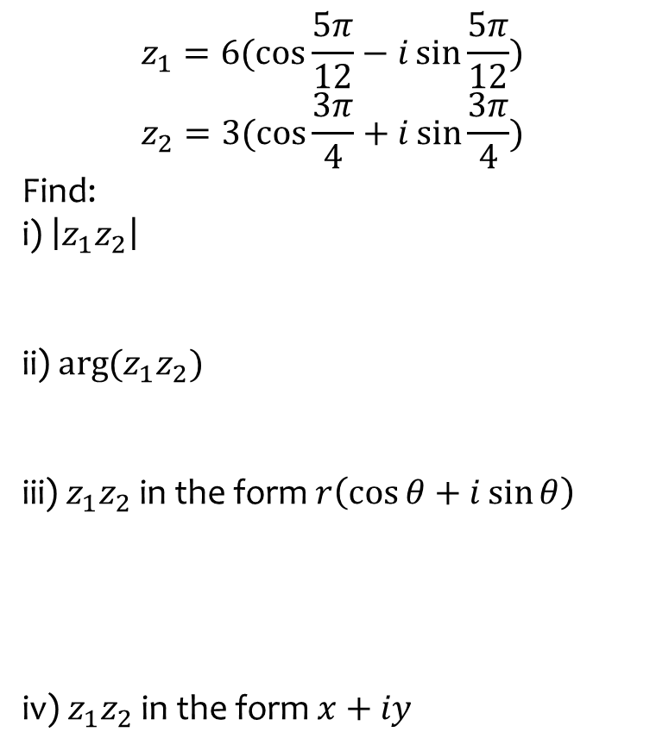

Worked example
Your turn
$$z_{1}=6(\cos{\frac{5π}{12}−i\sin{\frac{5π}{12}})}$$
$$z_{2}=3(\cos{\frac{3π}{4}+i\sin{\frac{3π}{4}})}$$
Find:
i) $\left|z_{1}z_{2}\right|$
ii) $\arg{(z_{1}z_{2}})$
iii) $z_{1}z_{2}$ in the form $r\left(\cos{θ}+i\sin{θ}\right)$
iv)$z_{1}z_{2}$ in the form $x+iy$
$$z_{1}=8(\cos{\frac{7π}{10}+i\sin{\frac{7π}{10}})}$$
$$z_{2}=4(\cos{\frac{4π}{5}−i\sin{\frac{4π}{5}})}$$
Find:
i) $\left|z_{1}z_{2}\right|$
ii) $\arg{(z_{1}z_{2}})$
iii) $z_{1}z_{2}$ in the form $r\left(\cos{θ}+i\sin{θ}\right)$
iv)$z_{1}z_{2}$ in the form $x+iy$
$$32$$
$$−\frac{π}{10}$$
$$32\left(\cos\left(−\frac{π}{10}\right)+i\sin{(−\frac{π}{10}})\right)$$
$$30.4−9.89i$$

