Slide 1
2.4) Series expansions of compound functions

Slide 2


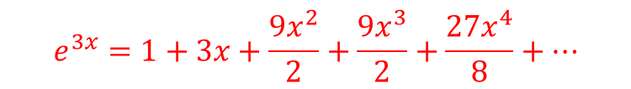
Worked example
Your turn
Find the Maclaurin series for $e^{4x}$ up to and including the term in $x^{4}$
Find the Maclaurin series for $e^{3x}$ up to and including the term in $x^{4}$
$$e^{3x}=1+3x+\frac{{9x}^{2}}{2}+\frac{{9x}^{3}}{2}+\frac{27x^{4}}{8}+…$$

Slide 3
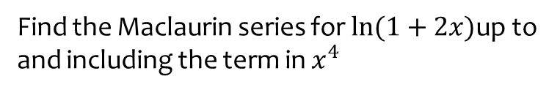

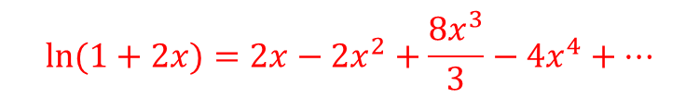
Worked example
Your turn
Find the Maclaurin series for $\ln{(1+3x)}$ up to and including the term in $x^{4}$
Find the Maclaurin series for $\ln{(1+2x)}$up to and including the term in $x^{4}$
$$\ln{(1+2x)}=2x−2x^{2}+\frac{8x^{3}}{3}−4x^{4}+…$$

Slide 4
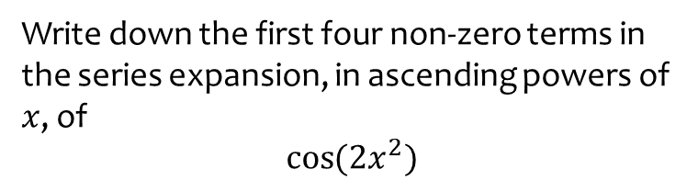
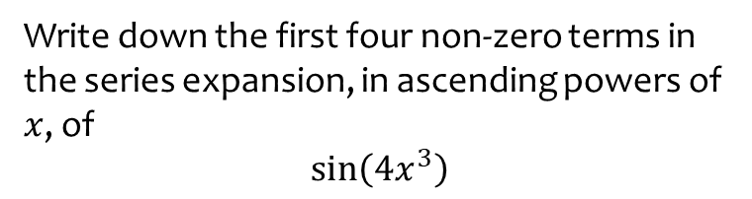

Worked example
Your turn
Write down the first four non-zero terms in the series expansion, in ascending powers of $x$, of
$$\sin\left(4x^{3}\right)$$
Write down the first four non-zero terms in the series expansion, in ascending powers of $x$, of
$$\cos{(2x^{2})}$$
$$1−3x^{4}+\frac{2}{3}x^{8}−\frac{4}{45}x^{12}+…$$

Slide 5
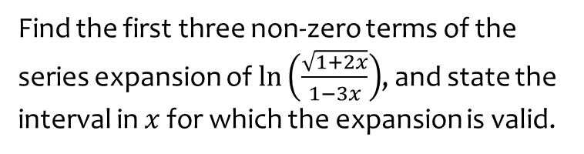
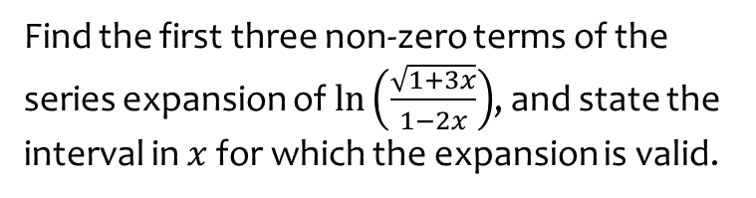

Worked example
Your turn
Find the first three non-zero terms of the series expansion of $\ln\left(\frac{\sqrt{1+3x}}{1−2x}\right)$, and state the interval in $x$ for which the expansion is valid.
Find the first three non-zero terms of the series expansion of $\ln\left(\frac{\sqrt{1+2x}}{1−3x}\right)$, and state the interval in $x$ for which the expansion is valid.
$$4x+\frac{7}{2}x^{2}+\frac{31}{3}x^{3}+…$$
Valid for $−\frac{1}{3}≤x<\frac{1}{3}$

Slide 6



Worked example
Your turn
Find the first three terms in the Maclaurin series expansion of $e^{\cos{x}}$
Find the first three terms in the Maclaurin series expansion of $e^{\sin{x}}$
$$1+x+\frac{x^{2}}{2}$$

Slide 7
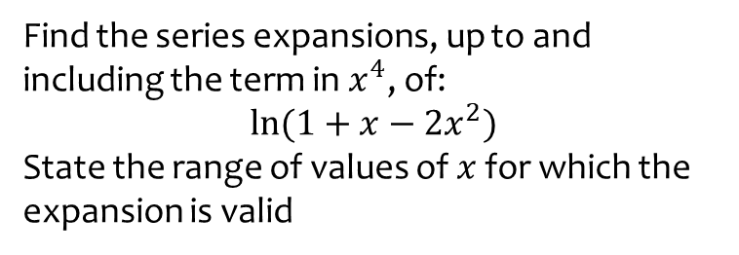
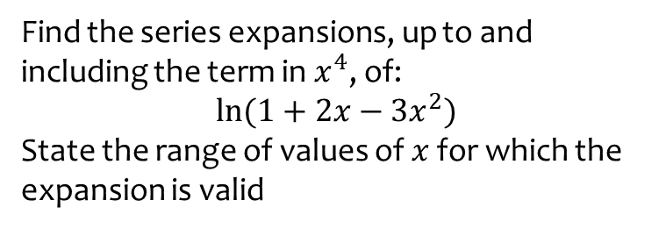
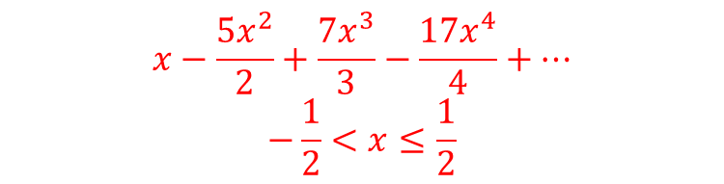
Worked example
Your turn
Find the series expansions, up to and including the term in $x^{4}$, of:
$$\ln{(1+2x−3x^{2})}$$
State the range of values of $x$ for which the expansion is valid
Find the series expansions, up to and including the term in $x^{4}$, of:
$$\ln{(1+x−2x^{2})}$$
State the range of values of $x$ for which the expansion is valid
$$x−\frac{5x^{2}}{2}+\frac{7x^{3}}{3}−\frac{17x^{4}}{4}+…$$
$$−\frac{1}{2}<x≤\frac{1}{2}$$

Slide 8
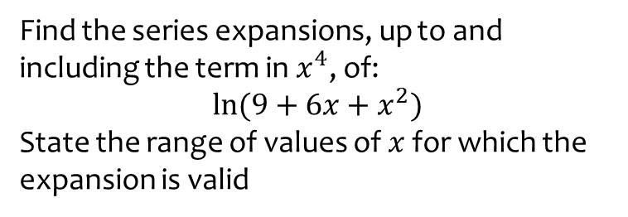
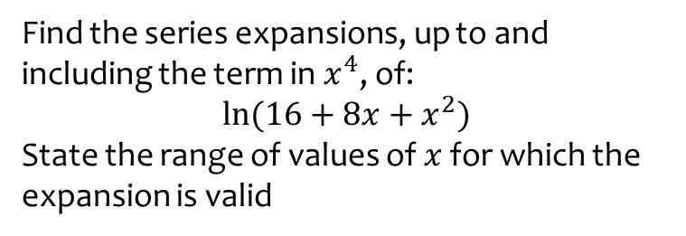
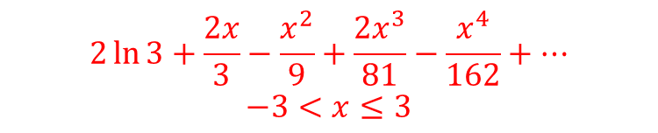
Worked example
Your turn
Find the series expansions, up to and including the term in $x^{4}$, of:
$$\ln{(16+8x+x^{2})}$$
State the range of values of $x$ for which the expansion is valid
Find the series expansions, up to and including the term in $x^{4}$, of:
$$\ln{(9+6x+x^{2})}$$
State the range of values of $x$ for which the expansion is valid
$$2\ln{3}+\frac{2x}{3}−\frac{x^{2}}{9}+\frac{2x^{3}}{81}−\frac{x^{4}}{162}+…$$
$$−3<x≤3$$

Slide 9
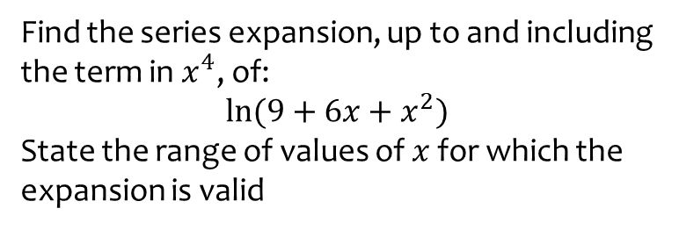
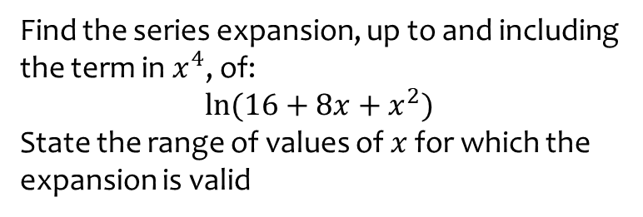
Worked example
Your turn
Find the series expansion, up to and including the term in $x^{4}$, of:
$$\ln{(16+8x+x^{2})}$$
State the range of values of $x$ for which the expansion is valid
Find the series expansion, up to and including the term in $x^{4}$, of:
$$\ln{(9+6x+x^{2})}$$
State the range of values of $x$ for which the expansion is valid
$$2\ln{3}+\frac{2x}{3}−\frac{x^{2}}{9}+\frac{2x^{3}}{81}−\frac{x^{4}}{162}+…$$
$$−3<x≤3$$

Slide 10
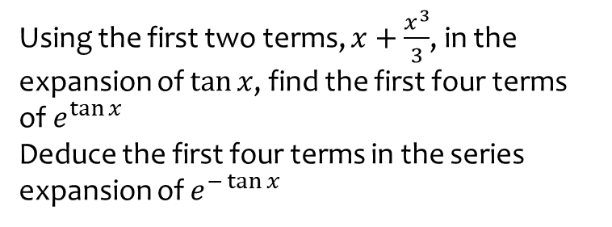
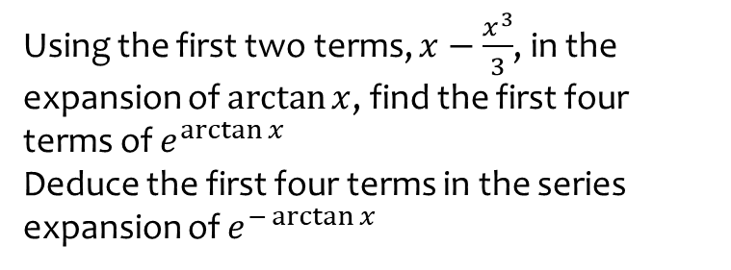
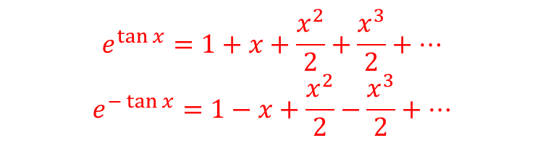
Worked example
Your turn
Using the first two terms, $x−\frac{x^{3}}{3}$, in the expansion of $\arctan{x}$, find the first four terms of $e^{\arctan{x}}$
Deduce the first four terms in the series expansion of $e^{−\arctan{x}}$
Using the first two terms, $x+\frac{x^{3}}{3}$, in the expansion of $\tan{x}$, find the first four terms of $e^{\tan{x}}$
Deduce the first four terms in the series expansion of $e^{−\tan{x}}$
$$e^{\tan{x}}=1+x+\frac{x^{2}}{2}+\frac{x^{3}}{2}+…$$
$$e^{−\tan{x}}=1−x+\frac{x^{2}}{2}−\frac{x^{3}}{2}+…$$

