Slide 1
2.3) Modulus-argument form of complex numbers

Slide 2
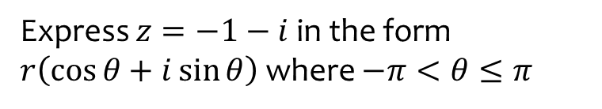
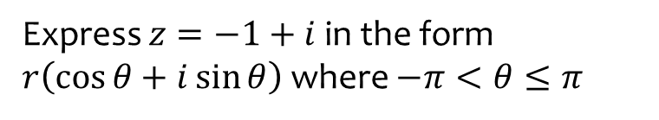
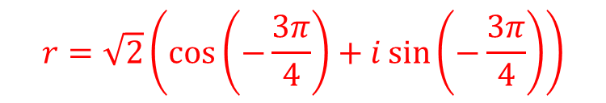
Worked example
Your turn
Express $z=−1+i$ in the form $r\left(\cos{θ}+i\sin{θ}\right)$ where $−π<θ≤π$
Express $z=−1−i$ in the form $r\left(\cos{θ}+i\sin{θ}\right)$ where $−π<θ≤π$
$$r=\sqrt{2}\left(\cos\left(−\frac{3π}{4}\right)+i\sin\left(−\frac{3π}{4}\right)\right)$$

Slide 3
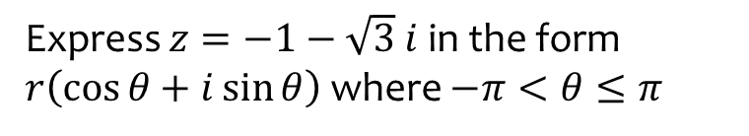
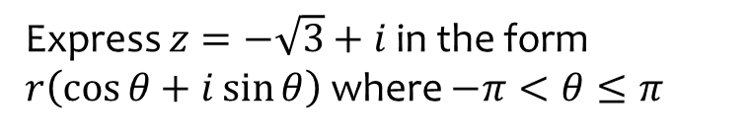
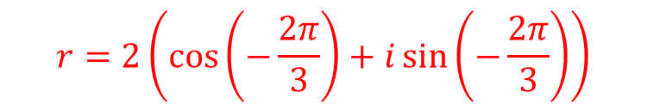
Worked example
Your turn
Express $z=−\sqrt{3}+i$ in the form $r\left(\cos{θ}+i\sin{θ}\right)$ where $−π<θ≤π$
Express $z=−1−\sqrt{3} i$ in the form $r\left(\cos{θ}+i\sin{θ}\right)$ where $−π<θ≤π$
$$r=2\left(\cos\left(−\frac{2π}{3}\right)+i\sin\left(−\frac{2π}{3}\right)\right)$$

Slide 4
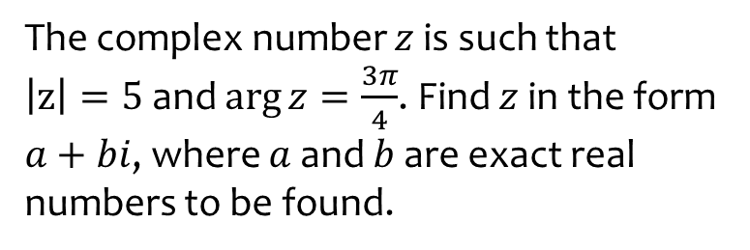
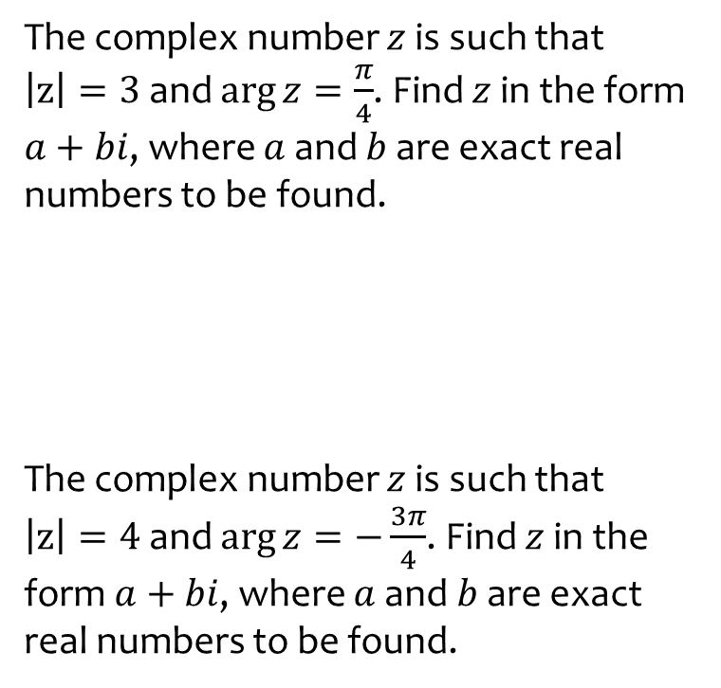

Worked example
Your turn
The complex number $z$ is such that
$\left|z\right|=3$ and $\arg{z}=\frac{π}{4}$. Find $z$ in the form $a+bi$, where $a$ and $b$ are exact real numbers to be found.
The complex number $z$ is such that
$\left|z\right|=4$ and $\arg{z}=−\frac{3π}{4}$. Find $z$ in the form $a+bi$, where $a$ and $b$ are exact real numbers to be found.
The complex number $z$ is such that
$\left|z\right|=5$ and $\arg{z}=\frac{3π}{4}$. Find $z$ in the form $a+bi$, where $a$ and $b$ are exact real numbers to be found.
$$a=−\frac{5\sqrt{2}}{2}, b=\frac{5\sqrt{2}}{2}$$

