Slide 1
2.2) Modulus and argument

Slide 2



Worked example
Your turn
Determine the modulus and argument:
$$4+3i$$
$$−1+i$$
$$−2i$$
$$−1−3i$$
Determine the modulus and argument:
$$8+6i$$
$$1−i$$
$$−2$$
$$−1+3i$$
Modulus $=10$
Argument $=0.644$ (3 sf)
Modulus $=\sqrt{2}$
Argument $=−\frac{π}{4}$
Modulus $=2$
Argument $=±π$
Modulus $=\sqrt{10}$
Argument $=1.25$ (3 sf)

Slide 3
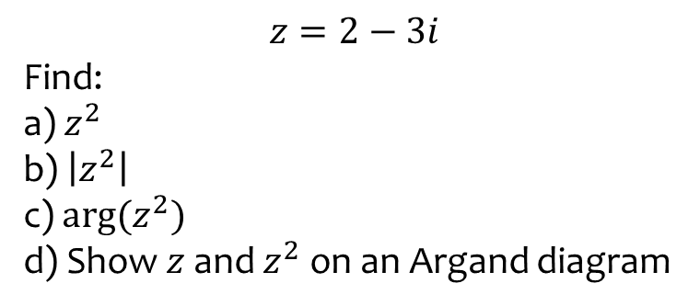

Worked example
Your turn
$$z=3−2i$$
Find:
a) $z^{2}$
b) $\left|z^{2}\right|$
c) $\arg{(z^{2})}$
d) Show $z$ and $z^{2}$ on an Argand diagram
$$z=2−3i$$
Find:
a) $z^{2}$
b) $\left|z^{2}\right|$
c) $\arg{(z^{2})}$
d) Show $z$ and $z^{2}$ on an Argand diagram
(a) $−5−12i$
(b) $13$
(c) $−1.97$ (3 sf)
(d) Shown

Slide 4
Worked example
Your turn
$$w=2+3i$$
Given that $\arg\left(λ+5i+w\right)=\frac{π}{4}$, where $λ$ is a real constant, find the value of $λ$
$$w=2+5i$$
Given that $\arg\left(λ+3i+w\right)=\frac{π}{4}$, where $λ$ is a real constant, find the value of $λ$
$$λ=6$$

Slide 5
Worked example
Your turn
The complex numbers $w$ and $z$ are given by
$w=k−i$ and $z=3−5ki$, where $k$ is a real constant. Given that $\arg\left(w+z\right)=\frac{π}{3}$, find the exact value of $k$
The complex numbers $w$ and $z$ are given by
$w=k+i$ and $z=−4+5ki$, where $k$ is a real constant. Given that $\arg\left(w+z\right)=\frac{2π}{3}$, find the exact value of $k$
$$k=\frac{21\sqrt{3}−17}{22}$$

Slide 6
Worked example
Your turn
The complex numbers $w$ and $z$ are defined such that $\arg{w}=\frac{π}{20}$, $\left|w\right|=3$ and $\arg{z}=\frac{7π}{20}$.
Given that $\arg\left(w+z\right)=\frac{π}{4}$, find the value of $|z|$
The complex numbers $w$ and $z$ are defined such that $\arg{w}=\frac{π}{10}$, $\left|w\right|=5$ and $\arg{z}=\frac{2π}{5}$.
Given that $\arg\left(w+z\right)=\frac{π}{5}$, find the value of $|z|$
$2.63$ (3 sf)

