Slide 1
2.2) Higher derivatives

Slide 2
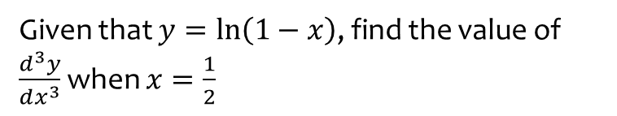
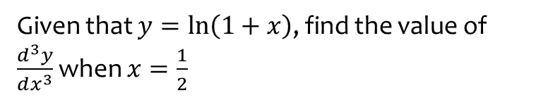
Worked example
Your turn
Given that $y=\ln\left(1+x\right)$, find the value of $\frac{d^{3}y}{dx^{3}}$ when $x=\frac{1}{2}$
Given that $y=\ln\left(1−x\right)$, find the value of $\frac{d^{3}y}{dx^{3}}$ when $x=\frac{1}{2}$
$$−16$$

Slide 3
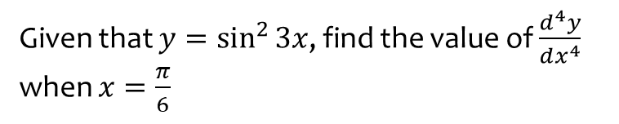
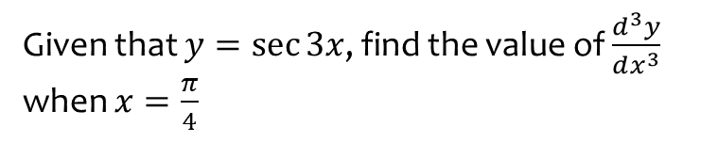
Worked example
Your turn
Given that $y=\sec{3x}$, find the value of $\frac{d^{3}y}{dx^{3}}$ when $x=\frac{π}{4}$
Given that $y=\sin^{2}{3x}$, find the value of $\frac{d^{4}y}{dx^{4}}$ when $x=\frac{π}{6}$
$$648$$

Slide 4
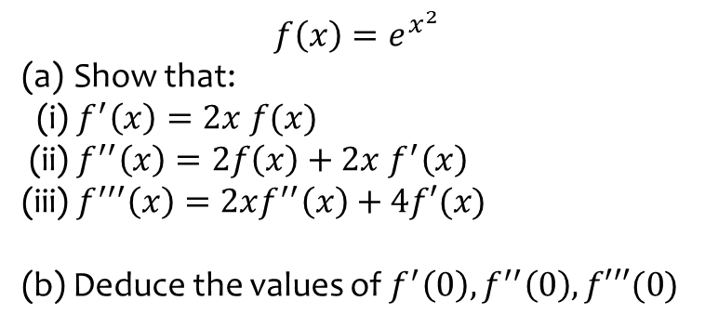
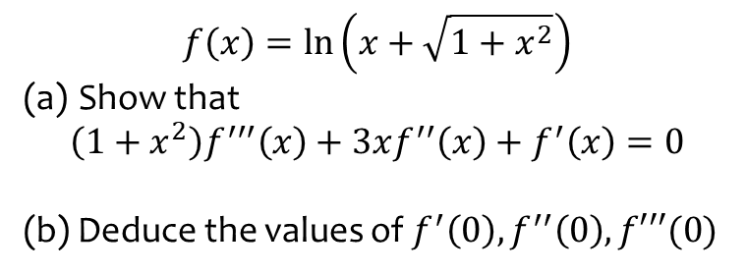
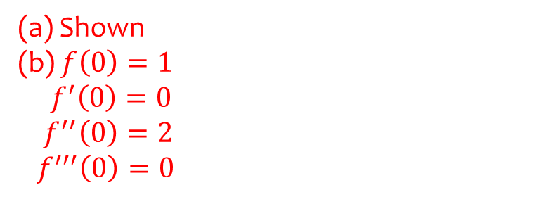
Worked example
Your turn
$$f\left(x\right)=\ln\left(x+\sqrt{1+x^{2}}\right)$$
Show that
$$\left(1+x^{2}\right)f^{′′′}\left(x\right)+3xf^{′′}\left(x\right)+f^{′}\left(x\right)=0$$
(b) Deduce the values of $f^{′}\left(0\right), f^{′′}\left(0\right), f′′′(0)$
$$f\left(x\right)=e^{x^{2}}$$
Show that:
(i) $f^{′}\left(x\right)=2x f(x)$
(ii) $f^{′′}\left(x\right)=2f\left(x\right)+2x f^{′}\left(x\right)$
(iii) $f^{′′′}\left(x\right)=2xf^{′′}\left(x\right)+4f′(x)$
(b) Deduce the values of $f^{′}\left(0\right), f^{′′}\left(0\right), f′′′(0)$
(a) Shown
(b) $f\left(0\right)=1$
$f^{′}\left(0\right)=0$
$f^{′′}\left(0\right)=2$
$f^{′′′}\left(0\right)=0$

