Slide 1
2.1) The method of differences

Slide 2
Worked example
Your turn
Show that $r=\frac{1}{2}(r\left(r+1\right)−r\left(r−1\right))$
Hence prove, by the method of differences, that
$$\sum_{r=1}^{n}{r}=\frac{1}{2}n(n+1)$$
Show that
$$4r^{3}=r^{2}{\left(r+1\right)}^{2}−{\left(r−1\right)}^{2}r^{2}$$
Hence prove, by the method of differences, that
$$\sum_{r=1}^{n}{r^{3}}=\frac{1}{4}n^{2}{\left(n+1\right)}^{2}$$
Shown

Slide 3
Worked example
Your turn
Find, using the method of differences,
$$\sum_{r=1}^{n}{\frac{1}{(r+2)(r+3)}}$$
Find, using the method of differences,
$$\sum_{r=1}^{n}{\frac{1}{r(r+1)}}$$
$$\frac{n}{n+1}$$

Slide 4
Worked example
Your turn
Find, using the method of differences,
$$\sum_{r=1}^{n}{\frac{2}{r(r+2)}}$$
Find, using the method of differences,
$$\sum_{r=1}^{n}{\frac{2}{\left(r+1\right)\left(r+3\right)}}$$
$$\frac{n\left(5n+13\right)}{6\left(n+2\right)\left(n+3\right)}$$

Slide 5
Worked example
Your turn
Find, using the method of differences,
$$\sum_{r=1}^{n}{\frac{2}{(4r^{2}+8r+3)}}$$
Find, using the method of differences,
$$\sum_{r=1}^{n}{\frac{2}{4r^{2}−1}}$$
$$\frac{2n}{2n+1}$$

Slide 6
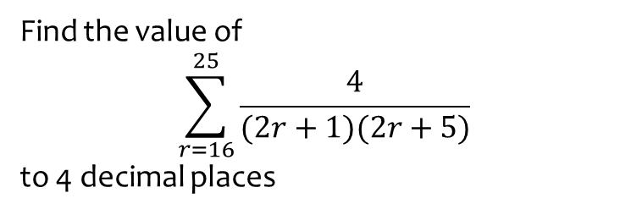
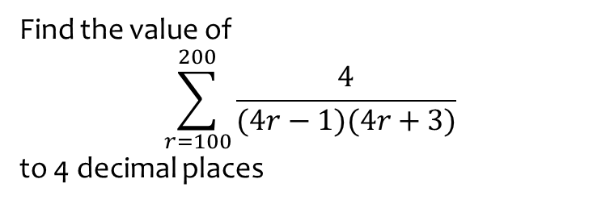
Worked example
Your turn
Find the value of
$$\sum_{r=100}^{200}{\frac{4}{(4r−1)(4r+3)}}$$
to 4 decimal places
Find the value of
$$\sum_{r=16}^{25}{\frac{4}{(2r+1)(2r+5)}}$$
to 4 decimal places
$0.0218$(4 dp)

