Slide 1
Argand Diagrams
Twitter: @Owen134866
www.mathsfreeresourcelibrary.com

Slide 2

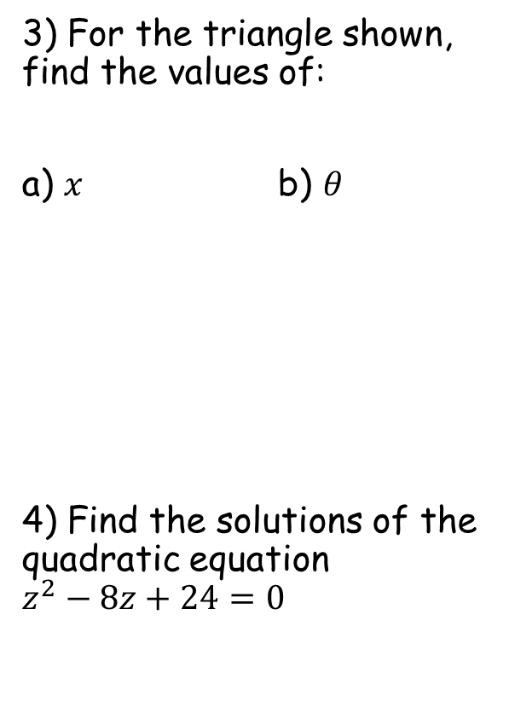


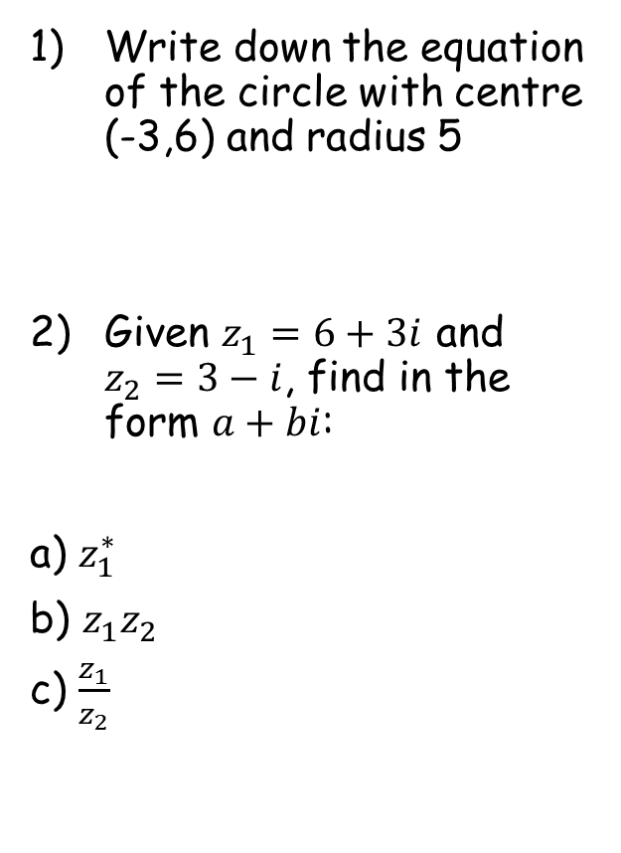






Prior Knowledge Check
Write down the equation of the circle with centre (-3,6) and radius 5
Given $z_{1}=6+3i$ and $z_{2}=3−i$, find in the form $a+bi$:
a) $z_{1}^{∗}$
b) $z_{1}z_{2}$
c) $\frac{z_{1}}{z_{2}}$
3) For the triangle shown, find the values of:
a) $x$ b) $θ$
4) Find the solutions of the quadratic equation $z^{2}−8z+24=0$
$${\left(x+3\right)}^{2}+{\left(y−6\right)}^{2}=25$$
5cm
$$67.4$$
$$θ$$
12cm
$$x$$
$$13$$
$$6−3i$$
$$21+3i$$
$$\frac{3}{2}+\frac{3}{2}i$$
$$4±2i\sqrt{2}$$

Slide 3
Teachings for
Exercise 2A

Slide 4
Argand Diagrams
You can represent complex numbers using an Argand diagram.
A grid where values for x and y can be plotted is known as a Cartesian set of axes (after Rene Descartes)
An Argand diagram is very similar, but the x-axis represents real numbers and the y-axis represents imaginary numbers.
These are named after Jean-Robert Argand (1768–1822), although they were first described by Norwegian-Danish land surveyor and mathematician Caspar Wessel
Complex numbers can be plotted on an Argand diagram, by considering the real and imaginary parts as coordinates
2A

Slide 5









Argand Diagrams
y (Imaginary)
z₁
You can represent complex numbers using an Argand diagram.
5i
√29
Represent the following complex numbers on an Argand diagram:
Find the magnitude of |OA|, |OB| and |OC|, where O is the origin of the Argand diagram, and A, B and C are z₁, z₂ and z₃ respectively
→ You can use Pythagoras’ Theorem to find the magnitude of the distances
5
z₃
√17
1
2
$$z_{1}=2+5i$$
x (Real)
-5
4
3
5
$$z_{2}=3−4i$$
4
5
$$z_{3}=−4+i$$
z₂
-5i
$$\left|OA\right|=\sqrt{2^{2}+5^{2}}$$
$$\left|OA\right|=\sqrt{29}$$
$$\left|OC\right|=\sqrt{4^{2}+1^{2}}$$
$$\left|OB\right|=\sqrt{3^{2}+4^{2}}$$
$$\left|OC\right|=\sqrt{17}$$
$$\left|OB\right|=5$$
2A

Slide 6





Argand Diagrams
You can represent complex numbers using an Argand diagram.
y (Imaginary)
10i
Show z₁, z₂ and z₁ + z₂ on an Argand diagram
$$z_{1}=4+i$$
$$z_{2}=3+3i$$
z₁+z₂
z₂
z₁
x (Real)
-10
10
$$z_{1}+z_{2}$$
$$\left(4+i\right)+(3+3i)$$
$$=7+4i$$
-10i
Notice that vector z₁ + z₂ is effectively the diagonal of a parallelogram
2A

Slide 7





Argand Diagrams
y (Imaginary)
z₁
You can represent complex numbers using an Argand diagram.
5i
z₁-z₂
z₂
$$z_{1}=2+5i$$
$$z_{2}=4+2i$$
Show z₁, z₂ and z₁ - z₂ on an Argand diagram
x (Real)
-5
5
$$z_{1}−z_{2}$$
-z₂
$$\left(2+5i\right)−(4+2i)$$
$$=−2+3i$$
-5i
Vector z₁ – z₂ is still the diagram of a parallelogram
→ One side is z₁ and the other side is –z₂ (shown on the diagram)
2A

