Slide 1
2) Series
2.1) The method of differences
2.2) Higher derivatives
2.3) Maclaurin series
2.4) Series expansions of compound functions

Slide 2
2.1) The method of differences
Chapter CONTENTS

Slide 3
Worked example
Your turn
Show that $r=\frac{1}{2}(r\left(r+1\right)−r\left(r−1\right))$
Hence prove, by the method of differences, that
$$\sum_{r=1}^{n}{r}=\frac{1}{2}n(n+1)$$
Show that
$$4r^{3}=r^{2}{\left(r+1\right)}^{2}−{\left(r−1\right)}^{2}r^{2}$$
Hence prove, by the method of differences, that
$$\sum_{r=1}^{n}{r^{3}}=\frac{1}{4}n^{2}{\left(n+1\right)}^{2}$$
Shown

Slide 4
Worked example
Your turn
Find, using the method of differences,
$$\sum_{r=1}^{n}{\frac{1}{(r+2)(r+3)}}$$
Find, using the method of differences,
$$\sum_{r=1}^{n}{\frac{1}{r(r+1)}}$$
$$\frac{n}{n+1}$$

Slide 5
Worked example
Your turn
Find, using the method of differences,
$$\sum_{r=1}^{n}{\frac{2}{r(r+2)}}$$
Find, using the method of differences,
$$\sum_{r=1}^{n}{\frac{2}{\left(r+1\right)\left(r+3\right)}}$$
$$\frac{n\left(5n+13\right)}{6\left(n+2\right)\left(n+3\right)}$$

Slide 6
Worked example
Your turn
Find, using the method of differences,
$$\sum_{r=1}^{n}{\frac{2}{(4r^{2}+8r+3)}}$$
Find, using the method of differences,
$$\sum_{r=1}^{n}{\frac{2}{4r^{2}−1}}$$
$$\frac{2n}{2n+1}$$

Slide 7
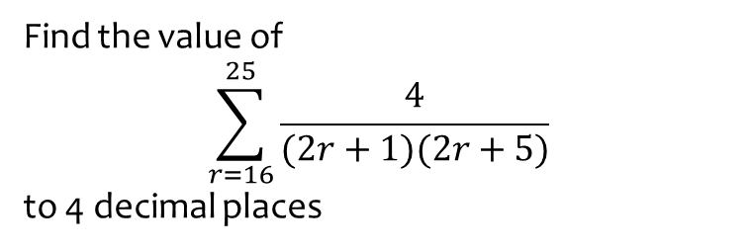
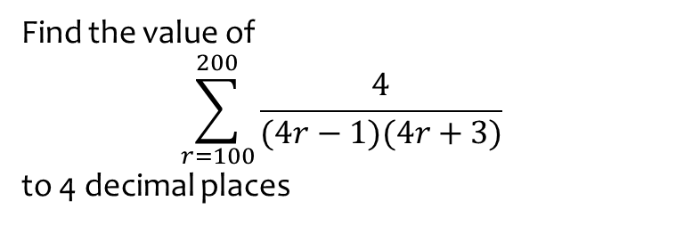
Worked example
Your turn
Find the value of
$$\sum_{r=100}^{200}{\frac{4}{(4r−1)(4r+3)}}$$
to 4 decimal places
Find the value of
$$\sum_{r=16}^{25}{\frac{4}{(2r+1)(2r+5)}}$$
to 4 decimal places
$0.0218$(4 dp)

Slide 8
2.2) Higher derivatives
Chapter CONTENTS

Slide 9
Worked example
Your turn
Given that $y=\ln\left(1+x\right)$, find the value of $\frac{d^{3}y}{dx^{3}}$ when $x=\frac{1}{2}$
Given that $y=\ln\left(1−x\right)$, find the value of $\frac{d^{3}y}{dx^{3}}$ when $x=\frac{1}{2}$
$$−16$$

Slide 10
Worked example
Your turn
Given that $y=\sec{3x}$, find the value of $\frac{d^{3}y}{dx^{3}}$ when $x=\frac{π}{4}$
Given that $y=\sin^{2}{3x}$, find the value of $\frac{d^{4}y}{dx^{4}}$ when $x=\frac{π}{6}$
$$648$$

Slide 11
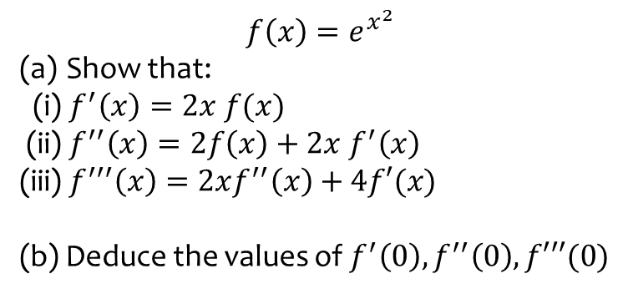
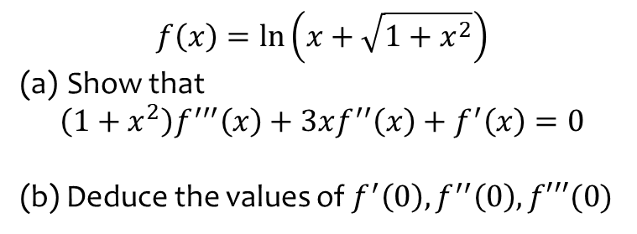
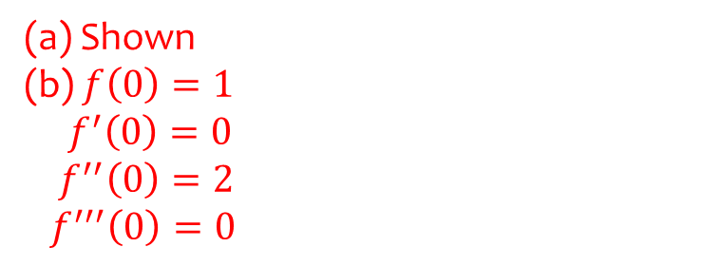
Worked example
Your turn
$$f\left(x\right)=\ln\left(x+\sqrt{1+x^{2}}\right)$$
Show that
$$\left(1+x^{2}\right)f^{′′′}\left(x\right)+3xf^{′′}\left(x\right)+f^{′}\left(x\right)=0$$
(b) Deduce the values of $f^{′}\left(0\right), f^{′′}\left(0\right), f′′′(0)$
$$f\left(x\right)=e^{x^{2}}$$
Show that:
(i) $f^{′}\left(x\right)=2x f(x)$
(ii) $f^{′′}\left(x\right)=2f\left(x\right)+2x f^{′}\left(x\right)$ (iii) $f^{′′′}\left(x\right)=2xf^{′′}\left(x\right)+4f′(x)$
(b) Deduce the values of $f^{′}\left(0\right), f^{′′}\left(0\right), f′′′(0)$
(a) Shown
(b) $f\left(0\right)=1$
$f^{′}\left(0\right)=0$
$f^{′′}\left(0\right)=2$
$f^{′′′}\left(0\right)=0$

Slide 12
2.3) Maclaurin series
Chapter CONTENTS

Slide 13
Worked example
Your turn
Find the Maclaurin series for $\frac{1}{1−x}$
Find the Maclaurin series for $\sqrt{1+x}$
$$\sqrt{1+x}=1+\frac{x}{2}−\frac{x^{2}}{8}+\frac{x^{3}}{16}−…$$

Slide 14
Worked example
Your turn
Find the Maclaurin series for $ln⁡(1+x)$
Find the Maclaurin series for $e^{x}$
$$e^{x}=1+x+\frac{x^{2}}{2!}+\frac{x^{3}}{3!}+\frac{x^{4}}{4!}+…+\frac{x^{n}}{n!}+…$$

Slide 15
Worked example
Your turn
Find the Maclaurin series for $\cos^{2}{x}$ up to and including the term in $x^{4}$
Find the Maclaurin series for $\sin^{2}{x}$up to and including the term in $x^{4}$
$$x^{2}−\frac{x^{4}}{3}+…$$

Slide 16
Worked example
Your turn
Find the Maclaurin series for $\cos{x}$
Use the first three terms of the series to find an approximation for $\cos{30°}$
Find the Maclaurin series for $\sin{x}$
Use the first two terms of the series to find an approximation for $\sin{10°}$
(a) $\cos\left(x\right)=1−\frac{x^{2}}{2!}+\frac{x^{4}}{4!}−\frac{x^{6}}{6!}+…+{\left(−1\right)}^{r}\frac{x^{2r}}{\left(2r\right)!}+…$
(b) $0.17365$ (5 dp)

Slide 17
2.4) Series expansions of compound functions
Chapter CONTENTS

Slide 18
Worked example
Your turn
Find the Maclaurin series for $e^{4x}$ up to and including the term in $x^{4}$
Find the Maclaurin series for $e^{3x}$ up to and including the term in $x^{4}$
$$e^{3x}=1+3x+\frac{{9x}^{2}}{2}+\frac{{9x}^{3}}{2}+\frac{27x^{4}}{8}+…$$

Slide 19
Worked example
Your turn
Find the Maclaurin series for $\ln{(1+3x)}$ up to and including the term in $x^{4}$
Find the Maclaurin series for $\ln{(1+2x)}$up to and including the term in $x^{4}$
$$\ln{(1+2x)}=2x−2x^{2}+\frac{8x^{3}}{3}−4x^{4}+…$$

Slide 20
Worked example
Your turn
Write down the first four non-zero terms in the series expansion, in ascending powers of $x$, of
$$\sin\left(4x^{3}\right)$$
Write down the first four non-zero terms in the series expansion, in ascending powers of $x$, of
$$\cos{(2x^{2})}$$
$$1−3x^{4}+\frac{2}{3}x^{8}−\frac{4}{45}x^{12}+…$$

Slide 21
Worked example
Your turn
Find the first three non-zero terms of the series expansion of $\ln\left(\frac{\sqrt{1+3x}}{1−2x}\right)$, and state the interval in $x$ for which the expansion is valid.
Find the first three non-zero terms of the series expansion of $\ln\left(\frac{\sqrt{1+2x}}{1−3x}\right)$, and state the interval in $x$ for which the expansion is valid.
$$4x+\frac{7}{2}x^{2}+\frac{31}{3}x^{3}+…$$
Valid for $−\frac{1}{3}≤x<\frac{1}{3}$

Slide 22
Worked example
Your turn
Find the first three terms in the Maclaurin series expansion of $e^{\cos{x}}$
Find the first three terms in the Maclaurin series expansion of $e^{\sin{x}}$
$$1+x+\frac{x^{2}}{2}$$

Slide 23
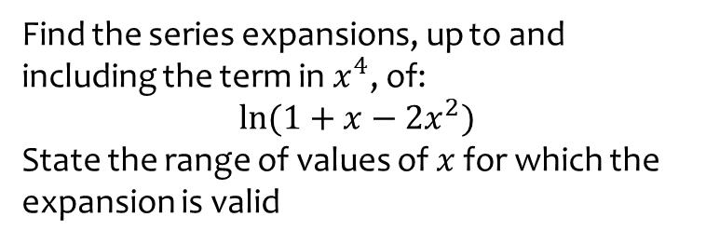
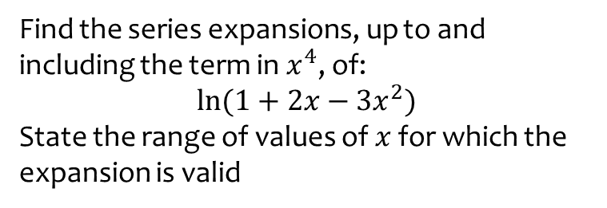
Worked example
Your turn
Find the series expansions, up to and including the term in $x^{4}$, of:
$$\ln{(1+2x−3x^{2})}$$
State the range of values of $x$ for which the expansion is valid
Find the series expansions, up to and including the term in $x^{4}$, of:
$$\ln{(1+x−2x^{2})}$$
State the range of values of $x$ for which the expansion is valid
$$x−\frac{5x^{2}}{2}+\frac{7x^{3}}{3}−\frac{17x^{4}}{4}+…$$
$$−\frac{1}{2}<x≤\frac{1}{2}$$

Slide 24
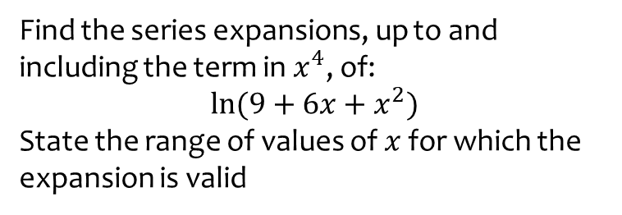
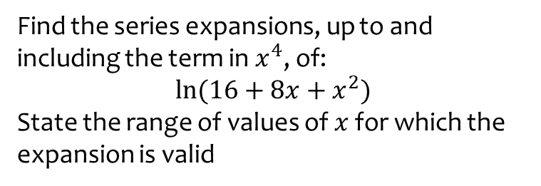
Worked example
Your turn
Find the series expansions, up to and including the term in $x^{4}$, of:
$$\ln{(16+8x+x^{2})}$$
State the range of values of $x$ for which the expansion is valid
Find the series expansions, up to and including the term in $x^{4}$, of:
$$\ln{(9+6x+x^{2})}$$
State the range of values of $x$ for which the expansion is valid
$$2\ln{3}+\frac{2x}{3}−\frac{x^{2}}{9}+\frac{2x^{3}}{81}−\frac{x^{4}}{162}+…$$
$$−3<x≤3$$

Slide 25
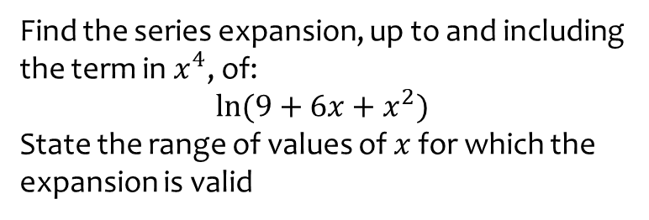
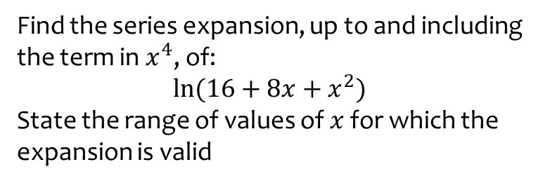
Worked example
Your turn
Find the series expansion, up to and including the term in $x^{4}$, of:
$$\ln{(16+8x+x^{2})}$$
State the range of values of $x$ for which the expansion is valid
Find the series expansion, up to and including the term in $x^{4}$, of:
$$\ln{(9+6x+x^{2})}$$
State the range of values of $x$ for which the expansion is valid
$$2\ln{3}+\frac{2x}{3}−\frac{x^{2}}{9}+\frac{2x^{3}}{81}−\frac{x^{4}}{162}+…$$
$$−3<x≤3$$

Slide 26
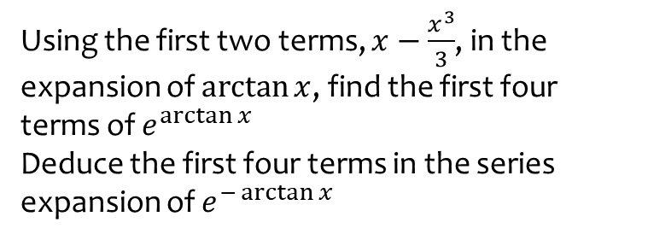
Worked example
Your turn
Using the first two terms, $x−\frac{x^{3}}{3}$, in the expansion of $\arctan{x}$, find the first four terms of $e^{\arctan{x}}$
Deduce the first four terms in the series expansion of $e^{−\arctan{x}}$
Using the first two terms, $x+\frac{x^{3}}{3}$, in the expansion of $\tan{x}$, find the first four terms of $e^{\tan{x}}$
Deduce the first four terms in the series expansion of $e^{−\tan{x}}$
$$e^{\tan{x}}=1+x+\frac{x^{2}}{2}+\frac{x^{3}}{2}+…$$
$$e^{−\tan{x}}=1−x+\frac{x^{2}}{2}−\frac{x^{3}}{2}+…$$

