Slide 1
2) Argand diagrams
2.1) Argand diagrams
2.2) Modulus and argument
2.3) Modulus-argument form of complex numbers
2.4) Loci in the Argand diagram
2.5) Regions in the Argand diagram

Slide 2
2.1) Argand diagrams
Chapter CONTENTS

Slide 3


Worked example
Your turn
Plot on an Argand diagram:
$$4+3i$$
$$−1+i$$
$$−2i$$
$$−1−3i$$
Plot on an Argand diagram:
$$8+6i$$
$$1−i$$
$$−2$$
$$−1+3i$$

Slide 4


Worked example
Your turn
Plot on an Argand diagram:
$$4+3i$$
$$3i−4$$
$$3−4i$$
Plot on an Argand diagram:
$$−4i+3$$

Slide 5
2.2) Modulus and argument
Chapter CONTENTS

Slide 6



Worked example
Your turn
Determine the modulus and argument:
$$4+3i$$
$$−1+i$$
$$−2i$$
$$−1−3i$$
Determine the modulus and argument:
$$8+6i$$
$$1−i$$
$$−2$$
$$−1+3i$$
Modulus $=10$
Argument $=0.644$ (3 sf)
Modulus $=\sqrt{2}$
Argument $=−\frac{π}{4}$
Modulus $=2$
Argument $=±π$
Modulus $=\sqrt{10}$
Argument $=1.25$ (3 sf)

Slide 7
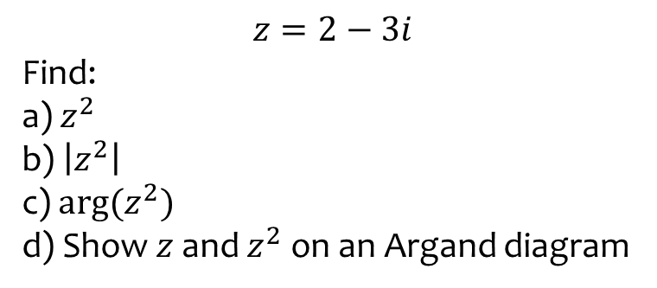

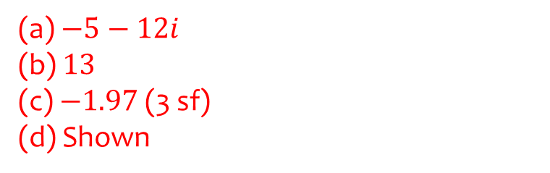
Worked example
Your turn
$$z=3−2i$$
Find:
a) $z^{2}$
b) $\left|z^{2}\right|$
c) $\arg{(z^{2})}$
d) Show $z$ and $z^{2}$ on an Argand diagram
$$z=2−3i$$
Find:
a) $z^{2}$
b) $\left|z^{2}\right|$
c) $\arg{(z^{2})}$
d) Show $z$ and $z^{2}$ on an Argand diagram
(a) $−5−12i$
(b) $13$
(c) $−1.97$ (3 sf)
(d) Shown

Slide 8
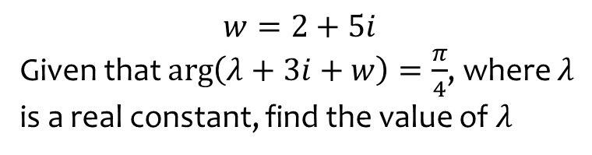
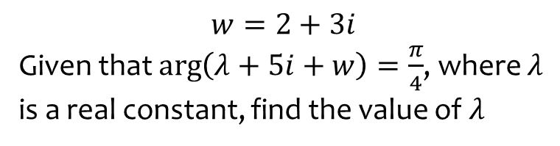
Worked example
Your turn
$$w=2+3i$$
Given that $\arg\left(λ+5i+w\right)=\frac{π}{4}$, where $λ$ is a real constant, find the value of $λ$
$$w=2+5i$$
Given that $\arg\left(λ+3i+w\right)=\frac{π}{4}$, where $λ$ is a real constant, find the value of $λ$
$$λ=6$$

Slide 9
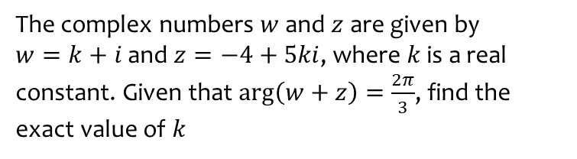
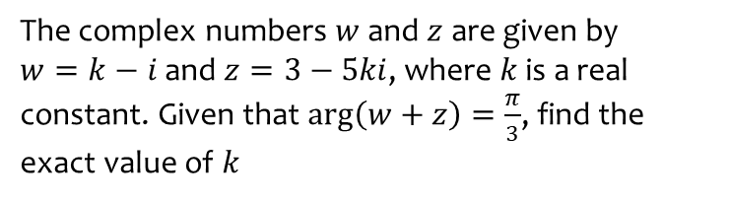

Worked example
Your turn
The complex numbers $w$ and $z$ are given by
$w=k−i$ and $z=3−5ki$, where $k$ is a real constant. Given that $\arg\left(w+z\right)=\frac{π}{3}$, find the exact value of $k$
The complex numbers $w$ and $z$ are given by
$w=k+i$ and $z=−4+5ki$, where $k$ is a real constant. Given that $\arg\left(w+z\right)=\frac{2π}{3}$, find the exact value of $k$
$$k=\frac{21\sqrt{3}−17}{22}$$

Slide 10
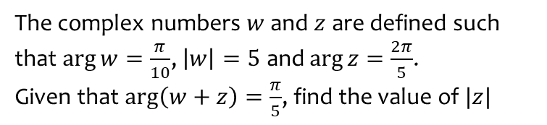
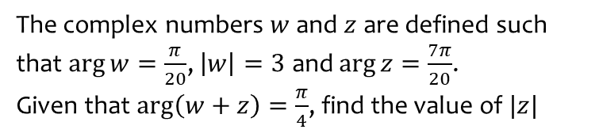

Worked example
Your turn
The complex numbers $w$ and $z$ are defined such that $\arg{w}=\frac{π}{20}$, $\left|w\right|=3$ and $\arg{z}=\frac{7π}{20}$.
Given that $\arg\left(w+z\right)=\frac{π}{4}$, find the value of $|z|$
The complex numbers $w$ and $z$ are defined such that $\arg{w}=\frac{π}{10}$, $\left|w\right|=5$ and $\arg{z}=\frac{2π}{5}$.
Given that $\arg\left(w+z\right)=\frac{π}{5}$, find the value of $|z|$
$2.63$ (3 sf)

Slide 11
2.3) Modulus-argument form of complex numbers
Chapter CONTENTS

Slide 12
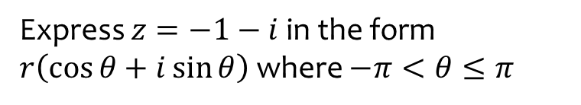
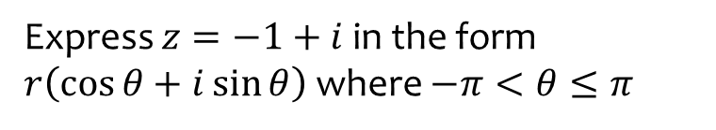
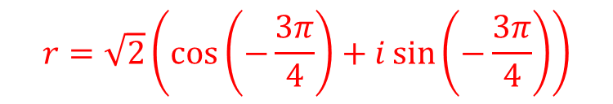
Worked example
Your turn
Express $z=−1+i$ in the form $r\left(\cos{θ}+i\sin{θ}\right)$ where $−π<θ≤π$
Express $z=−1−i$ in the form $r\left(\cos{θ}+i\sin{θ}\right)$ where $−π<θ≤π$
$$r=\sqrt{2}\left(\cos\left(−\frac{3π}{4}\right)+i\sin\left(−\frac{3π}{4}\right)\right)$$

Slide 13
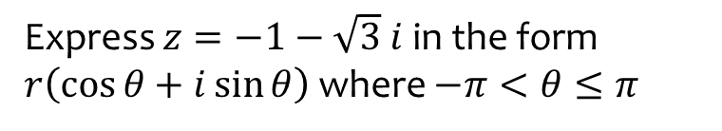
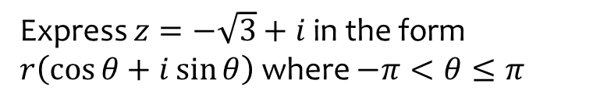
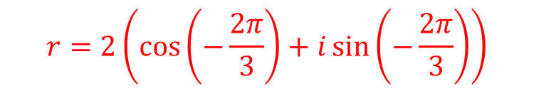
Worked example
Your turn
Express $z=−\sqrt{3}+i$ in the form $r\left(\cos{θ}+i\sin{θ}\right)$ where $−π<θ≤π$
Express $z=−1−\sqrt{3} i$ in the form $r\left(\cos{θ}+i\sin{θ}\right)$ where $−π<θ≤π$
$$r=2\left(\cos\left(−\frac{2π}{3}\right)+i\sin\left(−\frac{2π}{3}\right)\right)$$

Slide 14
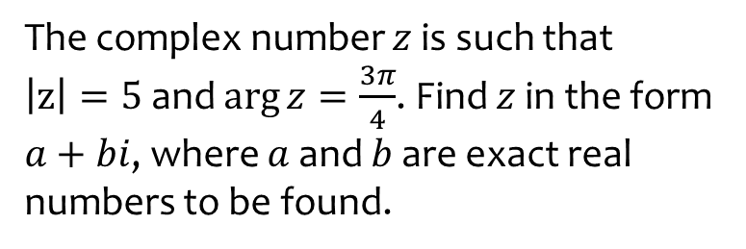
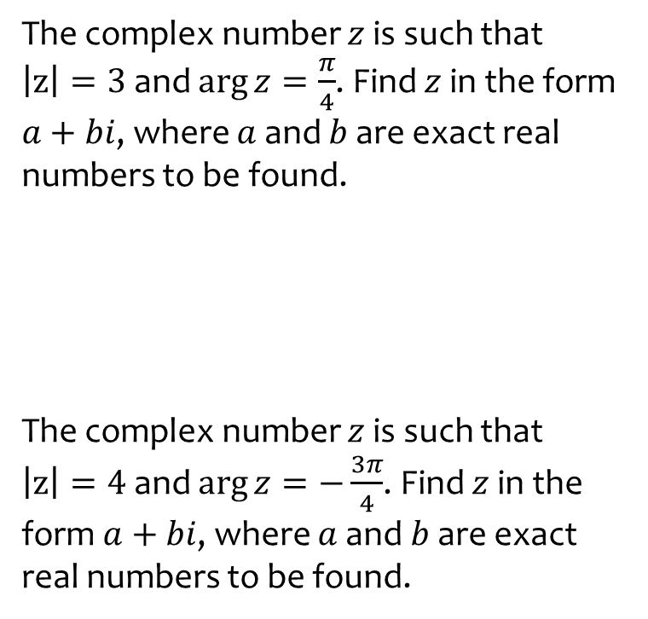

Worked example
Your turn
The complex number $z$ is such that
$\left|z\right|=3$ and $\arg{z}=\frac{π}{4}$. Find $z$ in the form $a+bi$, where $a$ and $b$ are exact real numbers to be found.
The complex number $z$ is such that
$\left|z\right|=4$ and $\arg{z}=−\frac{3π}{4}$. Find $z$ in the form $a+bi$, where $a$ and $b$ are exact real numbers to be found.
The complex number $z$ is such that
$\left|z\right|=5$ and $\arg{z}=\frac{3π}{4}$. Find $z$ in the form $a+bi$, where $a$ and $b$ are exact real numbers to be found.
$$a=−\frac{5\sqrt{2}}{2}, b=\frac{5\sqrt{2}}{2}$$

Slide 15

Worked example
Your turn
$$z_{1}=6(\cos{\frac{5π}{12}+i\sin{\frac{5π}{12}})}$$
$$z_{2}=3(\cos{\frac{3π}{4}+i\sin{\frac{3π}{4}})}$$
Find:
i) $\left|z_{1}z_{2}\right|$
ii) $\arg{(z_{1}z_{2}})$
iii) $z_{1}z_{2}$ in the form $r\left(\cos{θ}+i\sin{θ}\right)$
iv)$z_{1}z_{2}$ in the form $x+iy$
$$z_{1}=8(\cos{\frac{7π}{10}+i\sin{\frac{7π}{10}})}$$
$$z_{2}=4(\cos{\frac{4π}{5}+i\sin{\frac{4π}{5}})}$$
Find:
i) $\left|z_{1}z_{2}\right|$
ii) $\arg{(z_{1}z_{2}})$
iii) $z_{1}z_{2}$ in the form $r\left(\cos{θ}+i\sin{θ}\right)$
iv)$z_{1}z_{2}$ in the form $x+iy$
$$32$$
$$−\frac{π}{2}$$
$$32\left(\cos\left(−\frac{π}{2}\right)+i\sin{(−\frac{π}{2}})\right)$$
$$−32i$$

Slide 16

Worked example
Your turn
$$z_{1}=6(\cos{\frac{5π}{12}+i\sin{\frac{5π}{12}})}$$
$$z_{2}=3(\cos{\frac{3π}{4}+i\sin{\frac{3π}{4}})}$$
Find:
i) $\left|\frac{z_{1}}{z_{2}}\right|$
ii) $\arg{(\frac{z_{1}}{z_{2}}})$
iii) $\frac{z_{1}}{z_{2}}$in the form $r\left(\cos{θ}+i\sin{θ}\right)$
iv) $\frac{z_{1}}{z_{2}}$in the form $x+iy$
$$z_{1}=8(\cos{\frac{7π}{10}+i\sin{\frac{7π}{10}})}$$
$$z_{2}=4(\cos{\frac{4π}{5}+i\sin{\frac{4π}{5}})}$$
Find:
i) $\left|\frac{z_{1}}{z_{2}}\right|$
ii) $\arg{(\frac{z_{1}}{z_{2}}})$
iii) $\frac{z_{1}}{z_{2}}$in the form $r\left(\cos{θ}+i\sin{θ}\right)$
iv) $\frac{z_{1}}{z_{2}}$in the form $x+iy$
$$2$$
$$−\frac{π}{10}$$
$$2\left(\cos\left(−\frac{π}{10}\right)+i\sin{(−\frac{π}{10}})\right)$$
$$1.90−0.618i$$

Slide 17
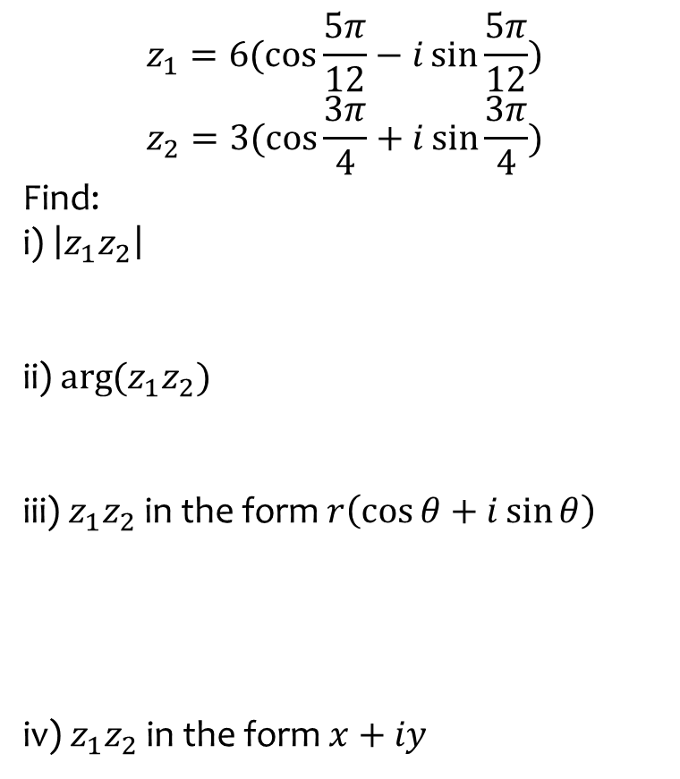

Worked example
Your turn
$$z_{1}=6(\cos{\frac{5π}{12}−i\sin{\frac{5π}{12}})}$$
$$z_{2}=3(\cos{\frac{3π}{4}+i\sin{\frac{3π}{4}})}$$
Find:
i) $\left|z_{1}z_{2}\right|$
ii) $\arg{(z_{1}z_{2}})$
iii) $z_{1}z_{2}$ in the form $r\left(\cos{θ}+i\sin{θ}\right)$
iv)$z_{1}z_{2}$ in the form $x+iy$
$$z_{1}=8(\cos{\frac{7π}{10}+i\sin{\frac{7π}{10}})}$$
$$z_{2}=4(\cos{\frac{4π}{5}−i\sin{\frac{4π}{5}})}$$
Find:
i) $\left|z_{1}z_{2}\right|$
ii) $\arg{(z_{1}z_{2}})$
iii) $z_{1}z_{2}$ in the form $r\left(\cos{θ}+i\sin{θ}\right)$
iv)$z_{1}z_{2}$ in the form $x+iy$
$$32$$
$$−\frac{π}{10}$$
$$32\left(\cos\left(−\frac{π}{10}\right)+i\sin{(−\frac{π}{10}})\right)$$
$$30.4−9.89i$$

Slide 18
2.4) Loci in the Argand diagram
Chapter CONTENTS

Slide 19



Worked example
Your turn
Sketch the locus of points represented by
$$\left|z\right|=3$$
$$\left|z\right|=4$$
Sketch the locus of points represented by
$$\left|z\right|=5$$
Circle centre $(0, 0)$ radius $5$
Cartesian equation: $x^{2}+y^{2}=25$

Slide 20



Worked example
Your turn
Sketch the locus of points represented by
$$\left|z+3−5i\right|=2$$
and find its Cartesian equation
Sketch the locus of points represented by
$$\left|z−3+5i\right|=4$$
and find its Cartesian equation
Draw the locus of points that satisfy:
$$\left|z−5−3i\right|=6$$
and find its Cartesian equation
Circle centre $(5, 3)$ radius $6$
$${\left(x−5\right)}^{2}+{\left(y−3\right)}^{2}=36$$

Slide 21

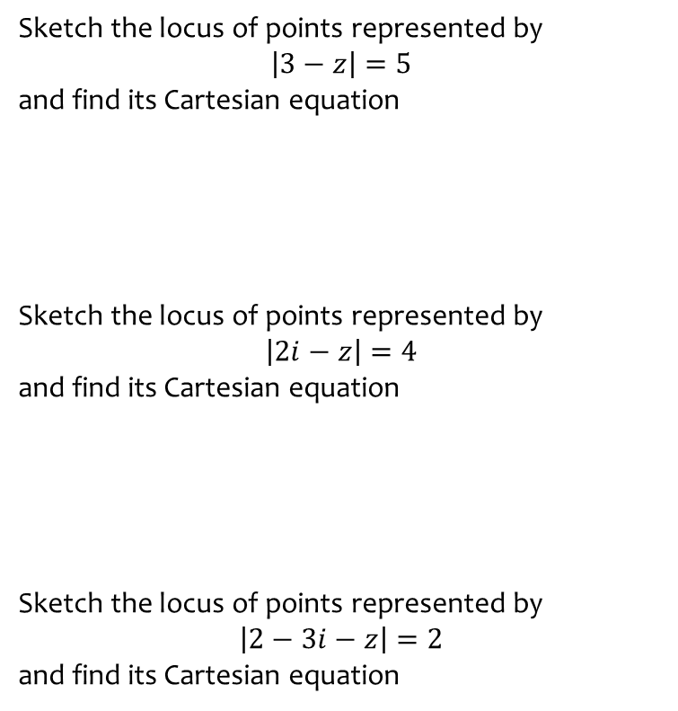

Worked example
Your turn
Sketch the locus of points represented by
$$\left|3−z\right|=5$$
and find its Cartesian equation
Sketch the locus of points represented by
$$\left|2i−z\right|=4$$
and find its Cartesian equation
Sketch the locus of points represented by
$$\left|2−3i−z\right|=2$$
and find its Cartesian equation
Draw the locus of points that satisfy:
$$\left|3−2i−z\right|=3$$
and find its Cartesian equation
Circle centre $(3, −2)$ radius $3$
$${\left(x−2\right)}^{2}+{\left(y+2\right)}^{2}=9$$

Slide 22
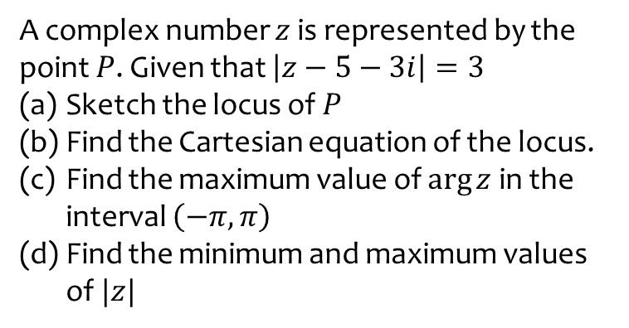
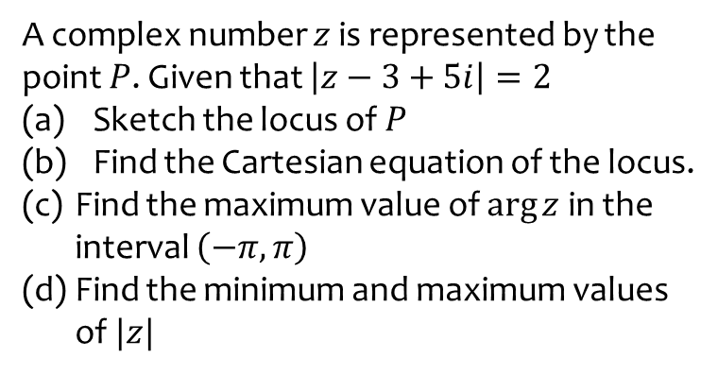
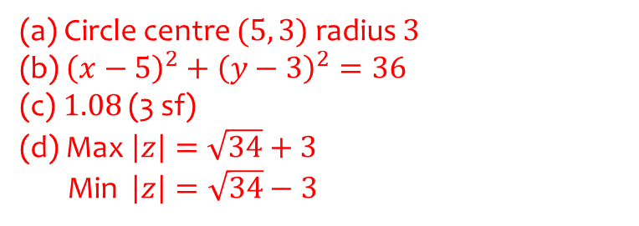
Worked example
Your turn
A complex number $z$ is represented by the point $P$. Given that $\left|z−3+5i\right|=2$
Sketch the locus of $P$
Find the Cartesian equation of the locus.
Find the maximum value of $\arg{z}$ in the interval $\left(−π,π\right)$
Find the minimum and maximum values of $|z|$
A complex number $z$ is represented by the point $P$. Given that $\left|z−5−3i\right|=3$
Sketch the locus of $P$
Find the Cartesian equation of the locus.
Find the maximum value of $\arg{z}$ in the interval $\left(−π,π\right)$
Find the minimum and maximum values of $|z|$
(a) Circle centre $(5, 3)$ radius $3$
(b) ${\left(x−5\right)}^{2}+{\left(y−3\right)}^{2}=36$
(c) $1.08$ (3 sf)
(d) Max $\left|z\right|=\sqrt{34}+3$
Min $\left|z\right|=\sqrt{34}−3$

Slide 23


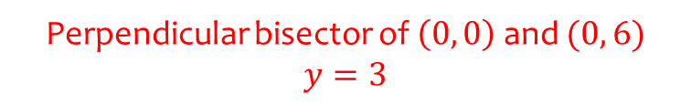
Worked example
Your turn
Sketch the locus of points represented by
$$\left|z\right|=\left|z+4i\right|$$
and find its Cartesian equation
Sketch the locus of points represented by
$$\left|z\right|=\left|z−5\right|$$
and find its Cartesian equation
Sketch the locus of points represented by
$$\left|z\right|=\left|z−6i\right|$$
and find its Cartesian equation
Perpendicular bisector of $\left(0, 0\right)$ and $(0, 6)$
$$y=3$$

Slide 24


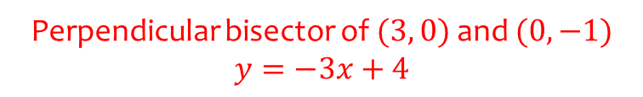
Worked example
Your turn
Sketch the locus of points represented by
$$\left|z−3i\right|=|z+1|$$
and find its Cartesian equation
Sketch the locus of points represented by
$$\left|z−3\right|=|z+i|$$
and find its Cartesian equation
Perpendicular bisector of $(3, 0)$ and $(0, −1)$
$$y=−3x+4$$

Slide 25
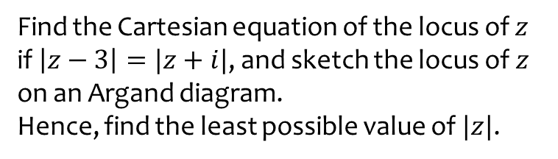
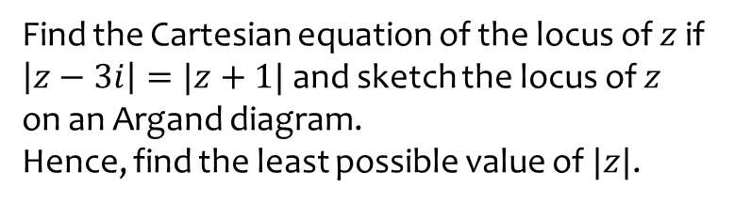

Worked example
Your turn
Find the Cartesian equation of the locus of $z$ if $\left|z−3i\right|=|z+1|$ and sketch the locus of $z$ on an Argand diagram.
Hence, find the least possible value of $|z|$.
Find the Cartesian equation of the locus of $z$ if $\left|z−3\right|=|z+i|$, and sketch the locus of $z$ on an Argand diagram.
Hence, find the least possible value of $|z|$.
$$\frac{2\sqrt{10}}{5}$$

Slide 26
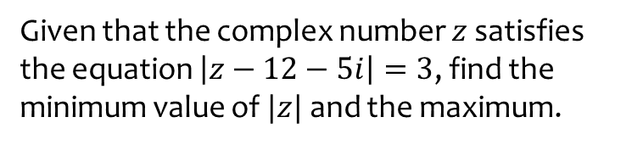
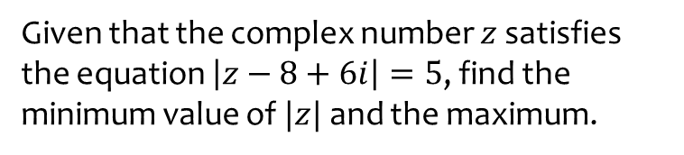

Worked example
Your turn
Given that the complex number $z$ satisfies the equation $\left|z−8+6i\right|=5$, find the minimum value of $|z|$ and the maximum.
Given that the complex number $z$ satisfies the equation $\left|z−12−5i\right|=3$, find the minimum value of $|z|$ and the maximum.
Minimum $=10$
Maximum $=16$

Slide 27

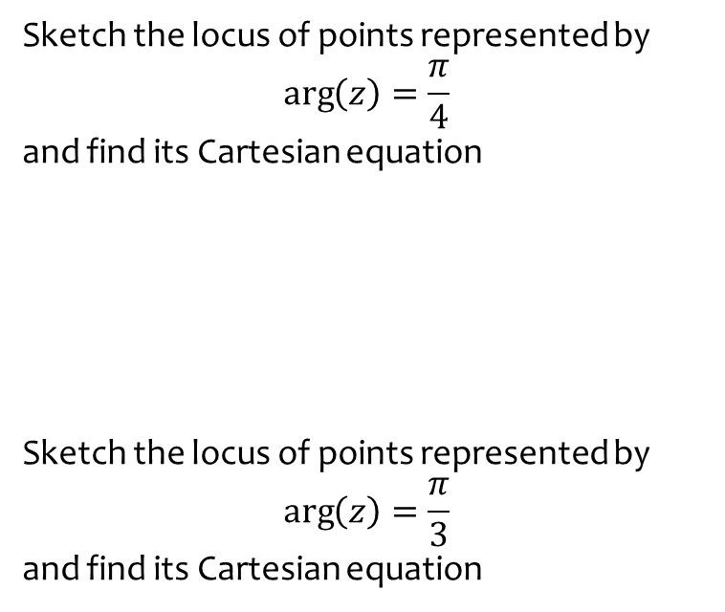

Worked example
Your turn
Sketch the locus of points represented by
$$\arg\left(z\right)=\frac{π}{4}$$
and find its Cartesian equation
Sketch the locus of points represented by
$$\arg\left(z\right)=\frac{π}{3}$$
and find its Cartesian equation
Sketch the locus of points represented by
$$\arg\left(z\right)=\frac{π}{6}$$
and find its Cartesian equation
Half-line from origin $(0, 0)$
$$y=\frac{1}{\sqrt{3}}x, x>0,y>0$$

Slide 28



Worked example
Your turn
Sketch the locus of points represented by
$$\arg\left(z−2+3i\right)=\frac{π}{4}$$
and find its Cartesian equation
Sketch the locus of points represented by
$$\arg\left(z+3+2i\right)=\frac{3π}{4}$$
and find its Cartesian equation
Half-line from $\left(−3, −2\right)$
$$y=−x−5, x<−3,y>−2$$

Slide 29
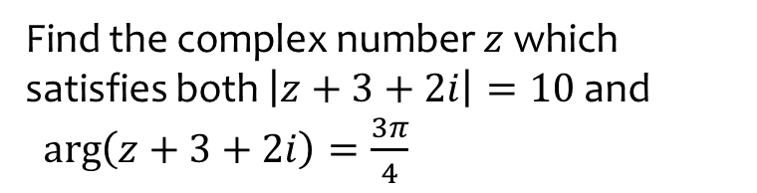
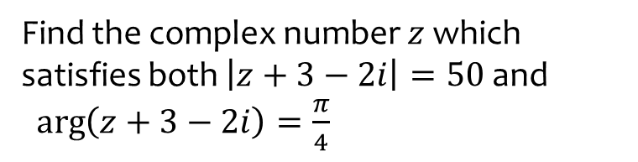

Worked example
Your turn
Find the complex number $z$ which satisfies both $\left|z+3−2i\right|=50$ and
$\arg\left(z+3−2i\right)=\frac{π}{4}$
Find the complex number $z$ which satisfies both $\left|z+3+2i\right|=10$ and
$\arg\left(z+3+2i\right)=\frac{3π}{4}$
$$z=\left(−3−5\sqrt{2}\right)+i(−2+5\sqrt{2})$$

Slide 30
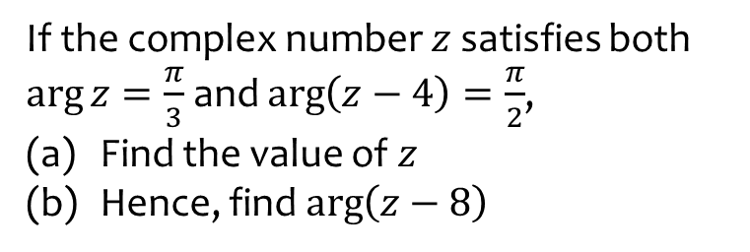
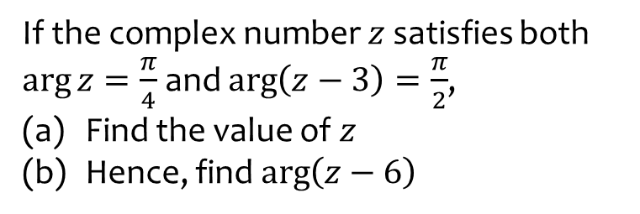
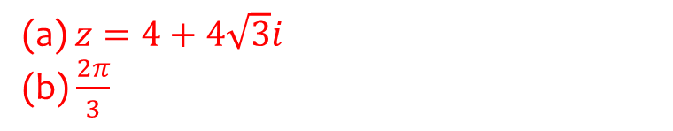
Worked example
Your turn
If the complex number $z$ satisfies both $\arg{z}=\frac{π}{4}$ and $\arg\left(z−3\right)=\frac{π}{2}$,
Find the value of $z$
Hence, find $\arg\left(z−6\right)$
If the complex number $z$ satisfies both $\arg{z}=\frac{π}{3}$ and $\arg\left(z−4\right)=\frac{π}{2}$,
Find the value of $z$
Hence, find $\arg\left(z−8\right)$
(a) $z=4+4\sqrt{3}i$
(b) $\frac{2π}{3}$

Slide 31
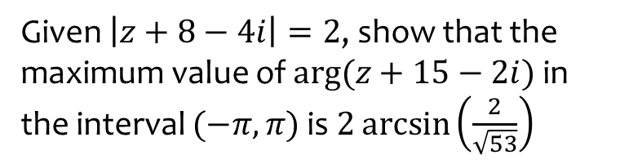
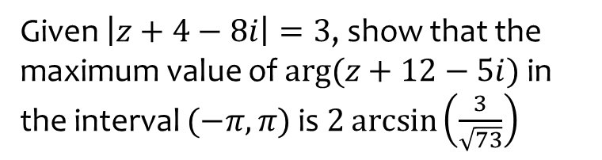
Worked example
Your turn
Given $\left|z+4−8i\right|=3$, show that the maximum value of $arg⁡(z+12−5i)$ in the interval $(−π, π)$ is $2\arcsin\left(\frac{3}{\sqrt{73}}\right)$
Given $\left|z+8−4i\right|=2$, show that the maximum value of $arg⁡(z+15−2i)$ in the interval $(−π, π)$ is $2\arcsin\left(\frac{2}{\sqrt{53}}\right)$
Shown

Slide 32
2.5) Regions in the Argand diagram
Chapter CONTENTS

Slide 33


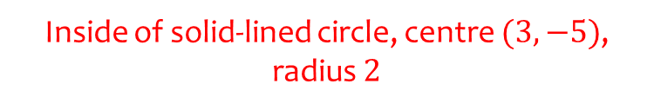
Worked example
Your turn
On an Argand diagram, shade the region for which
$$\left|z−3+5i\right|≤4$$
On an Argand diagram, shade the region for which
$$\left|z+3−5i\right|≤2$$
Inside of solid-lined circle, centre $(3, −5)$, radius $2$

Slide 34



Worked example
Your turn
On an Argand diagram, shade the region for which
$$2≤\left|z−3+5i\right|≤4$$
$$2<\left|z−3−5i\right|≤4$$
On an Argand diagram, shade the region for which
$$2≤\left|z+3−5i\right|<4$$
Region enclosed between two circles.
One solid-lined circle centred $(−3, 5)$ radius $2$
One dotted-lined circle centred $(−3, 5)$ radius $4$

Slide 35



Worked example
Your turn
On an Argand diagram, shade the region for which
$$\left|z−3\right|<|z−5|$$
$$\left|z−3i\right|>|z+5|$$
On an Argand diagram, shade the region for which
$$\left|z+3\right|<|z−5i|$$
Dotted line perpendicular bisector of $(−3, 0)$ and $(0, 5)$. Shaded below the line

Slide 36



Worked example
Your turn
On an Argand diagram, shade the region for which
$$\left\{z∈ℂ:\left|z−4\right|≤\left|z−8−6i\right|\right\}∩$$
$$\left\{z∈ℂ:0≤\arg\left(z−2−4i\right)≤\frac{π}{4}\right\}$$
On an Argand diagram, shade the region for which
$$\left\{z∈ℂ:\left|z−2\right|≤\left|z−6−8i\right|\right\}∩$$
$$\left\{z∈ℂ:0≤\arg\left(z−4−2i\right)≤\frac{π}{2}\right\}$$
Shaded region in first quadrant enclosed by half lines $x=4$ and $y=2$ both extending from $(4, 2)$ and perpendicular bisector of $(2, 0)$ and $(6, 8)$ $y=−\frac{1}{2}x+6$

Slide 37



Worked example
Your turn
On an Argand diagram, shade the region for which
$$0≤\arg\left(z−3−5i\right)≤\frac{π}{4}$$
$$\arg\left(z−3+5i\right)>\frac{π}{2}$$
On an Argand diagram, shade the region for which
$$0≤\arg\left(z+3−5i\right)≤\frac{π}{3}$$
Shaded between two solid half-lines.
First half-line horizontal from point $(3, −5)$ in 4th quadrant only
Second half-line from point $(3, −5)$ at angle of $\frac{π}{3}$ to the horizontal

