Slide 1
1.7) Solving geometric problems

Slide 2
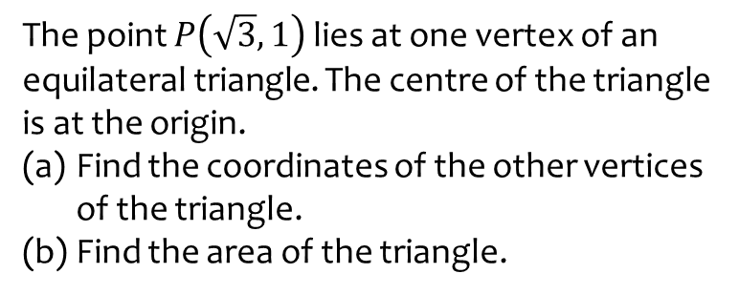
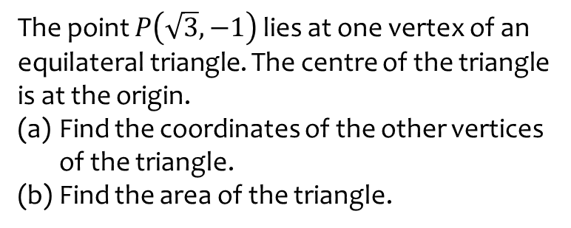
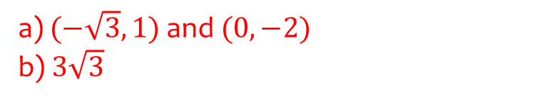
Worked example
Your turn
The point $P\left(\sqrt{3},−1\right)$ lies at one vertex of an equilateral triangle. The centre of the triangle is at the origin.
Find the coordinates of the other vertices of the triangle.
Find the area of the triangle.
The point $P\left(\sqrt{3},1\right)$ lies at one vertex of an equilateral triangle. The centre of the triangle is at the origin.
Find the coordinates of the other vertices of the triangle.
Find the area of the triangle.
a) $(−\sqrt{3},1)$ and $(0,−2)$
b) $3\sqrt{3}$

Slide 3
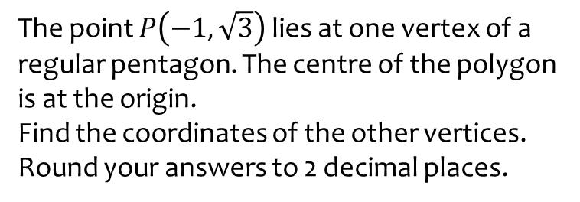
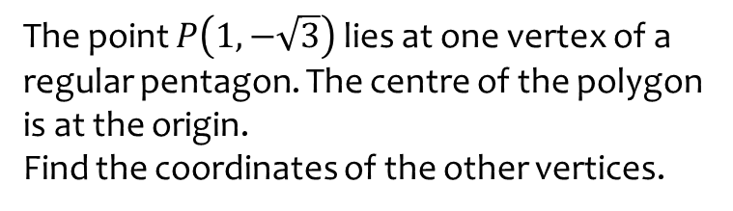

Worked example
Your turn
The point $P\left(1, −\sqrt{3}\right)$ lies at one vertex of a regular pentagon. The centre of the polygon is at the origin.
Find the coordinates of the other vertices.
The point $P\left(−1, \sqrt{3}\right)$ lies at one vertex of a regular pentagon. The centre of the polygon is at the origin.
Find the coordinates of the other vertices.
Round your answers to 2 decimal places.
$$\left(−1.96, 0.42\right)$$
$$(−0.21, −1.99)$$
$$(1.83, −0.81)$$
$$(1.34, 1.49)$$

