Slide 1
Teachings for
Exercise 1F

Slide 2



Complex Numbers
$$If: z=r\left(cosθ+isinθ\right)$$
$$Then: z=r\left(cos⁡(θ+2kπ)+isin(θ+2kπ)\right)$$
$${\left[r(cosθ+isinθ)\right]}^{n}=r^{n}\left(cosnθ+isinnθ\right)$$
You can use De Moivre’s theorem to find the nth roots of a complex number
You already know how to find real roots of a number, but now we need to find both real roots and imaginary roots!
We need to apply the following results:
If:
Then:
where k is an integer
This is because we can add multiples of 2π to the argument as it will end up in the same place (2π = 360º)
2) De Moivre’s theorem
$$z=r\left(cosθ+isinθ\right)$$
$$z=r\left(cos⁡(θ+2kπ)+isin(θ+2kπ)\right)$$
$${\left[r(cosθ+isinθ)\right]}^{n}=r^{n}\left(cosnθ+isinnθ\right)$$
1F

Slide 3




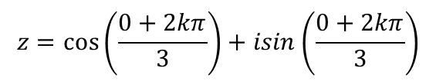

Complex Numbers
$$If: z=r\left(cosθ+isinθ\right)$$
$$Then: z=r\left(cos⁡(θ+2kπ)+isin(θ+2kπ)\right)$$
$${\left[r(cosθ+isinθ)\right]}^{n}=r^{n}\left(cosnθ+isinnθ\right)$$
Im
In this case the modulus and argument are simple to find!
You can use De Moivre’s theorem to find the nth roots of a complex number
Solve the equation z³ = 1 and represent your solutions on an Argand diagram.
First you need to express z in the modulus-argument form. Use an Argand diagram.
Now we know r and θ we can set z³ equal to this expression, when written in the modulus-argument form
We can then find an expression for z in terms of k
We can then solve this to find the roots of the equation above
$$r=1$$
1
Re
$$θ=0$$
$$z^{3}=1\left(cos0+isin0\right)$$
Apply the rule above
$$z^{3}=\left(cos⁡(0+2kπ)+isin(0+2kπ)\right)$$
Cube root (use a relevant power)
$$z={\left[\cos\left(0+2kπ\right)+isin(0+2kπ)\right]}^{\frac{1}{3}}$$
Apply De Moivre’s theorem
$$z=\cos\left(\frac{0+2kπ}{3}\right)+isin\left(\frac{0+2kπ}{3}\right)$$
1F

Slide 4








Complex Numbers
$$If: z=r\left(cosθ+isinθ\right)$$
$$Then: z=r\left(cos⁡(θ+2kπ)+isin(θ+2kπ)\right)$$
$${\left[r(cosθ+isinθ)\right]}^{n}=r^{n}\left(cosnθ+isinnθ\right)$$
$$z=\cos\left(\frac{0+2kπ}{3}\right)+isin\left(\frac{0+2kπ}{3}\right)$$
You can use De Moivre’s theorem to find the nth roots of a complex number
Solve the equation z³ = 1 and represent your solutions on an Argand diagram.
We now just need to choose different values for k until we have found all the roots
The values of k you choose should keep the argument within the range:
-π < θ ≤ π
k = 0
$$z=\cos\left(0\right)+isin\left(0\right)$$
Sub k = 0 in and calculate the cosine and sine parts
$$z=1$$
k = 1
$$z=\cos\left(\frac{2π}{3}\right)+isin\left(\frac{2π}{3}\right)$$
Sub k = 1 in and calculate the cosine and sine parts
$$z=−\frac{1}{2}+i\frac{\sqrt{3}}{2}$$
k = -1
So the roots of z³ = 1 are:
$$z=\cos\left(−\frac{2π}{3}\right)+isin\left(−\frac{2π}{3}\right)$$
Sub k = -1 in and calculate the cosine and sine parts
→ (k = 2 would cause the argument to be outside the range)
$$z=1, −\frac{1}{2}+i\frac{\sqrt{3}}{2} and−\frac{1}{2}−i\frac{\sqrt{3}}{2}$$
$$z=−\frac{1}{2}−i\frac{\sqrt{3}}{2}$$
(these are known as the cube roots of unity (ie 1))
1F

Slide 5





Complex Numbers
$$If: z=r\left(cosθ+isinθ\right)$$
$$Then: z=r\left(cos⁡(θ+2kπ)+isin(θ+2kπ)\right)$$
$${\left[r(cosθ+isinθ)\right]}^{n}=r^{n}\left(cosnθ+isinnθ\right)$$
Im
You can use De Moivre’s theorem to find the nth roots of a complex number
Solve the equation z³ = 1 and represent your solutions on an Argand diagram.
We now just need to choose different values for k until we have found all the roots
The values of k you choose should keep the argument within the range:
-π < θ ≤ π
$$−\frac{1}{2}+i\frac{\sqrt{3}}{2}$$
$$\frac{2}{3}π$$
$$1$$
$$\frac{2}{3}π$$
Re
$$\frac{2}{3}π$$
$$−\frac{1}{2}−i\frac{\sqrt{3}}{2}$$
So the roots of z³ = 1 are:
The solutions will all the same distance from the origin
The angles between them will also be the same
The sum of the roots is always equal to 0
$$z=1, −\frac{1}{2}+i\frac{\sqrt{3}}{2} and−\frac{1}{2}−i\frac{\sqrt{3}}{2}$$
1F

Slide 6




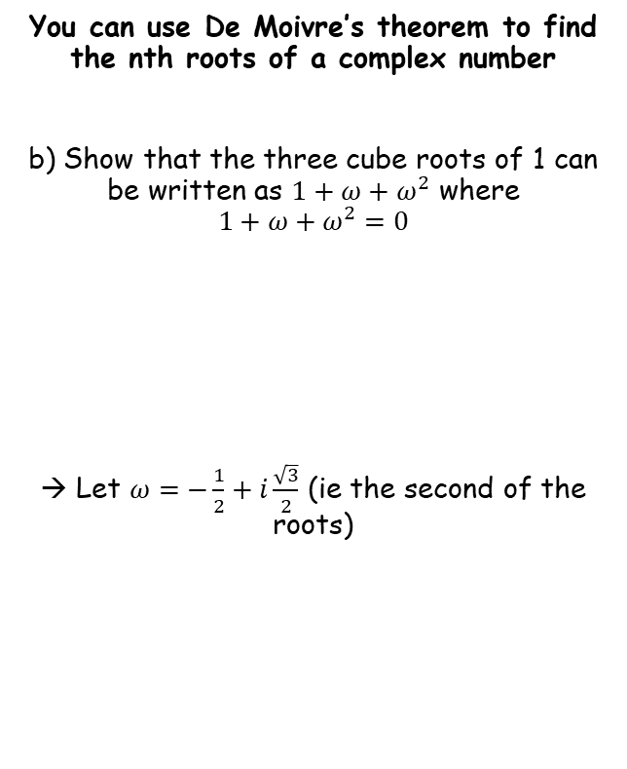




Complex Numbers
$$If: z=r\left(cosθ+isinθ\right)$$
$$Then: z=r\left(cos⁡(θ+2kπ)+isin(θ+2kπ)\right)$$
$${\left[r(cosθ+isinθ)\right]}^{n}=r^{n}\left(cosnθ+isinnθ\right)$$
$$ω=−\frac{1}{2}+i\frac{\sqrt{3}}{2}$$
You can use De Moivre’s theorem to find the nth roots of a complex number
b) Show that the three cube roots of 1 can be written as $1+ω+ω^{2}$ where
$$1+ω+ω^{2}=0$$
→ Let $ω=−\frac{1}{2}+i\frac{\sqrt{3}}{2}$ (ie the second of the roots)
Square
$$ω^{2}={\left(−\frac{1}{2}+i\frac{\sqrt{3}}{2}\right)}^{2}$$
Expand bracket
$$ω^{2}=\frac{1}{4}−i\frac{\sqrt{3}}{4}−i\frac{\sqrt{3}}{4}+i^{2}\frac{3}{4}$$
The roots of z³ = 1 are:
$$z=1, −\frac{1}{2}+i\frac{\sqrt{3}}{2} and−\frac{1}{2}−i\frac{\sqrt{3}}{2}$$
Simplify
$$ω^{2}=\frac{1}{4}−2i\frac{\sqrt{3}}{4}−\frac{3}{4}$$
Simplify more
$$ω^{2}=−\frac{1}{2}−i\frac{\sqrt{3}}{2}$$
$$1+ω+ω^{2}=0$$
Replace terms
$$1+−\frac{1}{2}+i\frac{\sqrt{3}}{2}−\frac{1}{2}−i\frac{\sqrt{3}}{2}=0$$
1F

Slide 7

Complex Numbers
$$If: z=r\left(cosθ+isinθ\right)$$
$$Then: z=r\left(cos⁡(θ+2kπ)+isin(θ+2kπ)\right)$$
$${\left[r(cosθ+isinθ)\right]}^{n}=r^{n}\left(cosnθ+isinnθ\right)$$
You can use De Moivre’s theorem to find the nth roots of a complex number
This result will be very important next lesson!
In general, the solutions to $z^{n}=1$ are $z=cos\left(\frac{2πk}{n}\right)+isin\left(\frac{2πk}{n}\right)=e^{\frac{2πik}{n}}$ for $k=1,2..n$
→ These are known as the nth roots of unity
If $n$ is a positive integer, there will be a root of unity $ω$ such that:
→ The roots can be written as $1,ω,ω^{2}…ω^{n−1}$
  $1+ω+ω^{2}+..+ω^{n−1}=0$ (we just showed an example of this)
  The roots $1+ω+ω^{2}…$ will form the vertices of a regular polygon (more on this next lesson!)
1F

Slide 8

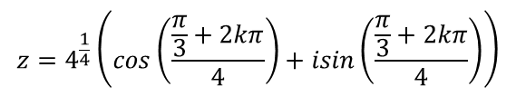

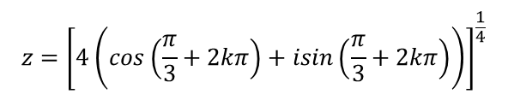
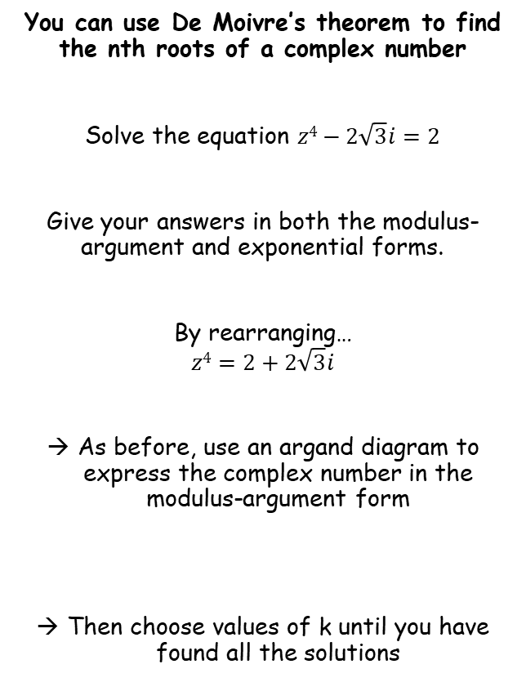




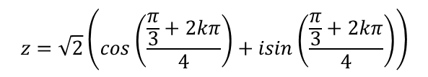
Complex Numbers
$$If: z=r\left(cosθ+isinθ\right)$$
$$Then: z=r\left(cos⁡(θ+2kπ)+isin(θ+2kπ)\right)$$
$${\left[r(cosθ+isinθ)\right]}^{n}=r^{n}\left(cosnθ+isinnθ\right)$$
Im
Find the modulus and argument
You can use De Moivre’s theorem to find the nth roots of a complex number
Solve the equation $z4−2\sqrt{3}i=2$
Give your answers in both the modulus-argument and exponential forms.
By rearranging…
$$z4=2+2\sqrt{3}i$$
As before, use an argand diagram to express the complex number in the modulus-argument form
Then choose values of k until you have found all the solutions
$$r=\sqrt{{\left(2\right)}^{2}+{\left(2\sqrt{3}\right)}^{2}}$$
r
$$r=4$$
2√3
θ
$$θ=\tan^{−1}\left(\frac{2\sqrt{3}}{2}\right)$$
$$θ=\frac{π}{3}$$
Re
2
$$z^{4}=4\left(cos\left(\frac{π}{3}\right)+isin\left(\frac{π}{3}\right)\right)$$
Apply the rule above
$$z^{4}=4\left(cos\left(\frac{π}{3}+2kπ\right)+isin\left(\frac{π}{3}+2kπ\right)\right)$$
Take the 4th root of each side
$$z={\left[4\left(cos\left(\frac{π}{3}+2kπ\right)+isin\left(\frac{π}{3}+2kπ\right)\right)\right]}^{\frac{1}{4}}$$
$$z=4^{\frac{1}{4}}\left(cos\left(\frac{\frac{π}{3}+2kπ}{4}\right)+isin\left(\frac{\frac{π}{3}+2kπ}{4}\right)\right)$$
De Moivre’s Theorem
Work out the power at the front
$$z=\sqrt{2}\left(cos\left(\frac{\frac{π}{3}+2kπ}{4}\right)+isin\left(\frac{\frac{π}{3}+2kπ}{4}\right)\right)$$
1F

Slide 9





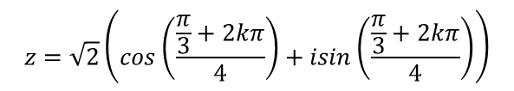


Complex Numbers
$$If: z=r\left(cosθ+isinθ\right)$$
$$Then: z=r\left(cos⁡(θ+2kπ)+isin(θ+2kπ)\right)$$
$${\left[r(cosθ+isinθ)\right]}^{n}=r^{n}\left(cosnθ+isinnθ\right)$$
$$z=\sqrt{2}\left(cos\left(\frac{\frac{π}{3}}{4}\right)+isin\left(\frac{\frac{π}{3}}{4}\right)\right)$$
You can use De Moivre’s theorem to find the nth roots of a complex number
Solve the equation $z4−2\sqrt{3}i=2$
Give your answers in both the modulus-argument and exponential forms.
By rearranging…
$$z4=2+2\sqrt{3}i$$
As before, use an argand diagram to express the complex number in the modulus-argument form
Then choose values of k until you have found all the solutions
Sub k = 0 in and simplify (you can leave in this form)
k = 0
$$z=\sqrt{2}\left(cos\left(\frac{π}{12}\right)+isin\left(\frac{π}{12}\right)\right)$$
$$z=\sqrt{2}\left(cos\left(\frac{\frac{π}{3}+2π}{4}\right)+isin\left(\frac{\frac{π}{3}+2π}{4}\right)\right)$$
k = 1
$$z=\sqrt{2}\left(cos\left(\frac{7π}{12}\right)+isin\left(\frac{7π}{12}\right)\right)$$
Choose values of k that keep the argument between –π and π
$$z=\sqrt{2}\left(cos\left(\frac{\frac{π}{3}−2π}{4}\right)+isin\left(\frac{\frac{π}{3}−2π}{4}\right)\right)$$
k = -1
$$z=\sqrt{2}\left(cos\left(−\frac{5π}{12}\right)+isin\left(−\frac{5π}{12}\right)\right)$$
$$z=\sqrt{2}\left(cos\left(\frac{\frac{π}{3}−2π}{4}\right)+isin\left(\frac{\frac{π}{3}−2π}{4}\right)\right)$$
$$z=\sqrt{2}\left(cos\left(\frac{\frac{π}{3}+2kπ}{4}\right)+isin\left(\frac{\frac{π}{3}+2kπ}{4}\right)\right)$$
k = -2
$$z=\sqrt{2}\left(cos\left(−\frac{11π}{12}\right)+isin\left(−\frac{11π}{12}\right)\right)$$
1F

Slide 10








Complex Numbers
$$If: z=r\left(cosθ+isinθ\right)$$
$$Then: z=r\left(cos⁡(θ+2kπ)+isin(θ+2kπ)\right)$$
$${\left[r(cosθ+isinθ)\right]}^{n}=r^{n}\left(cosnθ+isinnθ\right)$$
Solutions in the modulus-argument form
You can use De Moivre’s theorem to find the nth roots of a complex number
Solve the equation $z4−2\sqrt{3}i=2$
Give your answers in both the modulus-argument and exponential forms.
By rearranging…
$$z4=2+2\sqrt{3}i$$
As before, use an argand diagram to express the complex number in the modulus-argument form
Then choose values of k until you have found all the solutions
$$z=\sqrt{2}\left(cos\left(\frac{π}{12}\right)+isin\left(\frac{π}{12}\right)\right)$$
$$z=\sqrt{2}\left(cos\left(−\frac{5π}{12}\right)+isin\left(−\frac{5π}{12}\right)\right)$$
$$z=\sqrt{2}\left(cos\left(\frac{7π}{12}\right)+isin\left(\frac{7π}{12}\right)\right)$$
$$z=\sqrt{2}\left(cos\left(−\frac{11π}{12}\right)+isin\left(−\frac{11π}{12}\right)\right)$$
Solutions in the exponential form
$$z=\sqrt{2}e^{\frac{π}{12}i}$$
$$z=\sqrt{2}e^{−\frac{5π}{12}i}$$
$$z=\sqrt{2}e^{\frac{7π}{12}i}$$
$$z=\sqrt{2}e^{−\frac{11π}{12}i}$$
$$z=\sqrt{2}\left(cos\left(\frac{\frac{π}{3}+2kπ}{4}\right)+isin\left(\frac{\frac{π}{3}+2kπ}{4}\right)\right)$$
1F

Slide 11








Complex Numbers
$$If: z=r\left(cosθ+isinθ\right)$$
$$Then: z=r\left(cos⁡(θ+2kπ)+isin(θ+2kπ)\right)$$
$${\left[r(cosθ+isinθ)\right]}^{n}=r^{n}\left(cosnθ+isinnθ\right)$$
Im
Find the modulus and argument
You can use De Moivre’s theorem to find the nth roots of a complex number
Solve the equation:
Sketch the complex number on an argand diagram
$$r=\sqrt{{\left(4\sqrt{2}\right)}^{2}+{\left(4\sqrt{2}\right)}^{2}}$$
$$r=8$$
$$argz=−\frac{3π}{4}$$
4√2
θ
Re
$$z^{3}+4\sqrt{2}+4i\sqrt{2}=0$$
4√2
r
Rearrange
$$z^{3}=−4\sqrt{2}−4i\sqrt{2}$$
For the angle, since the lengths are equal, $θ={45}^{°}=\frac{π}{4}$
So the argument will be equal to $−\frac{3π}{4}$
You can also solve these problems using the exponential form
$$z^{3}=−4\sqrt{2}−4i\sqrt{2}$$
Write using the exponential form
$$z^{3}={8e}^{−\frac{3π}{4}i}$$
1F

Slide 12












Complex Numbers
$$If: z=r\left(cosθ+isinθ\right)$$
$$Then: z=r\left(cos⁡(θ+2kπ)+isin(θ+2kπ)\right)$$
$${\left[r(cosθ+isinθ)\right]}^{n}=r^{n}\left(cosnθ+isinnθ\right)$$
You can use De Moivre’s theorem to find the nth roots of a complex number
Solve the equation:
$$z^{3}={8e}^{−\frac{3π}{4}i}$$
Apply the rule above
$$z^{3}={8e}^{\left(−\frac{3π}{4}+2kπ\right)i}$$
Cube root
$$z={8^{\frac{1}{3}}e}^{\frac{1}{3}\left(−\frac{3π}{4}+2kπ\right)i}$$
$$z^{3}+4\sqrt{2}+4i\sqrt{2}=0$$
Simplify
$$z={2e}^{\left(\frac{−\frac{3π}{4}+2kπ}{3}\right)i}$$
$$k=0$$
$$k=−1$$
$$k=1$$
$$z={2e}^{\left(\frac{−\frac{3π}{4}}{3}\right)i}$$
$$z={2e}^{\left(\frac{−\frac{3π}{4}+2π}{3}\right)i}$$
$$z={2e}^{\left(\frac{−\frac{3π}{4}−2π}{3}\right)i}$$
$$z={2e}^{−\frac{π}{4}i}$$
$$z={2e}^{\frac{5π}{12}i}$$
$$z={2e}^{−\frac{11π}{12}i}$$
Remember to ensure that the arguments are between $−π$ and $π$
1F

