Slide 1
1.6) nth roots of a complex number

Slide 2
Worked example
Your turn
Solve
$$z^{8}=1$$
Express the roots in the form $x+iy,$ where $x,y∈ℝ$
Solve
$$z^{4}=1$$
Express the roots in the form $x+iy,$ where $x,y∈ℝ$
$$z_{1}=1$$
$$z_{2}=i$$
$$z_{3}=−1$$
$$z_{4}=−i$$

Slide 3
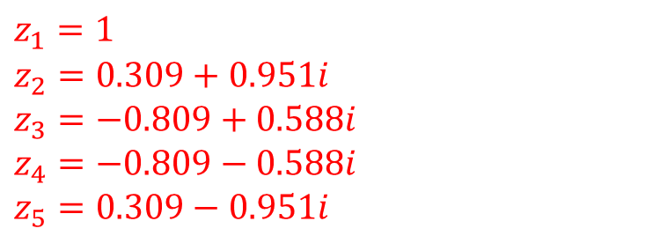
Worked example
Your turn
Solve
$$z^{7}−1=0$$
Express the roots in the form $x+iy,$ where $x,y∈ℝ$
Solve
$$z^{5}−1=0$$
Express the roots in the form $x+iy,$ where $x,y∈ℝ$
$$z_{1}=1$$
$$z_{2}=0.309+0.951i$$
$$z_{3}=−0.809+0.588i$$
$$z_{4}=−0.809−0.588i$$
$$z_{5}=0.309−0.951i$$

Slide 4

Worked example
Your turn
Solve $z^{3}=−1$
Express the roots in the form
$x+iy,$where $x,y∈ℝ$
Solve $z^{3}=1$
Express the roots in the form
$x+iy,$where $x,y∈ℝ$
$$z_{1}=1$$
$$z_{2}=−\frac{1}{2}+i\frac{\sqrt{3}}{2}$$
$$z_{3}=−\frac{1}{2}−i\frac{\sqrt{3}}{2}$$

Slide 5
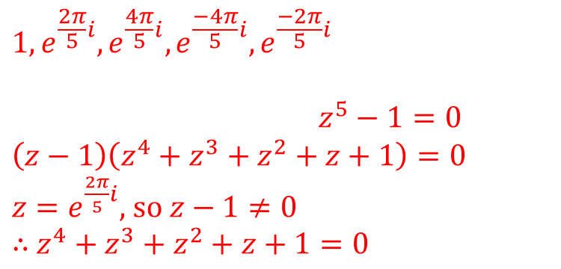
Worked example
Your turn
Find the cubic roots of unity, and the value of their sum.
Find the quintic roots of unity, and the value of their sum.
$$1,e^{\frac{2π}{5}i},e^{\frac{4π}{5}i},e^{\frac{−4π}{5}i},e^{\frac{−2π}{5}i}$$
$z^{5}−1=0$
$$\left(z−1\right)\left(z^{4}+z^{3}+z^{2}+z+1\right)=0$$
$z=e^{\frac{2π}{5}i}$, so $z−1≠0$
$∴$ $z^{4}+z^{3}+z^{2}+z+1=0$

Slide 6
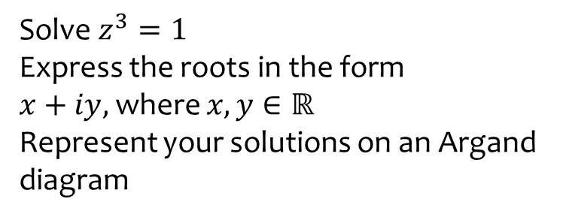
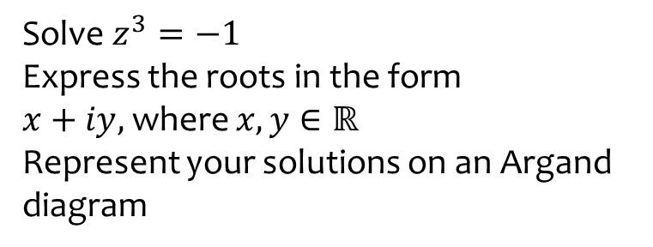
Worked example
Your turn
Solve $z^{3}=−1$
Express the roots in the form
$x+iy,$where $x,y∈ℝ$
Represent your solutions on an Argand diagram
Solve $z^{3}=1$
Express the roots in the form
$x+iy,$where $x,y∈ℝ$
Represent your solutions on an Argand diagram

Slide 7
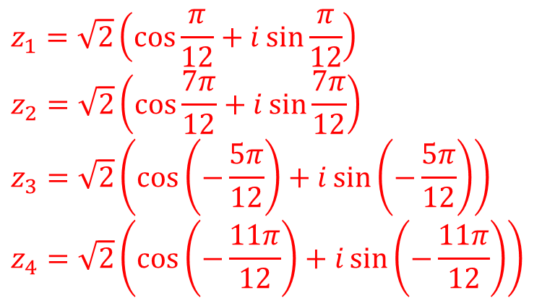
Worked example
Your turn
Solve $z^{4}=−2+2\sqrt{3} i$
Express the roots in the form
$r\left(\cos{θ}+i\sin{θ}\right),$where $−π<θ≤π$
Solve $z^{4}=2+2\sqrt{3} i$
Express the roots in the form
$r\left(\cos{θ}+i\sin{θ}\right),$where $−π<θ≤π$
$$z_{1}=\sqrt{2}\left(\cos{\frac{π}{12}}+i\sin{\frac{π}{12}}\right)$$
$$z_{2}=\sqrt{2}\left(\cos{\frac{7π}{12}}+i\sin{\frac{7π}{12}}\right)$$
$$z_{3}=\sqrt{2}\left(\cos\left(−\frac{5π}{12}\right)+i\sin\left(−\frac{5π}{12}\right)\right)$$
$$z_{4}=\sqrt{2}\left(\cos\left(−\frac{11π}{12}\right)+i\sin\left(−\frac{11π}{12}\right)\right)$$

Slide 8
Worked example
Your turn
Solve $z^{3}+32\sqrt{2}+32i\sqrt{2}=0$
Express the roots in the form
$re^{iθ},$where $r>0$ and $−π<θ≤π$
Solve $z^{3}+4\sqrt{2}+4i\sqrt{2}=0$
Express the roots in the form
$re^{iθ},$where $r>0$ and $−π<θ≤π$
$$z_{1}=2e^{−\frac{πi}{4}}$$
$$z_{2}=2e^{\frac{5πi}{12}}$$
$$z_{3}=2e^{−\frac{11πi}{12}}$$

Slide 9
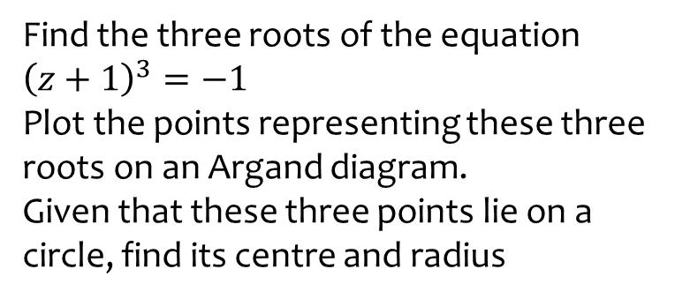
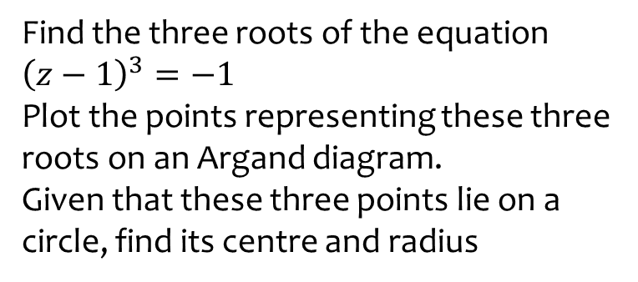
Worked example
Your turn
Find the three roots of the equation ${\left(z−1\right)}^{3}=−1$
Plot the points representing these three roots on an Argand diagram.
Given that these three points lie on a circle, find its centre and radius
Find the three roots of the equation ${\left(z+1\right)}^{3}=−1$
Plot the points representing these three roots on an Argand diagram.
Given that these three points lie on a circle, find its centre and radius
Centre $(1,0)$ ; Radius $1$

