Slide 1
1.5) Solving cubic and quartic equations

Slide 2
Worked example
Your turn
Given that $−2$is a root of the cubic equation
$$z^{3}−{2z}^{2}−3z+k=0$$
Find the value of $k$
Find the other two roots
Given that $−1$is a root of the cubic equation
$$z^{3}−z^{2}+3z+k=0$$
Find the value of $k$
Find the other two roots
(a) $k=5$
(b) $1+2i$ and $1−2i$

Slide 3
Worked example
Your turn
Given that $3+i$ is a root of the quartic equation
$2z^{4}−37z^{3}+221z^{2}−380z−250=0$, solve the equation completely.
Given that $3+i$ is a root of the quartic equation
$2z^{4}−3z^{3}−39z^{2}+120z−50=0$, solve the equation completely.
$$z_{1}=−5$$
$$z_{2}=\frac{1}{2}$$
$$z_{3}=3+i$$
$$z_{4}=3−i$$

Slide 4
Worked example
Your turn
Show that $z^{2}+9$ is a factor of
$$z^{4}−8z^{3}+26z^{2}−72z+153$$
Hence solve the equation
$$z^{4}−8z^{3}+26z^{2}−72z+153=0$$
Show that $z^{2}+4$ is a factor of
$$z^{4}−2z^{3}+21z^{2}−8z+68$$
Hence solve the equation
$$z^{4}−2z^{3}+21z^{2}−8z+68=0$$
$$z_{1}=2i$$
$$z_{2}=−2i$$
$$z_{3}=1+4i$$
$$z_{4}=1−4i$$

Slide 5
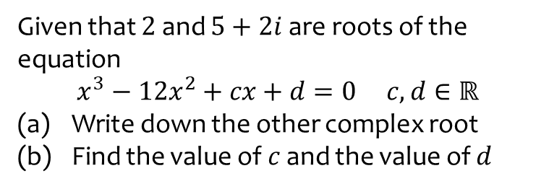
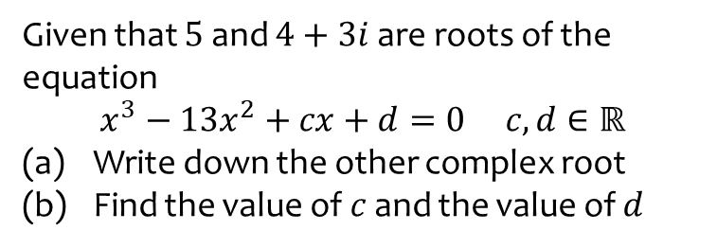
Worked example
Your turn
Given that $5$ and $4+3i$ are roots of the equation
$$x^{3}−13x^{2}+cx+d=0 c,d∈ℝ$$
Write down the other complex root
Find the value of $c$ and the value of $d$
Given that $2$ and $5+2i$ are roots of the equation
$$x^{3}−12x^{2}+cx+d=0 c,d∈ℝ$$
Write down the other complex root
Find the value of $c$ and the value of $d$
(a) $5−2i$
(b) $c=49, d=−58$

Slide 6

Worked example
Your turn
Solve:
$z^{4}=1$
$$z^{4}=16$$
Solve:
$z^{4}=81$
$$z_{1}=3$$
$$z_{2}=−3$$
$$z_{3}=3i$$
$$z_{4}=1−4i$$

Slide 7
Worked example
Your turn
$$f\left(z\right)=z^{3}+4z^{2}+kz+36, k∈ℝ$$
Given that $f\left(3i\right)=0$, find the value of $k$ and the other two roots of the equation
$$f\left(z\right)=z^{3}+3z^{2}+kz+48, k∈ℝ$$
Given that $f\left(4i\right)=0$, find the value of $k$ and the other two roots of the equation
$$k=16$$
$−4i$ and $−3$

Slide 8
Worked example
Your turn
Find the square root of $3+4i$
Find the square root of $i$
Find the square root of $5+12i$
$$3−2i, −3+2i$$

