Slide 1
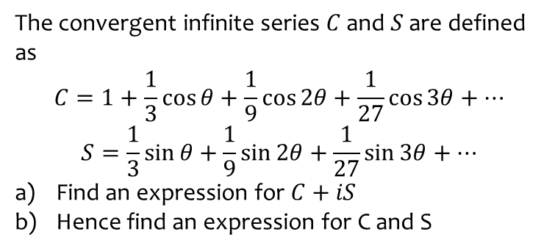
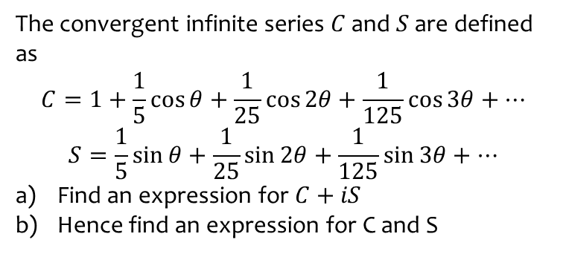

Worked example
Your turn
The convergent infinite series $C$ and $S$ are defined as
$$C=1+\frac{1}{5}\cos{θ}+\frac{1}{25}\cos{2θ}+\frac{1}{125}\cos{3θ}+…$$
$$S=\frac{1}{5}\sin{θ}+\frac{1}{25}\sin{2θ+\frac{1}{125}\sin{3θ+…}}$$
Find an expression for $C+iS$
Hence find an expression for C and S
The convergent infinite series $C$ and $S$ are defined as
$$C=1+\frac{1}{3}\cos{θ}+\frac{1}{9}\cos{2θ}+\frac{1}{27}\cos{3θ}+…$$
$$S=\frac{1}{3}\sin{θ}+\frac{1}{9}\sin{2θ+\frac{1}{27}\sin{3θ+…}}$$
Find an expression for $C+iS$
Hence find an expression for C and S
a) $C+iS=\frac{3}{3−e^{iθ}}$
b) $C=\frac{9−3\cos{θ}}{10−6\cos{θ}}$
$S=\frac{3\sin{θ}}{10−6\cos{θ}}$

Slide 2
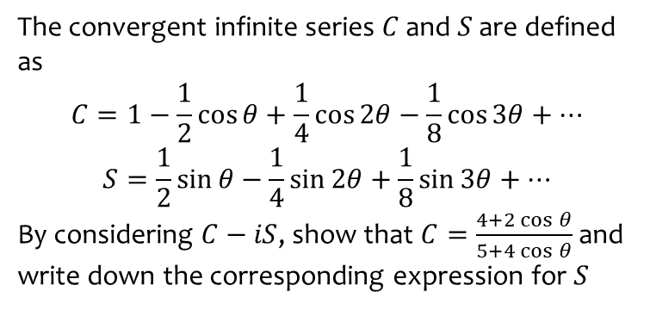
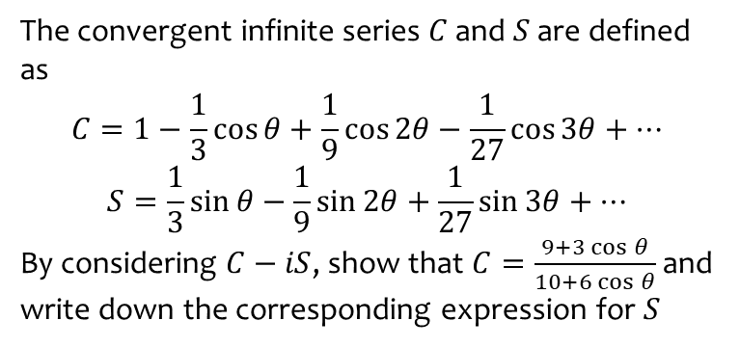

Worked example
Your turn
The convergent infinite series $C$ and $S$ are defined as
$$C=1−\frac{1}{3}\cos{θ}+\frac{1}{9}\cos{2θ}−\frac{1}{27}\cos{3θ}+…$$
$$S=\frac{1}{3}\sin{θ}−\frac{1}{9}\sin{2θ+\frac{1}{27}\sin{3θ+…}}$$
By considering $C−iS$, show that $C=\frac{9+3\cos{θ}}{10+6\cos{θ}}$ and write down the corresponding expression for $S$
The convergent infinite series $C$ and $S$ are defined as
$$C=1−\frac{1}{2}\cos{θ}+\frac{1}{4}\cos{2θ}−\frac{1}{8}\cos{3θ}+…$$
$$S=\frac{1}{2}\sin{θ}−\frac{1}{4}\sin{2θ+\frac{1}{8}\sin{3θ+…}}$$
By considering $C−iS$, show that $C=\frac{4+2\cos{θ}}{5+4\cos{θ}}$ and write down the corresponding expression for $S$
Shown
$$S=\frac{2\sin{θ}}{5+4\cos{θ}}$$

