Slide 1
Teachings for
Exercise 1E

Slide 2



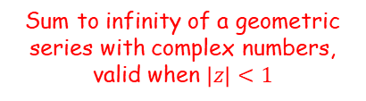






Complex Numbers
You can use the results for Geometric series with complex numbers
$a$ = the first term
$r$ = the common ratio
$n$ = the number of terms
$$S_{n}=\frac{a\left(1−r^{n}\right)}{1−r}$$
$$S_{∞}=\frac{a}{1−r}$$
Sum to infinity of a geometric series, valid when $\left|r\right|<1$
Sum of a geometric series
For $w,z∈ℂ$
The alternative form is also ok!
$$\frac{w\left(z^{n}−1\right)}{z−1}$$
$w$ = the first term
$z$ = the common ratio
$n$ = the number of terms
Sum of a geometric series with complex numbers
$$=\frac{w\left(1−z^{n}\right)}{1−z}$$
$$=\frac{w}{1−z}$$
Sum to infinity of a geometric series with complex numbers, valid when $\left|z\right|<1$
1E

Slide 3



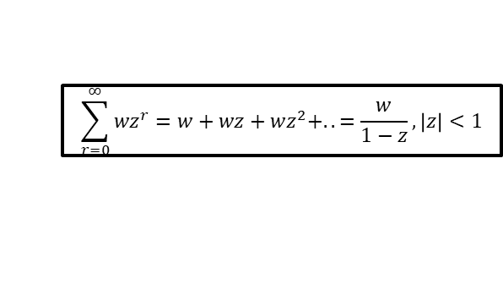






Complex Numbers
$$\sum_{r=0}^{n−1}{{wz}^{r}=w+wz+wz^{2}+..+wz^{n−1}=\frac{w\left(1−z^{n}\right)}{1−z} }$$
$$\sum_{r=0}^{∞}{{wz}^{r}=w+wz+wz^{2}+..=\frac{w}{1−z}}, \left|z\right|<1$$
You can use the results for Geometric series with complex numbers
Formally, it looks like this…
For $w,z∈ℂ$
$$\sum_{r=0}^{n−1}{{wz}^{r}}$$
$$=\frac{w\left(1−z^{n}\right)}{1−z}$$
$$=w+wz+wz^{2}+..+wz^{n−1}$$
$$\sum_{r=0}^{∞}{{wz}^{r}}$$
$$=\frac{w}{1−z}$$
$$=w+wz+wz^{2}+..$$
$$, \left|z\right|<1$$
1E

Slide 4














Complex Numbers
$$\sum_{r=0}^{n−1}{{wz}^{r}=w+wz+wz^{2}+..+wz^{n−1}=\frac{w\left(1−z^{n}\right)}{1−z} }$$
$$\sum_{r=0}^{∞}{{wz}^{r}=w+wz+wz^{2}+..=\frac{w}{1−z}}, \left|z\right|<1$$
$$\frac{1}{2}\left(e^{inθ}+e^{−inθ}\right)=cosnθ$$
$$\frac{1}{2i}\left(e^{inθ}−e^{−inθ}\right)=sinnθ$$
$$z^{n}+\frac{1}{z^{n}}=2cosnθ$$
You can use the results for Geometric series with complex numbers
You will also need a variation on a result from the previous section (you should hopefully have encountered this in exercise 1D!)
Use the exponential form, $z=e^{iθ}$
$${\left(e^{iθ}\right)}^{n}+\frac{1}{{\left(e^{iθ}\right)}^{n}}=2cosnθ$$
Rewrite
$$e^{inθ}+e^{−inθ}=2cosnθ$$
Divide by 2
$$\frac{1}{2}\left(e^{inθ}+e^{−inθ}\right)=cosnθ$$
$$z^{n}+\frac{1}{z^{n}}=2cosnθ$$
$$z^{n}−\frac{1}{z^{n}}=2icosnθ$$
$$z^{n}−\frac{1}{z^{n}}=2isinnθ$$
Use the exponential form, $z=e^{iθ}$
You will need to learn to spot situations where you can create this pattern in order to use it!
$${\left(e^{iθ}\right)}^{n}−\frac{1}{{\left(e^{iθ}\right)}^{n}}=2isinnθ$$
Rewrite
$$e^{inθ}−e^{−inθ}=2isinnθ$$
Divide by 2i
$$\frac{1}{2i}\left(e^{inθ}−e^{−inθ}\right)=sinnθ$$
1E

Slide 5


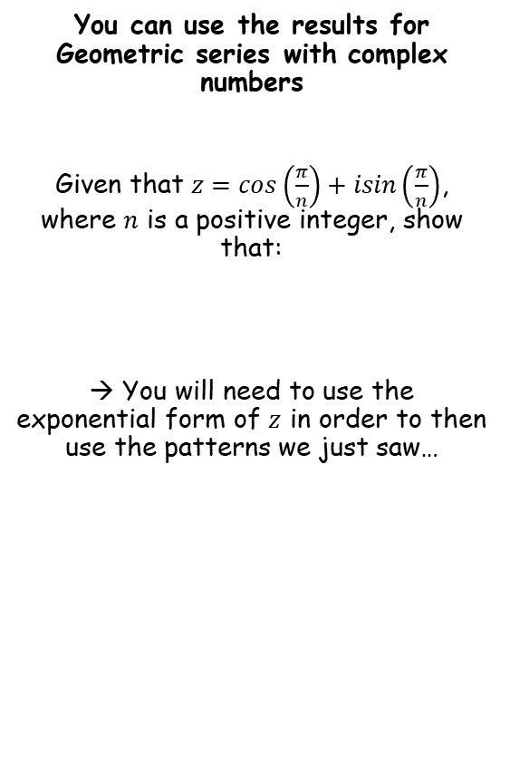











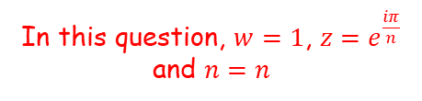

Complex Numbers
$$\sum_{r=0}^{n−1}{{wz}^{r}=w+wz+wz^{2}+..+wz^{n−1}=\frac{w\left(1−z^{n}\right)}{1−z} }$$
$$\sum_{r=0}^{∞}{{wz}^{r}=w+wz+wz^{2}+..=\frac{w}{1−z}}, \left|z\right|<1$$
$$\frac{1}{2}\left(e^{inθ}+e^{−inθ}\right)=cosnθ$$
$$e^{iπ}=−1$$
$$\frac{1}{2i}\left(e^{inθ}−e^{−inθ}\right)=sinnθ$$
You can use the results for Geometric series with complex numbers
Given that $z=cos\left(\frac{π}{n}\right)+isin\left(\frac{π}{n}\right)$, where $n$ is a positive integer, show that:
→ You will need to use the exponential form of $z$ in order to then use the patterns we just saw…
$$\frac{w\left(1−z^{n}\right)}{1−z}$$
In this question, $w=1$, $z=e^{\frac{iπ}{n}}$ and $n=n$
$$=\frac{1−{\left(e^{\frac{iπ}{n}}\right)}^{n}}{1−e^{\frac{iπ}{n}}}$$
We can simplify the numerator
$$=\frac{1−e^{iπ}}{1−e^{\frac{iπ}{n}}}$$
$$1+z+z^{2}+..+z^{n−1}=1+icot\left(\frac{π}{2n}\right)$$
Start with Euler’s relation…
$$e^{iθ}=cosθ+isinθ$$
Let $θ=π$
$$cosθ+isinθ=e^{iθ}$$
$$e^{iπ}=cosπ+isinπ$$
$$cos\left(\frac{π}{n}\right)+isin\left(\frac{π}{n}\right)=e^{i\frac{π}{n}}$$
Calculate terms on RHS
$$e^{iπ}=−1+i(0)$$
$$=e^{\frac{iπ}{n}}$$
Simplify
$$e^{iπ}=−1$$
(don’t confuse $π$ symbols with the letter ‘n’!)
Add 1
$$e^{iπ}+1=0$$
This is known as ‘Euler’s identity’, and is one of the most famous relationships in all of Maths!
1E

Slide 6

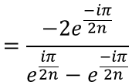
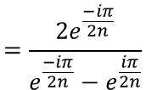

Complex Numbers
$$\sum_{r=0}^{n−1}{{wz}^{r}=w+wz+wz^{2}+..+wz^{n−1}=\frac{w\left(1−z^{n}\right)}{1−z} }$$
$$\sum_{r=0}^{∞}{{wz}^{r}=w+wz+wz^{2}+..=\frac{w}{1−z}}, \left|z\right|<1$$
$$\frac{1}{2}\left(e^{inθ}+e^{−inθ}\right)=cosnθ$$
$$e^{iπ}=−1$$
$$\frac{1}{2i}\left(e^{inθ}−e^{−inθ}\right)=sinnθ$$
You can use the results for Geometric series with complex numbers
Given that $z=cos\left(\frac{π}{n}\right)+isin\left(\frac{π}{n}\right)$, where $n$ is a positive integer, show that:
→ You will need to use the exponential form of $z$ in order to then use the patterns we just saw…
$$\frac{w\left(1−z^{n}\right)}{1−z}$$
In this question, $w=1$, $z=e^{\frac{iπ}{n}}$ and $n=n$
$$=\frac{1−{\left(e^{\frac{iπ}{n}}\right)}^{n}}{1−e^{\frac{iπ}{n}}}$$
We can simplify the numerator
$$=\frac{1−e^{iπ}}{1−e^{\frac{iπ}{n}}}$$
$$1+z+z^{2}+..+z^{n−1}=1+icot\left(\frac{π}{2n}\right)$$
The numerator will therefore be equal to 2
$$=\frac{2}{1−e^{\frac{iπ}{n}}}$$
Now we need to manipulate the fraction to create one of the patterns above. The denominator has a subtraction, so we are aiming for that one…
$$=\frac{2e^{\frac{−iπ}{2n}}}{e^{\frac{−iπ}{2n}}−e^{\frac{iπ}{2n}}}$$
→ Multiply all terms by $e^{\frac{−iπ}{2n}}$
$$cosθ+isinθ=e^{iθ}$$
$$cos\left(\frac{π}{n}\right)+isin\left(\frac{π}{n}\right)=e^{i\frac{π}{n}}$$
Now multiply all terms by -1 (the terms on the denominator have had their positions switched)
$$=\frac{−2e^{\frac{−iπ}{2n}}}{{e^{\frac{iπ}{2n}}−e}^{\frac{−iπ}{2n}}}$$
$$=e^{\frac{iπ}{n}}$$
(don’t confuse $π$ symbols with the letter ‘n’!)
1E

Slide 7







Complex Numbers
$$\sum_{r=0}^{n−1}{{wz}^{r}=w+wz+wz^{2}+..+wz^{n−1}=\frac{w\left(1−z^{n}\right)}{1−z} }$$
$$\sum_{r=0}^{∞}{{wz}^{r}=w+wz+wz^{2}+..=\frac{w}{1−z}}, \left|z\right|<1$$
$$\frac{1}{2}\left(e^{inθ}+e^{−inθ}\right)=cosnθ$$
$$e^{iπ}=−1$$
$$\frac{1}{2i}\left(e^{inθ}−e^{−inθ}\right)=sinnθ$$
You can use the results for Geometric series with complex numbers
Given that $z=cos\left(\frac{π}{n}\right)+isin\left(\frac{π}{n}\right)$, where $n$ is a positive integer, show that:
→ You will need to use the exponential form of $z$ in order to then use the patterns we just saw…
$$=\frac{−2e^{\frac{−iπ}{2n}}}{{e^{\frac{iπ}{2n}}−e}^{\frac{−iπ}{2n}}}$$
Replace denominator with $2isin\left(\frac{π}{2n}\right)$
$$=\frac{−2e^{\frac{−iπ}{2n}}}{2isin\left(\frac{π}{2n}\right)}$$
$$1+z+z^{2}+..+z^{n−1}=1+icot\left(\frac{π}{2n}\right)$$
$$\frac{1}{2i}\left(e^{inθ}−e^{−inθ}\right)=sinnθ$$
Multiply by 2i
$$e^{inθ}−e^{−inθ}=2isinnθ$$
Replace $nθ$ with $\frac{π}{2n}$
$$cosθ+isinθ=e^{iθ}$$
$$e^{\frac{iπ}{2n}}−e^{−\frac{iπ}{2n}}=2isin\left(\frac{π}{2n}\right)$$
$$cos\left(\frac{π}{n}\right)+isin\left(\frac{π}{n}\right)=e^{i\frac{π}{n}}$$
$$=e^{\frac{iπ}{n}}$$
(don’t confuse $π$ symbols with the letter ‘n’!)
1E

Slide 8


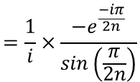

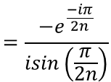





Complex Numbers
$$\sum_{r=0}^{n−1}{{wz}^{r}=w+wz+wz^{2}+..+wz^{n−1}=\frac{w\left(1−z^{n}\right)}{1−z} }$$
$$\sum_{r=0}^{∞}{{wz}^{r}=w+wz+wz^{2}+..=\frac{w}{1−z}}, \left|z\right|<1$$
$$\frac{1}{2}\left(e^{inθ}+e^{−inθ}\right)=cosnθ$$
$$e^{iπ}=−1$$
$$\frac{1}{2i}\left(e^{inθ}−e^{−inθ}\right)=sinnθ$$
You can use the results for Geometric series with complex numbers
Given that $z=cos\left(\frac{π}{n}\right)+isin\left(\frac{π}{n}\right)$, where $n$ is a positive integer, show that:
→ You will need to use the exponential form of $z$ in order to then use the patterns we just saw…
$$=\frac{−2e^{\frac{−iπ}{2n}}}{{e^{\frac{iπ}{2n}}−e}^{\frac{−iπ}{2n}}}$$
Replace denominator with $2isin\left(\frac{π}{2n}\right)$
$$=\frac{−2e^{\frac{−iπ}{2n}}}{2isin\left(\frac{π}{2n}\right)}$$
Divide all by 2
$$=\frac{−e^{\frac{−iπ}{2n}}}{isin\left(\frac{π}{2n}\right)}$$
$$1+z+z^{2}+..+z^{n−1}=1+icot\left(\frac{π}{2n}\right)$$
You can rewrite like this (you will not need to do this everytime, but it helps to show what happens next…)
$$=\frac{1}{i}×\frac{−e^{\frac{−iπ}{2n}}}{sin\left(\frac{π}{2n}\right)}$$
$$cosθ+isinθ=e^{iθ}$$
$$cos\left(\frac{π}{n}\right)+isin\left(\frac{π}{n}\right)=e^{i\frac{π}{n}}$$
Let $\frac{1}{i}=x$
$$1=x×i$$
$$=e^{\frac{iπ}{n}}$$
Let $x=−i$
So $x=−i$
$$1=−i×i$$
Rewrite RHS
(don’t confuse $π$ symbols with the letter ‘n’!)
$$1=−i^{2}$$
So $\frac{1}{i}=−i$
This works!
$$1=1$$
1E

Slide 9


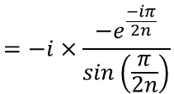
Complex Numbers
$$\sum_{r=0}^{n−1}{{wz}^{r}=w+wz+wz^{2}+..+wz^{n−1}=\frac{w\left(1−z^{n}\right)}{1−z} }$$
$$\sum_{r=0}^{∞}{{wz}^{r}=w+wz+wz^{2}+..=\frac{w}{1−z}}, \left|z\right|<1$$
$$\frac{1}{2}\left(e^{inθ}+e^{−inθ}\right)=cosnθ$$
$$e^{iπ}=−1$$
$$\frac{1}{2i}\left(e^{inθ}−e^{−inθ}\right)=sinnθ$$
You can use the results for Geometric series with complex numbers
Given that $z=cos\left(\frac{π}{n}\right)+isin\left(\frac{π}{n}\right)$, where $n$ is a positive integer, show that:
→ You will need to use the exponential form of $z$ in order to then use the patterns we just saw…
$$=\frac{−2e^{\frac{−iπ}{2n}}}{{e^{\frac{iπ}{2n}}−e}^{\frac{−iπ}{2n}}}$$
Replace denominator with $2isin\left(\frac{π}{2n}\right)$
$$=\frac{−2e^{\frac{−iπ}{2n}}}{2isin\left(\frac{π}{2n}\right)}$$
Divide all by 2
$$=\frac{−e^{\frac{−iπ}{2n}}}{isin\left(\frac{π}{2n}\right)}$$
$$1+z+z^{2}+..+z^{n−1}=1+icot\left(\frac{π}{2n}\right)$$
You can rewrite like this (you will not need to do this everytime, but it helps to show what happens next…)
$$=\frac{1}{i}×\frac{−e^{\frac{−iπ}{2n}}}{sin\left(\frac{π}{2n}\right)}$$
Replace $\frac{1}{i}$ with $−i$
$$cosθ+isinθ=e^{iθ}$$
$$=−i×\frac{−e^{\frac{−iπ}{2n}}}{sin\left(\frac{π}{2n}\right)}$$
$$cos\left(\frac{π}{n}\right)+isin\left(\frac{π}{n}\right)=e^{i\frac{π}{n}}$$
$$=e^{\frac{iπ}{n}}$$
Simplify
$$=\frac{ie^{\frac{−iπ}{2n}}}{sin\left(\frac{π}{2n}\right)}$$
(don’t confuse $π$ symbols with the letter ‘n’!)
1E

Slide 10
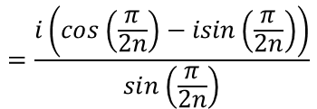


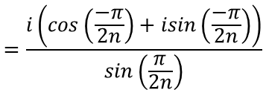
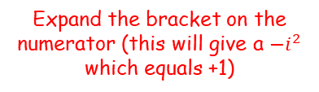
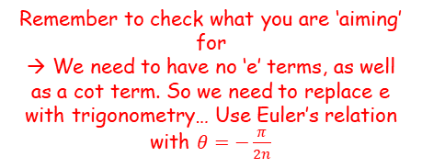


Complex Numbers
$$\sum_{r=0}^{n−1}{{wz}^{r}=w+wz+wz^{2}+..+wz^{n−1}=\frac{w\left(1−z^{n}\right)}{1−z} }$$
$$\sum_{r=0}^{∞}{{wz}^{r}=w+wz+wz^{2}+..=\frac{w}{1−z}}, \left|z\right|<1$$
$$\frac{1}{2}\left(e^{inθ}+e^{−inθ}\right)=cosnθ$$
$$e^{iπ}=−1$$
$$\frac{1}{2i}\left(e^{inθ}−e^{−inθ}\right)=sinnθ$$
$$=\frac{ie^{\frac{−iπ}{2n}}}{sin\left(\frac{π}{2n}\right)}$$
You can use the results for Geometric series with complex numbers
Given that $z=cos\left(\frac{π}{n}\right)+isin\left(\frac{π}{n}\right)$, where $n$ is a positive integer, show that:
→ You will need to use the exponential form of $z$ in order to then use the patterns we just saw…
Remember to check what you are ‘aiming’ for
→ We need to have no ‘e’ terms, as well as a cot term. So we need to replace e with trigonometry… Use Euler’s relation with $θ=−\frac{π}{2n}$
$$=\frac{i\left(cos\left(\frac{−π}{2n}\right)+isin\left(\frac{−π}{2n}\right)\right)}{sin\left(\frac{π}{2n}\right)}$$
Use $\cos\left(−θ\right)=cosθ$and $sin⁡(−θ)=−sinθ$
$$=\frac{i\left(cos\left(\frac{π}{2n}\right)−isin\left(\frac{π}{2n}\right)\right)}{sin\left(\frac{π}{2n}\right)}$$
(this will make all the angles the same)
$$1+z+z^{2}+..+z^{n−1}=1+icot\left(\frac{π}{2n}\right)$$
Expand the bracket on the numerator (this will give a $−i^{2}$ which equals +1)
$$=\frac{icos\left(\frac{π}{2n}\right)+sin\left(\frac{π}{2n}\right)}{sin\left(\frac{π}{2n}\right)}$$
$$cosθ+isinθ=e^{iθ}$$
Simplify
$$cos\left(\frac{π}{n}\right)+isin\left(\frac{π}{n}\right)=e^{i\frac{π}{n}}$$
$$=icot\left(\frac{π}{2n}\right)+1$$
$$=e^{\frac{iπ}{n}}$$
(don’t confuse $π$ symbols with the letter ‘n’!)
1E

Slide 11






Complex Numbers
$$\sum_{r=0}^{n−1}{{wz}^{r}=w+wz+wz^{2}+..+wz^{n−1}=\frac{w\left(1−z^{n}\right)}{1−z} }$$
$$\sum_{r=0}^{∞}{{wz}^{r}=w+wz+wz^{2}+..=\frac{w}{1−z}}, \left|z\right|<1$$
$$\frac{1}{2}\left(e^{inθ}+e^{−inθ}\right)=cosnθ$$
$$e^{iπ}=−1$$
$$\frac{1}{2i}\left(e^{inθ}−e^{−inθ}\right)=sinnθ$$
You can use the results for Geometric series with complex numbers
You can also use patterns where you separate the real and imaginary parts of a geometric series
The series:
$$e^{iθ}+e^{2iθ}+e^{3iθ}+..+e^{niθ}$$
is geometric with first term $e^{iθ}$, common ratio $e^{iθ}$ and $n$ terms.
$$S_{n}=\frac{w\left(1−z^{n}\right)}{1−z}$$
Replace $w=e^{iθ}$, ${z=e}^{iθ}$ and $n=n$
$$S_{n}=\frac{e^{iθ}\left(1−e^{niθ}\right)}{1−e^{iθ}}$$
Remember this can be written in this way as well
$$S_{n}=\frac{e^{iθ}\left(e^{niθ}−1\right)}{e^{iθ}−1}$$
1E

Slide 12





Complex Numbers
$$\sum_{r=0}^{n−1}{{wz}^{r}=w+wz+wz^{2}+..+wz^{n−1}=\frac{w\left(1−z^{n}\right)}{1−z} }$$
$$\sum_{r=0}^{∞}{{wz}^{r}=w+wz+wz^{2}+..=\frac{w}{1−z}}, \left|z\right|<1$$
$$\frac{1}{2}\left(e^{inθ}+e^{−inθ}\right)=cosnθ$$
$$e^{iπ}=−1$$
$$\frac{1}{2i}\left(e^{inθ}−e^{−inθ}\right)=sinnθ$$
You can use the results for Geometric series with complex numbers
You can also use patterns where you separate the real and imaginary parts of a geometric series
$$S_{n}=\frac{e^{iθ}\left(1−e^{niθ}\right)}{1−e^{iθ}}$$
$$S_{n}=\frac{e^{iθ}\left(e^{niθ}−1\right)}{e^{iθ}−1}$$
$$e^{iθ}+e^{2iθ}+e^{3iθ}+..+e^{niθ}$$
Replacing each term using Euler’s relation
$$=\left(cosθ+isinθ\right)+\left(cos2θ+isin2θ\right)+\left(cos3θ+isin3θ\right)+..+\left(cosnθ+isinnθ\right)$$
Grouping real and imaginary parts separately
$$=\left(cosθ+cos2θ+cos3θ+..+cosnθ\right)+i\left(sinθ+sin2θ+sin3θ+..+sinnθ\right)$$
Real
Imaginary
Therefore:
$$cosθ+cos2θ+cos3θ+..+cosnθ=Re\left(\frac{e^{iθ}\left(1−e^{niθ}\right)}{1−e^{iθ}}\right)$$
The sum of the sequence on the left side is the real part of the formula on the right side
$$sinθ+sin2θ+sin3θ+..+sinnθ=Im\left(\frac{e^{iθ}\left(1−e^{niθ}\right)}{1−e^{iθ}}\right)$$
The sum of the sequence on the left side is the imaginary part of the formula on the right side
1E

Slide 13
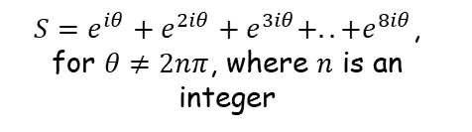
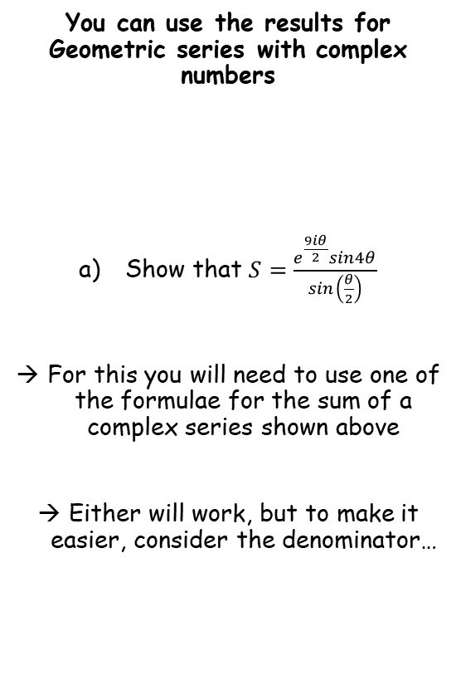



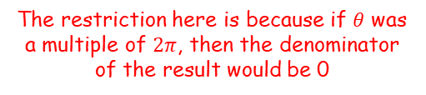


Complex Numbers
$$cosθ+cos2θ+cos3θ+..+cosnθ=Re\left(\frac{e^{iθ}\left(1−e^{niθ}\right)}{1−e^{iθ}}\right)$$
$$sinθ+sin2θ+sin3θ+..+sinnθ=Im\left(\frac{e^{iθ}\left(1−e^{niθ}\right)}{1−e^{iθ}}\right)$$
$$S_{n}=\frac{e^{iθ}\left(1−e^{niθ}\right)}{1−e^{iθ}}$$
$$S_{n}=\frac{e^{iθ}\left(e^{niθ}−1\right)}{e^{iθ}−1}$$
You can use the results for Geometric series with complex numbers
Show that $S=\frac{e^{\frac{9iθ}{2}}sin4θ}{sin\left(\frac{θ}{2}\right)}$
For this you will need to use one of the formulae for the sum of a complex series shown above
Either will work, but to make it easier, consider the denominator…
The restriction here is because if $θ$ was a multiple of $2π$, then the denominator of the result would be 0
So using this formula should lead to fewer steps!
$S=e^{iθ}+e^{2iθ}+e^{3iθ}+..+e^{8iθ}$, for $θ≠2nπ$, where $n$ is an integer
The denominator contains sine, which means we are probably going to use the formula to the right to replace it as in the previous example
$$\frac{1}{2i}\left(e^{inθ}−e^{−inθ}\right)=sinnθ$$
The power on the left needs to be higher than the power on the right, if it is written this way
1E

Slide 14



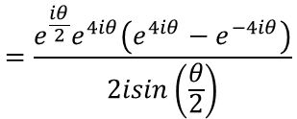



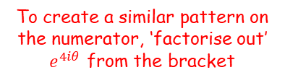

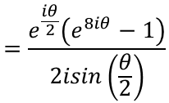



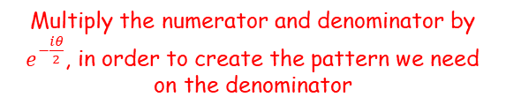
Complex Numbers
$$cosθ+cos2θ+cos3θ+..+cosnθ=Re\left(\frac{e^{iθ}\left(1−e^{niθ}\right)}{1−e^{iθ}}\right)$$
$$sinθ+sin2θ+sin3θ+..+sinnθ=Im\left(\frac{e^{iθ}\left(1−e^{niθ}\right)}{1−e^{iθ}}\right)$$
$$S_{n}=\frac{e^{iθ}\left(1−e^{niθ}\right)}{1−e^{iθ}}$$
$$S_{n}=\frac{e^{iθ}\left(e^{niθ}−1\right)}{e^{iθ}−1}$$
You can use the results for Geometric series with complex numbers
Show that $S=\frac{e^{\frac{9iθ}{2}}sin4θ}{sin\left(\frac{θ}{2}\right)}$
$$S_{n}=\frac{e^{iθ}\left(e^{niθ}−1\right)}{e^{iθ}−1}$$
In our question, $n=8$
$$=\frac{e^{iθ}\left({\left(e^{iθ}\right)}^{8}−1\right)}{e^{iθ}−1}$$
$S=e^{iθ}+e^{2iθ}+e^{3iθ}+..+e^{8iθ}$, for $θ≠2nπ$, where $n$ is an integer
Rewrite
$$=\frac{e^{iθ}\left(e^{8iθ}−1\right)}{e^{iθ}−1}$$
Multiply the numerator and denominator by $e^{−\frac{iθ}{2}}$, in order to create the pattern we need on the denominator
$$=\frac{e^{\frac{iθ}{2}}\left(e^{8iθ}−1\right)}{e^{\frac{iθ}{2}}−e^{−\frac{iθ}{2}}}$$
Replace the denominator using the pattern to the left
$$\frac{1}{2i}\left(e^{inθ}−e^{−inθ}\right)=sinnθ$$
$$=\frac{e^{\frac{iθ}{2}}\left(e^{8iθ}−1\right)}{2isin\left(\frac{θ}{2}\right)}$$
Multiply by 2i
$$e^{inθ}−e^{−inθ}=2isinnθ$$
To create a similar pattern on the numerator, ‘factorise out’ $e^{4iθ}$ from the bracket
Replace $n$ with $\frac{1}{2}$
$$=\frac{e^{\frac{iθ}{2}}e^{4iθ}\left(e^{4iθ}−e^{−4iθ}\right)}{2isin\left(\frac{θ}{2}\right)}$$
$$e^{\frac{iθ}{2}}−e^{−\frac{iθ}{2}}=2isin\left(\frac{θ}{2}\right)$$
1E

Slide 15



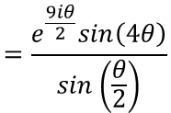

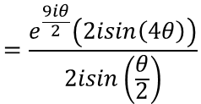
Complex Numbers
$$cosθ+cos2θ+cos3θ+..+cosnθ=Re\left(\frac{e^{iθ}\left(1−e^{niθ}\right)}{1−e^{iθ}}\right)$$
$$sinθ+sin2θ+sin3θ+..+sinnθ=Im\left(\frac{e^{iθ}\left(1−e^{niθ}\right)}{1−e^{iθ}}\right)$$
$$S_{n}=\frac{e^{iθ}\left(1−e^{niθ}\right)}{1−e^{iθ}}$$
$$S_{n}=\frac{e^{iθ}\left(e^{niθ}−1\right)}{e^{iθ}−1}$$
You can use the results for Geometric series with complex numbers
Show that $S=\frac{e^{\frac{9iθ}{2}}sin4θ}{sin\left(\frac{θ}{2}\right)}$
$$=\frac{e^{\frac{iθ}{2}}e^{4iθ}\left(e^{4iθ}−e^{−4iθ}\right)}{2isin\left(\frac{θ}{2}\right)}$$
Simplify/replace terms on the numerator
$S=e^{iθ}+e^{2iθ}+e^{3iθ}+..+e^{8iθ}$, for $θ≠2nπ$, where $n$ is an integer
$$=\frac{e^{\frac{9iθ}{2}}\left(2isin\left(4θ\right)\right)}{2isin\left(\frac{θ}{2}\right)}$$
Divide numerator and denominator by $2i$
$$=\frac{e^{\frac{9iθ}{2}}sin\left(4θ\right)}{sin\left(\frac{θ}{2}\right)}$$
$$\frac{1}{2i}\left(e^{inθ}−e^{−inθ}\right)=sinnθ$$
Multiply by 2i
$$e^{inθ}−e^{−inθ}=2isinnθ$$
Replace $n$ with $4$
$$e^{4iθ}−e^{−4iθ}=2isin\left(4θ\right)$$
1E

Slide 16
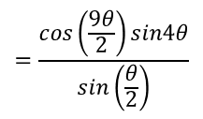
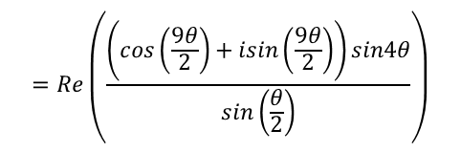


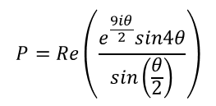
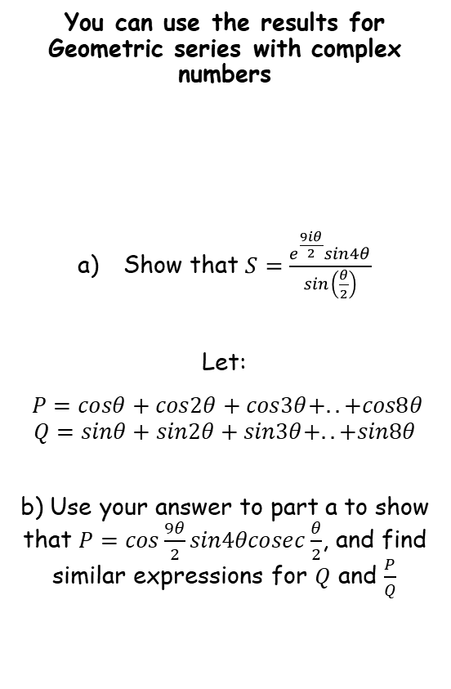

Complex Numbers
$$cosθ+cos2θ+cos3θ+..+cosnθ=Re\left(\frac{e^{iθ}\left(1−e^{niθ}\right)}{1−e^{iθ}}\right)$$
$$sinθ+sin2θ+sin3θ+..+sinnθ=Im\left(\frac{e^{iθ}\left(1−e^{niθ}\right)}{1−e^{iθ}}\right)$$
$$S_{n}=\frac{e^{iθ}\left(1−e^{niθ}\right)}{1−e^{iθ}}$$
$$S_{n}=\frac{e^{iθ}\left(e^{niθ}−1\right)}{e^{iθ}−1}$$
$$P=Re\left(\frac{e^{\frac{9iθ}{2}}sin4θ}{sin\left(\frac{θ}{2}\right)}\right)$$
You can use the results for Geometric series with complex numbers
Show that $S=\frac{e^{\frac{9iθ}{2}}sin4θ}{sin\left(\frac{θ}{2}\right)}$
Let:
$P=cosθ+cos2θ+cos3θ+..+cos8θ$
$$Q=sinθ+sin2θ+sin3θ+..+sin8θ$$
b) Use your answer to part a to show that $P=cos\frac{9θ}{2}sin4θcosec\frac{θ}{2}$, and find similar expressions for $Q$ and $\frac{P}{Q}$
Replace the exponential term using Euler’s relation
$$=Re\left(\frac{\left(cos\left(\frac{9θ}{2}\right)+isin\left(\frac{9θ}{2}\right)\right)sin4θ}{sin\left(\frac{θ}{2}\right)}\right)$$
$S=e^{iθ}+e^{2iθ}+e^{3iθ}+..+e^{8iθ}$, for $θ≠2nπ$, where $n$ is an integer
For $P$, we are only considering the real part
$$=\frac{cos\left(\frac{9θ}{2}\right)sin4θ}{sin\left(\frac{θ}{2}\right)}$$
From this, $P$ is the real part of the sum of $S$, which we showed in part a)
Rewrite
$$=cos\left(\frac{9θ}{2}\right)sin4θcosec\left(\frac{θ}{2}\right)$$
1E

Slide 17
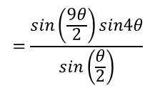
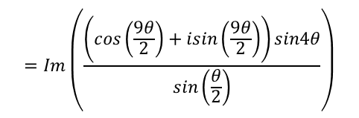


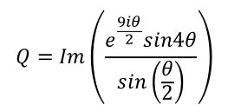

Complex Numbers
$$cosθ+cos2θ+cos3θ+..+cosnθ=Re\left(\frac{e^{iθ}\left(1−e^{niθ}\right)}{1−e^{iθ}}\right)$$
$$sinθ+sin2θ+sin3θ+..+sinnθ=Im\left(\frac{e^{iθ}\left(1−e^{niθ}\right)}{1−e^{iθ}}\right)$$
$$S_{n}=\frac{e^{iθ}\left(1−e^{niθ}\right)}{1−e^{iθ}}$$
$$S_{n}=\frac{e^{iθ}\left(e^{niθ}−1\right)}{e^{iθ}−1}$$
$$Q=Im\left(\frac{e^{\frac{9iθ}{2}}sin4θ}{sin\left(\frac{θ}{2}\right)}\right)$$
You can use the results for Geometric series with complex numbers
Show that $S=\frac{e^{\frac{9iθ}{2}}sin4θ}{sin\left(\frac{θ}{2}\right)}$
Let:
$P=cosθ+cos2θ+cos3θ+..+cos8θ$
$$Q=sinθ+sin2θ+sin3θ+..+sin8θ$$
b) Use your answer to part a to show that $P=cos\frac{9θ}{2}sin4θcosec\frac{θ}{2}$, and find similar expressions for $Q$ and $\frac{P}{Q}$
Replace the exponential term using Euler’s relation
$$=Im\left(\frac{\left(cos\left(\frac{9θ}{2}\right)+isin\left(\frac{9θ}{2}\right)\right)sin4θ}{sin\left(\frac{θ}{2}\right)}\right)$$
$S=e^{iθ}+e^{2iθ}+e^{3iθ}+..+e^{8iθ}$, for $θ≠2nπ$, where $n$ is an integer
For $Q$, we are only considering the imaginary part (you don’t need to include the $i$ itself since the expression for Q on the left does not)
$$=\frac{sin\left(\frac{9θ}{2}\right)sin4θ}{sin\left(\frac{θ}{2}\right)}$$
Rewrite
From this, $Q$ is the imaginary part of the sum of $S$, which we showed in part a)
$$=sin\left(\frac{9θ}{2}\right)sin4θcosec\left(\frac{θ}{2}\right)$$
1E

Slide 18

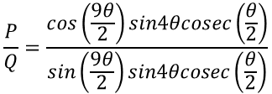


Complex Numbers
$$cosθ+cos2θ+cos3θ+..+cosnθ=Re\left(\frac{e^{iθ}\left(1−e^{niθ}\right)}{1−e^{iθ}}\right)$$
$$sinθ+sin2θ+sin3θ+..+sinnθ=Im\left(\frac{e^{iθ}\left(1−e^{niθ}\right)}{1−e^{iθ}}\right)$$
$$S_{n}=\frac{e^{iθ}\left(1−e^{niθ}\right)}{1−e^{iθ}}$$
$$S_{n}=\frac{e^{iθ}\left(e^{niθ}−1\right)}{e^{iθ}−1}$$
You can use the results for Geometric series with complex numbers
Show that $S=\frac{e^{\frac{9iθ}{2}}sin4θ}{sin\left(\frac{θ}{2}\right)}$
Let:
$P=cosθ+cos2θ+cos3θ+..+cos8θ$
$$Q=sinθ+sin2θ+sin3θ+..+sin8θ$$
b) Use your answer to part a to show that $P=cos\frac{9θ}{2}sin4θcosec\frac{θ}{2}$, and find similar expressions for $Q$ and $\frac{P}{Q}$
$$P=cos\left(\frac{9θ}{2}\right)sin4θcosec\left(\frac{θ}{2}\right)$$
$$Q=sin\left(\frac{9θ}{2}\right)sin4θcosec\left(\frac{θ}{2}\right)$$
$S=e^{iθ}+e^{2iθ}+e^{3iθ}+..+e^{8iθ}$, for $θ≠2nπ$, where $n$ is an integer
$$\frac{P}{Q}=\frac{cos\left(\frac{9θ}{2}\right)sin4θcosec\left(\frac{θ}{2}\right)}{sin\left(\frac{9θ}{2}\right)sin4θcosec\left(\frac{θ}{2}\right)}$$
Simplify
$$\frac{P}{Q}=tan\left(\frac{9θ}{2}\right)$$
1E

