Slide 1
1.4) Trigonometric identities

Slide 2
Worked example
Your turn
Use de Moivre’s theorem to show that
$$\cos{6θ}=32\cos^{6}{θ}−48\cos^{4}{θ}+18\cos^{2}{θ}−1$$
Use de Moivre’s theorem to show that
$$\cos{5θ}=16\cos^{5}{θ}−20\cos^{3}{θ}+5\cos{θ}$$
Shown

Slide 3
Worked example
Your turn
Use de Moivre’s theorem to show that
$$\sin{5θ}=16\sin^{5}{θ}−20\sin^{3}{θ}+5\sin{θ}$$
Use de Moivre’s theorem to show that
$$\sin{4θ}=4\cos^{3}{θ}\sin{θ}−4\cos{θ}\sin^{3}{θ}$$
Shown

Slide 4
Worked example
Your turn
Use de Moivre’s theorem to show that
$$\cos^{6}{θ}=\frac{1}{32}\cos{6θ}+\frac{3}{16}\cos{4θ}+\frac{15}{32}\cos{2θ}+\frac{5}{16}$$
Use de Moivre’s theorem to show that
$$\cos^{5}{θ}=\frac{1}{16}\cos{5θ}+\frac{5}{16}\cos{3θ}+\frac{5}{8}\cos{θ}$$
Shown

Slide 5
Worked example
Your turn
Use de Moivre’s theorem to show that
$$\sin^{5}{θ}=\frac{1}{16}\sin{5θ}−\frac{5}{16}\sin{3θ}+\frac{5}{8}\sin{θ}$$
Use de Moivre’s theorem to show that
$$\sin^{4}{θ}=\frac{1}{8}\cos{4θ}−\frac{1}{2}\cos{2θ}+\frac{3}{8}$$
Shown

Slide 6
Worked example
Your turn
Use de Moivre’s theorem to show that
$$\sin^{5}{θ}=\frac{1}{16}\sin{5θ}−\frac{5}{16}\sin{3θ}+\frac{5}{8}\sin{θ}$$
Hence find the exact value of
$$\int_{0}^{\frac{π}{2}}{\sin^{5}{θ}}$$
Use de Moivre’s theorem to show that
$$\sin^{4}{θ}=\frac{1}{8}\cos{4θ}−\frac{1}{2}\cos{2θ}+\frac{3}{8}$$
Hence find the exact value of
$$\int_{0}^{\frac{π}{2}}{\sin^{4}{θ}}$$
$$\frac{3π}{16}$$

Slide 7
Worked example
Your turn
Show that
$$32\cos^{2}{θ}\sin^{4}{θ}=\cos{6θ}−2\cos{4θ}−\cos{2θ}+2$$
Show that
$32\sin^{2}{θ}\cos^{4}{θ}=−cos{6θ}−2\cos{4θ}+\cos{2θ}+2$
Shown

Slide 8
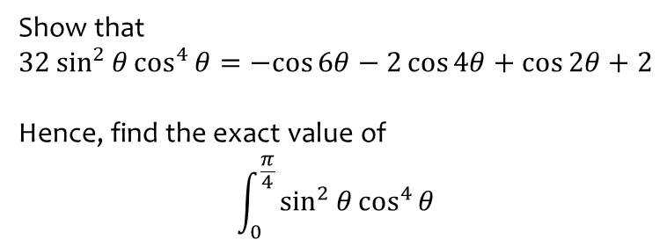
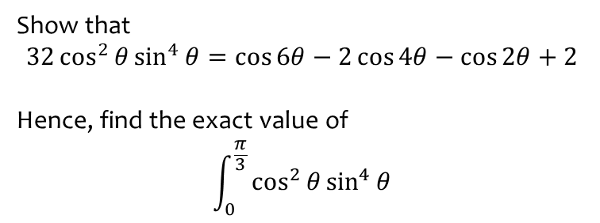
Worked example
Your turn
Show that
$$32\cos^{2}{θ}\sin^{4}{θ}=\cos{6θ}−2\cos{4θ}−\cos{2θ}+2$$
Hence, find the exact value of
$$\int_{0}^{\frac{π}{3}}{\cos^{2}{θ}\sin^{4}{θ}}$$
Show that
$32\sin^{2}{θ}\cos^{4}{θ}=−cos{6θ}−2\cos{4θ}+\cos{2θ}+2$
Hence, find the exact value of
$$\int_{0}^{\frac{π}{4}}{\sin^{2}{θ}\cos^{4}{θ}}$$
$$\frac{π}{64}+\frac{1}{48}$$

Slide 9
Worked example
Your turn
Use de Moivre’s theorem to show that
$$\cos{5θ}=16\cos^{5}{θ}−20\cos^{3}{θ}+5\cos{θ}$$
Hence find the distinct solutions of the equation $16x^{5}−20x^{3}+5x−\frac{1}{2}=0$, giving your answers to 3 decimal places where necessary.
Use de Moivre’s theorem to show that
$$\cos{6θ}=32\cos^{6}{θ}−48\cos^{4}{θ}+18\cos^{2}{θ}−1$$
Hence find the six distinct solutions of the equation $32x^{6}−48x^{4}+18x^{2}−\frac{3}{2}=0$, giving your answers to 3 decimal places where necessary.
$$x=±0.342, ±0.643, ±0.985$$

Slide 10
Worked example
Your turn
Use de Moivre’s theorem to show that
$$\cos{5θ}=\cos{θ}(16\cos^{4}{θ}−20\cos^{2}{θ}+5)$$
Hence solve for $0≤θ<π$
$$\cos{5θ}−\cos{θ}\cos{2θ}=0$$
Use de Moivre’s theorem to show that
$$\sin{5θ}=\sin{θ}(16\cos^{4}{θ}−12\cos^{2}{θ}+1)$$
Hence solve for $0≤θ<π$
$$\sin{5θ}+\cos{θ}\sin{2θ}=0$$
$$θ=0,\frac{π}{4},\frac{3π}{4}, 1.209\text{ (3 }\text{dp}\text{) }\text{and} 1.932\text{ (3 }\text{dp}\text{)}$$

