Slide 1
1.3) de Moivre’s theorem

Slide 2

Worked example
Your turn
Use de Moivre’s theorem to express in the form $x+iy$, where $x,y∈ℝ$
$${\left(\cos{θ}+i\sin{θ}\right)}^{5}$$
$${\left(\cos{2θ}+i\sin{2θ}\right)}^{3}$$
Use de Moivre’s theorem to express in the form $x+iy$, where $x,y∈ℝ$
$${\left(\cos{θ}+i\sin{θ}\right)}^{7}$$
$${\left(\cos{3θ}+i\sin{3θ}\right)}^{5}$$
$$\cos{7θ}+i\sin{7θ}$$
$$\cos{15θ}+i\sin{15θ}$$

Slide 3
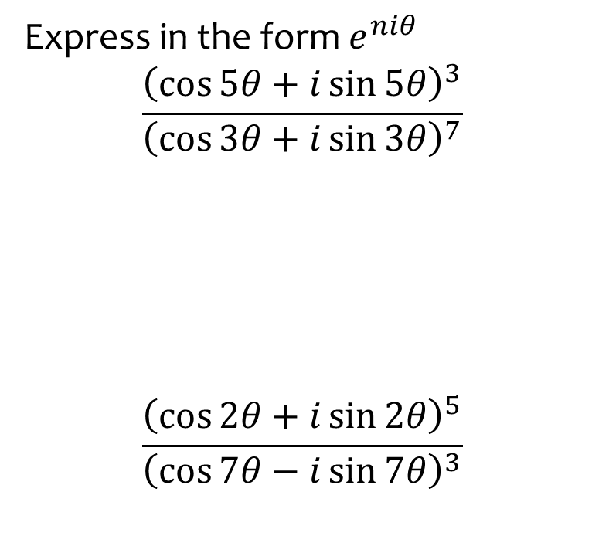
Worked example
Your turn
Express in the form $e^{niθ}$
$$\frac{{\left(\cos{5θ}+i\sin{5θ}\right)}^{3}}{{\left(\cos{3θ}+i\sin{3θ}\right)}^{7}}$$
$$\frac{{\left(\cos{2θ}+i\sin{2θ}\right)}^{5}}{{\left(\cos{7θ}−i\sin{7θ}\right)}^{3}}$$
Express in the form $e^{niθ}$
$$\frac{{\left(\cos{3θ}+i\sin{3θ}\right)}^{7}}{{\left(\cos{5θ}+i\sin{5θ}\right)}^{4}}$$
$$e^{iθ}$$

Slide 4
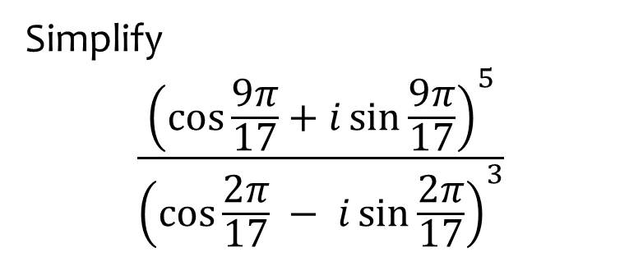
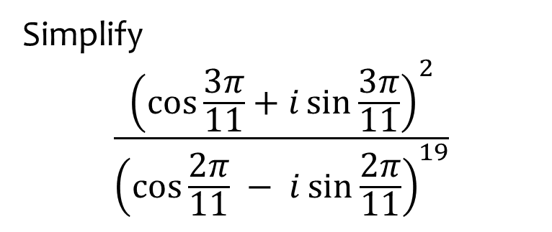
Worked example
Your turn
Simplify
$$\frac{{\left(\cos{\frac{3π}{11}}+i\sin{\frac{3π}{11}}\right)}^{2}}{{\left(\cos{\frac{2π}{11}} − i\sin{\frac{2π}{11}}\right)}^{19}}$$
Simplify
$$\frac{{\left(\cos{\frac{9π}{17}}+i\sin{\frac{9π}{17}}\right)}^{5}}{{\left(\cos{\frac{2π}{17}} − i\sin{\frac{2π}{17}}\right)}^{3}}$$
$$−1$$

Slide 5
Worked example
Your turn
Express in the form $x+iy$ where $x,y∈ℝ$
$${\left(1−\sqrt{3}i\right)}^{6}$$
Express in the form $x+iy$ where $x,y∈ℝ$
$${\left(1+\sqrt{3} i\right)}^{7}$$
$$64+64\sqrt{3} i$$

Slide 6
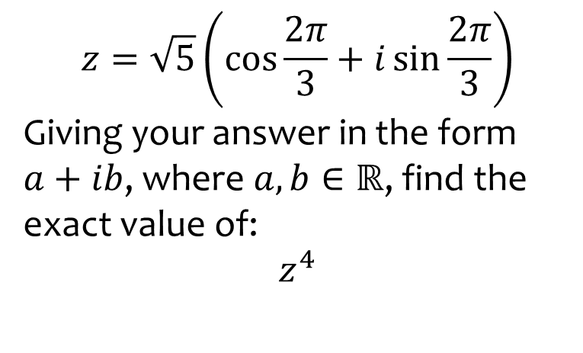
Worked example
Your turn
$$w=\sqrt{2}\left(\cos{\frac{π}{3}}+i\sin{\frac{π}{3}}\right)$$
Giving your answer in the form $a+ib$, where $a, b∈ℝ$, find the exact value of:
$$w^{6}$$
$$z=\sqrt{5}\left(\cos{\frac{2π}{3}}+i\sin{\frac{2π}{3}}\right)$$
Giving your answer in the form $a+ib$, where $a, b∈ℝ$, find the exact value of:
$$z^{4}$$
$$−\frac{25}{2}+\frac{25\sqrt{3}}{2}i$$

Slide 7

Worked example
Your turn
$$w=−2−2\sqrt{3}i$$
Using de Moivre’s Theorem, find
$$w^{5}$$
$$w^{4}$$
$$z=−8+8\sqrt{3}i$$
Using de Moivre’s Theorem, find
$$z^{3}$$
$$4096$$

Slide 8
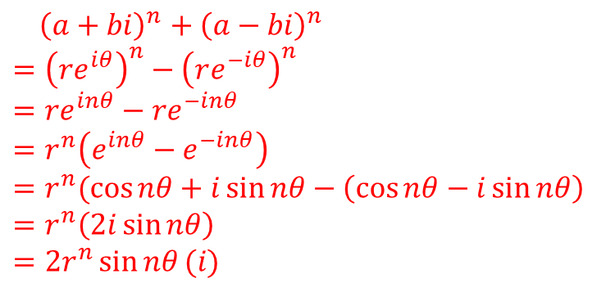
Worked example
Your turn
Use de Moivre’s theorem to show that ${\left(a+bi\right)}^{n}−{\left(a−bi\right)}^{n}$ is imaginary for all integers $n$
Use de Moivre’s theorem to show that ${\left(a+bi\right)}^{n}+{\left(a−bi\right)}^{n}$ is real for all integers $n$
${\left(a+bi\right)}^{n}+{\left(a−bi\right)}^{n}$
$={\left(re^{iθ}\right)}^{n}−{\left(re^{−iθ}\right)}^{n}$
$$=re^{inθ}−re^{−inθ}$$
$$=r^{n}\left(e^{inθ}−e^{−inθ}\right)=r^{n}(\cos{nθ}+i\sin{nθ}−\left(\cos{nθ}−i\sin{nθ}\right)$$
$$=r^{n}\left(2i\sin{nθ}\right)$$
$$=2r^{n}\sin{nθ}(i)$$

Slide 9

Worked example
Your turn
Using Euler’s relation, prove that if $n$ is a positive integer,
$${\left(r\left(\cos{θ}+i\sin{θ}\right)\right)}^{n}=r^{n}(\cos{nθ}+i\sin{nθ})$$
Using Euler’s relation, prove that if $n$ is a positive integer,
$${\left(r\left(\cos{θ}+i\sin{θ}\right)\right)}^{−n}=r^{−n}(\cos{(−nθ)}+i\sin{(−nθ)})$$
${\left(r\left(\cos{θ}+i\sin{θ}\right)\right)}^{−n}$
$$={{(re}^{iθ})}^{−n}$$
$$={r^{−n}e}^{−inθ}$$
$$=r^{−n}\left(\cos\left(−nθ\right)+i\sin\left(−nθ\right)\right)$$

Slide 10
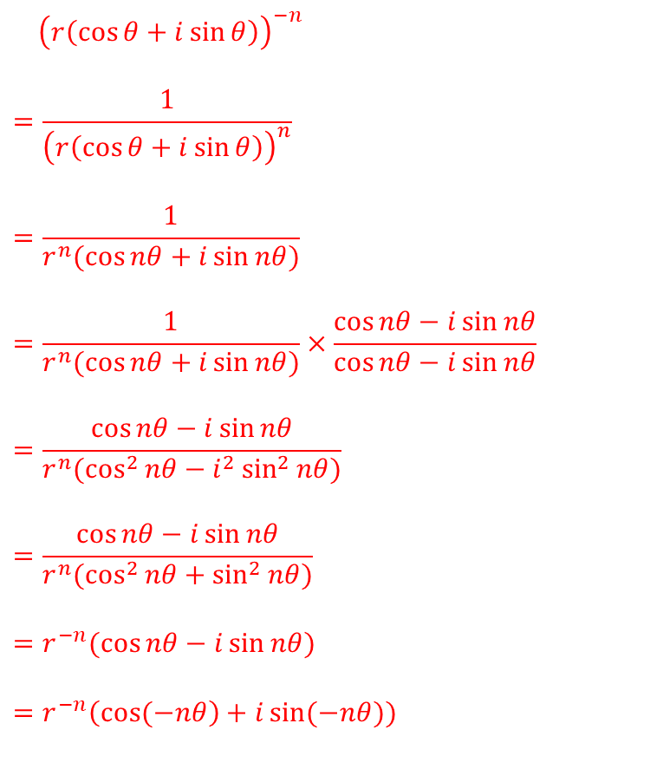
Worked example
Your turn
Without using Euler’s relation, prove that if $n$ is a positive integer,
$${\left(r\left(\cos{θ}+i\sin{θ}\right)\right)}^{n}=r^{n}(\cos{nθ}+i\sin{nθ})$$
Without using Euler’s relation, prove that if $n$ is a positive integer,
$${\left(r\left(\cos{θ}+i\sin{θ}\right)\right)}^{−n}=r^{−n}(\cos{(−nθ)}+i\sin{(−nθ)})$$
${\left(r\left(\cos{θ}+i\sin{θ}\right)\right)}^{−n}$
$$=\frac{1}{{\left(r\left(\cos{θ}+i\sin{θ}\right)\right)}^{n}}$$
$$=\frac{1}{r^{n}(\cos{nθ}+i\sin{nθ})}$$
$$=\frac{1}{r^{n}(\cos{nθ}+i\sin{nθ})}×\frac{\cos{nθ}−i\sin{nθ}}{\cos{nθ}−i\sin{nθ}}$$
$$=\frac{\cos{nθ}−i\sin{nθ}}{r^{n}(\cos^{2}{nθ}−i^{2}\sin^{2}{nθ})}$$
$$=\frac{\cos{nθ}−i\sin{nθ}}{r^{n}(\cos^{2}{nθ}+\sin^{2}{nθ})}$$
$$=r^{−n}(\cos{nθ}−i\sin{nθ})$$
$$=r^{−n}\left(\cos{(−nθ}\right)+i\sin{(−nθ}))$$

