Slide 1
Teachings for
Exercise 1B

Slide 2

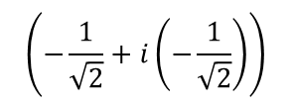

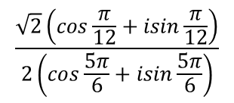


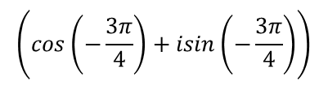

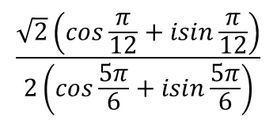
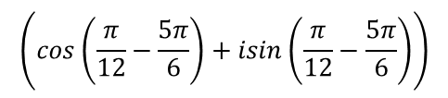

Complex Numbers
$$z_{1}z_{2}=r_{1}r_{2}\left(cos\left(θ_{1}+θ_{2}\right)+isin\left(θ_{1}+θ_{2}\right)\right)$$
$$\frac{z_{1}}{z_{2}} =\frac{r_{1}}{r_{2}}\left(cos\left(θ_{1}−θ_{2}\right)+isin\left(θ_{1}−θ_{2}\right)\right)$$
Reminder of rules from last year…
Express the following calculation in the form x + iy:
$$\frac{\sqrt{2}\left(cos\frac{π}{12}+isin\frac{π}{12}\right)}{2\left(cos\frac{5π}{6}+isin\frac{5π}{6}\right)}$$
Combine using one of the rules above
Divide the moduli
Subtract the arguments
$$\left(cos\left(\frac{π}{12}−\frac{5π}{6}\right)+isin\left(\frac{π}{12}−\frac{5π}{6}\right)\right)$$
$$\frac{\sqrt{2}}{2}$$
$$\frac{\sqrt{2}\left(cos\frac{π}{12}+isin\frac{π}{12}\right)}{2\left(cos\frac{5π}{6}+isin\frac{5π}{6}\right)}$$
Simplify
$$\left(cos\left(−\frac{3π}{4}\right)+isin\left(−\frac{3π}{4}\right)\right)$$
$$\frac{\sqrt{2}}{2}$$
You can work out the sin and cos parts
$$\left(−\frac{1}{\sqrt{2}}+i\left(−\frac{1}{\sqrt{2}}\right)\right)$$
$$\frac{\sqrt{2}}{2}$$
Multiply out
$$=−\frac{1}{2}−\frac{1}{2}i$$
1B

Slide 3



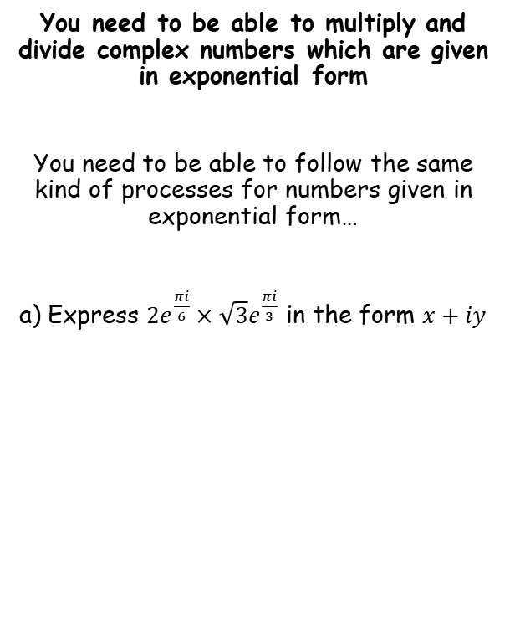





Complex Numbers
$$z_{1}z_{2}=r_{1}r_{2}\left(cos\left(θ_{1}+θ_{2}\right)+isin\left(θ_{1}+θ_{2}\right)\right)$$
$$\frac{z_{1}}{z_{2}} =\frac{r_{1}}{r_{2}}\left(cos\left(θ_{1}−θ_{2}\right)+isin\left(θ_{1}−θ_{2}\right)\right)$$
$$z_{1}z_{2}=r_{1}r_{2}e^{i(θ_{1}+θ_{2})}$$
$$\frac{z_{1}}{z_{2}} =\frac{r_{1}}{r_{2}}e^{i{(θ}_{1}−θ_{2})}$$
You need to be able to multiply and divide complex numbers which are given in exponential form
You need to be able to follow the same kind of processes for numbers given in exponential form…
a) Express $2e^{\frac{πi}{6}}×\sqrt{3}e^{\frac{πi}{3}}$ in the form $x+iy$
$$2e^{\frac{πi}{6}}×\sqrt{3}e^{\frac{πi}{3}}$$
Apply one of the rules above
$$=\left(2×\sqrt{3}\right)e^{\frac{πi}{6}+\frac{πi}{3}}$$
Simplify
$$=2\sqrt{3}e^{\frac{πi}{2}}$$
Write in modulus-argument form
$$=2\sqrt{3}\left(cos\frac{π}{2}+isin\frac{π}{2}\right)$$
Calculate the cos and sine parts
$$=2\sqrt{3}\left(0+i\right)$$
Simplify
$$=2i\sqrt{3}$$
1B

Slide 4


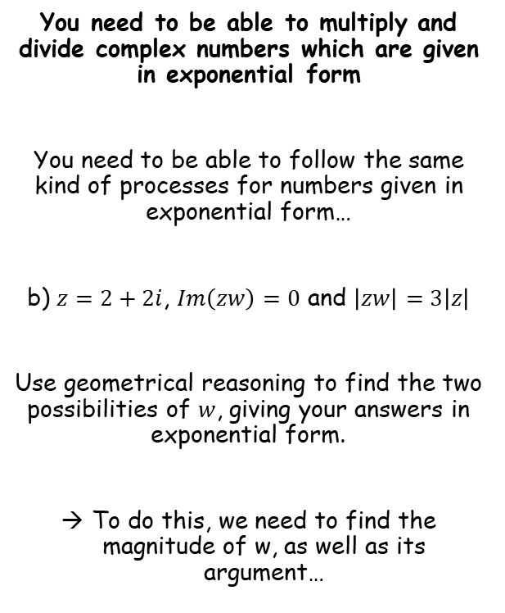



Complex Numbers
$$z_{1}z_{2}=r_{1}r_{2}\left(cos\left(θ_{1}+θ_{2}\right)+isin\left(θ_{1}+θ_{2}\right)\right)$$
$$\frac{z_{1}}{z_{2}} =\frac{r_{1}}{r_{2}}\left(cos\left(θ_{1}−θ_{2}\right)+isin\left(θ_{1}−θ_{2}\right)\right)$$
$$z_{1}z_{2}=r_{1}r_{2}e^{i(θ_{1}+θ_{2})}$$
$$\frac{z_{1}}{z_{2}} =\frac{r_{1}}{r_{2}}e^{i{(θ}_{1}−θ_{2})}$$
You need to be able to multiply and divide complex numbers which are given in exponential form
You need to be able to follow the same kind of processes for numbers given in exponential form…
b) $z=2+2i$, $Im\left(zw\right)=0$ and $\left|zw\right|=3\left|z\right|$
Use geometrical reasoning to find the two possibilities of $w$, giving your answers in exponential form.
To do this, we need to find the magnitude of w, as well as its argument…
$$\left|zw\right|=3\left|z\right|$$
The left hand side can be written as two separate moduli…
$$\left|z\right|\left|w\right|=3\left|z\right|$$
Divide both sides by $\left|z\right|$
$$\left|w\right|=3$$
$$\left|w\right|=3$$
1B

Slide 5


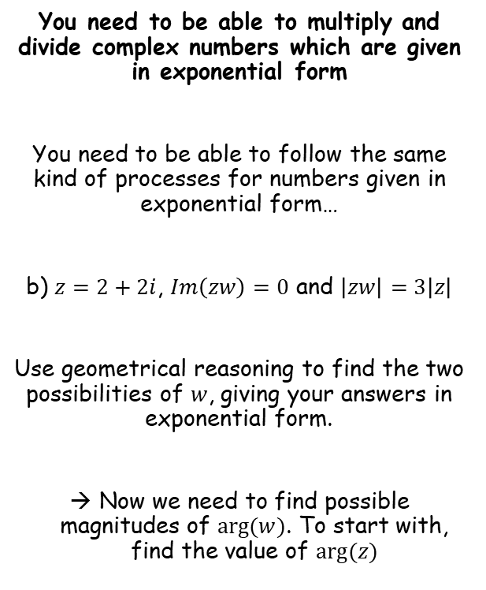

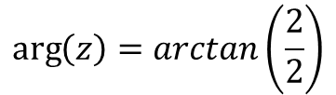

Complex Numbers
$$z_{1}z_{2}=r_{1}r_{2}\left(cos\left(θ_{1}+θ_{2}\right)+isin\left(θ_{1}+θ_{2}\right)\right)$$
$$\frac{z_{1}}{z_{2}} =\frac{r_{1}}{r_{2}}\left(cos\left(θ_{1}−θ_{2}\right)+isin\left(θ_{1}−θ_{2}\right)\right)$$
$$z_{1}z_{2}=r_{1}r_{2}e^{i(θ_{1}+θ_{2})}$$
$$\frac{z_{1}}{z_{2}} =\frac{r_{1}}{r_{2}}e^{i{(θ}_{1}−θ_{2})}$$
Im
You need to be able to multiply and divide complex numbers which are given in exponential form
You need to be able to follow the same kind of processes for numbers given in exponential form…
b) $z=2+2i$, $Im\left(zw\right)=0$ and $\left|zw\right|=3\left|z\right|$
Use geometrical reasoning to find the two possibilities of $w$, giving your answers in exponential form.
Now we need to find possible magnitudes of $arg⁡(w)$. To start with, find the value of $arg⁡(z)$
$$z$$
$$2$$
$$θ$$
Re
$$2$$
$$\left|w\right|=3$$
$$arg⁡(z)=\frac{π}{4}$$
$$\arg\left(z\right)=arctan\left(\frac{2}{2}\right)$$
Calculate
$$arg⁡(z)=\frac{π}{4}$$
1B

Slide 6
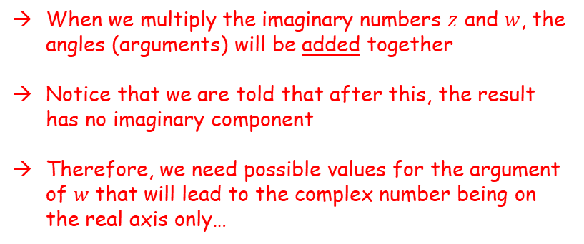

Complex Numbers
$$z_{1}z_{2}=r_{1}r_{2}\left(cos\left(θ_{1}+θ_{2}\right)+isin\left(θ_{1}+θ_{2}\right)\right)$$
$$\frac{z_{1}}{z_{2}} =\frac{r_{1}}{r_{2}}\left(cos\left(θ_{1}−θ_{2}\right)+isin\left(θ_{1}−θ_{2}\right)\right)$$
$$z_{1}z_{2}=r_{1}r_{2}e^{i(θ_{1}+θ_{2})}$$
$$\frac{z_{1}}{z_{2}} =\frac{r_{1}}{r_{2}}e^{i{(θ}_{1}−θ_{2})}$$
Im
You need to be able to multiply and divide complex numbers which are given in exponential form
You need to be able to follow the same kind of processes for numbers given in exponential form…
b) $z=2+2i$, $Im\left(zw\right)=0$ and $\left|zw\right|=3\left|z\right|$
Use geometrical reasoning to find the two possibilities of $w$, giving your answers in exponential form.
Now we need to find possible magnitudes of $arg⁡(w)$. To start with, find the value of $arg⁡(z)$
$$z$$
$$\frac{π}{4}$$
Re
When we multiply the imaginary numbers $z$ and $w$, the angles (arguments) will be added together
Notice that we are told that after this, the result has no imaginary component
Therefore, we need possible values for the argument of $w$ that will lead to the complex number being on the real axis only…
$$\left|w\right|=3$$
$$arg⁡(z)=\frac{π}{4}$$
1B

Slide 7


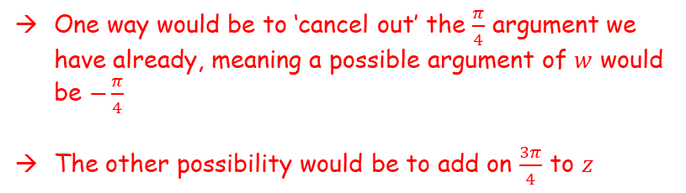

Complex Numbers
$$z_{1}z_{2}=r_{1}r_{2}\left(cos\left(θ_{1}+θ_{2}\right)+isin\left(θ_{1}+θ_{2}\right)\right)$$
$$\frac{z_{1}}{z_{2}} =\frac{r_{1}}{r_{2}}\left(cos\left(θ_{1}−θ_{2}\right)+isin\left(θ_{1}−θ_{2}\right)\right)$$
$$z_{1}z_{2}=r_{1}r_{2}e^{i(θ_{1}+θ_{2})}$$
$$\frac{z_{1}}{z_{2}} =\frac{r_{1}}{r_{2}}e^{i{(θ}_{1}−θ_{2})}$$
Im
You need to be able to multiply and divide complex numbers which are given in exponential form
You need to be able to follow the same kind of processes for numbers given in exponential form…
b) $z=2+2i$, $Im\left(zw\right)=0$ and $\left|zw\right|=3\left|z\right|$
Use geometrical reasoning to find the two possibilities of $w$, giving your answers in exponential form.
Now we need to find possible magnitudes of $arg⁡(w)$. To start with, find the value of $arg⁡(z)$
$$z$$
$$\frac{3π}{4}$$
$$\frac{π}{4}$$
Re
$$−\frac{π}{4}$$
One way would be to ‘cancel out’ the $\frac{π}{4}$ argument we have already, meaning a possible argument of $w$ would be $−\frac{π}{4}$
The other possibility would be to add on $\frac{3π}{4}$ to $z$
$$\left|w\right|=3$$
$$arg⁡(z)=\frac{π}{4}$$
$\arg\left(w\right)=−\frac{π}{4}$ or $\frac{3π}{4}$
1B

Slide 8

Complex Numbers
$$z_{1}z_{2}=r_{1}r_{2}\left(cos\left(θ_{1}+θ_{2}\right)+isin\left(θ_{1}+θ_{2}\right)\right)$$
$$\frac{z_{1}}{z_{2}} =\frac{r_{1}}{r_{2}}\left(cos\left(θ_{1}−θ_{2}\right)+isin\left(θ_{1}−θ_{2}\right)\right)$$
$$z_{1}z_{2}=r_{1}r_{2}e^{i(θ_{1}+θ_{2})}$$
$$\frac{z_{1}}{z_{2}} =\frac{r_{1}}{r_{2}}e^{i{(θ}_{1}−θ_{2})}$$
Im
You need to be able to multiply and divide complex numbers which are given in exponential form
You need to be able to follow the same kind of processes for numbers given in exponential form…
b) $z=2+2i$, $Im\left(zw\right)=0$ and $\left|zw\right|=3\left|z\right|$
Use geometrical reasoning to find the two possibilities of $w$, giving your answers in exponential form.
Now we need to find possible magnitudes of $arg⁡(w)$. To start with, find the value of $arg⁡(z)$
$$z$$
$$\frac{π}{4}$$
Re
$$\left|w\right|=3$$
$$arg⁡(z)=\frac{π}{4}$$
$w_{1}=3e^{−\frac{πi}{4}}$ and $w_{2}=3e^{\frac{3πi}{4}}$
$\arg\left(w\right)=−\frac{π}{4}$ or $\frac{3π}{4}$
1B

