Slide 1
1.2) Multiplying and dividing complex numbers

Slide 2
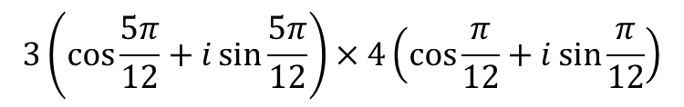


Worked example
Your turn
$$2\left(\cos{\frac{π}{6}}+i\sin{\frac{π}{6}}\right)×5\left(\cos{\frac{π}{3}}+i\sin{\frac{π}{3}}\right)$$
$$3\left(\cos{\frac{5π}{12}}+i\sin{\frac{5π}{12}}\right)×4\left(\cos{\frac{π}{12}}+i\sin{\frac{π}{12}}\right)$$
$$12i$$

Slide 3
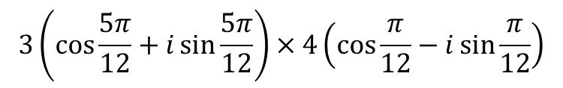


Worked example
Your turn
$$2\left(\cos{\frac{π}{6}}+i\sin{\frac{π}{6}}\right)×5\left(\cos{\frac{π}{3}}−i\sin{\frac{π}{3}}\right)$$
$$3\left(\cos{\frac{5π}{12}}+i\sin{\frac{5π}{12}}\right)×4\left(\cos{\frac{π}{12}}−i\sin{\frac{π}{12}}\right)$$
$$6+6i\sqrt{3}$$

Slide 4
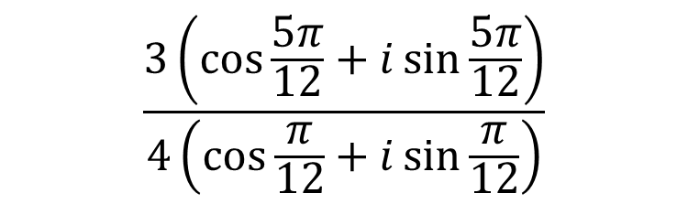
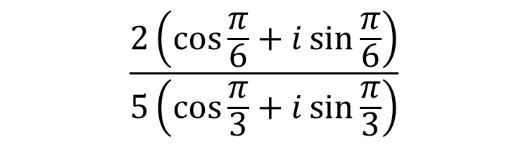

Worked example
Your turn
$$\frac{2\left(\cos{\frac{π}{6}}+i\sin{\frac{π}{6}}\right)}{5\left(\cos{\frac{π}{3}}+i\sin{\frac{π}{3}}\right)}$$
$$\frac{3\left(\cos{\frac{5π}{12}}+i\sin{\frac{5π}{12}}\right)}{4\left(\cos{\frac{π}{12}}+i\sin{\frac{π}{12}}\right)}$$
$$\frac{3}{8}+\frac{3\sqrt{3}}{8}i$$

Slide 5



Worked example
Your turn
Express in the form $x+iy$
$$3e^{\frac{πi}{12}}×\sqrt{2}e^{\frac{πi}{4}}$$
$$5e^{\frac{πi}{4}}×\sqrt{7}e^{\frac{πi}{2}}$$
Express in the form $x+iy$
$$2e^{\frac{πi}{6}}×\sqrt{3}e^{\frac{πi}{3}}$$
$$2i\sqrt{3}$$

Slide 6
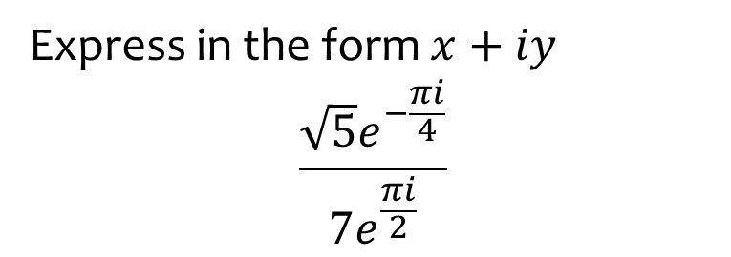


Worked example
Your turn
Express in the form $x+iy$
$$\frac{3e^{\frac{πi}{4}}}{6e^{\frac{πi}{12}}}$$
$$\frac{5e^{\frac{πi}{4}}}{\sqrt{7}e^{−\frac{πi}{2}}}$$
Express in the form $x+iy$
$$\frac{\sqrt{5}e^{−\frac{πi}{4}}}{7e^{\frac{πi}{2}}}$$
$$−\frac{\sqrt{10}}{14}−\frac{\sqrt{10}}{14}i$$

Slide 7

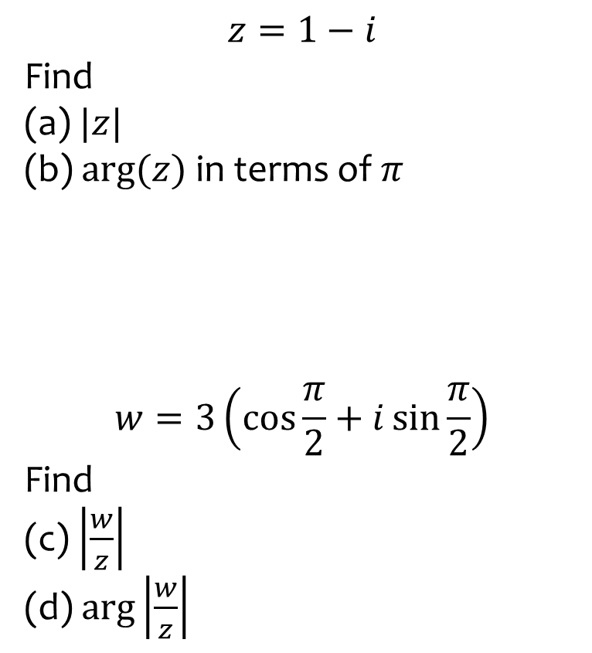

Worked example
Your turn
$$z=1−i$$
Find
$|z|$
$arg⁡(z)$ in terms of $π$
$$w=3\left(\cos{\frac{π}{2}}+i\sin{\frac{π}{2}}\right)$$
Find
(c) $\left|\frac{w}{z}\right|$
(d) $\arg\left|\frac{w}{z}\right|$
$$z=5\sqrt{3}−5i$$
Find
$|z|$
(b) $arg⁡(z)$ in terms of $π$
$$w=2\left(\cos{\frac{π}{4}}+i\sin{\frac{π}{4}}\right)$$
Find
(c) $\left|\frac{w}{z}\right|$
(d) $\arg\left|\frac{w}{z}\right|$
$$10$$
$$−\frac{π}{6}$$
$$\frac{1}{5}$$
$$\frac{5π}{12}$$

Slide 8
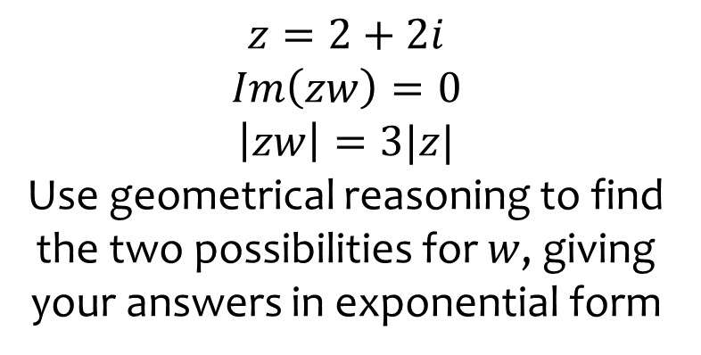
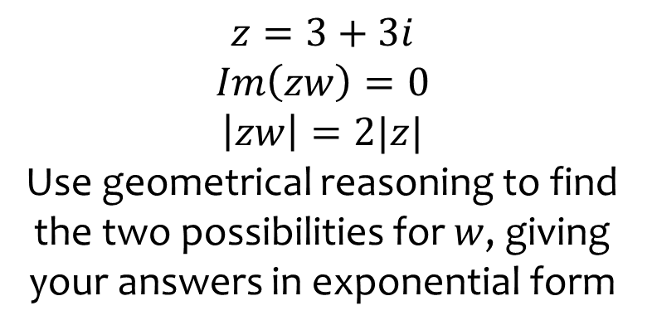

Worked example
Your turn
$$z=3+3i$$
$$Im\left(zw\right)=0$$
$$\left|zw\right|=2|z|$$
Use geometrical reasoning to find the two possibilities for $w$, giving your answers in exponential form
$$z=2+2i$$
$$Im\left(zw\right)=0$$
$$\left|zw\right|=3|z|$$
Use geometrical reasoning to find the two possibilities for $w$, giving your answers in exponential form
w₁ $=3e^{−\frac{πi}{4}}$, w₂ $=3e^{\frac{3πi}{4}}$

