Slide 1
1.1) Exponential form of complex numbers

Slide 2



Worked example
Your turn
Express in the form $re^{iθ}$, where $−π<θ≤π$:
$$3−2i$$
$$1$$
$$−i$$
Express in the form $re^{iθ}$, where $−π<θ≤π$:
$$2−3i$$
$$−1$$
$$i$$
$$\sqrt{13}e^{−0.983i}$$
$$e^{iπ}$$
$$e^{\frac{iπ}{2}}$$

Slide 3

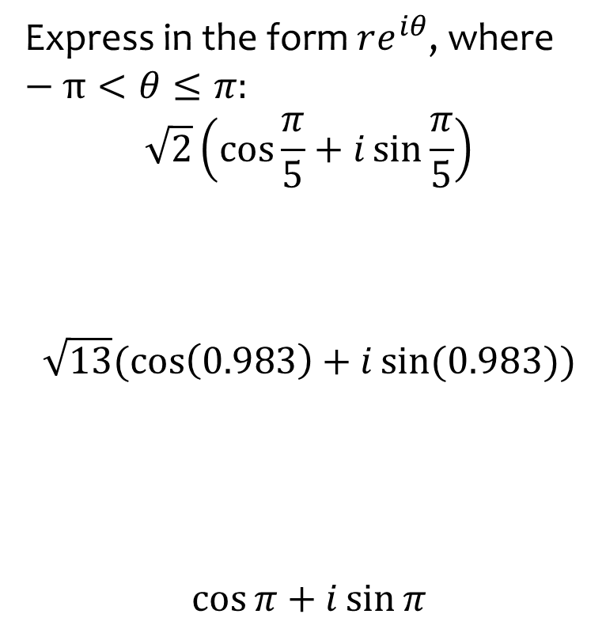

Worked example
Your turn
Express in the form $re^{iθ}$, where $−π<θ≤π:$
$$\sqrt{2}\left(\cos{\frac{π}{5}}+i\sin{\frac{π}{5}}\right)$$
$$\sqrt{13}(\cos\left(0.983\right)+i\sin{(0.983))}$$
$$\cos{π}+i\sin{π}$$
Express in the form $re^{iθ}$, where $−π<θ≤π:$
$$\sqrt{3}\left(\cos{\frac{π}{8}}+i\sin{\frac{π}{8}}\right)$$
$$\sqrt{13}(\cos\left(−0.983\right)+i\sin{(−0.983))}$$
$$\cos{\frac{π}{2}}+i\sin{\frac{π}{2}}$$
$$\sqrt{3}e^{\frac{πi}{8}}$$
$$\sqrt{13}e^{−0.983i}$$
$$e^{\frac{iπ}{2}}$$

Slide 4
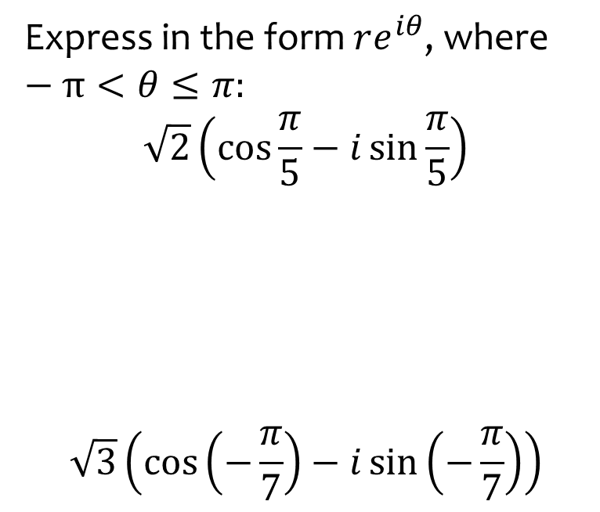
Worked example
Your turn
Express in the form $re^{iθ}$, where $−π<θ≤π:$
$$\sqrt{2}\left(\cos{\frac{π}{5}}−i\sin{\frac{π}{5}}\right)$$
$$\sqrt{3}\left(\cos\left(−\frac{π}{7}\right)−i\sin\left(−\frac{π}{7}\right)\right)$$
Express in the form $re^{iθ}$, where $−π<θ≤π:$
$$\sqrt{5}\left(\cos{\frac{π}{3}}−i\sin{\frac{π}{3}}\right)$$
$$\sqrt{5}e^{\frac{−πi}{3}}$$

Slide 5



Worked example
Your turn
Express in the form $x+iy$, where $x,y∈ℝ:$
$$\sqrt{2}e^{\frac{3πi}{4}}$$
$$e^{−\frac{iπ}{2}}$$
Express in the form $x+iy$, where $x,y∈ℝ:$
$$\sqrt{2}e^{−\frac{3πi}{4}}$$
$$e^{i(0)}$$
$$z=−1−i$$
$$z=1$$

Slide 6
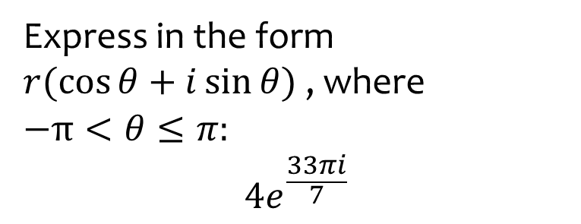

Worked example
Your turn
Express in the form
$r(\cos{θ}+i\sin{θ})$ , where
$$−π<θ≤π:$$
$$2e^{\frac{23πi}{5}}$$
$$3e^{\frac{−25πi}{8}}$$
Express in the form
$r(\cos{θ}+i\sin{θ})$ , where
$$−π<θ≤π:$$
$$4e^{\frac{33πi}{7}}$$
$$4(\cos{\frac{5π}{7}}+i\sin{\frac{5π}{7}})$$

Slide 7
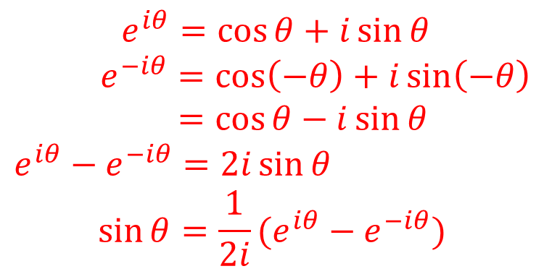
Worked example
Your turn
Use $e^{iθ}=\cos{θ}+i\sin{θ}$ to show that $\cos{θ}={\frac{1}{2}(e}^{iθ}+e^{−iθ})$
Use $e^{iθ}=\cos{θ}+i\sin{θ}$ to show that $\sin{θ}={\frac{1}{2i}(e}^{iθ}−e^{−iθ})$
$e^{iθ}=\cos{θ}+i\sin{θ}$
$e^{−iθ}=\cos\left(−θ\right)+i\sin\left(−θ\right)$
$=\cos{θ}−i\sin{θ}$
$e^{iθ}−e^{−iθ}=2i\sin{θ}$
$$\sin{θ}={\frac{1}{2i}(e}^{iθ}−e^{−iθ})$$

