Slide 1
1) Complex numbers
1.1) Imaginary and complex numbers
1.2) Multiplying complex numbers
1.3) Complex conjugation
1.4) Roots of quadratic equations
1.5) Solving cubic and quartic equations

Slide 2
1.1) Imaginary and complex numbers
Chapter CONTENTS

Slide 3



Worked example
Your turn
Write in terms of $i$:
$$\sqrt{−39}$$
$\sqrt{−40}$
Write in terms of $i$:
$$\sqrt{−49}$$
$\sqrt{−20}$
$$7i$$
$$\left(2\sqrt{5}\right)i$$

Slide 4



Worked example
Your turn
Simplify, giving your answers in the form $a+bi$, where $a,b∈ℝ:$
$$\left(2+5i\right)+\left(3+4i\right)$$
$$\left(2−5i\right)−(4−3i)$$
Simplify, giving your answers in the form $a+bi$, where $a,b∈ℝ:$
$$\left(2+3i\right)+\left(4+5i\right)$$
$$\left(2−3i\right)−(4−5i)$$
$$6+8i$$
$$−2+2i$$

Slide 5
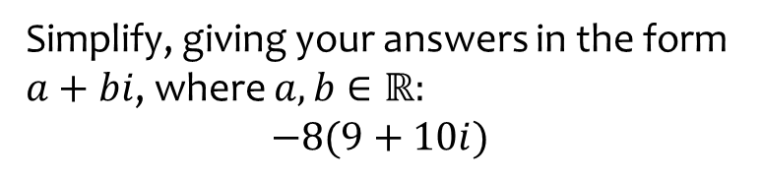

Worked example
Your turn
Simplify, giving your answers in the form $a+bi$, where $a,b∈ℝ:$
$$2\left(3+4i\right)$$
$$−5(6−7i)$$
Simplify, giving your answers in the form $a+bi$, where $a,b∈ℝ:$
$$−8(9+10i)$$
$$−72−80i$$

Slide 6
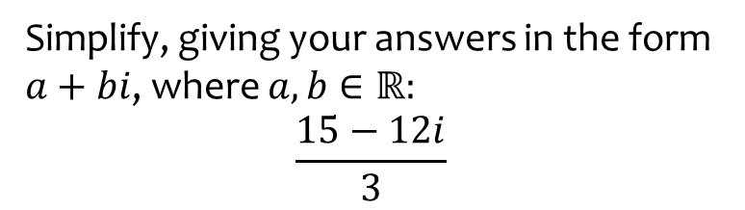

Worked example
Your turn
Simplify, giving your answers in the form $a+bi$, where $a,b∈ℝ:$
$$\frac{6−8i}{2}$$
$$\frac{−7+21i}{7}$$
Simplify, giving your answers in the form $a+bi$, where $a,b∈ℝ:$
$$\frac{15−12i}{3}$$
$$5−4i$$

Slide 7
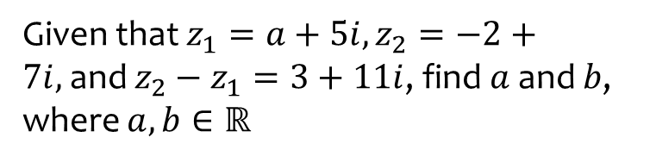
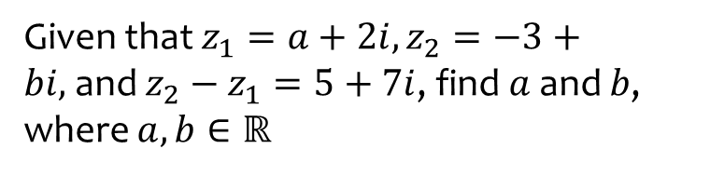
Worked example
Your turn
Given that $z_{1}=a+2i,z_{2}=−3+bi,$and $z_{2}−z_{1}=5+7i$, find $a$and $b$, where $a,b∈ℝ$
Given that $z_{1}=a+5i,z_{2}=−2+7i,$and $z_{2}−z_{1}=3+11i$, find $a$and $b$, where $a,b∈ℝ$
$$a=−5, b=16$$

Slide 8
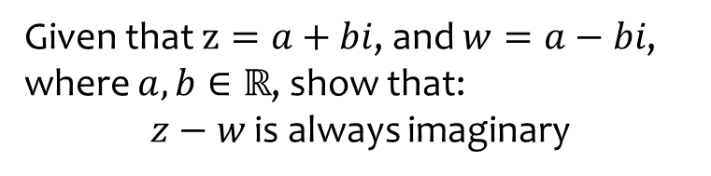
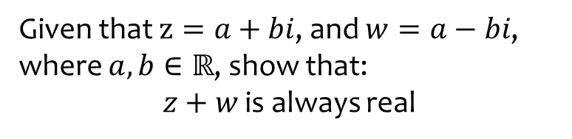
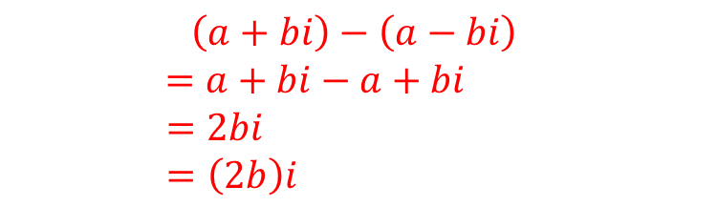
Worked example
Your turn
Given that $z=a+bi$, and $w=a−bi$, where $a,b∈ℝ$, show that:
$z+w$ is always real
Given that $z=a+bi$, and $w=a−bi$, where $a,b∈ℝ$, show that:
$z−w$ is always imaginary
$$\left(a+bi\right)−\left(a−bi\right)$$
$$=a+bi−a+bi$$
$$=2bi$$
$$=\left(2b\right)i$$

Slide 9
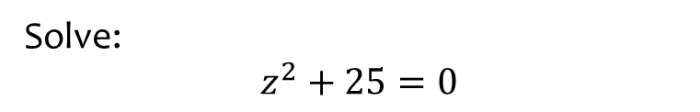


Worked example
Your turn
Solve:
$$z^{2}=−9$$
$$z^{2}+16=0$$
Solve:
$z^{2}+25=0$
$$z=±5i$$

Slide 10
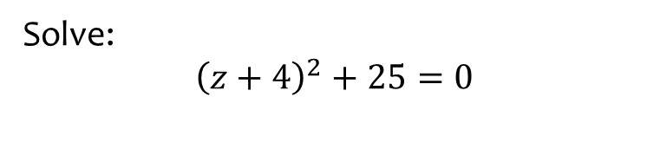

Worked example
Your turn
Solve:
$${\left(z+2\right)}^{2}+9=0$$
$${\left(z−3\right)}^{2}+16=0$$
Solve:
$${\left(z+4\right)}^{2}+25=0$$
$$z=−4±5i$$

Slide 11
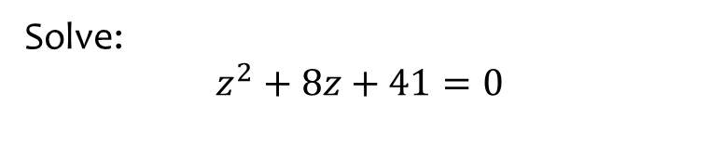

Worked example
Your turn
Solve:
$$z^{2}+4z+13=0$$
$$z^{2}−6z+25=0$$
Solve:
$$z^{2}+8z+41=0$$
$$z=−4±5i$$

Slide 12
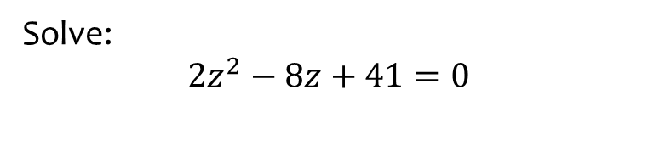


Worked example
Your turn
Solve:
$$z^{2}+3z+13=0$$
$${3z}^{2}−7z+25=0$$
Solve:
$$2z^{2}−8z+41=0$$
$$z=2±\frac{\sqrt{66}}{2}i$$

Slide 13
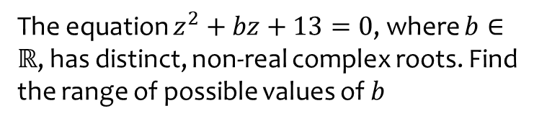
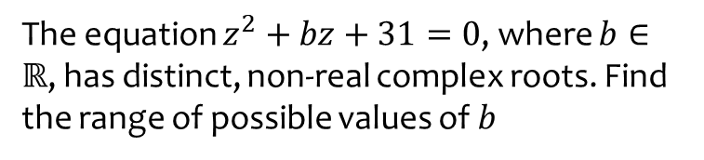
Worked example
Your turn
The equation $z^{2}+bz+31=0$, where $b∈ℝ$, has distinct, non-real complex roots. Find the range of possible values of $b$
The equation $z^{2}+bz+13=0$, where $b∈ℝ$, has distinct, non-real complex roots. Find the range of possible values of $b$
$$−2\sqrt{13}<b<2\sqrt{13}$$

Slide 14
1.2) Multiplying complex numbers
Chapter CONTENTS

Slide 15



Worked example
Your turn
Determine the value of:
$$i^{2}$$
$$i^{3}$$
$$i^{4}$$
$${\left(3i\right)}^{5}$$
Determine the value of:
$$i^{10}$$
$$i^{7}$$
$$i^{40}$$
$${\left(2i\right)}^{5}$$
$$−1$$
$$−i$$
$$1$$
$$32i$$

Slide 16



Worked example
Your turn
Determine the value of:
$$i^{101}$$
$$i^{202}$$
$$i^{3003}$$
Determine the value of:
$$i^{10007}$$
$$−i$$

Slide 17
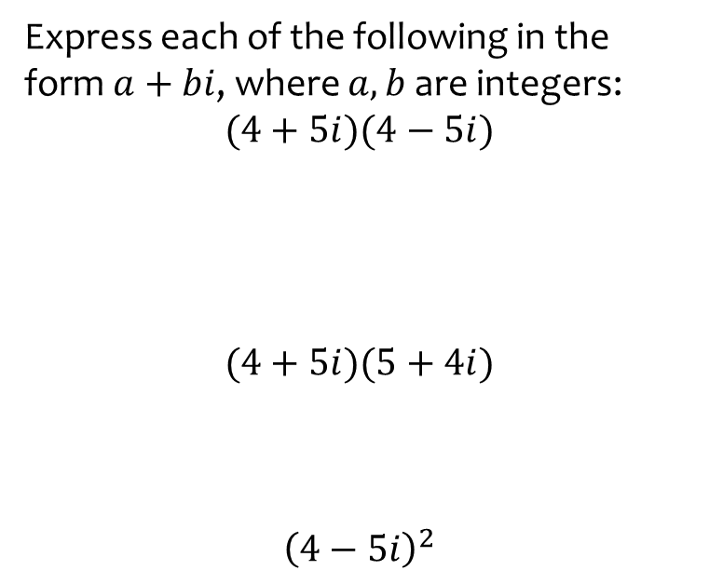
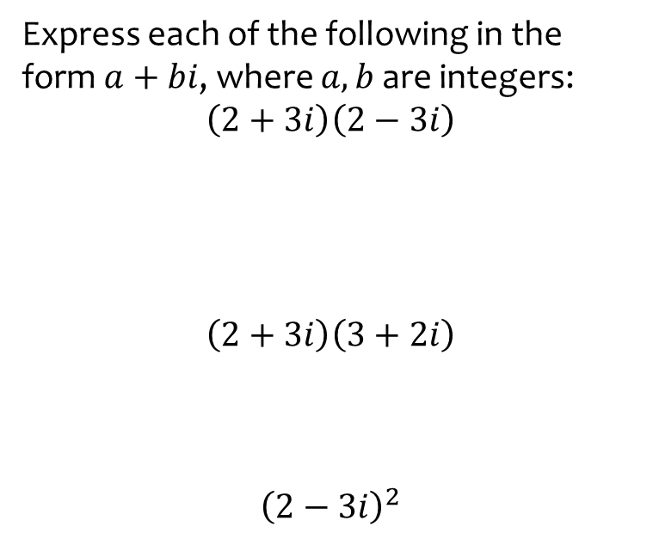

Worked example
Your turn
Express each of the following in the form $a+bi$, where $a,b$ are integers:
$$\left(2+3i\right)\left(2−3i\right)$$
$$\left(2+3i\right)\left(3+2i\right)$$
$${\left(2−3i\right)}^{2}$$
Express each of the following in the form $a+bi$, where $a,b$ are integers:
$$(4+5i)(4−5i)$$
$$(4+5i)(5+4i)$$
$${\left(4−5i\right)}^{2}$$
$$29$$
$$41i$$
$$41−40i$$

Slide 18
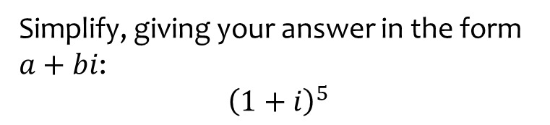

Worked example
Your turn
Simplify, giving your answer in the form $a+bi$:
$${\left(1+i\right)}^{3}$$
$${\left(1+i\right)}^{4}$$
Simplify, giving your answer in the form $a+bi$:
$${\left(1+i\right)}^{5}$$
$$−4−4i$$

Slide 19
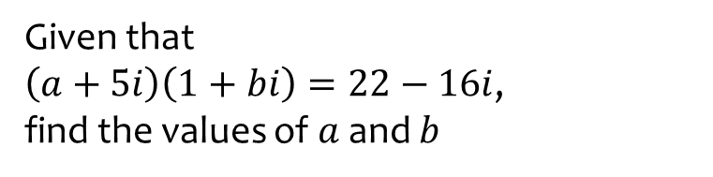
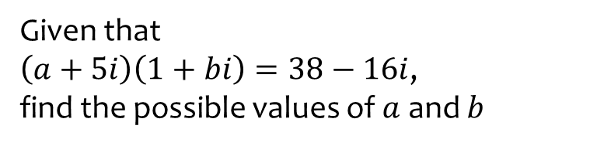

Worked example
Your turn
Given that
$\left(a+5i\right)\left(1+bi\right)=38−16i$,
find the possible values of $a$ and $b$
Given that
$\left(a+5i\right)\left(1+bi\right)=22−16i$,
find the values of $a$ and $b$
$$a=7, b=−3$$
$$a=15 , b=−\frac{7}{5}$$

Slide 20
1.3) Complex conjugation
Chapter CONTENTS

Slide 21


Worked example
Your turn
Write the complex conjugate for:
$$z=2+3i$$
$$z=−2−3i$$
$$z=3i−2$$
Write the complex conjugate for:
$$z=−5−4i$$
$$z^{∗}=−5+4i$$

Slide 22



Worked example
Your turn
Write in the form $a+bi:$
$$\frac{5+4i}{2+3i}$$
$$\frac{2−3i}{4−5i}$$
Write in the form $a+bi:$
$$\frac{5+4i}{2−3i}$$
$$−\frac{2}{13}+\frac{23}{13}i$$

Slide 23
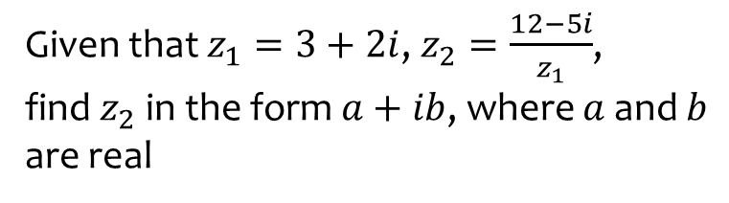
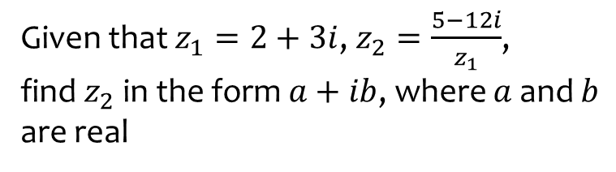

Worked example
Your turn
Given that $z_{1}=2+3i$, $z_{2}=\frac{5−12i}{z_{1}}$, find$z_{2}$ in the form $a+ib$, where $a$ and $b$ are real
Given that $z_{1}=3+2i$, $z_{2}=\frac{12−5i}{z_{1}}$, find$z_{2}$ in the form $a+ib$, where $a$ and $b$ are real
$$2−3i$$

Slide 24
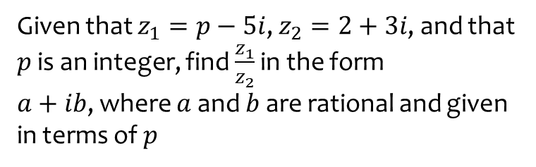
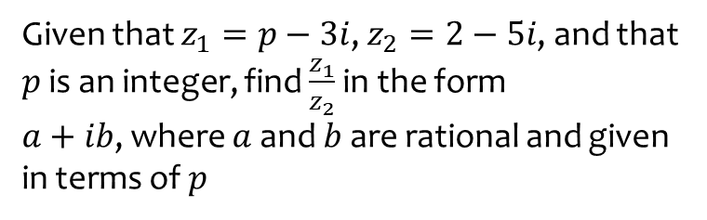

Worked example
Your turn
Given that $z_{1}=p−3i$, $z_{2}=2−5i$, and that $p$ is an integer, find $\frac{z_{1}}{z_{2}}$ in the form
$a+ib$, where $a$ and $b$ are rational and given in terms of $p$
Given that $z_{1}=p−5i$, $z_{2}=2+3i$, and that $p$ is an integer, find $\frac{z_{1}}{z_{2}}$ in the form
$a+ib$, where $a$ and $b$ are rational and given in terms of $p$
$$\frac{2p−15}{13}+\frac{−10−3p}{13}i$$

Slide 25
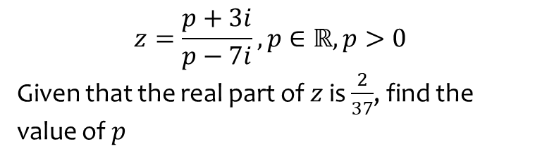
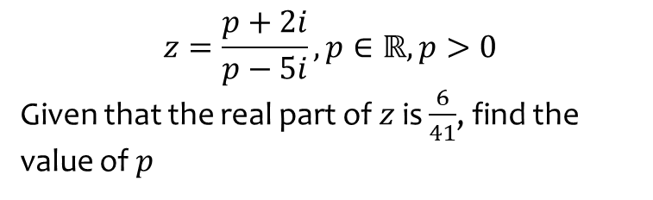
Worked example
Your turn
$$z=\frac{p+2i}{p−5i}, p∈ℝ,p>0$$
Given that the real part of $z$ is $\frac{6}{41}$, find the value of $p$
$$z=\frac{p+3i}{p−7i}, p∈ℝ,p>0$$
Given that the real part of $z$ is $\frac{2}{37}$, find the value of $p$
$$p=5$$

Slide 26
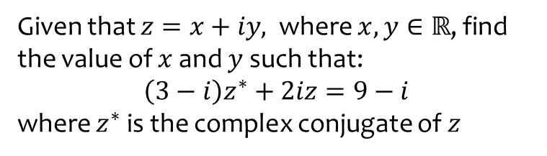
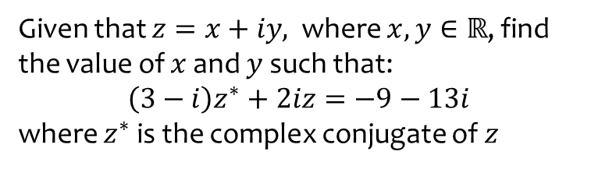
Worked example
Your turn
Given that $z=x+iy,$ where $x,y∈ℝ$, find the value of $x$ and $y$ such that:
$$\left(3−i\right)z^{∗}+2iz=−9−13i$$
where $z^{∗}$ is the complex conjugate of $z$
Given that $z=x+iy,$ where $x,y∈ℝ$, find the value of $x$ and $y$ such that:
$$\left(3−i\right)z^{∗}+2iz=9−i$$
where $z^{∗}$ is the complex conjugate of $z$
$$x=5, y=2$$

Slide 27
1.4) Roots of quadratic equations
Chapter CONTENTS

Slide 28
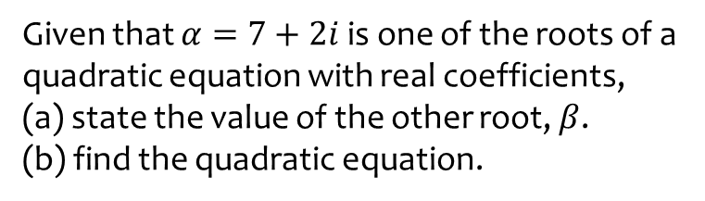
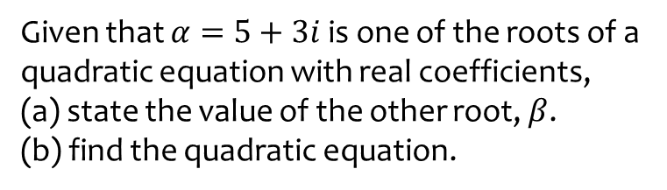
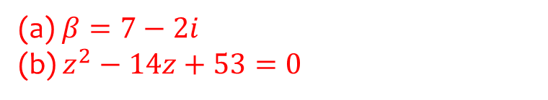
Worked example
Your turn
Given that $α=5+3i$ is one of the roots of a quadratic equation with real coefficients,
(a) state the value of the other root, $β$.
(b) find the quadratic equation.
Given that $α=7+2i$ is one of the roots of a quadratic equation with real coefficients,
(a) state the value of the other root, $β$.
(b) find the quadratic equation.
(a)$β=7−2i$
(b) $z^{2}−14z+53=0$

Slide 29
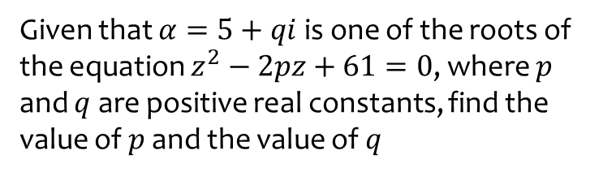

Worked example
Your turn
Given that $α=5+qi$ is one of the roots of the equation $z^{2}−5pz+41=0$, where $p$ and $q$ are positive real constants, find the value of $p$ and the value of $q$
Given that $α=5+qi$ is one of the roots of the equation $z^{2}−2pz+61=0$, where $p$ and $q$ are positive real constants, find the value of $p$ and the value of $q$
$$p=5 , q=6$$

Slide 30
1.5) Solving cubic and quartic equations
Chapter CONTENTS

Slide 31



Worked example
Your turn
Given that $−2$is a root of the cubic equation
$$z^{3}−{2z}^{2}−3z+k=0$$
Find the value of $k$
Find the other two roots
Given that $−1$is a root of the cubic equation
$$z^{3}−z^{2}+3z+k=0$$
Find the value of $k$
Find the other two roots
(a) $k=5$
(b) $1+2i$ and $1−2i$

Slide 32



Worked example
Your turn
Given that $3+i$ is a root of the quartic equation
$2z^{4}−37z^{3}+221z^{2}−380z−250=0$, solve the equation completely.
Given that $3+i$ is a root of the quartic equation
$2z^{4}−3z^{3}−39z^{2}+120z−50=0$, solve the equation completely.
$$z_{1}=−5$$
$$z_{2}=\frac{1}{2}$$
$$z_{3}=3+i$$
$$z_{4}=3−i$$

Slide 33



Worked example
Your turn
Show that $z^{2}+9$ is a factor of
$$z^{4}−8z^{3}+26z^{2}−72z+153$$
Hence solve the equation
$$z^{4}−8z^{3}+26z^{2}−72z+153=0$$
Show that $z^{2}+4$ is a factor of
$$z^{4}−2z^{3}+21z^{2}−8z+68$$
Hence solve the equation
$$z^{4}−2z^{3}+21z^{2}−8z+68=0$$
$$z_{1}=2i$$
$$z_{2}=−2i$$
$$z_{3}=1+4i$$
$$z_{4}=1−4i$$

Slide 34



Worked example
Your turn
Given that $5$ and $4+3i$ are roots of the equation
$$x^{3}−13x^{2}+cx+d=0 c,d∈ℝ$$
Write down the other complex root
Find the value of $c$ and the value of $d$
Given that $2$ and $5+2i$ are roots of the equation
$$x^{3}−12x^{2}+cx+d=0 c,d∈ℝ$$
Write down the other complex root
Find the value of $c$ and the value of $d$
(a) $5−2i$
(b) $c=49, d=−58$

Slide 35



Worked example
Your turn
Solve:
$z^{4}=1$
$$z^{4}=16$$
Solve:
$z^{4}=81$
$$z_{1}=3$$
$$z_{2}=−3$$
$$z_{3}=3i$$
$$z_{4}=1−4i$$

Slide 36



Worked example
Your turn
$$f\left(z\right)=z^{3}+4z^{2}+kz+36, k∈ℝ$$
Given that $f\left(3i\right)=0$, find the value of $k$ and the other two roots of the equation
$$f\left(z\right)=z^{3}+3z^{2}+kz+48, k∈ℝ$$
Given that $f\left(4i\right)=0$, find the value of $k$ and the other two roots of the equation
$$k=16$$
$−4i$ and $−3$

Slide 37



Worked example
Your turn
Find the square root of $3+4i$
Find the square root of $i$
Find the square root of $5+12i$
$$3−2i, −3+2i$$

