Slide 1
Complex Numbers
Twitter: @Owen134866
www.mathsfreeresourcelibrary.com

Slide 2


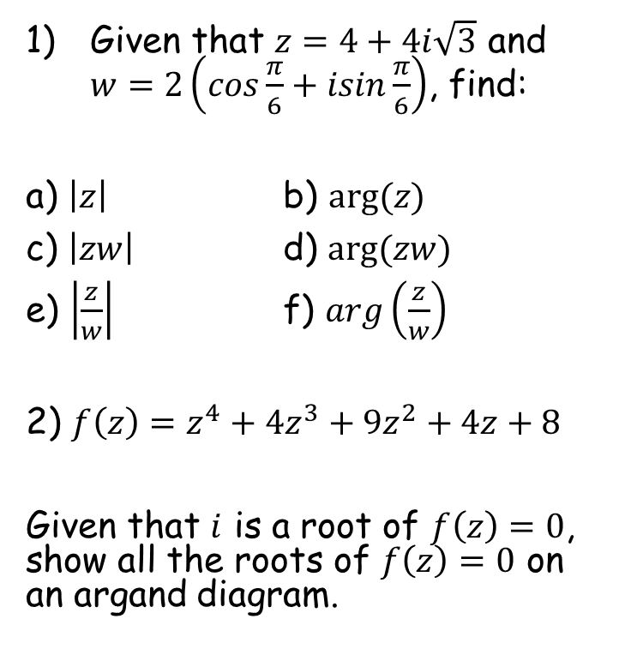



Prior Knowledge Check
Given that $z=4+4i\sqrt{3}$ and $w=2\left(cos\frac{π}{6}+isin\frac{π}{6}\right)$, find:
a) $\left|z\right|$ b) $arg⁡(z)$
c) $\left|zw\right|$ d) $arg⁡(zw)$
e) $\left|\frac{z}{w}\right|$ f) $arg\left(\frac{z}{w}\right)$
2) $f\left(z\right)=z^{4}+4z^{3}+9z^{2}+4z+8$
Given that $i$ is a root of $f\left(z\right)=0$, show all the roots of $f\left(z\right)=0$ on an argand diagram.
3) Use the binomial expansion to find the $n^{4}$ term in the expansion of ${\left(2+n\right)}^{9}$
$$4032n^{4}$$
$$\frac{π}{3}$$
8
$$\frac{π}{2}$$
16
Im
4
$$\frac{π}{6}$$
2
1
-2
-1
1
2
Re
-1
-2

Slide 3
Teachings for
Exercise 1A

Slide 4









Complex Numbers
Im
A reminder of the modulus-argument form…
Express the numbers following numbers in the modulus argument form:
z₁
3
√3
$$z_{1}=1+i\sqrt{3}$$
θ
Re
θ
1
$$z_{2}=−3−3i$$
3
$$z_{1}=2\left(cos\frac{π}{3}+isin\frac{π}{3}\right)$$
z₂
Modulus for z₁
Argument for z₁
$$\sqrt{1^{2}+{\sqrt{3}}^{2}}$$
$$Tan^{−1}\left(\frac{\sqrt{3}}{1}\right)$$
$$=2$$
$$=\frac{π}{3}$$
$$z_{1}=r(cosθ+isinθ)$$
$$z_{1}=2\left(cos\frac{π}{3}+isin\frac{π}{3}\right)$$
1A

Slide 5


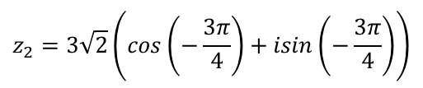


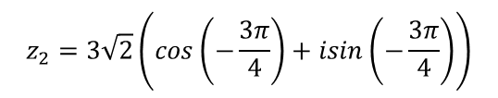



Complex Numbers
Im
A reminder of the modulus-argument form…
Express the numbers following numbers in the modulus argument form:
z₁
3
√3
$$z_{1}=1+i\sqrt{3}$$
θ
Re
θ
1
$$z_{2}=−3−3i$$
3
$$z_{1}=2\left(cos\frac{π}{3}+isin\frac{π}{3}\right)$$
z₂
$$z_{2}=3\sqrt{2}\left(cos\left(−\frac{3π}{4}\right)+isin\left(−\frac{3π}{4}\right)\right)$$
Modulus for z₂
Argument for z₂
$$\sqrt{3^{2}+3^{2}}$$
$$Tan^{−1}\left(\frac{3}{3}\right)$$
Remember the angle you actually want!
$$=\sqrt{18}$$
$$=\frac{π}{4}$$
$$=−\frac{3π}{4}$$
$$=3\sqrt{2}$$
$$z_{2}=r(cosθ+isinθ)$$
$$z_{2}=3\sqrt{2}\left(cos\left(−\frac{3π}{4}\right)+isin\left(−\frac{3π}{4}\right)\right)$$
1A

Slide 6

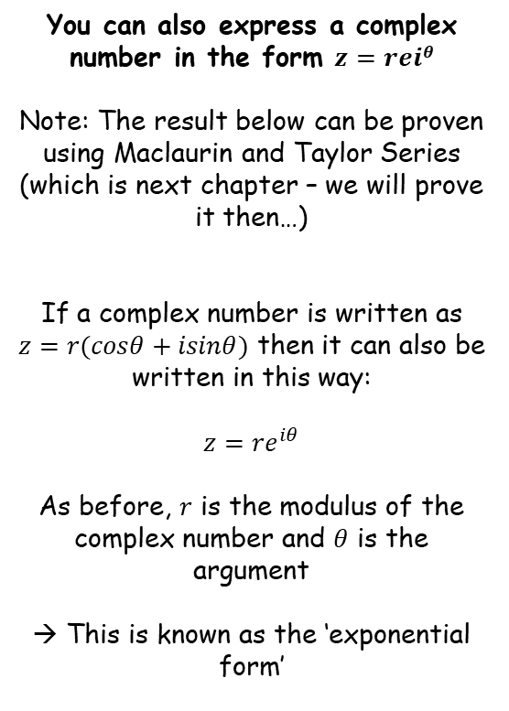

Complex Numbers
$$z=r(cosθ+isinθ)$$
$$z={re}^{iθ}$$
You can also express a complex number in the form $z=reiθ$
Note: The result below can be proven using Maclaurin and Taylor Series (which is next chapter – we will prove it then…)
If a complex number is written as $z=r(cosθ+isinθ)$ then it can also be written in this way:
$$z={re}^{iθ}$$
As before, $r$ is the modulus of the complex number and $θ$ is the argument
→ This is known as the ‘exponential form’
1A

Slide 7


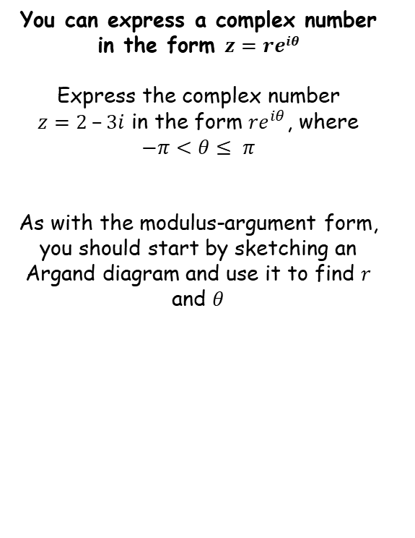





Complex Numbers
$$z=r(cosθ+isinθ)$$
$$z={re}^{iθ}$$
y
You can express a complex number in the form $z=reiθ$
Express the complex number $z=2 –3i$ in the form ${re}^{iθ}$, where
$$−π<θ≤ π$$
As with the modulus-argument form, you should start by sketching an Argand diagram and use it to find $r$ and $θ$
Pay attention to the directions
The ‘x’ part is positive so will go in the positive direction horizontally
The ‘y’ part is negative so will go downwards
2
x
θ
r
3
→ Once sketched you can then find the modulus and argument using GCSE Pythagoras and Trigonometry
$$z={re}^{iθ}$$
$$r=\sqrt{{\left(2\right)}^{2}+{(3)}^{2}}$$
$$Tanθ=\frac{3}{2}$$
Replace r and θ
Calculate
$$z={\sqrt{13}e}^{−0.98i}$$
Inverse Tan
$$r=\sqrt{13}$$
$$θ=0.98$$
Negative as below the x-axis
$$\arg{z=−0.98}$$
1A

Slide 8





Complex Numbers
$$z=r(cosθ+isinθ)$$
$$cos\left(−θ\right)=cosθ$$
$$sin\left(−θ\right)=−sinθ$$
$$z={re}^{iθ}$$
y
$$y=cosθ$$
You can express a complex number in the form $z=reiθ$
In the regular Maths course, you will have encountered the following:
$$cos⁡(−θ)=cosθ$$
$$sin⁡(−θ)=−sinθ$$
1
-θ
0
θ
θ
-360º
-270º
-180º
-90º
-θ
θ
90º
180º
270º
-1
You can see that $\cos\left(−θ\right)=cosθ$ anywhere on the graph
y
1
$$y=sinθ$$
-θ
0
θ
-360º
-270º
-180º
-90º
θ
90º
180º
270º
-1
You can see that $\sin\left(−θ\right)=−sinθ$ anywhere on the graph
1A

Slide 9







Complex Numbers
$$z=r(cosθ+isinθ)$$
$$cos\left(−θ\right)=cosθ$$
$$sin\left(−θ\right)=−sinθ$$
$$z={re}^{iθ}$$
You can express a complex number in the form $z=reiθ$
Express the following in the form
$z={re}^{iθ}$ where $–π<θ≤π$
$$z=\sqrt{2}\left(cos\left(\frac{π}{10}\right)+isin\left(\frac{π}{10}\right)\right)$$
You can see from the form that r = √2
You can see from the form that θ = ^{π}/₁₀
$$z=\sqrt{2}\left(cos\left(\frac{π}{10}\right)+isin\left(\frac{π}{10}\right)\right)$$
$$r=\sqrt{2}$$
$$θ=\frac{π}{10}$$
$$z={re}^{iθ}$$
Replace r and θ
$$z={\sqrt{2}e}^{\frac{π}{10}i}$$
1A

Slide 10



Complex Numbers
$$z=r(cosθ+isinθ)$$
$$cos\left(−θ\right)=cosθ$$
$$sin\left(−θ\right)=−sinθ$$
$$z={re}^{iθ}$$
You can express a complex number in the form $z=reiθ$
Express the following in the form
$z={re}^{iθ}$where $–π<θ≤π$
$$z=5\left(cos\left(\frac{π}{8}\right)−isin\left(\frac{π}{8}\right)\right)$$
$$z=5\left(cos\left(\frac{π}{8}\right)−isin\left(\frac{π}{8}\right)\right)$$
We need to adjust this first
The sign in the centre is negative, we need it to be positive for the ‘rules’ to work
We also need both angles to be identical. In this case we can apply the rules we saw a moment ago…
1A

Slide 11



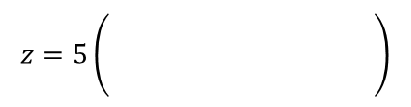





Complex Numbers
$$z=r(cosθ+isinθ)$$
$$cos\left(−θ\right)=cosθ$$
$$sin\left(−θ\right)=−sinθ$$
$$z={re}^{iθ}$$
You can express a complex number in the form $z=reiθ$
Express the following in the form
$z={re}^{iθ}$where $–π<θ≤π$
$$z=5\left(cos\left(\frac{π}{8}\right)−isin\left(\frac{π}{8}\right)\right)$$
Apply cosθ = cos(-θ)
Apply sin(-θ) = -sin(θ)
$$z=5\left(\begin{matrix} \\ \begin{matrix} \\ \end{matrix}\end{matrix} \right)$$
$$cos\left(−\frac{π}{8}\right)$$
$$+ isin\left(−\frac{π}{8}\right)$$
$$z=5\left(cos\left(\frac{π}{8}\right)−isin\left(\frac{π}{8}\right)\right)$$
You can see from the form that r = 5
You can see from the form that θ = -^{π}/₈
$$r=5$$
$$θ=−\frac{π}{8}$$
$$z={re}^{iθ}$$
Replace r and θ
$$z={5e}^{−\frac{π}{8}i}$$
1A

Slide 12





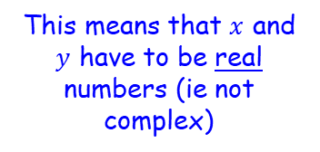


Complex Numbers
$$z=r(cosθ+isinθ)$$
$$cos\left(−θ\right)=cosθ$$
$$sin\left(−θ\right)=−sinθ$$
$$z={re}^{iθ}$$
$$z=\sqrt{2}e^{\frac{3π}{4}i}$$
You can express a complex number in the form $z=reiθ$
Express the following in the form
$z=x+iy$ where $x∈ℝ$ and $y∈ℝ$
You can see from the form that r = √2
You can see from the form that θ = ^{3π}/₄
$$z=\sqrt{2}e^{\frac{3π}{4}i}$$
$$r=\sqrt{2}$$
$$θ=\frac{3π}{4}$$
$$z=r(cosθ+isinθ)$$
This means that $x$ and $y$ have to be real numbers (ie not complex)
Replace r and θ
$$z=\sqrt{2}\left(cos\frac{3π}{4}+isin\frac{3π}{4}\right)$$
You can calculate all of this! Leave the second part in terms of i
$$z=−1+i$$
1A

Slide 13









Complex Numbers
$$z=r(cosθ+isinθ)$$
$$cos\left(−θ\right)=cosθ$$
$$sin\left(−θ\right)=−sinθ$$
$$z={re}^{iθ}$$
$$z=2e^{\frac{23π}{5}i}$$
You can express a complex number in the form $z=reiθ$
Express the following in the form
$r(cosθ+isinθ)$, where $–π<θ≤π$
The value of θ is not in the range we want. We can keep subtracting 2π until it is!
You can see from the form that r = 2
You can see from the form that θ = ^{23π}/₅
$$z=2e^{\frac{23π}{5}i}$$
$$r=2$$
$$θ=\frac{23π}{5}$$
Subtract 2π
$$θ=\frac{13π}{5}$$
Subtract 2π
$$θ=\frac{3π}{5}$$
$$z=r(cosθ+isinθ)$$
Replace r and θ
$$z=2\left(cos\frac{3π}{5}+isin\frac{3π}{5}\right)$$
1A

Slide 14











Complex Numbers
$$z=r(cosθ+isinθ)$$
$$cos\left(−θ\right)=cosθ$$
$$sin\left(−θ\right)=−sinθ$$
$$z={re}^{iθ}$$
You can express a complex number in the form $z=reiθ$
Use:
To show that:
$$e^{iθ}=cosθ+isinθ$$
Let $θ$ = $−θ$
$$e^{i(−θ)}=cos\left(−θ\right)+isin\left(−θ\right)$$
Use the relationships above to rewrite
$$e^{iθ}=cosθ+isinθ$$
$$e^{−iθ}=cosθ−isinθ$$
$$cosθ=\frac{1}{2}\left(e^{iθ}+e^{−iθ}\right)$$
1)
$$e^{iθ}=cosθ+isinθ$$
2)
$$e^{−iθ}=cosθ−isinθ$$
Add 1 and 2
$$e^{−iθ}+e^{iθ}=2cosθ$$
Divide by 2
$$\frac{1}{2}\left(e^{−iθ}+e^{iθ}\right)=cosθ$$
1A

Slide 15
Teachings for
Exercise 1B

Slide 16

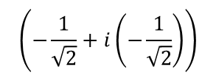

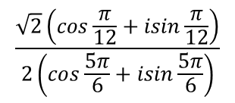


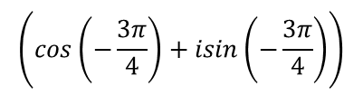

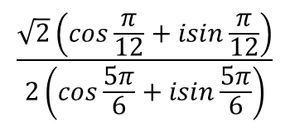
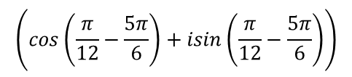

Complex Numbers
$$z_{1}z_{2}=r_{1}r_{2}\left(cos\left(θ_{1}+θ_{2}\right)+isin\left(θ_{1}+θ_{2}\right)\right)$$
$$\frac{z_{1}}{z_{2}} =\frac{r_{1}}{r_{2}}\left(cos\left(θ_{1}−θ_{2}\right)+isin\left(θ_{1}−θ_{2}\right)\right)$$
Reminder of rules from last year…
Express the following calculation in the form x + iy:
$$\frac{\sqrt{2}\left(cos\frac{π}{12}+isin\frac{π}{12}\right)}{2\left(cos\frac{5π}{6}+isin\frac{5π}{6}\right)}$$
Combine using one of the rules above
Divide the moduli
Subtract the arguments
$$\left(cos\left(\frac{π}{12}−\frac{5π}{6}\right)+isin\left(\frac{π}{12}−\frac{5π}{6}\right)\right)$$
$$\frac{\sqrt{2}}{2}$$
$$\frac{\sqrt{2}\left(cos\frac{π}{12}+isin\frac{π}{12}\right)}{2\left(cos\frac{5π}{6}+isin\frac{5π}{6}\right)}$$
Simplify
$$\left(cos\left(−\frac{3π}{4}\right)+isin\left(−\frac{3π}{4}\right)\right)$$
$$\frac{\sqrt{2}}{2}$$
You can work out the sin and cos parts
$$\left(−\frac{1}{\sqrt{2}}+i\left(−\frac{1}{\sqrt{2}}\right)\right)$$
$$\frac{\sqrt{2}}{2}$$
Multiply out
$$=−\frac{1}{2}−\frac{1}{2}i$$
1B

Slide 17



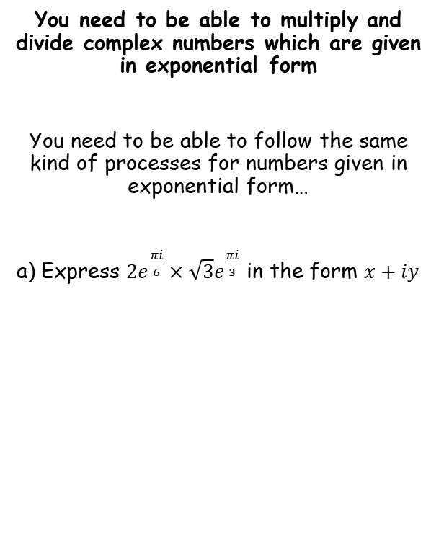





Complex Numbers
$$z_{1}z_{2}=r_{1}r_{2}\left(cos\left(θ_{1}+θ_{2}\right)+isin\left(θ_{1}+θ_{2}\right)\right)$$
$$\frac{z_{1}}{z_{2}} =\frac{r_{1}}{r_{2}}\left(cos\left(θ_{1}−θ_{2}\right)+isin\left(θ_{1}−θ_{2}\right)\right)$$
$$z_{1}z_{2}=r_{1}r_{2}e^{i(θ_{1}+θ_{2})}$$
$$\frac{z_{1}}{z_{2}} =\frac{r_{1}}{r_{2}}e^{i{(θ}_{1}−θ_{2})}$$
You need to be able to multiply and divide complex numbers which are given in exponential form
You need to be able to follow the same kind of processes for numbers given in exponential form…
a) Express $2e^{\frac{πi}{6}}×\sqrt{3}e^{\frac{πi}{3}}$ in the form $x+iy$
$$2e^{\frac{πi}{6}}×\sqrt{3}e^{\frac{πi}{3}}$$
Apply one of the rules above
$$=\left(2×\sqrt{3}\right)e^{\frac{πi}{6}+\frac{πi}{3}}$$
Simplify
$$=2\sqrt{3}e^{\frac{πi}{2}}$$
Write in modulus-argument form
$$=2\sqrt{3}\left(cos\frac{π}{2}+isin\frac{π}{2}\right)$$
Calculate the cos and sine parts
$$=2\sqrt{3}\left(0+i\right)$$
Simplify
$$=2i\sqrt{3}$$
1B

Slide 18


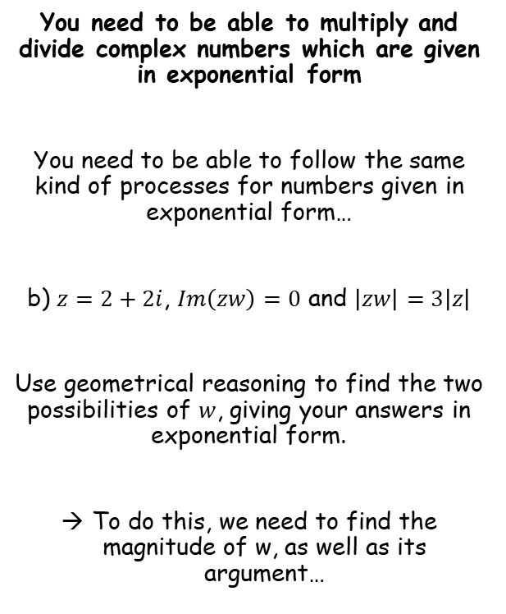



Complex Numbers
$$z_{1}z_{2}=r_{1}r_{2}\left(cos\left(θ_{1}+θ_{2}\right)+isin\left(θ_{1}+θ_{2}\right)\right)$$
$$\frac{z_{1}}{z_{2}} =\frac{r_{1}}{r_{2}}\left(cos\left(θ_{1}−θ_{2}\right)+isin\left(θ_{1}−θ_{2}\right)\right)$$
$$z_{1}z_{2}=r_{1}r_{2}e^{i(θ_{1}+θ_{2})}$$
$$\frac{z_{1}}{z_{2}} =\frac{r_{1}}{r_{2}}e^{i{(θ}_{1}−θ_{2})}$$
You need to be able to multiply and divide complex numbers which are given in exponential form
You need to be able to follow the same kind of processes for numbers given in exponential form…
b) $z=2+2i$, $Im\left(zw\right)=0$ and $\left|zw\right|=3\left|z\right|$
Use geometrical reasoning to find the two possibilities of $w$, giving your answers in exponential form.
To do this, we need to find the magnitude of w, as well as its argument…
$$\left|zw\right|=3\left|z\right|$$
The left hand side can be written as two separate moduli…
$$\left|z\right|\left|w\right|=3\left|z\right|$$
Divide both sides by $\left|z\right|$
$$\left|w\right|=3$$
$$\left|w\right|=3$$
1B

Slide 19


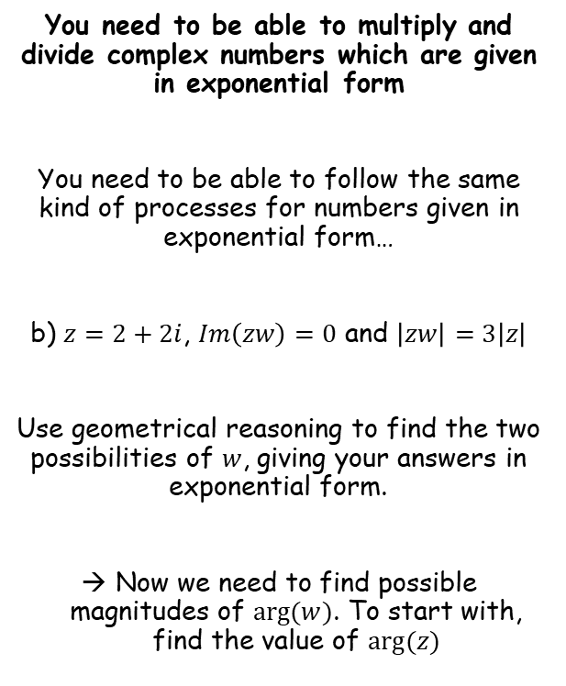

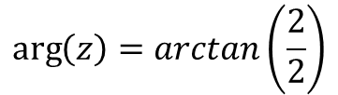

Complex Numbers
$$z_{1}z_{2}=r_{1}r_{2}\left(cos\left(θ_{1}+θ_{2}\right)+isin\left(θ_{1}+θ_{2}\right)\right)$$
$$\frac{z_{1}}{z_{2}} =\frac{r_{1}}{r_{2}}\left(cos\left(θ_{1}−θ_{2}\right)+isin\left(θ_{1}−θ_{2}\right)\right)$$
$$z_{1}z_{2}=r_{1}r_{2}e^{i(θ_{1}+θ_{2})}$$
$$\frac{z_{1}}{z_{2}} =\frac{r_{1}}{r_{2}}e^{i{(θ}_{1}−θ_{2})}$$
Im
You need to be able to multiply and divide complex numbers which are given in exponential form
You need to be able to follow the same kind of processes for numbers given in exponential form…
b) $z=2+2i$, $Im\left(zw\right)=0$ and $\left|zw\right|=3\left|z\right|$
Use geometrical reasoning to find the two possibilities of $w$, giving your answers in exponential form.
Now we need to find possible magnitudes of $arg⁡(w)$. To start with, find the value of $arg⁡(z)$
$$z$$
$$2$$
$$θ$$
Re
$$2$$
$$\left|w\right|=3$$
$$arg⁡(z)=\frac{π}{4}$$
$$\arg\left(z\right)=arctan\left(\frac{2}{2}\right)$$
Calculate
$$arg⁡(z)=\frac{π}{4}$$
1B

Slide 20
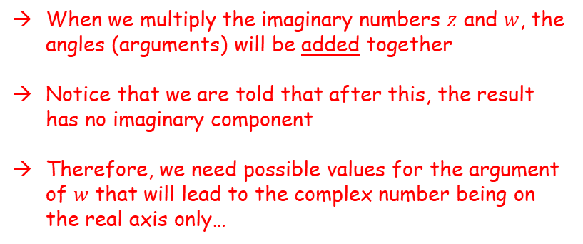

Complex Numbers
$$z_{1}z_{2}=r_{1}r_{2}\left(cos\left(θ_{1}+θ_{2}\right)+isin\left(θ_{1}+θ_{2}\right)\right)$$
$$\frac{z_{1}}{z_{2}} =\frac{r_{1}}{r_{2}}\left(cos\left(θ_{1}−θ_{2}\right)+isin\left(θ_{1}−θ_{2}\right)\right)$$
$$z_{1}z_{2}=r_{1}r_{2}e^{i(θ_{1}+θ_{2})}$$
$$\frac{z_{1}}{z_{2}} =\frac{r_{1}}{r_{2}}e^{i{(θ}_{1}−θ_{2})}$$
Im
You need to be able to multiply and divide complex numbers which are given in exponential form
You need to be able to follow the same kind of processes for numbers given in exponential form…
b) $z=2+2i$, $Im\left(zw\right)=0$ and $\left|zw\right|=3\left|z\right|$
Use geometrical reasoning to find the two possibilities of $w$, giving your answers in exponential form.
Now we need to find possible magnitudes of $arg⁡(w)$. To start with, find the value of $arg⁡(z)$
$$z$$
$$\frac{π}{4}$$
Re
When we multiply the imaginary numbers $z$ and $w$, the angles (arguments) will be added together
Notice that we are told that after this, the result has no imaginary component
Therefore, we need possible values for the argument of $w$ that will lead to the complex number being on the real axis only…
$$\left|w\right|=3$$
$$arg⁡(z)=\frac{π}{4}$$
1B

Slide 21


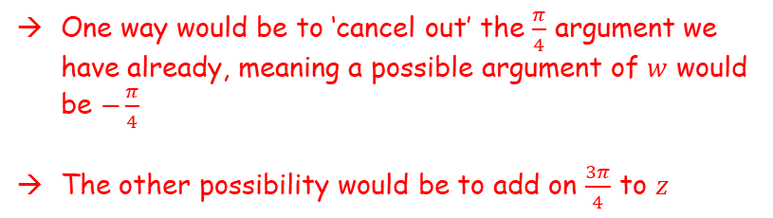

Complex Numbers
$$z_{1}z_{2}=r_{1}r_{2}\left(cos\left(θ_{1}+θ_{2}\right)+isin\left(θ_{1}+θ_{2}\right)\right)$$
$$\frac{z_{1}}{z_{2}} =\frac{r_{1}}{r_{2}}\left(cos\left(θ_{1}−θ_{2}\right)+isin\left(θ_{1}−θ_{2}\right)\right)$$
$$z_{1}z_{2}=r_{1}r_{2}e^{i(θ_{1}+θ_{2})}$$
$$\frac{z_{1}}{z_{2}} =\frac{r_{1}}{r_{2}}e^{i{(θ}_{1}−θ_{2})}$$
Im
You need to be able to multiply and divide complex numbers which are given in exponential form
You need to be able to follow the same kind of processes for numbers given in exponential form…
b) $z=2+2i$, $Im\left(zw\right)=0$ and $\left|zw\right|=3\left|z\right|$
Use geometrical reasoning to find the two possibilities of $w$, giving your answers in exponential form.
Now we need to find possible magnitudes of $arg⁡(w)$. To start with, find the value of $arg⁡(z)$
$$z$$
$$\frac{3π}{4}$$
$$\frac{π}{4}$$
Re
$$−\frac{π}{4}$$
One way would be to ‘cancel out’ the $\frac{π}{4}$ argument we have already, meaning a possible argument of $w$ would be $−\frac{π}{4}$
The other possibility would be to add on $\frac{3π}{4}$ to $z$
$$\left|w\right|=3$$
$$arg⁡(z)=\frac{π}{4}$$
$\arg\left(w\right)=−\frac{π}{4}$ or $\frac{3π}{4}$
1B

Slide 22

Complex Numbers
$$z_{1}z_{2}=r_{1}r_{2}\left(cos\left(θ_{1}+θ_{2}\right)+isin\left(θ_{1}+θ_{2}\right)\right)$$
$$\frac{z_{1}}{z_{2}} =\frac{r_{1}}{r_{2}}\left(cos\left(θ_{1}−θ_{2}\right)+isin\left(θ_{1}−θ_{2}\right)\right)$$
$$z_{1}z_{2}=r_{1}r_{2}e^{i(θ_{1}+θ_{2})}$$
$$\frac{z_{1}}{z_{2}} =\frac{r_{1}}{r_{2}}e^{i{(θ}_{1}−θ_{2})}$$
Im
You need to be able to multiply and divide complex numbers which are given in exponential form
You need to be able to follow the same kind of processes for numbers given in exponential form…
b) $z=2+2i$, $Im\left(zw\right)=0$ and $\left|zw\right|=3\left|z\right|$
Use geometrical reasoning to find the two possibilities of $w$, giving your answers in exponential form.
Now we need to find possible magnitudes of $arg⁡(w)$. To start with, find the value of $arg⁡(z)$
$$z$$
$$\frac{π}{4}$$
Re
$$\left|w\right|=3$$
$$arg⁡(z)=\frac{π}{4}$$
$w_{1}=3e^{−\frac{πi}{4}}$ and $w_{2}=3e^{\frac{3πi}{4}}$
$\arg\left(w\right)=−\frac{π}{4}$ or $\frac{3π}{4}$
1B

Slide 23
Teachings for
Exercise 1C

Slide 24





Complex Numbers
Using Euler’s relation
You can use De Moivre’s Theorem in problem solving
→ You will be able to use this to find higher powers of complex numbers given in modulus-argument form
$$(r\left(cosθ+isinθ\right))^{2}={\left({re}^{iθ}\right)}^{2}$$
Same thing multiplied by itself
$$(r\left(cosθ+isinθ\right))^{2}={re}^{iθ}×{re}^{iθ}$$
Use index laws
$$(r\left(cosθ+isinθ\right))^{2}={r^{2}e}^{i2θ}$$
Using the rule from 1A
$$(r\left(cosθ+isinθ\right))^{2}=r^{2}\left(cos2θ+isin2θ\right)$$
$$z=r(cosθ+isinθ)$$
$$z={re}^{iθ}$$
Continuing this…
$$(r\left(cosθ+isinθ\right))^{3}=r^{3}\left(cos3θ+isin3θ\right)$$
$$(r\left(cosθ+isinθ\right))^{4}=r^{4}\left(cos4θ+isin4θ\right)$$
Etc…
The generalization of this is known as ‘De Moivre’s Theorem’
(De “mwarve”)
1C

Slide 25




Complex Numbers
Using Euler’s relation
You can use De Moivre’s Theorem in problem solving
For any integer n;
This can be proven using Euler’s relation…
$$(r\left(cosθ+isinθ\right))^{n}={\left({re}^{iθ}\right)}^{n}$$
Use index law
$$=r^{n}×e^{inθ}$$
$${\left(r\left(cosθ+isinθ\right)\right)}^{n}=r^{n}\left(cos nθ+isin nθ\right)$$
Put together
$$=r^{n}e^{inθ}$$
Rewrite in modulus-argument form
$$=r^{n}\left(cos nθ+isin nθ\right)$$
1C

Slide 26

Complex Numbers
You can use De Moivre’s Theorem in problem solving
For any integer n;
You can also prove it for positive integer exponents directly from the modulus-argument form, using proof by induction…
BASIS
ASSUMPTION
INDUCTIVE
CONCLUSION
BASIS
→ Show that the statement is true for $n=1$
$${\left(r\left(cosθ+isinθ\right)\right)}^{n}=r^{n}\left(cos nθ+isin nθ\right)$$
Let $n=1$
$${\left(r\left(cosθ+isinθ\right)\right)}^{n}=r^{n}\left(cos nθ+isin nθ\right)$$
$${\left(r\left(cosθ+isinθ\right)\right)}^{1}=r^{1}\left(cos 1θ+isin 1θ\right)$$
Simplify
$$r\left(cosθ+isinθ\right)=r\left(cosθ+isinθ\right)$$
LHS = RHS, so De Moivre’s Theorem is true for $n=1$
1C

Slide 27











Complex Numbers
ASSUMPTION
You can use De Moivre’s Theorem in problem solving
For any integer n;
You can also prove it for positive integer exponents directly from the modulus-argument form, using proof by induction…
BASIS
ASSUMPTION
INDUCTIVE
CONCLUSION
→ Assume the statement is true for $n=k$, $k∈ℤ^{+}$
$${\left(r\left(cosθ+isinθ\right)\right)}^{k}=r^{k}\left(cos kθ+isin kθ\right)$$
INDUCTIVE
→ Show that, based on the assumption, that the statement is then true for $n=k+1$
$${\left(r\left(cosθ+isinθ\right)\right)}^{n}=r^{n}\left(cos nθ+isin nθ\right)$$
$${\left(r\left(cosθ+isinθ\right)\right)}^{k+1}=$$
$${(r\left(cosθ+isinθ\right))}^{k}$$
$$×r\left(cosθ+isinθ\right)$$
Use assumption step
$$=r^{k}\left(coskθ+isinkθ\right)$$
$$×r\left(cosθ+isinθ\right)$$
Rewrite
Expand the double bracket
$$=r^{k+1}\left(coskθ+isinkθ\right)\left(cosθ+isinθ\right)$$
$$=r^{k+1}(coskθcosθ+icoskθsinθ+isinkθcosθ+i^{2}sinkθsinθ)$$
$$i^{2}=−1$$
Separate real and imaginary components
$$=r^{k+1}(coskθcosθ+icoskθsinθ+isinkθcosθ−sinkθsinθ)$$
$$=r^{k+1}(coskθcosθ−sinkθsinθ)+i(coskθsinθ+sinkθcosθ)$$
$$\cos\left(A+B\right)=cosAcosB−sinAsinB$$
$$\sin\left(A+B\right)=sinAcosB+cosAsinB$$
$$=r^{k+1}(cos\left(kθ+θ\right)+isin\left(kθ+θ\right))$$
Factorise inside
$$=r^{k+1}(cos⁡(\left(k+1\right)θ)+isin(\left(k+1\right)θ))$$
So we have shown that if De Moivre’s theorem is true for $n=k$, it will also be true for $n=k+1$
1C

Slide 28
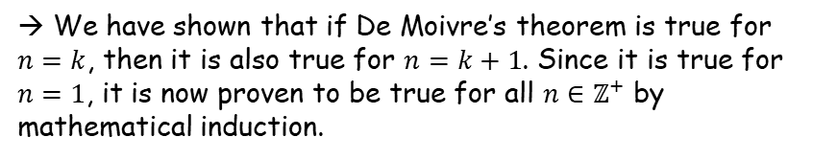
Complex Numbers
$${\left(r\left(cosθ+isinθ\right)\right)}^{n}=r^{n}\left(cos nθ+isin nθ\right)$$
CONCLUSION
You can use De Moivre’s Theorem in problem solving
For any integer n;
You can also prove it for positive integer exponents directly from the modulus-argument form, using proof by induction…
BASIS
ASSUMPTION
INDUCTIVE
CONCLUSION
→ We have shown that if De Moivre’s theorem is true for $n=k$, then it is also true for $n=k+1$. Since it is true for $n=1$, it is now proven to be true for all $n∈ℤ^{+}$ by mathematical induction.
$${\left(r\left(cosθ+isinθ\right)\right)}^{n}=r^{n}\left(cos nθ+isin nθ\right)$$
1C

Slide 29











Complex Numbers
$${\left(r\left(cosθ+isinθ\right)\right)}^{n}=r^{n}\left(cos nθ+isin nθ\right)$$
You can use De Moivre’s Theorem in problem solving
We have just proved the theorem for n = k where k is a positive integer
We can also show it is true for any negative integer…
If n is a negative integer, it can be written as ‘-m’, where m is a positive integer
$${\left[r\left(cosθ+isinθ\right)\right]}^{−m}$$
Write using a positive power instead
$$=\frac{1}{{\left[r(cosθ+isinθ)\right]}^{m}}$$
Use De Moivre’s theorem for a positive number (which we have proved)
$$=\frac{1}{r^{m}\left(cosmθ+isinmθ\right)}$$
Multiply to change some terms in the fraction
$$=\frac{1}{r^{m}\left(cosmθ+isinmθ\right)}$$
$$×\frac{\left(cosmθ−isinmθ\right)}{\left(cosmθ−isinmθ\right)}$$
Multiply out like quadratics – the bottom is the difference of two squares
$$=\frac{cosmθ−isinmθ}{r^{m}\left(\cos^{2}mθ−i^{2}\sin^{2}mθ\right)}$$
i² = -1
$$=\frac{cosmθ−isinmθ}{r^{m}\left(\cos^{2}mθ+\sin^{2}mθ\right)}$$
You can cancel the denominator as it is equal to 1
You can see that the answer has followed the same pattern as De Moivre’s theorem!
$$=\frac{1}{r^{m}}$$
$$\left(cosmθ−isinmθ\right)$$
Use cos(-θ) = cos(θ) and sin(-θ) = -sinθ
$$=r^{−m}$$
$$\left(\cos\left(−mθ\right)+isin(−mθ)\right)$$
1C

Slide 30




Complex Numbers
$${\left(r\left(cosθ+isinθ\right)\right)}^{n}=r^{n}\left(cos nθ+isin nθ\right)$$
You can use De Moivre’s Theorem in problem solving
Having now proved that De Moivre’s theorem works for both positive and negative integers, there is only one left
We need to prove it is true for 0!
This is straightforward. As it is just a single value, we can substitute it in to see what happens…
$${\left[r\left(cosθ+isinθ\right)\right]}^{n}=r^{n}\left(cosnθ+isinnθ\right)$$
Sub in n = 0
$${\left[r\left(cosθ+isinθ\right)\right]}^{0}=r^{0}\left(cos0+isin0\right)$$
Left side = 1 as anything to the power 0 is 1
→ You can find cos0 and sin0 as well
$$1=$$
$$1(1+0)$$
‘Calculate’
$$1=$$
$$1$$
So we have shown that De Moivre’s Theorem is true for all positive integers, all negative integers and 0’
→ It is therefore true for all integers!
3C

Slide 31



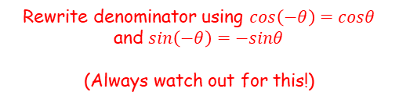
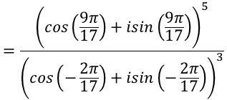

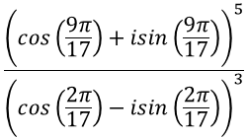


Complex Numbers
$${\left(r\left(cosθ+isinθ\right)\right)}^{n}=r^{n}\left(cos nθ+isin nθ\right)$$
$$\frac{{\left(cos\left(\frac{9π}{17}\right)+isin\left(\frac{9π}{17}\right)\right)}^{5}}{{\left(cos\left(\frac{2π}{17}\right)−isin\left(\frac{2π}{17}\right)\right)}^{3}}$$
You can use De Moivre’s Theorem in problem solving
Simplify:
$$\frac{{\left(cos\left(\frac{9π}{17}\right)+isin\left(\frac{9π}{17}\right)\right)}^{5}}{{\left(cos\left(\frac{2π}{17}\right)−isin\left(\frac{2π}{17}\right)\right)}^{3}}$$
Rewrite denominator using $cos\left(−θ\right)=cosθ$ and $sin\left(−θ\right)=−sinθ$
(Always watch out for this!)
$$=\frac{{\left(cos\left(\frac{9π}{17}\right)+isin\left(\frac{9π}{17}\right)\right)}^{5}}{{\left(cos\left(−\frac{2π}{17}\right)+isin\left(−\frac{2π}{17}\right)\right)}^{3}}$$
Apply De Moivre’s theorem
→ Since there is no ‘r’ term, essentially you just multiply the angles by the power and then remove it
$$=\frac{cos\left(\frac{45π}{17}\right)+isin\left(\frac{45π}{17}\right)}{cos\left(−\frac{6π}{17}\right)+isin\left(−\frac{6π}{17}\right)}$$
Use
$\frac{z_{1}}{z_{2}} =\frac{r_{1}}{r_{2}}\left(cos\left(θ_{1}−θ_{2}\right)+isin\left(θ_{1}−θ_{2}\right)\right)$
$$=cos\left(\frac{45π}{17}−\left(−\frac{6π}{17}\right)\right)+isin\left(\frac{45π}{17}−\left(−\frac{6π}{17}\right)\right)$$
Simplify
$$=cos\left(\frac{51π}{17}\right)+isin\left(\frac{51π}{17}\right)$$
Simplify
$$=cos\left(3π\right)+isin\left(3π\right)$$
Simplify
$$=−1+i(0)$$
Simplify
$$=−1$$
1C

Slide 32








Complex Numbers
$${\left(r\left(cosθ+isinθ\right)\right)}^{n}=r^{n}\left(cos nθ+isin nθ\right)$$
Im
You can use De Moivre’s Theorem in problem solving
Express ${\left(1+i\sqrt{3}\right)}^{7}$ in the form $x+iy$, where $x,y∈ℝ$
De Moivre’s theorem is based on the modulus-argument form, so you will need this first…
$$\sqrt{3}$$
$$θ$$
Re
$$1$$
$$r=\sqrt{{\left(1\right)}^{2}+{\left(\sqrt{3}\right)}^{2}}$$
$$θ={Tan}^{−1}\left(\frac{\sqrt{3}}{1}\right)$$
$$r=2$$
$$θ=\frac{π}{3}$$
1C

Slide 33
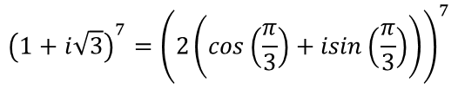


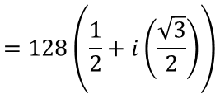








Complex Numbers
$${\left(r\left(cosθ+isinθ\right)\right)}^{n}=r^{n}\left(cos nθ+isin nθ\right)$$
Using the values of $r$ and $θ$ we found
You can use De Moivre’s Theorem in problem solving
Express ${\left(1+i\sqrt{3}\right)}^{7}$ in the form $x+iy$, where $x,y∈ℝ$
De Moivre’s theorem is based on the modulus-argument form, so you will need this first…
$$1+i\sqrt{3}=$$
$$2\left(cos\left(\frac{π}{3}\right)+isin\left(\frac{π}{3}\right)\right)$$
Raise to the power 7 as in the question
$${\left(1+i\sqrt{3}\right)}^{7}={\left(2\left(cos\left(\frac{π}{3}\right)+isin\left(\frac{π}{3}\right)\right)\right)}^{7}$$
Apply De Moivre’s Theorem
$$=2^{7}\left(cos\left(\frac{7π}{3}\right)+isin\left(\frac{7π}{3}\right)\right)$$
Work out the power of 2
$$=128\left(cos\left(\frac{7π}{3}\right)+isin\left(\frac{7π}{3}\right)\right)$$
Subtract $2π$ from the argument (this is a very useful step to look out for!)
$$r=2$$
$$θ=\frac{π}{3}$$
$$=128\left(cos\left(\frac{π}{3}\right)+isin\left(\frac{π}{3}\right)\right)$$
Work out the parts inside the bracket
$$=128\left(\frac{1}{2}+i\left(\frac{\sqrt{3}}{2}\right)\right)$$
Simplify
$$=64+64i\sqrt{3}$$
1C

Slide 34
Teachings for
Exercise 1D

Slide 35












Complex Numbers
$${\left(a+b\right)}^{n}=a^{n}+nC_{1}a^{n−1}b+nC_{2}a^{n−2}b^{2}+nC_{3}a^{n−3}b^{3}+ ………… +b^{n}$$
$${\left(a+b\right)}^{n}$$
You can apply De Moivre’s theorem to trigonometric identities
This involves changing expressions involving a function of θ into one without.
For example changing a cos6θ into powers of cosθ
You will need to use the binomial expansion from the regular Maths course
$$a^{n}+nC_{1}a^{n−1}b+nC_{2}a^{n−2}b^{2}+nC_{3}a^{n−3}b^{3}+ ………… +b^{n}$$
Remember ^{n}C_{r} is a function you can find on your calculator
The first term has the full power of n
→ As you move across you slowly swap the powers over to the second term until it has the full power of n
For example:
$${\left(a+b\right)}^{4}$$
Follow the pattern above
$$a^{4}$$
$$+ 4C_{1}a^{3}b$$
$$+ 4C_{2}a^{2}b^{2}$$
$$+ 4C_{3}ab^{3}$$
$$+ b^{4}$$
You can work out the ^{n}C_{r} parts
$$a^{4}$$
$$+ 4a^{3}b$$
$$+ 6a^{2}b^{2}$$
$$+ 4ab^{3}$$
$$+ b^{4}$$
1D

Slide 36

Complex Numbers
$${\left(a+b\right)}^{n}=a^{n}+nC_{1}a^{n−1}b+nC_{2}a^{n−2}b^{2}+nC_{3}a^{n−3}b^{3}+ ………… +b^{n}$$
$${\left(cosθ+isinθ\right)}^{3}$$
You can apply De Moivre’s theorem to trigonometric identities
Express cos3θ using powers of cosθ.
This type of question involves making a comparison between two processes
One which will give you a ‘cos3θ’ term – you will use De Moivre’s Theorem for this
One which will give you an expression in terms of cosθ – you will use the binomial expansion for this
You have to think logically and decide where to start
If we apply De Moivre’s theorem to this, we will end up with a ‘cos3θ’ term
If we apply the binomial expansion to it, we will end up with some terms with cosθ in
So this expression is a good starting point!
1D

Slide 37













Complex Numbers
$${\left(a+b\right)}^{n}=a^{n}+nC_{1}a^{n−1}b+nC_{2}a^{n−2}b^{2}+nC_{3}a^{n−3}b^{3}+ ………… +b^{n}$$
$${\left(cosθ+isinθ\right)}^{3}$$
You can apply De Moivre’s theorem to trigonometric identities
Express cos3θ using powers of cosθ.
This type of question involves making a comparison between two processes
One which will give you a ‘cos3θ’ term – you will use De Moivre’s Theorem for this
One which will give you an expression in terms of cosθ – you will use the binomial expansion for this
You have to think logically and decide where to start
Apply De Moivre’s theorem
$${\left(cosθ+isinθ\right)}^{3}$$
Follow the rules you know
$$=cos3θ+isin3θ$$
Apply the Binomial expansion
$${\left(cosθ+isinθ\right)}^{3}$$
Write out
$$={\left(cosθ\right)}^{3}$$
$$+ 3C_{1}{\left(cosθ\right)}^{2}\left(isinθ\right)$$
$$+ 3C_{2}{\left(cosθ\right)\left(isinθ\right)}^{2}$$
$$+ {\left(isinθ\right)}^{3}$$
‘Tidy up’
$$=\cos^{3}θ$$
$$+ 3{icos}^{2}θsinθ$$
$$+ 3i^{2}cosθ\sin^{2}θ$$
$$+ i^{3}\sin^{3}θ$$
Replace i² parts with -1
$$=\cos^{3}θ$$
$$+ 3{icos}^{2}θsinθ$$
$$− 3cosθ\sin^{2}θ$$
$$− i\sin^{3}θ$$
The two expressions we have made must be equal
Therefore the real parts in each and the imaginary parts in each must be the same
Equate the real parts
$$cos3θ=\cos^{3}θ−3cosθ\sin^{2}θ$$
1D

Slide 38




Complex Numbers
$${\left(a+b\right)}^{n}=a^{n}+nC_{1}a^{n−1}b+nC_{2}a^{n−2}b^{2}+nC_{3}a^{n−3}b^{3}+ ………… +b^{n}$$
You can apply De Moivre’s theorem to trigonometric identities
Express cos3θ using powers of cosθ.
This type of question involves making a comparison between two processes
One which will give you a ‘cos3θ’ term – you will use De Moivre’s Theorem for this
One which will give you an expression in terms of cosθ – you will use the binomial expansion for this
You have to think logically and decide where to start
$$cos3θ=\cos^{3}θ−3cosθ\sin^{2}θ$$
Replace sin²θ with an expression in cos²θ
$$cos3θ=\cos^{3}θ−3cosθ\left(1−\cos^{2}θ\right)$$
Expand the bracket
$$cos3θ=\cos^{3}θ−3cosθ+3\cos^{3}θ$$
Simplify
$$cos3θ={4cos}^{3}θ−3cosθ$$
We have successfully expressed cos3θ as posers of cosθ!
1D

Slide 39

























Complex Numbers
$${\left(a+b\right)}^{n}=a^{n}+nC_{1}a^{n−1}b+nC_{2}a^{n−2}b^{2}+nC_{3}a^{n−3}b^{3}+ ………… +b^{n}$$
You can apply De Moivre’s theorem to trigonometric identities
Use De Moivre’s theorem to show that:
$$cos6θ=32\cos^{6}θ−48cos^{4}θ+18\cos^{2}θ−1$$
Apply De Moivre’s theorem (use a power 6 to get the $cos6θ$ term)
$${\left(cosθ+isinθ\right)}^{6}$$
$$=cos6θ+isin6θ$$
Follow the rules you know
Apply the Binomial expansion
Write out
$${\left(cosθ+isinθ\right)}^{6}$$
$$={\left(cosθ\right)}^{6}$$
$$+ 6C_{1}{\left(cosθ\right)}^{5}\left(isinθ\right)$$
$$+ 6C_{2}{{\left(cosθ\right)}^{4}\left(isinθ\right)}^{2}$$
$$+ 6C_{3}{{\left(cosθ\right)}^{3}\left(isinθ\right)}^{3}$$
$$+ 6C_{4}{{\left(cosθ\right)}^{2}\left(isinθ\right)}^{4}$$
$$+ 6C_{5}{\left(cosθ\right)\left(isinθ\right)}^{5}$$
$$+{\left(isinθ\right)}^{6}$$
‘Tidy up’
Replace i² parts with -1, i³ parts with –i etc…
$$=\cos^{6}θ$$
$$+ 6i\cos^{5}θsinθ$$
$$+ 15i^{2}\cos^{4}θsin^{2}θ$$
$$+ 20i^{3}\cos^{3}θsin^{3}θ$$
$$+ 15i^{4}\cos^{2}θsin^{4}θ$$
$$+ 6i^{5}cosθsin^{5}θ$$
$$+ i^{6}sin^{6}θ$$
$$=\cos^{6}θ$$
$$+ 6i\cos^{5}θsinθ$$
$$− 15\cos^{4}θsin^{2}θ$$
$$− 20i\cos^{3}θsin^{3}θ$$
$$+ 15\cos^{2}θsin^{4}θ$$
$$+ 6icosθsin^{5}θ$$
$$− sin^{6}θ$$
The two expressions we have made must be equal
Therefore the real parts in each and the imaginary parts in each must be the same
Equate the real parts
$$cos6θ=\cos^{6}θ− 15\cos^{4}θsin^{2}θ+ 15\cos^{2}θsin^{4}θ− sin^{6}θ$$
1D

Slide 40


Complex Numbers
$${\left(a+b\right)}^{n}=a^{n}+nC_{1}a^{n−1}b+nC_{2}a^{n−2}b^{2}+nC_{3}a^{n−3}b^{3}+ ………… +b^{n}$$
You can apply De Moivre’s theorem to trigonometric identities
Use De Moivre’s theorem to show that:
$$cos6θ=32\cos^{6}θ−48cos^{4}θ+18\cos^{2}θ−1$$
As in the previous example, we will need to use the relationship $\sin^{2}θ=1−\cos^{2}θ$ to get all the terms in cosine
$$cos6θ=\cos^{6}θ− 15\cos^{4}θsin^{2}θ+ 15\cos^{2}θsin^{4}θ− sin^{6}θ$$
Replace $\sin^{2}θ$ terms with $1−\cos^{2}θ$ terms
$$=\cos^{6}θ− 15\cos^{4}θ\left(1−\cos^{2}θ\right)+ 15\cos^{2}θ{\left(1−\cos^{2}θ\right)}^{2}− {\left(1−\cos^{2}θ\right)}^{3}$$
Expand powered brackets
$$=\cos^{6}θ− 15\cos^{4}θ+15\cos^{6}θ+15\cos^{2}θ\left(1−2\cos^{2}θ+\cos^{4}θ\right)−\left(1−3\cos^{2}θ+{3cos}^{4}θ−\cos^{6}θ\right)$$
Expand again
$$=\cos^{6}θ− 15\cos^{4}θ+15\cos^{6}θ+15\cos^{2}θ−{30cos}^{4}θ+{15cos}^{6}θ−1+{3cos}^{2}θ−{3cos}^{4}θ+\cos^{6}θ$$
Group like terms
$$={32cos}^{6}θ−48\cos^{4}θ+18\cos^{2}θ−1$$
1D

Slide 41





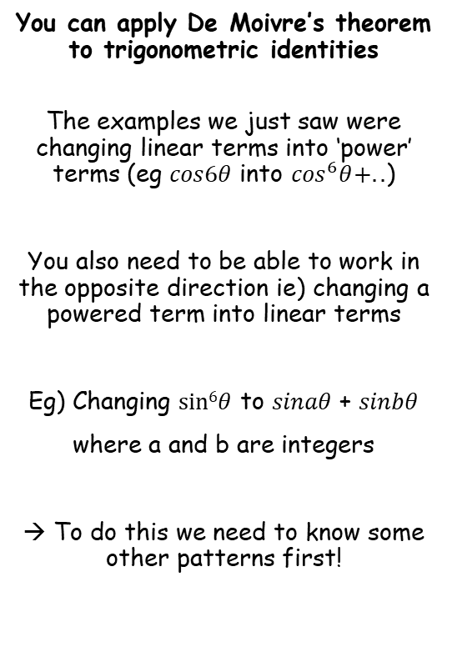




Complex Numbers
$$z+\frac{1}{z}=2cosθ$$
You can apply De Moivre’s theorem to trigonometric identities
The examples we just saw were changing linear terms into ‘power’ terms (eg $cos6θ$ into $\cos^{6}θ+..$)
You also need to be able to work in the opposite direction ie) changing a powered term into linear terms
Eg) Changing $sin6θ$ to $sinaθ$ + $sinbθ$
where a and b are integers
→ To do this we need to know some other patterns first!
Let:
$$z=cosθ+isinθ$$
Write as ‘1 over’ → or with a power of -1
$$\frac{1}{z}={\left(cosθ+isinθ \right)}^{−1}$$
Use De Moivre’s theorem
$$\frac{1}{z}=cos⁡(−θ)+isin(−θ)$$
Use cos(-θ) = cosθ and sin(-θ) = -sinθ
$$\frac{1}{z}=\cos{θ}−isinθ$$
We can add our two results together:
$$z+\frac{1}{z}=$$
$$\left(cosθ+isinθ \right)$$
$$+ \left(cosθ−isinθ \right)$$
Simplify
$$z+\frac{1}{z}=$$
$$2cosθ$$
1D

Slide 42




Complex Numbers
$$z+\frac{1}{z}=2cosθ$$
$$z−\frac{1}{z}=2isinθ$$
You can apply De Moivre’s theorem to trigonometric identities
The examples we just saw were changing linear terms into ‘power’ terms (eg $cos6θ$ into $\cos^{6}θ+..$)
You also need to be able to work in the opposite direction ie) changing a powered term into linear terms
Eg) Changing $sin6θ$ to $sinaθ$ + $sinbθ$
where a and b are integers
→ To do this we need to know some other patterns first!
Let:
$$z=cosθ+isinθ$$
Write as ‘1 over’ → or with a power of -1
$$\frac{1}{z}={\left(cosθ+isinθ \right)}^{−1}$$
Use De Moivre’s theorem
$$\frac{1}{z}=cos⁡(−θ)+isin(−θ)$$
Use cos(-θ) = cosθ and sin(-θ) = -sinθ
$$\frac{1}{z}=\cos{θ}−isinθ$$
We could also subtract our two results:
$$z−\frac{1}{z}=$$
$$\left(cosθ+isinθ \right)$$
$$− \left(cosθ−isinθ \right)$$
Simplify
$$z−\frac{1}{z}=$$
$$2isinθ$$
1D

Slide 43









Complex Numbers
$$z+\frac{1}{z}=2cosθ$$
$$z^{n}+\frac{1}{z^{n}}=2cosnθ$$
$$z−\frac{1}{z}=2isinθ$$
You can apply De Moivre’s theorem to trigonometric identities
The examples we just saw were changing linear terms into ‘power’ terms (eg $cos6θ$ into $\cos^{6}θ+..$)
You also need to be able to work in the opposite direction ie) changing a powered term into linear terms
Eg) Changing $sin6θ$ to $sinaθ$ + $sinbθ$
where a and b are integers
→ To do this we need to know some other patterns first!
Let:
$$z^{n}=cosnθ+isinnθ$$
Write as ‘1 over’ → or with a power of -1
$$\frac{1}{z^{n}}={\left(cosnθ+isinnθ \right)}^{−1}$$
Use De Moivre’s theorem
$$\frac{1}{z^{n}}=cos⁡(−nθ)+isin(−nθ)$$
Use cos(-θ) = cosθ and sin(-θ) = -sinθ
$$\frac{1}{z^{n}}=\cos{nθ}−isinnθ$$
We could add our two results together:
$$z^{n}+\frac{1}{z^{n}}=$$
$$\left(cosnθ+isinnθ \right)$$
$$+ \left(cosnθ−isinnθ \right)$$
Simplify
$$z^{n}+\frac{1}{z^{n}}=$$
$$2cosnθ$$
You can also apply the rules we just saw to powers of z
1D

Slide 44





Complex Numbers
$$z+\frac{1}{z}=2cosθ$$
$$z^{n}+\frac{1}{z^{n}}=2cosnθ$$
$$z−\frac{1}{z}=2isinθ$$
$$z^{n}−\frac{1}{z^{n}}=2isinnθ$$
You can apply De Moivre’s theorem to trigonometric identities
The examples we just saw were changing linear terms into ‘power’ terms (eg $cos6θ$ into $\cos^{6}θ+..$)
You also need to be able to work in the opposite direction ie) changing a powered term into linear terms
Eg) Changing $sin6θ$ to $sinaθ$ + $sinbθ$
where a and b are integers
→ To do this we need to know some other patterns first!
Let:
$$z^{n}=cosnθ+isinnθ$$
Write as ‘1 over’ → or with a power of -1
$$\frac{1}{z^{n}}={\left(cosnθ+isinnθ \right)}^{−1}$$
Use De Moivre’s theorem
$$\frac{1}{z^{n}}=cos⁡(−nθ)+isin(−nθ)$$
Use cos(-θ) = cosθ and sin(-θ) = -sinθ
$$\frac{1}{z^{n}}=\cos{nθ}−isinnθ$$
We could also subtract our two results:
$$z^{n}−\frac{1}{z^{n}}=$$
$$\left(cosnθ+isinnθ \right)$$
$$− \left(cosnθ−isinnθ \right)$$
Simplify
$$z^{n}−\frac{1}{z^{n}}=$$
$$2isinnθ$$
You can also apply the rules we just saw to powers of z
1D

Slide 45



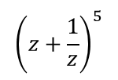





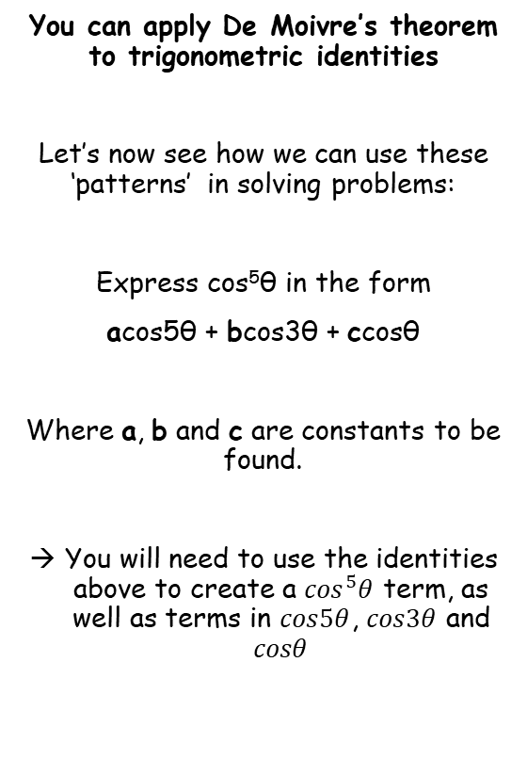















Complex Numbers
$$z+\frac{1}{z}=2cosθ$$
$$z^{n}+\frac{1}{z^{n}}=2cosnθ$$
$$z−\frac{1}{z}=2isinθ$$
$$z^{n}−\frac{1}{z^{n}}=2isinnθ$$
Let $z=cosθ+isinθ$
You can apply De Moivre’s theorem to trigonometric identities
Let’s now see how we can use these ‘patterns’ in solving problems:
Express cos⁵θ in the form
acos5θ + bcos3θ + ccosθ
Where a, b and c are constants to be found.
You will need to use the identities above to create a $\cos^{5}θ$ term, as well as terms in $cos5θ$, $cos3θ$ and $cosθ$
Creating a cos⁵θ term
Using the Identity above
$${\left(z+\frac{1}{z}\right)}^{5}$$
$${=\left(2cosθ\right)}^{5}$$
$$=32\cos^{5}θ$$
Creating the other cos terms – use the Binomial expansion!
$${\left(z+\frac{1}{z}\right)}^{5}$$
Use the B.E.
$$+ 5z^{4}\left(\frac{1}{z}\right)$$
$$+ 10z^{3}{\left(\frac{1}{z}\right)}^{2}$$
$$+ 10z^{2}{\left(\frac{1}{z}\right)}^{3}$$
$$+ 5z{\left(\frac{1}{z}\right)}^{4}$$
$$+ {\left(\frac{1}{z}\right)}^{5}$$
$$=z^{5}$$
Cancel some z terms
$$=z^{5}$$
$${+ 5z}^{3}$$
$$+ 10z$$
$$+ 10\left(\frac{1}{z}\right)$$
$$+ 5\left(\frac{1}{z^{3}}\right)$$
$$+ \left(\frac{1}{z^{5}}\right)$$
Group up terms with the same power
$$=\left(z^{5}+\frac{1}{z^{5}}\right)$$
$$+ 5\left(z^{3}+\frac{1}{z^{3}}\right)$$
$$+ 10\left(z+\frac{1}{z}\right)$$
Rewrite using an identity above
$$=2cos5θ$$
$$+ 5(2cos3θ)$$
$$+ 10(2cosθ)$$
Simplify
$$=2cos5θ$$
$$+ 10cos3θ$$
$$+ 20cosθ$$
1D

Slide 46


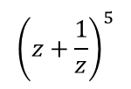

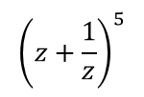
Complex Numbers
$$z+\frac{1}{z}=2cosθ$$
$$z^{n}+\frac{1}{z^{n}}=2cosnθ$$
$$z−\frac{1}{z}=2isinθ$$
$$z^{n}−\frac{1}{z^{n}}=2isinnθ$$
Using the two expressions
You can apply De Moivre’s theorem to trigonometric identities
Let’s now see how we can use these ‘patterns’ in solving problems:
Express cos⁵θ in the form
acos5θ + bcos3θ + ccosθ
Where a, b and c are constants to be found.
You will need to use the identities above to create a $\cos^{5}θ$ term, as well as terms in $cos5θ$, $cos3θ$ and $cosθ$
$${\left(z+\frac{1}{z}\right)}^{5}$$
These two expressions must be equal to each other
$$=32\cos^{5}θ$$
$${\left(z+\frac{1}{z}\right)}^{5}$$
$$=2cos5θ+10cos3θ+ 20cosθ$$
$$32\cos^{5}θ=2cos5θ+10cos3θ+ 20cosθ$$
Divide both sides by 32
$$\cos^{5}θ=\frac{1}{16}cos5θ+\frac{5}{16}cos3θ+ \frac{5}{8}cosθ$$
So we have written cos⁵θ using cos5θ, cos3θ and cosθ!
1D

Slide 47



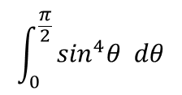
















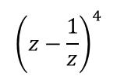



Complex Numbers
$$z+\frac{1}{z}=2cosθ$$
$$z^{n}+\frac{1}{z^{n}}=2cosnθ$$
$$z−\frac{1}{z}=2isinθ$$
$$z^{n}−\frac{1}{z^{n}}=2isinnθ$$
Using an Identity above (needs to be a subtraction to get the term in sine)
Creating a sin⁴θ term
You can apply De Moivre’s theorem to trigonometric identities
a) Express sin⁴θ in the form:
Where d, e and f are constants to be found.
b) Hence, find the exact value of the following integral:
→ Start exactly as with the previous question, by finding an expression with sin⁴θ and one with cos4θ, cos2θ and a number (notice that we are expressing sine as cosine)
$${\left(z−\frac{1}{z}\right)}^{4}$$
$${=\left(2isinθ\right)}^{4}$$
$$=16i^{4}\sin^{4}θ$$
$$=16\sin^{4}θ$$
$$dcos4θ+ecos2θ+f$$
Creating the cos terms – use the Binomial expansion!
$${\left(z−\frac{1}{z}\right)}^{4}$$
Use the B.E.
$$+ 4z^{3}\left(−\frac{1}{z}\right)$$
$$+ 6z^{2}{\left(−\frac{1}{z}\right)}^{2}$$
$$+ 4z{\left(−\frac{1}{z}\right)}^{3}$$
$$+{\left(−\frac{1}{z}\right)}^{4}$$
$$=z^{4}$$
Cancel some z terms
$$=z^{4}$$
$$− 4z^{2}$$
$$+ 6$$
$$− 4 \left(\frac{1}{z^{2}}\right)$$
$$+ \left(\frac{1}{z^{4}}\right)$$
$$\int_{0}^{\frac{π}{2}}{\sin^{4}θ dθ}$$
Group up terms with the same power (use positive values in the brackets so we get cos terms)
$$=\left(z^{4}+\frac{1}{z^{4}}\right)$$
$$− 4\left(z^{2}+\frac{1}{z^{2}}\right)$$
$$+ 6$$
Replace using an identity above
$$=2cos4θ$$
$$− 4(2cos2θ)$$
$$+ 6$$
Simplify
$$=2cos4θ$$
$$− 8cos2θ$$
$$+ 6$$
1D

Slide 48




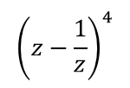
Complex Numbers
$$z+\frac{1}{z}=2cosθ$$
$$z^{n}+\frac{1}{z^{n}}=2cosnθ$$
$$z−\frac{1}{z}=2isinθ$$
$$z^{n}−\frac{1}{z^{n}}=2isinnθ$$
Using the two expressions
You can apply De Moivre’s theorem to trigonometric identities
a) Express sin⁴θ in the form:
Where d, e and f are constants to be found.
b) Hence, find the exact value of the following integral:
→ Start exactly as with the previous question, by finding an expression with sin⁴θ and one with cos4θ, cos2θ and a number (notice that we are expressing sine as cosine)
$${\left(z−\frac{1}{z}\right)}^{4}$$
These two expressions must be equal to each other
$$=16\sin^{4}θ$$
$${\left(z−\frac{1}{z}\right)}^{4}$$
$$dcos4θ+ecos2θ+f$$
$$=2cos4θ−8cos2θ+6$$
$$16\sin^{4}θ=2cos4θ−8cos2θ+6$$
Divide both sides by 16
$$\sin^{4}θ=\frac{1}{8}cos4θ−\frac{1}{2}cos2θ+\frac{3}{8}$$
$$\int_{0}^{\frac{π}{2}}{\sin^{4}θ dθ}$$
So we have written sin⁴θ using cos4θ and cos2θ!
1D

Slide 49


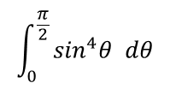


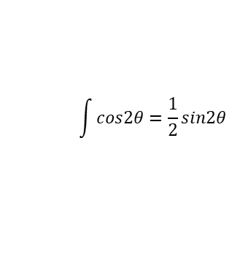

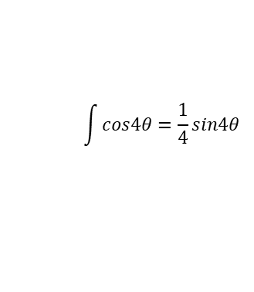

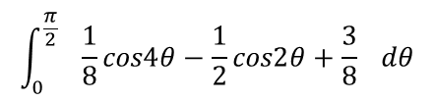

Complex Numbers
$$z+\frac{1}{z}=2cosθ$$
$$z^{n}+\frac{1}{z^{n}}=2cosnθ$$
$$z−\frac{1}{z}=2isinθ$$
$$z^{n}−\frac{1}{z^{n}}=2isinnθ$$
Cosine Integrals (in Pure Year 2)
$$\sin^{4}θ=\frac{1}{8}cos4θ−\frac{1}{2}cos2θ+\frac{3}{8}$$
$$\int{cos4θ}=\frac{1}{4}sin4θ$$
You can apply De Moivre’s theorem to trigonometric identities
a) Express sin⁴θ in the form:
Where d, e and f are constants to be found.
b) Hence, find the exact value of the following integral:
→ Start exactly as with the previous question, by finding an expression with sin⁴θ and one with cos4θ, cos2θ and a number (notice that we are expressing sine as cosine)
$$\int_{0}^{\frac{π}{2}}{\sin^{4}θ dθ}$$
$$\int{cos2θ}=\frac{1}{2}sin2θ$$
$$dcos4θ+ecos2θ+f$$
Replace with an equivalent expression
$$\int_{0}^{\frac{π}{2}}{ \frac{1}{8}cos4θ−\frac{1}{2}cos2θ+\frac{3}{8} dθ}$$
Integrate each term with respect to θ, using knowledge from C4
$$={\left[\begin{matrix} & \\ & \end{matrix}\right]}_{0}^{\frac{π}{2}}$$
$$\frac{1}{32}sin4θ$$
$$− \frac{1}{4}sin2θ$$
$$+ \frac{3}{8}θ$$
$$\int_{0}^{\frac{π}{2}}{\sin^{4}θ dθ}$$
Sub in limits
$$=\left[\frac{1}{32}sin4\left(\frac{π}{2}\right)−\frac{1}{4}sin2\left(\frac{π}{2}\right)+\frac{3}{8}\left(\frac{π}{2}\right)\right]$$
$$− \left[\frac{1}{32}sin4\left(0\right)−\frac{1}{4}sin2\left(0\right)+\frac{3}{8}\left(0\right)\right]$$
Work out
$$=\frac{3}{16}π$$
1D

Slide 50
Teachings for
Exercise 1E

Slide 51



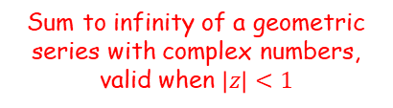






Complex Numbers
You can use the results for Geometric series with complex numbers
$a$ = the first term
$r$ = the common ratio
$n$ = the number of terms
$$S_{n}=\frac{a\left(1−r^{n}\right)}{1−r}$$
$$S_{∞}=\frac{a}{1−r}$$
Sum to infinity of a geometric series, valid when $\left|r\right|<1$
Sum of a geometric series
For $w,z∈ℂ$
The alternative form is also ok!
$$\frac{w\left(z^{n}−1\right)}{z−1}$$
$w$ = the first term
$z$ = the common ratio
$n$ = the number of terms
Sum of a geometric series with complex numbers
$$=\frac{w\left(1−z^{n}\right)}{1−z}$$
$$=\frac{w}{1−z}$$
Sum to infinity of a geometric series with complex numbers, valid when $\left|z\right|<1$
1E

Slide 52










Complex Numbers
$$\sum_{r=0}^{n−1}{{wz}^{r}=w+wz+wz^{2}+..+wz^{n−1}=\frac{w\left(1−z^{n}\right)}{1−z} }$$
$$\sum_{r=0}^{∞}{{wz}^{r}=w+wz+wz^{2}+..=\frac{w}{1−z}}, \left|z\right|<1$$
You can use the results for Geometric series with complex numbers
Formally, it looks like this…
For $w,z∈ℂ$
$$\sum_{r=0}^{n−1}{{wz}^{r}}$$
$$=\frac{w\left(1−z^{n}\right)}{1−z}$$
$$=w+wz+wz^{2}+..+wz^{n−1}$$
$$\sum_{r=0}^{∞}{{wz}^{r}}$$
$$=\frac{w}{1−z}$$
$$=w+wz+wz^{2}+..$$
$$, \left|z\right|<1$$
1E

Slide 53














Complex Numbers
$$\sum_{r=0}^{n−1}{{wz}^{r}=w+wz+wz^{2}+..+wz^{n−1}=\frac{w\left(1−z^{n}\right)}{1−z} }$$
$$\sum_{r=0}^{∞}{{wz}^{r}=w+wz+wz^{2}+..=\frac{w}{1−z}}, \left|z\right|<1$$
$$\frac{1}{2}\left(e^{inθ}+e^{−inθ}\right)=cosnθ$$
$$\frac{1}{2i}\left(e^{inθ}−e^{−inθ}\right)=sinnθ$$
$$z^{n}+\frac{1}{z^{n}}=2cosnθ$$
You can use the results for Geometric series with complex numbers
You will also need a variation on a result from the previous section (you should hopefully have encountered this in exercise 1D!)
Use the exponential form, $z=e^{iθ}$
$${\left(e^{iθ}\right)}^{n}+\frac{1}{{\left(e^{iθ}\right)}^{n}}=2cosnθ$$
Rewrite
$$e^{inθ}+e^{−inθ}=2cosnθ$$
Divide by 2
$$\frac{1}{2}\left(e^{inθ}+e^{−inθ}\right)=cosnθ$$
$$z^{n}+\frac{1}{z^{n}}=2cosnθ$$
$$z^{n}−\frac{1}{z^{n}}=2icosnθ$$
$$z^{n}−\frac{1}{z^{n}}=2isinnθ$$
Use the exponential form, $z=e^{iθ}$
You will need to learn to spot situations where you can create this pattern in order to use it!
$${\left(e^{iθ}\right)}^{n}−\frac{1}{{\left(e^{iθ}\right)}^{n}}=2isinnθ$$
Rewrite
$$e^{inθ}−e^{−inθ}=2isinnθ$$
Divide by 2i
$$\frac{1}{2i}\left(e^{inθ}−e^{−inθ}\right)=sinnθ$$
1E

Slide 54
















Complex Numbers
$$\sum_{r=0}^{n−1}{{wz}^{r}=w+wz+wz^{2}+..+wz^{n−1}=\frac{w\left(1−z^{n}\right)}{1−z} }$$
$$\sum_{r=0}^{∞}{{wz}^{r}=w+wz+wz^{2}+..=\frac{w}{1−z}}, \left|z\right|<1$$
$$\frac{1}{2}\left(e^{inθ}+e^{−inθ}\right)=cosnθ$$
$$e^{iπ}=−1$$
$$\frac{1}{2i}\left(e^{inθ}−e^{−inθ}\right)=sinnθ$$
You can use the results for Geometric series with complex numbers
Given that $z=cos\left(\frac{π}{n}\right)+isin\left(\frac{π}{n}\right)$, where $n$ is a positive integer, show that:
→ You will need to use the exponential form of $z$ in order to then use the patterns we just saw…
$$\frac{w\left(1−z^{n}\right)}{1−z}$$
In this question, $w=1$, $z=e^{\frac{iπ}{n}}$ and $n=n$
$$=\frac{1−{\left(e^{\frac{iπ}{n}}\right)}^{n}}{1−e^{\frac{iπ}{n}}}$$
We can simplify the numerator
$$=\frac{1−e^{iπ}}{1−e^{\frac{iπ}{n}}}$$
$$1+z+z^{2}+..+z^{n−1}=1+icot\left(\frac{π}{2n}\right)$$
Start with Euler’s relation…
$$e^{iθ}=cosθ+isinθ$$
Let $θ=π$
$$cosθ+isinθ=e^{iθ}$$
$$e^{iπ}=cosπ+isinπ$$
$$cos\left(\frac{π}{n}\right)+isin\left(\frac{π}{n}\right)=e^{i\frac{π}{n}}$$
Calculate terms on RHS
$$e^{iπ}=−1+i(0)$$
$$=e^{\frac{iπ}{n}}$$
Simplify
$$e^{iπ}=−1$$
(don’t confuse $π$ symbols with the letter ‘n’!)
Add 1
$$e^{iπ}+1=0$$
This is known as ‘Euler’s identity’, and is one of the most famous relationships in all of Maths!
1E

Slide 55




Complex Numbers
$$\sum_{r=0}^{n−1}{{wz}^{r}=w+wz+wz^{2}+..+wz^{n−1}=\frac{w\left(1−z^{n}\right)}{1−z} }$$
$$\sum_{r=0}^{∞}{{wz}^{r}=w+wz+wz^{2}+..=\frac{w}{1−z}}, \left|z\right|<1$$
$$\frac{1}{2}\left(e^{inθ}+e^{−inθ}\right)=cosnθ$$
$$e^{iπ}=−1$$
$$\frac{1}{2i}\left(e^{inθ}−e^{−inθ}\right)=sinnθ$$
You can use the results for Geometric series with complex numbers
Given that $z=cos\left(\frac{π}{n}\right)+isin\left(\frac{π}{n}\right)$, where $n$ is a positive integer, show that:
→ You will need to use the exponential form of $z$ in order to then use the patterns we just saw…
$$\frac{w\left(1−z^{n}\right)}{1−z}$$
In this question, $w=1$, $z=e^{\frac{iπ}{n}}$ and $n=n$
$$=\frac{1−{\left(e^{\frac{iπ}{n}}\right)}^{n}}{1−e^{\frac{iπ}{n}}}$$
We can simplify the numerator
$$=\frac{1−e^{iπ}}{1−e^{\frac{iπ}{n}}}$$
$$1+z+z^{2}+..+z^{n−1}=1+icot\left(\frac{π}{2n}\right)$$
The numerator will therefore be equal to 2
$$=\frac{2}{1−e^{\frac{iπ}{n}}}$$
Now we need to manipulate the fraction to create one of the patterns above. The denominator has a subtraction, so we are aiming for that one…
$$=\frac{2e^{\frac{−iπ}{2n}}}{e^{\frac{−iπ}{2n}}−e^{\frac{iπ}{2n}}}$$
→ Multiply all terms by $e^{\frac{−iπ}{2n}}$
$$cosθ+isinθ=e^{iθ}$$
$$cos\left(\frac{π}{n}\right)+isin\left(\frac{π}{n}\right)=e^{i\frac{π}{n}}$$
Now multiply all terms by -1 (the terms on the denominator have had their positions switched)
$$=\frac{−2e^{\frac{−iπ}{2n}}}{{e^{\frac{iπ}{2n}}−e}^{\frac{−iπ}{2n}}}$$
$$=e^{\frac{iπ}{n}}$$
(don’t confuse $π$ symbols with the letter ‘n’!)
1E

Slide 56







Complex Numbers
$$\sum_{r=0}^{n−1}{{wz}^{r}=w+wz+wz^{2}+..+wz^{n−1}=\frac{w\left(1−z^{n}\right)}{1−z} }$$
$$\sum_{r=0}^{∞}{{wz}^{r}=w+wz+wz^{2}+..=\frac{w}{1−z}}, \left|z\right|<1$$
$$\frac{1}{2}\left(e^{inθ}+e^{−inθ}\right)=cosnθ$$
$$e^{iπ}=−1$$
$$\frac{1}{2i}\left(e^{inθ}−e^{−inθ}\right)=sinnθ$$
You can use the results for Geometric series with complex numbers
Given that $z=cos\left(\frac{π}{n}\right)+isin\left(\frac{π}{n}\right)$, where $n$ is a positive integer, show that:
→ You will need to use the exponential form of $z$ in order to then use the patterns we just saw…
$$=\frac{−2e^{\frac{−iπ}{2n}}}{{e^{\frac{iπ}{2n}}−e}^{\frac{−iπ}{2n}}}$$
Replace denominator with $2isin\left(\frac{π}{2n}\right)$
$$=\frac{−2e^{\frac{−iπ}{2n}}}{2isin\left(\frac{π}{2n}\right)}$$
$$1+z+z^{2}+..+z^{n−1}=1+icot\left(\frac{π}{2n}\right)$$
$$\frac{1}{2i}\left(e^{inθ}−e^{−inθ}\right)=sinnθ$$
Multiply by 2i
$$e^{inθ}−e^{−inθ}=2isinnθ$$
Replace $nθ$ with $\frac{π}{2n}$
$$cosθ+isinθ=e^{iθ}$$
$$e^{\frac{iπ}{2n}}−e^{−\frac{iπ}{2n}}=2isin\left(\frac{π}{2n}\right)$$
$$cos\left(\frac{π}{n}\right)+isin\left(\frac{π}{n}\right)=e^{i\frac{π}{n}}$$
$$=e^{\frac{iπ}{n}}$$
(don’t confuse $π$ symbols with the letter ‘n’!)
1E

Slide 57










Complex Numbers
$$\sum_{r=0}^{n−1}{{wz}^{r}=w+wz+wz^{2}+..+wz^{n−1}=\frac{w\left(1−z^{n}\right)}{1−z} }$$
$$\sum_{r=0}^{∞}{{wz}^{r}=w+wz+wz^{2}+..=\frac{w}{1−z}}, \left|z\right|<1$$
$$\frac{1}{2}\left(e^{inθ}+e^{−inθ}\right)=cosnθ$$
$$e^{iπ}=−1$$
$$\frac{1}{2i}\left(e^{inθ}−e^{−inθ}\right)=sinnθ$$
You can use the results for Geometric series with complex numbers
Given that $z=cos\left(\frac{π}{n}\right)+isin\left(\frac{π}{n}\right)$, where $n$ is a positive integer, show that:
→ You will need to use the exponential form of $z$ in order to then use the patterns we just saw…
$$=\frac{−2e^{\frac{−iπ}{2n}}}{{e^{\frac{iπ}{2n}}−e}^{\frac{−iπ}{2n}}}$$
Replace denominator with $2isin\left(\frac{π}{2n}\right)$
$$=\frac{−2e^{\frac{−iπ}{2n}}}{2isin\left(\frac{π}{2n}\right)}$$
Divide all by 2
$$=\frac{−e^{\frac{−iπ}{2n}}}{isin\left(\frac{π}{2n}\right)}$$
$$1+z+z^{2}+..+z^{n−1}=1+icot\left(\frac{π}{2n}\right)$$
You can rewrite like this (you will not need to do this everytime, but it helps to show what happens next…)
$$=\frac{1}{i}×\frac{−e^{\frac{−iπ}{2n}}}{sin\left(\frac{π}{2n}\right)}$$
$$cosθ+isinθ=e^{iθ}$$
$$cos\left(\frac{π}{n}\right)+isin\left(\frac{π}{n}\right)=e^{i\frac{π}{n}}$$
Let $\frac{1}{i}=x$
$$1=x×i$$
$$=e^{\frac{iπ}{n}}$$
Let $x=−i$
So $x=−i$
$$1=−i×i$$
Rewrite RHS
(don’t confuse $π$ symbols with the letter ‘n’!)
$$1=−i^{2}$$
So $\frac{1}{i}=−i$
This works!
$$1=1$$
1E

Slide 58



Complex Numbers
$$\sum_{r=0}^{n−1}{{wz}^{r}=w+wz+wz^{2}+..+wz^{n−1}=\frac{w\left(1−z^{n}\right)}{1−z} }$$
$$\sum_{r=0}^{∞}{{wz}^{r}=w+wz+wz^{2}+..=\frac{w}{1−z}}, \left|z\right|<1$$
$$\frac{1}{2}\left(e^{inθ}+e^{−inθ}\right)=cosnθ$$
$$e^{iπ}=−1$$
$$\frac{1}{2i}\left(e^{inθ}−e^{−inθ}\right)=sinnθ$$
You can use the results for Geometric series with complex numbers
Given that $z=cos\left(\frac{π}{n}\right)+isin\left(\frac{π}{n}\right)$, where $n$ is a positive integer, show that:
→ You will need to use the exponential form of $z$ in order to then use the patterns we just saw…
$$=\frac{−2e^{\frac{−iπ}{2n}}}{{e^{\frac{iπ}{2n}}−e}^{\frac{−iπ}{2n}}}$$
Replace denominator with $2isin\left(\frac{π}{2n}\right)$
$$=\frac{−2e^{\frac{−iπ}{2n}}}{2isin\left(\frac{π}{2n}\right)}$$
Divide all by 2
$$=\frac{−e^{\frac{−iπ}{2n}}}{isin\left(\frac{π}{2n}\right)}$$
$$1+z+z^{2}+..+z^{n−1}=1+icot\left(\frac{π}{2n}\right)$$
You can rewrite like this (you will not need to do this everytime, but it helps to show what happens next…)
$$=\frac{1}{i}×\frac{−e^{\frac{−iπ}{2n}}}{sin\left(\frac{π}{2n}\right)}$$
Replace $\frac{1}{i}$ with $−i$
$$cosθ+isinθ=e^{iθ}$$
$$=−i×\frac{−e^{\frac{−iπ}{2n}}}{sin\left(\frac{π}{2n}\right)}$$
$$cos\left(\frac{π}{n}\right)+isin\left(\frac{π}{n}\right)=e^{i\frac{π}{n}}$$
$$=e^{\frac{iπ}{n}}$$
Simplify
$$=\frac{ie^{\frac{−iπ}{2n}}}{sin\left(\frac{π}{2n}\right)}$$
(don’t confuse $π$ symbols with the letter ‘n’!)
1E

Slide 59








Complex Numbers
$$\sum_{r=0}^{n−1}{{wz}^{r}=w+wz+wz^{2}+..+wz^{n−1}=\frac{w\left(1−z^{n}\right)}{1−z} }$$
$$\sum_{r=0}^{∞}{{wz}^{r}=w+wz+wz^{2}+..=\frac{w}{1−z}}, \left|z\right|<1$$
$$\frac{1}{2}\left(e^{inθ}+e^{−inθ}\right)=cosnθ$$
$$e^{iπ}=−1$$
$$\frac{1}{2i}\left(e^{inθ}−e^{−inθ}\right)=sinnθ$$
$$=\frac{ie^{\frac{−iπ}{2n}}}{sin\left(\frac{π}{2n}\right)}$$
You can use the results for Geometric series with complex numbers
Given that $z=cos\left(\frac{π}{n}\right)+isin\left(\frac{π}{n}\right)$, where $n$ is a positive integer, show that:
→ You will need to use the exponential form of $z$ in order to then use the patterns we just saw…
Remember to check what you are ‘aiming’ for
→ We need to have no ‘e’ terms, as well as a cot term. So we need to replace e with trigonometry… Use Euler’s relation with $θ=−\frac{π}{2n}$
$$=\frac{i\left(cos\left(\frac{−π}{2n}\right)+isin\left(\frac{−π}{2n}\right)\right)}{sin\left(\frac{π}{2n}\right)}$$
Use $\cos\left(−θ\right)=cosθ$and $sin⁡(−θ)=−sinθ$
$$=\frac{i\left(cos\left(\frac{π}{2n}\right)−isin\left(\frac{π}{2n}\right)\right)}{sin\left(\frac{π}{2n}\right)}$$
(this will make all the angles the same)
$$1+z+z^{2}+..+z^{n−1}=1+icot\left(\frac{π}{2n}\right)$$
Expand the bracket on the numerator (this will give a $−i^{2}$ which equals +1)
$$=\frac{icos\left(\frac{π}{2n}\right)+sin\left(\frac{π}{2n}\right)}{sin\left(\frac{π}{2n}\right)}$$
$$cosθ+isinθ=e^{iθ}$$
Simplify
$$cos\left(\frac{π}{n}\right)+isin\left(\frac{π}{n}\right)=e^{i\frac{π}{n}}$$
$$=icot\left(\frac{π}{2n}\right)+1$$
$$=e^{\frac{iπ}{n}}$$
(don’t confuse $π$ symbols with the letter ‘n’!)
1E

Slide 60






Complex Numbers
$$\sum_{r=0}^{n−1}{{wz}^{r}=w+wz+wz^{2}+..+wz^{n−1}=\frac{w\left(1−z^{n}\right)}{1−z} }$$
$$\sum_{r=0}^{∞}{{wz}^{r}=w+wz+wz^{2}+..=\frac{w}{1−z}}, \left|z\right|<1$$
$$\frac{1}{2}\left(e^{inθ}+e^{−inθ}\right)=cosnθ$$
$$e^{iπ}=−1$$
$$\frac{1}{2i}\left(e^{inθ}−e^{−inθ}\right)=sinnθ$$
You can use the results for Geometric series with complex numbers
You can also use patterns where you separate the real and imaginary parts of a geometric series
The series:
$$e^{iθ}+e^{2iθ}+e^{3iθ}+..+e^{niθ}$$
is geometric with first term $e^{iθ}$, common ratio $e^{iθ}$ and $n$ terms.
$$S_{n}=\frac{w\left(1−z^{n}\right)}{1−z}$$
Replace $w=e^{iθ}$, ${z=e}^{iθ}$ and $n=n$
$$S_{n}=\frac{e^{iθ}\left(1−e^{niθ}\right)}{1−e^{iθ}}$$
Remember this can be written in this way as well
$$S_{n}=\frac{e^{iθ}\left(e^{niθ}−1\right)}{e^{iθ}−1}$$
1E

Slide 61





Complex Numbers
$$\sum_{r=0}^{n−1}{{wz}^{r}=w+wz+wz^{2}+..+wz^{n−1}=\frac{w\left(1−z^{n}\right)}{1−z} }$$
$$\sum_{r=0}^{∞}{{wz}^{r}=w+wz+wz^{2}+..=\frac{w}{1−z}}, \left|z\right|<1$$
$$\frac{1}{2}\left(e^{inθ}+e^{−inθ}\right)=cosnθ$$
$$e^{iπ}=−1$$
$$\frac{1}{2i}\left(e^{inθ}−e^{−inθ}\right)=sinnθ$$
You can use the results for Geometric series with complex numbers
You can also use patterns where you separate the real and imaginary parts of a geometric series
$$S_{n}=\frac{e^{iθ}\left(1−e^{niθ}\right)}{1−e^{iθ}}$$
$$S_{n}=\frac{e^{iθ}\left(e^{niθ}−1\right)}{e^{iθ}−1}$$
$$e^{iθ}+e^{2iθ}+e^{3iθ}+..+e^{niθ}$$
Replacing each term using Euler’s relation
$$=\left(cosθ+isinθ\right)+\left(cos2θ+isin2θ\right)+\left(cos3θ+isin3θ\right)+..+\left(cosnθ+isinnθ\right)$$
Grouping real and imaginary parts separately
$$=\left(cosθ+cos2θ+cos3θ+..+cosnθ\right)+i\left(sinθ+sin2θ+sin3θ+..+sinnθ\right)$$
Real
Imaginary
Therefore:
$$cosθ+cos2θ+cos3θ+..+cosnθ=Re\left(\frac{e^{iθ}\left(1−e^{niθ}\right)}{1−e^{iθ}}\right)$$
The sum of the sequence on the left side is the real part of the formula on the right side
$$sinθ+sin2θ+sin3θ+..+sinnθ=Im\left(\frac{e^{iθ}\left(1−e^{niθ}\right)}{1−e^{iθ}}\right)$$
The sum of the sequence on the left side is the imaginary part of the formula on the right side
1E

Slide 62








Complex Numbers
$$cosθ+cos2θ+cos3θ+..+cosnθ=Re\left(\frac{e^{iθ}\left(1−e^{niθ}\right)}{1−e^{iθ}}\right)$$
$$sinθ+sin2θ+sin3θ+..+sinnθ=Im\left(\frac{e^{iθ}\left(1−e^{niθ}\right)}{1−e^{iθ}}\right)$$
$$S_{n}=\frac{e^{iθ}\left(1−e^{niθ}\right)}{1−e^{iθ}}$$
$$S_{n}=\frac{e^{iθ}\left(e^{niθ}−1\right)}{e^{iθ}−1}$$
You can use the results for Geometric series with complex numbers
Show that $S=\frac{e^{\frac{9iθ}{2}}sin4θ}{sin\left(\frac{θ}{2}\right)}$
For this you will need to use one of the formulae for the sum of a complex series shown above
Either will work, but to make it easier, consider the denominator…
The restriction here is because if $θ$ was a multiple of $2π$, then the denominator of the result would be 0
So using this formula should lead to fewer steps!
$S=e^{iθ}+e^{2iθ}+e^{3iθ}+..+e^{8iθ}$, for $θ≠2nπ$, where $n$ is an integer
The denominator contains sine, which means we are probably going to use the formula to the right to replace it as in the previous example
$$\frac{1}{2i}\left(e^{inθ}−e^{−inθ}\right)=sinnθ$$
The power on the left needs to be higher than the power on the right, if it is written this way
1E

Slide 63














Complex Numbers
$$cosθ+cos2θ+cos3θ+..+cosnθ=Re\left(\frac{e^{iθ}\left(1−e^{niθ}\right)}{1−e^{iθ}}\right)$$
$$sinθ+sin2θ+sin3θ+..+sinnθ=Im\left(\frac{e^{iθ}\left(1−e^{niθ}\right)}{1−e^{iθ}}\right)$$
$$S_{n}=\frac{e^{iθ}\left(1−e^{niθ}\right)}{1−e^{iθ}}$$
$$S_{n}=\frac{e^{iθ}\left(e^{niθ}−1\right)}{e^{iθ}−1}$$
You can use the results for Geometric series with complex numbers
Show that $S=\frac{e^{\frac{9iθ}{2}}sin4θ}{sin\left(\frac{θ}{2}\right)}$
$$S_{n}=\frac{e^{iθ}\left(e^{niθ}−1\right)}{e^{iθ}−1}$$
In our question, $n=8$
$$=\frac{e^{iθ}\left({\left(e^{iθ}\right)}^{8}−1\right)}{e^{iθ}−1}$$
$S=e^{iθ}+e^{2iθ}+e^{3iθ}+..+e^{8iθ}$, for $θ≠2nπ$, where $n$ is an integer
Rewrite
$$=\frac{e^{iθ}\left(e^{8iθ}−1\right)}{e^{iθ}−1}$$
Multiply the numerator and denominator by $e^{−\frac{iθ}{2}}$, in order to create the pattern we need on the denominator
$$=\frac{e^{\frac{iθ}{2}}\left(e^{8iθ}−1\right)}{e^{\frac{iθ}{2}}−e^{−\frac{iθ}{2}}}$$
Replace the denominator using the pattern to the left
$$\frac{1}{2i}\left(e^{inθ}−e^{−inθ}\right)=sinnθ$$
$$=\frac{e^{\frac{iθ}{2}}\left(e^{8iθ}−1\right)}{2isin\left(\frac{θ}{2}\right)}$$
Multiply by 2i
$$e^{inθ}−e^{−inθ}=2isinnθ$$
To create a similar pattern on the numerator, ‘factorise out’ $e^{4iθ}$ from the bracket
Replace $n$ with $\frac{1}{2}$
$$=\frac{e^{\frac{iθ}{2}}e^{4iθ}\left(e^{4iθ}−e^{−4iθ}\right)}{2isin\left(\frac{θ}{2}\right)}$$
$$e^{\frac{iθ}{2}}−e^{−\frac{iθ}{2}}=2isin\left(\frac{θ}{2}\right)$$
1E

Slide 64






Complex Numbers
$$cosθ+cos2θ+cos3θ+..+cosnθ=Re\left(\frac{e^{iθ}\left(1−e^{niθ}\right)}{1−e^{iθ}}\right)$$
$$sinθ+sin2θ+sin3θ+..+sinnθ=Im\left(\frac{e^{iθ}\left(1−e^{niθ}\right)}{1−e^{iθ}}\right)$$
$$S_{n}=\frac{e^{iθ}\left(1−e^{niθ}\right)}{1−e^{iθ}}$$
$$S_{n}=\frac{e^{iθ}\left(e^{niθ}−1\right)}{e^{iθ}−1}$$
You can use the results for Geometric series with complex numbers
Show that $S=\frac{e^{\frac{9iθ}{2}}sin4θ}{sin\left(\frac{θ}{2}\right)}$
$$=\frac{e^{\frac{iθ}{2}}e^{4iθ}\left(e^{4iθ}−e^{−4iθ}\right)}{2isin\left(\frac{θ}{2}\right)}$$
Simplify/replace terms on the numerator
$S=e^{iθ}+e^{2iθ}+e^{3iθ}+..+e^{8iθ}$, for $θ≠2nπ$, where $n$ is an integer
$$=\frac{e^{\frac{9iθ}{2}}\left(2isin\left(4θ\right)\right)}{2isin\left(\frac{θ}{2}\right)}$$
Divide numerator and denominator by $2i$
$$=\frac{e^{\frac{9iθ}{2}}sin\left(4θ\right)}{sin\left(\frac{θ}{2}\right)}$$
$$\frac{1}{2i}\left(e^{inθ}−e^{−inθ}\right)=sinnθ$$
Multiply by 2i
$$e^{inθ}−e^{−inθ}=2isinnθ$$
Replace $n$ with $4$
$$e^{4iθ}−e^{−4iθ}=2isin\left(4θ\right)$$
1E

Slide 65







Complex Numbers
$$cosθ+cos2θ+cos3θ+..+cosnθ=Re\left(\frac{e^{iθ}\left(1−e^{niθ}\right)}{1−e^{iθ}}\right)$$
$$sinθ+sin2θ+sin3θ+..+sinnθ=Im\left(\frac{e^{iθ}\left(1−e^{niθ}\right)}{1−e^{iθ}}\right)$$
$$S_{n}=\frac{e^{iθ}\left(1−e^{niθ}\right)}{1−e^{iθ}}$$
$$S_{n}=\frac{e^{iθ}\left(e^{niθ}−1\right)}{e^{iθ}−1}$$
$$P=Re\left(\frac{e^{\frac{9iθ}{2}}sin4θ}{sin\left(\frac{θ}{2}\right)}\right)$$
You can use the results for Geometric series with complex numbers
Show that $S=\frac{e^{\frac{9iθ}{2}}sin4θ}{sin\left(\frac{θ}{2}\right)}$
Let:
$P=cosθ+cos2θ+cos3θ+..+cos8θ$
$$Q=sinθ+sin2θ+sin3θ+..+sin8θ$$
b) Use your answer to part a to show that $P=cos\frac{9θ}{2}sin4θcosec\frac{θ}{2}$, and find similar expressions for $Q$ and $\frac{P}{Q}$
Replace the exponential term using Euler’s relation
$$=Re\left(\frac{\left(cos\left(\frac{9θ}{2}\right)+isin\left(\frac{9θ}{2}\right)\right)sin4θ}{sin\left(\frac{θ}{2}\right)}\right)$$
$S=e^{iθ}+e^{2iθ}+e^{3iθ}+..+e^{8iθ}$, for $θ≠2nπ$, where $n$ is an integer
For $P$, we are only considering the real part
$$=\frac{cos\left(\frac{9θ}{2}\right)sin4θ}{sin\left(\frac{θ}{2}\right)}$$
From this, $P$ is the real part of the sum of $S$, which we showed in part a)
Rewrite
$$=cos\left(\frac{9θ}{2}\right)sin4θcosec\left(\frac{θ}{2}\right)$$
1E

Slide 66






Complex Numbers
$$cosθ+cos2θ+cos3θ+..+cosnθ=Re\left(\frac{e^{iθ}\left(1−e^{niθ}\right)}{1−e^{iθ}}\right)$$
$$sinθ+sin2θ+sin3θ+..+sinnθ=Im\left(\frac{e^{iθ}\left(1−e^{niθ}\right)}{1−e^{iθ}}\right)$$
$$S_{n}=\frac{e^{iθ}\left(1−e^{niθ}\right)}{1−e^{iθ}}$$
$$S_{n}=\frac{e^{iθ}\left(e^{niθ}−1\right)}{e^{iθ}−1}$$
$$Q=Im\left(\frac{e^{\frac{9iθ}{2}}sin4θ}{sin\left(\frac{θ}{2}\right)}\right)$$
You can use the results for Geometric series with complex numbers
Show that $S=\frac{e^{\frac{9iθ}{2}}sin4θ}{sin\left(\frac{θ}{2}\right)}$
Let:
$P=cosθ+cos2θ+cos3θ+..+cos8θ$
$$Q=sinθ+sin2θ+sin3θ+..+sin8θ$$
b) Use your answer to part a to show that $P=cos\frac{9θ}{2}sin4θcosec\frac{θ}{2}$, and find similar expressions for $Q$ and $\frac{P}{Q}$
Replace the exponential term using Euler’s relation
$$=Im\left(\frac{\left(cos\left(\frac{9θ}{2}\right)+isin\left(\frac{9θ}{2}\right)\right)sin4θ}{sin\left(\frac{θ}{2}\right)}\right)$$
$S=e^{iθ}+e^{2iθ}+e^{3iθ}+..+e^{8iθ}$, for $θ≠2nπ$, where $n$ is an integer
For $Q$, we are only considering the imaginary part (you don’t need to include the $i$ itself since the expression for Q on the left does not)
$$=\frac{sin\left(\frac{9θ}{2}\right)sin4θ}{sin\left(\frac{θ}{2}\right)}$$
Rewrite
From this, $Q$ is the imaginary part of the sum of $S$, which we showed in part a)
$$=sin\left(\frac{9θ}{2}\right)sin4θcosec\left(\frac{θ}{2}\right)$$
1E

Slide 67




Complex Numbers
$$cosθ+cos2θ+cos3θ+..+cosnθ=Re\left(\frac{e^{iθ}\left(1−e^{niθ}\right)}{1−e^{iθ}}\right)$$
$$sinθ+sin2θ+sin3θ+..+sinnθ=Im\left(\frac{e^{iθ}\left(1−e^{niθ}\right)}{1−e^{iθ}}\right)$$
$$S_{n}=\frac{e^{iθ}\left(1−e^{niθ}\right)}{1−e^{iθ}}$$
$$S_{n}=\frac{e^{iθ}\left(e^{niθ}−1\right)}{e^{iθ}−1}$$
You can use the results for Geometric series with complex numbers
Show that $S=\frac{e^{\frac{9iθ}{2}}sin4θ}{sin\left(\frac{θ}{2}\right)}$
Let:
$P=cosθ+cos2θ+cos3θ+..+cos8θ$
$$Q=sinθ+sin2θ+sin3θ+..+sin8θ$$
b) Use your answer to part a to show that $P=cos\frac{9θ}{2}sin4θcosec\frac{θ}{2}$, and find similar expressions for $Q$ and $\frac{P}{Q}$
$$P=cos\left(\frac{9θ}{2}\right)sin4θcosec\left(\frac{θ}{2}\right)$$
$$Q=sin\left(\frac{9θ}{2}\right)sin4θcosec\left(\frac{θ}{2}\right)$$
$S=e^{iθ}+e^{2iθ}+e^{3iθ}+..+e^{8iθ}$, for $θ≠2nπ$, where $n$ is an integer
$$\frac{P}{Q}=\frac{cos\left(\frac{9θ}{2}\right)sin4θcosec\left(\frac{θ}{2}\right)}{sin\left(\frac{9θ}{2}\right)sin4θcosec\left(\frac{θ}{2}\right)}$$
Simplify
$$\frac{P}{Q}=tan\left(\frac{9θ}{2}\right)$$
1E

Slide 68
Teachings for
Exercise 1F

Slide 69



Complex Numbers
$$If: z=r\left(cosθ+isinθ\right)$$
$$Then: z=r\left(cos⁡(θ+2kπ)+isin(θ+2kπ)\right)$$
$${\left[r(cosθ+isinθ)\right]}^{n}=r^{n}\left(cosnθ+isinnθ\right)$$
You can use De Moivre’s theorem to find the nth roots of a complex number
You already know how to find real roots of a number, but now we need to find both real roots and imaginary roots!
We need to apply the following results:
If:
Then:
where k is an integer
This is because we can add multiples of 2π to the argument as it will end up in the same place (2π = 360º)
2) De Moivre’s theorem
$$z=r\left(cosθ+isinθ\right)$$
$$z=r\left(cos⁡(θ+2kπ)+isin(θ+2kπ)\right)$$
$${\left[r(cosθ+isinθ)\right]}^{n}=r^{n}\left(cosnθ+isinnθ\right)$$
1F

Slide 70






Complex Numbers
$$If: z=r\left(cosθ+isinθ\right)$$
$$Then: z=r\left(cos⁡(θ+2kπ)+isin(θ+2kπ)\right)$$
$${\left[r(cosθ+isinθ)\right]}^{n}=r^{n}\left(cosnθ+isinnθ\right)$$
Im
In this case the modulus and argument are simple to find!
You can use De Moivre’s theorem to find the nth roots of a complex number
Solve the equation z³ = 1 and represent your solutions on an Argand diagram.
First you need to express z in the modulus-argument form. Use an Argand diagram.
Now we know r and θ we can set z³ equal to this expression, when written in the modulus-argument form
We can then find an expression for z in terms of k
We can then solve this to find the roots of the equation above
$$r=1$$
1
Re
$$θ=0$$
$$z^{3}=1\left(cos0+isin0\right)$$
Apply the rule above
$$z^{3}=\left(cos⁡(0+2kπ)+isin(0+2kπ)\right)$$
Cube root (use a relevant power)
$$z={\left[\cos\left(0+2kπ\right)+isin(0+2kπ)\right]}^{\frac{1}{3}}$$
Apply De Moivre’s theorem
$$z=\cos\left(\frac{0+2kπ}{3}\right)+isin\left(\frac{0+2kπ}{3}\right)$$
1F

Slide 71








Complex Numbers
$$If: z=r\left(cosθ+isinθ\right)$$
$$Then: z=r\left(cos⁡(θ+2kπ)+isin(θ+2kπ)\right)$$
$${\left[r(cosθ+isinθ)\right]}^{n}=r^{n}\left(cosnθ+isinnθ\right)$$
$$z=\cos\left(\frac{0+2kπ}{3}\right)+isin\left(\frac{0+2kπ}{3}\right)$$
You can use De Moivre’s theorem to find the nth roots of a complex number
Solve the equation z³ = 1 and represent your solutions on an Argand diagram.
We now just need to choose different values for k until we have found all the roots
The values of k you choose should keep the argument within the range:
-π < θ ≤ π
k = 0
$$z=\cos\left(0\right)+isin\left(0\right)$$
Sub k = 0 in and calculate the cosine and sine parts
$$z=1$$
k = 1
$$z=\cos\left(\frac{2π}{3}\right)+isin\left(\frac{2π}{3}\right)$$
Sub k = 1 in and calculate the cosine and sine parts
$$z=−\frac{1}{2}+i\frac{\sqrt{3}}{2}$$
k = -1
So the roots of z³ = 1 are:
$$z=\cos\left(−\frac{2π}{3}\right)+isin\left(−\frac{2π}{3}\right)$$
Sub k = -1 in and calculate the cosine and sine parts
→ (k = 2 would cause the argument to be outside the range)
$$z=1, −\frac{1}{2}+i\frac{\sqrt{3}}{2} and−\frac{1}{2}−i\frac{\sqrt{3}}{2}$$
$$z=−\frac{1}{2}−i\frac{\sqrt{3}}{2}$$
(these are known as the cube roots of unity (ie 1))
1F

Slide 72





Complex Numbers
$$If: z=r\left(cosθ+isinθ\right)$$
$$Then: z=r\left(cos⁡(θ+2kπ)+isin(θ+2kπ)\right)$$
$${\left[r(cosθ+isinθ)\right]}^{n}=r^{n}\left(cosnθ+isinnθ\right)$$
Im
You can use De Moivre’s theorem to find the nth roots of a complex number
Solve the equation z³ = 1 and represent your solutions on an Argand diagram.
We now just need to choose different values for k until we have found all the roots
The values of k you choose should keep the argument within the range:
-π < θ ≤ π
$$−\frac{1}{2}+i\frac{\sqrt{3}}{2}$$
$$\frac{2}{3}π$$
$$1$$
$$\frac{2}{3}π$$
Re
$$\frac{2}{3}π$$
$$−\frac{1}{2}−i\frac{\sqrt{3}}{2}$$
So the roots of z³ = 1 are:
The solutions will all the same distance from the origin
The angles between them will also be the same
The sum of the roots is always equal to 0
$$z=1, −\frac{1}{2}+i\frac{\sqrt{3}}{2} and−\frac{1}{2}−i\frac{\sqrt{3}}{2}$$
1F

Slide 73









Complex Numbers
$$If: z=r\left(cosθ+isinθ\right)$$
$$Then: z=r\left(cos⁡(θ+2kπ)+isin(θ+2kπ)\right)$$
$${\left[r(cosθ+isinθ)\right]}^{n}=r^{n}\left(cosnθ+isinnθ\right)$$
$$ω=−\frac{1}{2}+i\frac{\sqrt{3}}{2}$$
You can use De Moivre’s theorem to find the nth roots of a complex number
b) Show that the three cube roots of 1 can be written as $1+ω+ω^{2}$ where
$$1+ω+ω^{2}=0$$
→ Let $ω=−\frac{1}{2}+i\frac{\sqrt{3}}{2}$ (ie the second of the roots)
Square
$$ω^{2}={\left(−\frac{1}{2}+i\frac{\sqrt{3}}{2}\right)}^{2}$$
Expand bracket
$$ω^{2}=\frac{1}{4}−i\frac{\sqrt{3}}{4}−i\frac{\sqrt{3}}{4}+i^{2}\frac{3}{4}$$
The roots of z³ = 1 are:
$$z=1, −\frac{1}{2}+i\frac{\sqrt{3}}{2} and−\frac{1}{2}−i\frac{\sqrt{3}}{2}$$
Simplify
$$ω^{2}=\frac{1}{4}−2i\frac{\sqrt{3}}{4}−\frac{3}{4}$$
Simplify more
$$ω^{2}=−\frac{1}{2}−i\frac{\sqrt{3}}{2}$$
$$1+ω+ω^{2}=0$$
Replace terms
$$1+−\frac{1}{2}+i\frac{\sqrt{3}}{2}−\frac{1}{2}−i\frac{\sqrt{3}}{2}=0$$
1F

Slide 74

Complex Numbers
$$If: z=r\left(cosθ+isinθ\right)$$
$$Then: z=r\left(cos⁡(θ+2kπ)+isin(θ+2kπ)\right)$$
$${\left[r(cosθ+isinθ)\right]}^{n}=r^{n}\left(cosnθ+isinnθ\right)$$
You can use De Moivre’s theorem to find the nth roots of a complex number
This result will be very important next lesson!
In general, the solutions to $z^{n}=1$ are $z=cos\left(\frac{2πk}{n}\right)+isin\left(\frac{2πk}{n}\right)=e^{\frac{2πik}{n}}$ for $k=1,2..n$
→ These are known as the nth roots of unity
If $n$ is a positive integer, there will be a root of unity $ω$ such that:
→ The roots can be written as $1,ω,ω^{2}…ω^{n−1}$
  $1+ω+ω^{2}+..+ω^{n−1}=0$ (we just showed an example of this)
  The roots $1+ω+ω^{2}…$ will form the vertices of a regular polygon (more on this next lesson!)
1F

Slide 75










Complex Numbers
$$If: z=r\left(cosθ+isinθ\right)$$
$$Then: z=r\left(cos⁡(θ+2kπ)+isin(θ+2kπ)\right)$$
$${\left[r(cosθ+isinθ)\right]}^{n}=r^{n}\left(cosnθ+isinnθ\right)$$
Im
Find the modulus and argument
You can use De Moivre’s theorem to find the nth roots of a complex number
Solve the equation $z4−2\sqrt{3}i=2$
Give your answers in both the modulus-argument and exponential forms.
By rearranging…
$$z4=2+2\sqrt{3}i$$
As before, use an argand diagram to express the complex number in the modulus-argument form
Then choose values of k until you have found all the solutions
$$r=\sqrt{{\left(2\right)}^{2}+{\left(2\sqrt{3}\right)}^{2}}$$
r
$$r=4$$
2√3
θ
$$θ=\tan^{−1}\left(\frac{2\sqrt{3}}{2}\right)$$
$$θ=\frac{π}{3}$$
Re
2
$$z^{4}=4\left(cos\left(\frac{π}{3}\right)+isin\left(\frac{π}{3}\right)\right)$$
Apply the rule above
$$z^{4}=4\left(cos\left(\frac{π}{3}+2kπ\right)+isin\left(\frac{π}{3}+2kπ\right)\right)$$
Take the 4th root of each side
$$z={\left[4\left(cos\left(\frac{π}{3}+2kπ\right)+isin\left(\frac{π}{3}+2kπ\right)\right)\right]}^{\frac{1}{4}}$$
$$z=4^{\frac{1}{4}}\left(cos\left(\frac{\frac{π}{3}+2kπ}{4}\right)+isin\left(\frac{\frac{π}{3}+2kπ}{4}\right)\right)$$
De Moivre’s Theorem
Work out the power at the front
$$z=\sqrt{2}\left(cos\left(\frac{\frac{π}{3}+2kπ}{4}\right)+isin\left(\frac{\frac{π}{3}+2kπ}{4}\right)\right)$$
1F

Slide 76








Complex Numbers
$$If: z=r\left(cosθ+isinθ\right)$$
$$Then: z=r\left(cos⁡(θ+2kπ)+isin(θ+2kπ)\right)$$
$${\left[r(cosθ+isinθ)\right]}^{n}=r^{n}\left(cosnθ+isinnθ\right)$$
$$z=\sqrt{2}\left(cos\left(\frac{\frac{π}{3}}{4}\right)+isin\left(\frac{\frac{π}{3}}{4}\right)\right)$$
You can use De Moivre’s theorem to find the nth roots of a complex number
Solve the equation $z4−2\sqrt{3}i=2$
Give your answers in both the modulus-argument and exponential forms.
By rearranging…
$$z4=2+2\sqrt{3}i$$
As before, use an argand diagram to express the complex number in the modulus-argument form
Then choose values of k until you have found all the solutions
Sub k = 0 in and simplify (you can leave in this form)
k = 0
$$z=\sqrt{2}\left(cos\left(\frac{π}{12}\right)+isin\left(\frac{π}{12}\right)\right)$$
$$z=\sqrt{2}\left(cos\left(\frac{\frac{π}{3}+2π}{4}\right)+isin\left(\frac{\frac{π}{3}+2π}{4}\right)\right)$$
k = 1
$$z=\sqrt{2}\left(cos\left(\frac{7π}{12}\right)+isin\left(\frac{7π}{12}\right)\right)$$
Choose values of k that keep the argument between –π and π
$$z=\sqrt{2}\left(cos\left(\frac{\frac{π}{3}−2π}{4}\right)+isin\left(\frac{\frac{π}{3}−2π}{4}\right)\right)$$
k = -1
$$z=\sqrt{2}\left(cos\left(−\frac{5π}{12}\right)+isin\left(−\frac{5π}{12}\right)\right)$$
$$z=\sqrt{2}\left(cos\left(\frac{\frac{π}{3}−2π}{4}\right)+isin\left(\frac{\frac{π}{3}−2π}{4}\right)\right)$$
$$z=\sqrt{2}\left(cos\left(\frac{\frac{π}{3}+2kπ}{4}\right)+isin\left(\frac{\frac{π}{3}+2kπ}{4}\right)\right)$$
k = -2
$$z=\sqrt{2}\left(cos\left(−\frac{11π}{12}\right)+isin\left(−\frac{11π}{12}\right)\right)$$
1F

Slide 77








Complex Numbers
$$If: z=r\left(cosθ+isinθ\right)$$
$$Then: z=r\left(cos⁡(θ+2kπ)+isin(θ+2kπ)\right)$$
$${\left[r(cosθ+isinθ)\right]}^{n}=r^{n}\left(cosnθ+isinnθ\right)$$
Solutions in the modulus-argument form
You can use De Moivre’s theorem to find the nth roots of a complex number
Solve the equation $z4−2\sqrt{3}i=2$
Give your answers in both the modulus-argument and exponential forms.
By rearranging…
$$z4=2+2\sqrt{3}i$$
As before, use an argand diagram to express the complex number in the modulus-argument form
Then choose values of k until you have found all the solutions
$$z=\sqrt{2}\left(cos\left(\frac{π}{12}\right)+isin\left(\frac{π}{12}\right)\right)$$
$$z=\sqrt{2}\left(cos\left(−\frac{5π}{12}\right)+isin\left(−\frac{5π}{12}\right)\right)$$
$$z=\sqrt{2}\left(cos\left(\frac{7π}{12}\right)+isin\left(\frac{7π}{12}\right)\right)$$
$$z=\sqrt{2}\left(cos\left(−\frac{11π}{12}\right)+isin\left(−\frac{11π}{12}\right)\right)$$
Solutions in the exponential form
$$z=\sqrt{2}e^{\frac{π}{12}i}$$
$$z=\sqrt{2}e^{−\frac{5π}{12}i}$$
$$z=\sqrt{2}e^{\frac{7π}{12}i}$$
$$z=\sqrt{2}e^{−\frac{11π}{12}i}$$
$$z=\sqrt{2}\left(cos\left(\frac{\frac{π}{3}+2kπ}{4}\right)+isin\left(\frac{\frac{π}{3}+2kπ}{4}\right)\right)$$
1F

Slide 78








Complex Numbers
$$If: z=r\left(cosθ+isinθ\right)$$
$$Then: z=r\left(cos⁡(θ+2kπ)+isin(θ+2kπ)\right)$$
$${\left[r(cosθ+isinθ)\right]}^{n}=r^{n}\left(cosnθ+isinnθ\right)$$
Im
Find the modulus and argument
You can use De Moivre’s theorem to find the nth roots of a complex number
Solve the equation:
Sketch the complex number on an argand diagram
$$r=\sqrt{{\left(4\sqrt{2}\right)}^{2}+{\left(4\sqrt{2}\right)}^{2}}$$
$$r=8$$
$$argz=−\frac{3π}{4}$$
4√2
θ
Re
$$z^{3}+4\sqrt{2}+4i\sqrt{2}=0$$
4√2
r
Rearrange
$$z^{3}=−4\sqrt{2}−4i\sqrt{2}$$
For the angle, since the lengths are equal, $θ={45}^{°}=\frac{π}{4}$
So the argument will be equal to $−\frac{3π}{4}$
You can also solve these problems using the exponential form
$$z^{3}=−4\sqrt{2}−4i\sqrt{2}$$
Write using the exponential form
$$z^{3}={8e}^{−\frac{3π}{4}i}$$
1F

Slide 79












Complex Numbers
$$If: z=r\left(cosθ+isinθ\right)$$
$$Then: z=r\left(cos⁡(θ+2kπ)+isin(θ+2kπ)\right)$$
$${\left[r(cosθ+isinθ)\right]}^{n}=r^{n}\left(cosnθ+isinnθ\right)$$
You can use De Moivre’s theorem to find the nth roots of a complex number
Solve the equation:
$$z^{3}={8e}^{−\frac{3π}{4}i}$$
Apply the rule above
$$z^{3}={8e}^{\left(−\frac{3π}{4}+2kπ\right)i}$$
Cube root
$$z={8^{\frac{1}{3}}e}^{\frac{1}{3}\left(−\frac{3π}{4}+2kπ\right)i}$$
$$z^{3}+4\sqrt{2}+4i\sqrt{2}=0$$
Simplify
$$z={2e}^{\left(\frac{−\frac{3π}{4}+2kπ}{3}\right)i}$$
$$k=0$$
$$k=−1$$
$$k=1$$
$$z={2e}^{\left(\frac{−\frac{3π}{4}}{3}\right)i}$$
$$z={2e}^{\left(\frac{−\frac{3π}{4}+2π}{3}\right)i}$$
$$z={2e}^{\left(\frac{−\frac{3π}{4}−2π}{3}\right)i}$$
$$z={2e}^{−\frac{π}{4}i}$$
$$z={2e}^{\frac{5π}{12}i}$$
$$z={2e}^{−\frac{11π}{12}i}$$
Remember to ensure that the arguments are between $−π$ and $π$
1F

Slide 80
Teachings for
Exercise 1G

Slide 81






Complex Numbers
In general, the solutions to $z^{n}=1$ are $z=cos\left(\frac{2πk}{n}\right)+isin\left(\frac{2πk}{n}\right)=e^{\frac{2πik}{n}}$ for $k=1,2..n$
Im
Find the modulus and argument
You can use the properties of complex nth roots to solve geometric problems
Find the 6th roots of the complex number $7+24i$
$$r=\sqrt{{\left(7\right)}^{2}+{\left(24\right)}^{2}}$$
$$r=25$$
r
$argz=1.29$ (to 2dp)
24
θ
Re
7
$$z^{6}=7+24i$$
Rewrite in modulus-argument form
$$z^{6}=25\left(cos\left(1.29\right)+isin\left(1.29\right)\right)$$
Use the rule above
$$z^{6}=25\left(cos\left(1.29+2kπ\right)+isin\left(1.29+2kπ\right)\right)$$
Take the sixth root
$$z={\left[25\left(cos\left(1.29+2kπ\right)+isin\left(1.29+2kπ\right)\right)\right]}^{\frac{1}{6}}$$
Rewrite and apply De Moivre’s theorem
$$z=\sqrt[6]{25}\left(cos\left(\frac{1.29+2kπ}{6}\right)+isin\left(\frac{1.29+2kπ}{6}\right)\right)$$
1G

Slide 82



















Complex Numbers
In general, the solutions to $z^{n}=1$ are $z=cos\left(\frac{2πk}{n}\right)+isin\left(\frac{2πk}{n}\right)=e^{\frac{2πik}{n}}$ for $k=1,2..n$
Im
You can use the properties of complex nth roots to solve geometric problems
Find the 6th roots of the complex number $7+24i$
$$z_{5}$$
$$z_{6}$$
$$z_{4}$$
Re
$$z_{1}$$
$$z=\sqrt[6]{25}\left(cos\left(\frac{1.29+2kπ}{6}\right)+isin\left(\frac{1.29+2kπ}{6}\right)\right)$$
$$z_{3}$$
$$k=−3$$
$$z_{1}=−1.67−0.36i$$
$$z_{2}$$
$$k=−2$$
$$z_{2}=−0.52−1.63i$$
$$k=−1$$
$$z_{3}=1.15−1.26i$$
The roots will form a regular polygon
(each is the same distance from the origin ie) the same magnitude, and due to sine and cosine being cyclical they appear at consistent intervals)
$$k=0$$
$$z_{4}=1.67+0.36i$$
$$k=1$$
$$z_{5}=0.52+1.63i$$
$$k=2$$
$$z_{6}=−1.15+1.26i$$
1G

Slide 83






















Complex Numbers
In general, the solutions to $z^{n}=1$ are $z=cos\left(\frac{2πk}{n}\right)+isin\left(\frac{2πk}{n}\right)=e^{\frac{2πik}{n}}$ for $k=1,2..n$
You can use the properties of complex nth roots to solve geometric problems
Find the 6th roots of unity
Since we are finding the 6th roots, $n=6$ in all cases here
In general, the solutions to $z^{n}=1$ are $z=cos\left(\frac{2πk}{n}\right)+isin\left(\frac{2πk}{n}\right)=e^{\frac{2πik}{n}}$ for $k=1,2..n$
$$k=1$$
$$k=6$$
$$k=2$$
$$k=3$$
$$k=4$$
$$k=5$$
$$z=cos\left(\frac{2π}{6}\right)+isin\left(\frac{2π}{6}\right)$$
$$z=cos\left(\frac{4π}{6}\right)+isin\left(\frac{4π}{6}\right)$$
$$z=cos\left(\frac{6π}{6}\right)+isin\left(\frac{6π}{6}\right)$$
$$z=cos\left(\frac{8π}{6}\right)+isin\left(\frac{8π}{6}\right)$$
$$z=cos\left(\frac{10π}{6}\right)+isin\left(\frac{10π}{6}\right)$$
$$z=cos\left(\frac{12π}{6}\right)+isin\left(\frac{12π}{6}\right)$$
$$z=\frac{1}{2}+i\frac{\sqrt{3}}{2}$$
$$z=−\frac{1}{2}+i\frac{\sqrt{3}}{2}$$
$$z=−\frac{1}{2}−i\frac{\sqrt{3}}{2}$$
$$z=\frac{1}{2}−i\frac{\sqrt{3}}{2}$$
$$z=1$$
$$z=−1$$
x $\frac{1}{2}+i\frac{\sqrt{3}}{2}$
x $\frac{1}{2}+i\frac{\sqrt{3}}{2}$
x $\frac{1}{2}+i\frac{\sqrt{3}}{2}$
x $\frac{1}{2}+i\frac{\sqrt{3}}{2}$
x $\frac{1}{2}+i\frac{\sqrt{3}}{2}$
The 6th roots of unity actually follow a cyclical sequence with common ratio $\frac{1}{2}+i\frac{\sqrt{3}}{2}$
→ Notice that this common ratio is the value we get when $k=1$
1G

Slide 84























Complex Numbers
In general, the solutions to $z^{n}=1$ are $z=cos\left(\frac{2πk}{n}\right)+isin\left(\frac{2πk}{n}\right)=e^{\frac{2πik}{n}}$ for $k=1,2..n$
You can use the properties of complex nth roots to solve geometric problems
Bringing things together…
Amazingly, the 6th roots of $7+24i$ also have the same common ratio!
The 6th roots of unity
$$z_{1}=\frac{1}{2}+i\frac{\sqrt{3}}{2}$$
$$z_{2}=−\frac{1}{2}+i\frac{\sqrt{3}}{2}$$
$$z_{4}=−\frac{1}{2}−i\frac{\sqrt{3}}{2}$$
$$z_{5}=\frac{1}{2}−i\frac{\sqrt{3}}{2}$$
$$z_{3}=−1$$
$$z_{6}=1$$
x $\frac{1}{2}+i\frac{\sqrt{3}}{2}$
x $\frac{1}{2}+i\frac{\sqrt{3}}{2}$
x $\frac{1}{2}+i\frac{\sqrt{3}}{2}$
x $\frac{1}{2}+i\frac{\sqrt{3}}{2}$
x $\frac{1}{2}+i\frac{\sqrt{3}}{2}$
The 6th roots of $7+24i$
(the first example we did)
$$z_{1}=−1.67−0.36i$$
$$z_{2}=−0.52−1.63i$$
$$z_{3}=1.15−1.26i$$
$$z_{4}=1.67+0.36i$$
$$z_{5}=0.52+1.63i$$
$$z_{6}=−1.15+1.26i$$
x $\frac{1}{2}+i\frac{\sqrt{3}}{2}$
x $\frac{1}{2}+i\frac{\sqrt{3}}{2}$
x $\frac{1}{2}+i\frac{\sqrt{3}}{2}$
x $\frac{1}{2}+i\frac{\sqrt{3}}{2}$
x $\frac{1}{2}+i\frac{\sqrt{3}}{2}$
x ??
x ??
x ??
x ??
x ??
1G

Slide 85




Complex Numbers
In general, the solutions to $z^{n}=1$ are $z=cos\left(\frac{2πk}{n}\right)+isin\left(\frac{2πk}{n}\right)=e^{\frac{2πik}{n}}$ for $k=1,2..n$
This is the result when $k=1$
Im
You can use the properties of complex nth roots to solve geometric problems
Looking at the arrangement of points from our first example, we can conclude that multiplying by $\frac{1}{2}+i\frac{\sqrt{3}}{2}$ rotates a point ${60}^{°}$ anticlockwise about the origin
→ So, another way to find these roots would have been to find one, and then repeatedly multiply it by $\frac{1}{2}+i\frac{\sqrt{3}}{2}$ until we have found all of them
$$z_{5}$$
$$z_{6}$$
$$z_{4}$$
Re
$$z_{1}$$
$${60}^{°}$$
$$z_{3}$$
$$z_{2}$$
To find all the roots of a complex number:
First, find any root
Then find $ω$ where $ω=cos\left(\frac{2π}{n}\right)+isin\left(\frac{2π}{n}\right)$
Then multiply the root by $ω$ repeatedly until you have found all the roots
1G

Slide 86

Complex Numbers
In general, the solutions to $z^{n}=1$ are $z=cos\left(\frac{2πk}{n}\right)+isin\left(\frac{2πk}{n}\right)=e^{\frac{2πik}{n}}$ for $k=1,2..n$
You can use the properties of complex nth roots to solve geometric problems
More formally:
If $z_{1}$ is one root of the equation $z^{n}=s$, and $1,ω,ω^{2}..ω^{n−1}$ are the roots of unity, then the roots of $z^{n}=s$ are given by $z_{1},{ z}_{1}ω,{{ z}_{1}ω}^{2 }..{{ z}_{1}ω}^{n−1}$
First, find any root
Then find $ω$ where $ω=cos\left(\frac{2π}{n}\right)+isin\left(\frac{2π}{n}\right)$
Then multiply the root by $ω$ repeatedly until you have found all the roots
1G

Slide 87










Complex Numbers
In general, the solutions to $z^{n}=1$ are $z=cos\left(\frac{2πk}{n}\right)+isin\left(\frac{2πk}{n}\right)=e^{\frac{2πik}{n}}$ for $k=1,2..n$
First, find any root
Then find $ω$ where $ω=cos\left(\frac{2π}{n}\right)+isin\left(\frac{2π}{n}\right)$
Then multiply the root by $ω$ repeatedly until you have found all the roots
y
You can use the properties of complex nth roots to solve geometric problems
The coordinate $\left(\sqrt{3},1\right)$ lies at one vertex of an equilateral triangle. The centre of the triangle is at the origin.
Find the coordinates of the other vertices of the triangle
$$\left(\sqrt{3},1\right)$$
This will be our first root, $z_{1}$
x
$$ω=cos\left(\frac{2π}{n}\right)+isin\left(\frac{2π}{n}\right)$$
In this case we are considering an equilateral triangle, so $n=3$
Although this problem involves regular coordinates, you can model it using complex numbers in order to solve it!
$$ω=cos\left(\frac{2π}{3}\right)+isin\left(\frac{2π}{3}\right)$$
Work out
$$ω=−\frac{1}{2}+i\frac{\sqrt{3}}{2}$$
$$ω=−\frac{1}{2}+i\frac{\sqrt{3}}{2}$$
$$z_{1}=\sqrt{3}+i$$
1G

Slide 88







Complex Numbers
In general, the solutions to $z^{n}=1$ are $z=cos\left(\frac{2πk}{n}\right)+isin\left(\frac{2πk}{n}\right)=e^{\frac{2πik}{n}}$ for $k=1,2..n$
First, find any root
Then find $ω$ where $ω=cos\left(\frac{2π}{n}\right)+isin\left(\frac{2π}{n}\right)$
Then multiply the root by $ω$ repeatedly until you have found all the roots
y
You can use the properties of complex nth roots to solve geometric problems
The coordinate $\left(\sqrt{3},1\right)$ lies at one vertex of an equilateral triangle. The centre of the triangle is at the origin.
Find the coordinates of the other vertices of the triangle
$$\left(\sqrt{3},1\right)$$
x
Multiplying $z_{1}$ by $ω$
$$\left(\sqrt{3}+i \right)\left(−\frac{1}{2}+i\frac{\sqrt{3}}{2}\right)$$
Although this problem involves regular coordinates, you can model it using complex numbers in order to solve it!
Expand brackets
$$=−\frac{\sqrt{3}}{2}−i\frac{1}{2}+i\frac{3}{2}+i^{2}\frac{\sqrt{3}}{2}$$
$$ω=−\frac{1}{2}+i\frac{\sqrt{3}}{2}$$
$$i^{2}=−1$$
$$z_{1}=\sqrt{3}+i$$
$$=−\frac{\sqrt{3}}{2}−i\frac{1}{2}+i\frac{3}{2}−\frac{\sqrt{3}}{2}$$
$$z_{2}=−\sqrt{3}+i$$
Group like terms
$$=−\sqrt{3}+i$$
1G

Slide 89






Complex Numbers
In general, the solutions to $z^{n}=1$ are $z=cos\left(\frac{2πk}{n}\right)+isin\left(\frac{2πk}{n}\right)=e^{\frac{2πik}{n}}$ for $k=1,2..n$
First, find any root
Then find $ω$ where $ω=cos\left(\frac{2π}{n}\right)+isin\left(\frac{2π}{n}\right)$
Then multiply the root by $ω$ repeatedly until you have found all the roots
y
You can use the properties of complex nth roots to solve geometric problems
The coordinate $\left(\sqrt{3},1\right)$ lies at one vertex of an equilateral triangle. The centre of the triangle is at the origin.
Find the coordinates of the other vertices of the triangle
$$\left(\sqrt{3},1\right)$$
x
Multiplying $z_{2}$ by $ω$
$$\left(−\sqrt{3}+i \right)\left(−\frac{1}{2}+i\frac{\sqrt{3}}{2}\right)$$
Although this problem involves regular coordinates, you can model it using complex numbers in order to solve it!
Expand brackets
$$=\frac{\sqrt{3}}{2}−i\frac{1}{2}−i\frac{3}{2}+i^{2}\frac{\sqrt{3}}{2}$$
$$ω=−\frac{1}{2}+i\frac{\sqrt{3}}{2}$$
$$i^{2}=−1$$
$$z_{1}=\sqrt{3}+i$$
$$=\frac{\sqrt{3}}{2}−i\frac{1}{2}−i\frac{3}{2}−\frac{\sqrt{3}}{2}$$
$$z_{2}=−\sqrt{3}+i$$
Group like terms
$$z_{3}=−2i$$
$$=−2i$$
1G

Slide 90


Complex Numbers
In general, the solutions to $z^{n}=1$ are $z=cos\left(\frac{2πk}{n}\right)+isin\left(\frac{2πk}{n}\right)=e^{\frac{2πik}{n}}$ for $k=1,2..n$
First, find any root
Then find $ω$ where $ω=cos\left(\frac{2π}{n}\right)+isin\left(\frac{2π}{n}\right)$
Then multiply the root by $ω$ repeatedly until you have found all the roots
y
You can use the properties of complex nth roots to solve geometric problems
The coordinate $\left(\sqrt{3},1\right)$ lies at one vertex of an equilateral triangle. The centre of the triangle is at the origin.
Find the coordinates of the other vertices of the triangle
$$\left(−\sqrt{3},1\right)$$
$$\left(\sqrt{3},1\right)$$
x
$$\left(0,−2\right)$$
Although this problem involves regular coordinates, you can model it using complex numbers in order to solve it!
$$ω=−\frac{1}{2}+i\frac{\sqrt{3}}{2}$$
$$z_{1}=\sqrt{3}+i$$
$$z_{2}=−\sqrt{3}+i$$
This will correspond to the coordinate $\left(−\sqrt{3},1\right)$
$$z_{3}=−2i$$
This will correspond to the coordinate $\left(0,−2\right)$
1G

