Slide 1
Old Spec Q’s
With induction part
transformations
Matrices
SAM (i)
SAM 2
SAM (ii)
2019 2
2018 (i)
2018 (ii)
2018 (iii)
2019 (i)
2019 (ii)

Slide 2
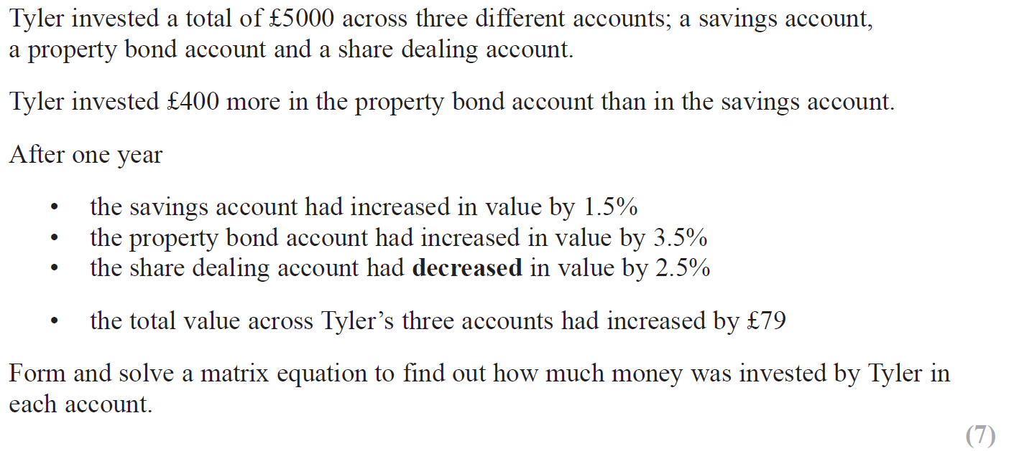
SAM

Slide 3
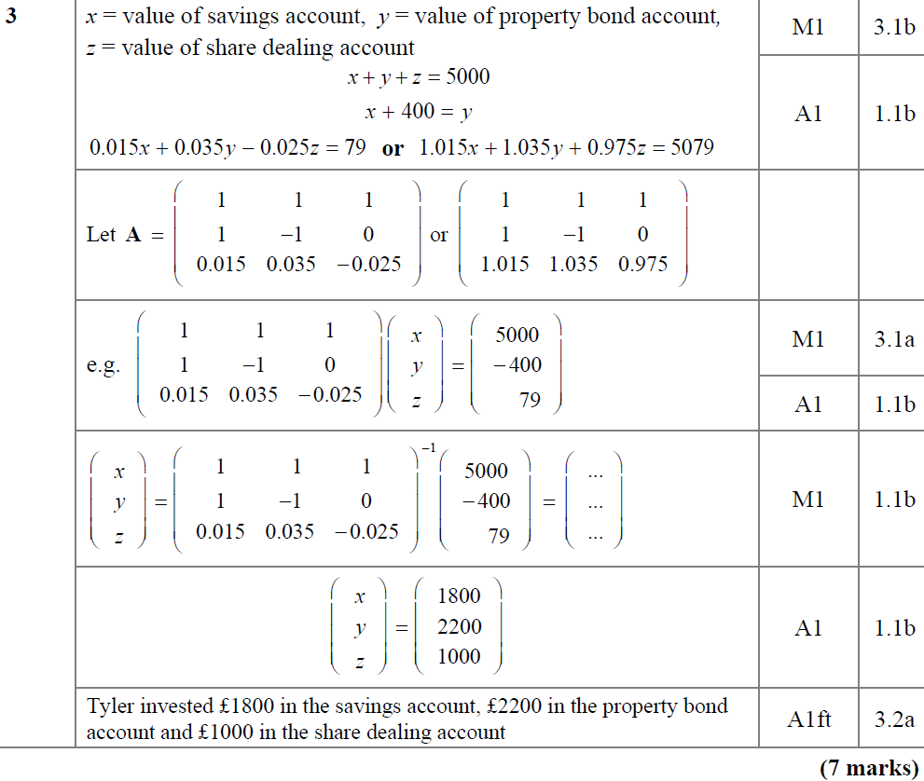
SAM
A

Slide 4
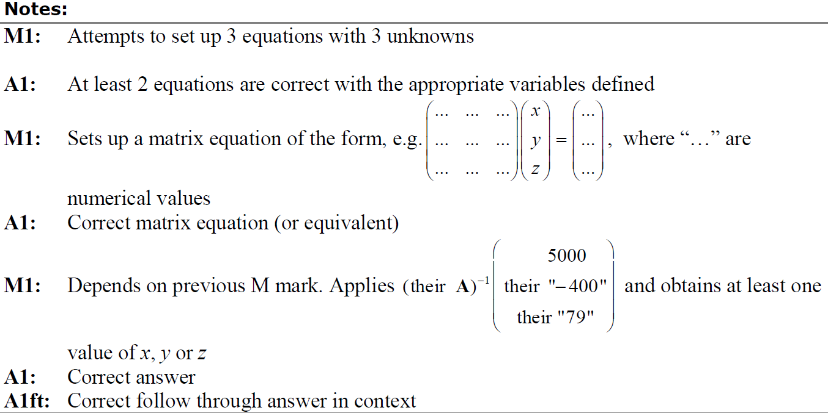
SAM
A notes

Slide 5
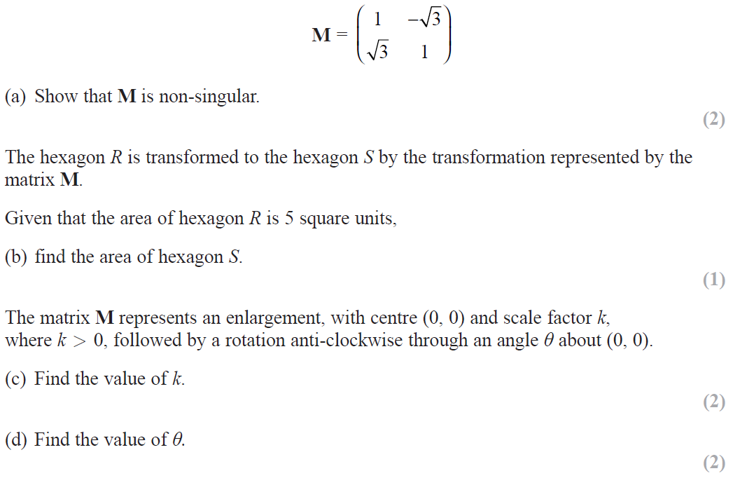
SAM

Slide 6
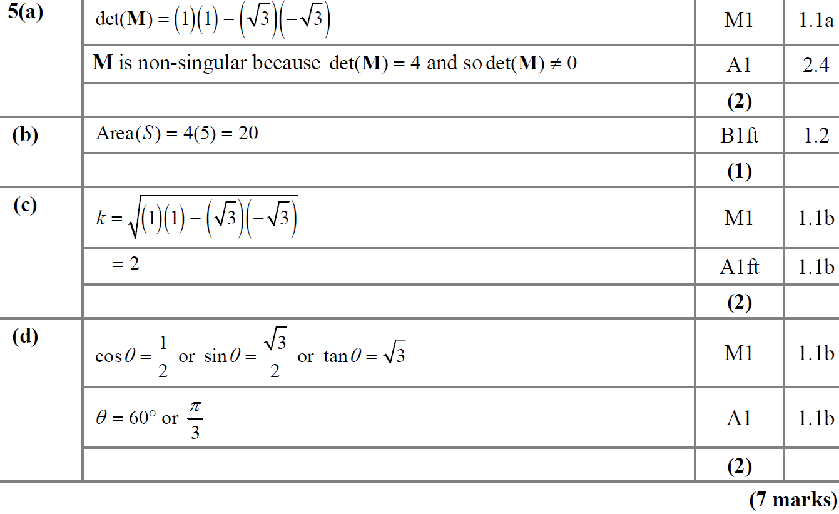
SAM
A
B
C
D

Slide 7
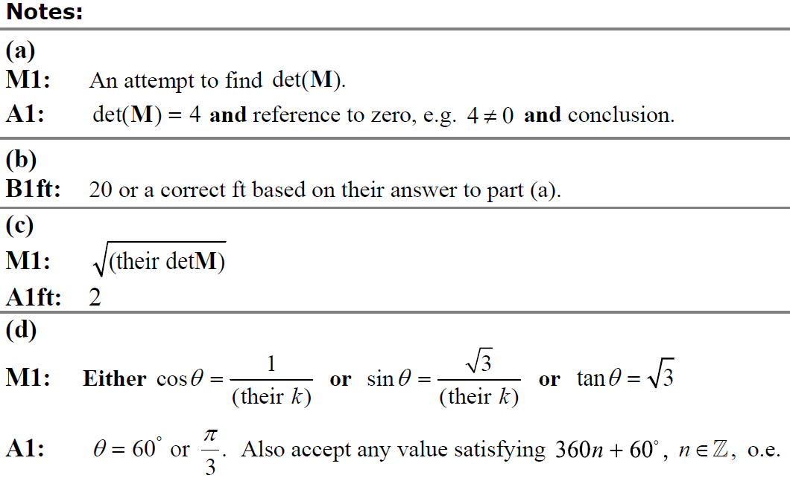
SAM
A notes
B notes
C notes
D notes

Slide 8
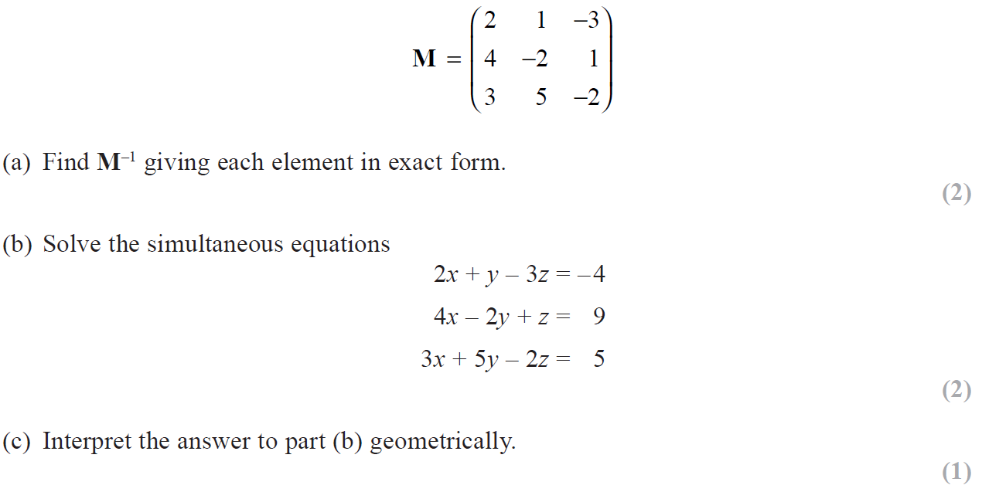
2018

Slide 9
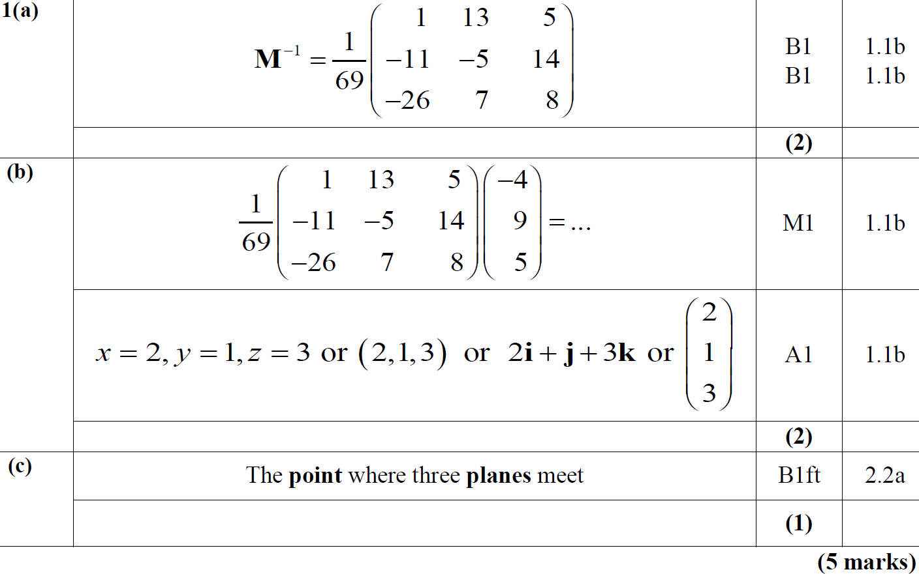
2018
A
B
C

Slide 10
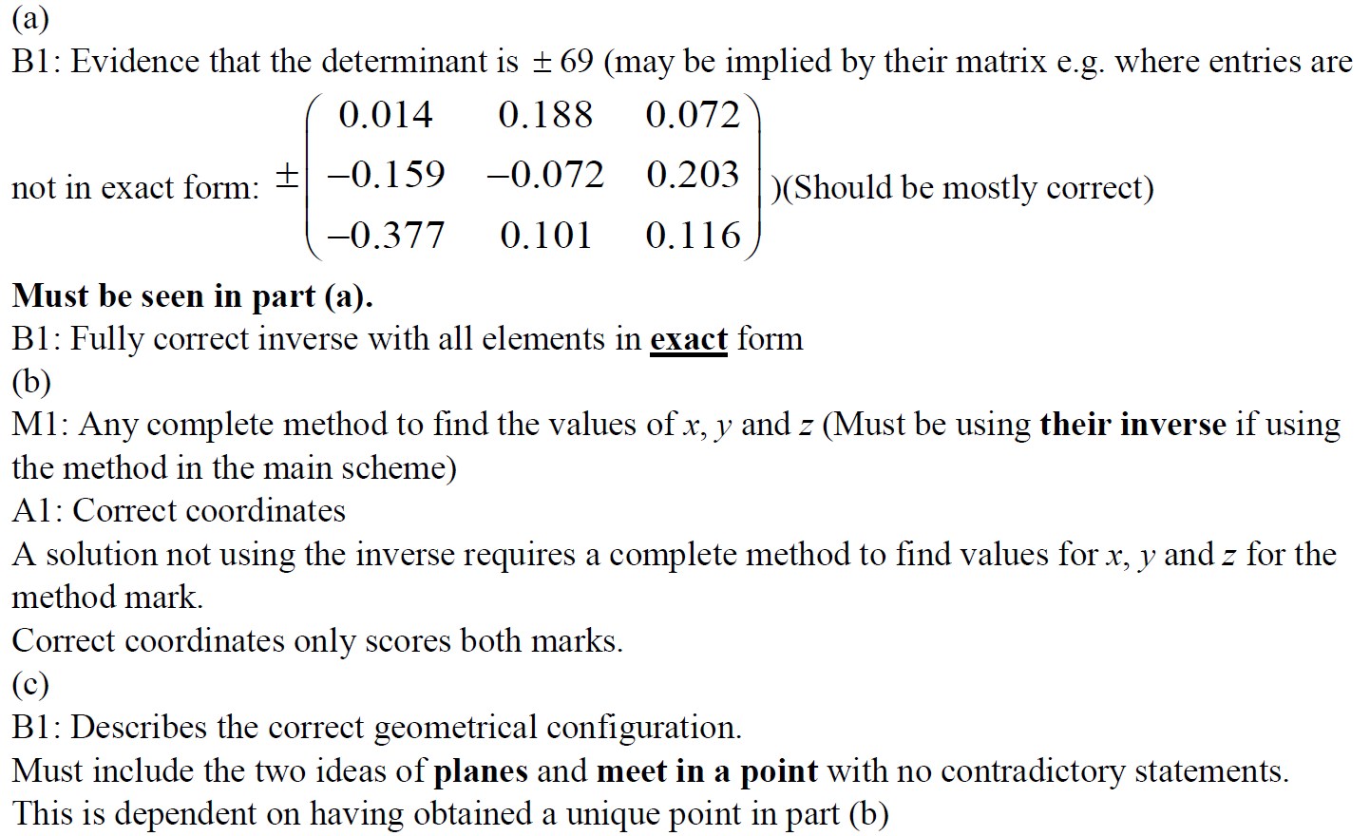
2018
A
B
C

Slide 11
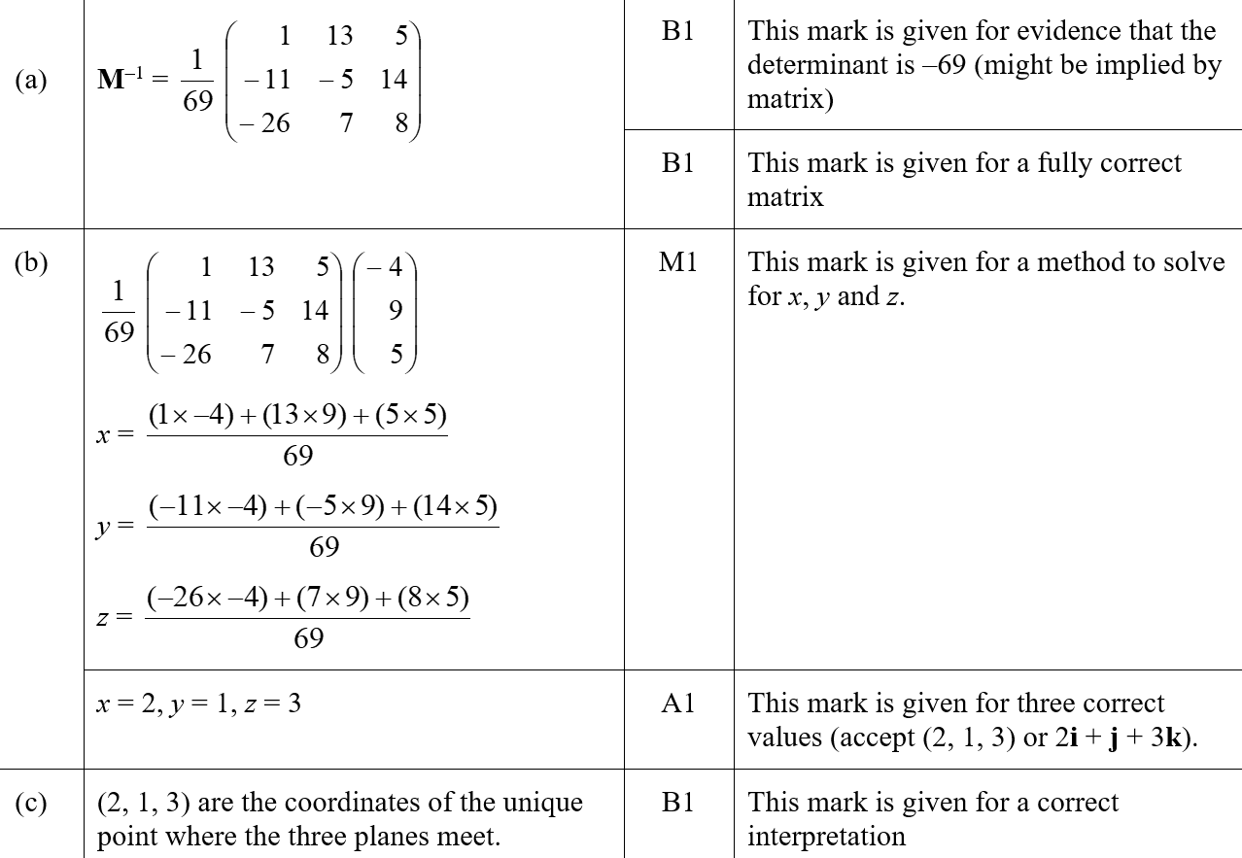
2018
A notes
B SF
C SF

Slide 12
2018

Slide 13
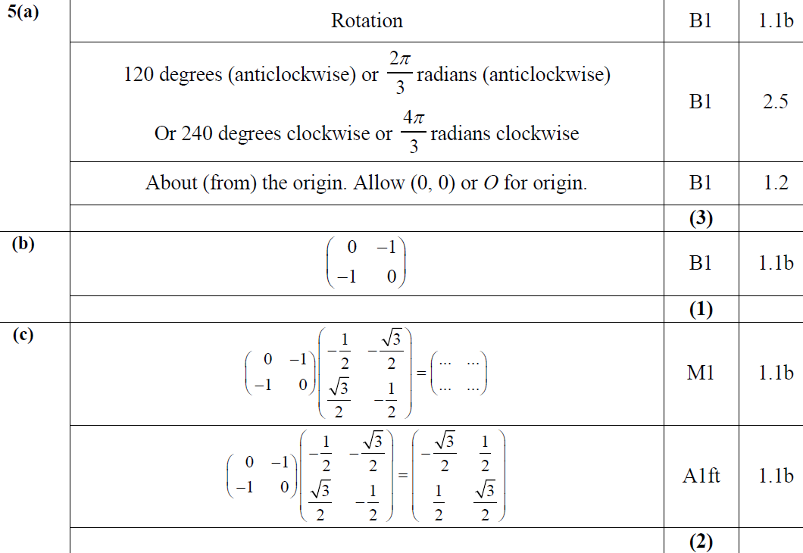
2018
A
B
C

Slide 14
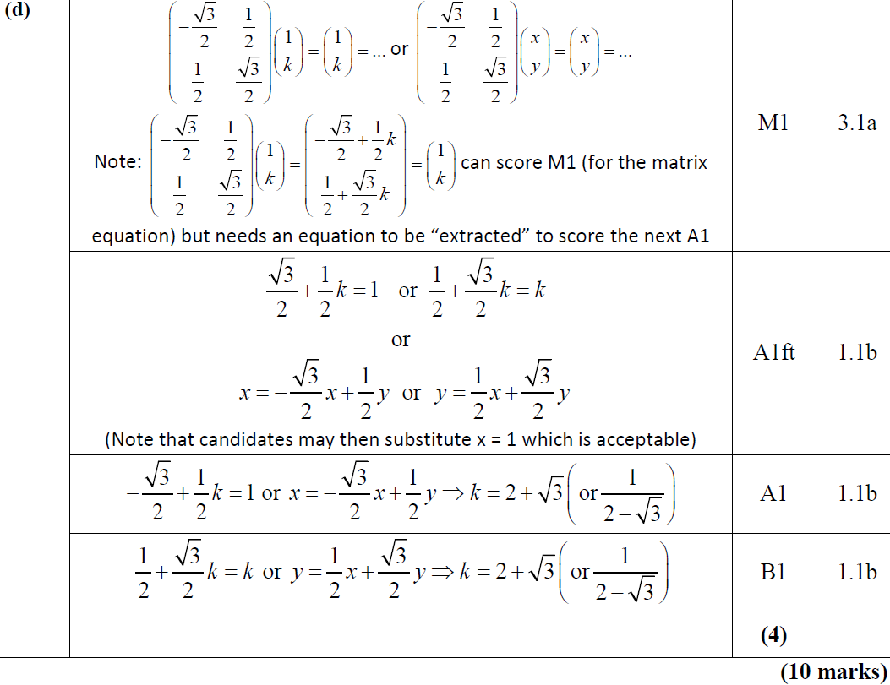
2018
B

Slide 15
2018
A notes
B notes
C notes
D notes

Slide 16
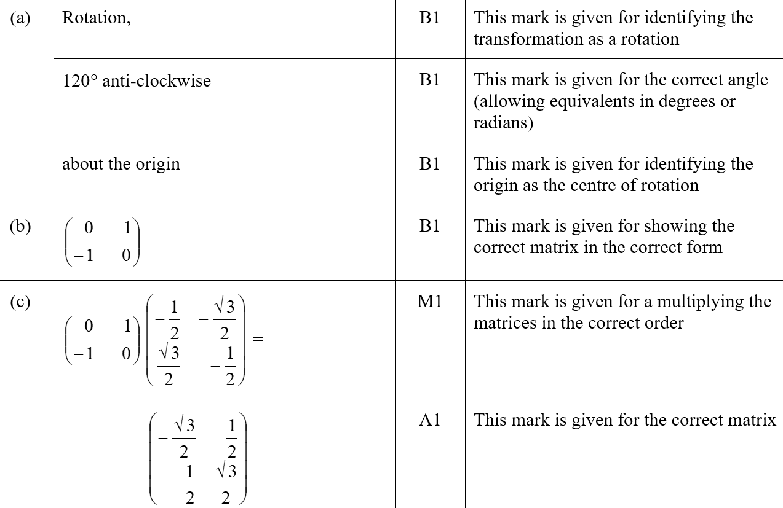
2018
A SF
B SF
C SF

Slide 17
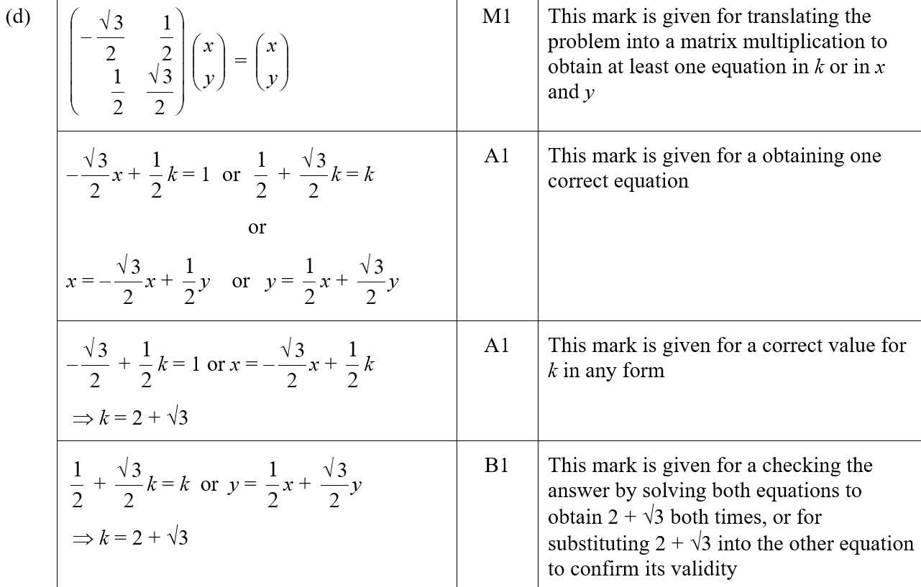
2018
D SF

Slide 18
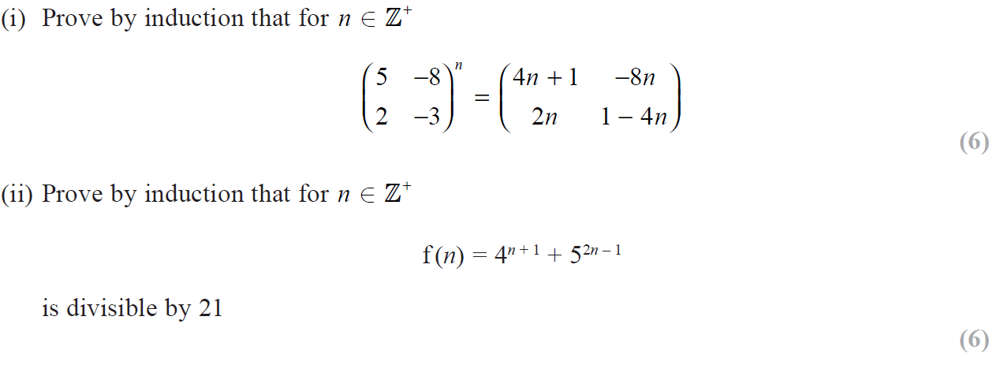
2018

Slide 19
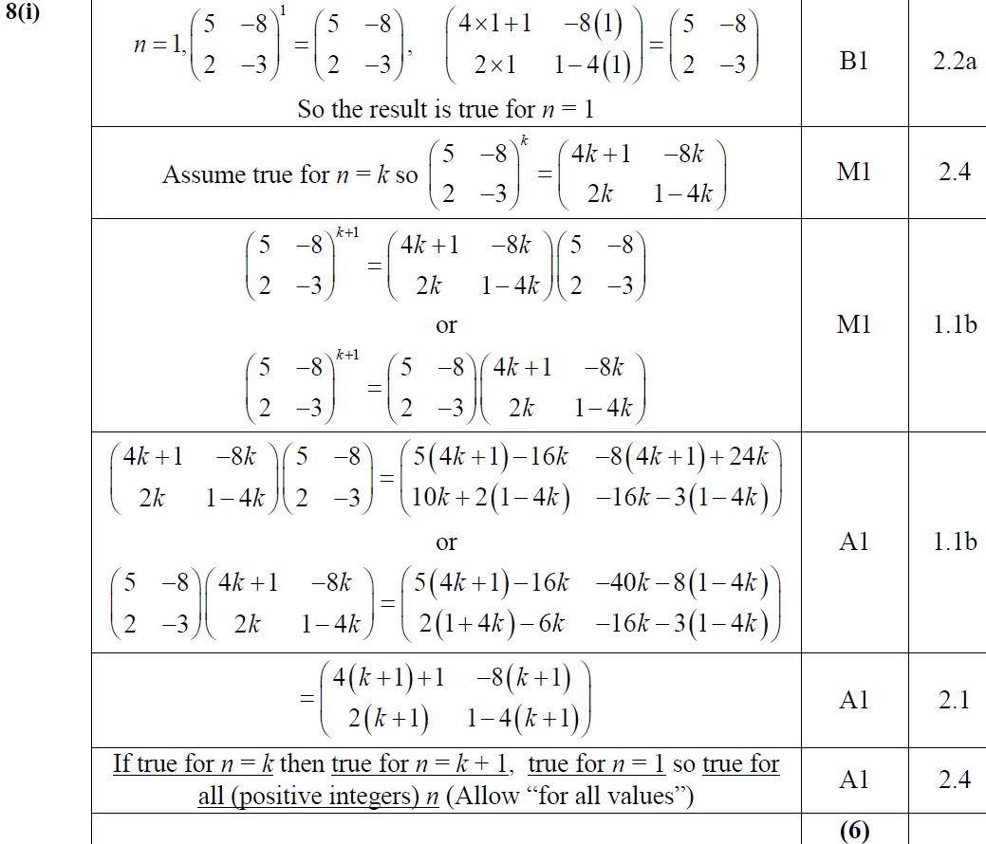
2018
(i)

Slide 20
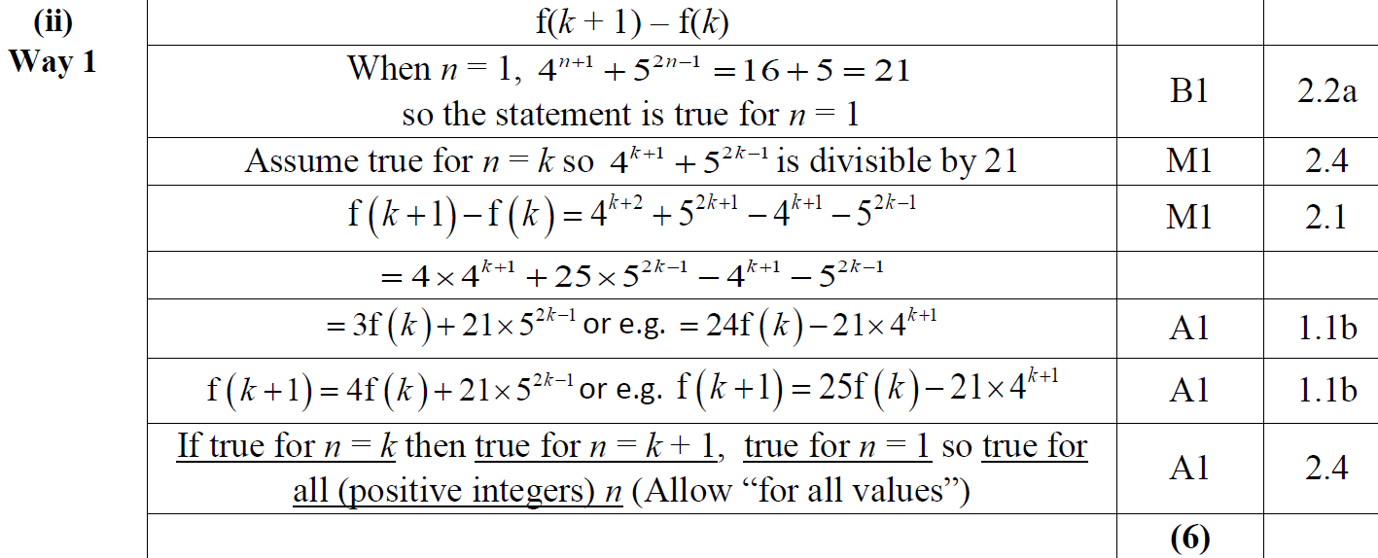
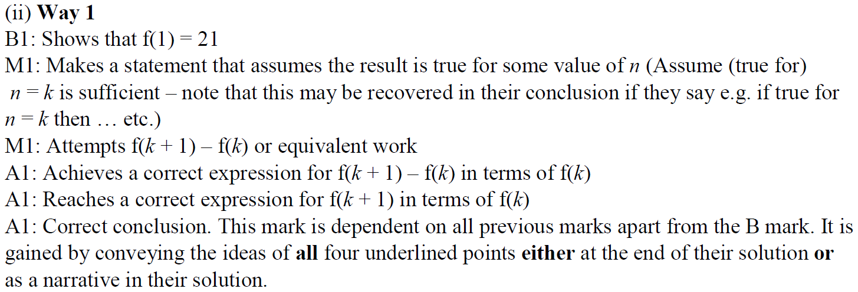
2018
(ii)

Slide 21
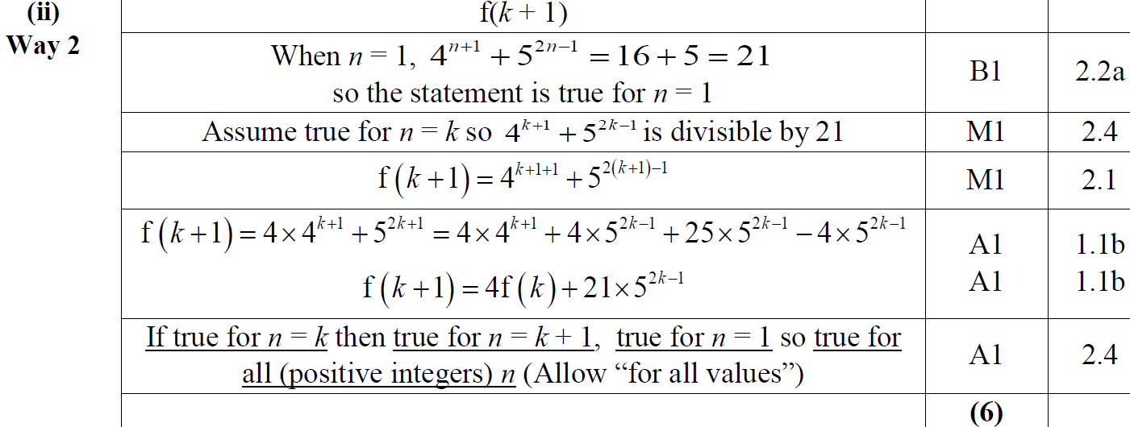
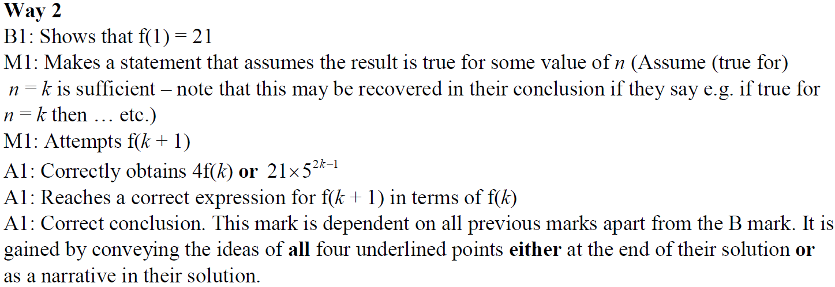
2018
(ii) Alternative 1

Slide 22
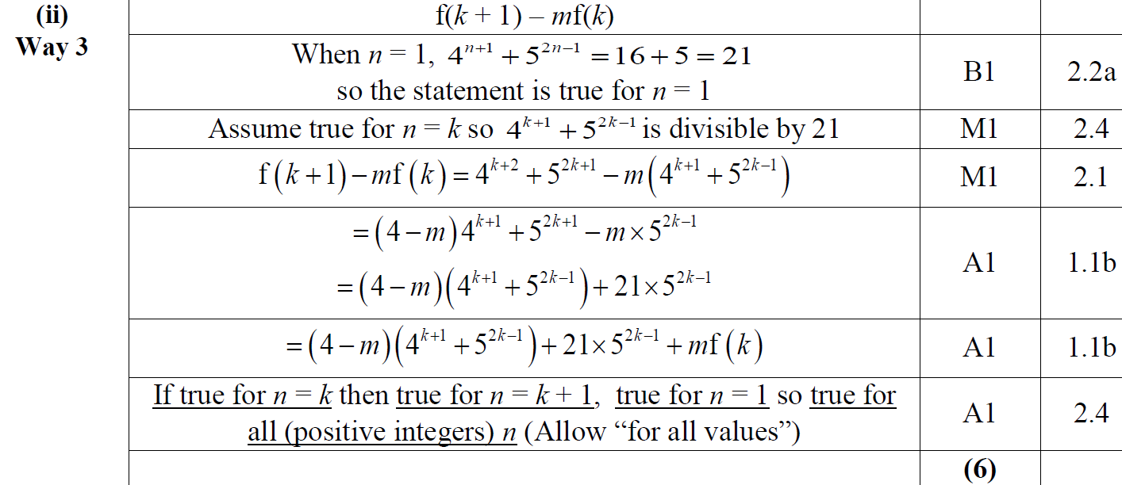
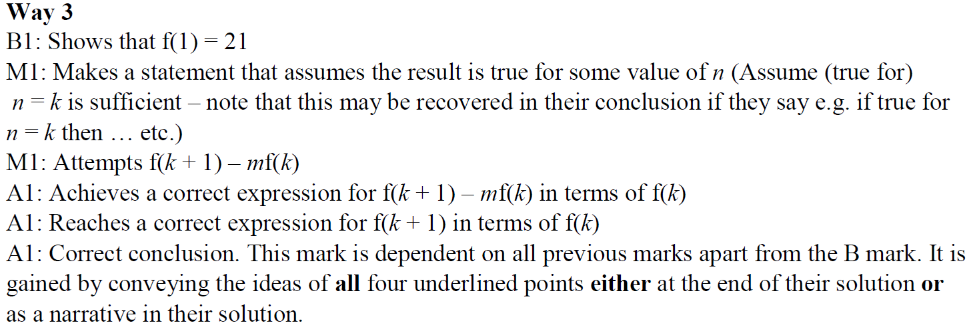
2018
(ii) Alternative 2

Slide 23
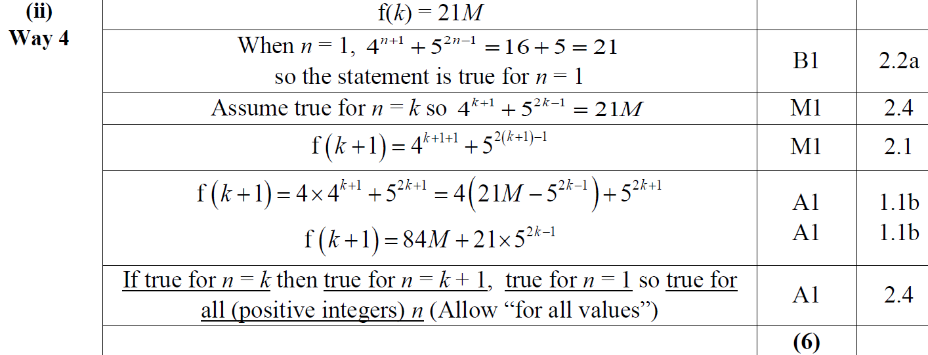
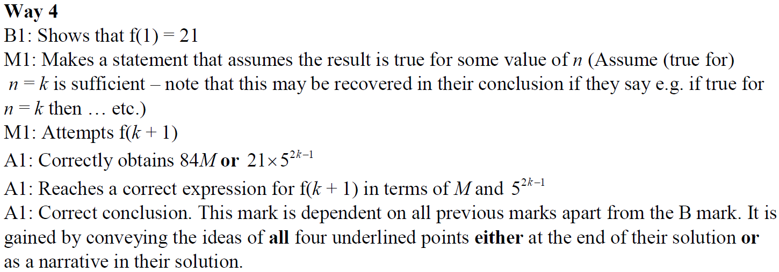
2018
(ii) Alternative 3

Slide 24
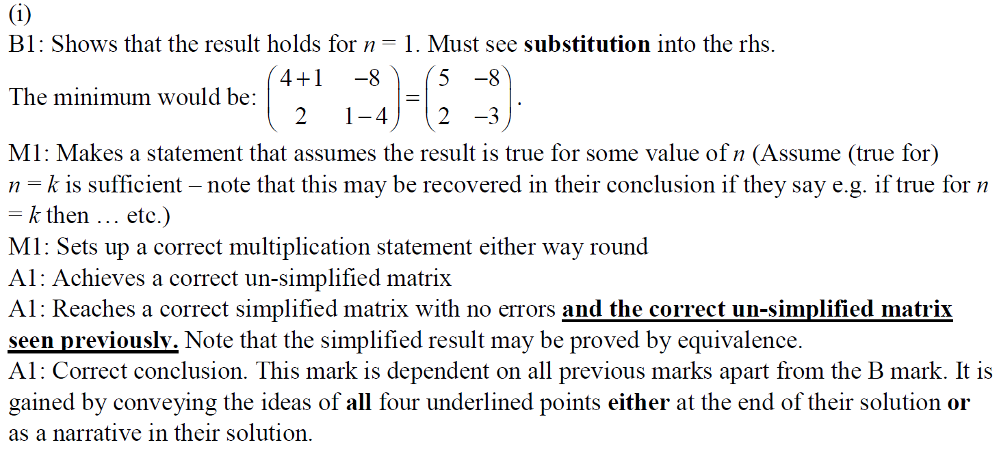
2018
(i) notes

Slide 25
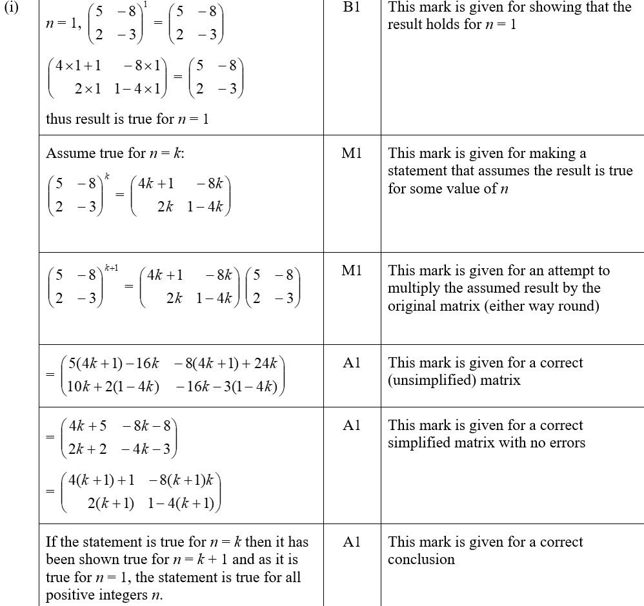
2018
(i) SF

Slide 26
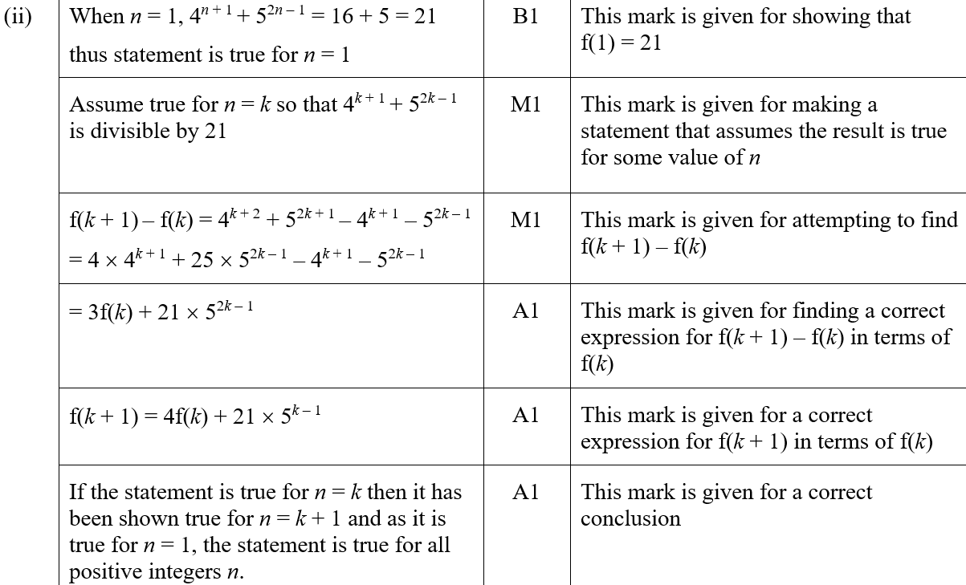
2018
(ii) SF

Slide 27
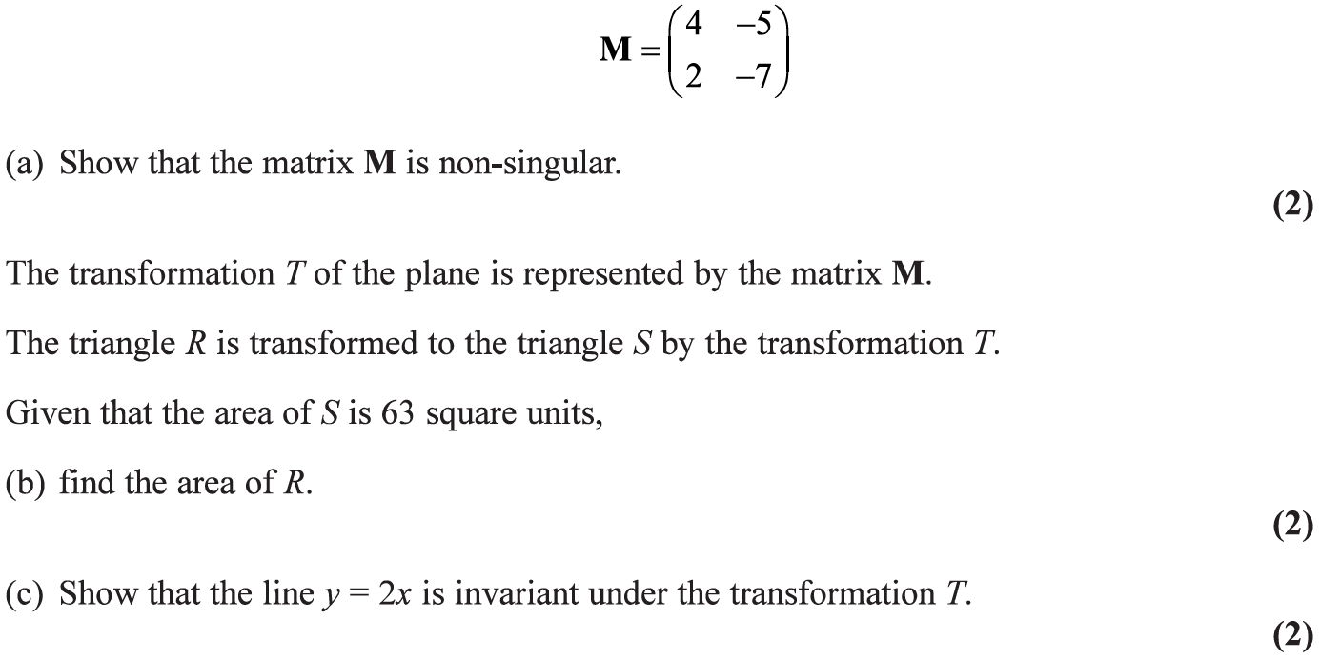
2019

Slide 28
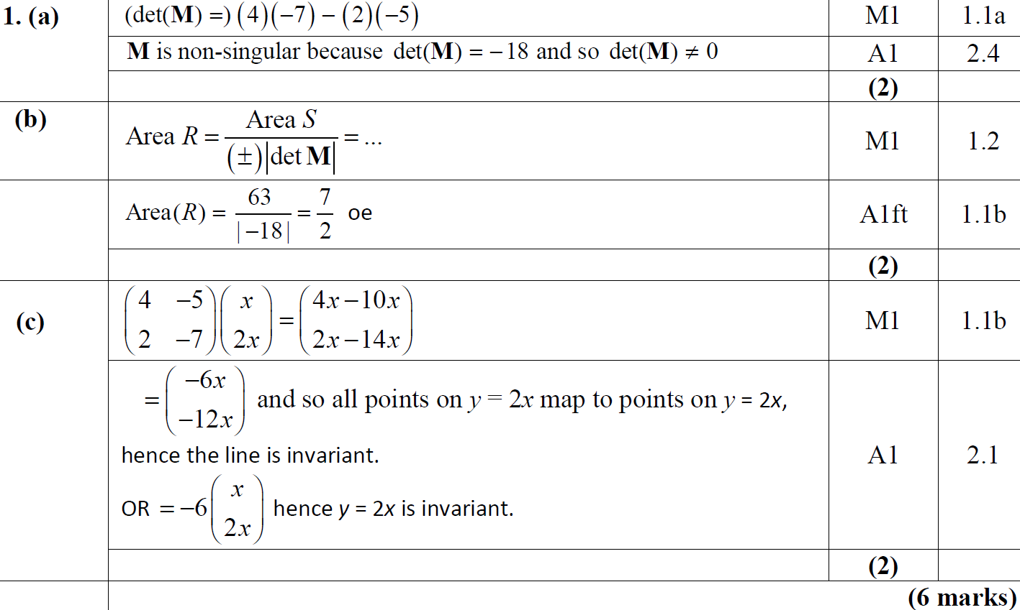
2019
A
B
C

Slide 29
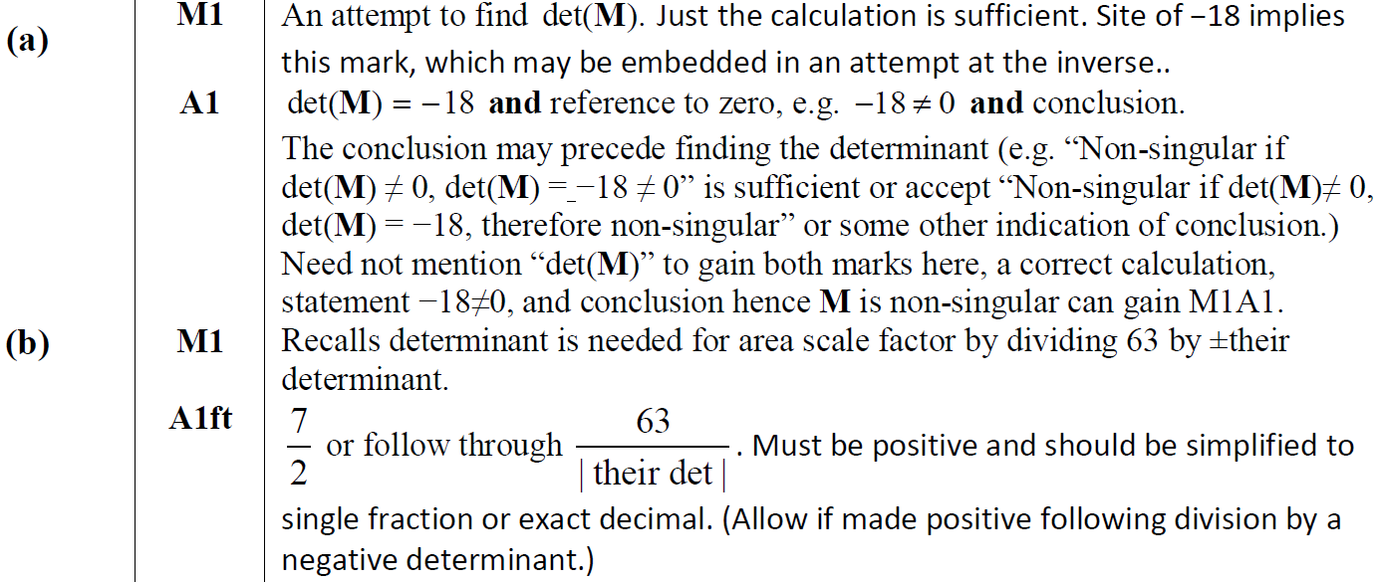
2019
A notes
B notes

Slide 30
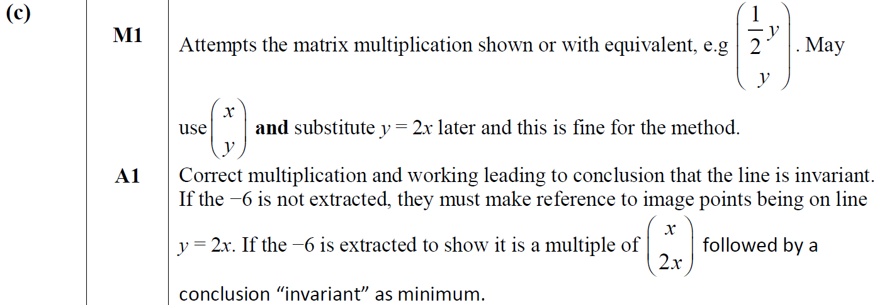
2019
C notes

Slide 31
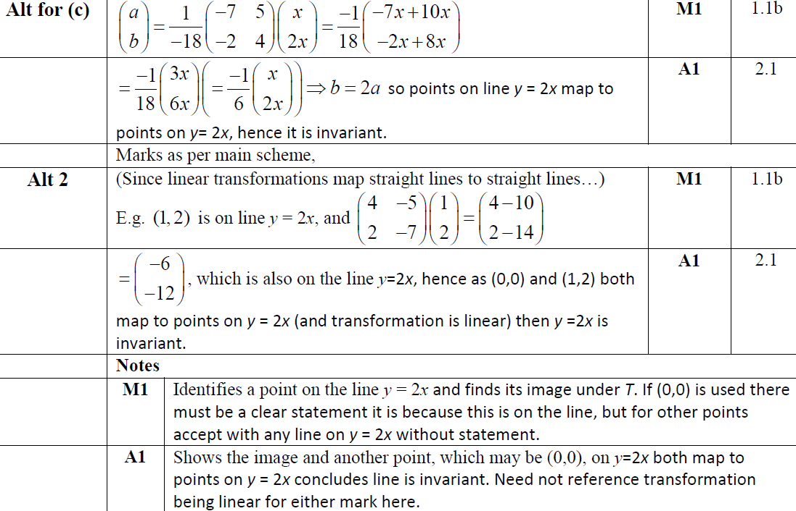
2019
C Alternatives 1 & 2

Slide 32
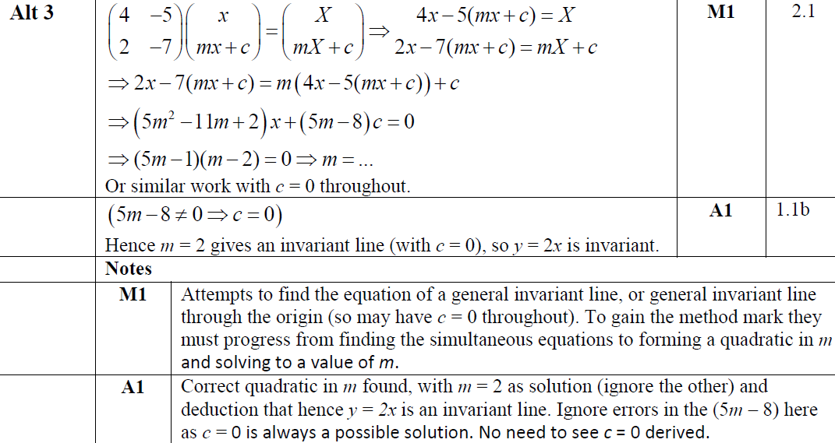
2019
C Alternative 3

Slide 33
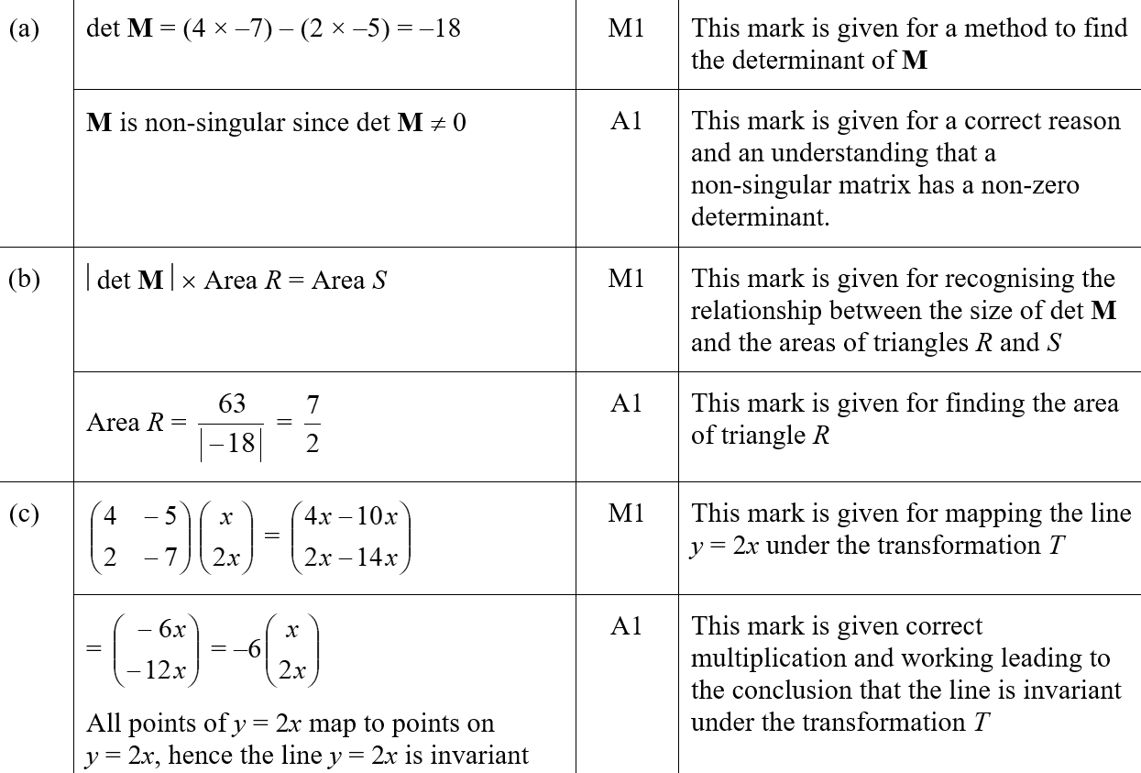
2019
A SF
B SF
C SF

Slide 34
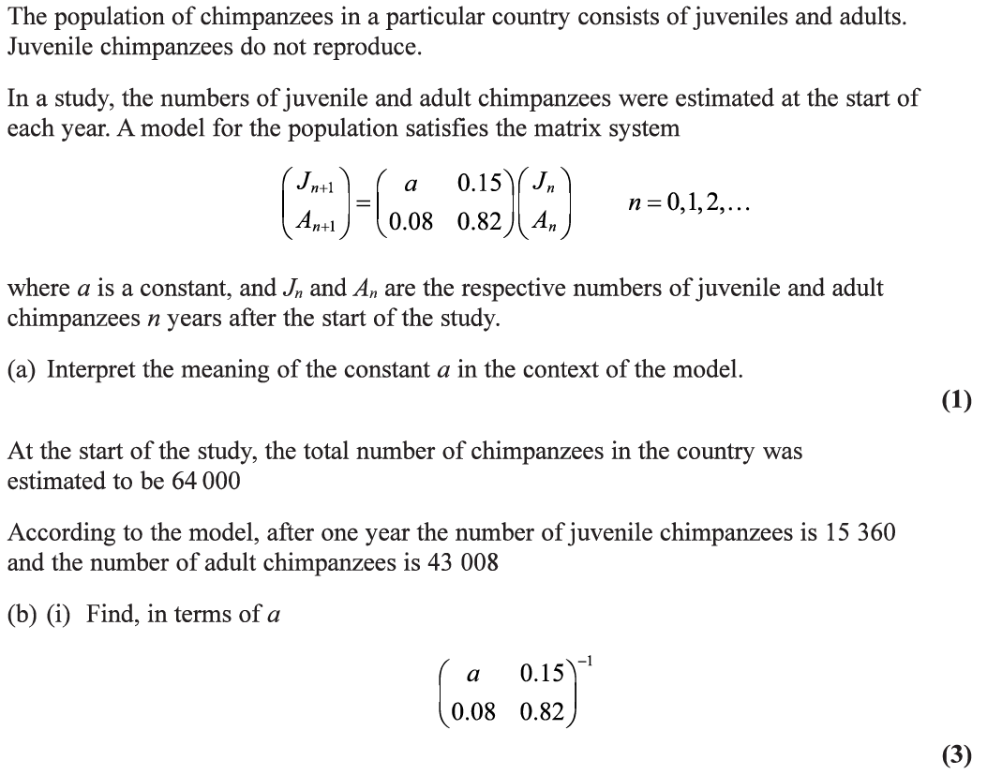
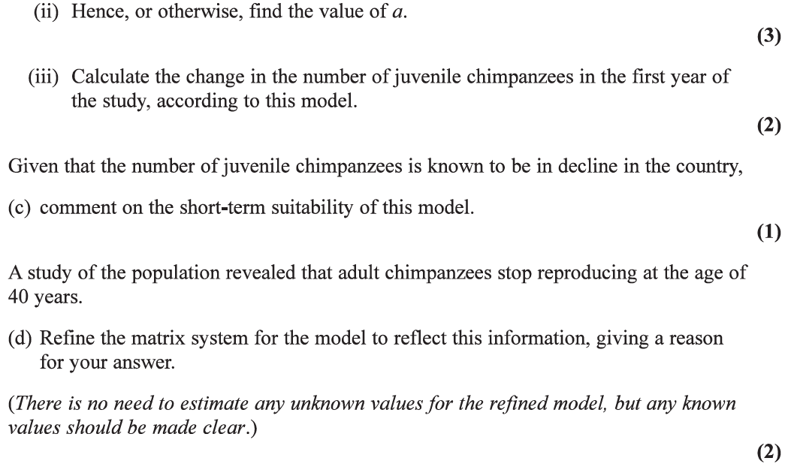
2019

Slide 35
2019
A
B (i)

Slide 36
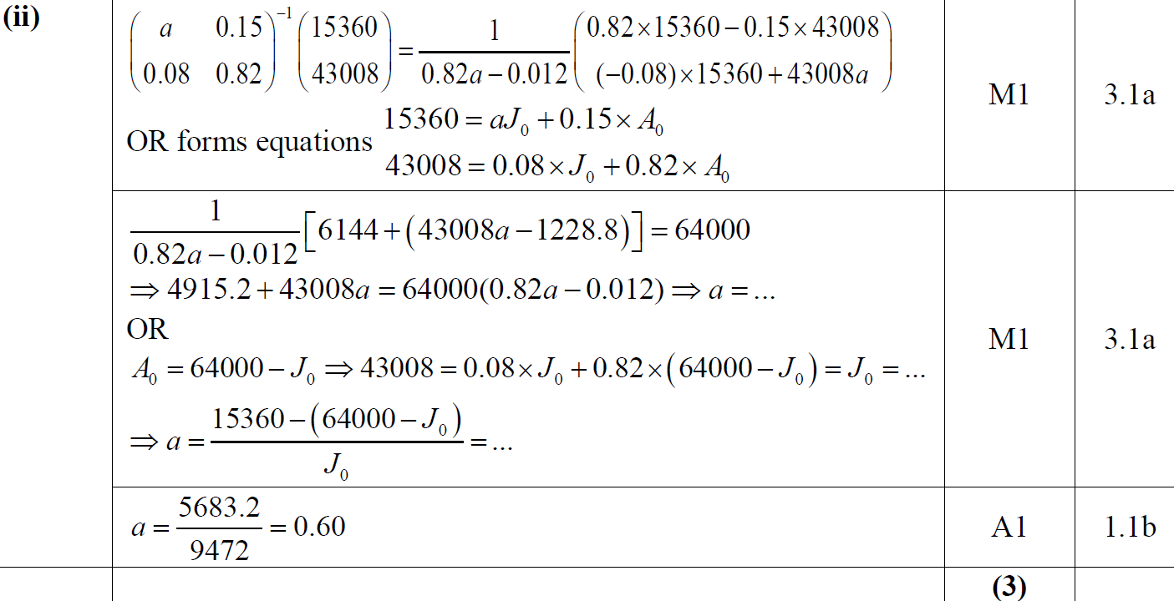
2019
B (ii)

Slide 37
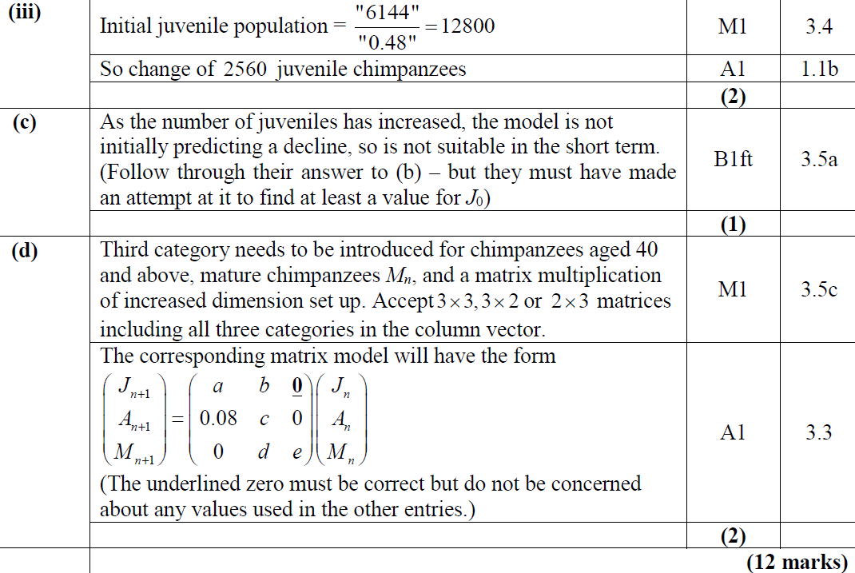
2019
B (iii)
C
D

Slide 38
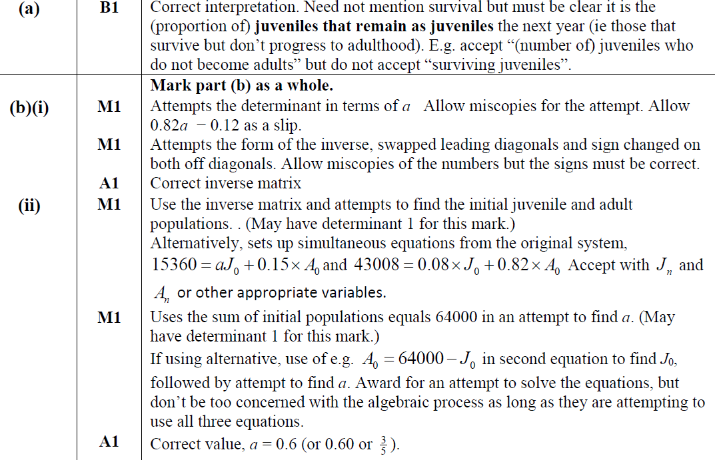
2019
A notes
B (i) notes
B (ii) notes

Slide 39
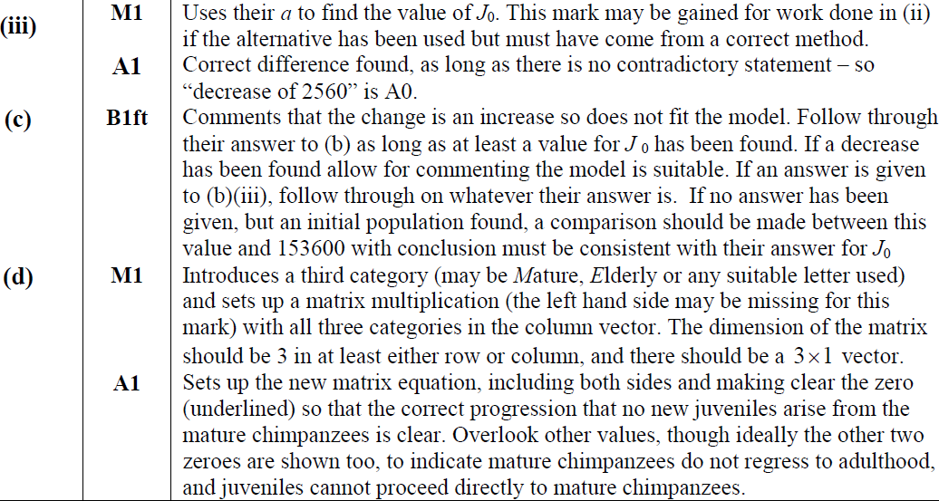
2019
B (iii) notes
C notes
D notes

Slide 40
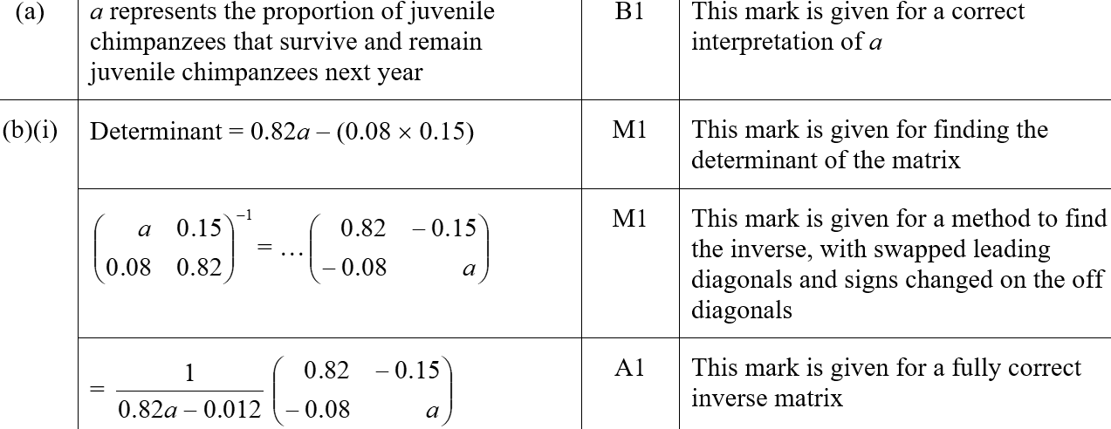
2019
A SF
B (i) SF

Slide 41
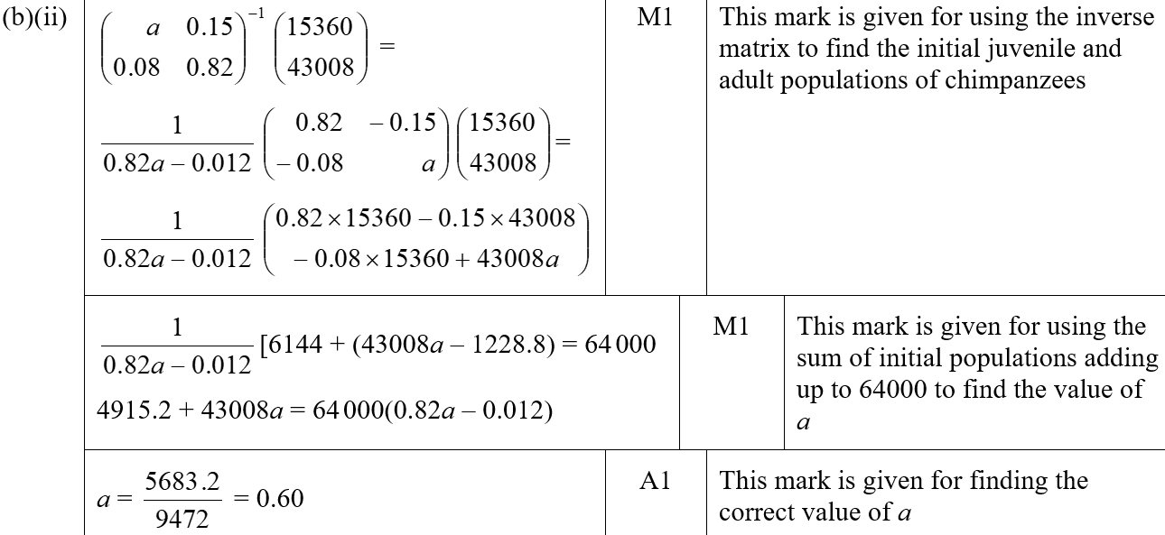
2019
B (ii) SF

Slide 42
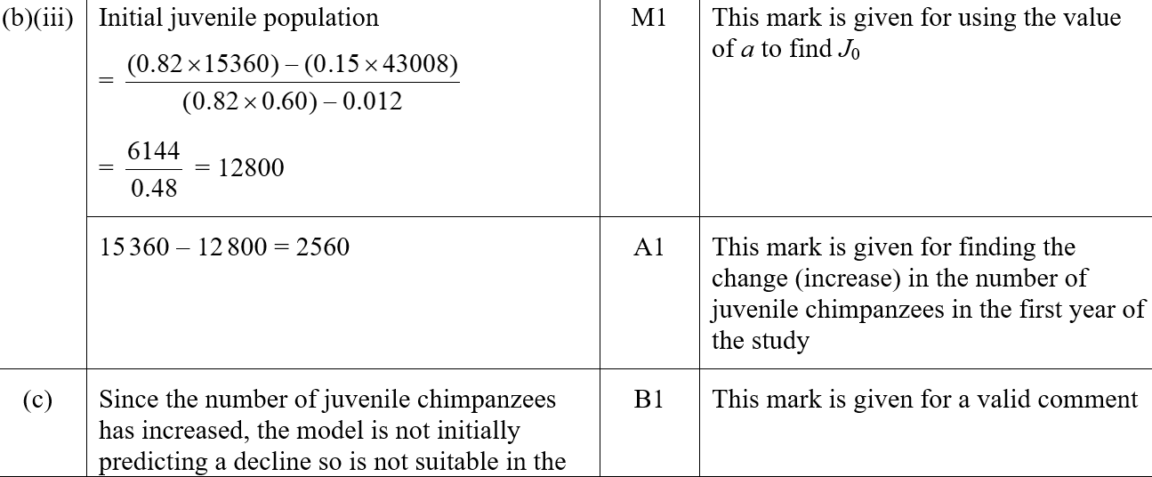
2019
B (ii) SF
C SF

Slide 43
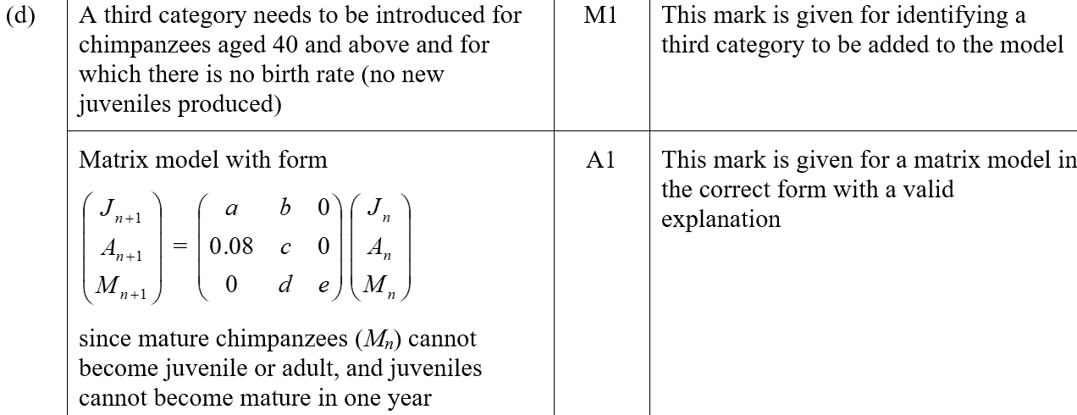
2019
D SF

Slide 44
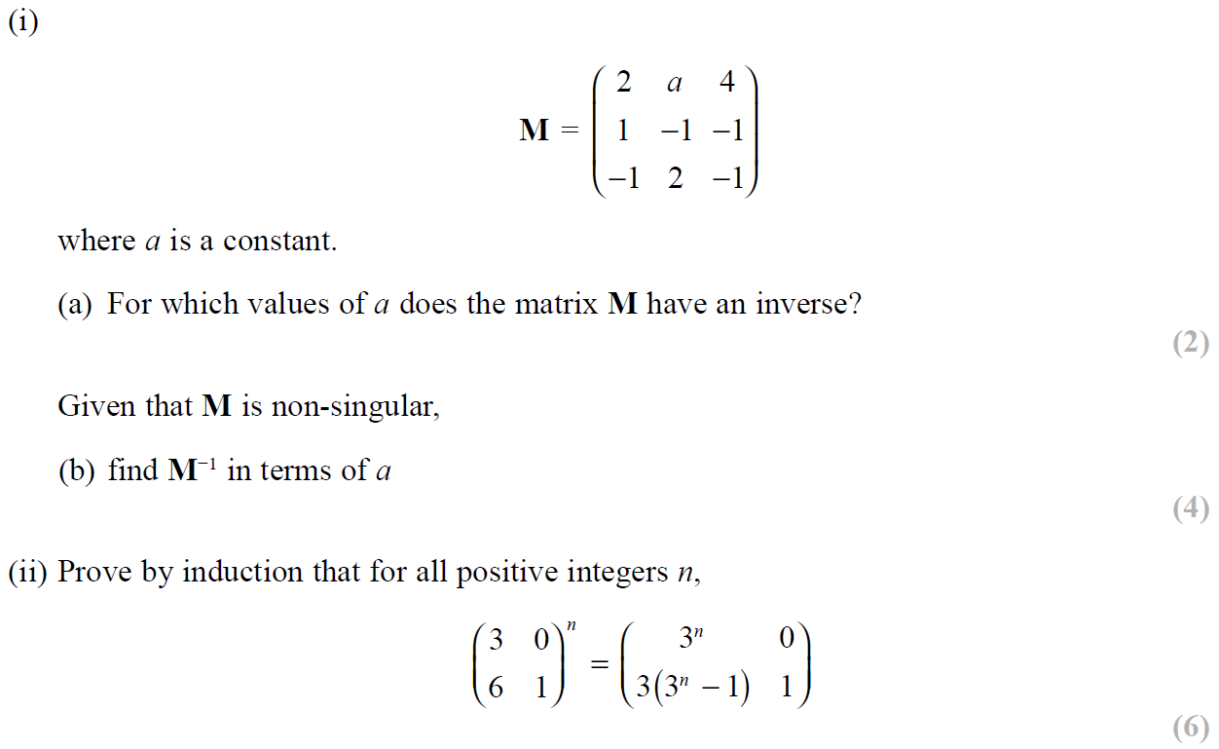
SAM Paper 2

Slide 45
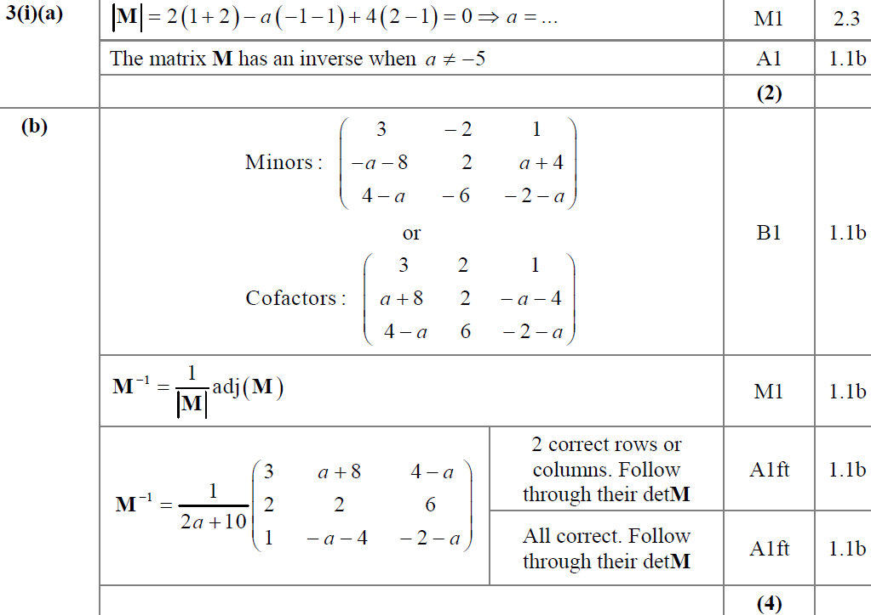
SAM Paper 2
(i) A
(i) B

Slide 46
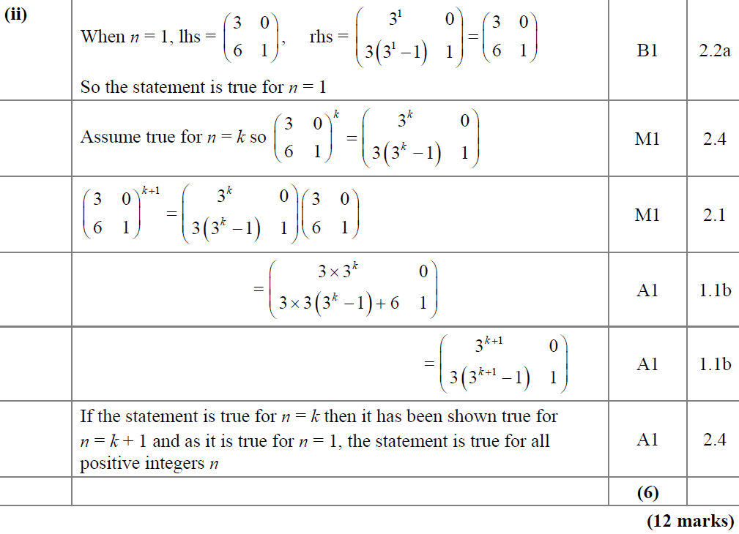
SAM Paper 2
(ii)

Slide 47
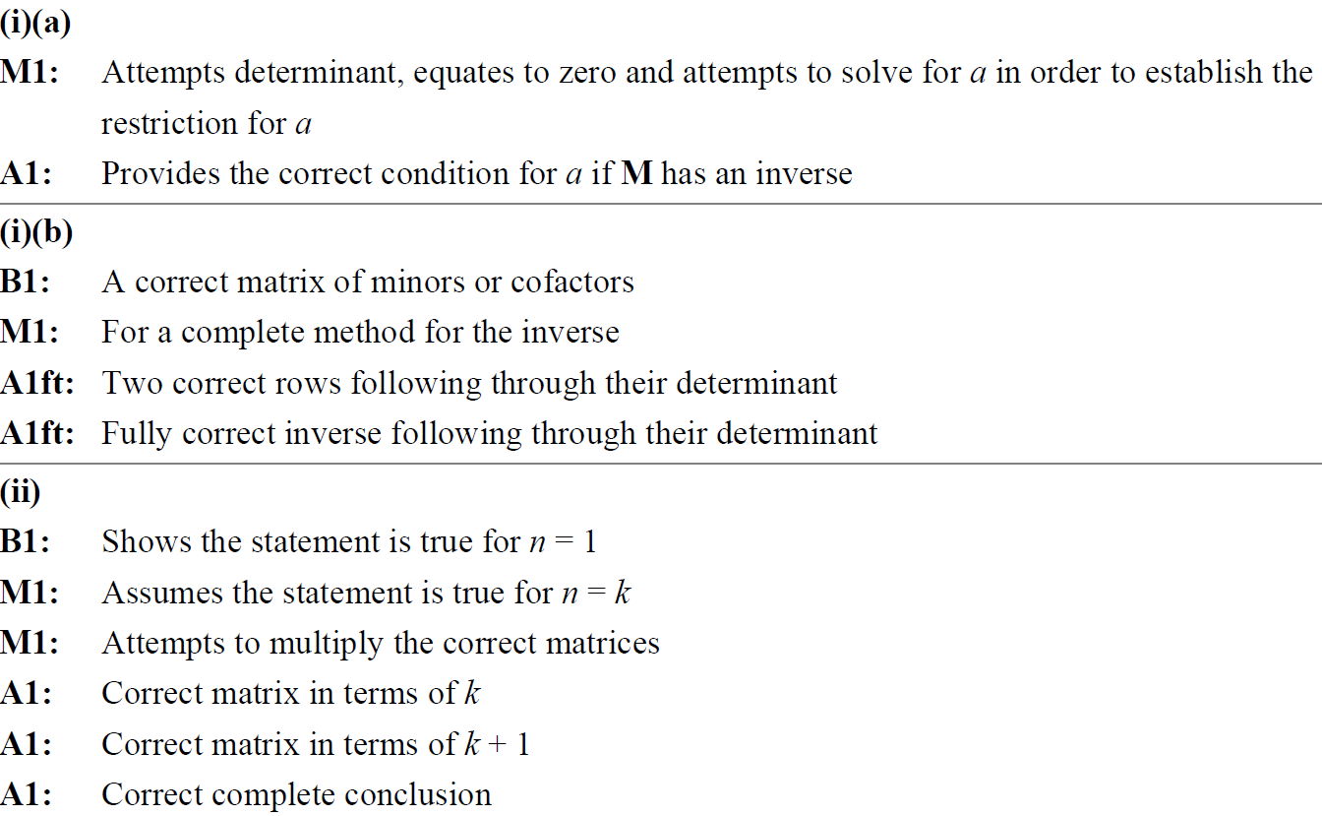
SAM Paper 2
(i) A notes
(i) B notes
(ii) notes

Slide 48
2019 Paper 2

Slide 49
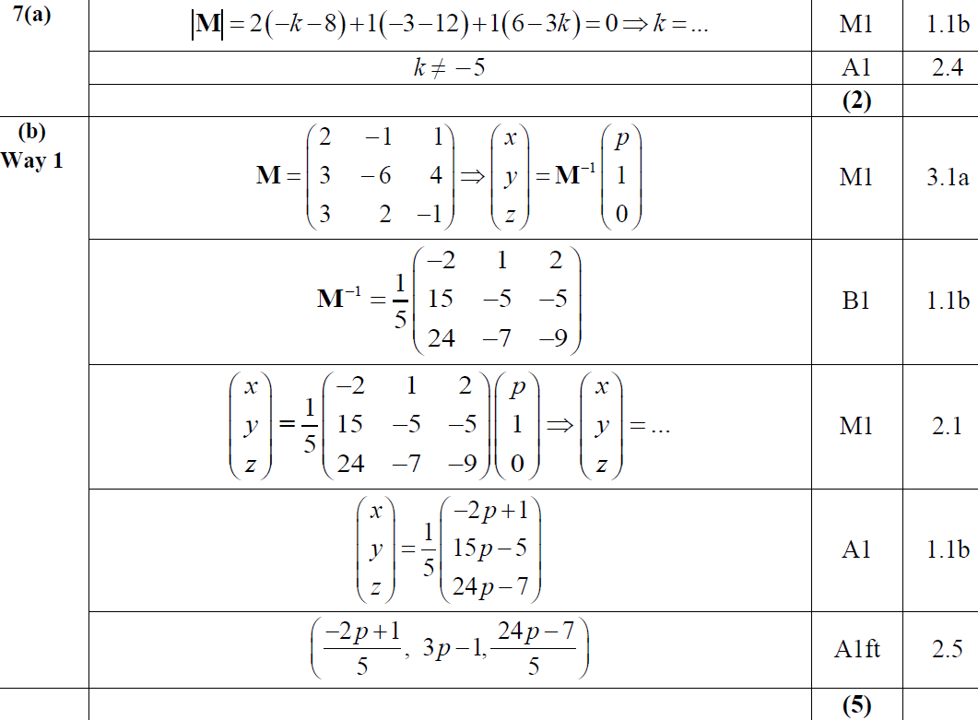
2019 Paper 2
A
B

Slide 50
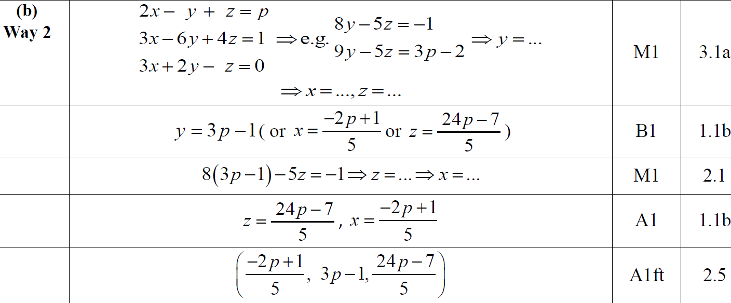
2019 Paper 2
B Alternative

Slide 51
2019 Paper 2
C (i)
C (ii)

Slide 52
2019 Paper 2
A notes
B notes

Slide 53
2019 Paper 2
C (i) notes
C (ii) notes

Slide 54
New Spec Q’s
With induction part
transformations
Old Spec Matrices
*not sure if new spec.
3D invariant line/ plane
FP1 2x2 only
P6/ Old FP3
FP3
Jan 2009 (i)
Jan 2011 (ii)
June 2013 (i)
June 2014 R (ii)
June 2003 (i)
June 2006 (ii)
June 2010*
Jan 2009 (ii)
June 2011 (i)
June 2013 (ii)
June 2015 (i)
June 2003 (ii)
June 2007
June 2011
June 2009 (i)
June 2011 (ii)
June 2013 (iii)
June 2015 (ii)
June 2004
June 2008
June 2013
June 2009 (ii)
June 2011 (iii)
June 2013 R (i)
May 2016 (i)
June 2005 (i)
June 2009
June 2013 R*
June 2009 (iii)
Jan 2012 (i)
June 2013 R (ii)
May 2016 (ii)
June 2005 (ii)
Feb 2010
June 2013 W*
Jan 2010 (i)
Jan 2012 (ii)
June 2013 W (i)
May 2017 (i)
Jan 2006 (i)
June 2014*
Jan 2010 (ii)
June 2012 (i)
June 2013 W (ii)
May 2017 (ii)
Jan 2006 (ii)
June 2016
June 2010 (i)
June 2012 (ii)
June 2014 (i)
June 2006 (i)
June 2017*
June 2010 (ii)
Jan 2013 (i)
June 2014 (ii)
cross product/ eigenvalues/vectors /transforming planes/lines part (ignore as not in this spec yet)
Jan 2011 (i)
Jan 2013 (ii)
June 2014 R (i)

Slide 55
Jan 2009

Slide 56
Jan 2009
A
B

Slide 57
Jan 2009
A notes
B notes

Slide 58
Jan 2009

Slide 59
Jan 2009
A
B
C
D
E

Slide 60
Jan 2009
A notes
B notes
C notes
D notes
E notes

Slide 61
June 2009

Slide 62
June 2009
A
B
A notes

Slide 63
June 2009
B notes

Slide 64
June 2009

Slide 65
June 2009
A
B
C

Slide 66
June 2009
A notes
B notes
C notes

Slide 67
June 2009

Slide 68
June 2009
A
B

Slide 69
June 2009
A Alternative & notes
B Alternative & notes

Slide 70
Jan 2010

Slide 71
Jan 2010
A
B
C
A notes
B notes
C notes

Slide 72
Jan 2010

Slide 73
Jan 2010
A
B
C
D
E

Slide 74
Jan 2010
A notes
B notes
C notes
E notes

Slide 75
June 2010

Slide 76
June 2010
A
B
A notes
B notes

Slide 77
June 2010

Slide 78
June 2010
A
B
C
D
E

Slide 79
June 2010
C notes
D notes
E notes

Slide 80
Jan 2011

Slide 81
Jan 2011
A
B
C

Slide 82
Jan 2011

Slide 83
Jan 2011
A
B
C

Slide 84
Jan 2011
D

Slide 85
June 2011

Slide 86
June 2011
A (i)
A (ii)

Slide 87
June 2011
B
C

Slide 88
June 2011

Slide 89
June 2011
A
B

Slide 90
June 2011
D

Slide 91
June 2011

Slide 92
June 2011
A

Slide 93
June 2011
B

Slide 94
Jan 2012

Slide 95
Jan 2012
A
B
C

Slide 96
Jan 2012
D
E

Slide 97
Jan 2012

Slide 98
Jan 2012
A
B
B Alternative 1

Slide 99
Jan 2012
B Alternative 2 & 3

Slide 100
June 2012

Slide 101
June 2012
A

Slide 102
June 2012
B

Slide 103
June 2012

Slide 104
June 2012
A
B
C
D

Slide 105
June 2012
E
F

Slide 106
Jan 2013

Slide 107
Jan 2013
A
B
C
D
E

Slide 108
Jan 2013
A & B notes
C notes
D notes
E notes

Slide 109
Jan 2013

Slide 110
Jan 2013
A
B
C

Slide 111
Jan 2013
B notes
C notes

Slide 112
June 2013

Slide 113
June 2013
A

Slide 114
June 2013
A notes

Slide 115
June 2013

Slide 116
June 2013
A
B

Slide 117
June 2013
C

Slide 118
June 2013

Slide 119
June 2013
A

Slide 120
June 2013
B

Slide 121
June 2013 Reserve

Slide 122
June 2013 Reserve
(i) A
(i) B

Slide 123
June 2013 Reserve
(ii)

Slide 124
June 2013 Reserve

Slide 125
June 2013 Reserve
A
B

Slide 126
June 2013 Reserve
C

Slide 127
June 2013 Withdrawn

Slide 128
June 2013 Withdrawn
A
B

Slide 129
June 2013 Withdrawn
A notes
B notes

Slide 130
June 2013 Withdrawn

Slide 131
June 2013 Withdrawn
A
B
C
D

Slide 132
June 2013 Withdrawn
D Alternative

Slide 133
June 2014

Slide 134
June 2014
(i) A
(i) B
(ii)

Slide 135
June 2014

Slide 136
June 2014
(i) A
(i) B
(i) C
(ii)

Slide 137
June 2014 Reserve

Slide 138
June 2014 Reserve
(i) A
(i) B
(ii)

Slide 139
June 2014 Reserve

Slide 140
June 2014 Reserve
A

Slide 141
June 2014 Reserve
B

Slide 142
June 2015

Slide 143
June 2015
(i)

Slide 144
June 2015
(ii)

Slide 145
June 2015
(i) notes
(ii) notes

Slide 146
June 2015

Slide 147
June 2015
(i)
(ii) A
(ii) B

Slide 148
June 2015
(ii) C
(i) notes
(ii) A notes
(ii) B notes
(ii) C notes

Slide 149
May 2016

Slide 150
May 2016
A

Slide 151
May 2016

Slide 152
May 2016
A
B
C
D

Slide 153
May 2016
E
A notes
B notes
D notes
E notes

Slide 154
May 2017

Slide 155
May 2017
A
B

Slide 156
May 2017
B Alternative

Slide 157
May 2017

Slide 158
May 2017
(i) A
(i) B

Slide 159
May 2017
(ii)

Slide 160
June 2003

Slide 161
June 2003
A
B

Slide 162
June 2003

Slide 163
June 2003
A
B
C

Slide 164
June 2004

Slide 165
June 2004
A
B
C
D

Slide 166
June 2004
C Alternative
D Alternative

Slide 167
June 2005

Slide 168
June 2005
A (i)
A (ii)
B (i)
B (ii)

Slide 169
June 2005

Slide 170
June 2005
A
B
C

Slide 171
June 2005
D

Slide 172
Jan 2006

Slide 173
Jan 2006
A
B

Slide 174
Jan 2006

Slide 175
Jan 2006
A
B

Slide 176
June 2006

Slide 177
June 2006
A

Slide 178
June 2006

Slide 179
June 2006
A
B
C

Slide 180
June 2006
D
C Alternative
D Alternative

Slide 181
June 2007

Slide 182
June 2007
A
B

Slide 183
June 2007
C

Slide 184
June 2008

Slide 185
June 2008
A
B
C
D

Slide 186
June 2008
B notes
C notes
D notes

Slide 187
June 2009

Slide 188
June 2009
A

Slide 189
June 2009
B

Slide 190
Feb 2010

Slide 191
Feb 2010
(i)

Slide 192
Feb 2010
(ii)

Slide 193
June 2010

Slide 194
June 2010
A
B

Slide 195
June 2010
C
D

Slide 196
June 2011

Slide 197
June 2011
A

Slide 198
June 2011
B
C

Slide 199
June 2013

Slide 200
June 2013
A

Slide 201
June 2013
B (i)
B (ii)

Slide 202
June 2013 Reserve

Slide 203
June 2013 Reserve
A

Slide 204
June 2013 Withdrawn

Slide 205
June 2013 Withdrawn
A
B

Slide 206
June 2013 Withdrawn
C

Slide 207
June 2014

Slide 208
June 2014
A
B

Slide 209
June 2014
C
D

Slide 210
June 2016

Slide 211
June 2016
A

Slide 212
June 2017

Slide 213
June 2017
A

Slide 214
June 2017
B

Slide 215
June 2017
C

Slide 216
June 2017
C Alternative 1

Slide 217
June 2017
C Alternative 2

Slide 218
June 2017
C Alternative 3

