Slide 1
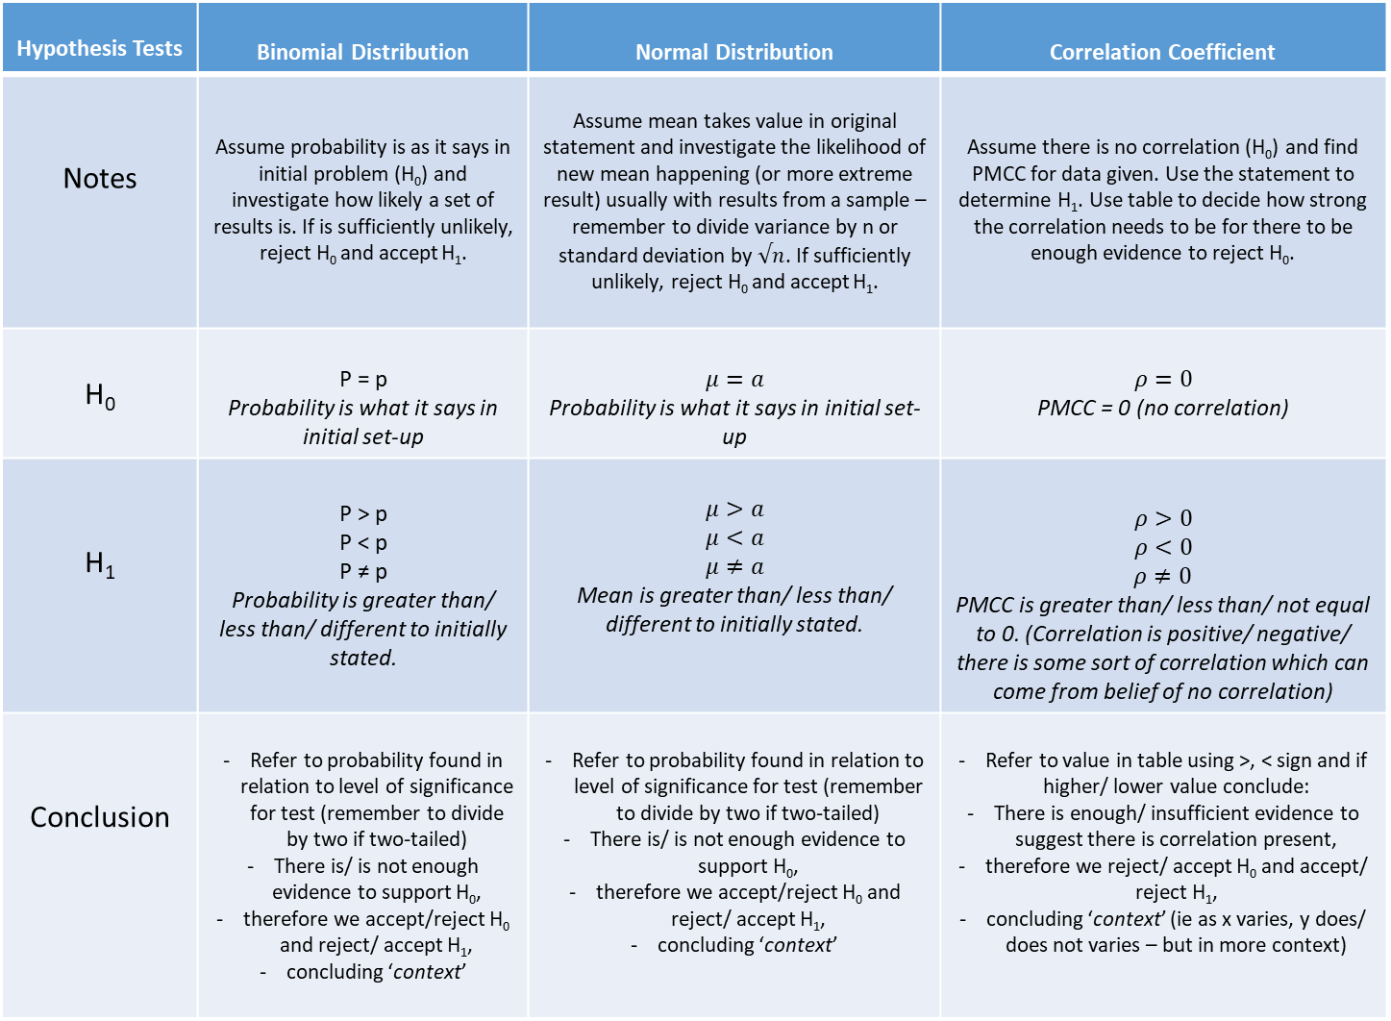
Hypothesis Tests | Binomial Distribution | Normal Distribution | Correlation Coefficient
Notes | Assume probability is as it says in initial problem (H₀) and investigate how likely a set of results is. If is sufficiently unlikely, reject H₀ and accept H₁. | Assume mean takes value in original statement and investigate the likelihood of new mean happening (or more extreme result) usually with results from a sample –remember to divide variance by n or standard deviation by $√n$. If sufficiently unlikely, reject H₀ and accept H₁. | Assume there is no correlation (H₀) and find PMCC for data given. Use the statement to determine H₁. Use table to decide how strong the correlation needs to be for there to be enough evidence to reject H₀.
H₀ | P = p Probability is what it says in initial set-up | $$μ=a$$ Probability is what it says in initial set-up | $$ρ=0$$ PMCC = 0 (no correlation)
H₁ | P > p P < p P ≠ p Probability is greater than/ less than/ different to initially stated. | $$μ>a$$ $$μ<a$$ $$μ≠a$$ Mean is greater than/ less than/ different to initially stated. | $$ρ>0$$ $$ρ<0$$ $ρ≠0$ PMCC is greater than/ less than/ not equal to 0. (Correlation is positive/ negative/ there is some sort of correlation which can come from belief of no correlation)
Conclusion | Refer to probability found in relation to level of significance for test (remember to divide by two if two-tailed) There is/ is not enough evidence to support H₀, therefore we accept/reject H₀ and reject/ accept H₁, concluding ‘context’ | Refer to probability found in relation to level of significance for test (remember to divide by two if two-tailed) There is/ is not enough evidence to support H₀, therefore we accept/reject H₀ and reject/ accept H₁, concluding ‘context’ | Refer to value in table using >, < sign and if higher/ lower value conclude: There is enough/ insufficient evidence to suggest there is correlation present, therefore we reject/ accept H₀ and accept/ reject H₁, concluding ‘context’ (ie as x varies, y does/ does not varies – but in more context)

