Slide 1
Old Spec Q’s
Trigonometry
Practice A (i)
SAM (i)
Practice A (ii)
SAM (ii)
Practice B (i)
2018 (i)
Practice B (ii)
2018 (ii)
Practice C (i) (with vectors)
Practice C (ii)
Practice D (i)
Practice D (ii)

Slide 2
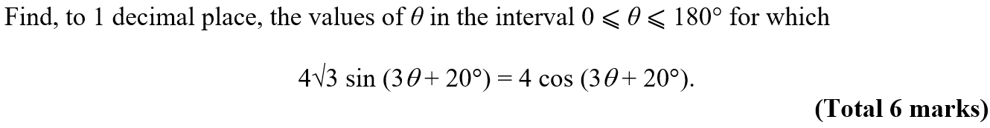


Practice A

Slide 3
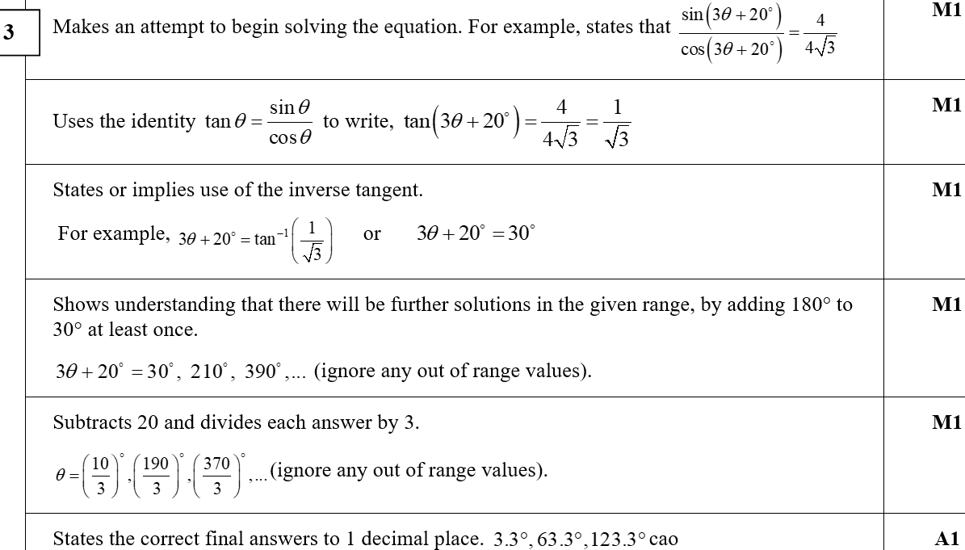

Practice A
A

Slide 4
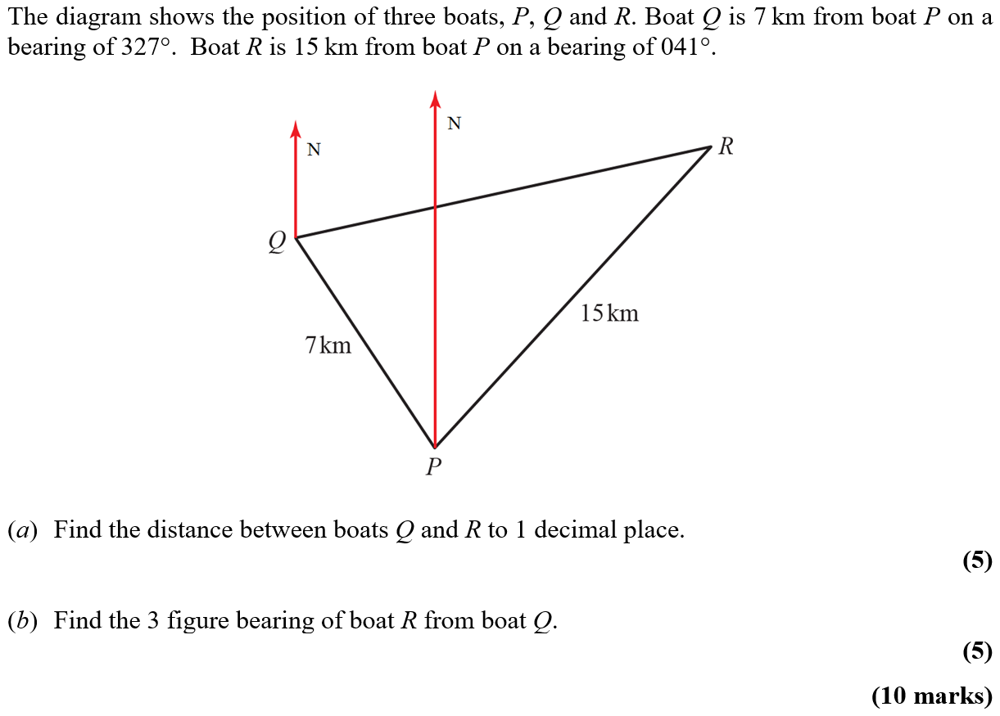
Practice A

Slide 5
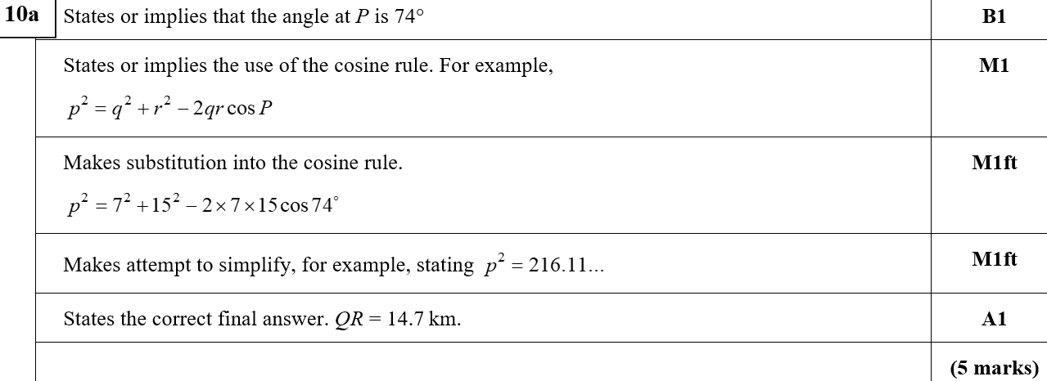
Practice A
A
A notes

Slide 6
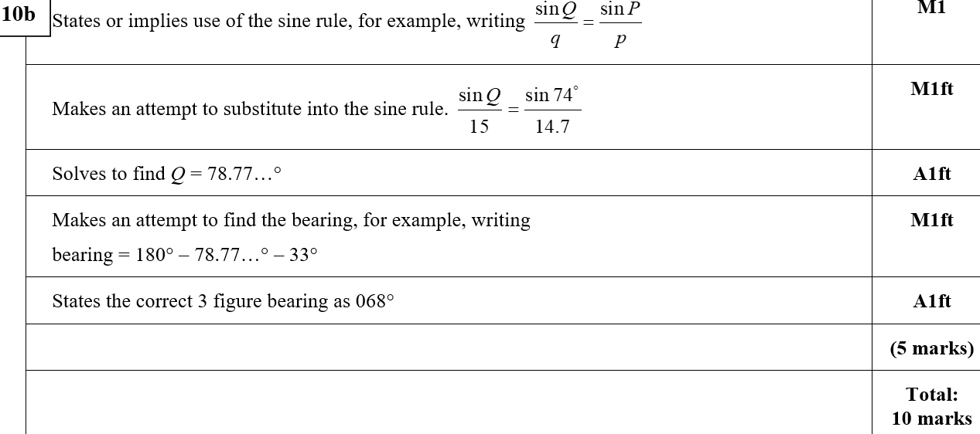
Practice A
B
B notes

Slide 7
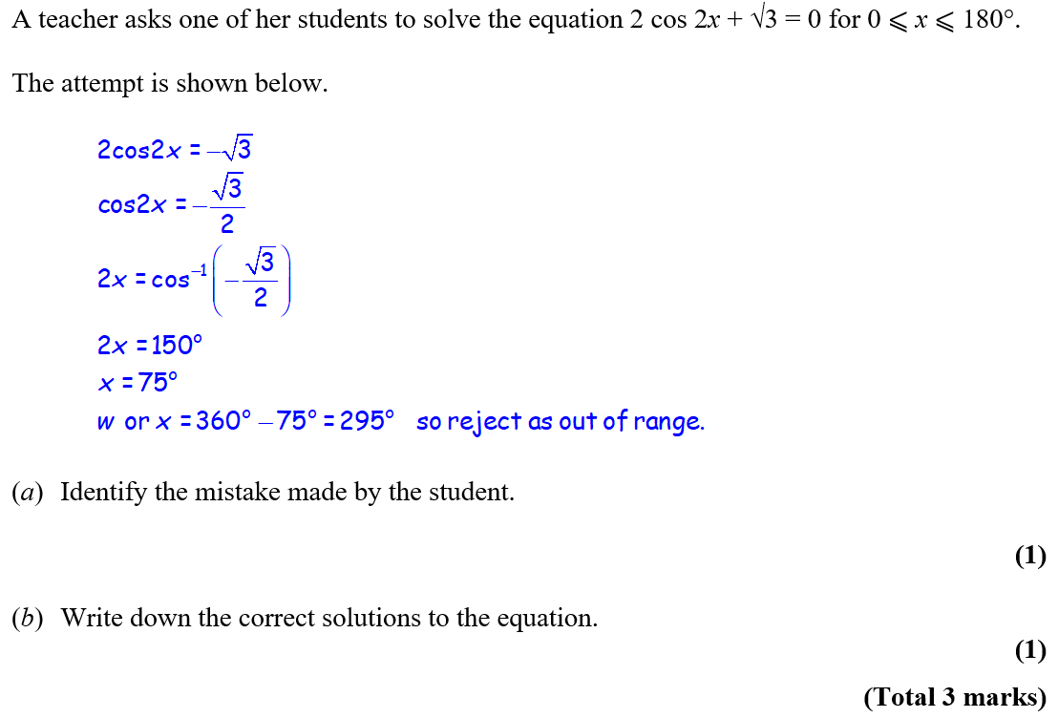
Practice B

Slide 8
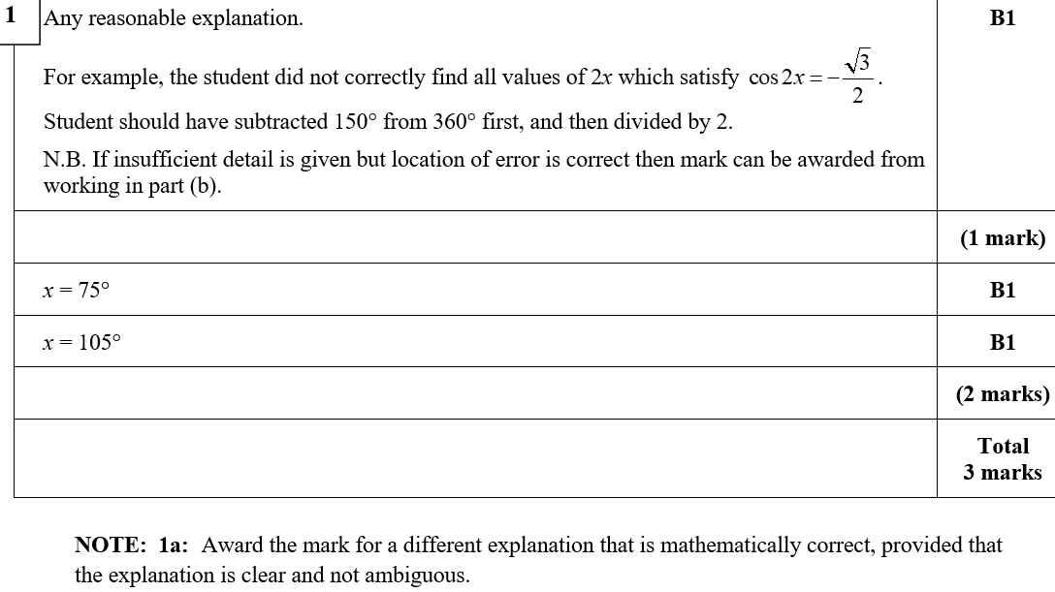
Practice B
A
A notes

Slide 9
Practice B

Slide 10
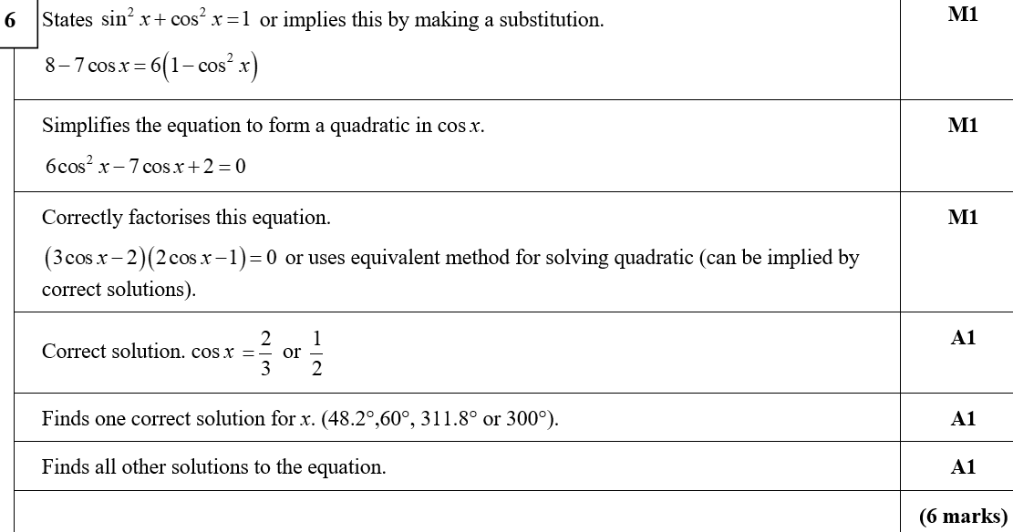
Practice B
A

Slide 11
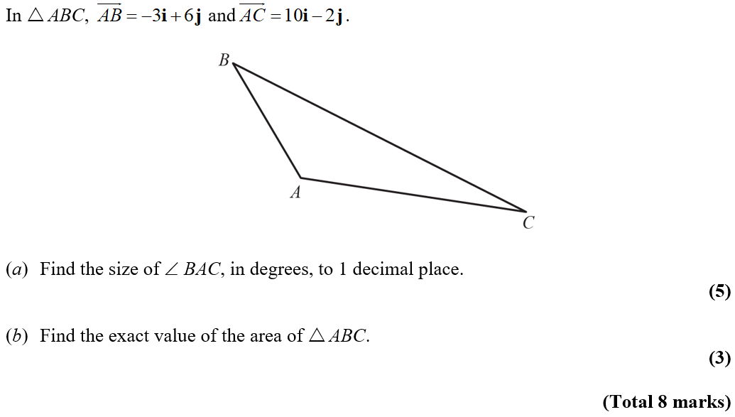
Practice C

Slide 12
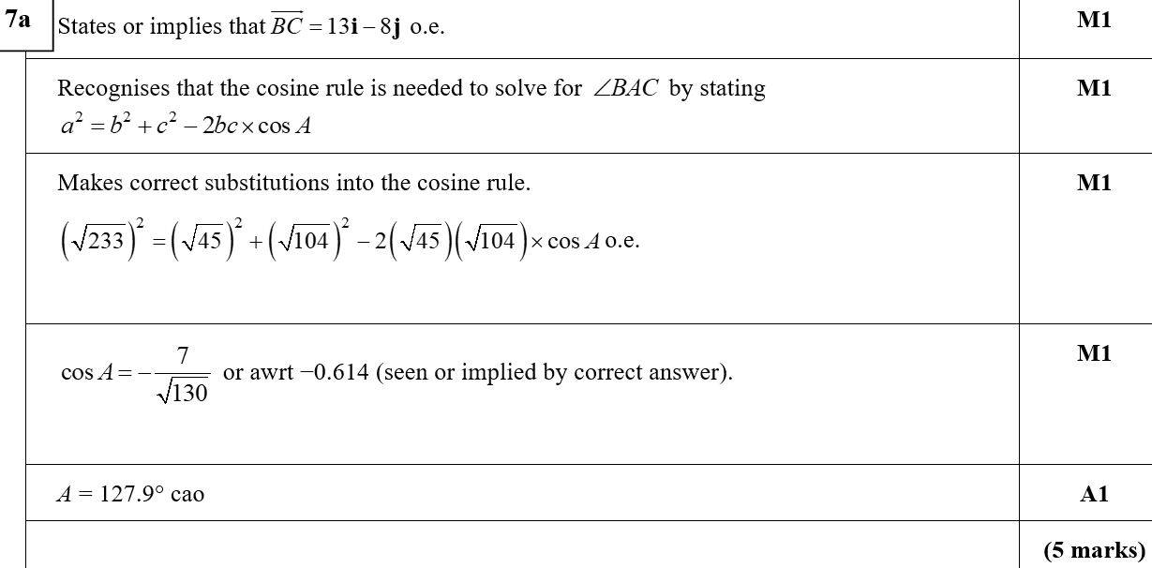
Practice C
A

Slide 13
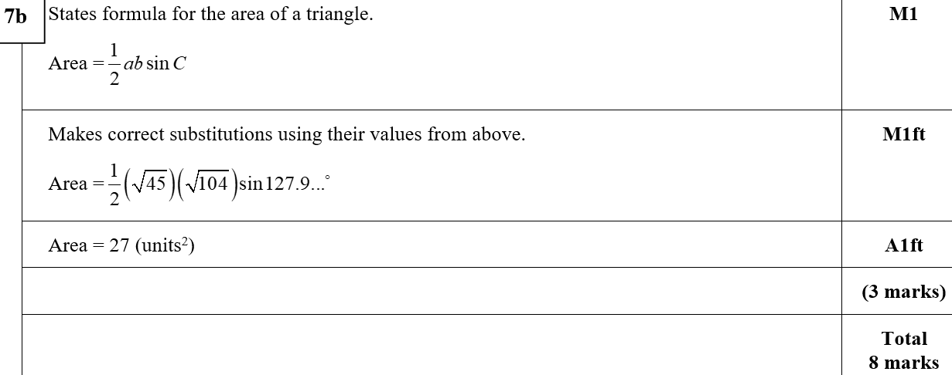
Practice C
B

Slide 14
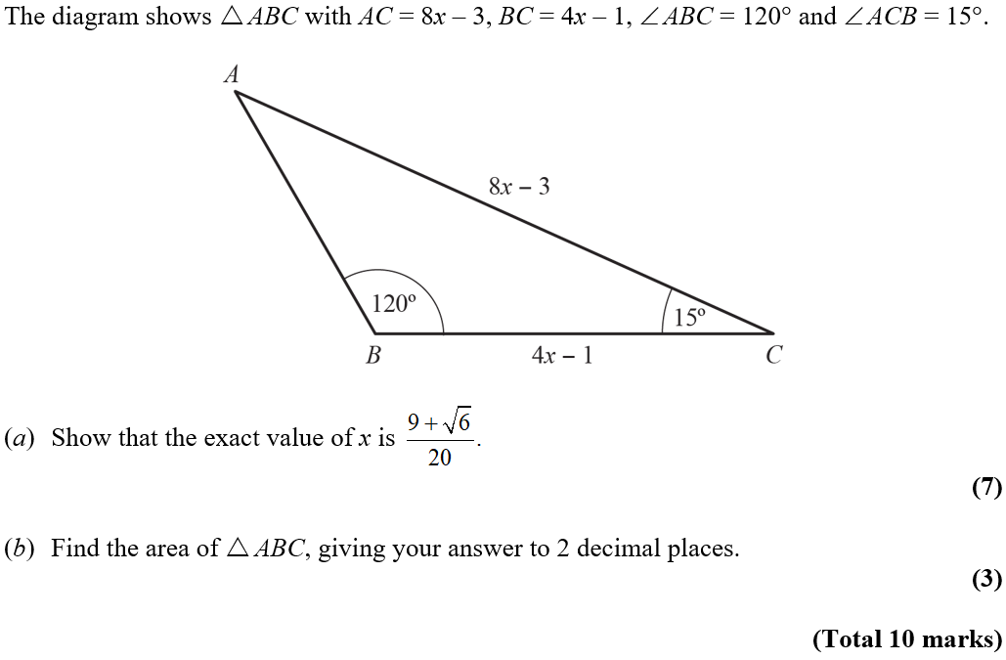
Practice C

Slide 15
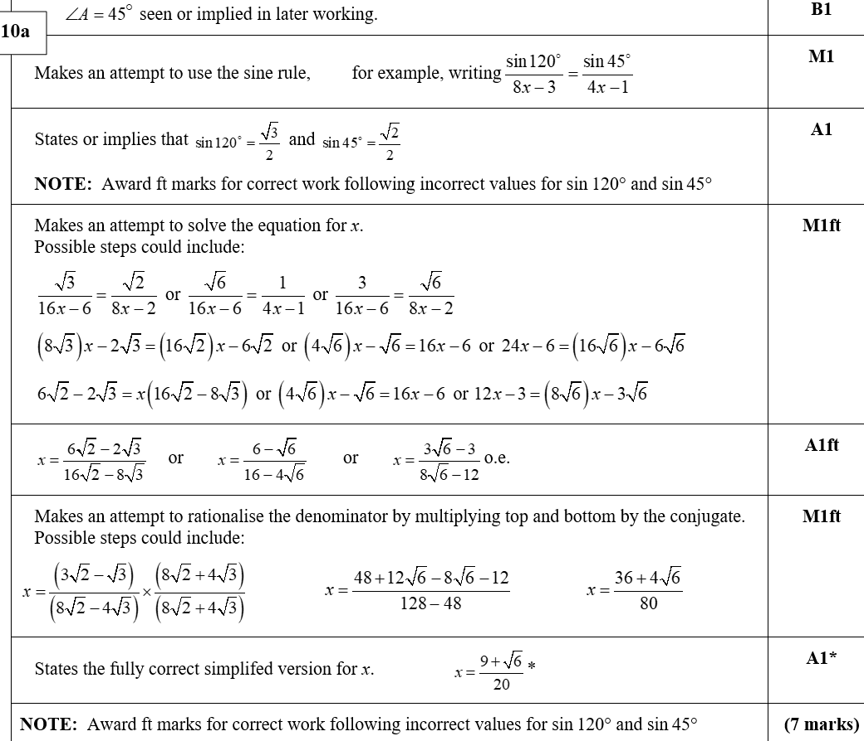
Practice C
A

Slide 16
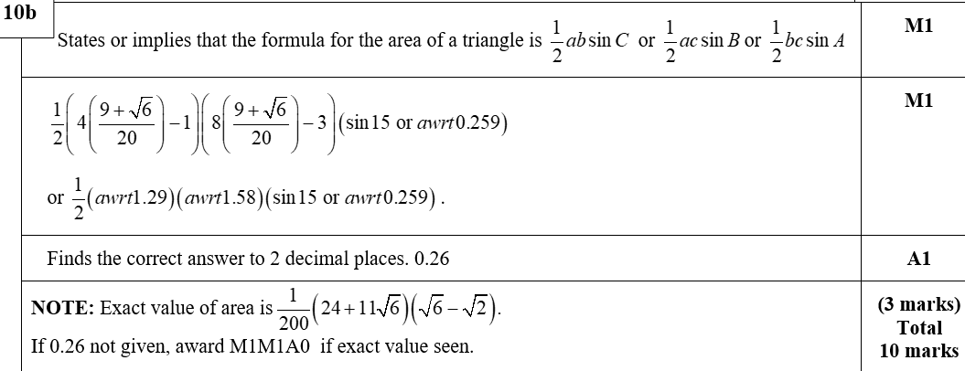
Practice C
B

Slide 17
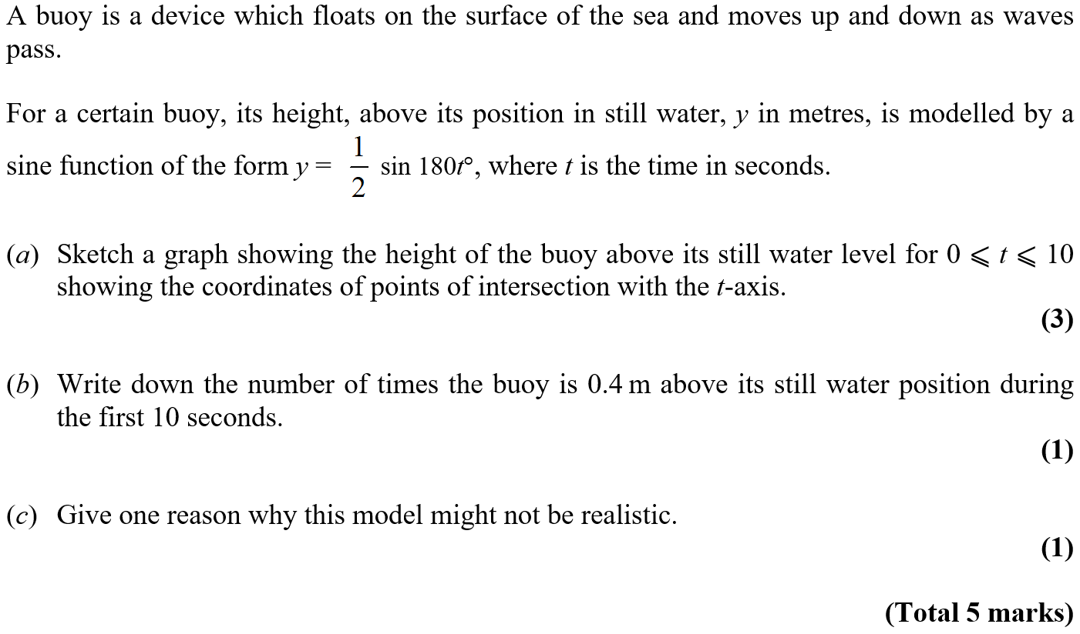
Practice D

Slide 18
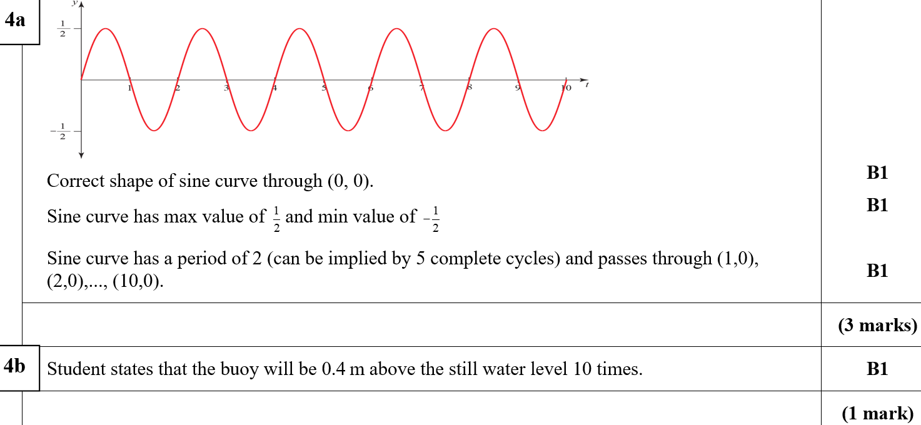
Practice D
A
B

Slide 19
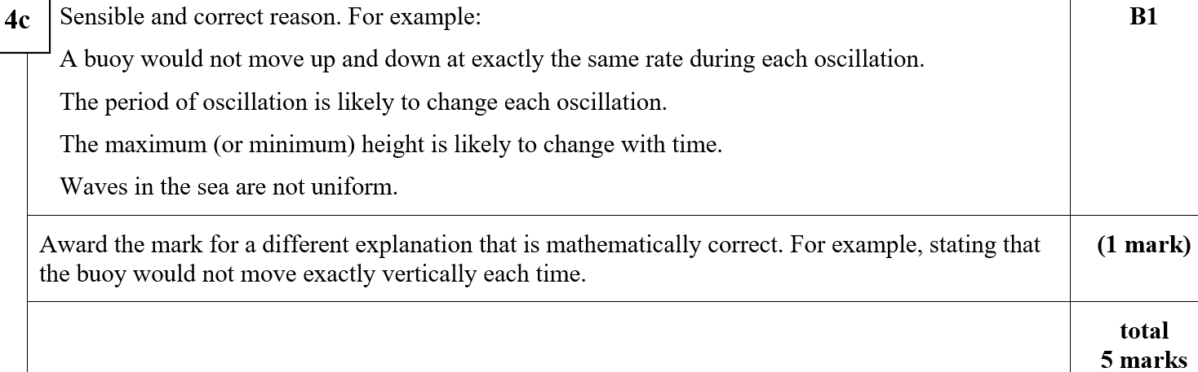
Practice D
C

Slide 20
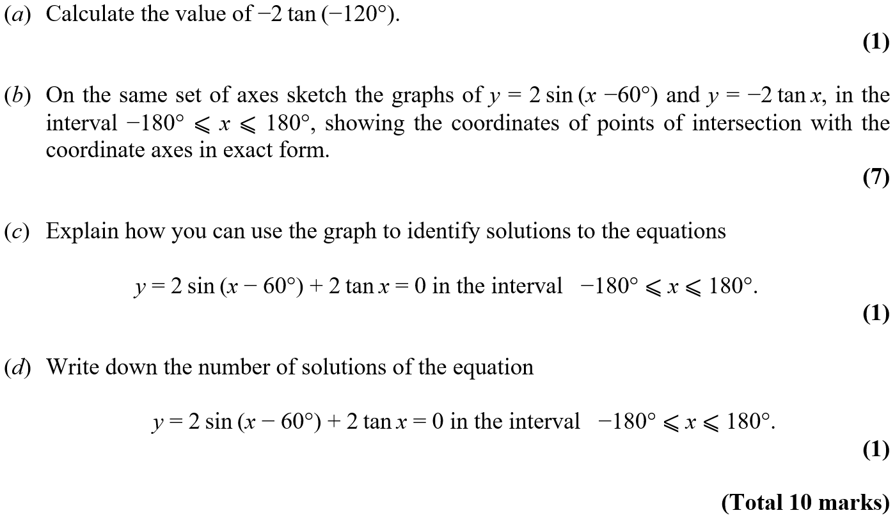
Practice D

Slide 21
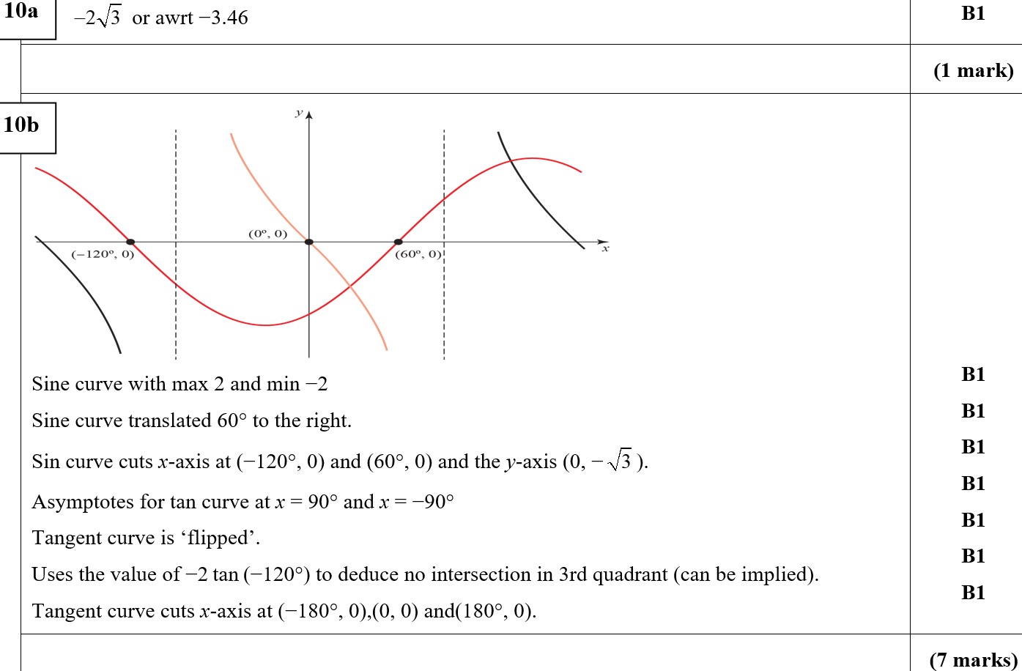
Practice D
A
B

Slide 22
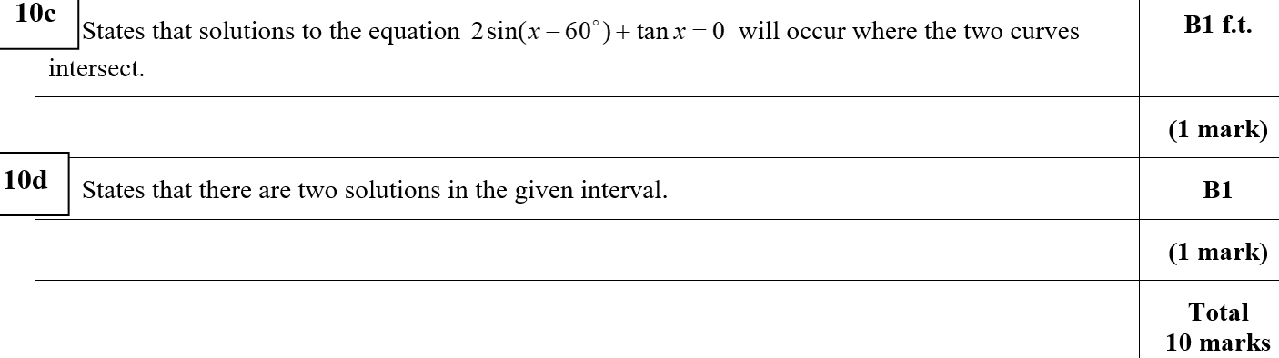
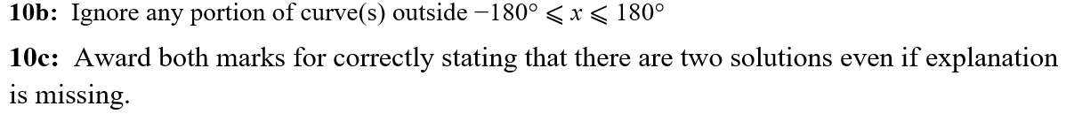
Practice D
C
D
B notes
C notes

Slide 23
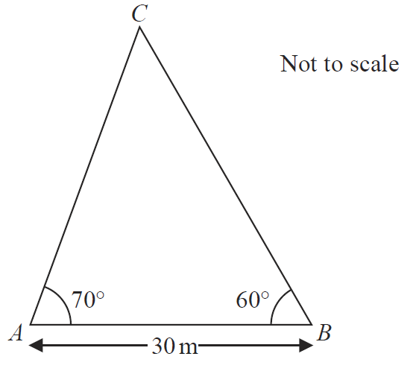

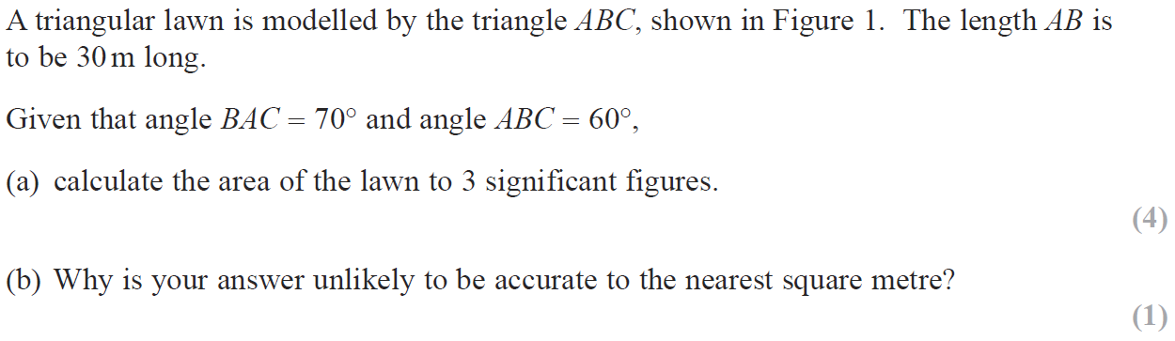
SAM

Slide 24
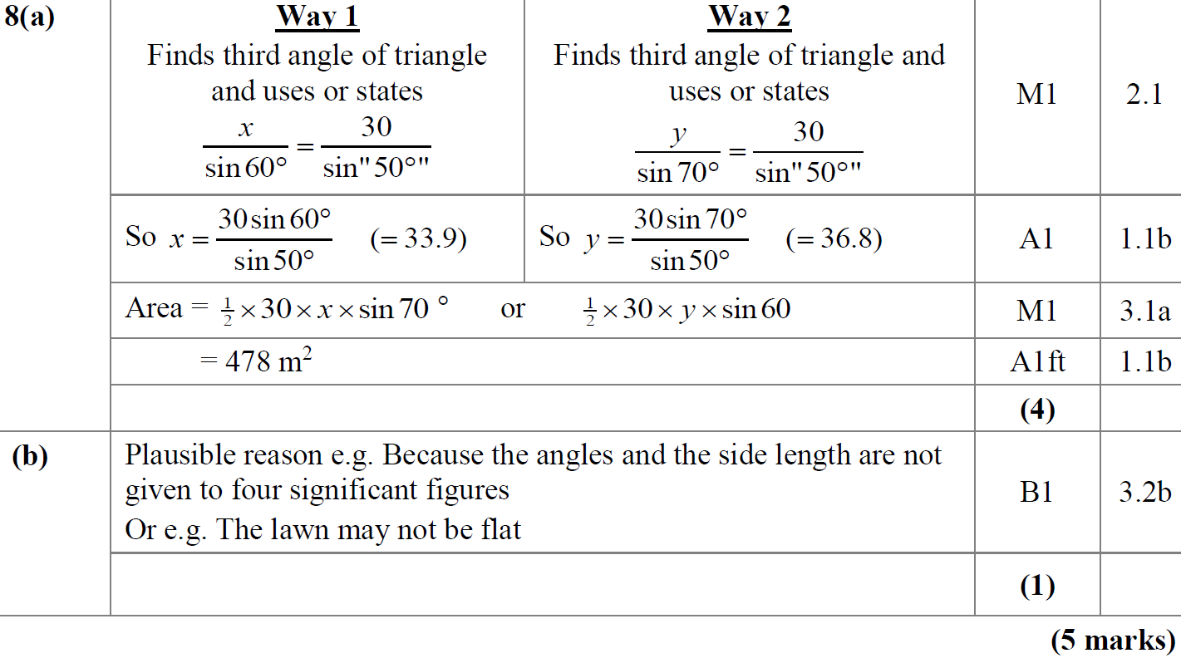
SAM
A
B

Slide 25
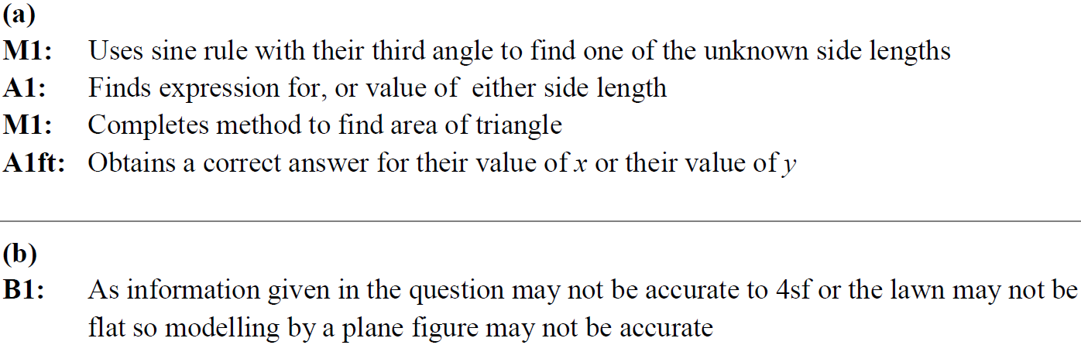
SAM
A notes
B notes

Slide 26
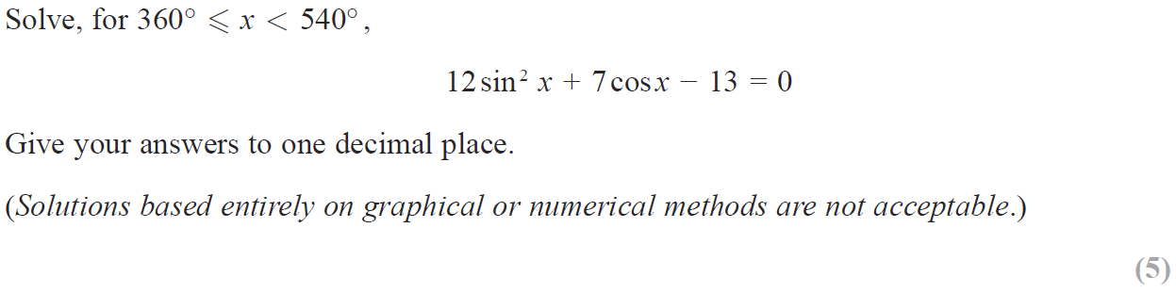
SAM

Slide 27
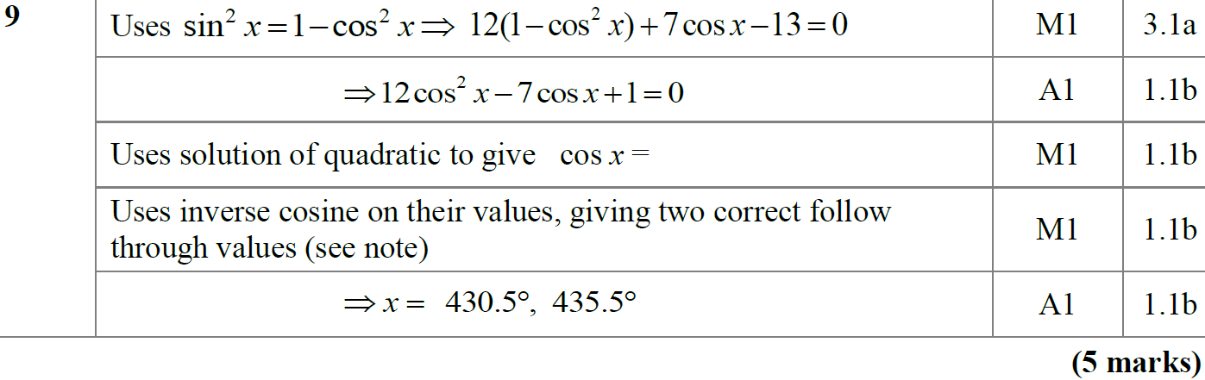
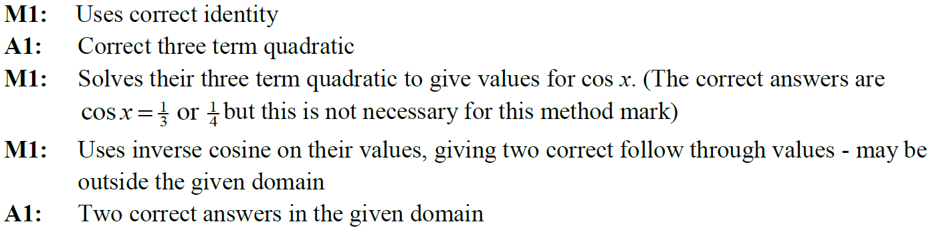
SAM
A
A notes

Slide 28
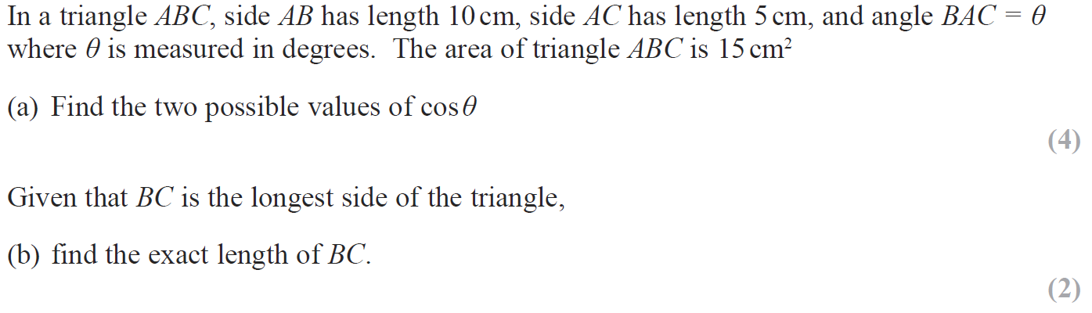
2018

Slide 29
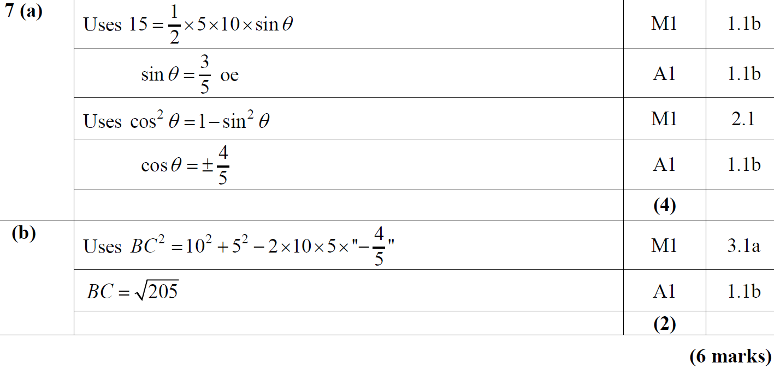
2018
A
B

Slide 30
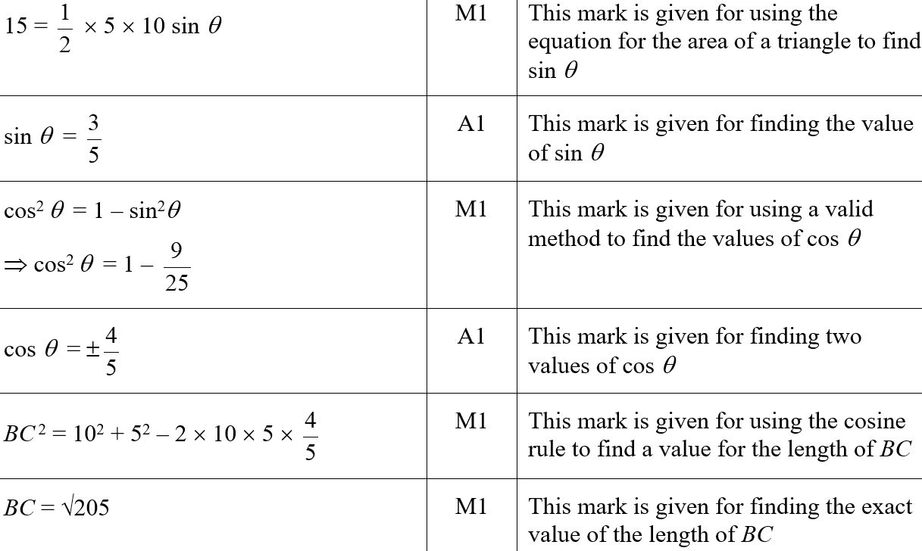
2018
A (SF)
B (SF)

Slide 31
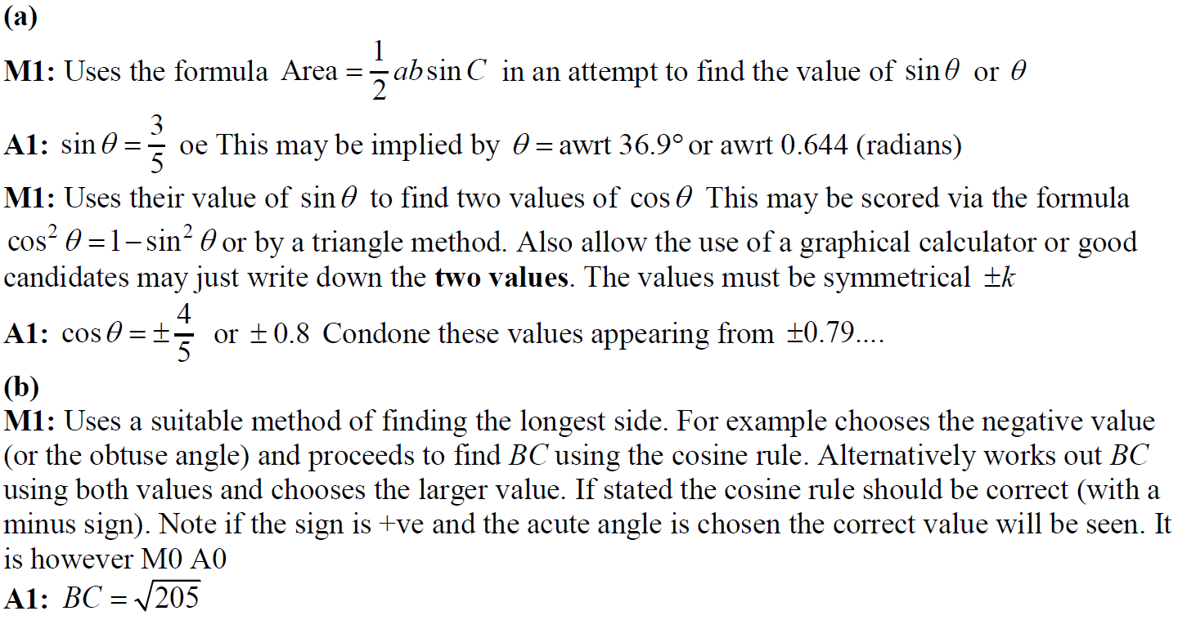
2018
A notes
B notes

Slide 32
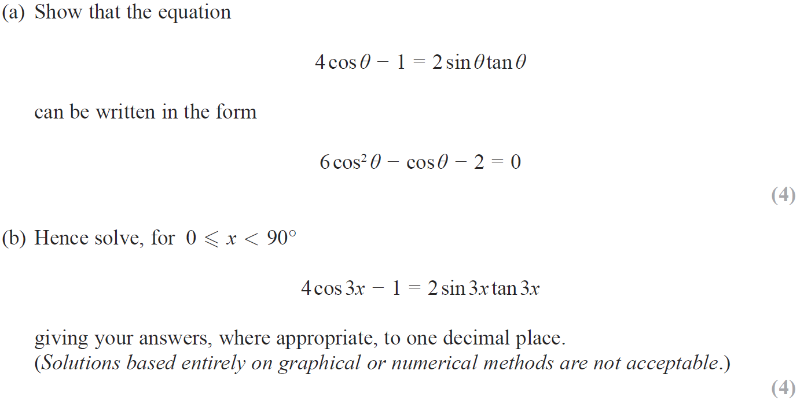
2018

Slide 33
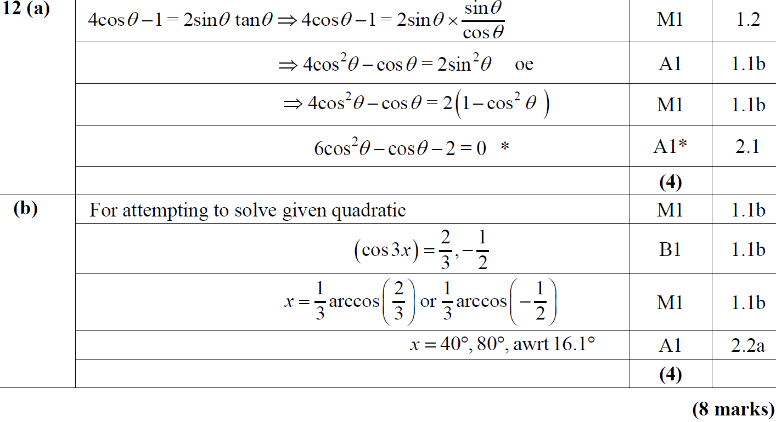
2018
A
B

Slide 34
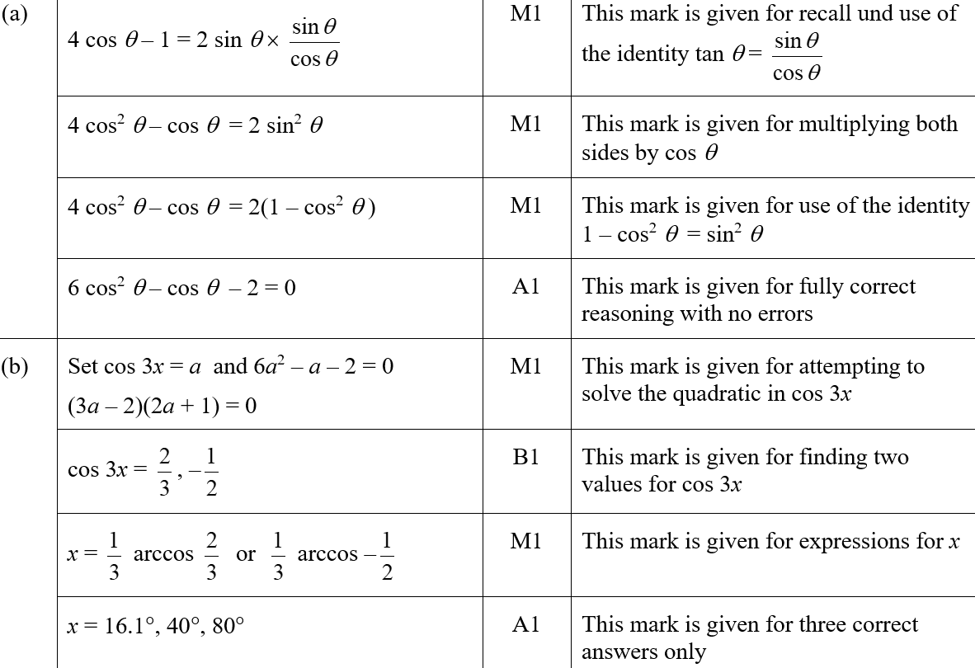
2018
A (SF)
B (SF)

Slide 35
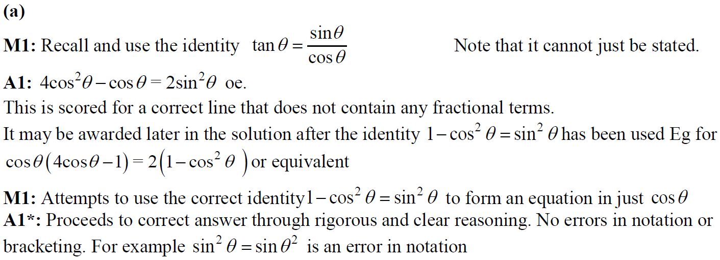
2018
A notes

Slide 36
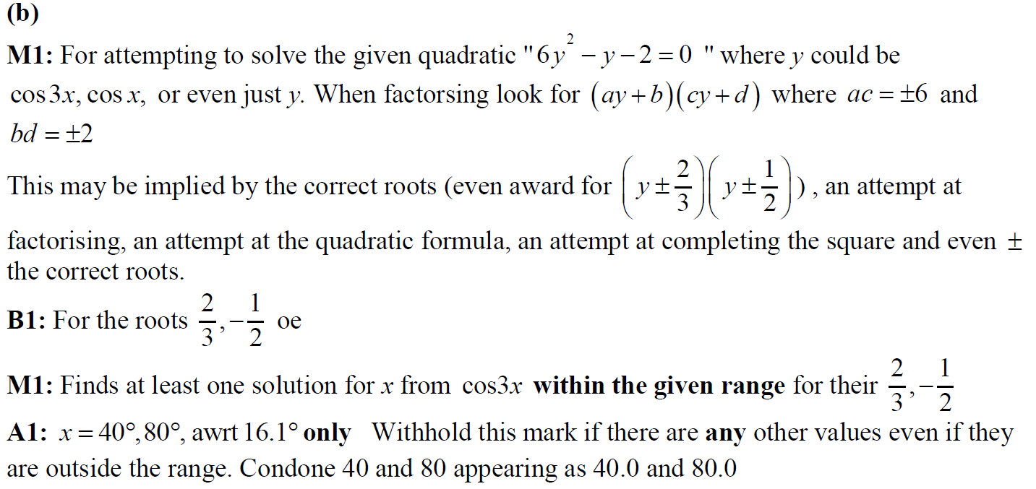
2018
B notes

Slide 37
2018 Paper 1
A notes

Slide 38
New Spec Q’s
Old Spec Trigonometry
Jan 2006
Jan 2009
Jan 2013
May 2006
June 2009
May 2013
Jan 2007
Jan 2010
May 2014
May 2007 (i)
June 2010
May 2015
May 2007 (ii)
Jan 2011
May 2016
Jan 2008 (i)
May 2011
May 2017 (i)
Jan 2008 (ii)
Jan 2012
May 2017 (ii)
June 2008
May 2012
May 2018

Slide 39
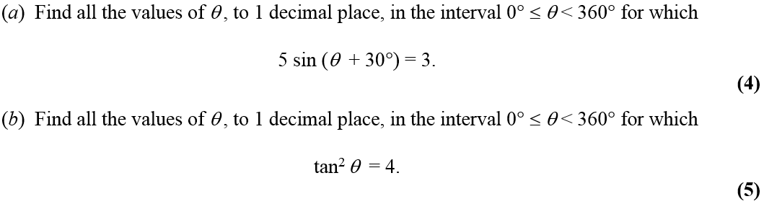
Jan 2006

Slide 40
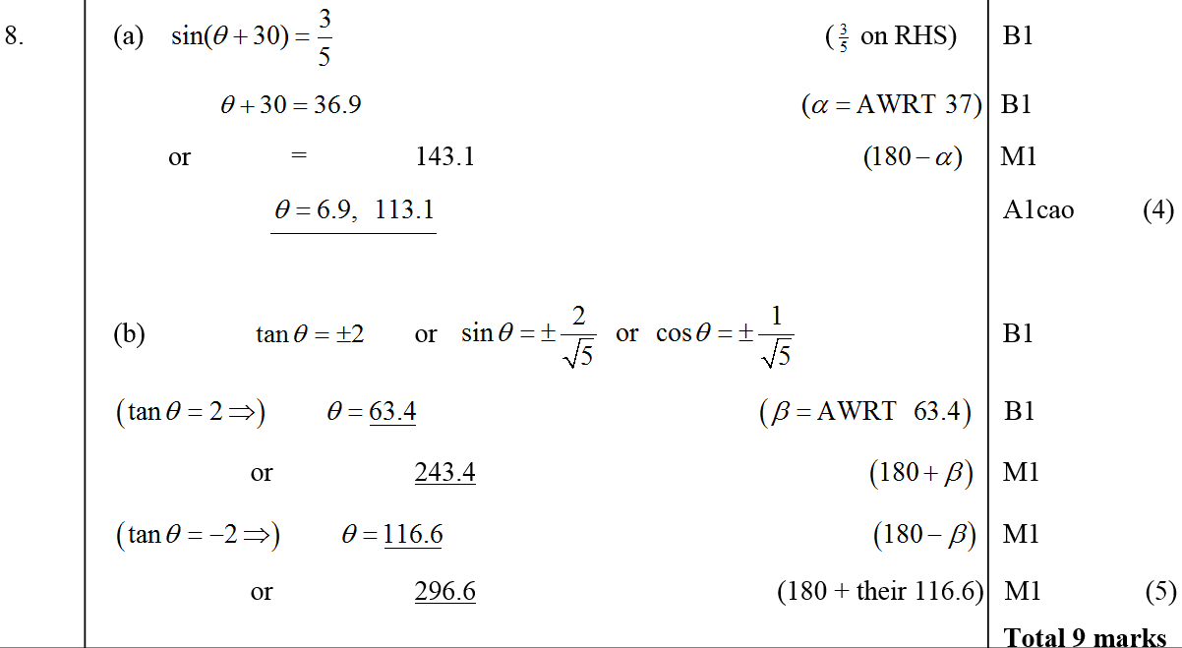
Jan 2006
A
B

Slide 41
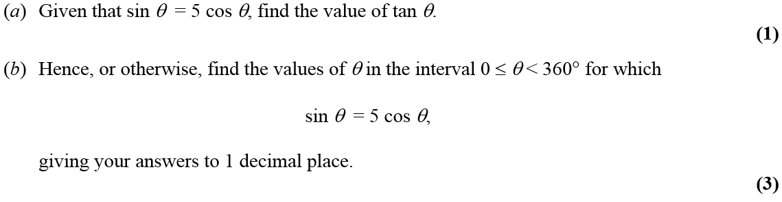
May 2006

Slide 42
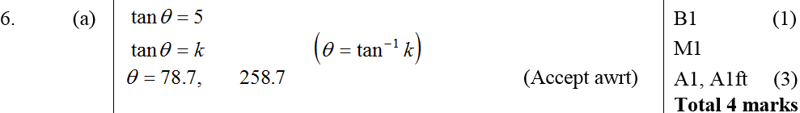
May 2006
A
B

Slide 43
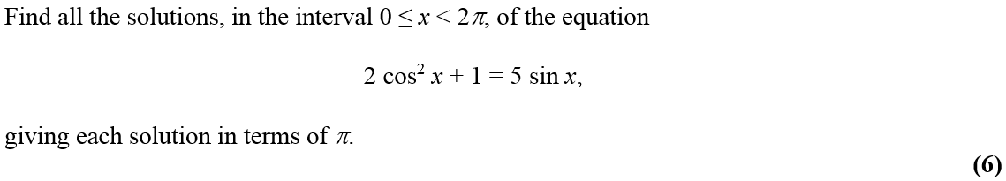
Jan 2007

Slide 44
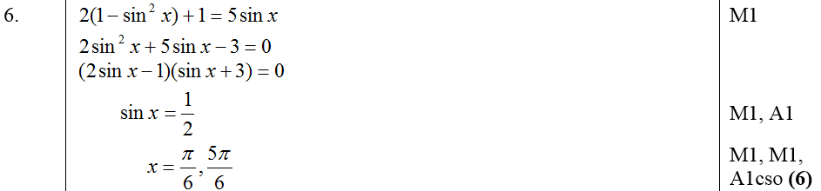
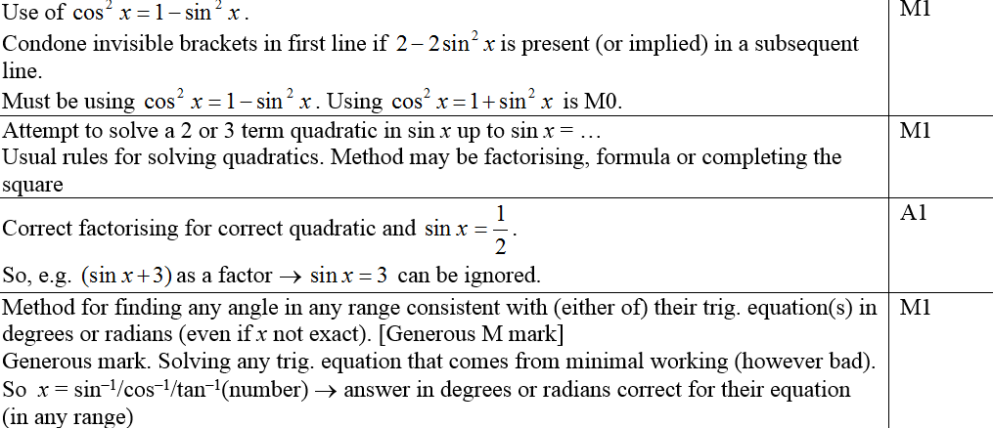
Jan 2007
A
Notes (first 4 marks)

Slide 45
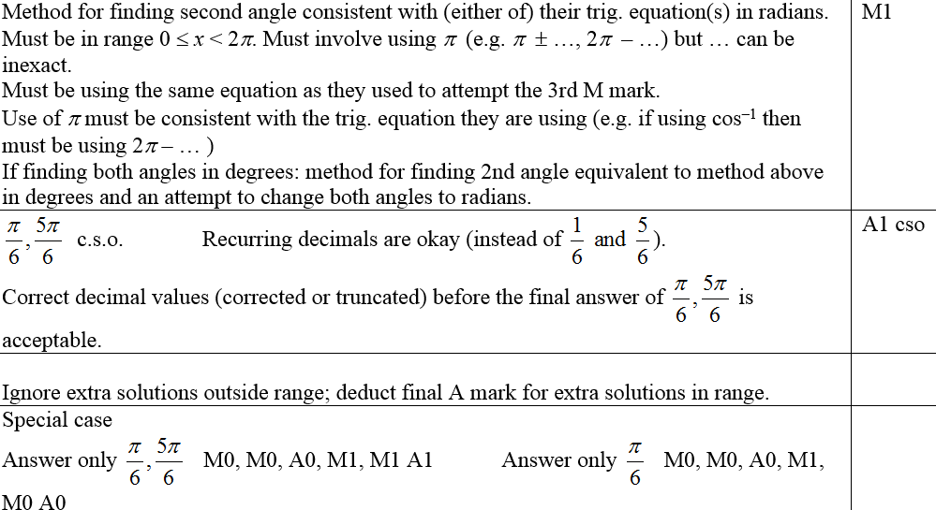
Jan 2007
Notes (last 2 marks and in general)

Slide 46
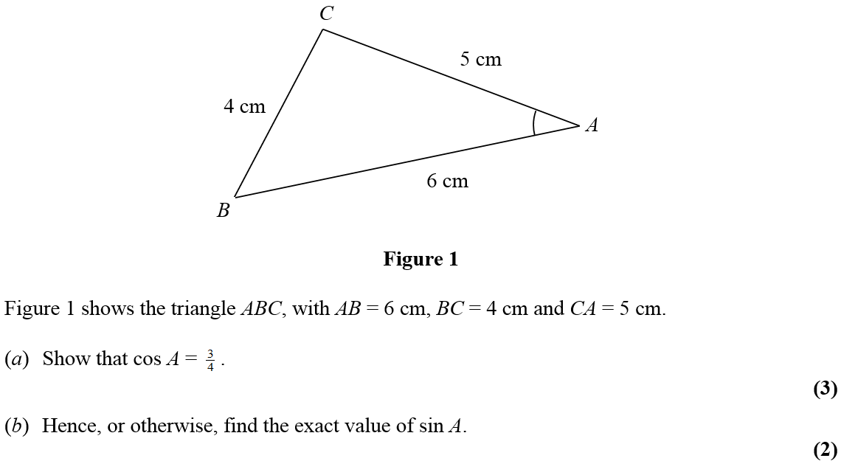
May 2007

Slide 47
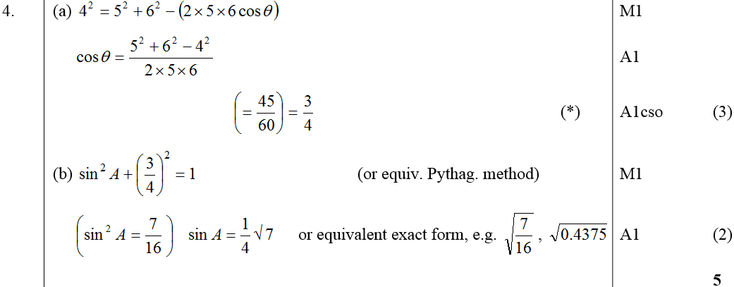
May 2007
A
B

Slide 48
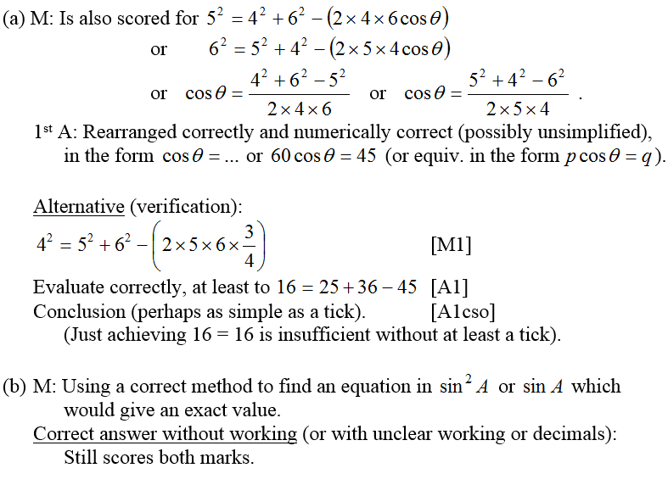
May 2007
A notes
B notes

Slide 49
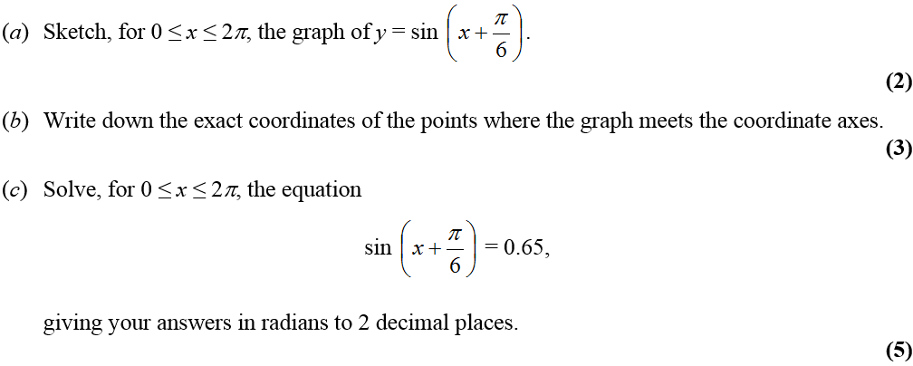
May 2007

Slide 50
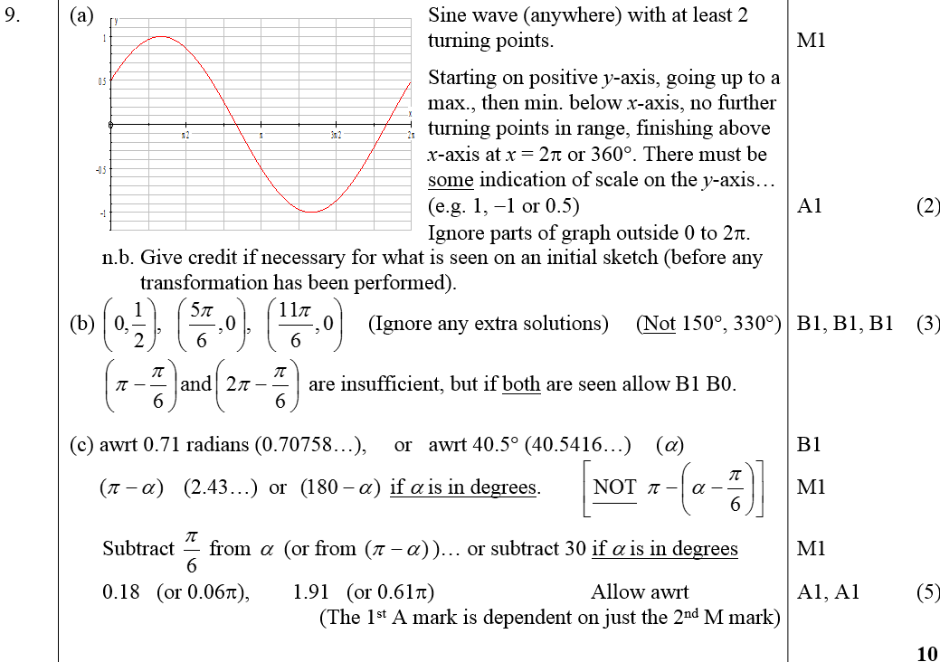
May 2007
A
B
C

Slide 51

May 2007
B notes
C notes

Slide 52

Jan 2008

Slide 53

Jan 2008
A
B

Slide 54

A notes
Jan 2008
B notes

Slide 55


Jan 2008

Slide 56

Jan 2008
A
B

Slide 57

A notes
Jan 2008
B notes (several other methods)

Slide 58

June 2008

Slide 59

June 2008
A
B

Slide 60

Jan 2009

Slide 61

Jan 2009
A
B
A notes
B notes
Special case for B

Slide 62

June 2009

Slide 63

June 2009
(i)
(ii)

Slide 64

Jan 2010

Slide 65

Jan 2010
A
B

Slide 66

Jan 2010
A
B

Slide 67

June 2010

Slide 68

June 2010
A
B

Slide 69

Jan 2011

Slide 70

Jan 2011
A
B

Slide 71

Jan 2011
A
B

Slide 72

May 2011

Slide 73

May 2011
A
B

Slide 74

May 2011
A

Slide 75


May 2011
B

Slide 76

Jan 2012

Slide 77



i
Jan 2012
ii
Alternative Method

Slide 78


Jan 2012
i
ii

Slide 79

May 2012

Slide 80

May 2012
A
B

Slide 81

May 2012
A
B

Slide 82

Jan 2013

Slide 83

Jan 2013
A

Slide 84

May 2013

Slide 85

May 2013
i
ii (a)
ii (b)

Slide 86

May 2014

Slide 87

May 2014
i

Slide 88

May 2014
ii

Slide 89

May 2015

Slide 90

May 2015
(i)
(ii) A
(ii) B

Slide 91

May 2015
(i) notes
(ii) A notes
(ii) B notes

Slide 92

May 2016

Slide 93


May 2016
(i)
(i) notes

Slide 94

May 2016
(ii)

Slide 95

May 2016
(ii) notes

Slide 96

May 2017

Slide 97


May 2017
A
A Alternative

Slide 98

May 2017
A notes

Slide 99

May 2017

Slide 100

May 2017
A
B

Slide 101

May 2017
A notes
B notes

Slide 102

May 2018

Slide 103

May 2018
(i)
(ii)

Slide 104

May 2018
(i) notes
(ii) notes

