Slide 1
Old Spec Q’s
Sketching & Transforming Graphs
Practice A
Practice D (ii)
Practice B (i)
Practice D (iii)
Practice B (ii)
SAM
Practice C (i)
2018
Practice C (ii)
Practice D (i)

Slide 2
Practice A

Slide 3
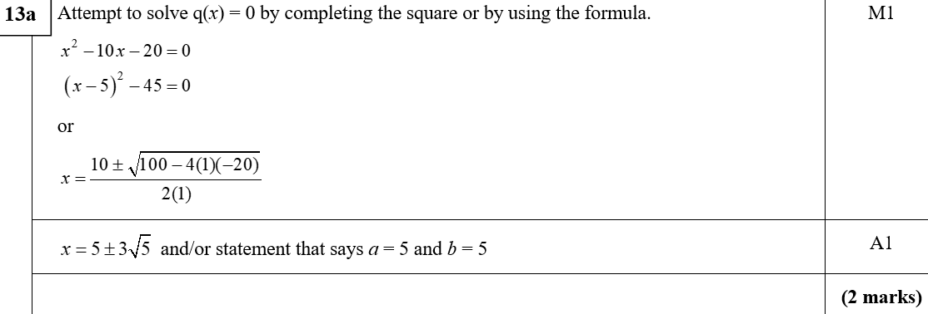
Practice A
A
A notes

Slide 4
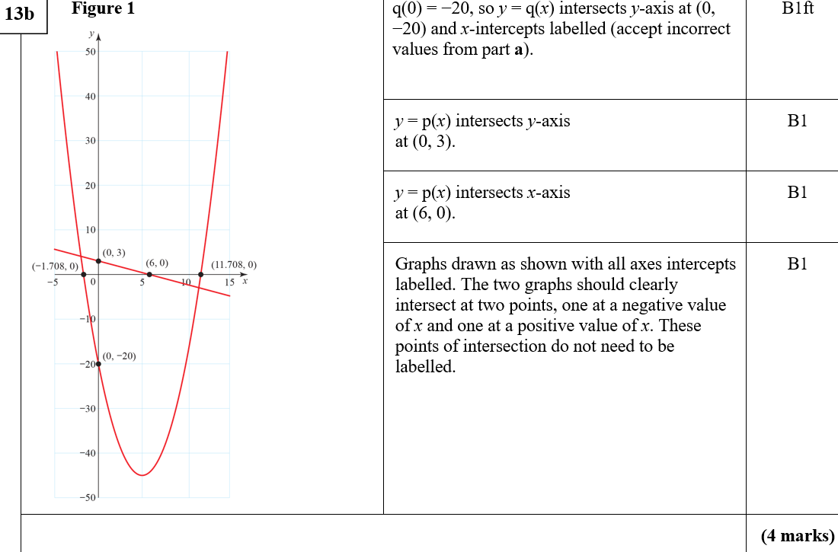
Practice A
B
B notes

Slide 5
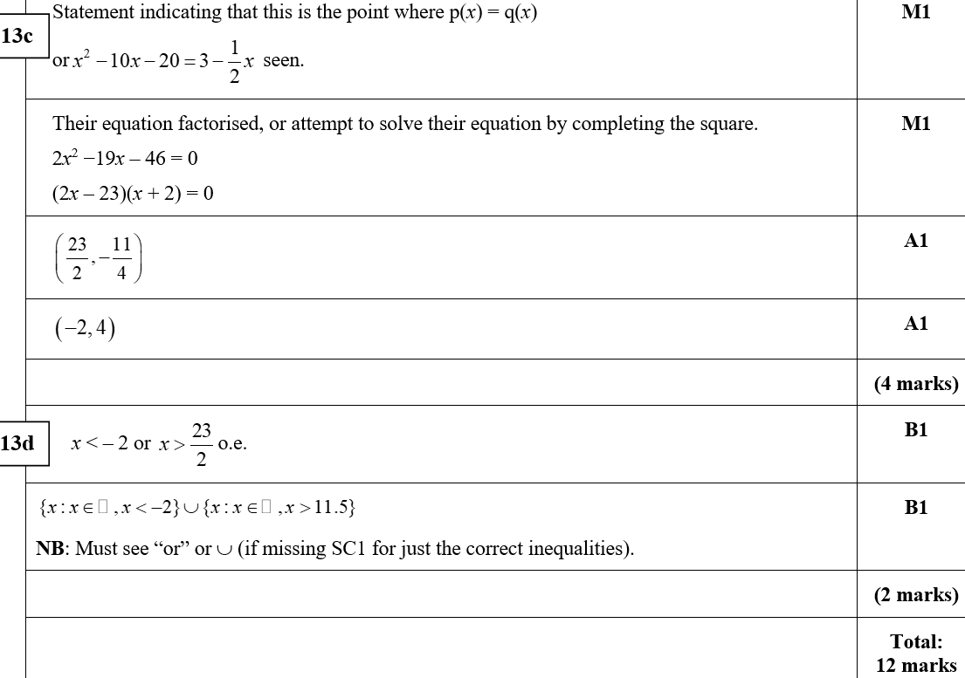
Practice A
C
D
C notes

Slide 6
Practice B

Slide 7
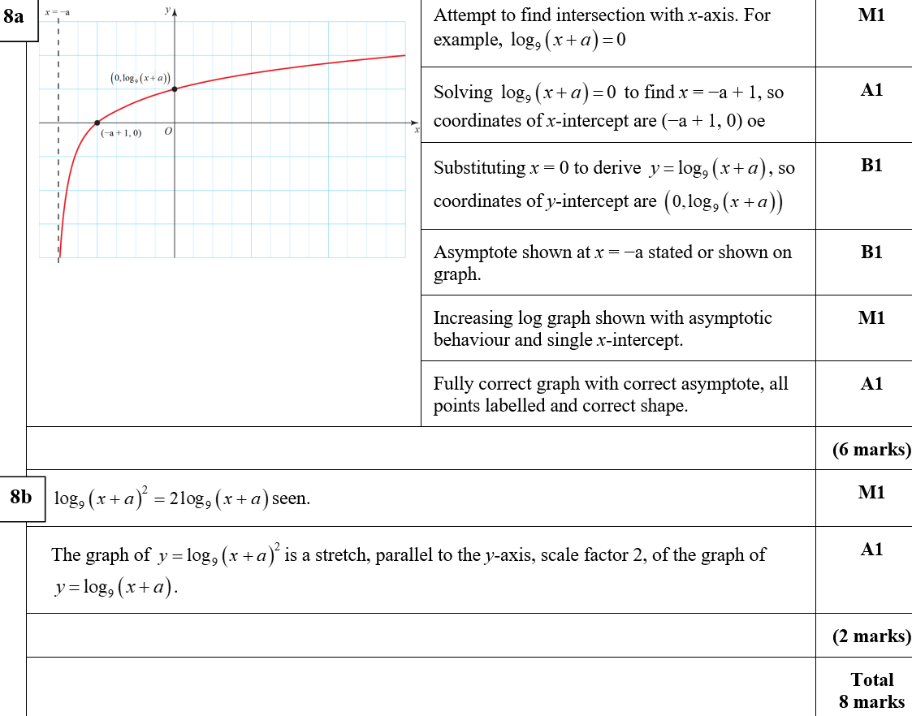
Practice B
A
B
A notes

Slide 8
Practice B

Slide 9
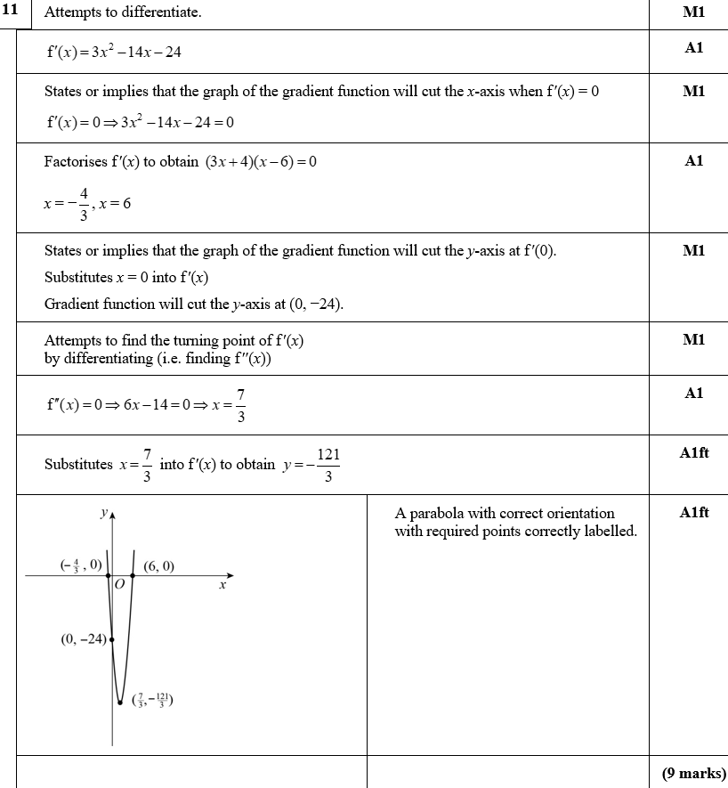
Practice B
A

Slide 10
Practice B
A notes

Slide 11
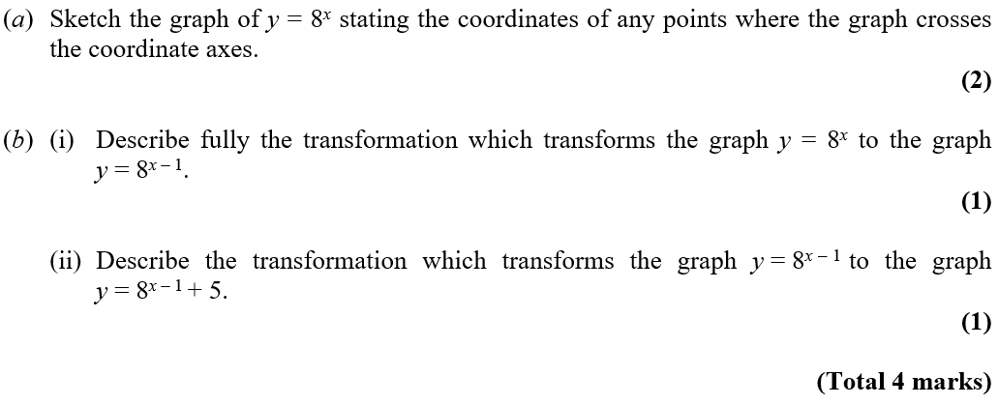
Practice C

Slide 12
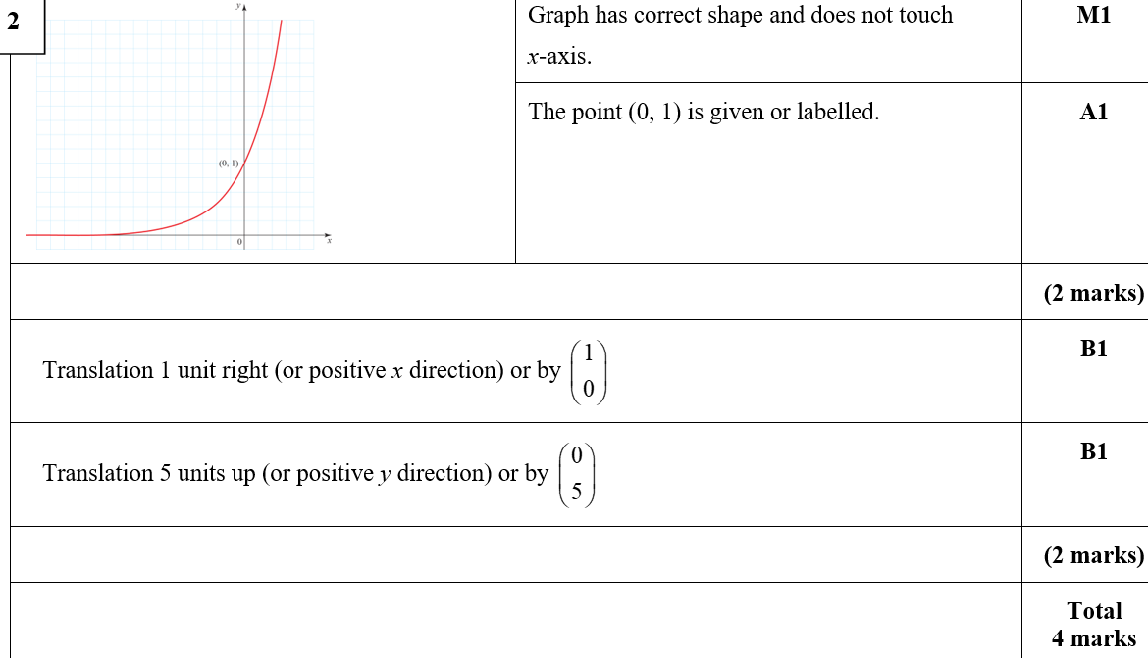
Practice C
A

Slide 13
Practice C

Slide 14
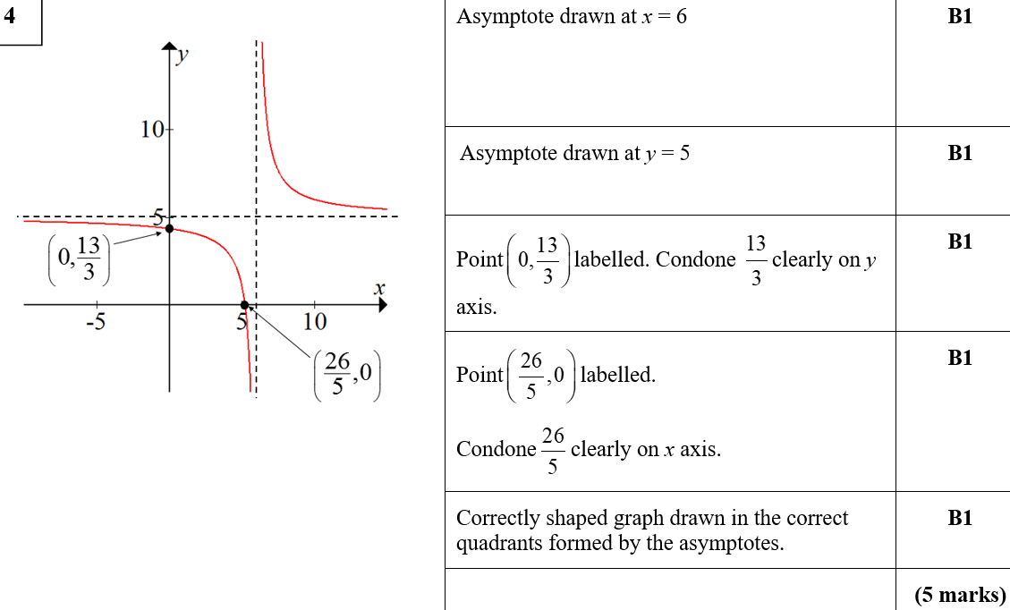
Practice C
A

Slide 15
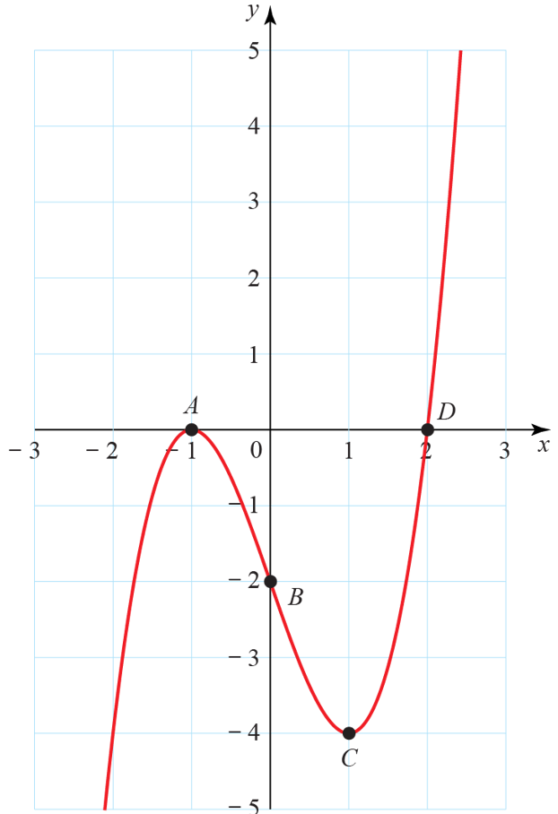
Practice D

Slide 16
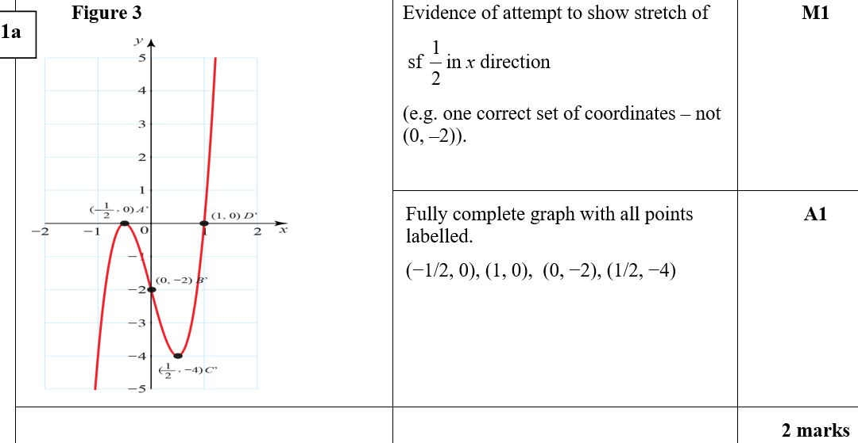
Practice D
A

Slide 17
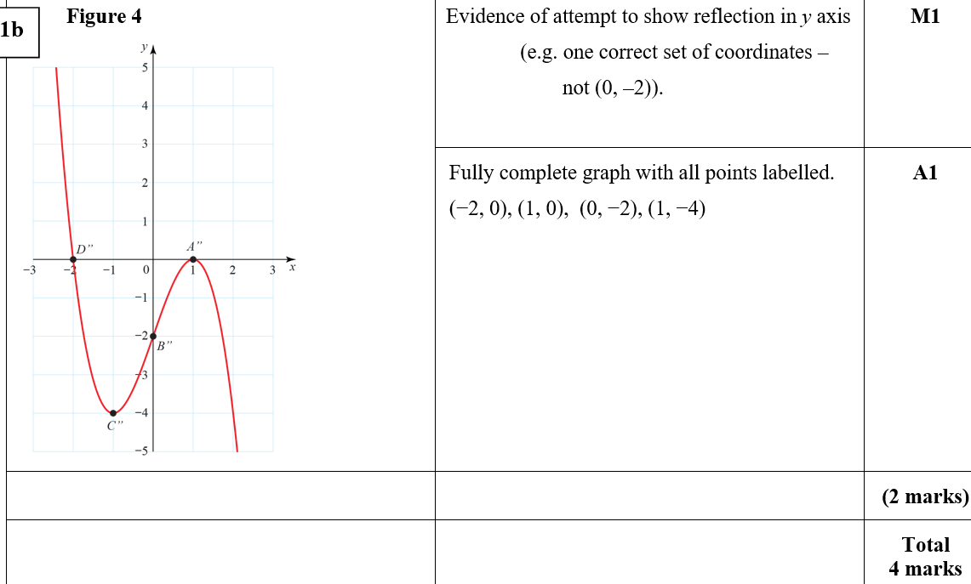
Practice D
B

Slide 18
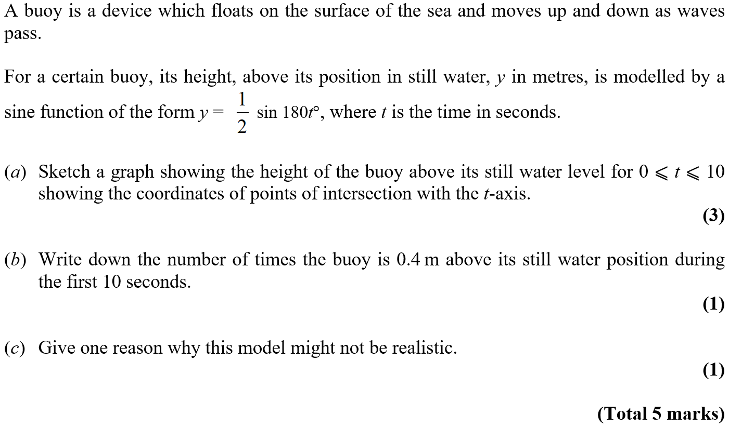
Practice D

Slide 19
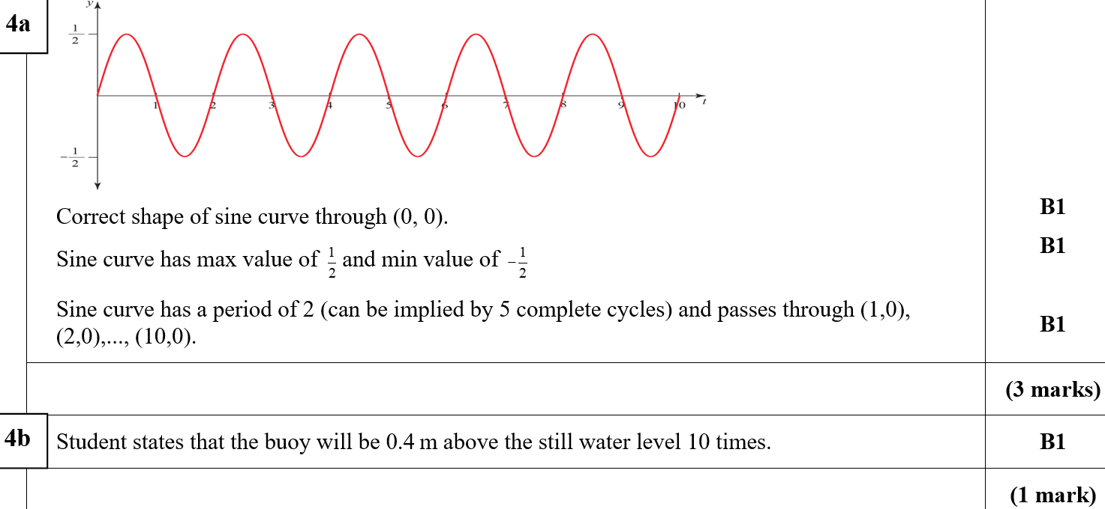
Practice D
A
B

Slide 20
Practice D
C

Slide 21
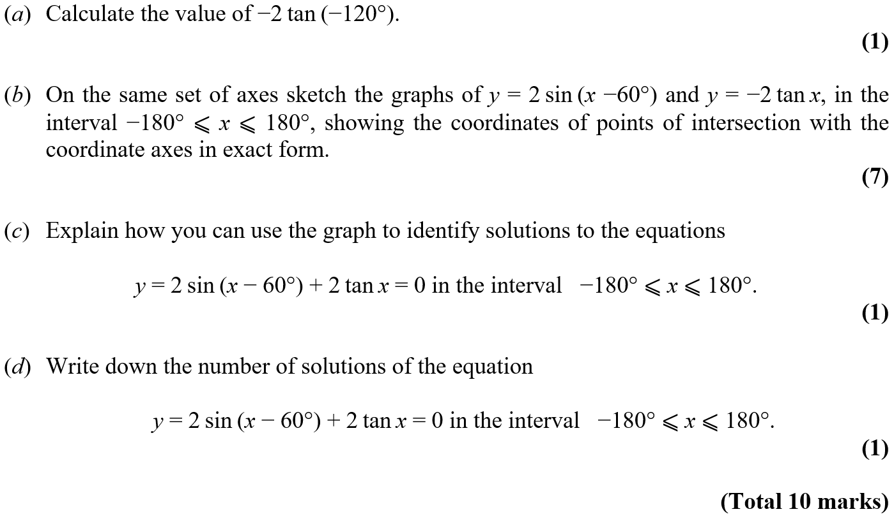
Practice D

Slide 22
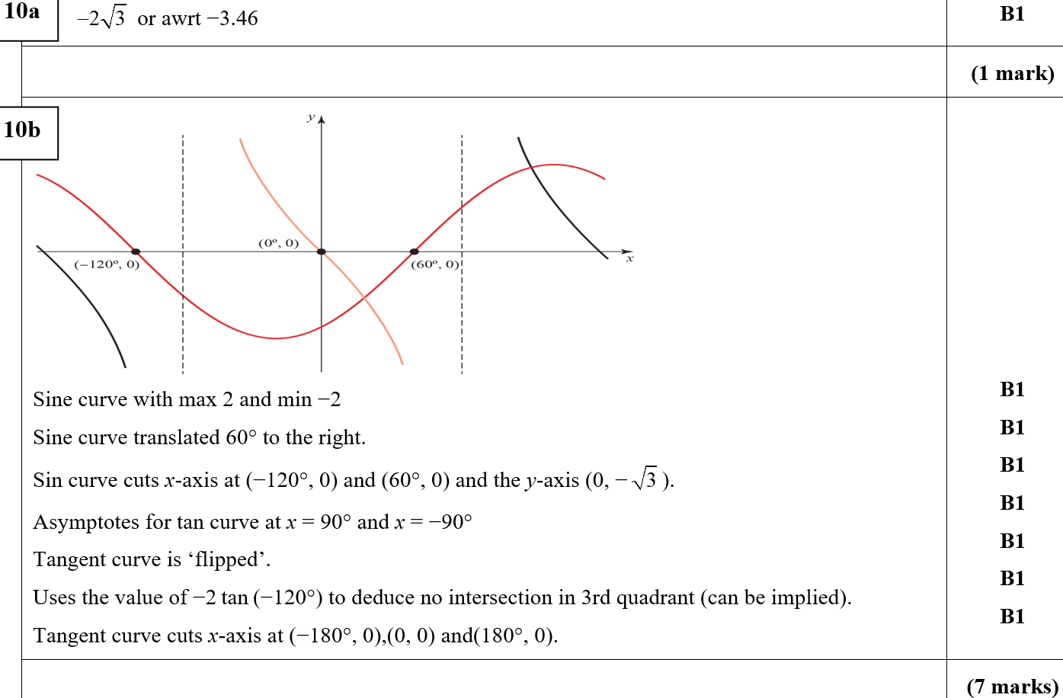
Practice D
A
B

Slide 23
Practice D
C
D
B notes
C notes

Slide 24
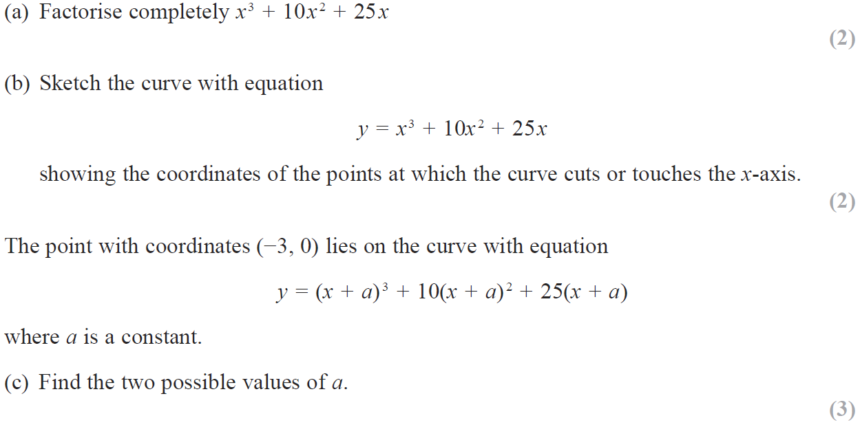
SAM

Slide 25
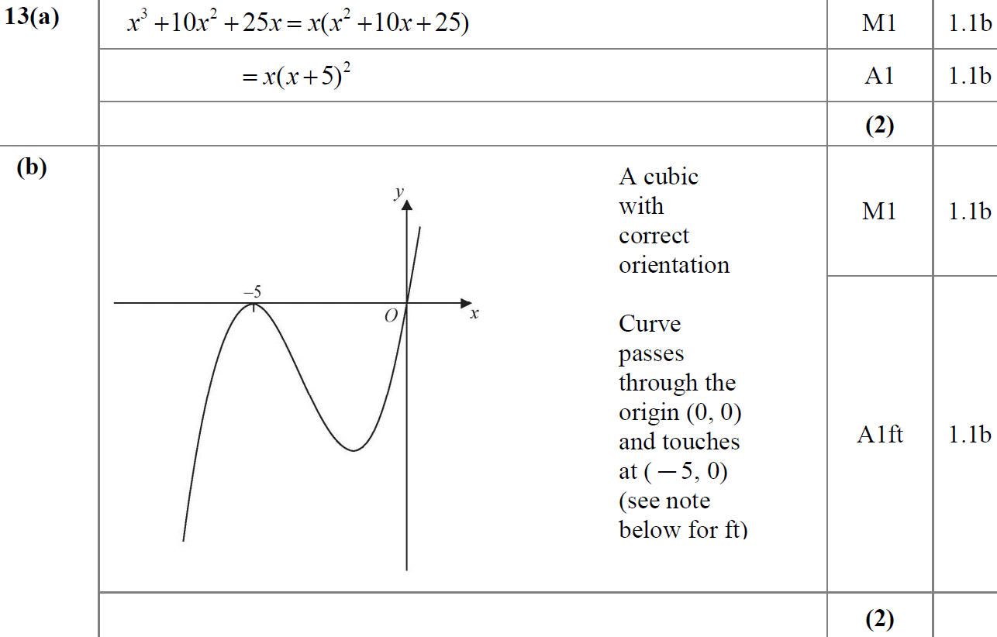
SAM
A
B

Slide 26
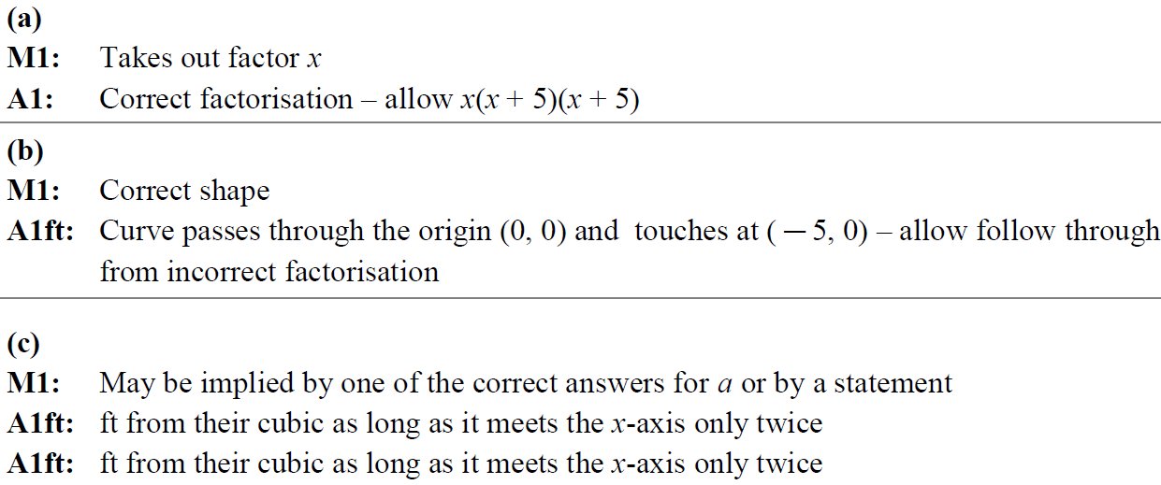
SAM
C
A notes
B notes
C notes

Slide 27
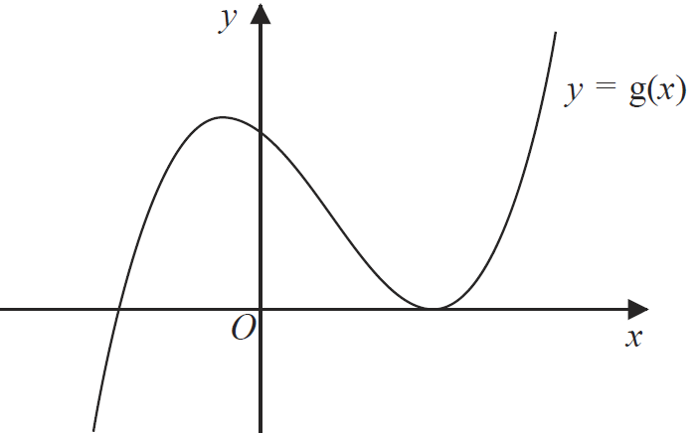
2018

Slide 28
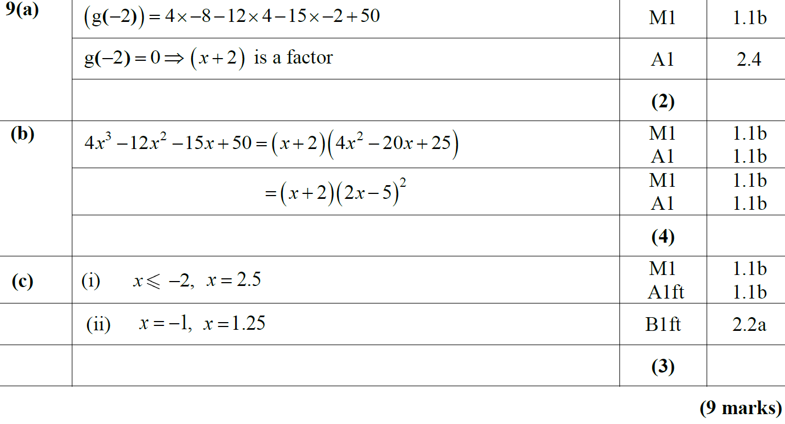
2018
A
B
C

Slide 29
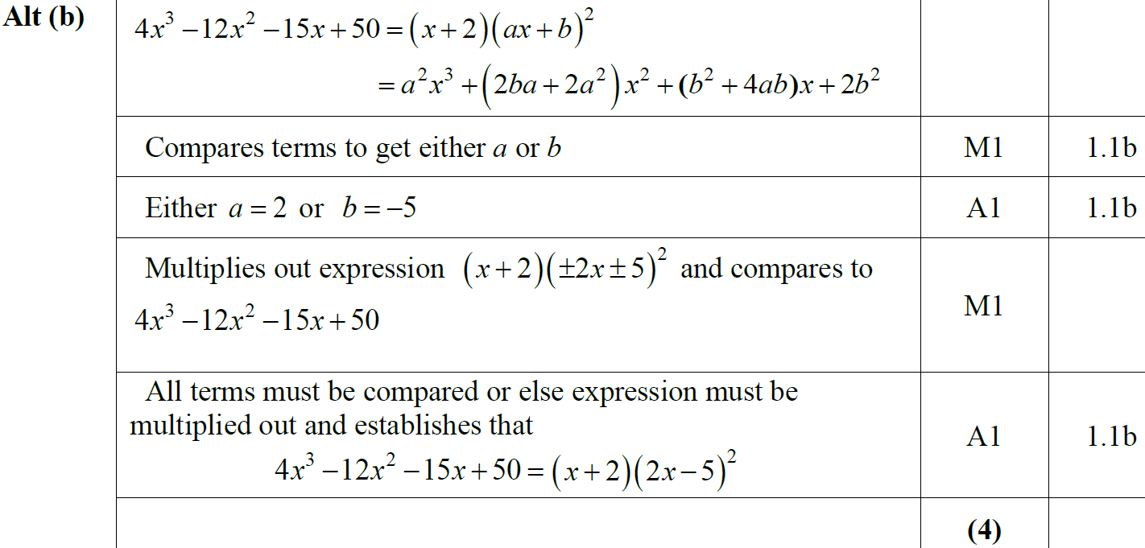
2018
B Alternative

Slide 30
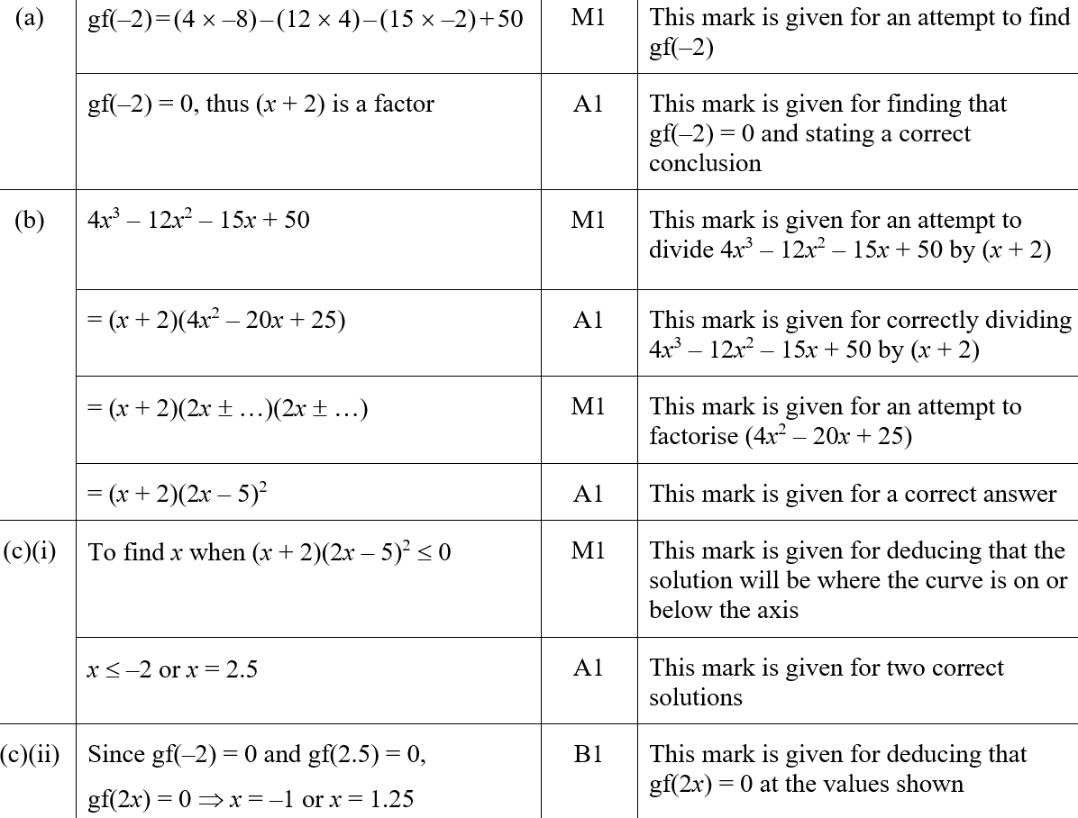
2018
A (SF)
B (SF)

Slide 31
2018
C (i) (SF)
C (ii) (SF)
A notes

Slide 32
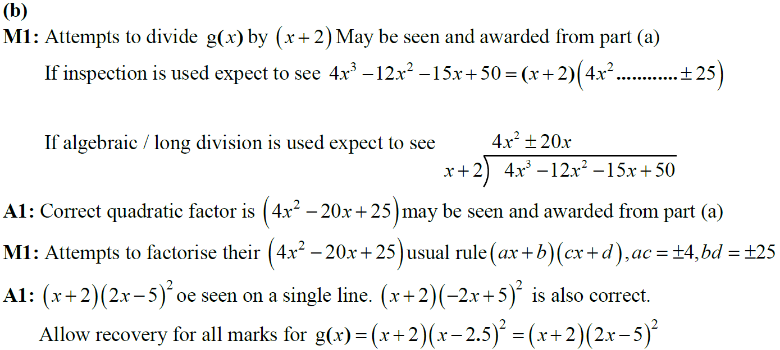
2018
B notes

Slide 33
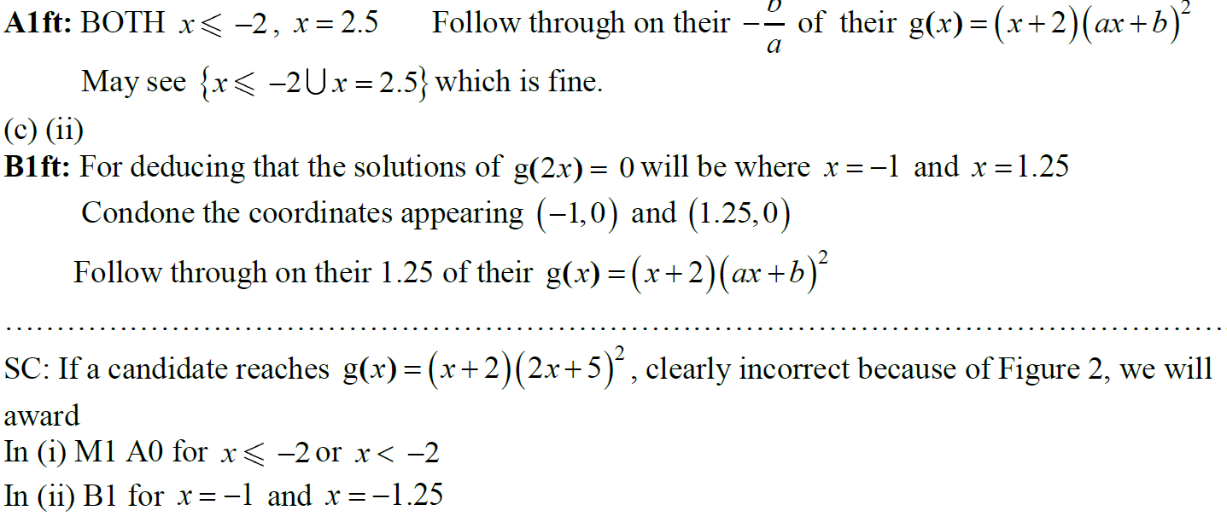
2018
C notes

Slide 34
New Spec Q’s
Old Spec Sketching & Transforming Graphs
Jan 2006
June 2008 (ii)
Jan 2011 (i)
May 2013
May 2006 (i)
Jan 2009 (i)
Jan 2011 (ii)
May 2014
May 2006 (ii)
Jan 2009 (ii)
May 2011 (i)
May 2015
Jan 2007 (i)
June 2009
May 2011 (ii)
May 2016
Jan 2007 (ii)
Jan 2010 (i)
Jan 2012 (i)
May 2017 (i)
May 2007 (i)
Jan 2010 (ii)
Jan 2012 (ii)
May 2017 (ii)
May 2007 (ii)
Jan 2010 (iii)
May 2012 (i)
May 2017 (iii)
Jan 2008 (i)
June 2010 (i)
May 2012 (ii)
May 2018 (i)
Jan 2008 (ii)
June 2010 (ii)
Jan 2013 (i)
May 2018 (ii)
June 2008 (i)
June 2010 (iii)
Jan 2013 (ii)

Slide 35
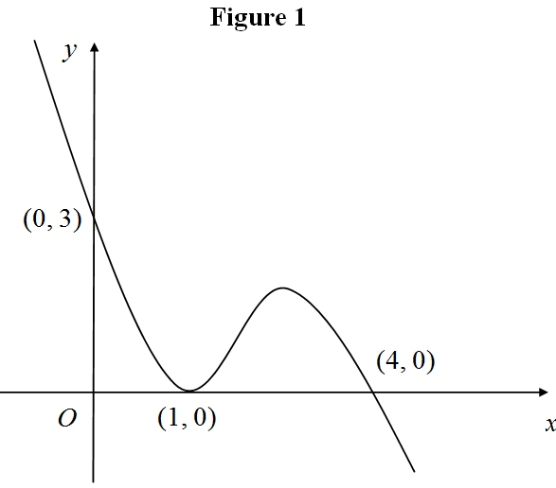
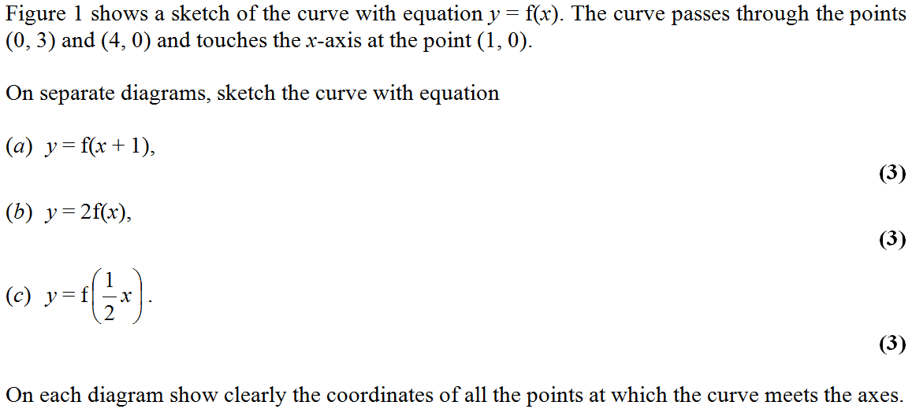
Jan 2006

Slide 36
Jan 2006
A
B
C

Slide 37
May 2006

Slide 38
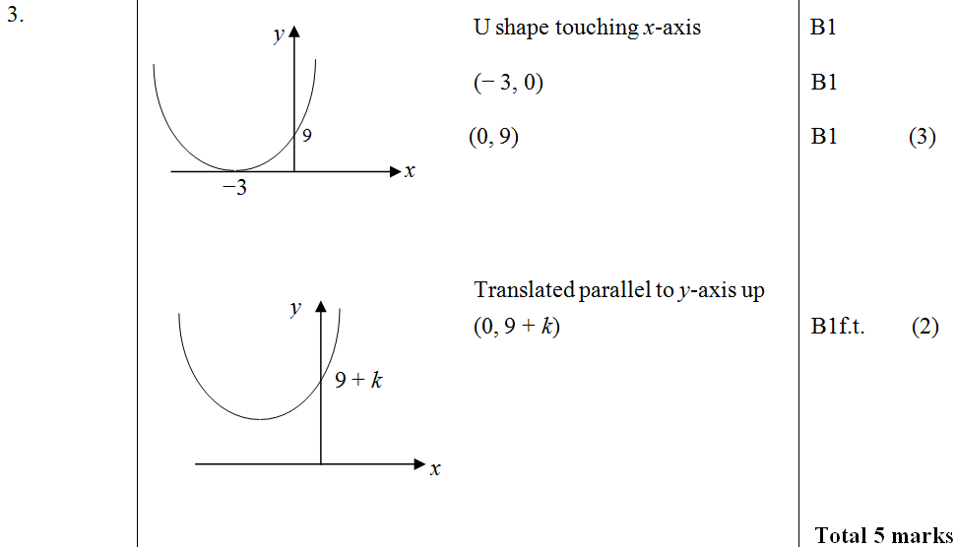
May 2006
A
B

Slide 39
May 2006

Slide 40
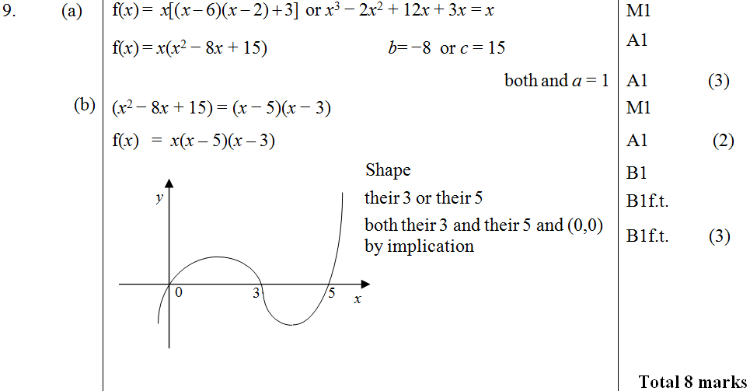
May 2006
A
B
C

Slide 41
Jan 2007

Slide 42
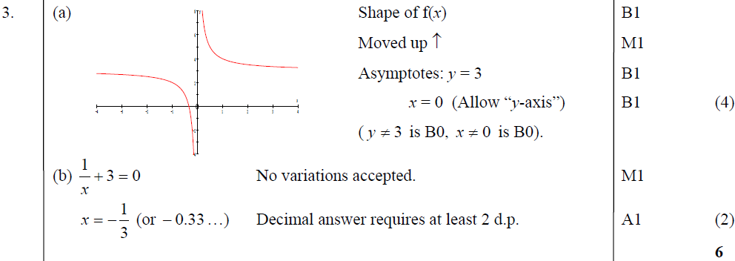
Jan 2007
A
B

Slide 43
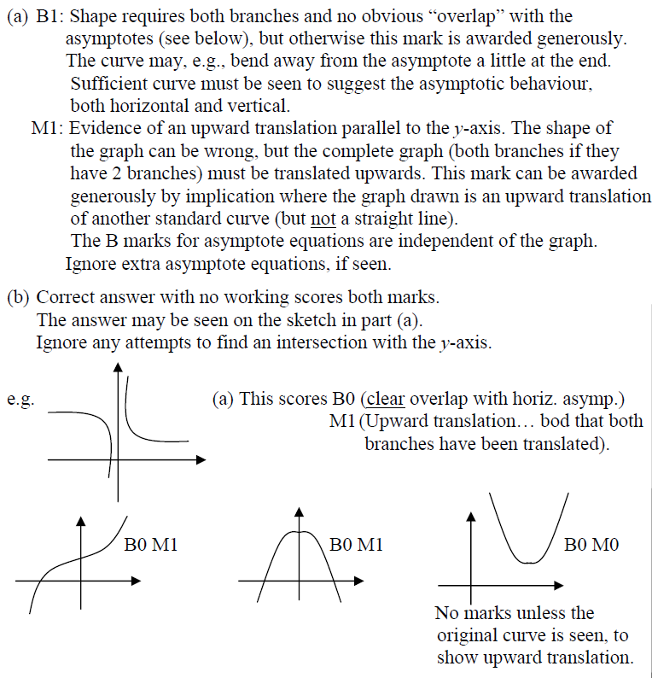
Jan 2007
A notes
B notes

Slide 44
Jan 2007

Slide 45
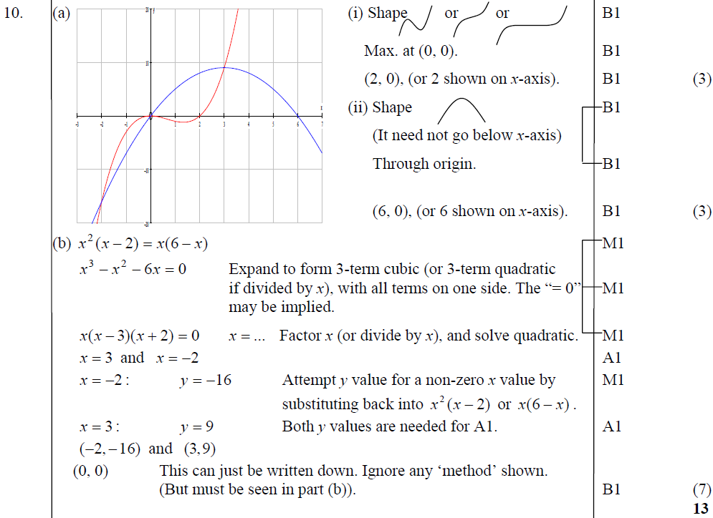
Jan 2007
A
B

Slide 46
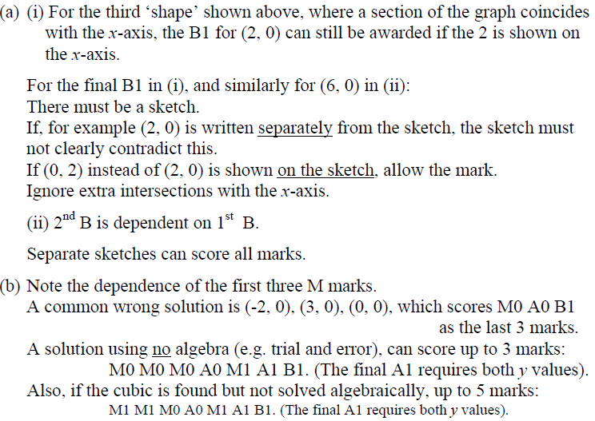
Jan 2007
A notes
B notes

Slide 47
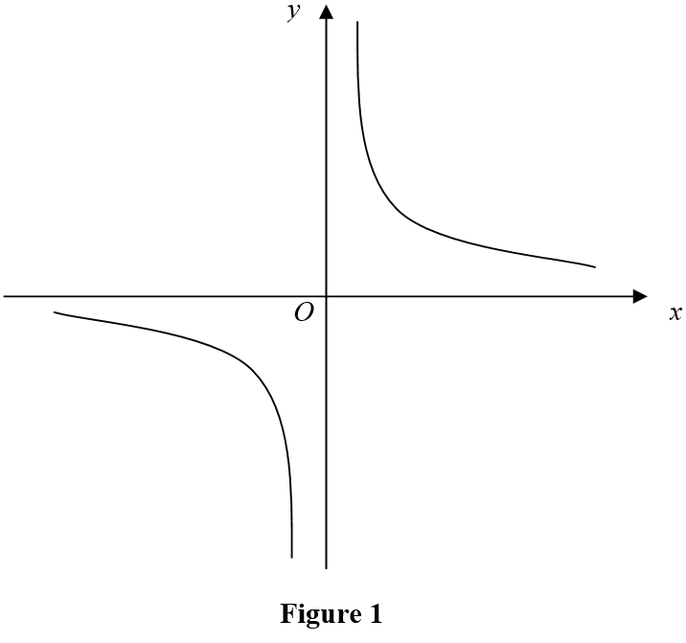
May 2007

Slide 48
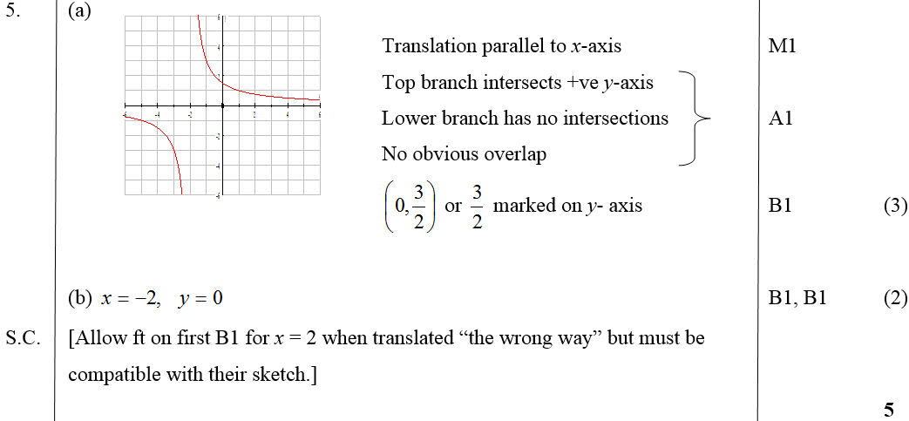
May 2007
A
B

Slide 49
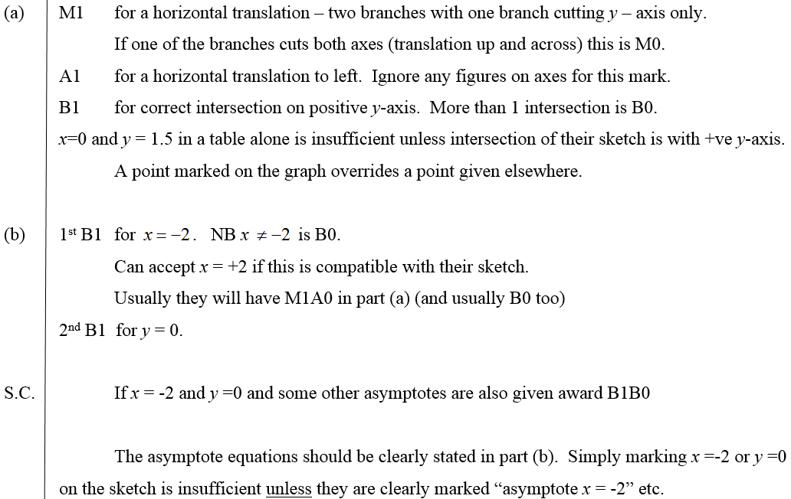
May 2007
A notes
B notes

Slide 50
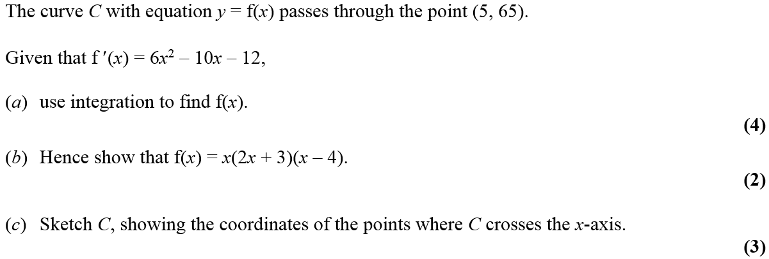
May 2007

Slide 51
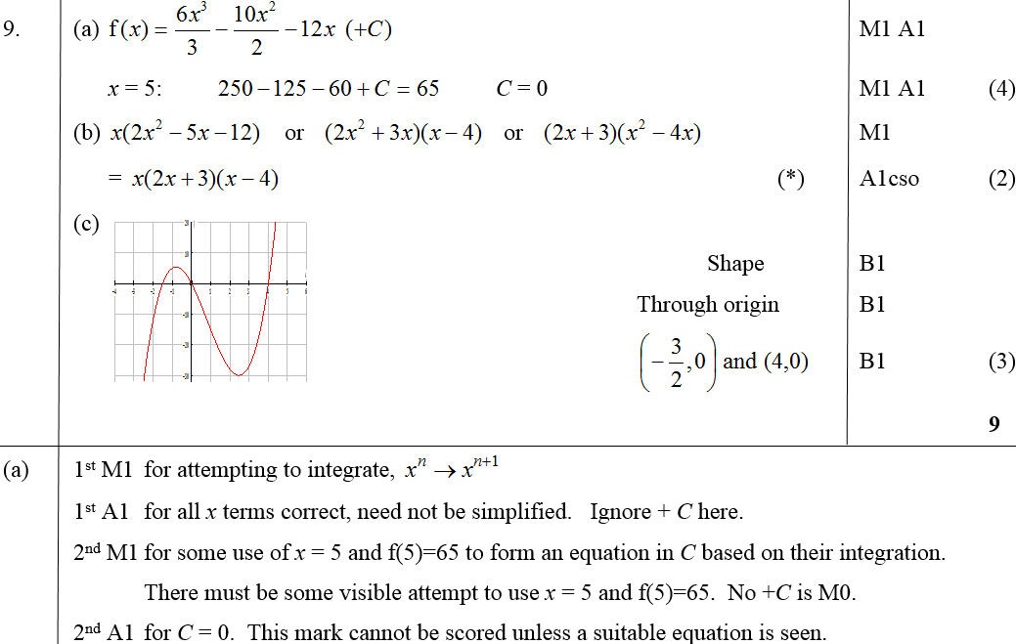
May 2007
A
B
C
A notes

Slide 52
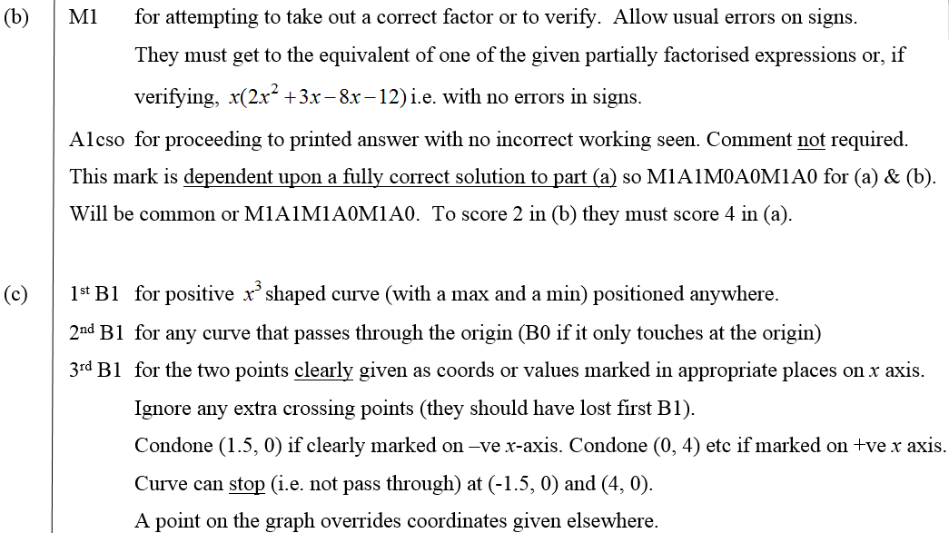
May 2007
B notes
C notes

Slide 53
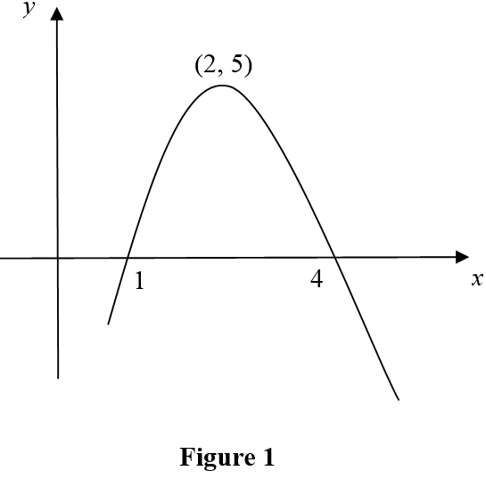
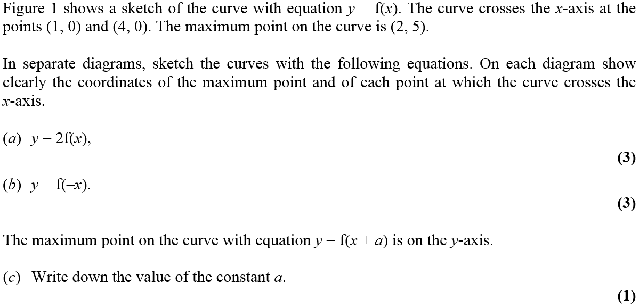
Jan 2008

Slide 54
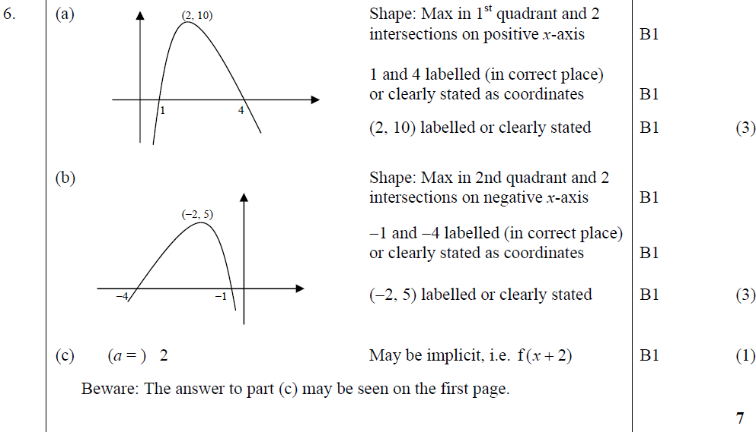
Jan 2008
A
B
C

Slide 55
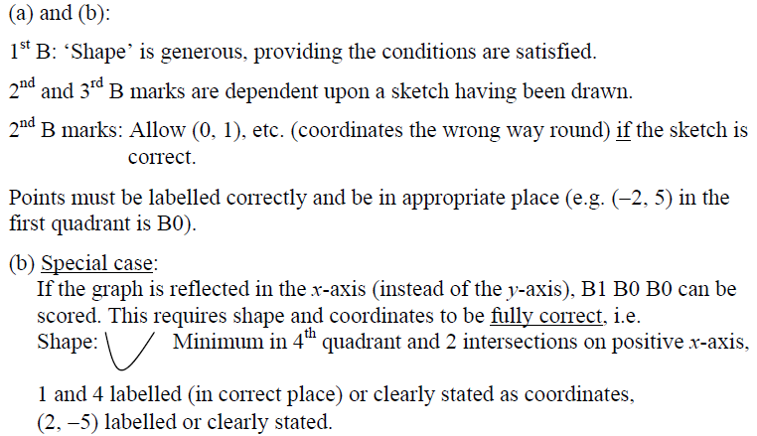
Jan 2008
A & B notes
B Special Case

Slide 56
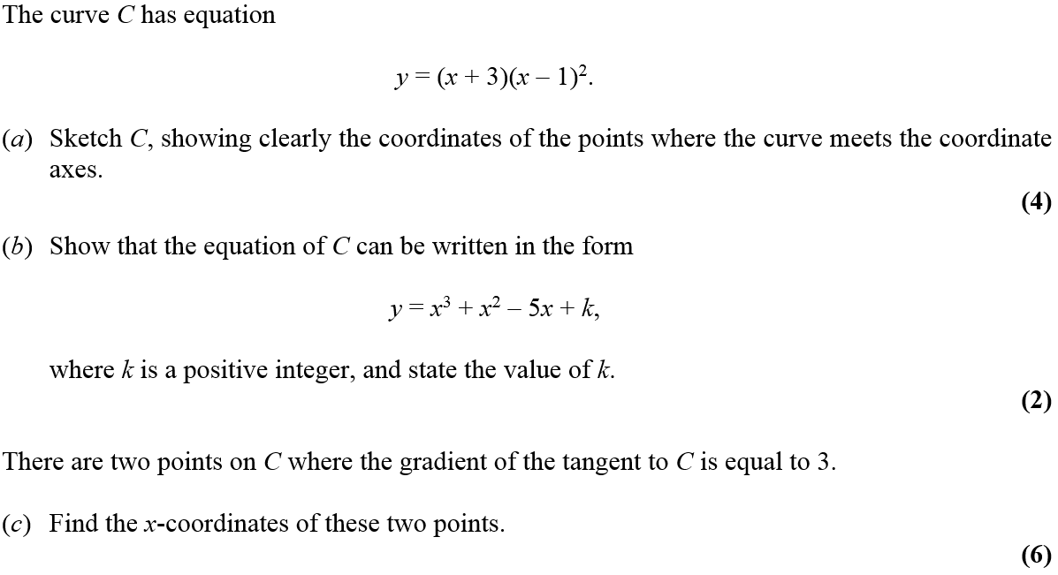
Jan 2008

Slide 57
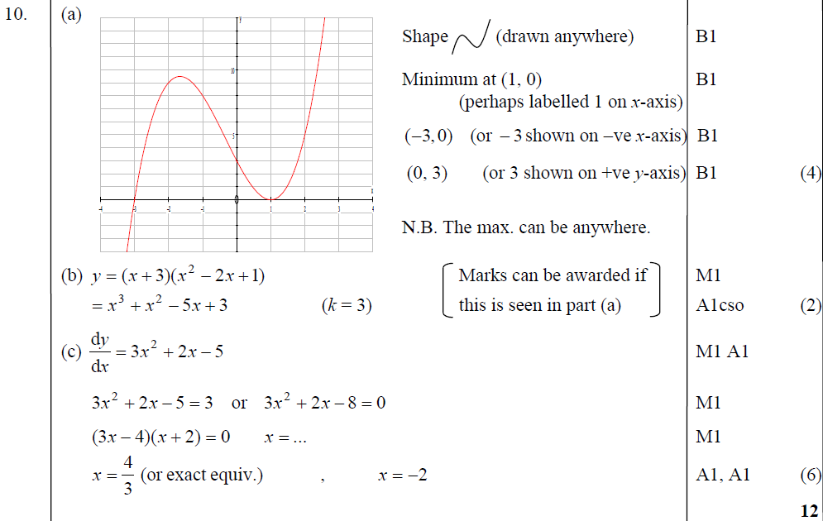
Jan 2008
A
B
C

Slide 58
Jan 2008
A notes
B notes
C notes

Slide 59
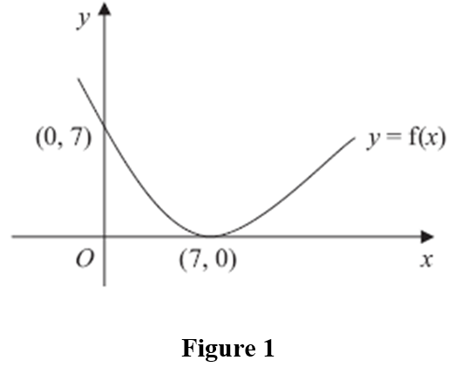
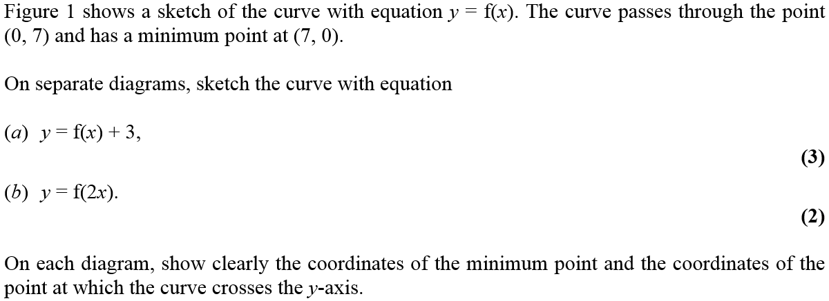
June 2008

Slide 60
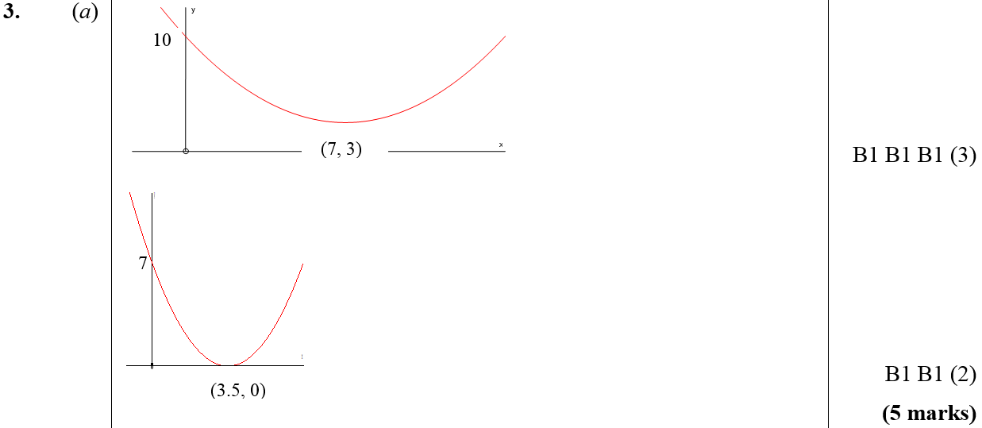
June 2008
A
B

Slide 61
June 2008

Slide 62
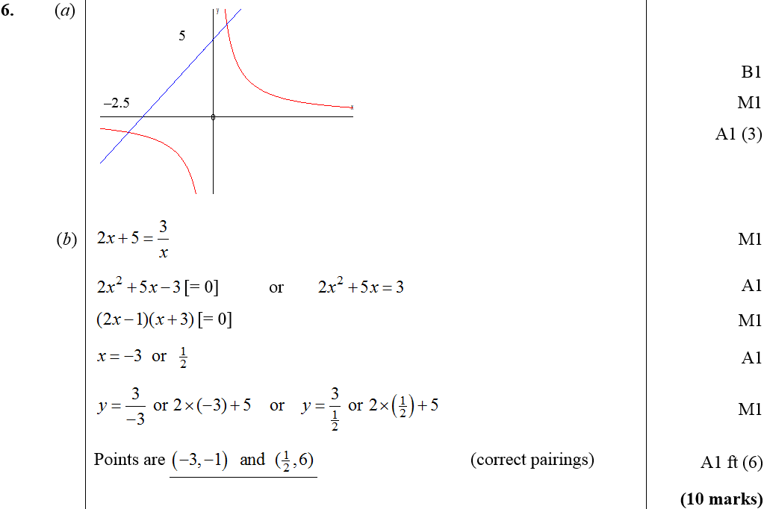
June 2008
A
B

Slide 63
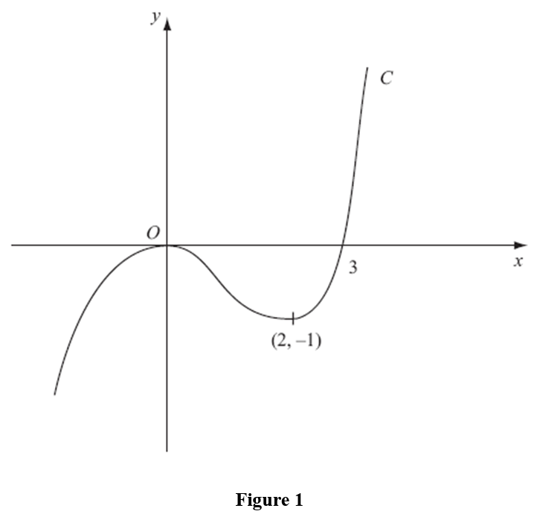
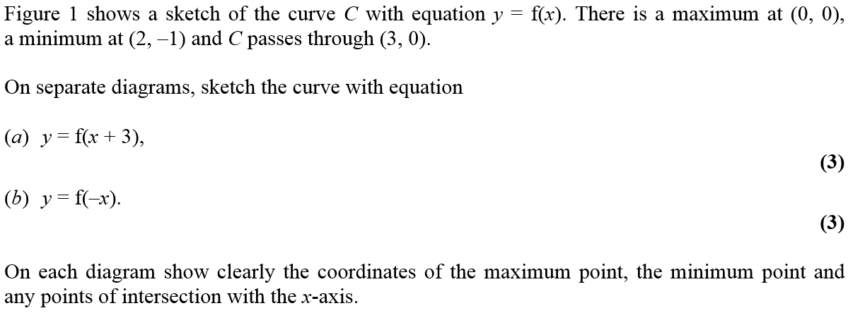
Jan 2009

Slide 64
Jan 2009
A
B

Slide 65
Jan 2009
A notes
B notes

Slide 66
Jan 2009

Slide 67
Jan 2009
A
B
C

Slide 68
Jan 2009
B notes
C notes

Slide 69
June 2009

Slide 70
June 2009
A
B
C

Slide 71
Jan 2010

Slide 72
Jan 2010
A
B
C
A
B
C

Slide 73
Jan 2010

Slide 74
Jan 2010
A
B
C
D

Slide 75
Jan 2010

Slide 76
A
Jan 2010
B
C

Slide 77
June 2010

Slide 78
June 2010
A
B
C

Slide 79
June 2010

Slide 80
June 2010
A
B
C

Slide 81
June 2010

Slide 82
June 2010
A
B
C

Slide 83
Jan 2011

Slide 84
Jan 2011
A
B

Slide 85
Jan 2011
B notes

Slide 86
Jan 2011

Slide 87
Jan 2011
A
B
B notes

Slide 88
May 2011

Slide 89
May 2011
A
B
C

Slide 90
May 2011
A
B
C

Slide 91
May 2011

Slide 92
May 2011
A
B
C
D

Slide 93
May 2011
A notes
B notes
C notes
D notes

Slide 94
Jan 2012

Slide 95
Jan 2012
A
B

Slide 96
Jan 2012

Slide 97
Jan 2012
A
B
C
D

Slide 98
May 2012

Slide 99
May 2012
A
B
C

Slide 100
May 2012
A notes
Alternative A (i)
Alternative A (ii)
Alternative A (iii)
Special Case A

Slide 101
May 2012
B notes
C notes

Slide 102
May 2012

Slide 103
May 2012
A
B (i)
B (ii)
C

Slide 104
May 2012
A notes
B (i) notes
B (ii) notes
C notes

Slide 105
Jan 2013

Slide 106
Jan 2013
A
B
C

Slide 107
Jan 2013

Slide 108
Jan 2013
A
B

Slide 109
May 2013

Slide 110
May 2013
A
B
C

Slide 111
May 2014

Slide 112
May 2014
A
B
C

Slide 113
May 2014
A Notes
B Notes
C Notes

Slide 114
May 2015

Slide 115
May 2015
A

Slide 116
May 2015
B

Slide 117
May 2015
C

Slide 118
May 2016

Slide 119
May 2016
A

Slide 120
May 2016
B

Slide 121
May 2017

Slide 122
May 2017
A

Slide 123
May 2017
B

Slide 124
May 2017
C

Slide 125
May 2017

Slide 126
May 2017
A (i)

Slide 127
May 2017
A (ii)

Slide 128
May 2017
B

Slide 129
May 2017
C

Slide 130
May 2017

Slide 131
May 2017
A (i)
A (ii)

Slide 132
May 2017
B
B Alternative

Slide 133
May 2017
C

Slide 134
May 2018

Slide 135
May 2018
A
B
C
D

Slide 136
May 2018

Slide 137
May 2018
A
B

Slide 138
May 2018
B Alternative 1
B Alternative 2
B notes

Slide 139
May 2018
C

