Slide 1
Old Spec Q’s
Quadratics
Practice A (i)
Practice D (iii)
Practice A (ii)
SAM (i)
Practice A (iii)
SAM (ii)
Practice B
SAM (iii)
Practice C
2018 (i)
Practice D (i)
2018 (ii)
Practice D (ii)
2018 (iii)

Slide 2
Practice A

Slide 3
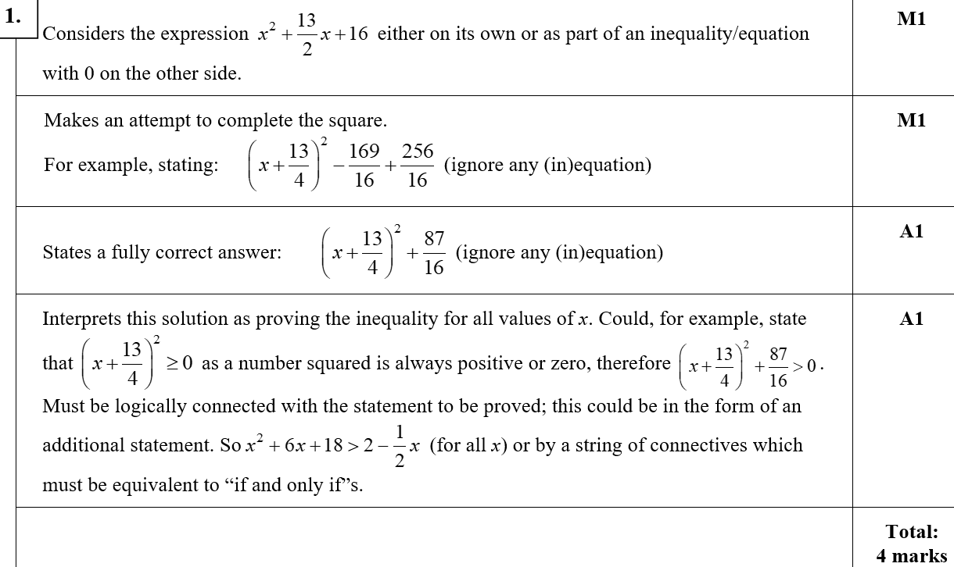
Practice Algebra part 1
A

Slide 4
Practice Algebra part 1
A notes

Slide 5
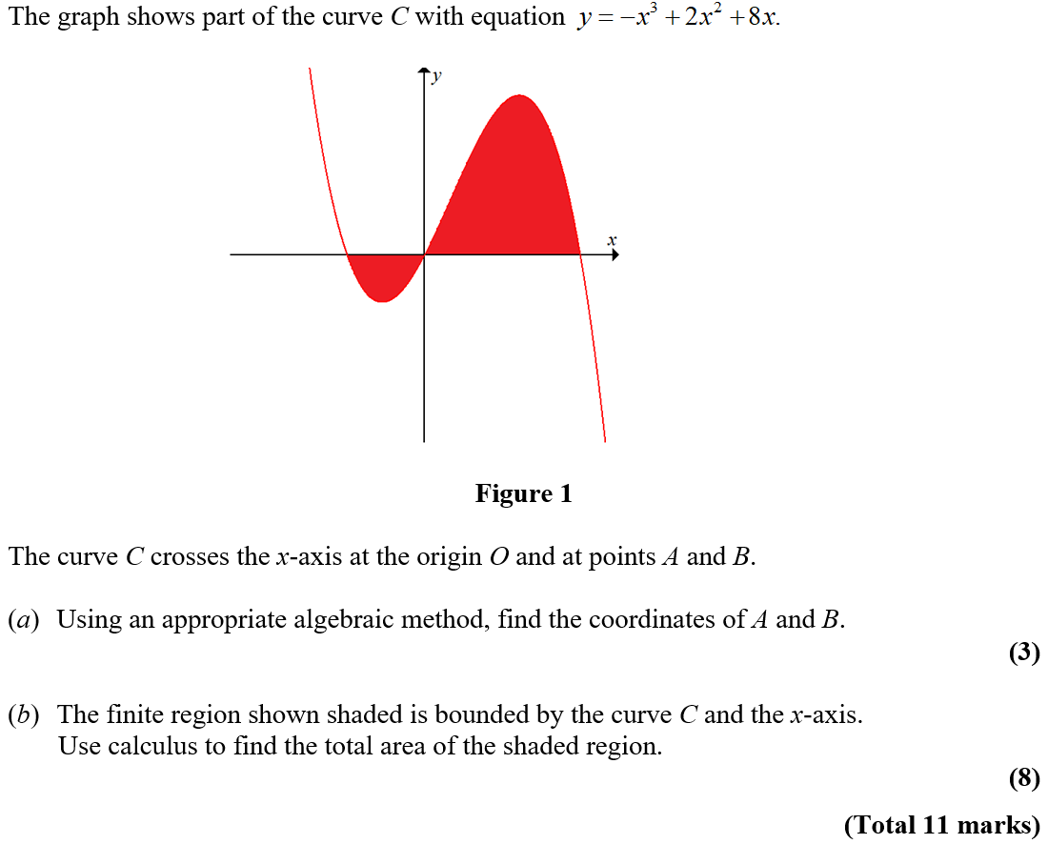
Practice A

Slide 6
Practice A
A
A notes

Slide 7
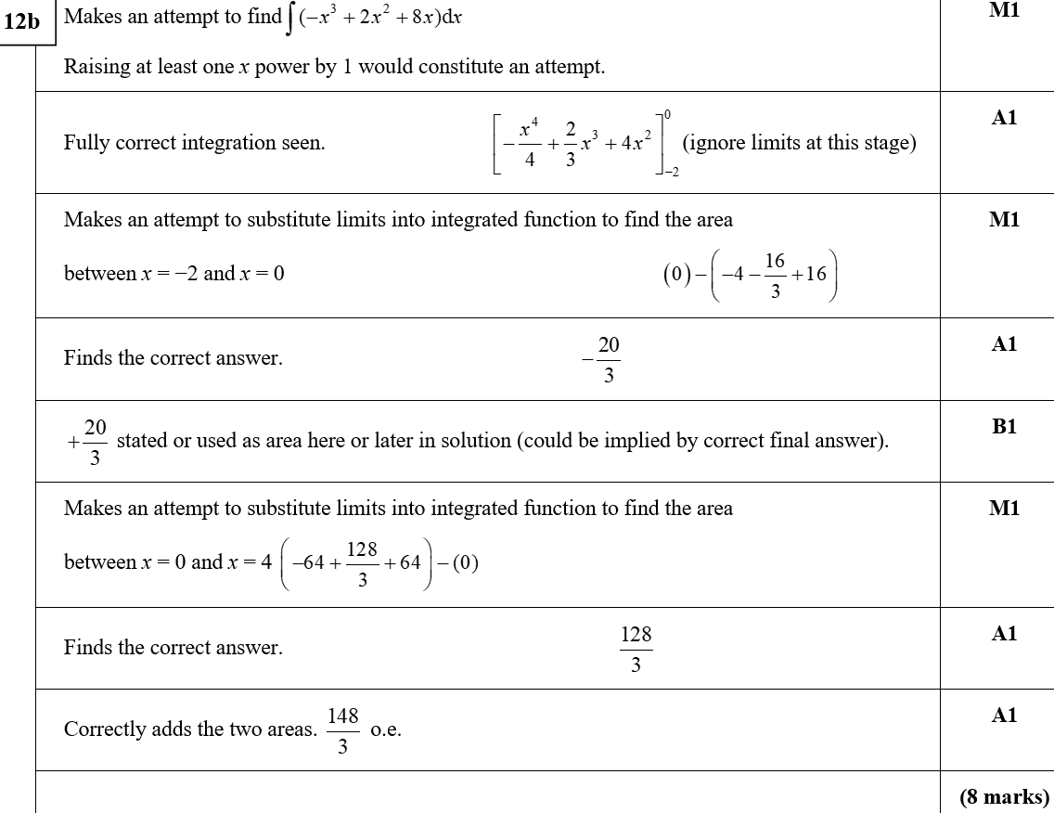
Practice A
B
B notes

Slide 8
Practice A

Slide 9
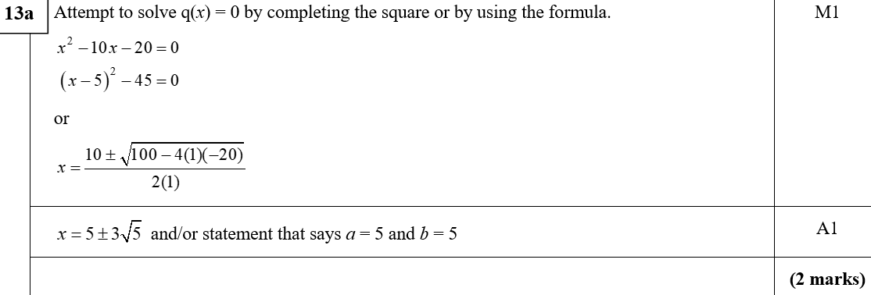
Practice A
A
A notes

Slide 10
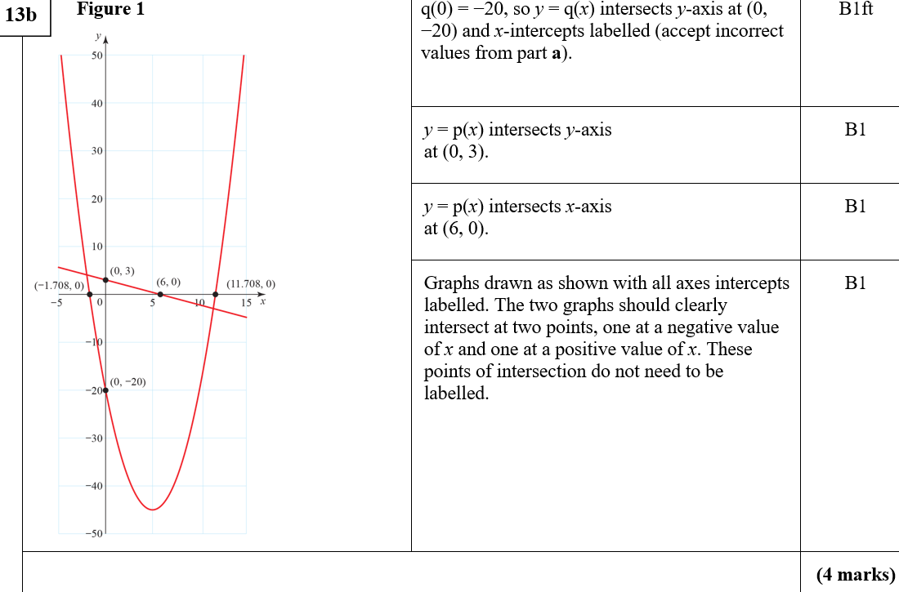
Practice A
B
B notes

Slide 11
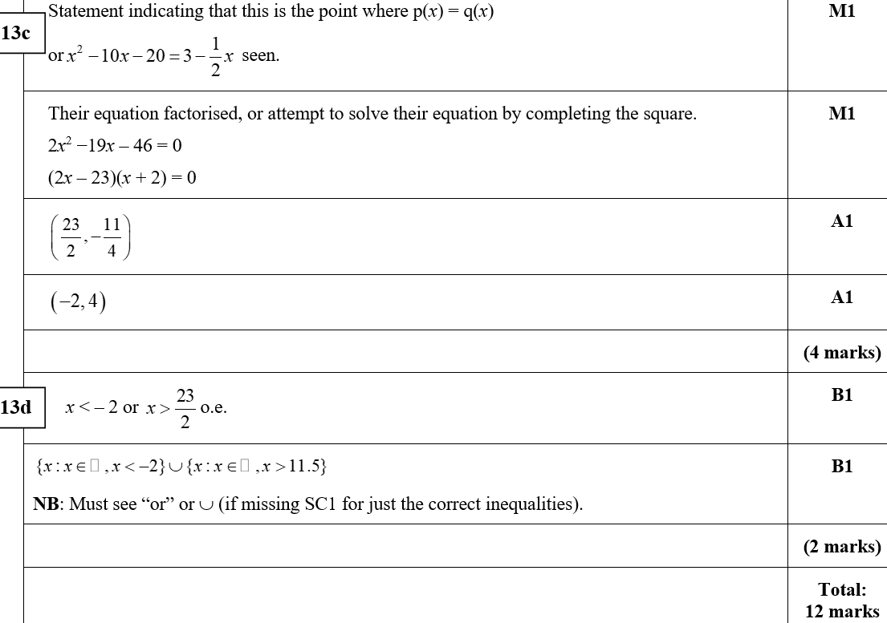
Practice A
C
D
C notes

Slide 12
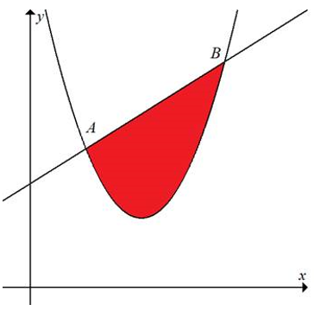
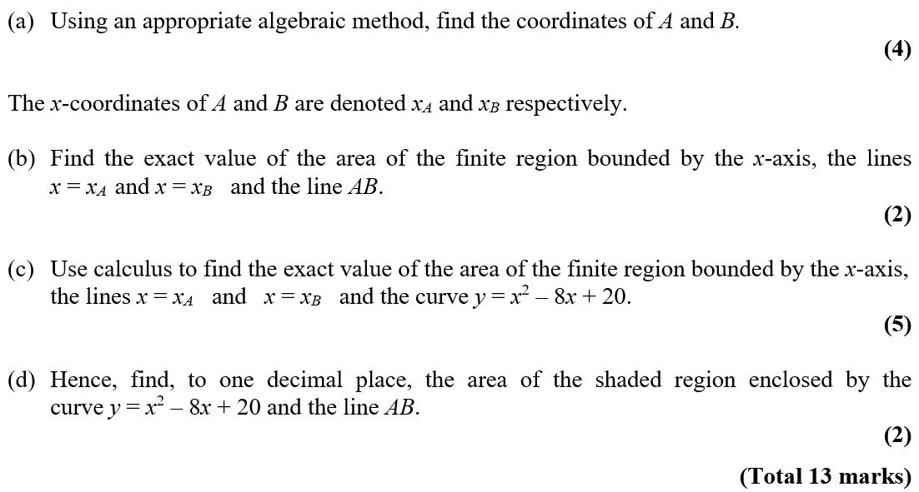
Practice B

Slide 13
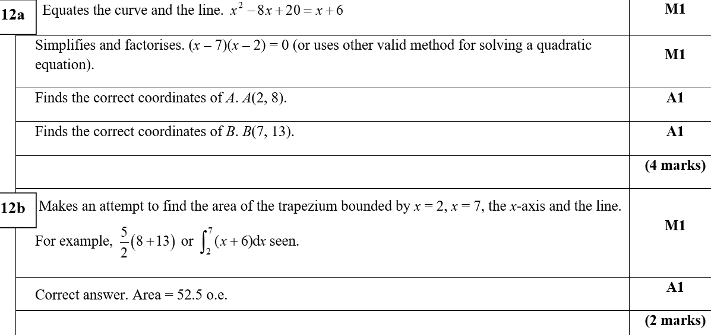
Practice B
A
B
A notes

Slide 14
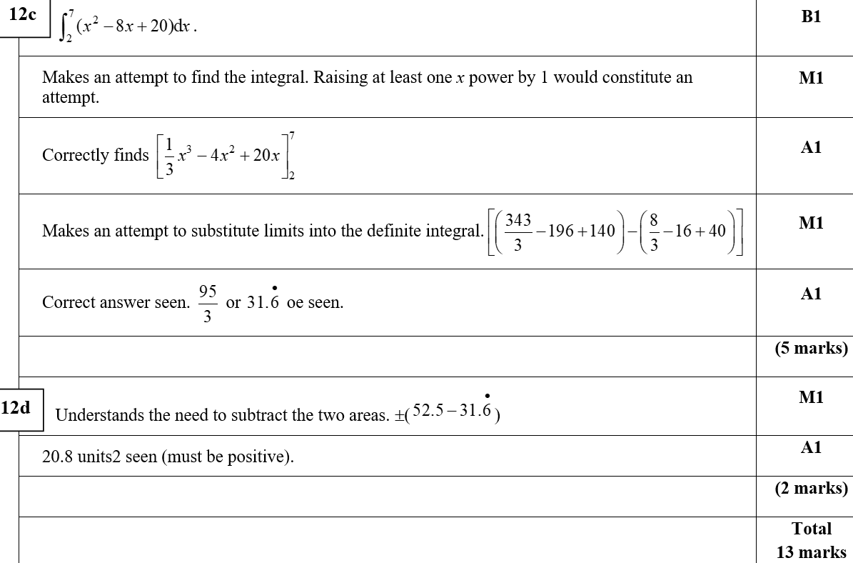
Practice B
C
D

Slide 15
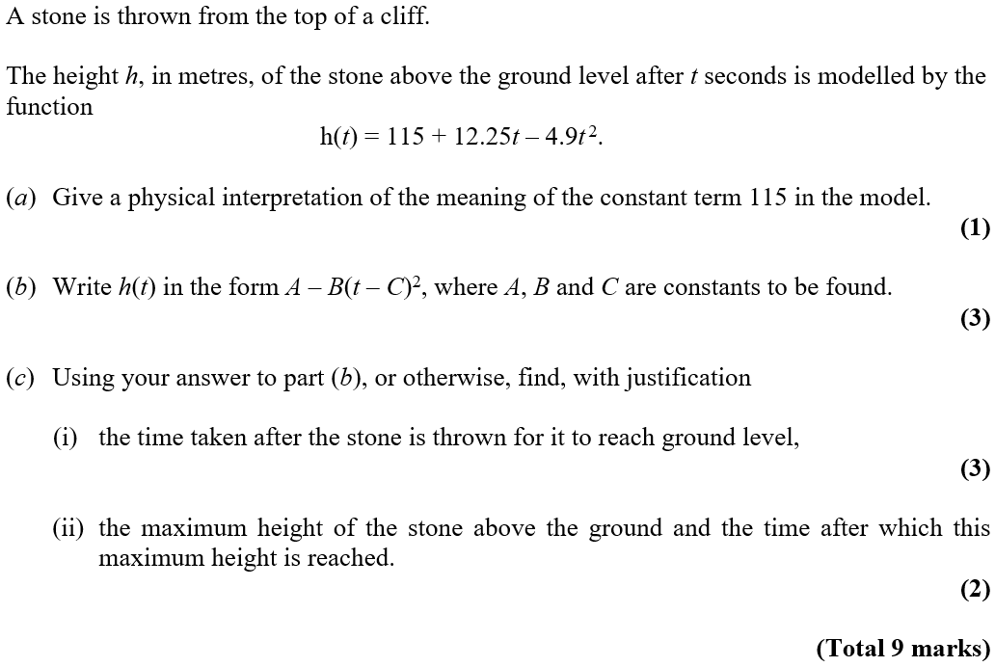
Practice C

Slide 16
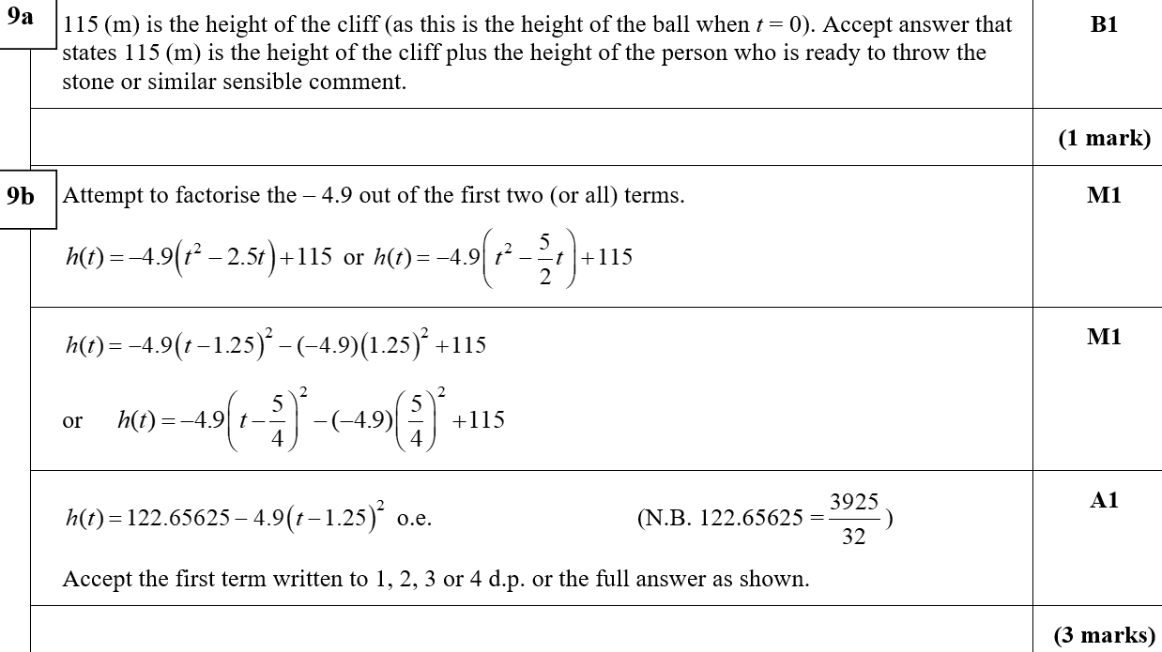
Practice C
A
B

Slide 17
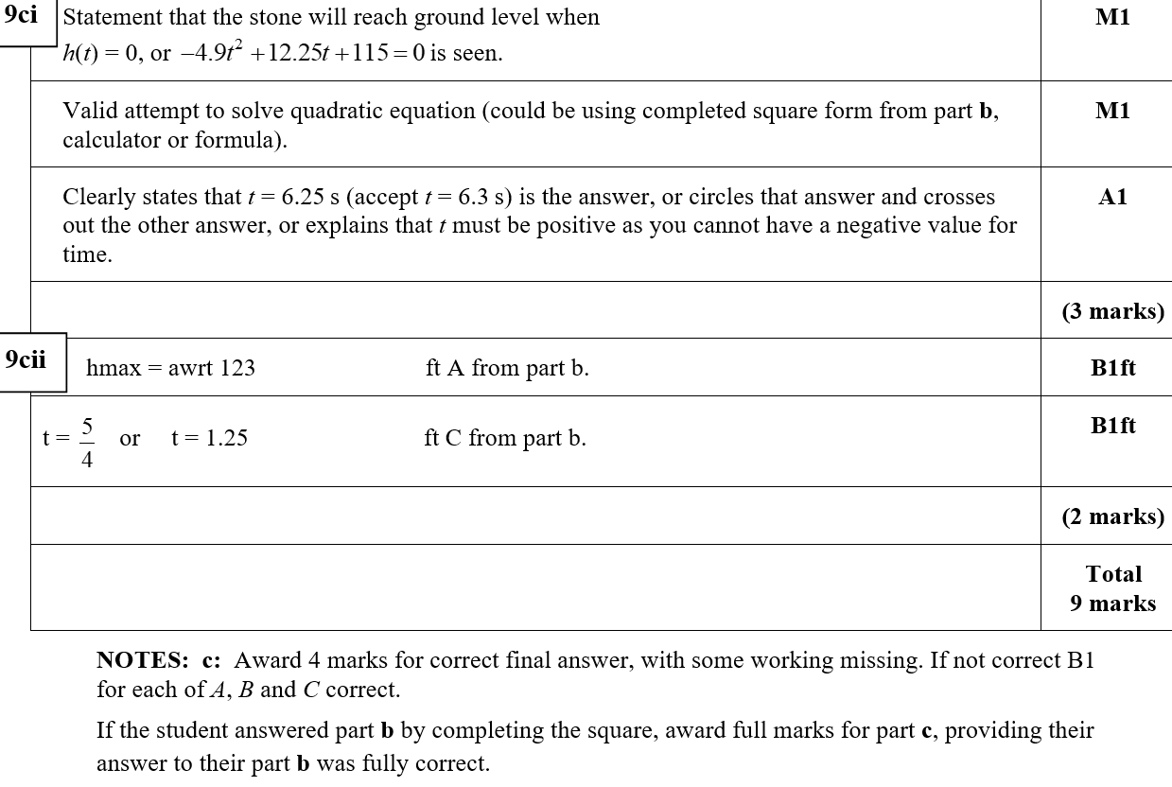
Practice C
C (i)
C (ii)
C notes

Slide 18
Practice D

Slide 19
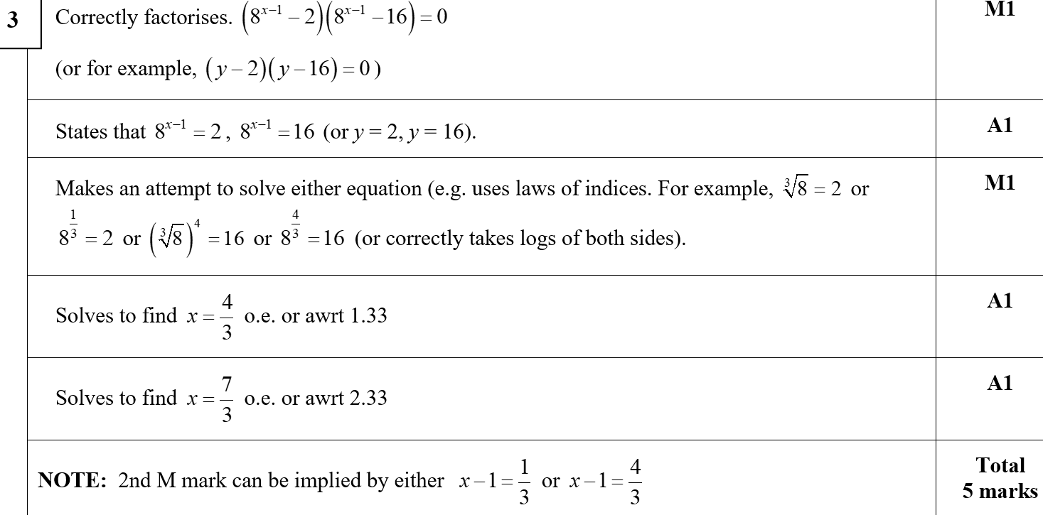
Practice D
A

Slide 20
Practice D

Slide 21
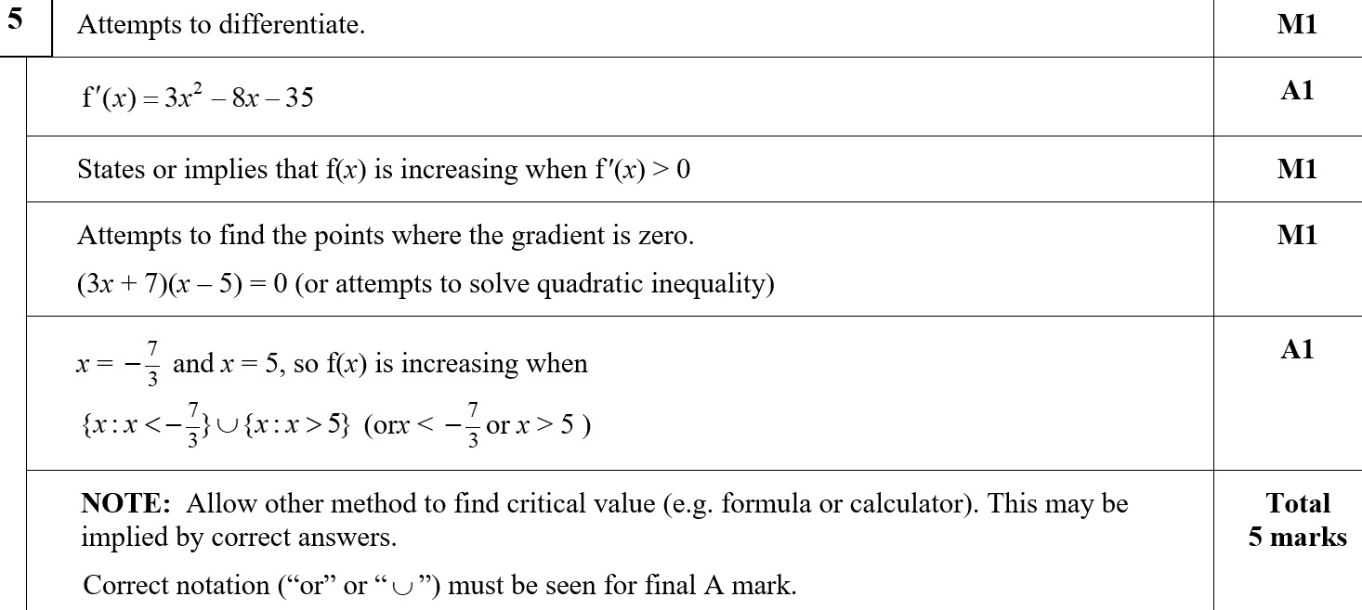
Practice D
A

Slide 22
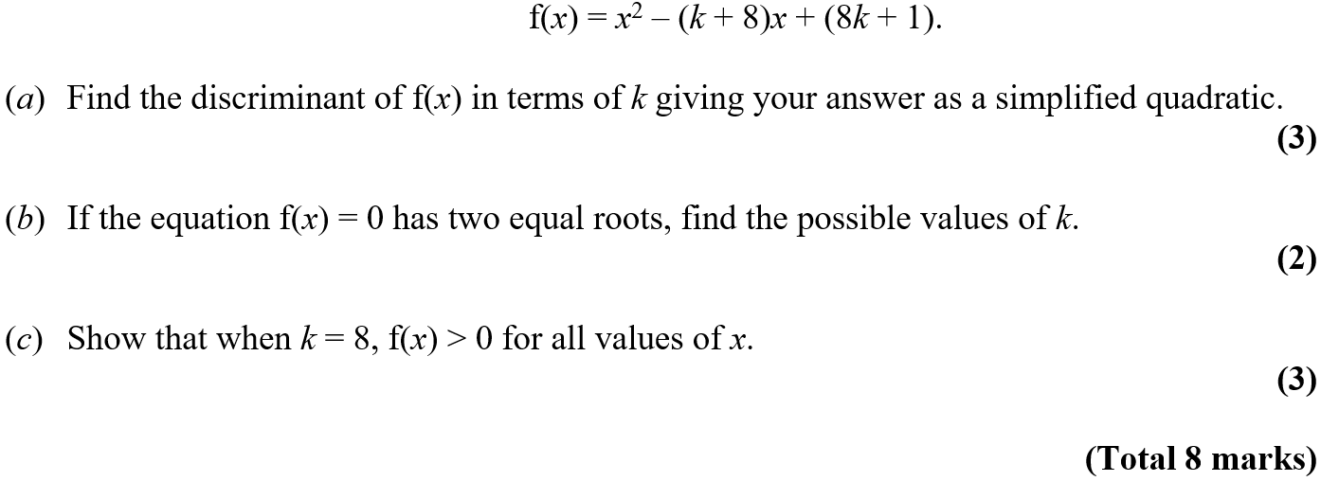
Practice D

Slide 23
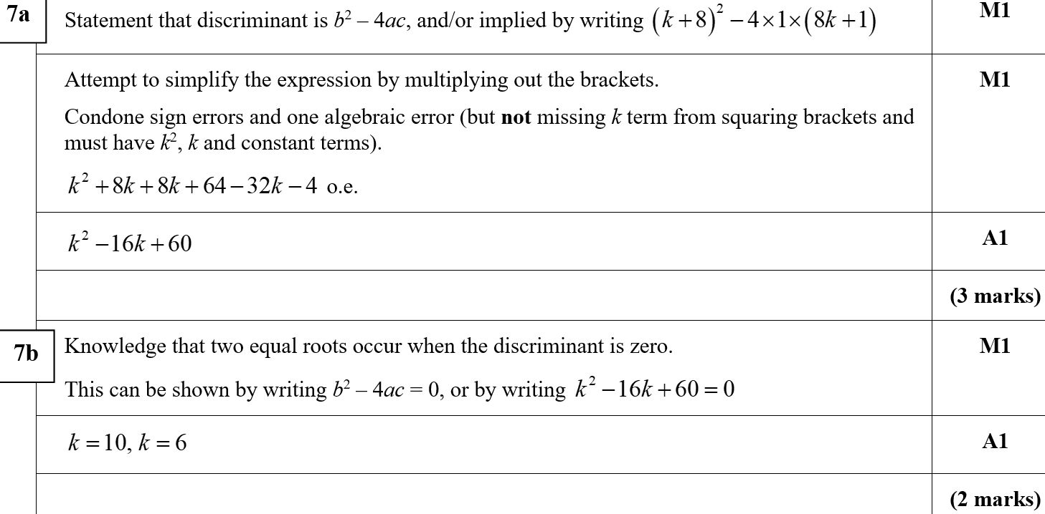
Practice D
A
B

Slide 24
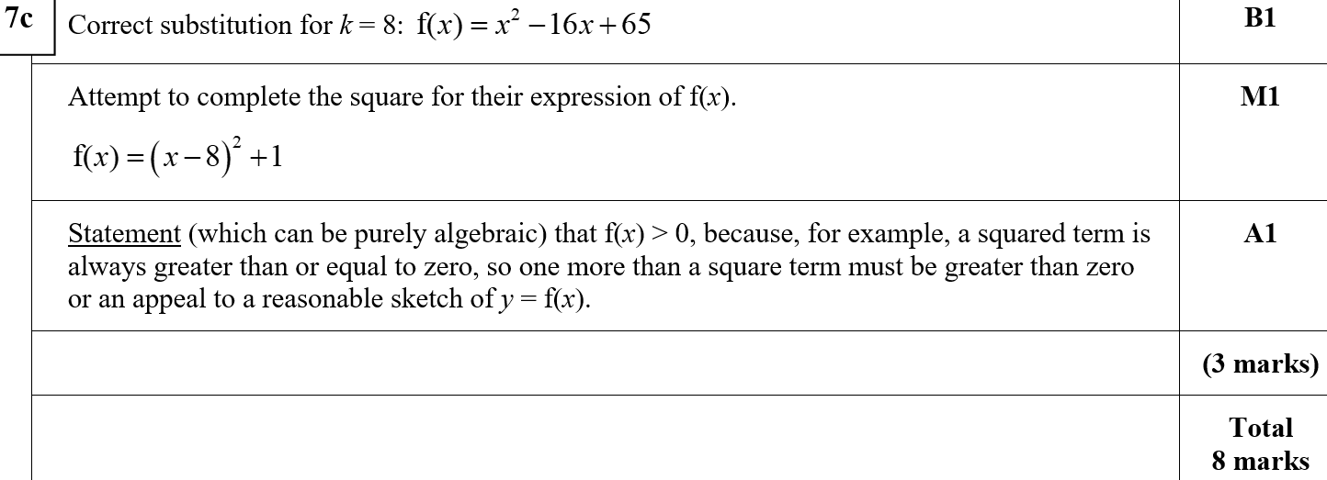
Practice D
A
A notes
B notes
C notes

Slide 25
SAM

Slide 26
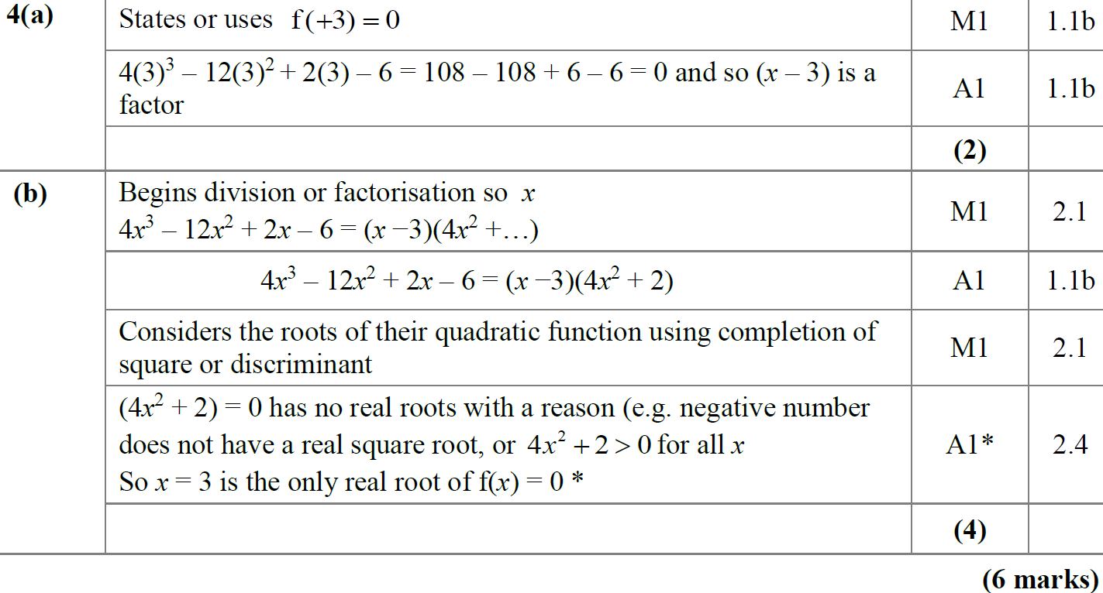
SAM
A
B

Slide 27
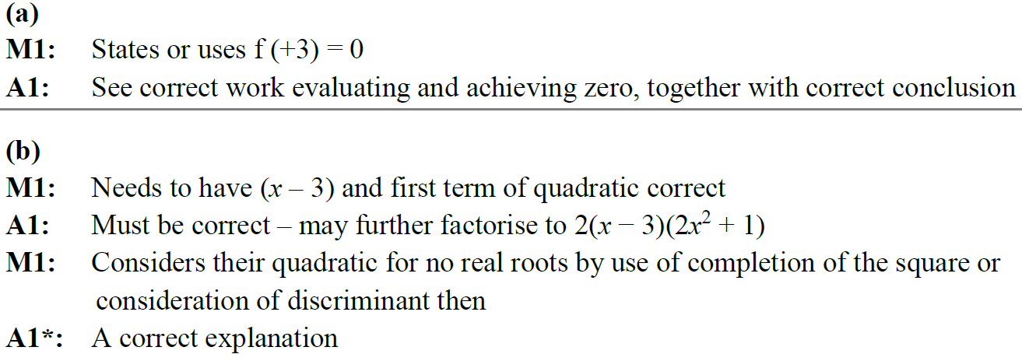
SAM
A notes
B notes

Slide 28
SAM

Slide 29
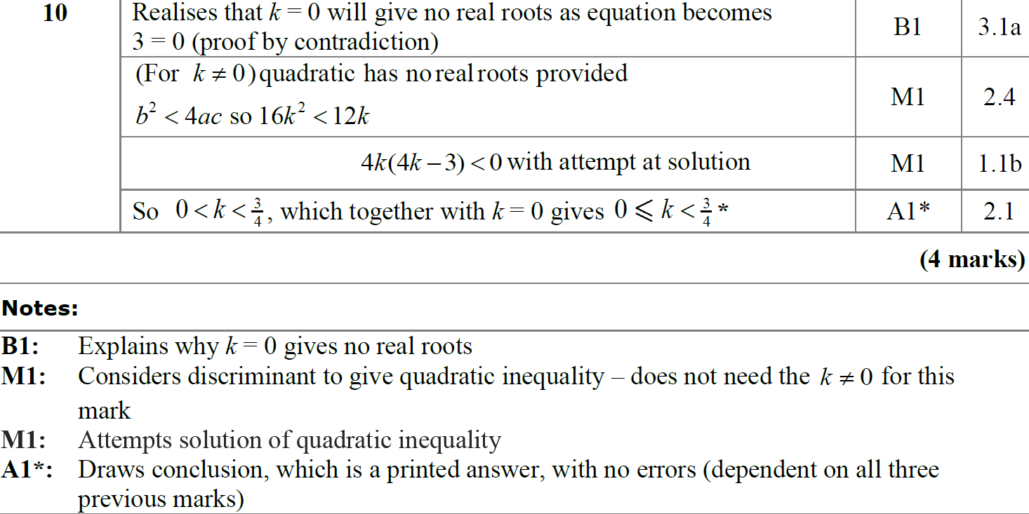
SAM
A
A notes

Slide 30
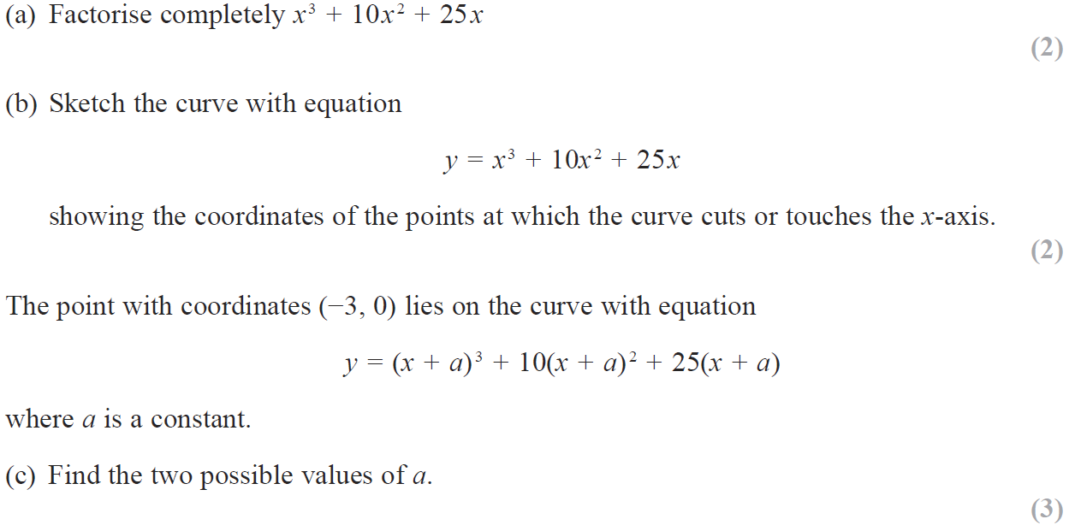
SAM

Slide 31
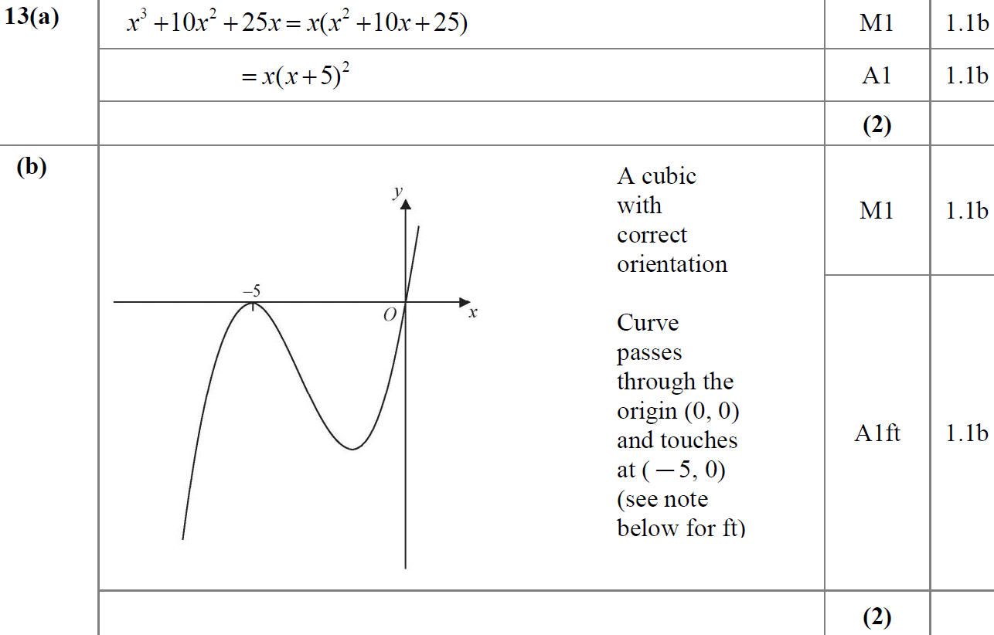
SAM
A
B

Slide 32
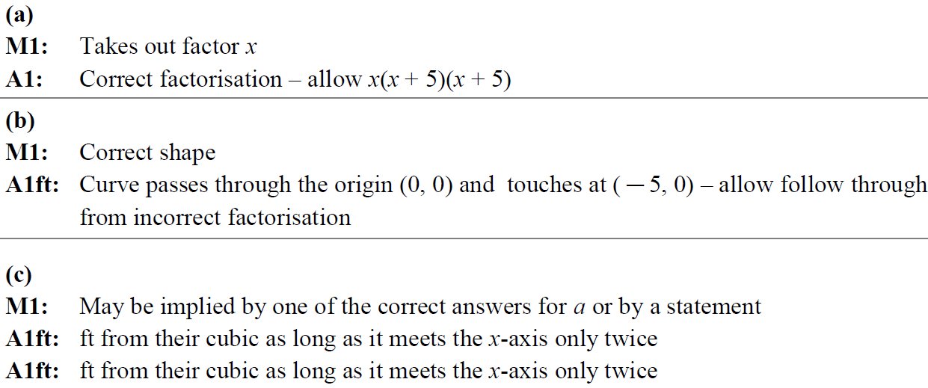
SAM
C
A notes
B notes
C notes

Slide 33
2018

Slide 34
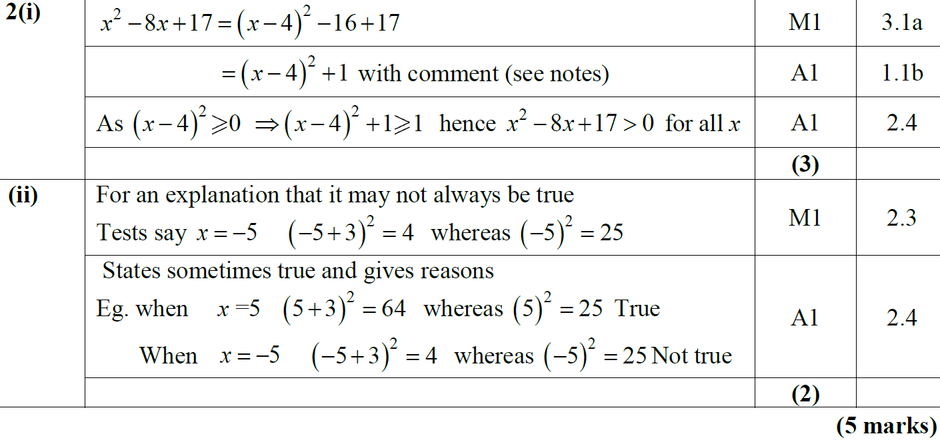
2018
(i)
(ii)

Slide 35
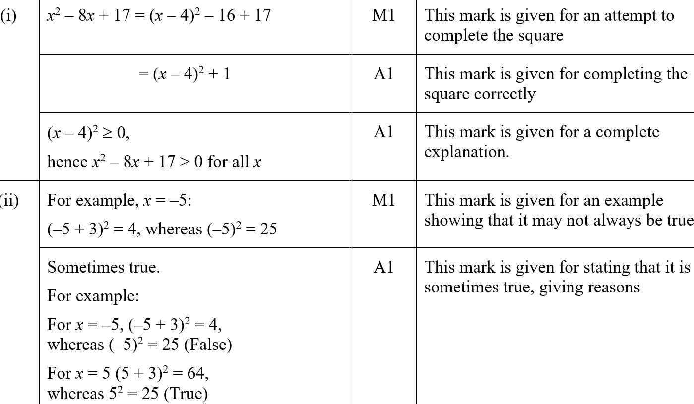
2018
(i) (SF)
(ii) (SF)

Slide 36
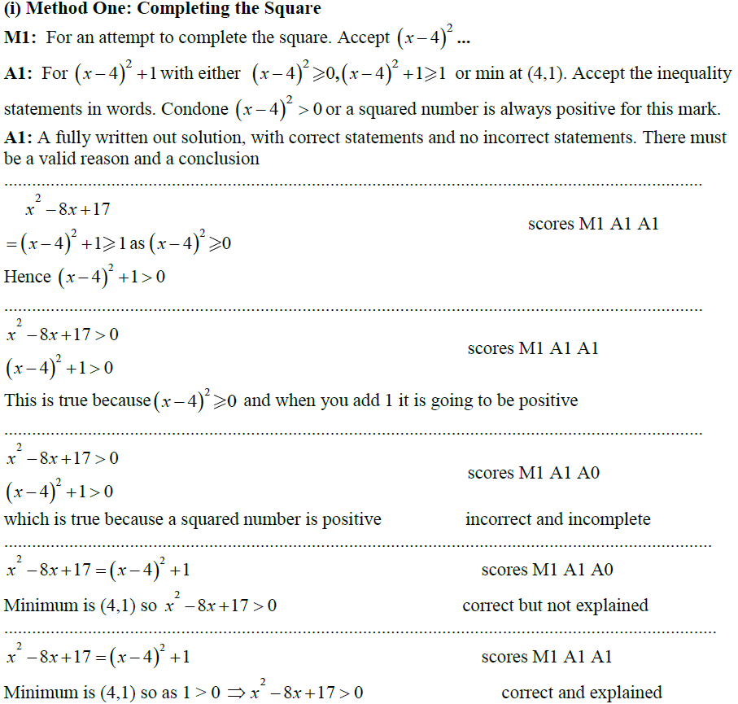
2018
(i) notes on completing the square method

Slide 37
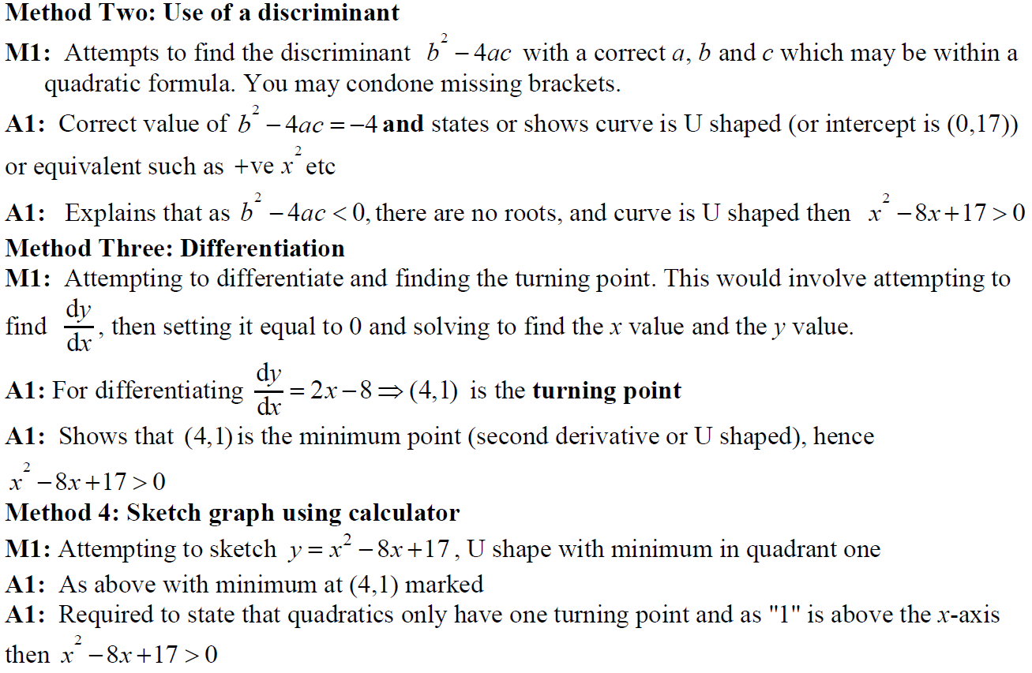
2018
(i) notes on discriminant method
(i) notes on differentiation method
(i) notes on graph sketching method

Slide 38
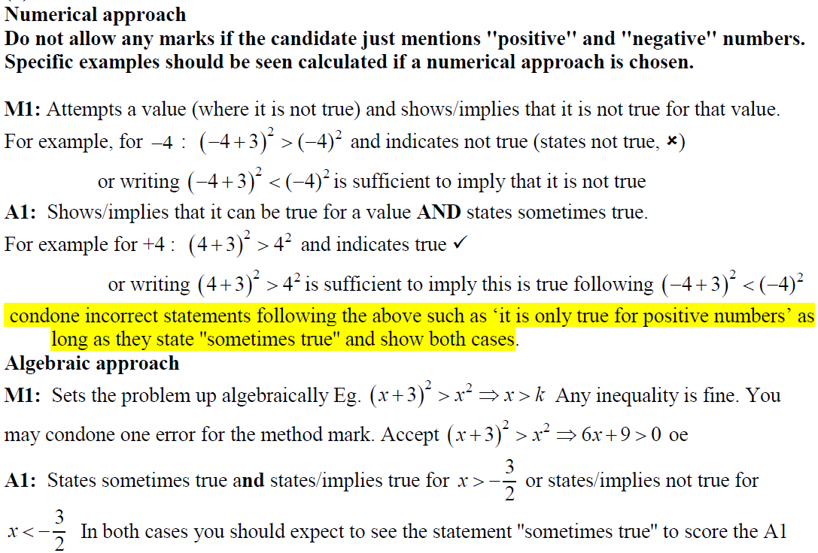
2018
(ii) notes on numerical approach
(ii) notes on algebraic approach

Slide 39
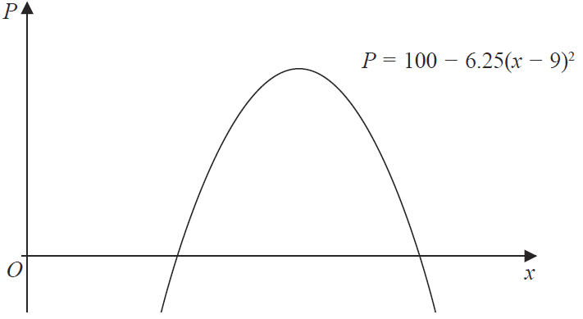
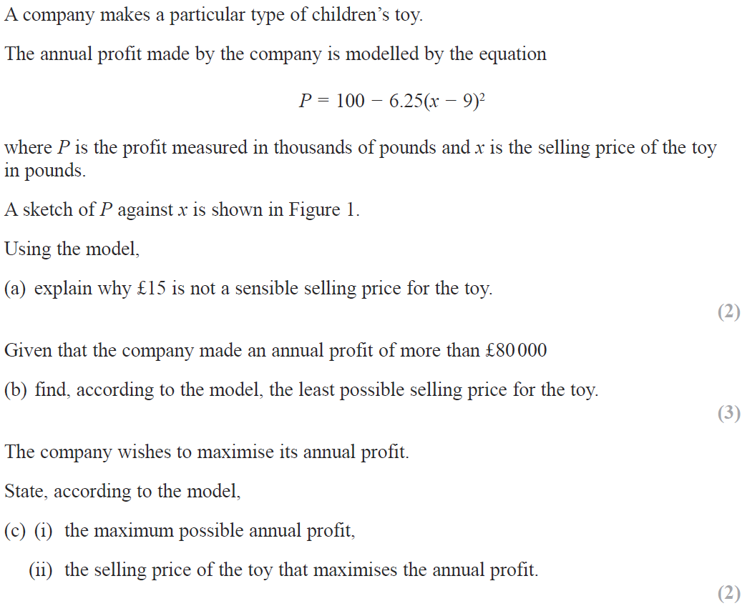
2018

Slide 40
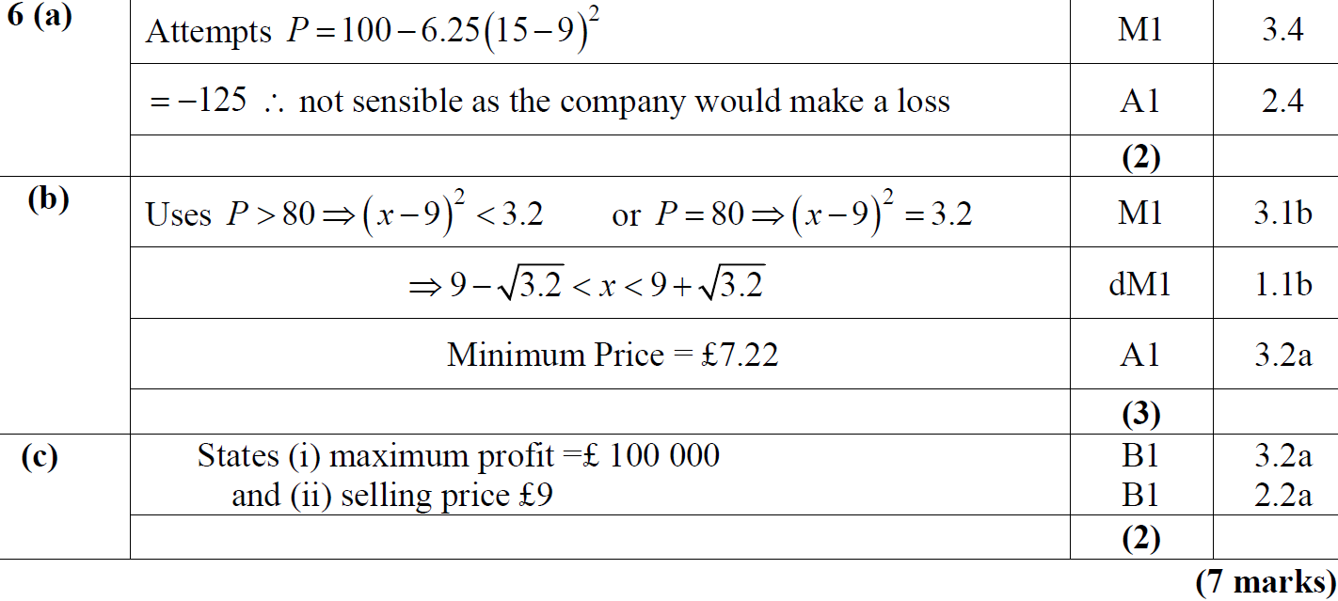
2018
A
B
C

Slide 41
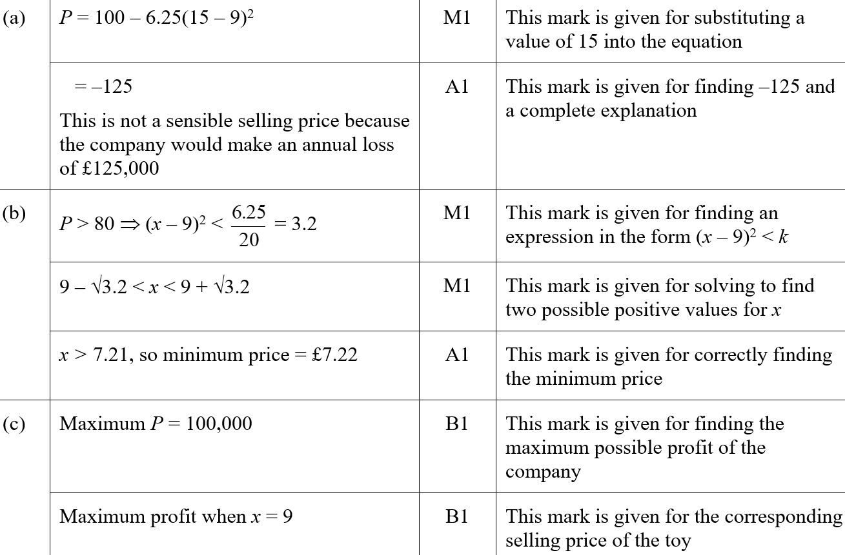
2018
A
B
C

Slide 42
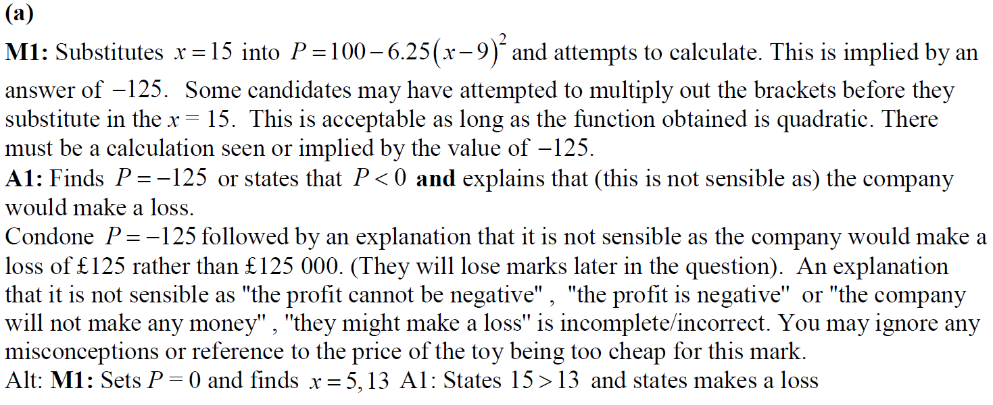
2018
A notes

Slide 43
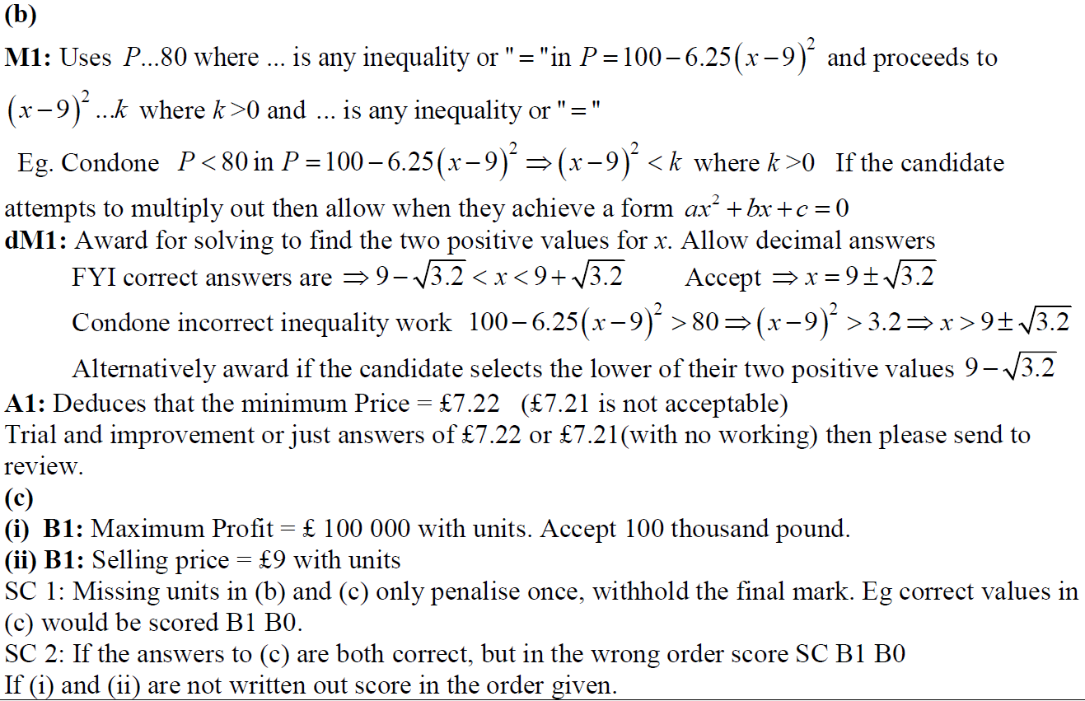
2018
B notes
C (i) notes
C (ii) notes

Slide 44
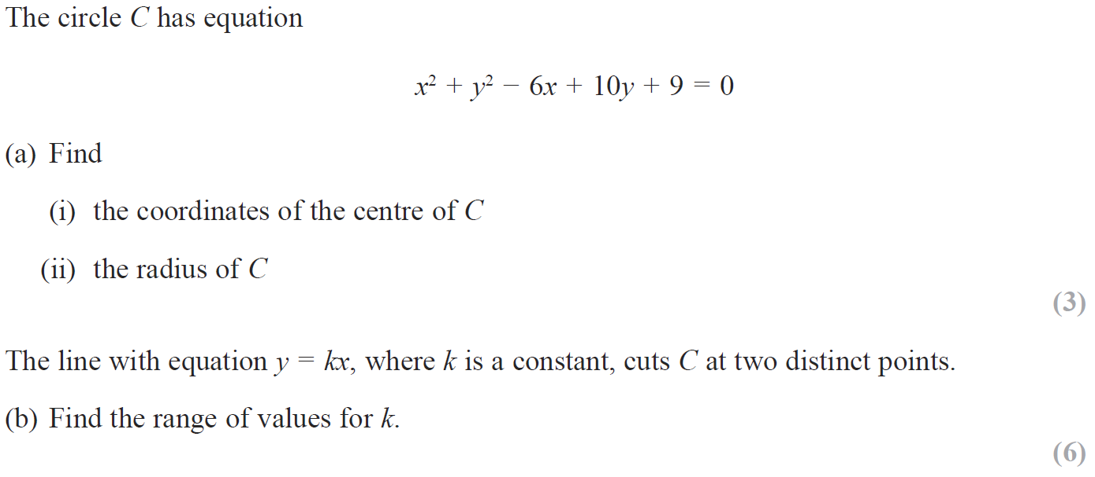
2018

Slide 45
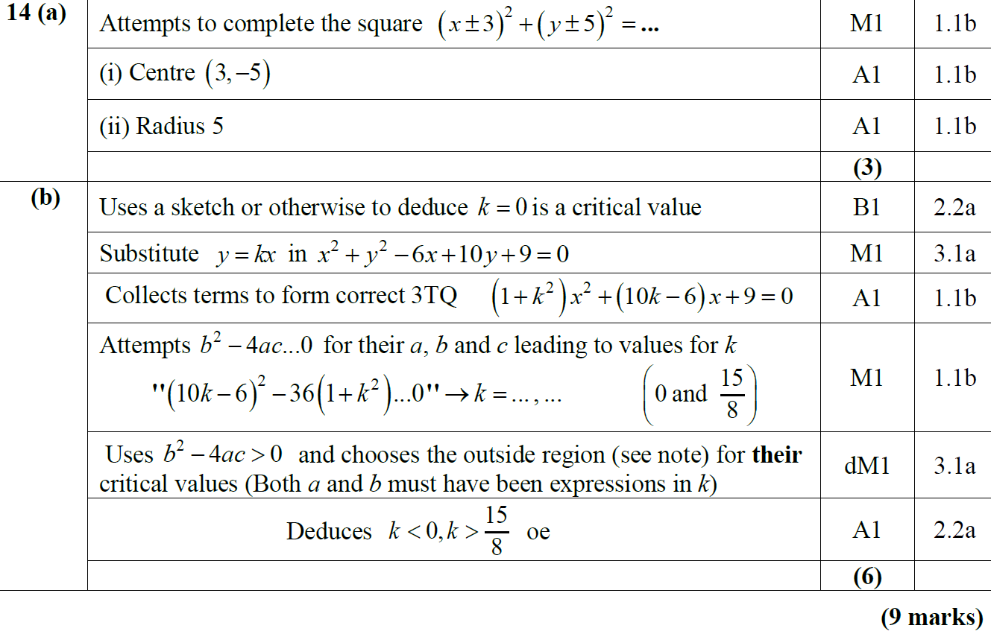
2018
A
B

Slide 46
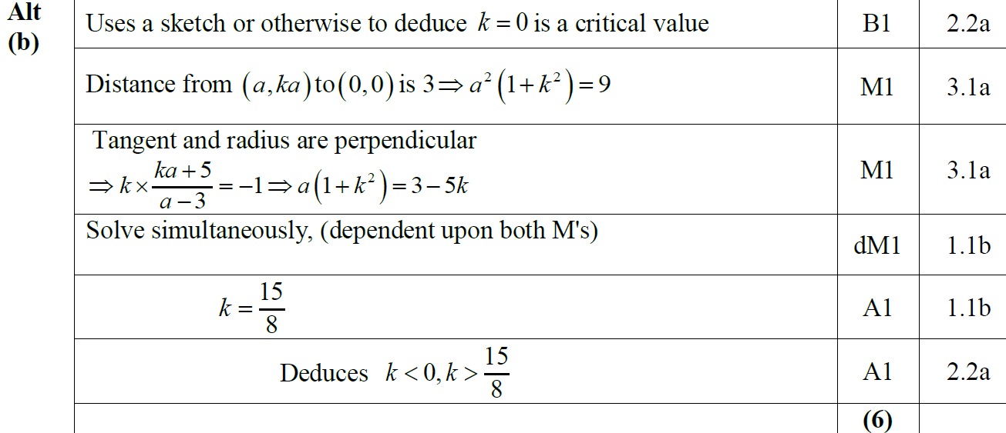
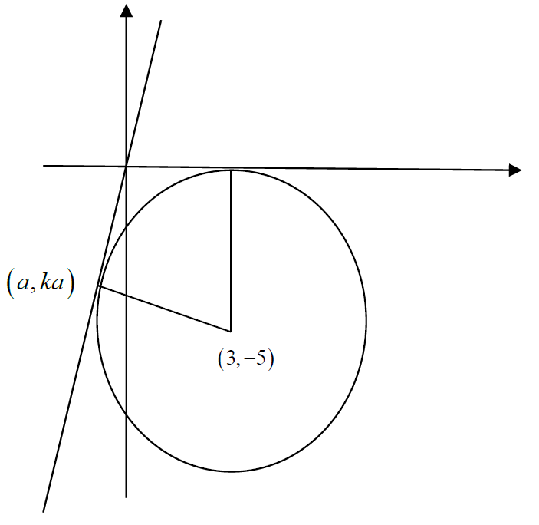
2018
B Alternative

Slide 47
2018
A (i) (SF)
A (ii) (SF)

Slide 48
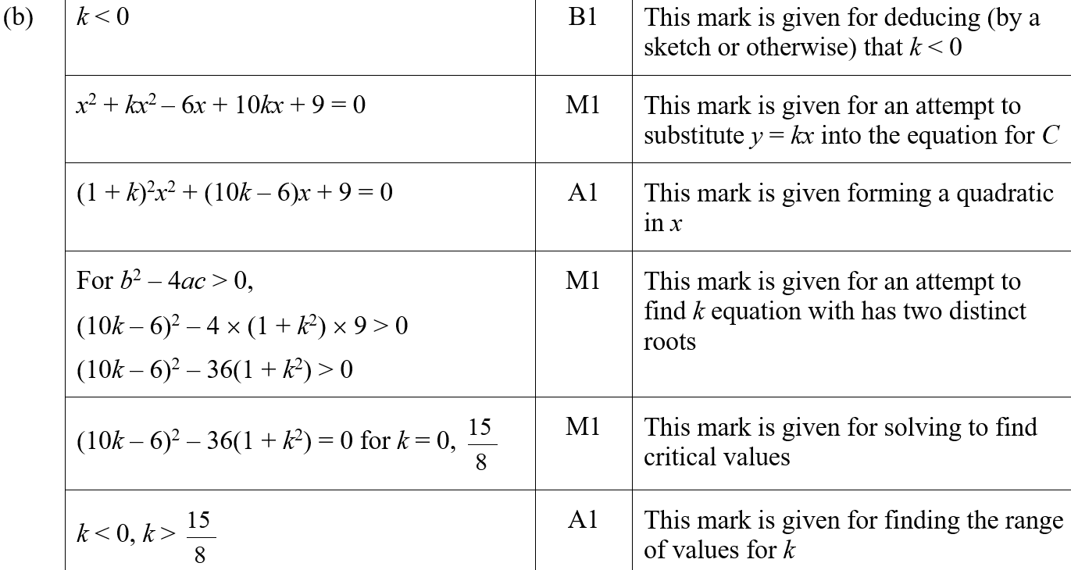
2018
B (SF)

Slide 49
2018
A notes

Slide 50
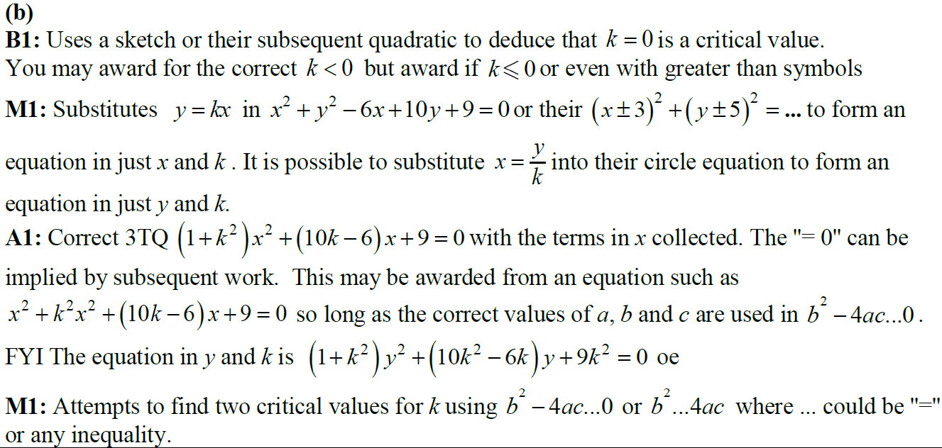
2018
B notes

Slide 51
New Spec Q’s
Old Spec Quadratics
Jan 2006
June 2009
Jan 2013 (i)
May 2017 (i)
May 2006
Jan 2010
Jan 2013 (ii)
May 2017 (ii)
Jan 2007
June 2010
May 2013
May 2017 (iii)
May 2007
Jan 2011
May 2014
May 2018 (i)
Jan 2008
May 2011
May 2015 (i)
May 2018 (ii)
June 2008
Jan 2012
May 2015 (ii)
Jan 2009
May 2012
May 2016

Slide 52
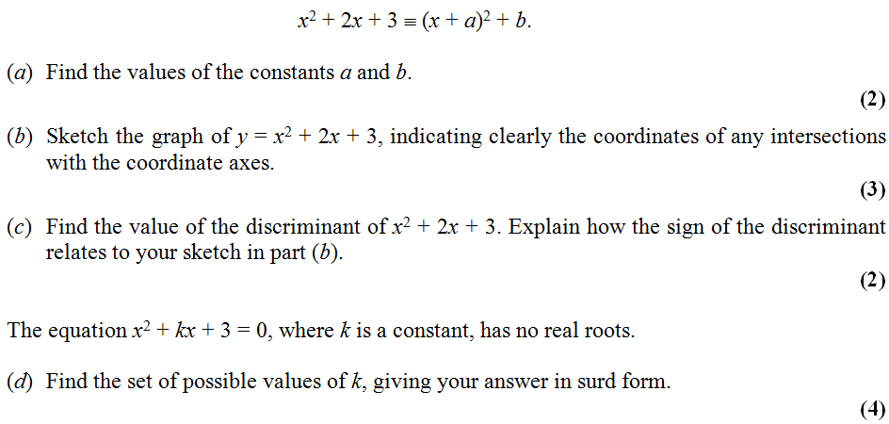
Jan 2006

Slide 53
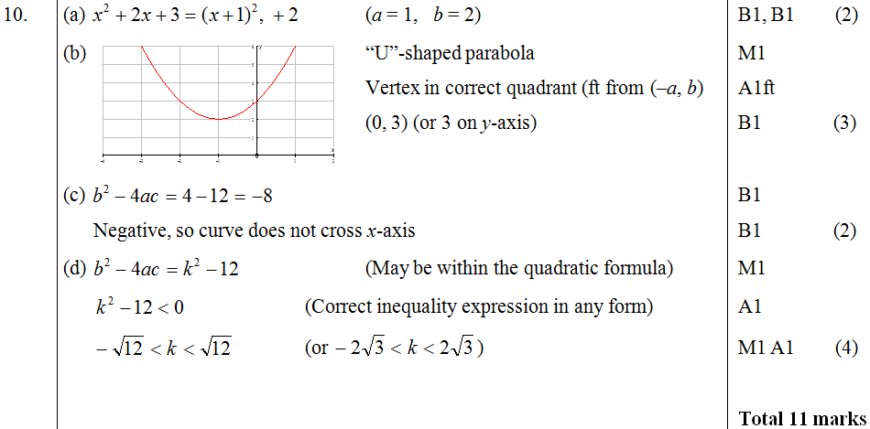
Jan 2006
A
B
C
D

Slide 54
May 2006

Slide 55
May 2006
A
B

Slide 56
Jan 2007

Slide 57
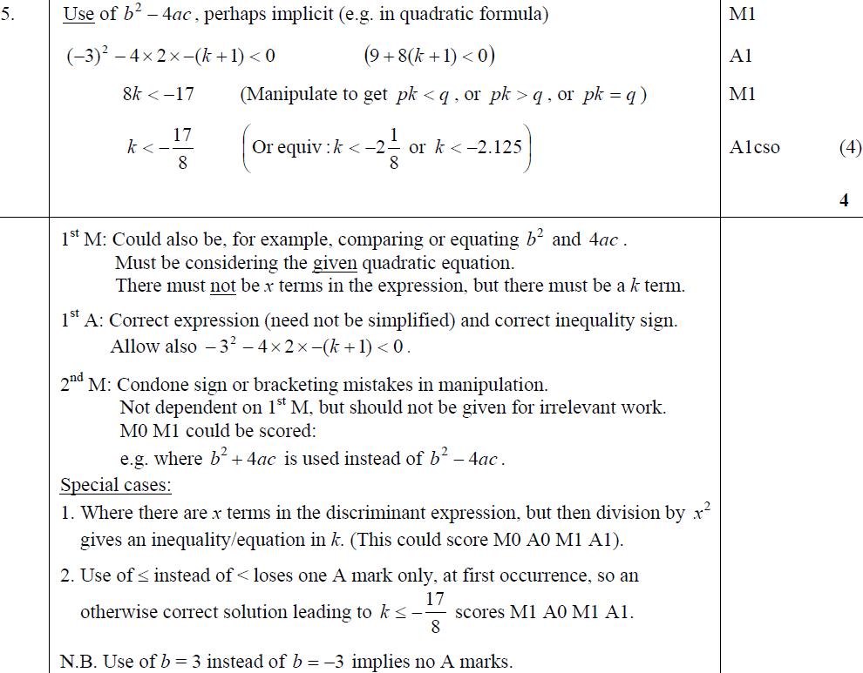
A
Jan 2007
Notes

Slide 58
May 2007

Slide 59
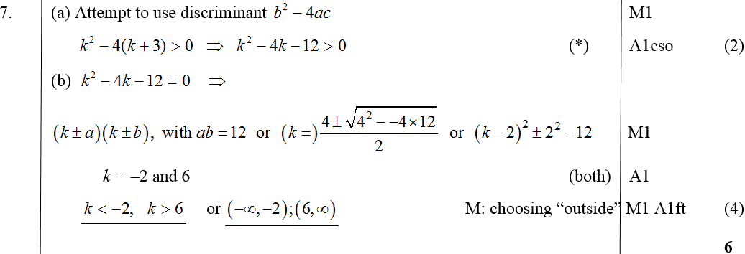
May 2007
A
B

Slide 60
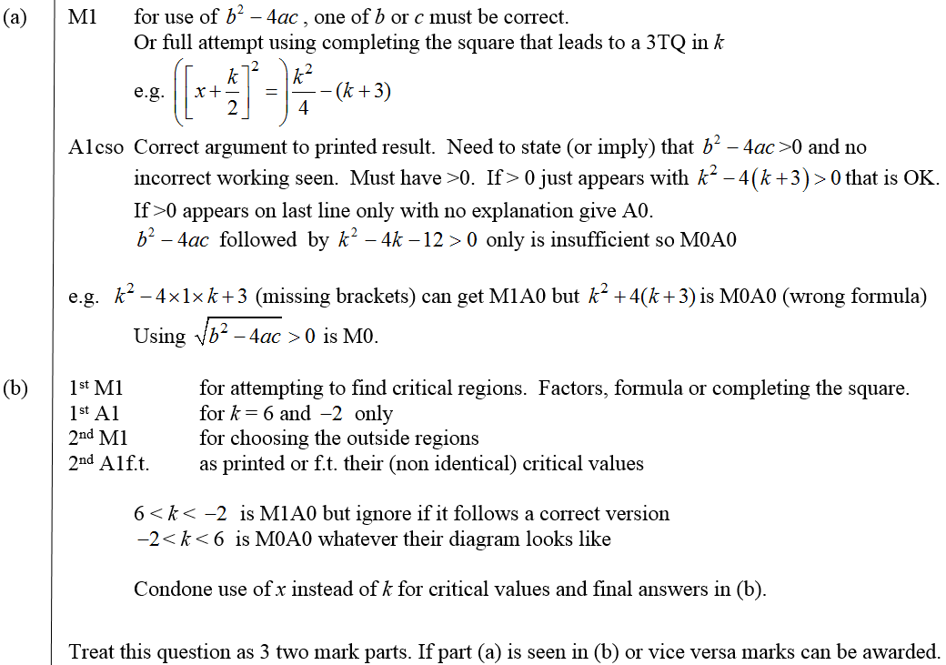
May 2007
A notes
B notes

Slide 61
Jan 2008

Slide 62
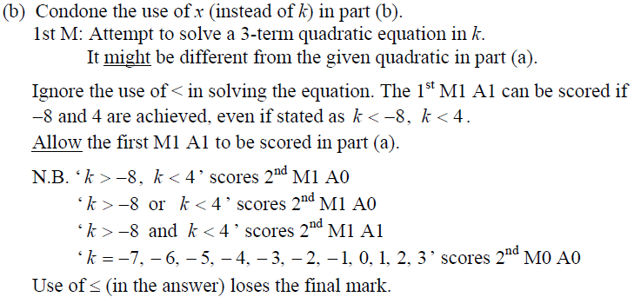
Jan 2008
A
B
B notes

Slide 63
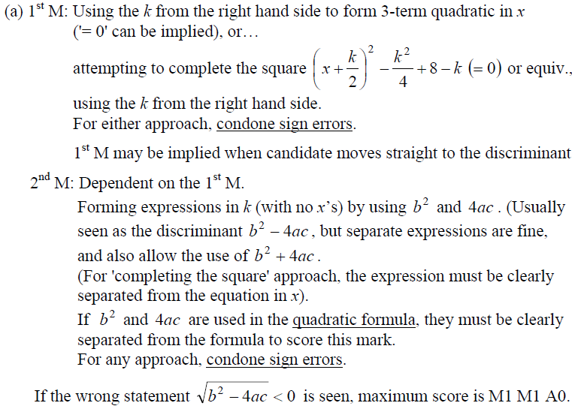
Jan 2008
A notes

Slide 64
June 2008

Slide 65
June 2008
A
B

Slide 66
Jan 2009

Slide 67
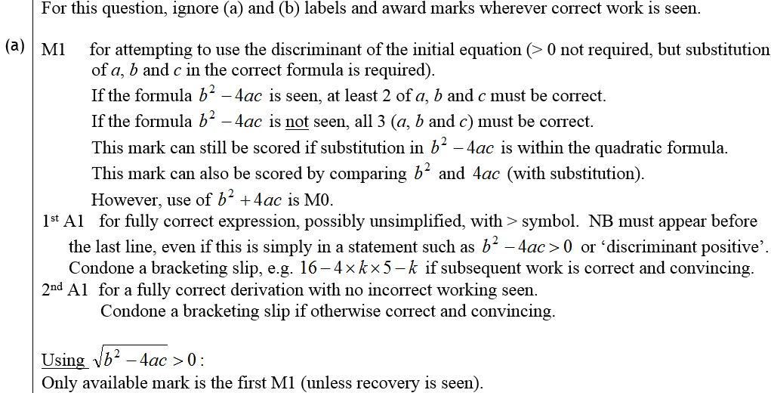
Jan 2009
A
B
A notes

Slide 68
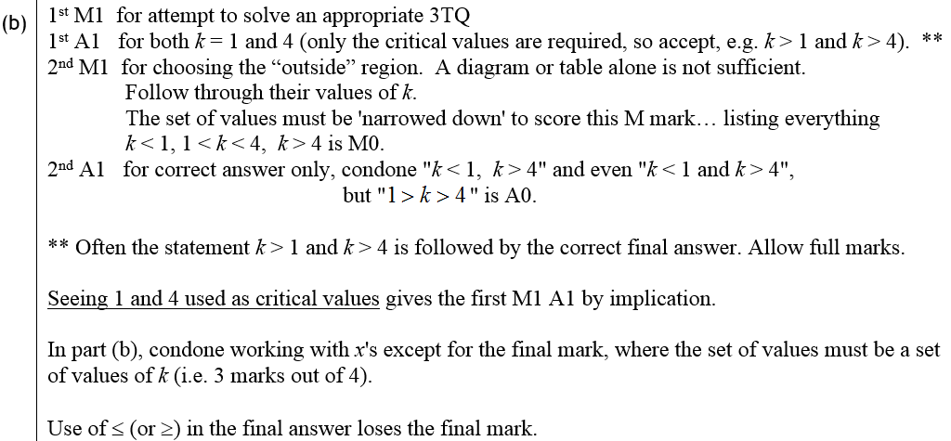
Jan 2009
B notes

Slide 69
June 2009

Slide 70
June 2009
A

Slide 71
Jan 2010

Slide 72
A
Jan 2010
B
C

Slide 73
June 2010

Slide 74
June 2010
A
B
C

Slide 75
Jan 2011

Slide 76
Jan 2011
A
B
A notes
B notes

Slide 77
May 2011

Slide 78
May 2011
A
B
C
A notes
B notes
C notes

Slide 79
Jan 2012

Slide 80
Jan 2012
A
B

Slide 81
May 2012

Slide 82
May 2012
A
B
C

Slide 83
May 2012
A notes
Alternative A (i)
Alternative A (ii)
Alternative A (iii)
Special Case A

Slide 84
May 2012
B notes
C notes

Slide 85
Jan 2013

Slide 86
Jan 2013
A Method 1
A Method 2
B

Slide 87
Jan 2013

Slide 88
Jan 2013
A
B

Slide 89
May 2013

Slide 90
May 2013
A
B
C

Slide 91
May 2014

Slide 92
May 2014
A
B
A Notes
B Notes

Slide 93
May 2014
C (Method 1A)
C (Method 1A) Notes

Slide 94
May 2014
C (Method 1B)
C (Method 1B) Notes

Slide 95
May 2014
C (Method 2)
C (Method 2) Notes

Slide 96
May 2014
C (Method 3)
C (Method 3) Notes

Slide 97
May 2014
Special case uses perpendicular gradient

Slide 98
May 2015

Slide 99
May 2015
A

Slide 100
May 2015
B

Slide 101
May 2015

Slide 102
May 2015
A
B

Slide 103
May 2016

Slide 104
May 2016
A

Slide 105
May 2016
B

Slide 106
May 2017

Slide 107
May 2017
A

Slide 108
May 2017
B

Slide 109
May 2017
C

Slide 110
May 2017

Slide 111
May 2017
A

Slide 112
May 2017
A notes

Slide 113
May 2017
B

Slide 114
May 2017

Slide 115
May 2017
A (i)

Slide 116
May 2017
A (ii)

Slide 117
May 2017
B

Slide 118
May 2017
C

Slide 119
May 2018

Slide 120
May 2018
A
B

Slide 121
May 2018
C

Slide 122
May 2018

Slide 123
May 2018
A

Slide 124
May 2018
B

