Slide 1
There are no old past paper questions on proof (new to spec)
Proof
Practice B
SAM

Slide 2
Practice B

Slide 3
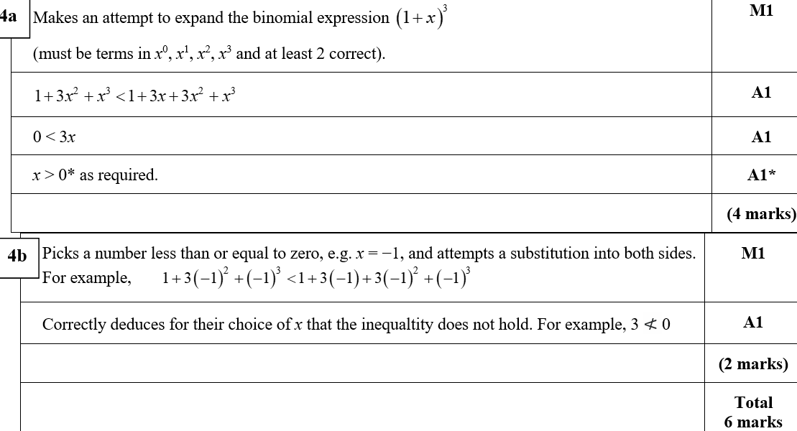
Practice B
A
B

Slide 4
SAM

Slide 5
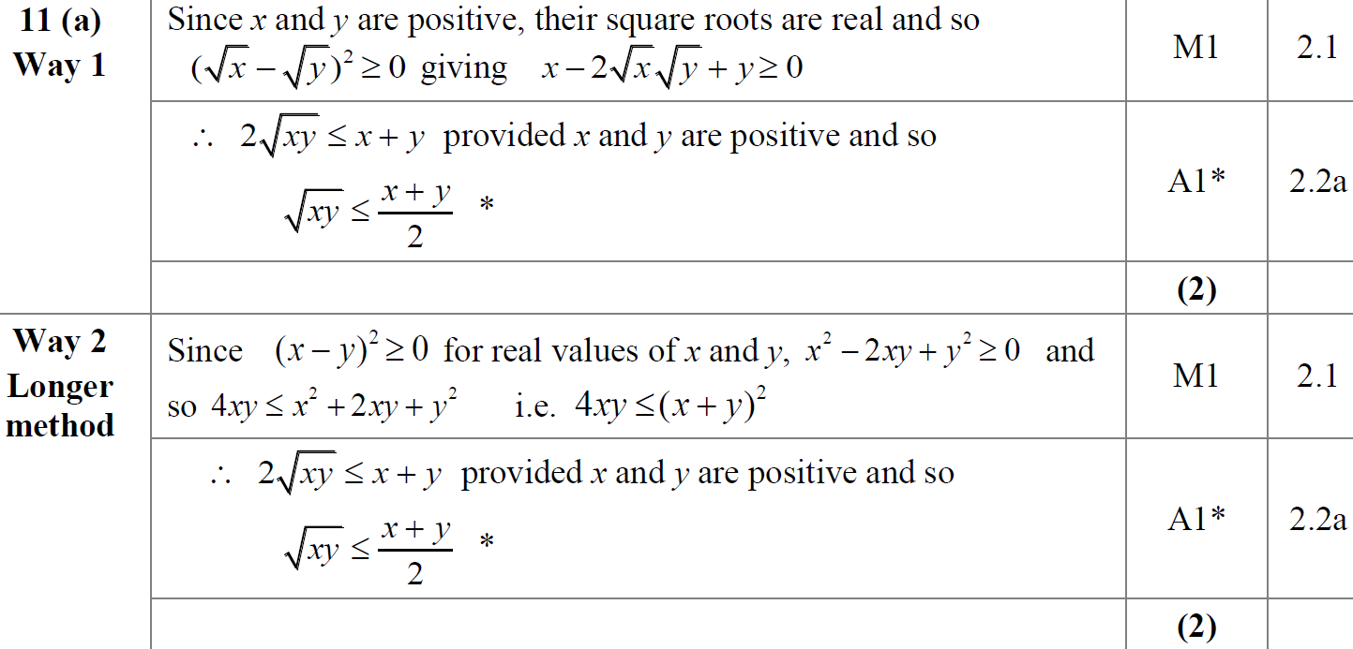
SAM
A
A Alternative

Slide 6
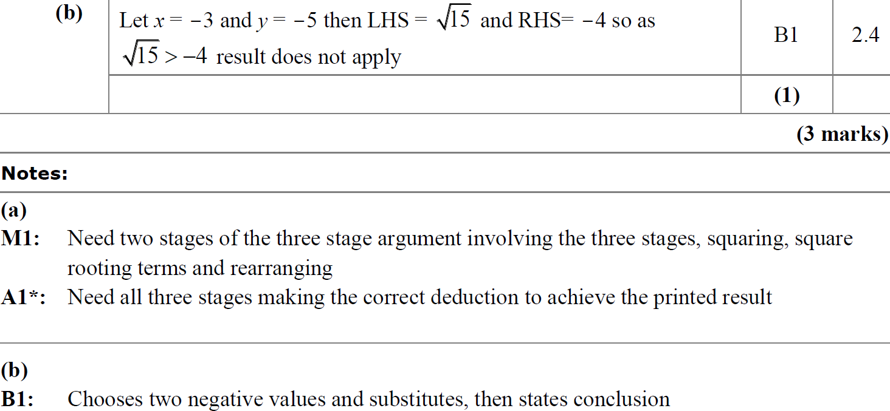
SAM
B
A notes
B notes

