Slide 1
Old Spec Q’s
Polynomials
Practice C
Practice D
SAM
2018

Slide 2
Practice C

Slide 3
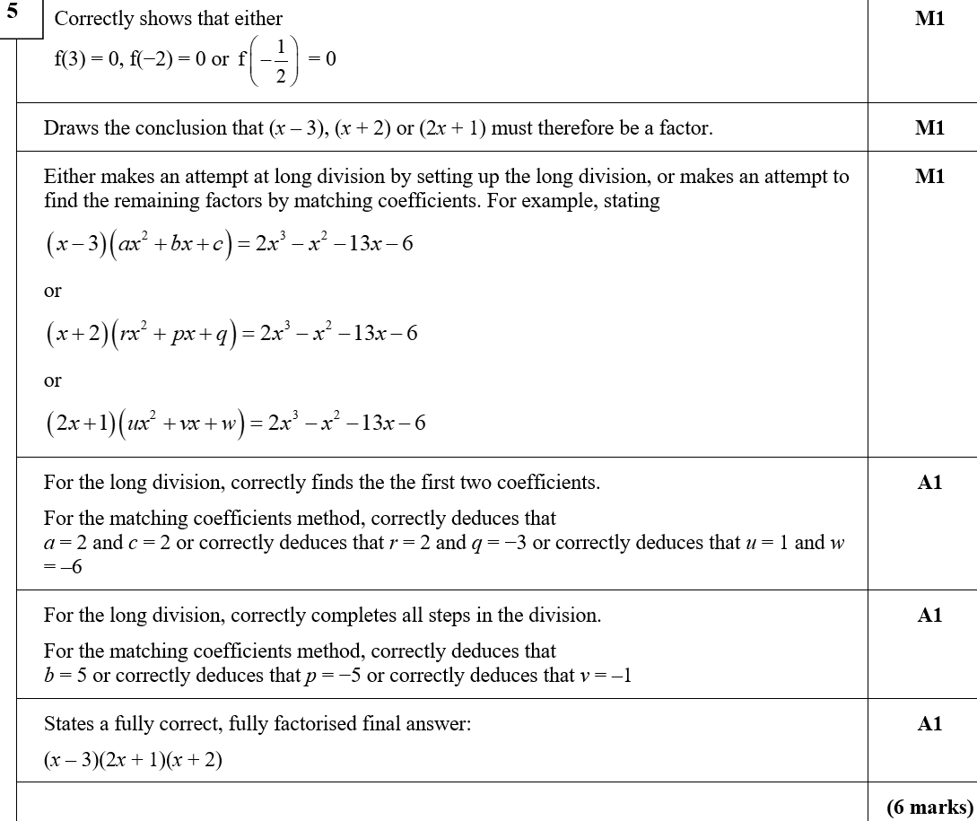
Practice C
A

Slide 4
Practice C
A notes

Slide 5
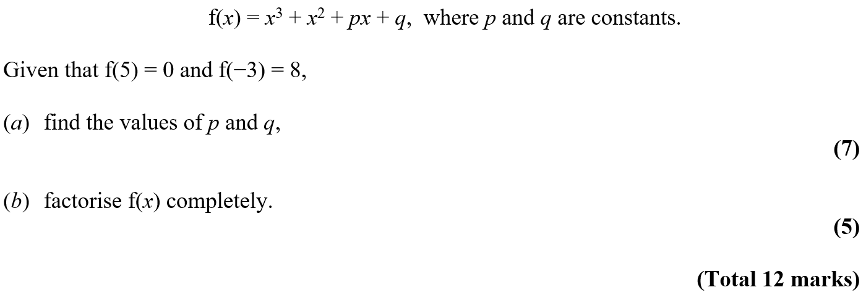
Practice D

Slide 6
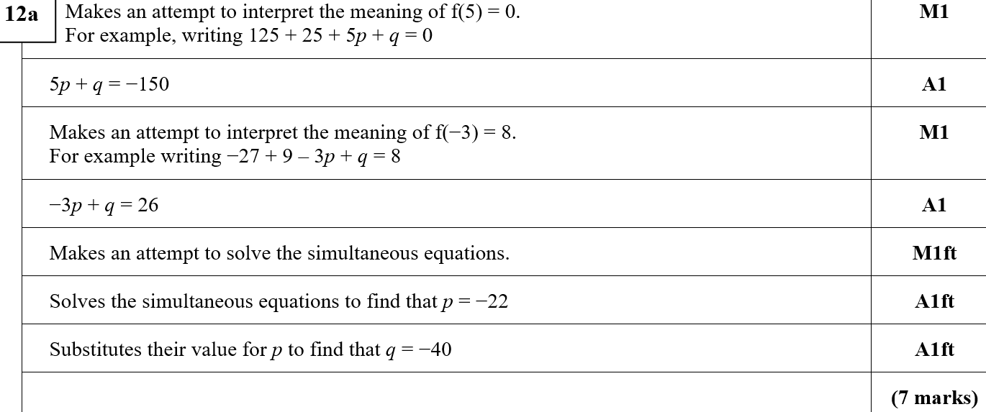
Practice D
A

Slide 7
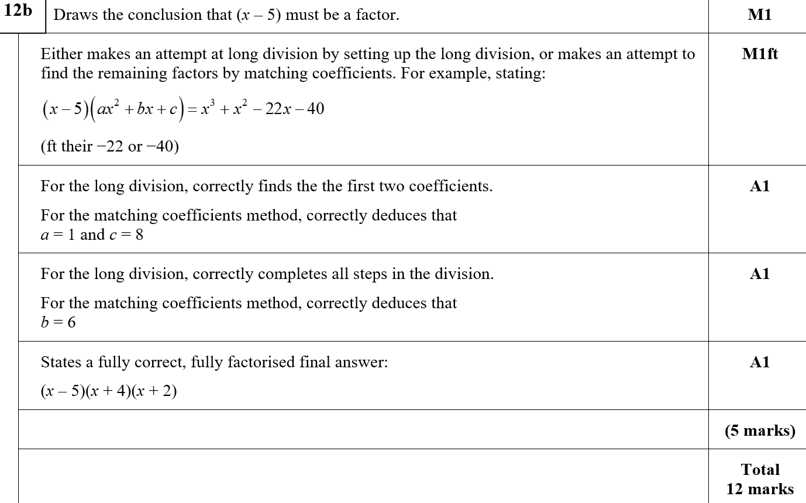
Practice D
B

Slide 8
SAM

Slide 9
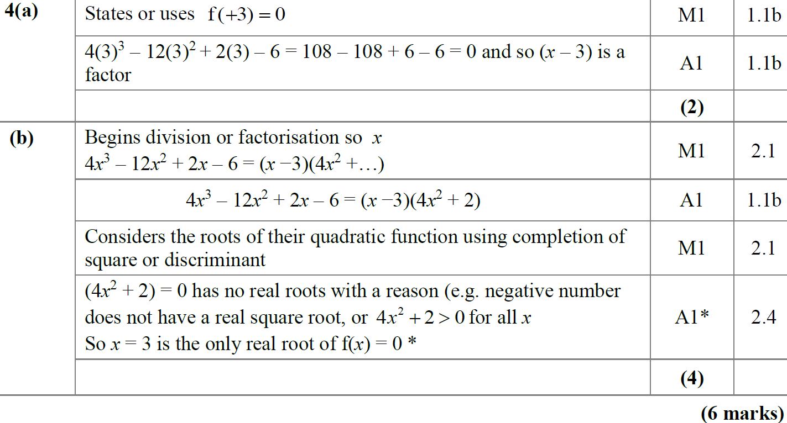
SAM
A
B

Slide 10
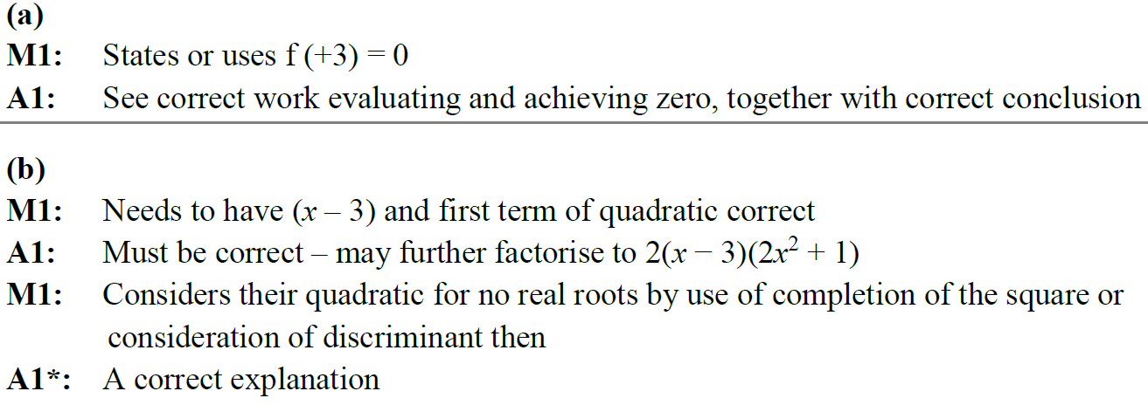
SAM
A notes
B notes

Slide 11
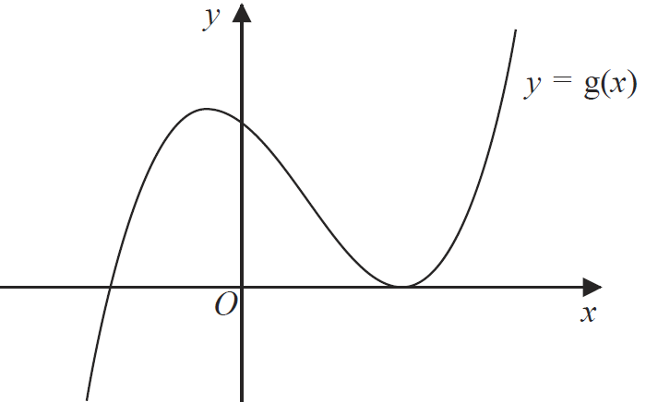
2018

Slide 12
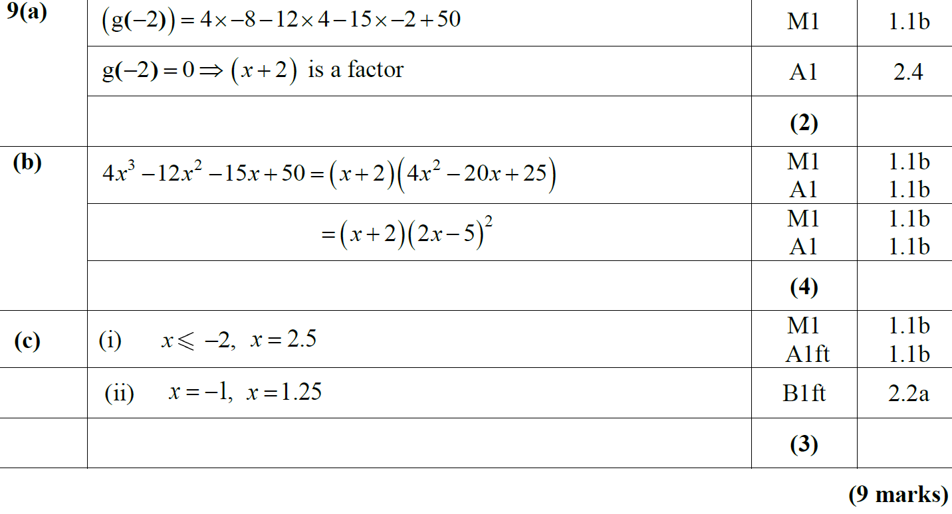
2018
A
B
C

Slide 13
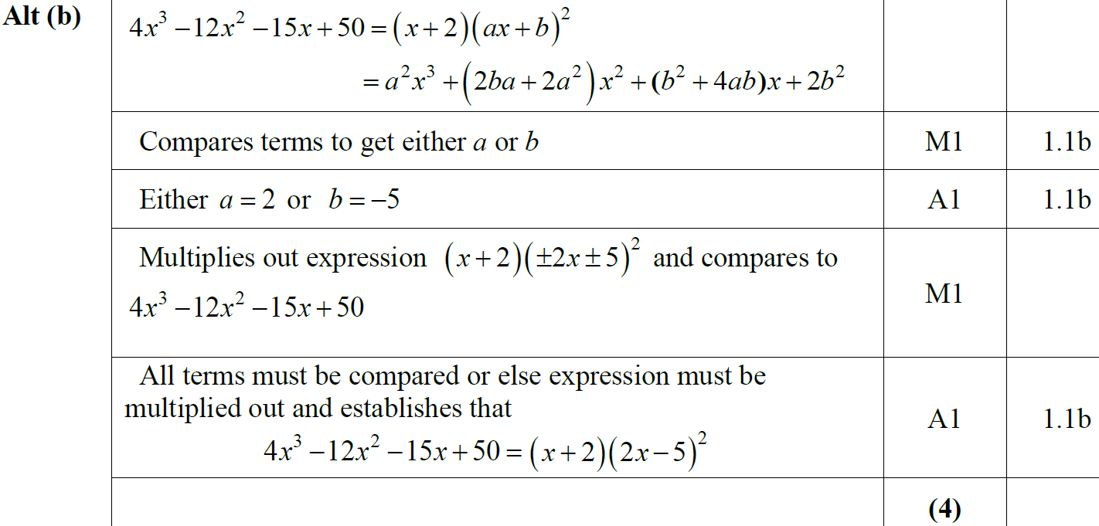
2018
B Alternative

Slide 14
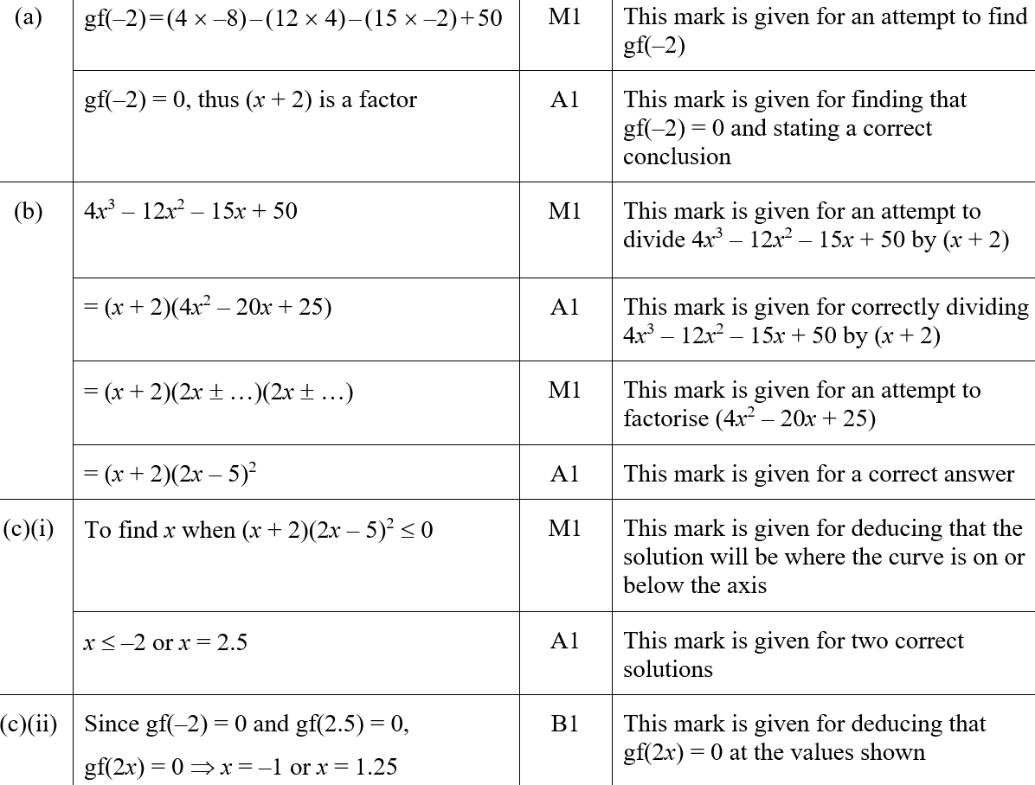
2018
A (SF)
B (SF)

Slide 15
2018
C (i) (SF)
C (ii) (SF)
A notes

Slide 16
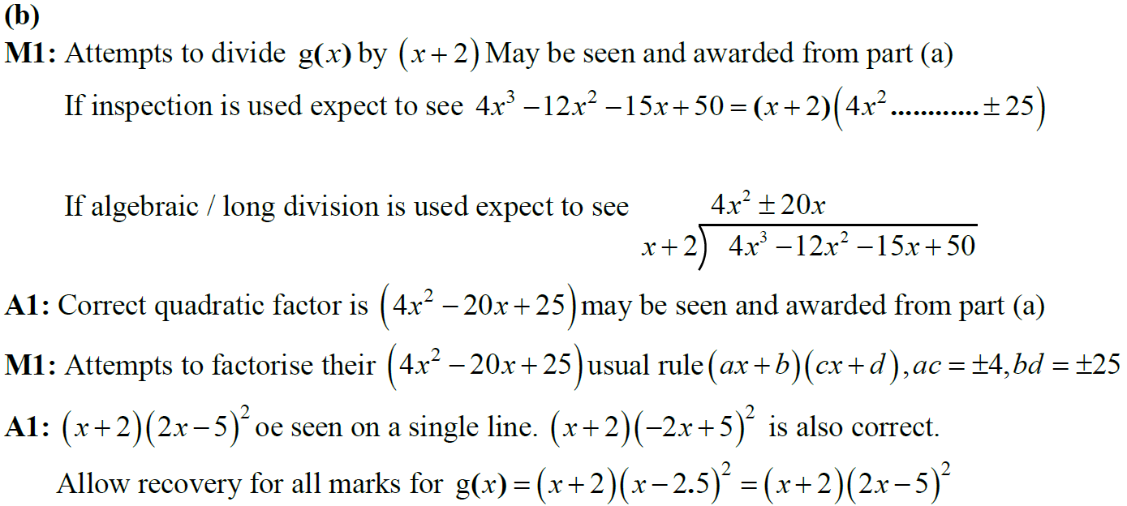
2018
B notes

Slide 17
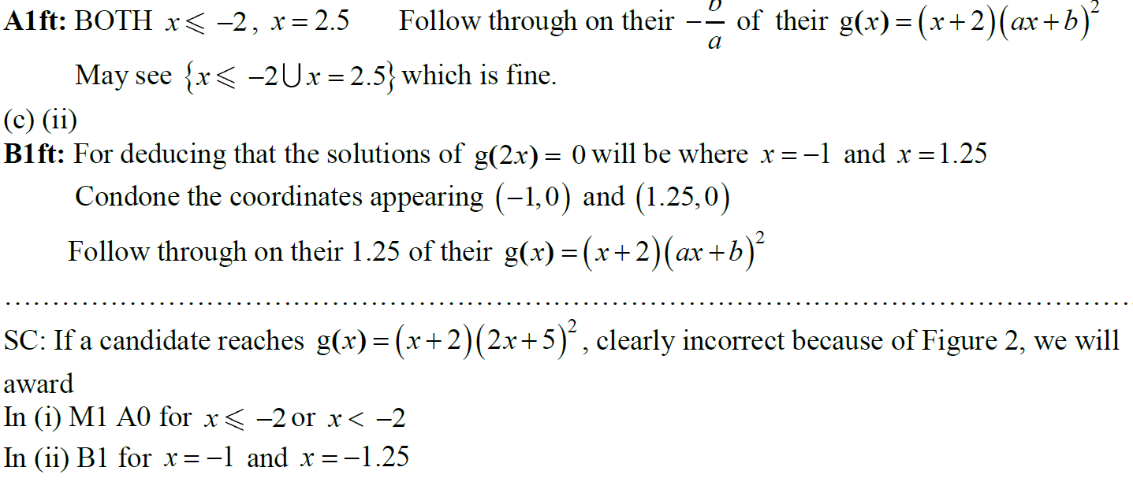
2018
C notes

Slide 18
New Spec Q’s
Old Spec Polynomials
Jan 2006
June 2009
Jan 2013
May 2006
Jan 2010
May 2013
Jan 2007
June 2010
May 2014
May 2007
Jan 2011
May 2015
Jan 2008
May 2011
May 2016
June 2008
Jan 2012
May 2017
Jan 2009
May 2012
May 2018

Slide 19
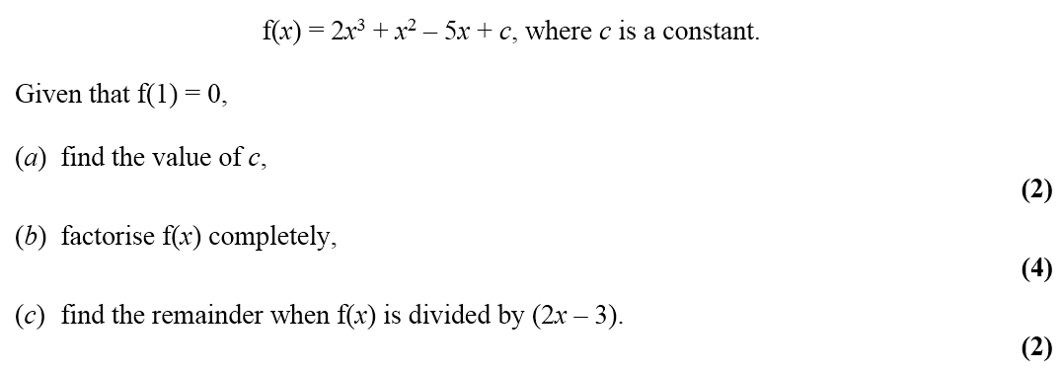
Jan 2006

Slide 20
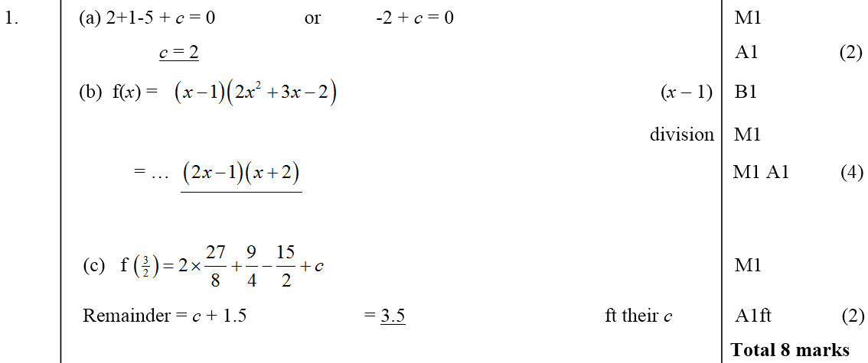
Jan 2006
A
B
C

Slide 21
May 2006

Slide 22
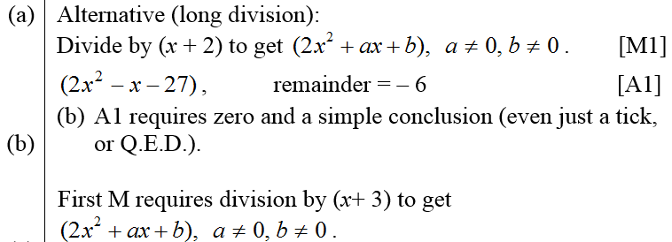
May 2006
A
B
C
A
B

Slide 23
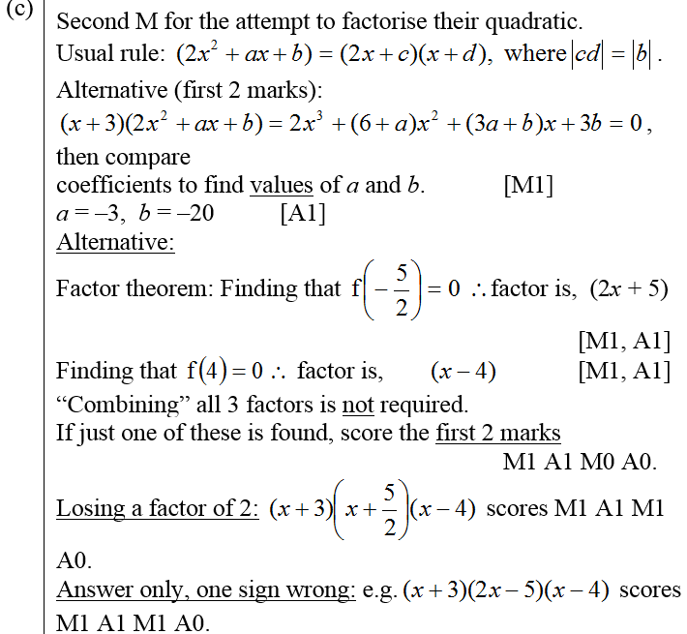
May 2006
C

Slide 24
Jan 2007

Slide 25
Jan 2007
A
B
C
A notes

Slide 26
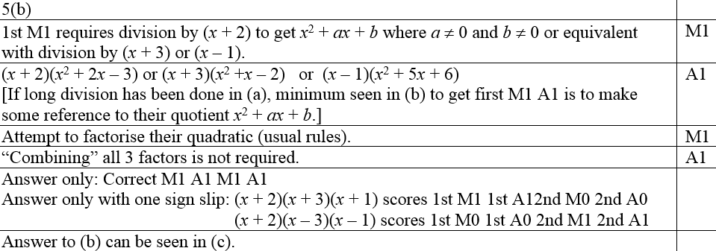
Jan 2007
B notes (i)
B notes (comparing coefficents)

Slide 27
Jan 2007
B notes (factor theorem)
C notes

Slide 28
May 2007

Slide 29
May 2007
A
B
A notes

Slide 30
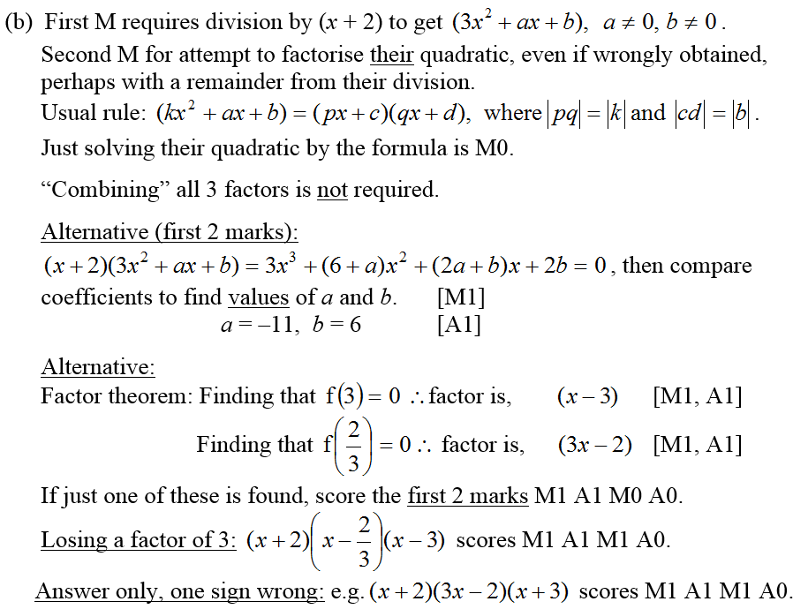
May 2007
B notes

Slide 31
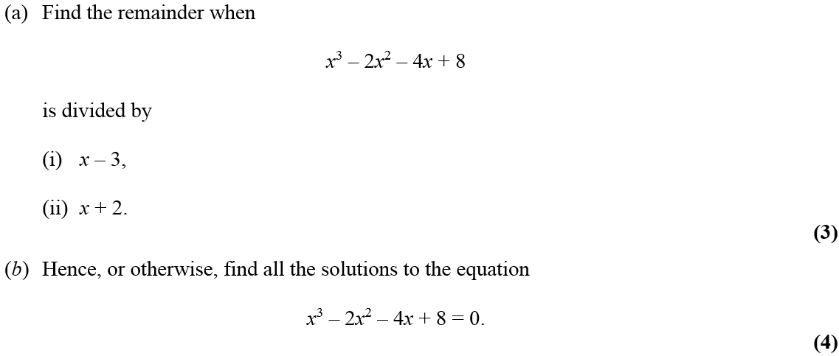
Jan 2008

Slide 32
Jan 2008
A (i)
A (ii)
B
A notes

Slide 33
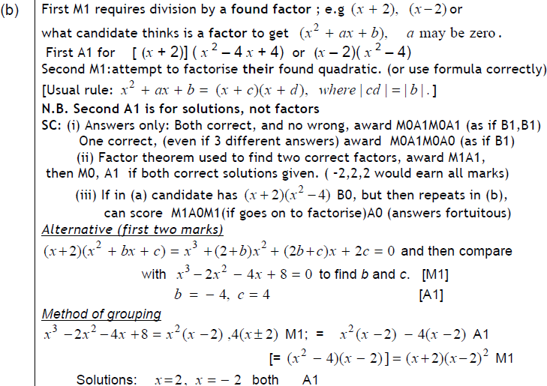
Jan 2008
B

Slide 34
June 2008

Slide 35
June 2008
A
B

Slide 36
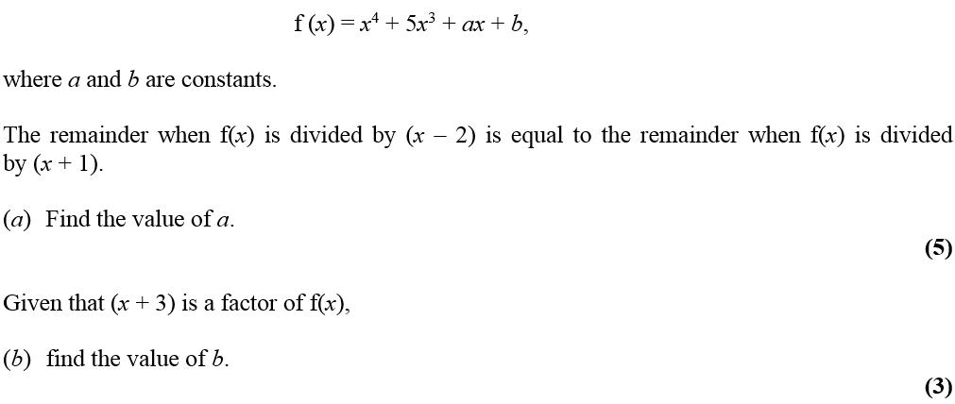
Jan 2009

Slide 37
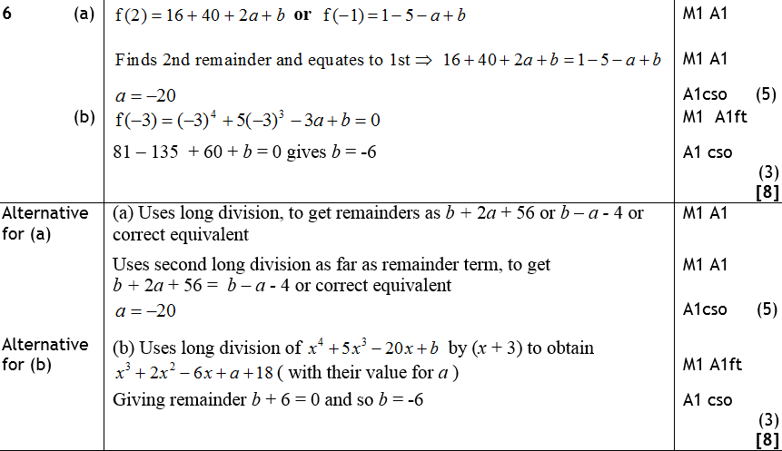
Jan 2009
A
B
Alternative A
Alternative B

Slide 38
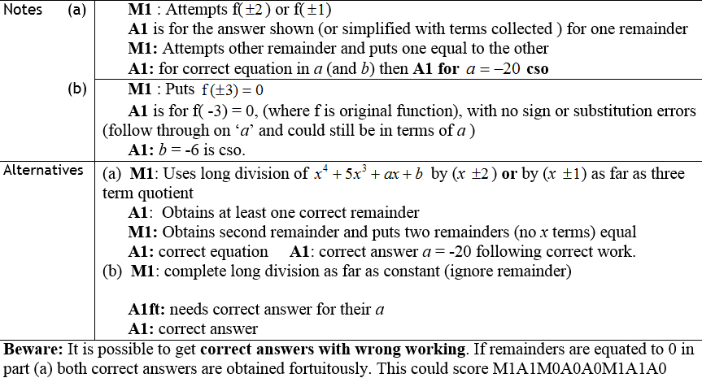
Jan 2009
A notes
B notes
Alternative A
Alternative B
Beware

Slide 39
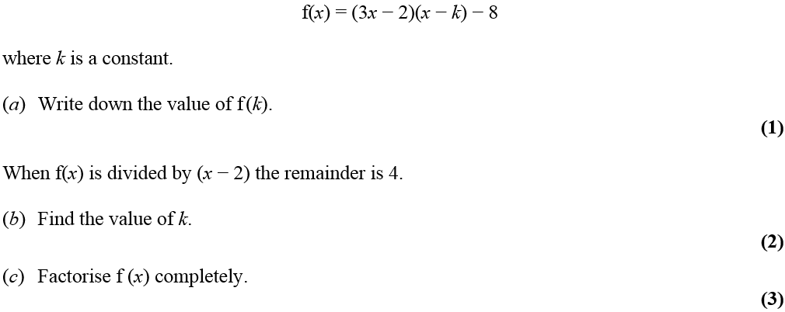
June 2009

Slide 40
June 2009
A
B
C

Slide 41
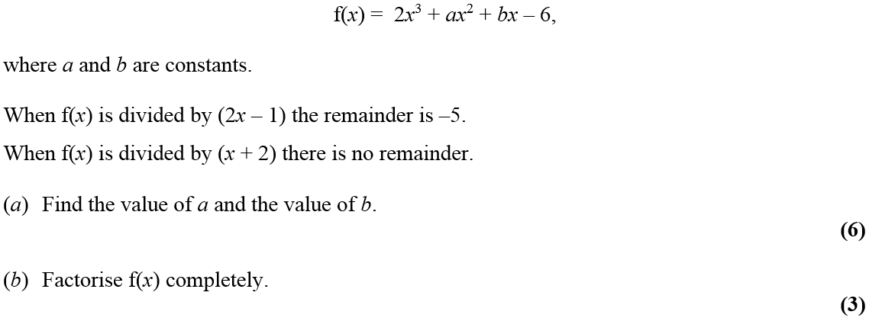
Jan 2010

Slide 42
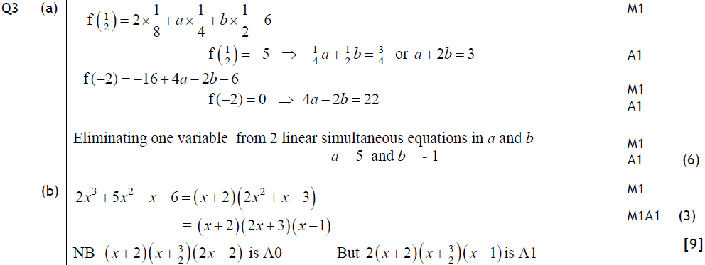
Jan 2010
A
B
Alternative A
Alternative B

Slide 43
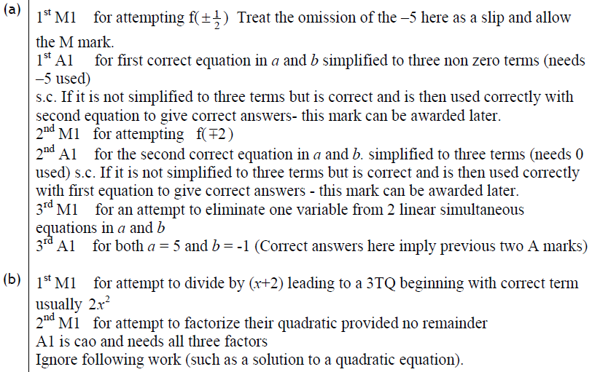
Jan 2010
A
B

Slide 44
June 2010

Slide 45
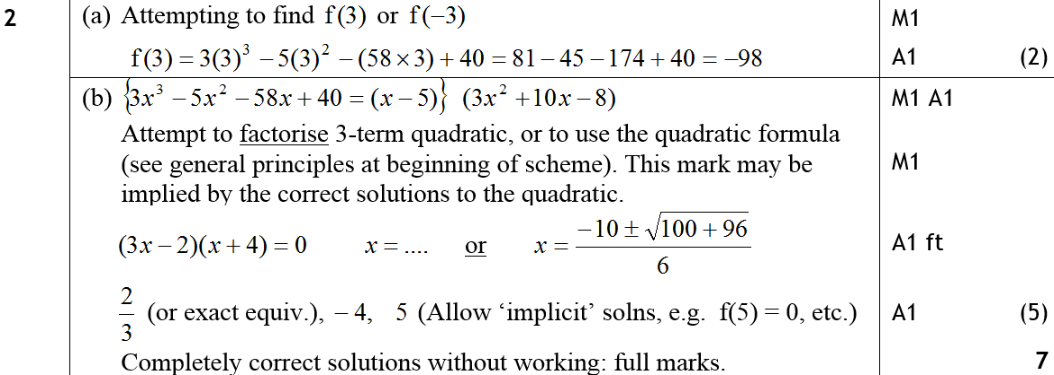
June 2010
A
B

Slide 46
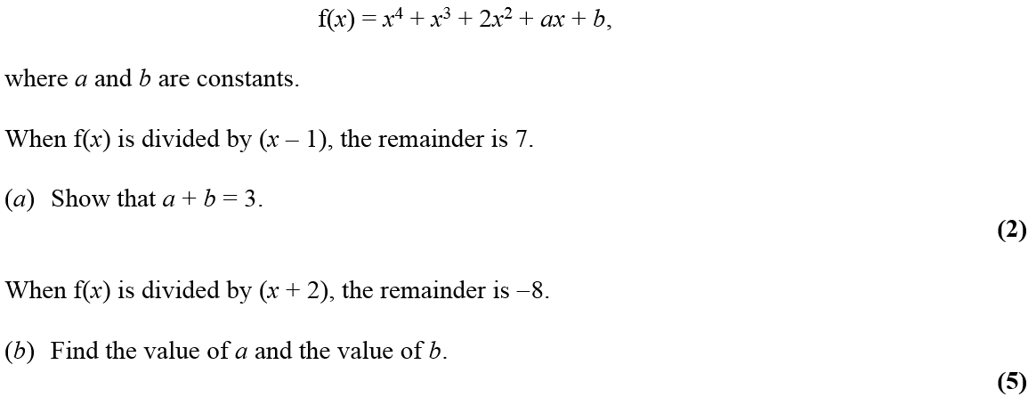
Jan 2011

Slide 47
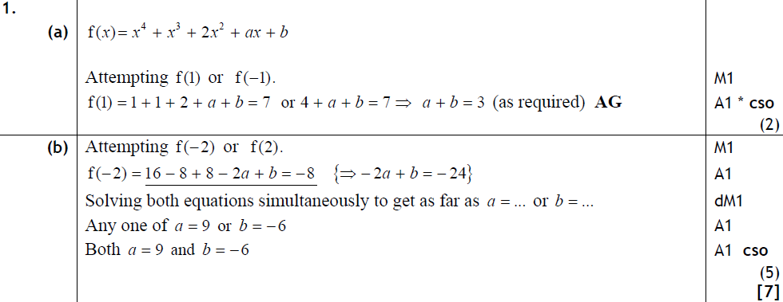
Jan 2011
A
B

Slide 48
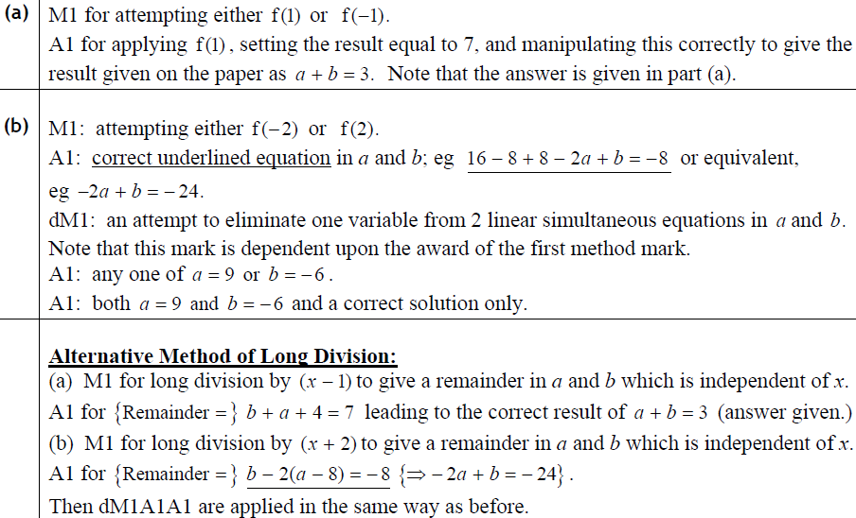
Jan 2011
A
B
A (long division)
B (long division)

Slide 49
May 2011

Slide 50
May 2011
A
B
C
A
B

Slide 51
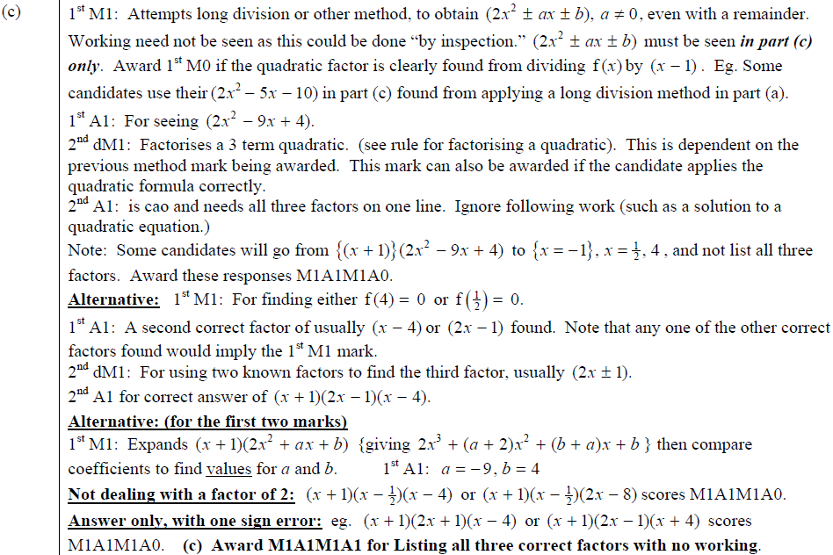
May 2011
C

Slide 52
Jan 2012

Slide 53
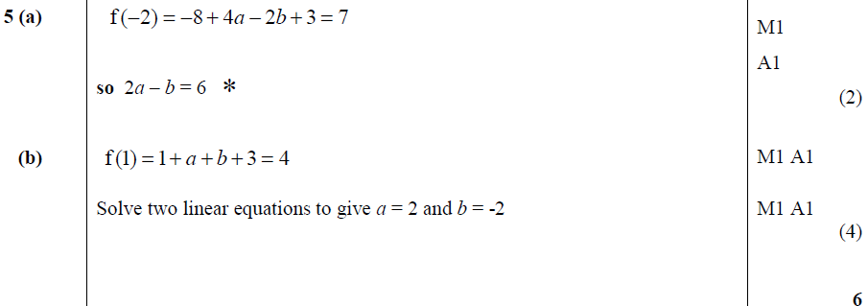
Jan 2012
A
B
Long Division

Slide 54
Jan 2012
A
B

Slide 55
May 2012

Slide 56
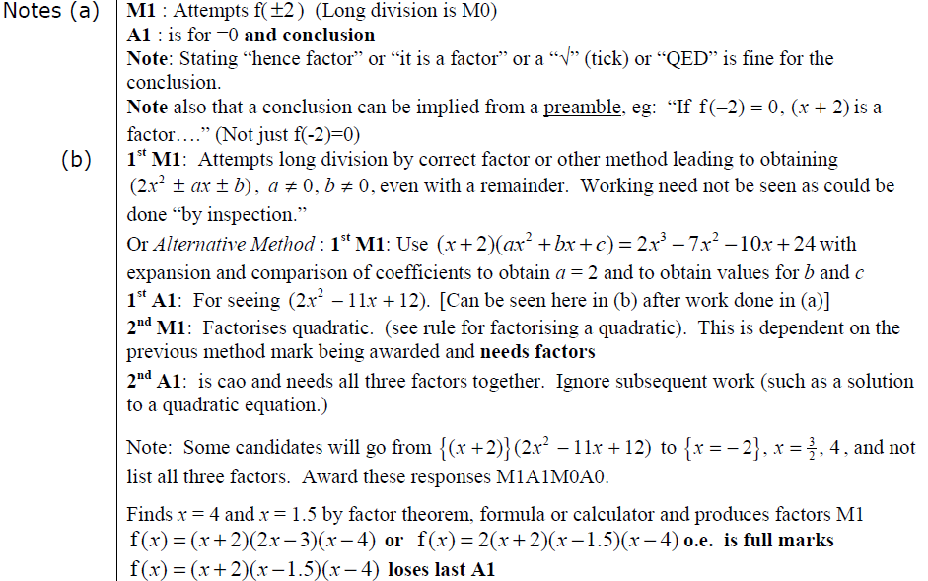
May 2012
A
B
A
B

Slide 57
Jan 2013

Slide 58
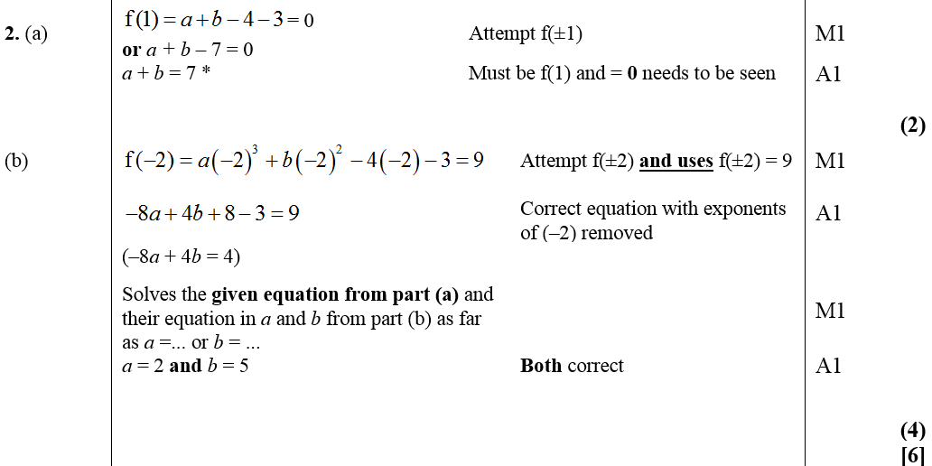
Jan 2013
A
B

Slide 59
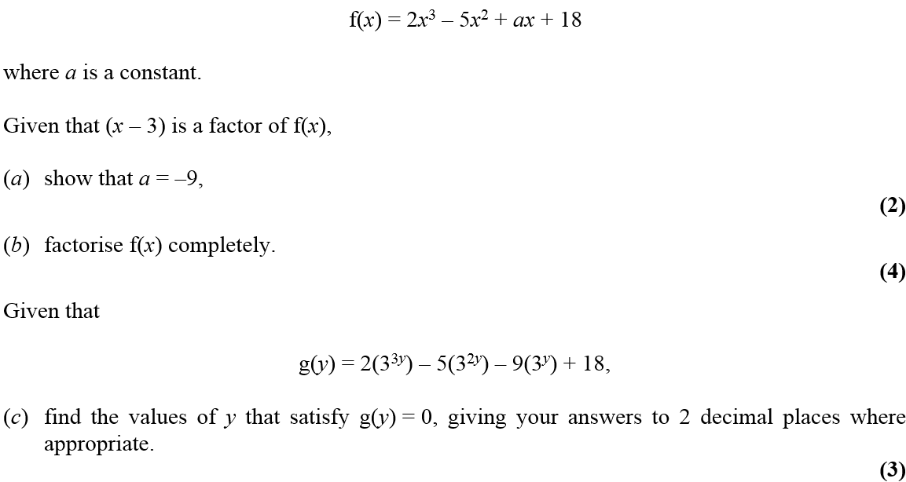
May 2013

Slide 60
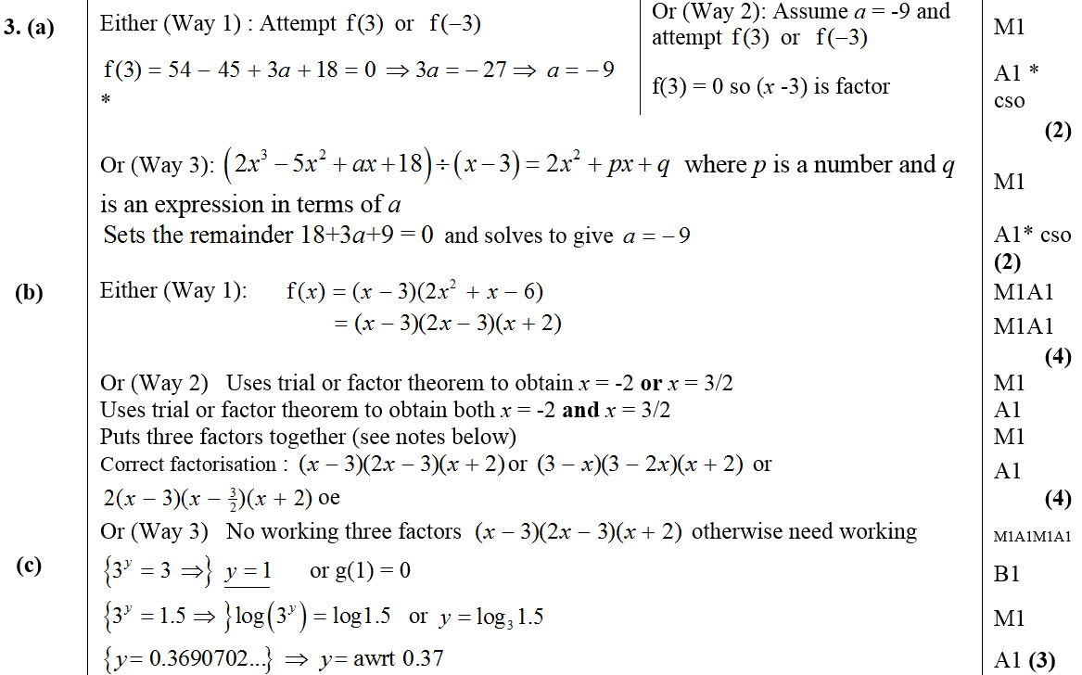
May 2013
A
B
C

Slide 61
May 2014

Slide 62
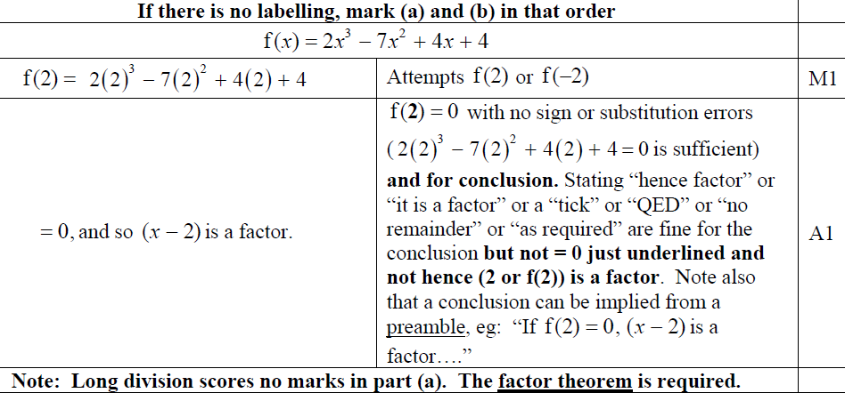
May 2014
A

Slide 63
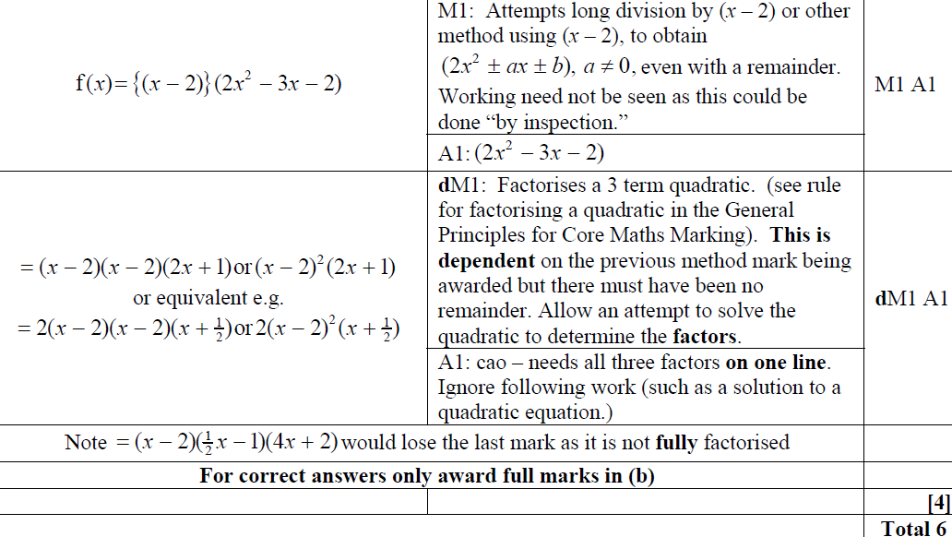
May 2014
B

Slide 64
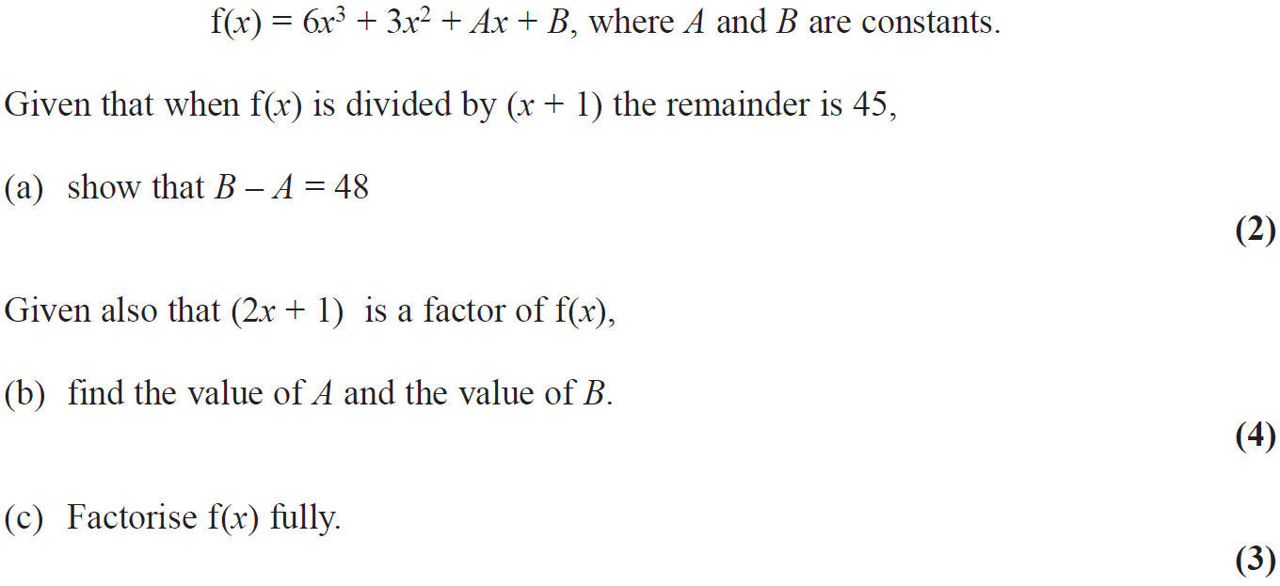
May 2015

Slide 65
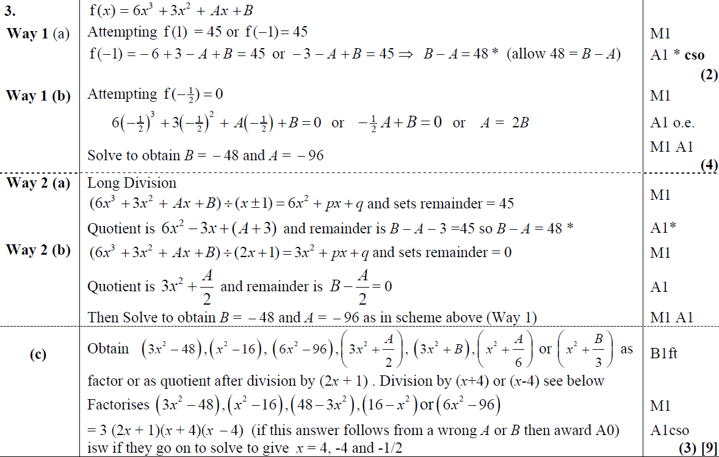
May 2015
A
B
A Alternative
B Alternative
C

Slide 66
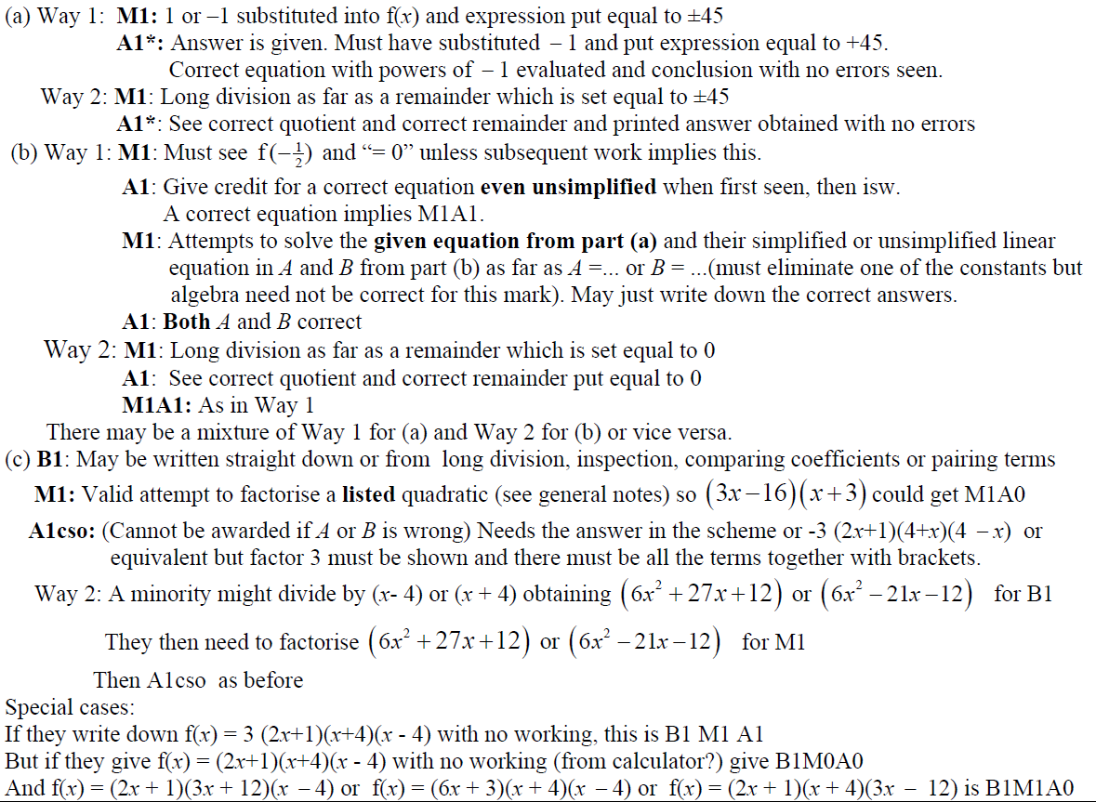
May 2015
A notes
A Alternative notes
B notes
B Alternative notes
C notes

Slide 67
May 2016

Slide 68
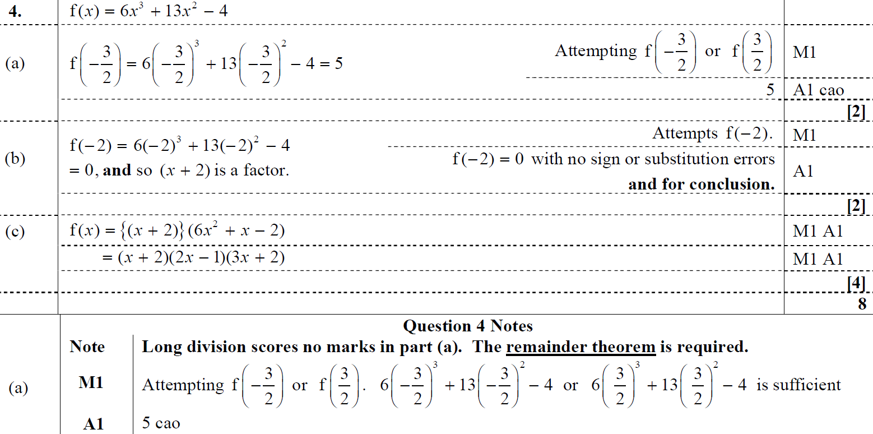
May 2016
A
B
C
A notes

Slide 69
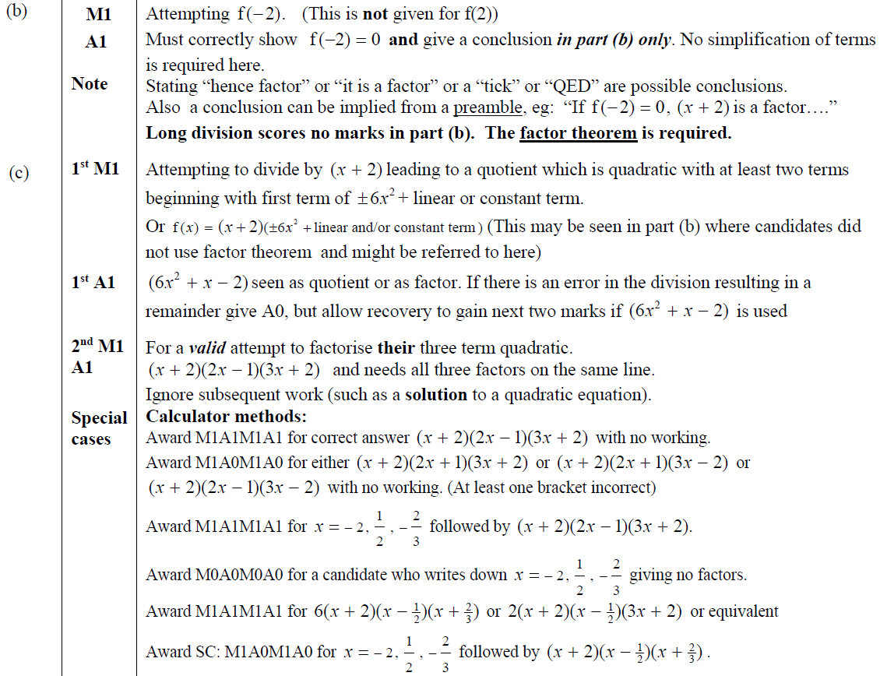
May 2016
B notes
C notes

Slide 70
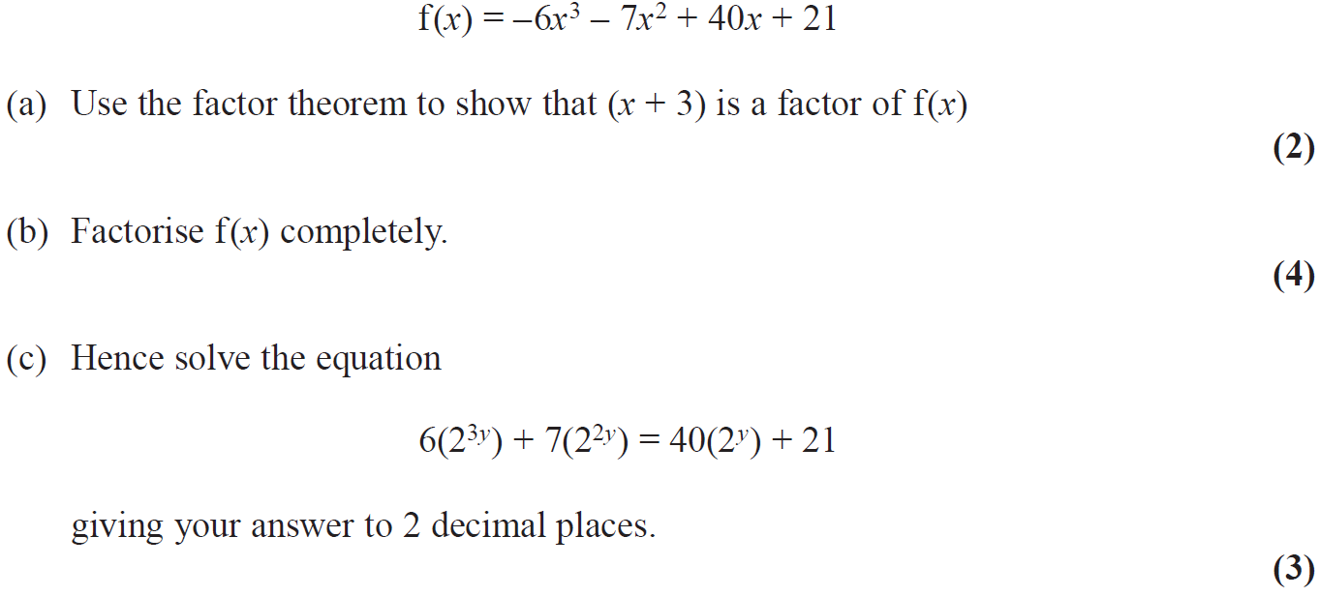
May 2017

Slide 71
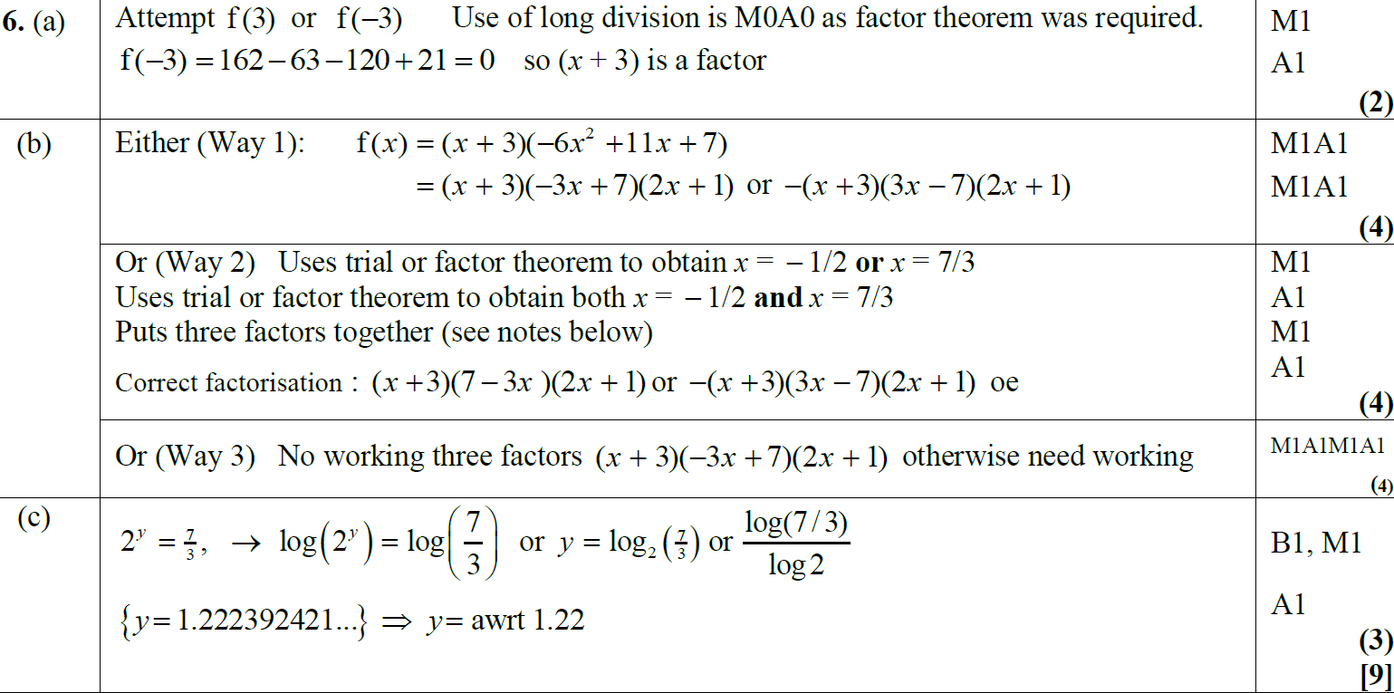
May 2017
A
B
B Alternative 1
B Alternative 2
C

Slide 72
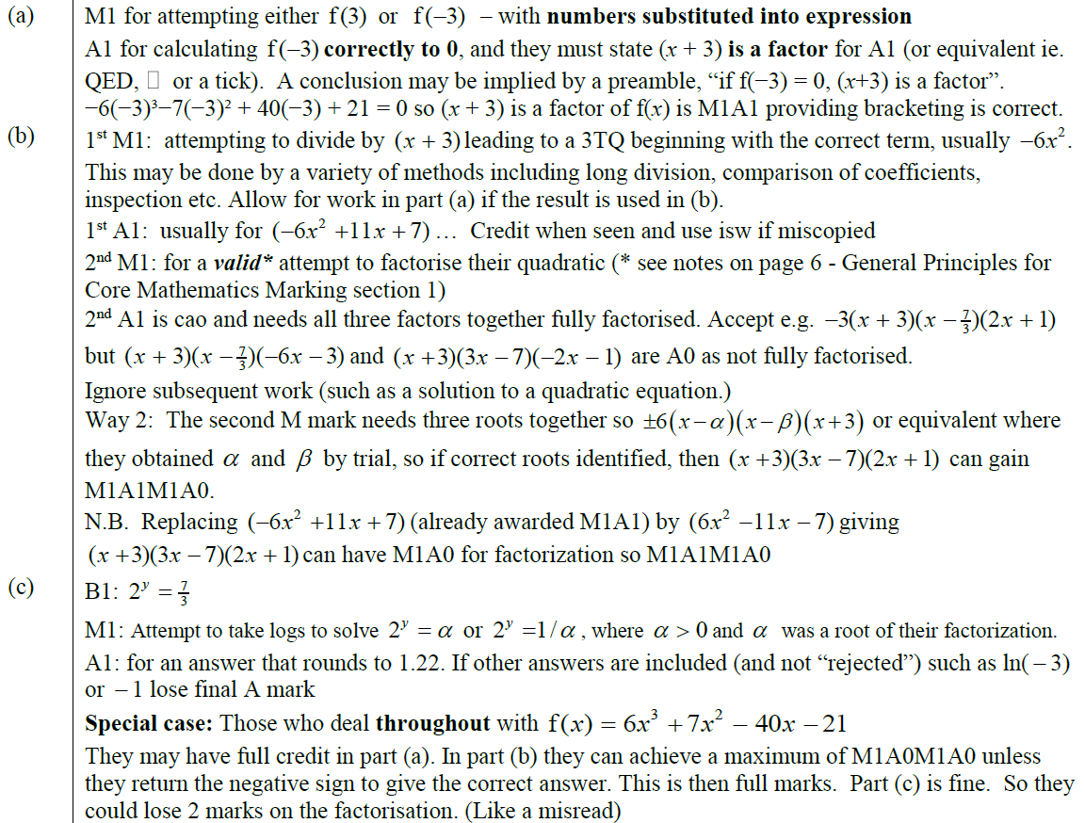
May 2017
A notes
B notes
C notes

Slide 73
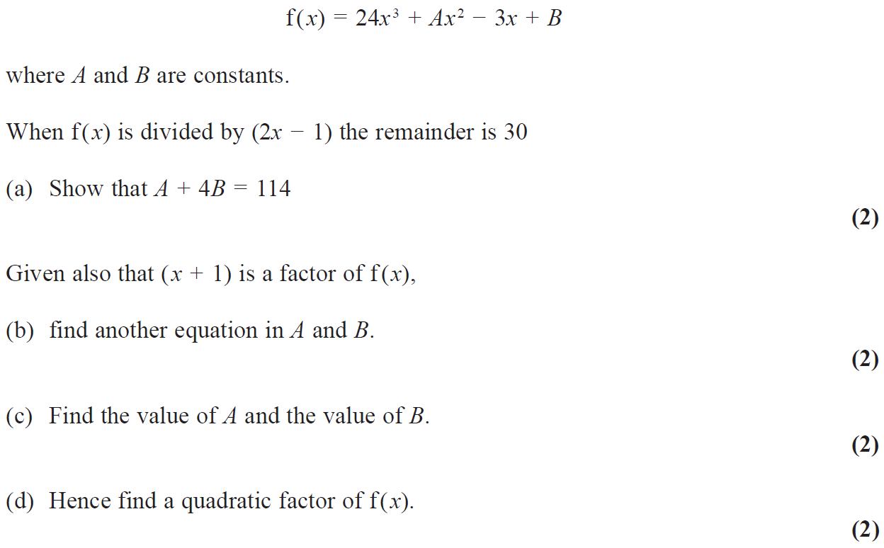
May 2018

Slide 74
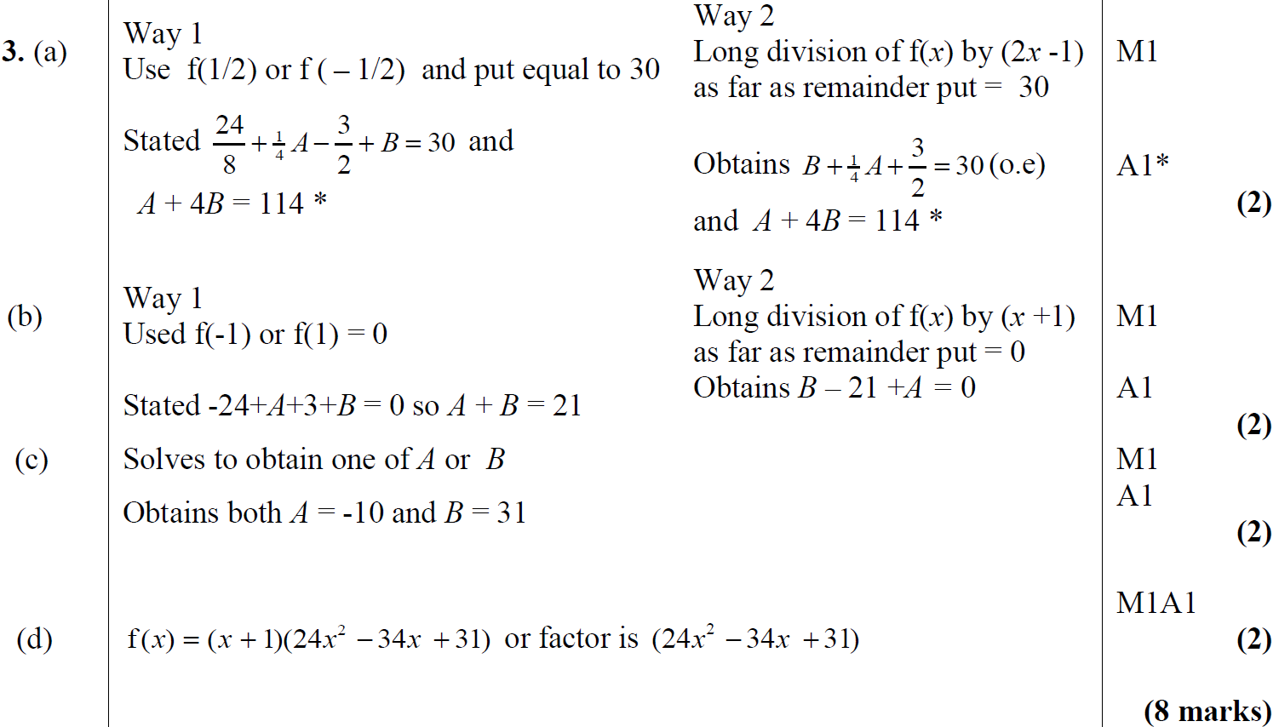
May 2018
A
B
C
D

Slide 75
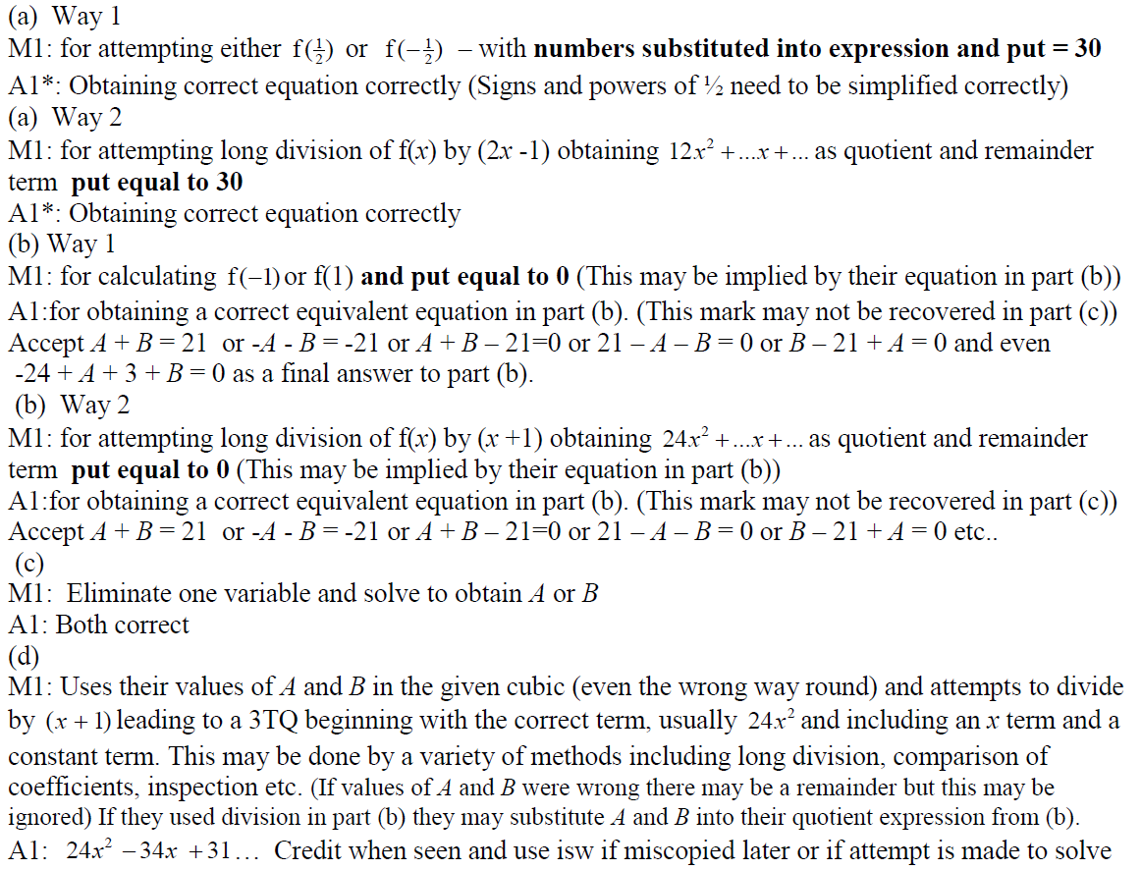
May 2018
A notes
A Alternative notes
B notes
B Alternative notes
C notes
D notes

