Slide 1
Old Spec Q’s
Coordinate Geometry
with Circles
Practice A (i)
SAM (i)
Practice A (ii)
SAM (ii)
Practice B (i)
SAM (iii)
Practice B (ii)
2018 (i)
Practice C (i)
2018 (ii)
Practice C (ii)
Practice D

Slide 2
Practice A

Slide 3
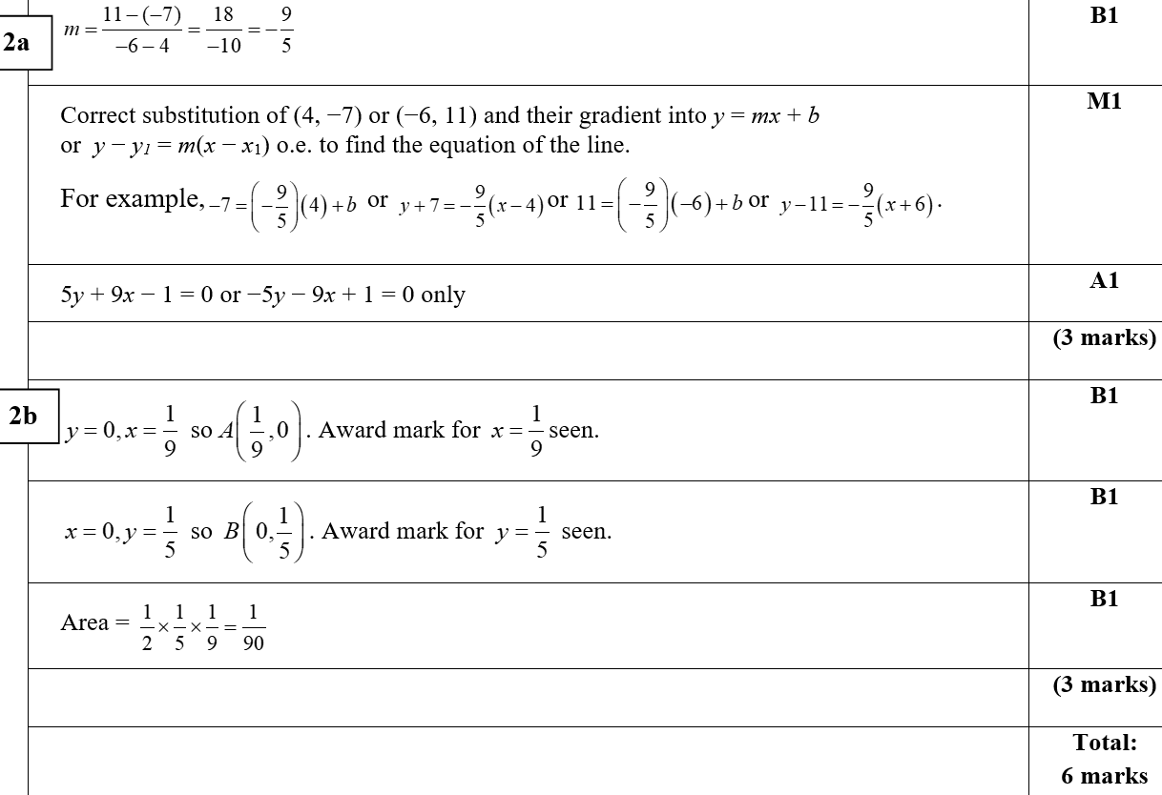
Practice A
A
B

Slide 4
Practice A

Slide 5
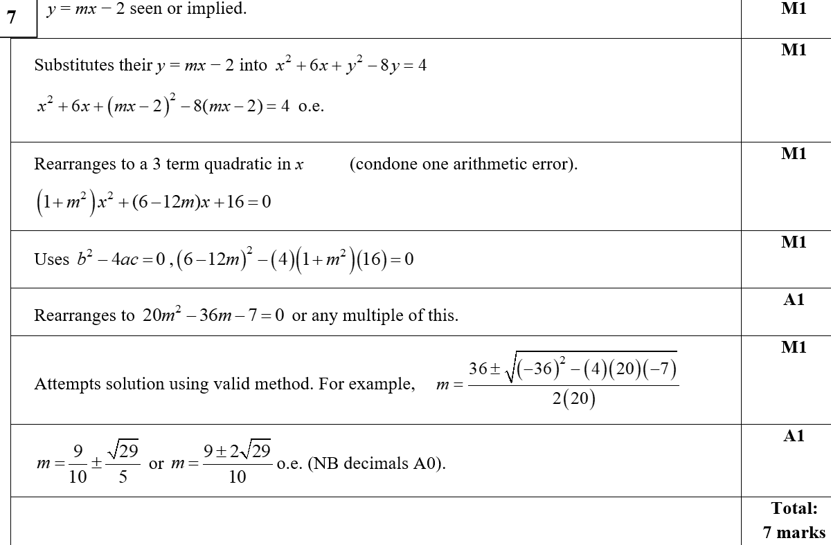
Practice A
A

Slide 6
Practice A
A notes

Slide 7
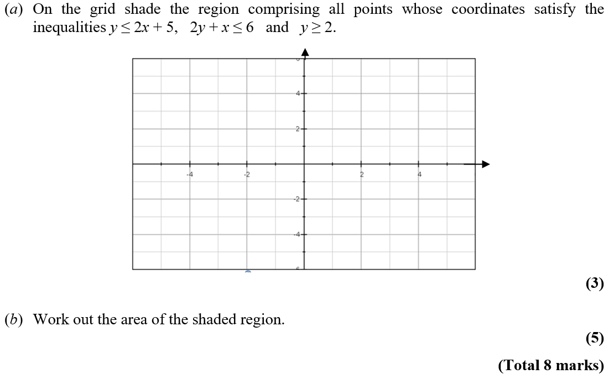
Practice B

Slide 8
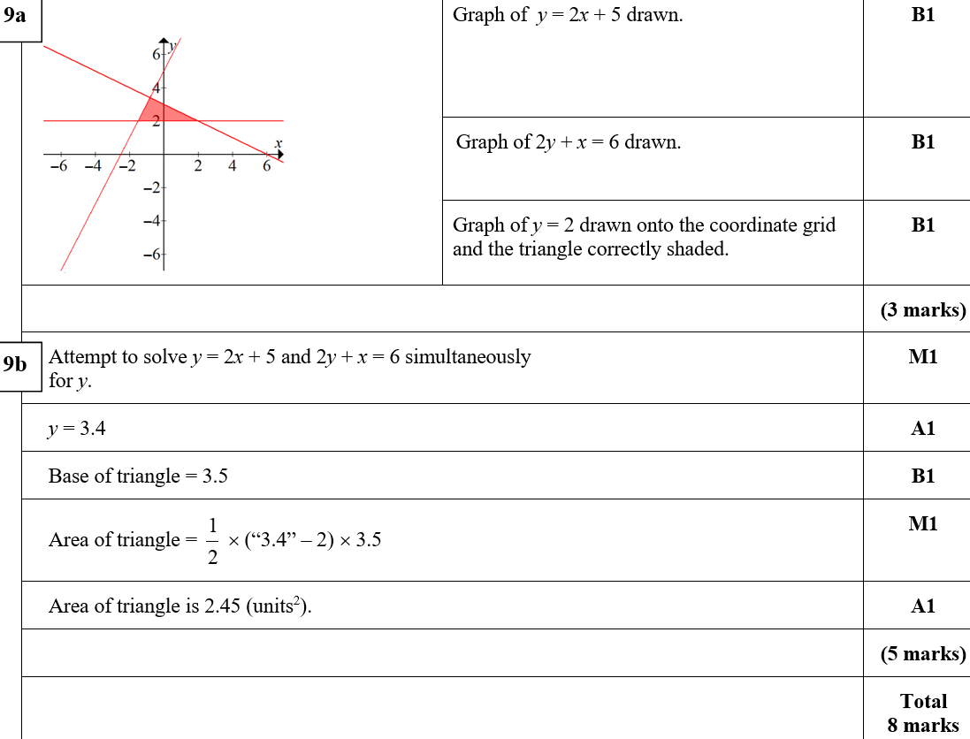
Practice B
A
B
B notes

Slide 9
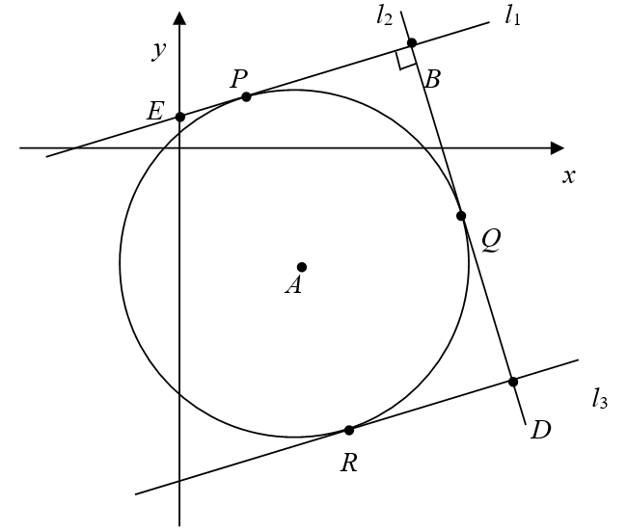
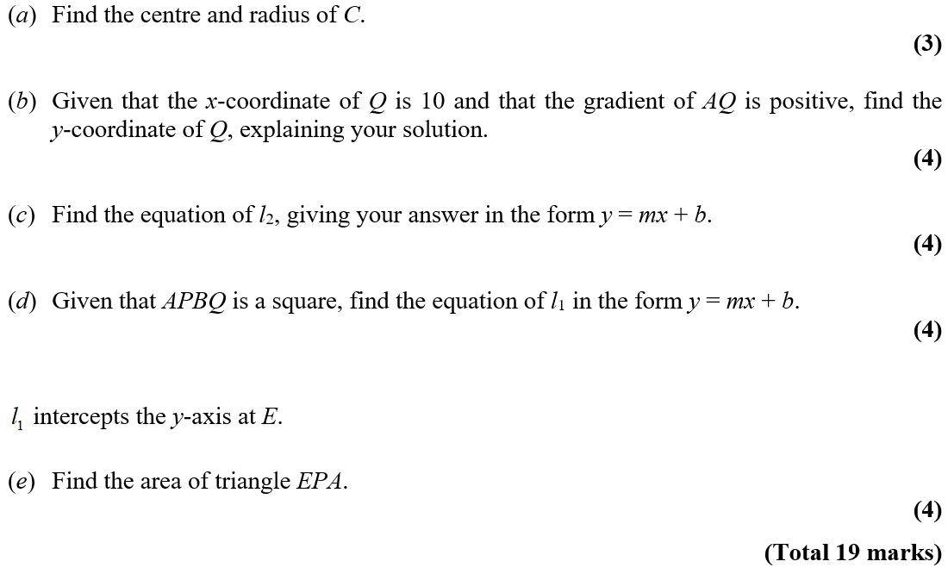
Practice B

Slide 10
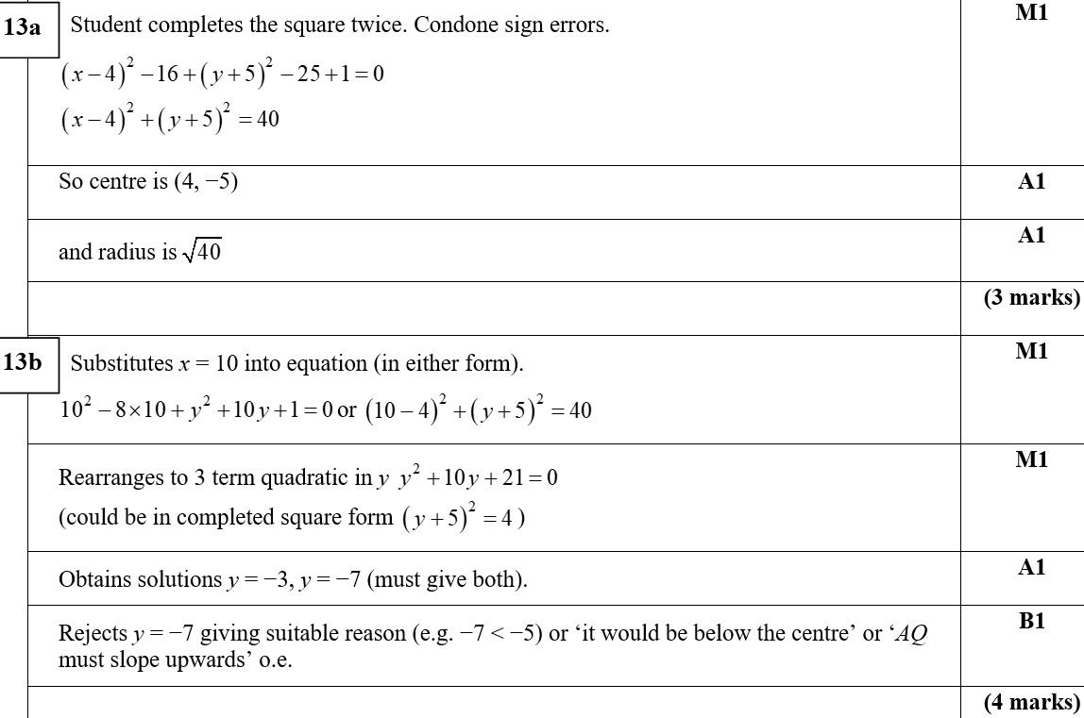
Practice B
A
B

Slide 11
Practice B
C

Slide 12
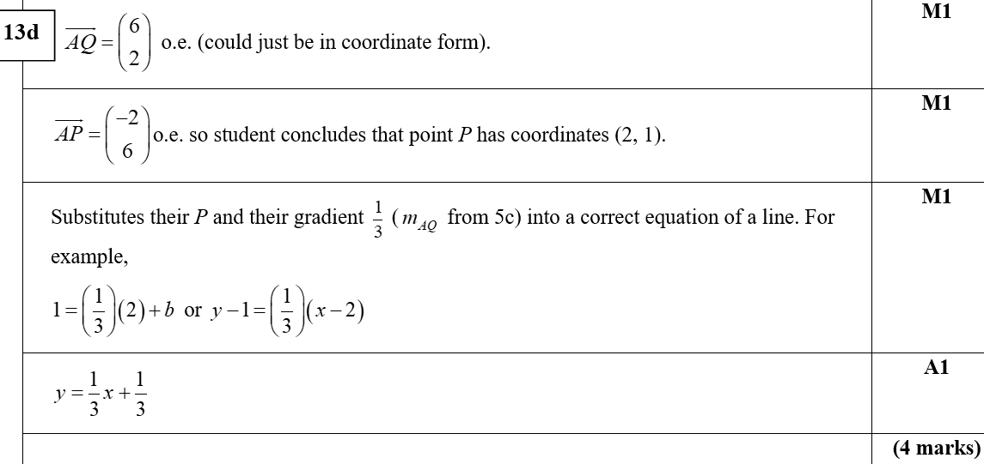
Practice B
D

Slide 13
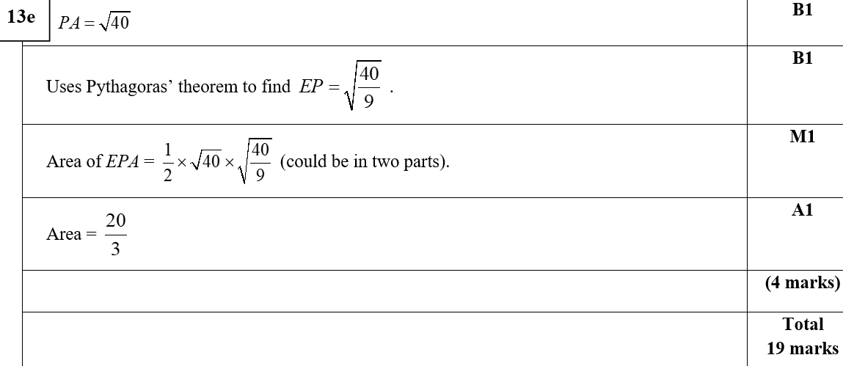
Practice B
E

Slide 14
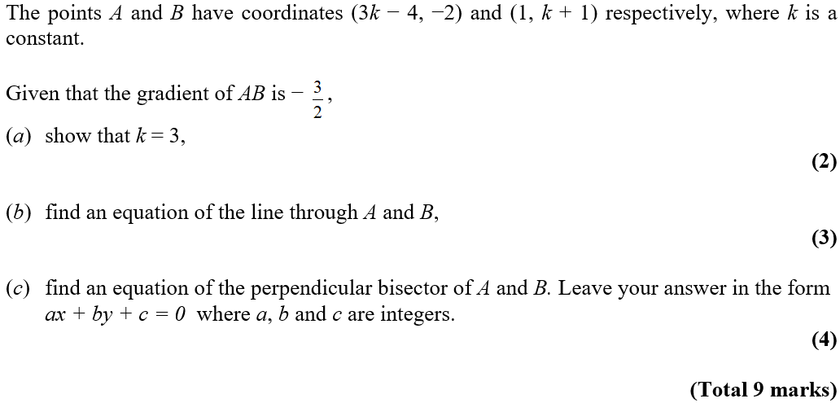
Practice C

Slide 15
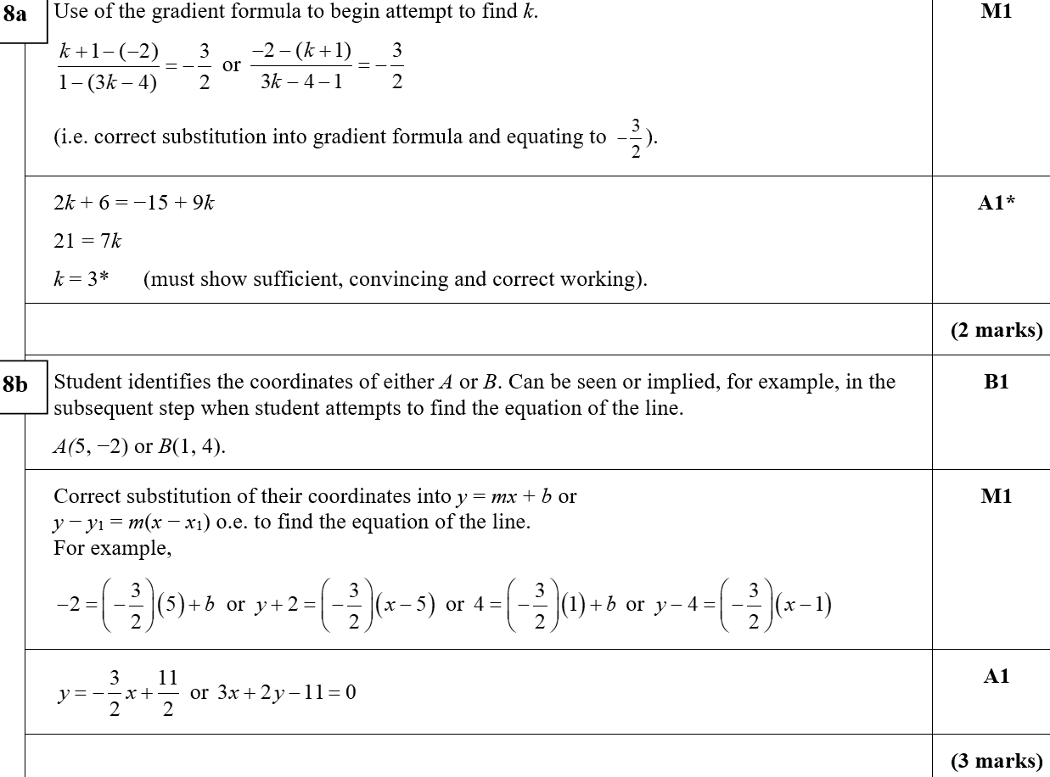
Practice C
A
B

Slide 16
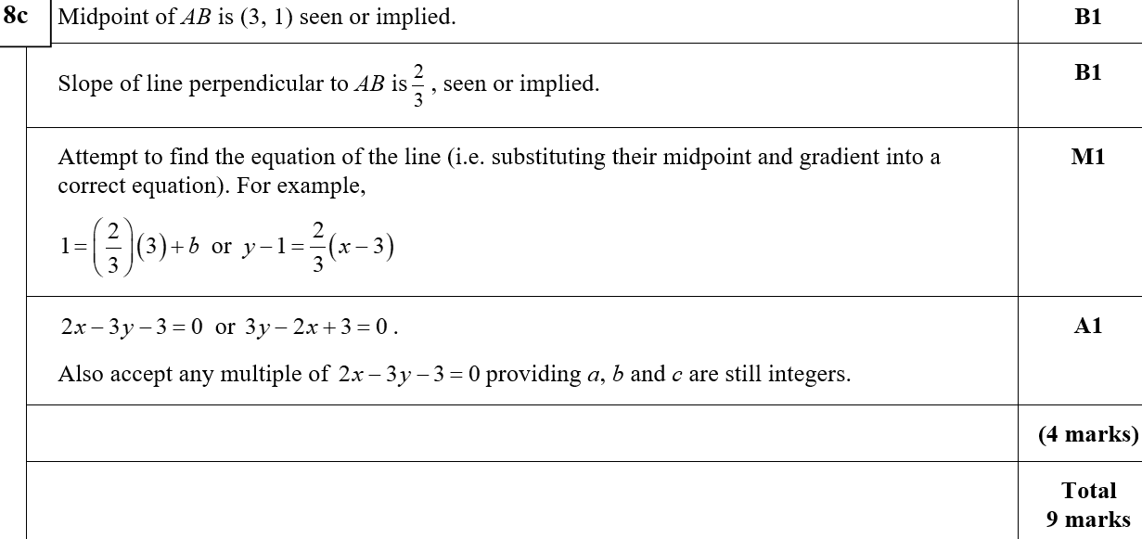
Practice C
A

Slide 17
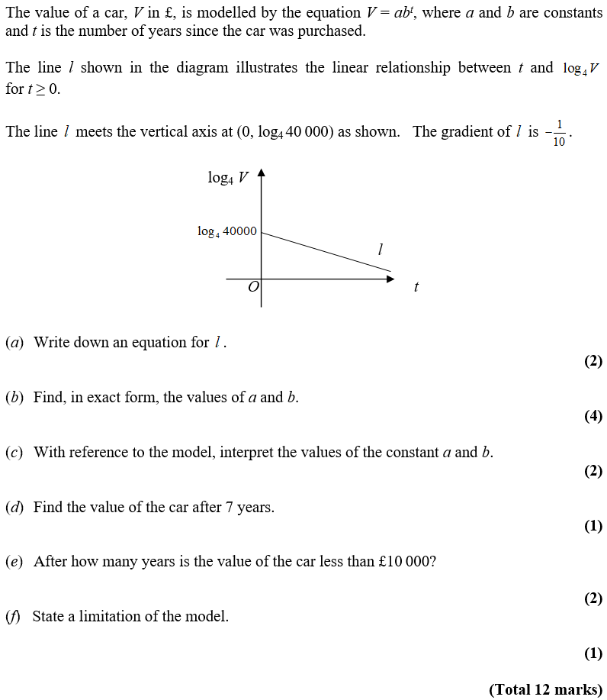
Practice C

Slide 18
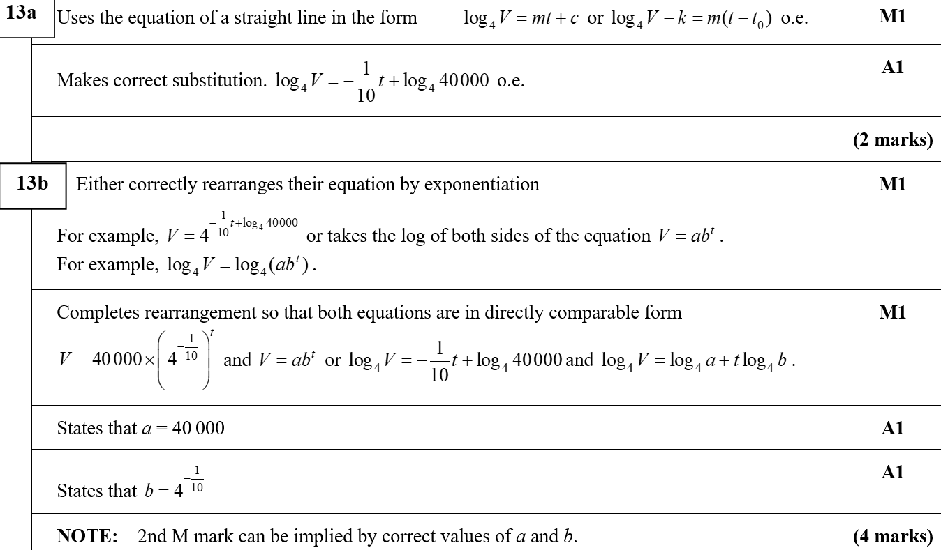
Practice C
A
B

Slide 19
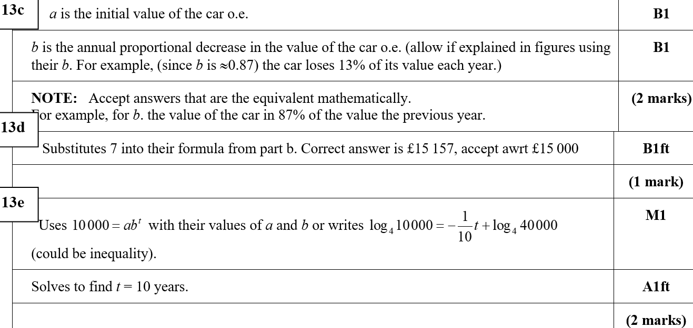
Practice C
C
D
C notes
E
F

Slide 20
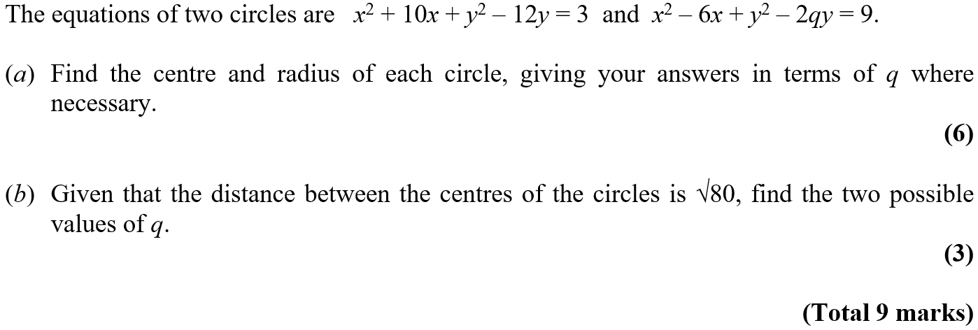
Practice D

Slide 21
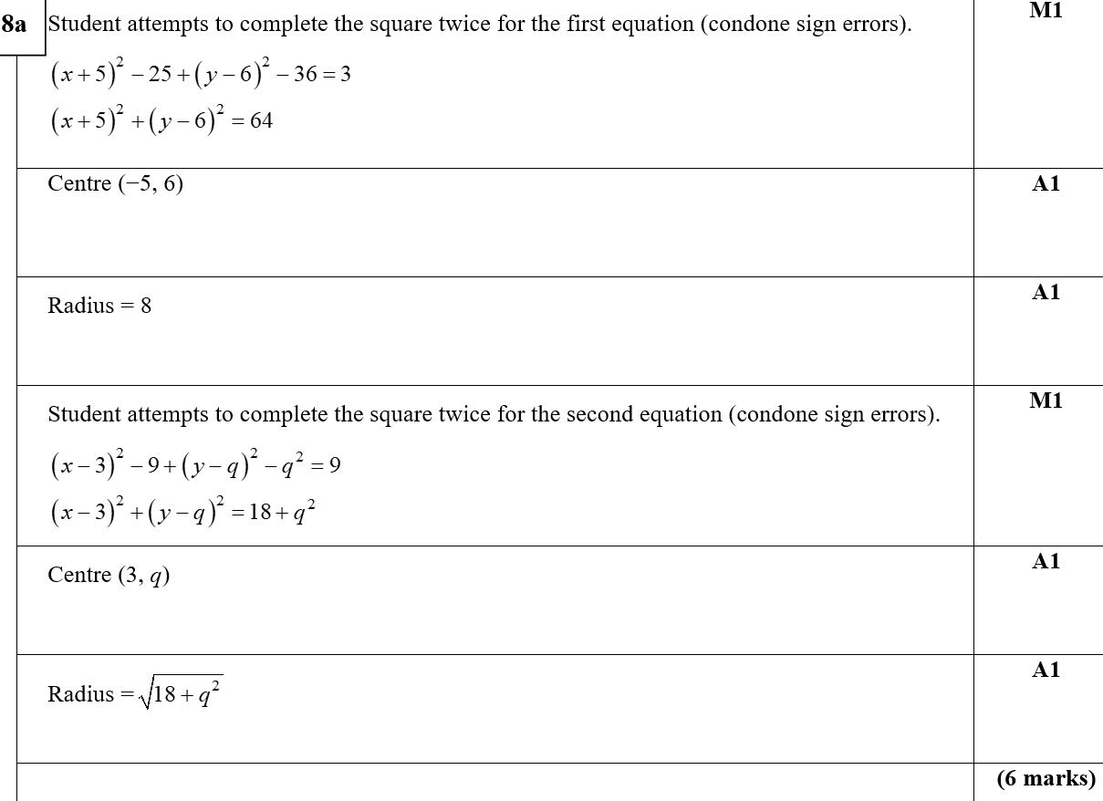
Practice D
A

Slide 22
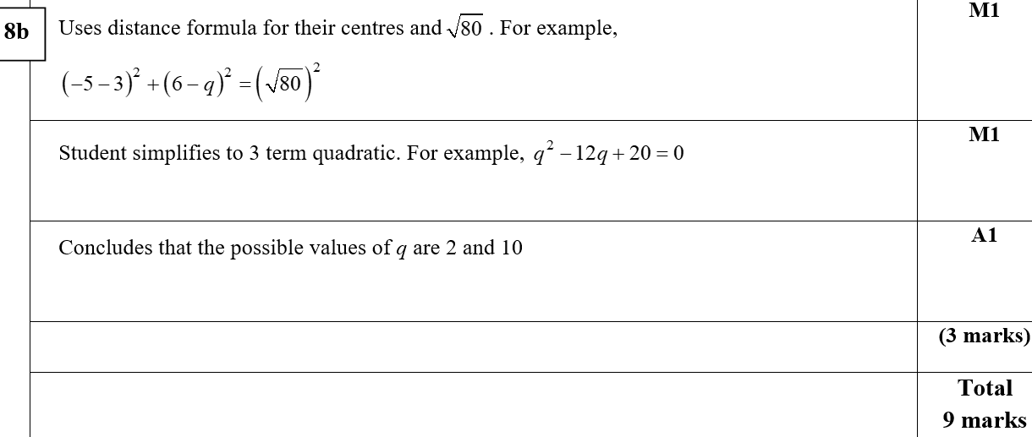
Practice D
B

Slide 23
SAM

Slide 24
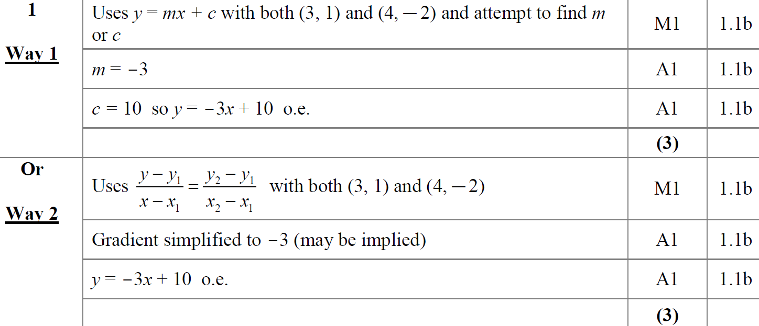
SAM
A
A Alternative 1

Slide 25
SAM
A Alternative 2
A notes

Slide 26
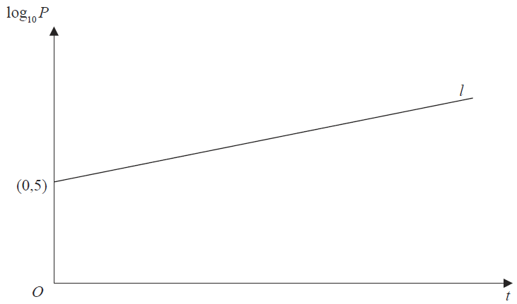
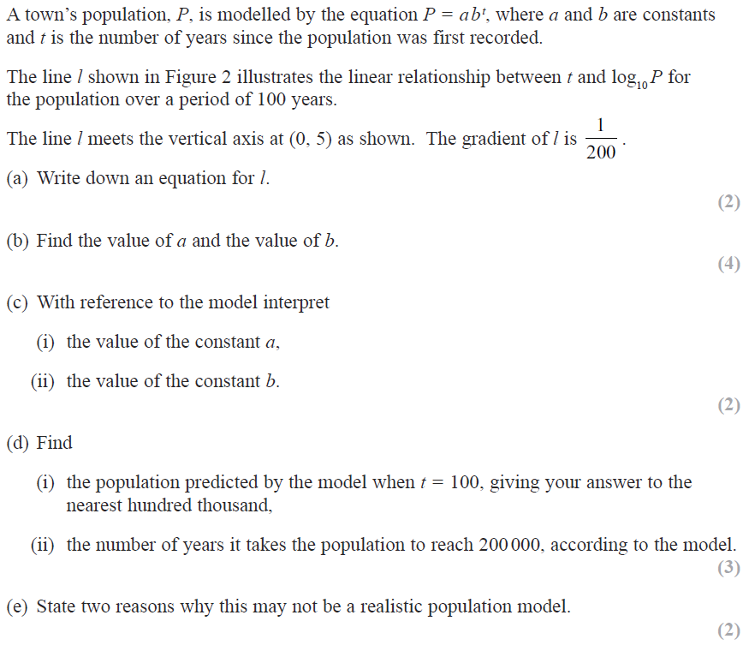
SAM

Slide 27
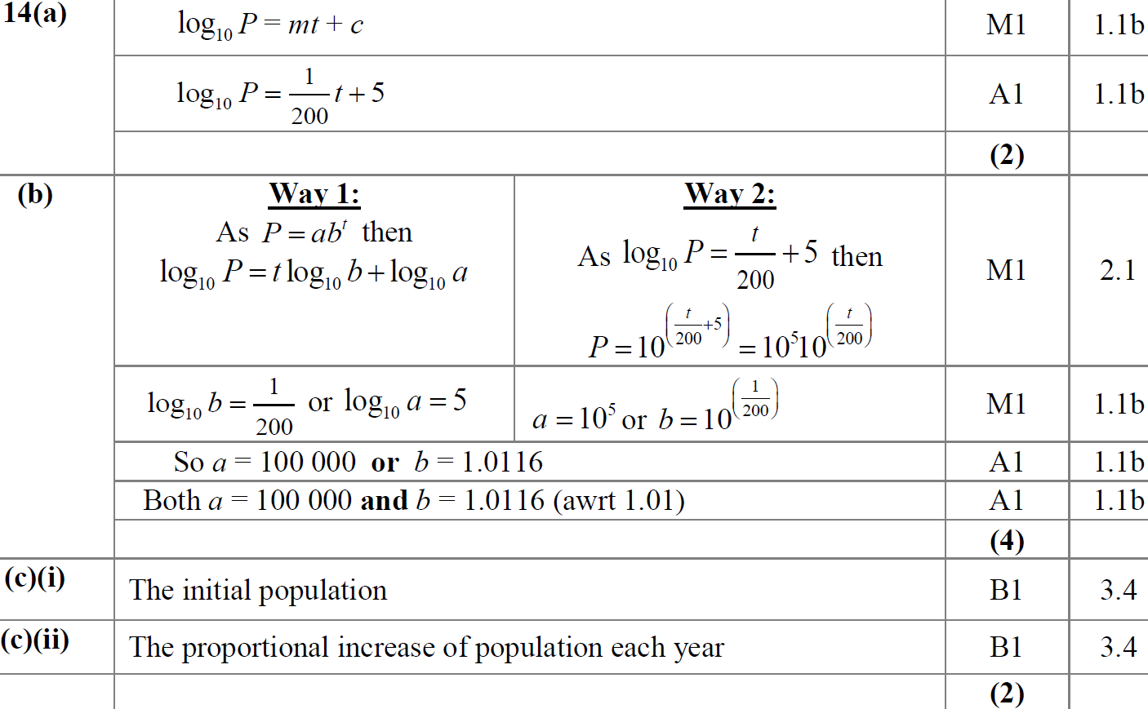
SAM
A
B
C (i)
C (ii)

Slide 28
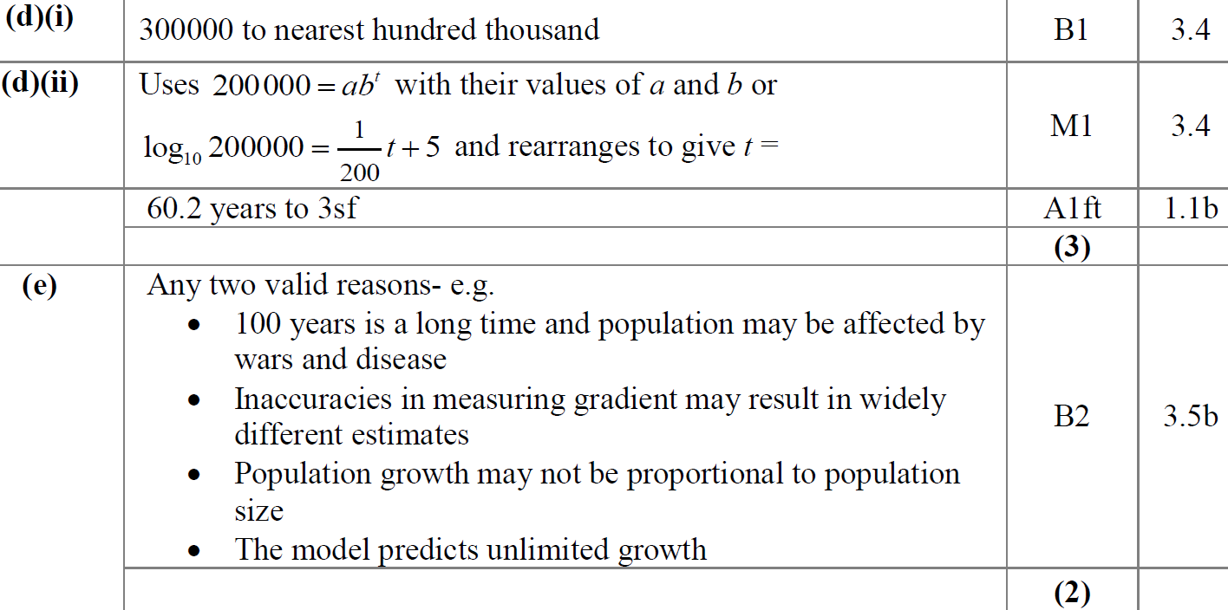
SAM
D (i)
D (ii)
E

Slide 29
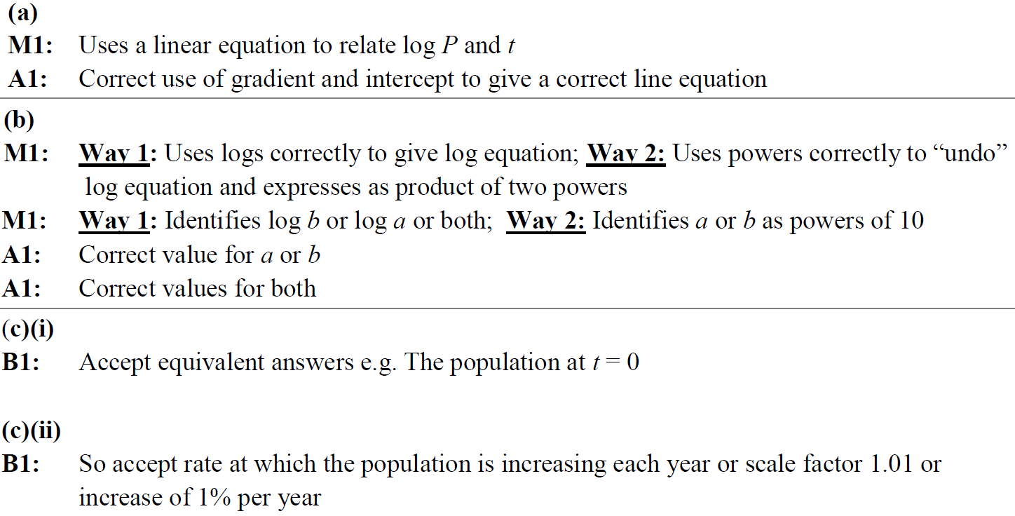
SAM
A notes
B notes
C (i) notes
C (ii) notes

Slide 30
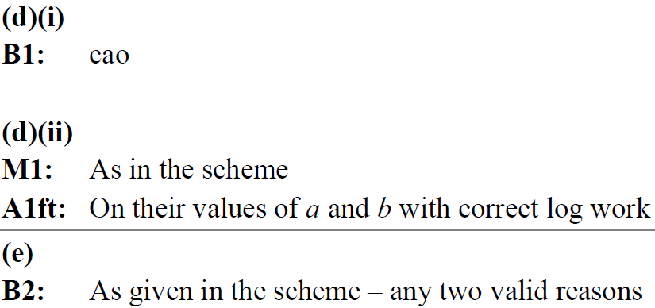
SAM
D (i) notes
D (ii) notes
E notes

Slide 31
SAM

Slide 32
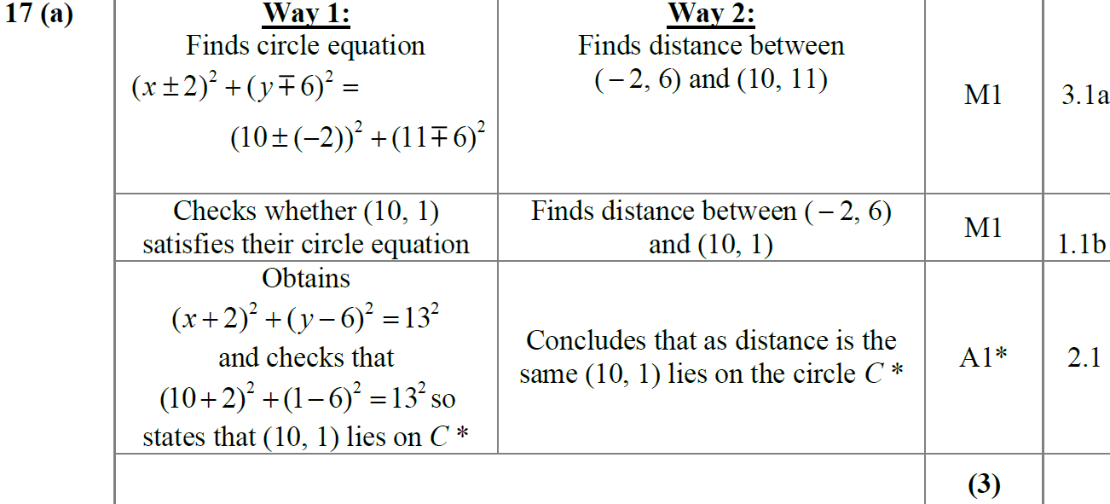
SAM
A
A notes

Slide 33
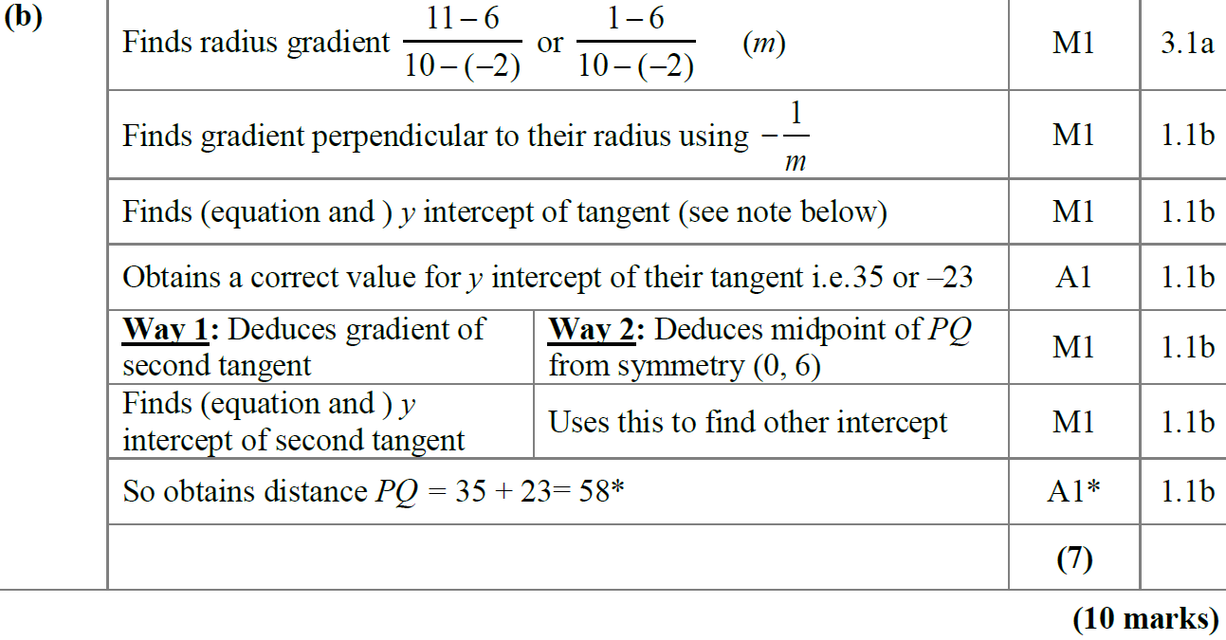
SAM
B

Slide 34
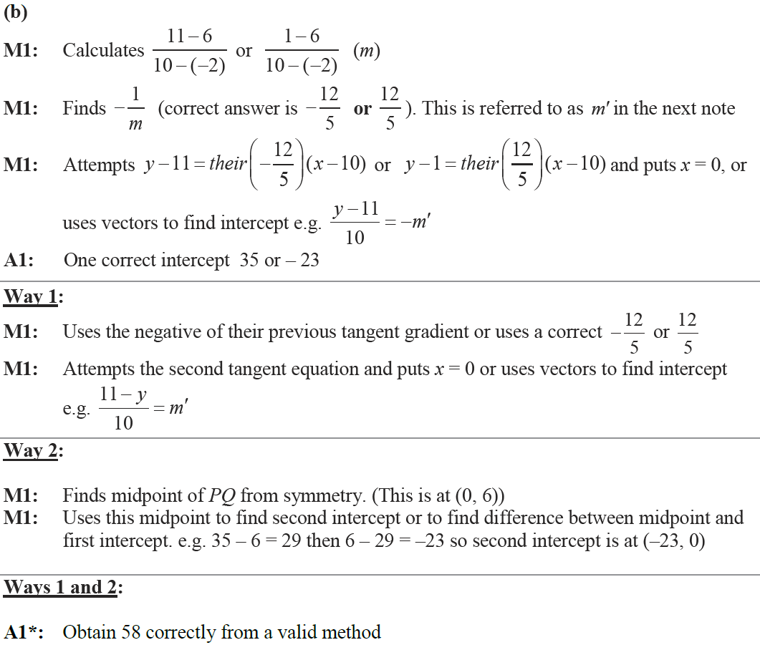
SAM
B notes

Slide 35
2018

Slide 36
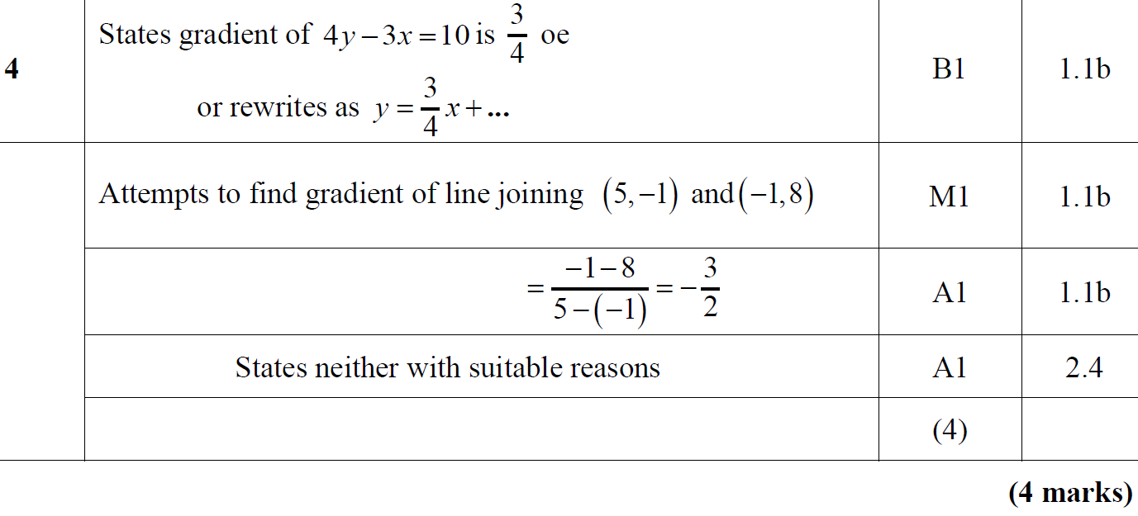
2018
A

Slide 37
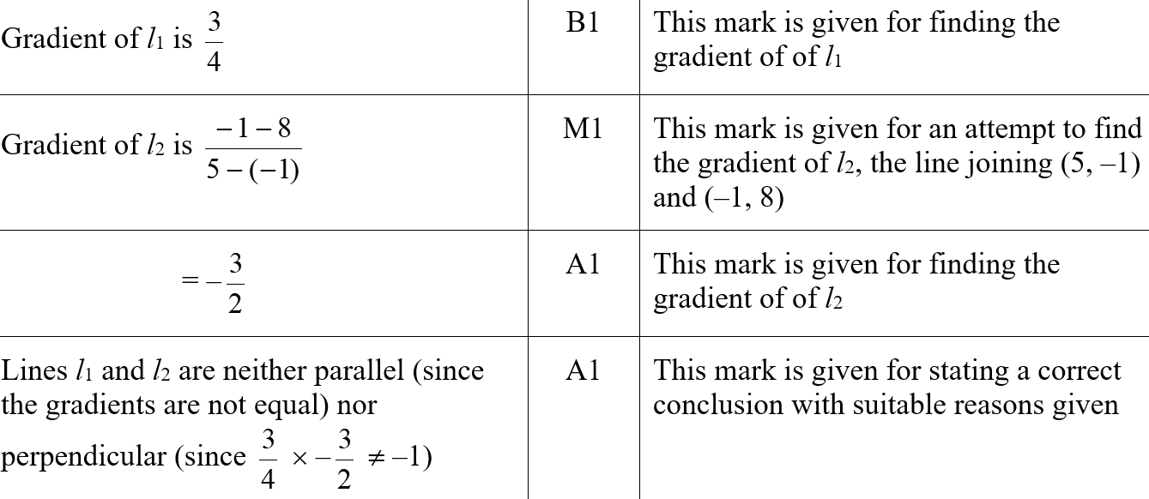
2018
A (SF)

Slide 38
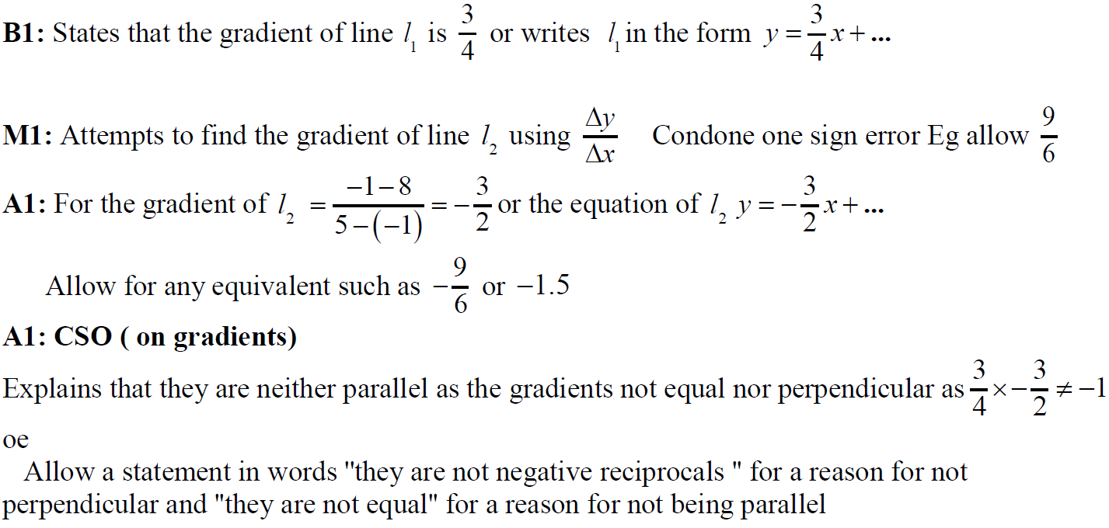
2018
A notes

Slide 39
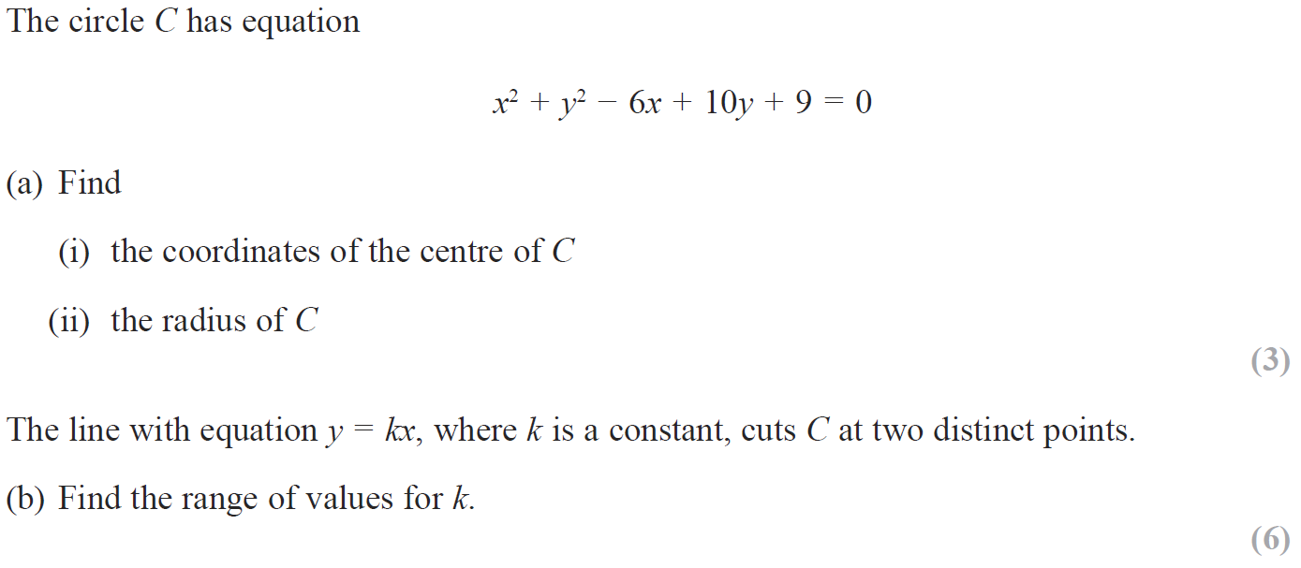
2018

Slide 40
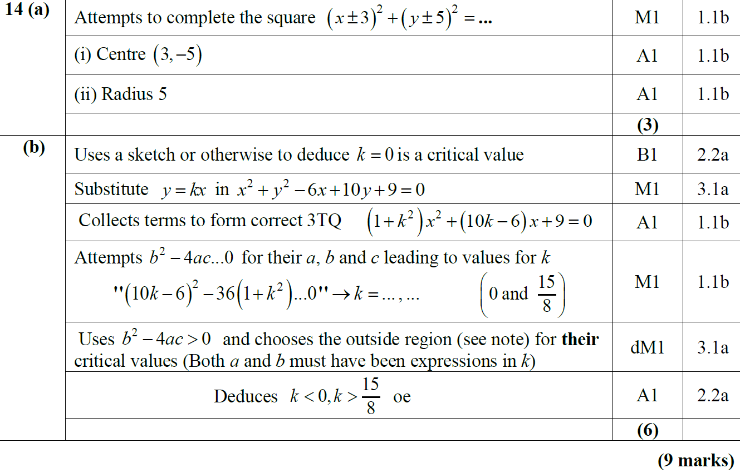
2018
A
B

Slide 41
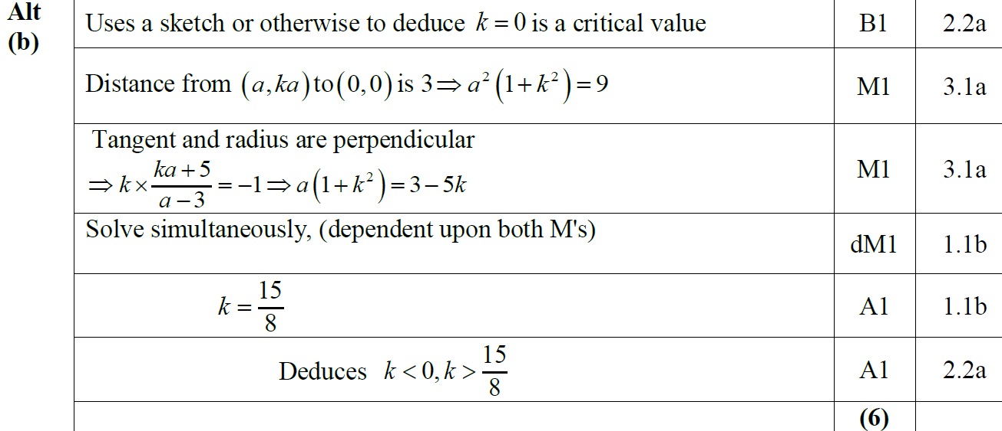
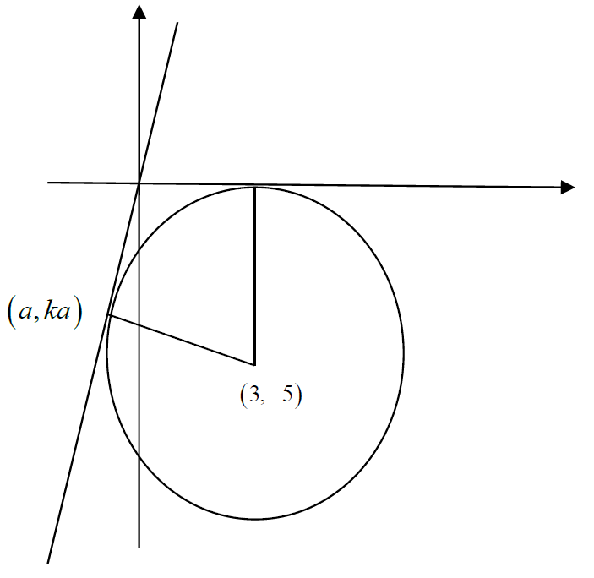
2018
B Alternative

Slide 42
2018
A (i) (SF)
A (ii) (SF)

Slide 43
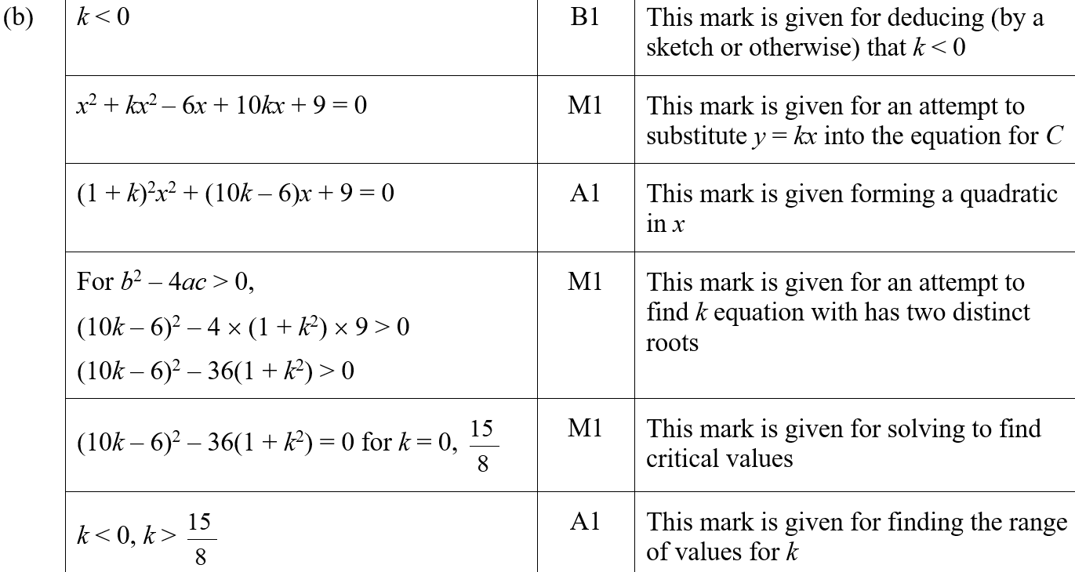
2018
B (SF)

Slide 44
2018
A notes

Slide 45
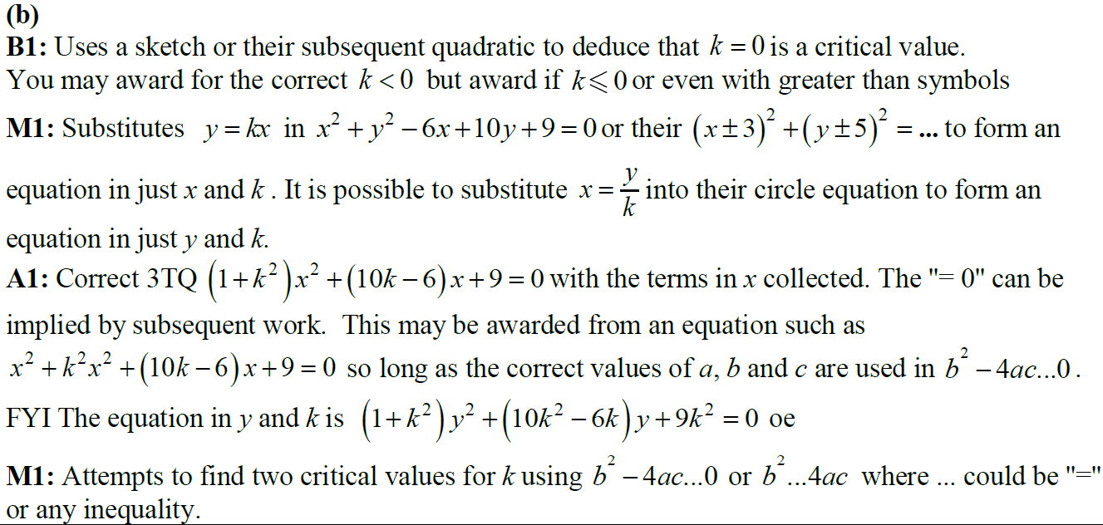
2018
B notes

Slide 46
New Spec Q’s
Old Spec Co-ordinate Geometry
C1
C2
Jan 2006
June 2010
May 2015 (i)
Jan 2006
May 2011
May 2018
May 2006
Jan 2011
May 2015 (ii)
May 2006
Jan 2012
May 2007
May 2011
May 2016 (i)
Jan 2007
May 2012
Jan 2008
Jan 2012
May 2016 (ii)
May 2007
Jan 2013
June 2008
May 2012
May 2017 (i)
June 2008
May 2013
Jan 2009
Jan 2013
May 2017 (ii)
Jan 2009
May 2014
June 2009
May 2013
May 2017 (iii)
June 2009
May 2015
Jan 2010 (i)
May 2014 (i)
May 2018
Jan 2010
May 2016
Jan 2010 (ii)
May 2014 (ii)
Jan 2011
May 2017

Slide 47
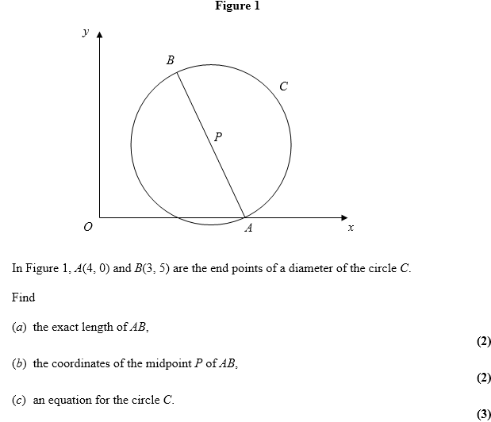
Jan 2006

Slide 48
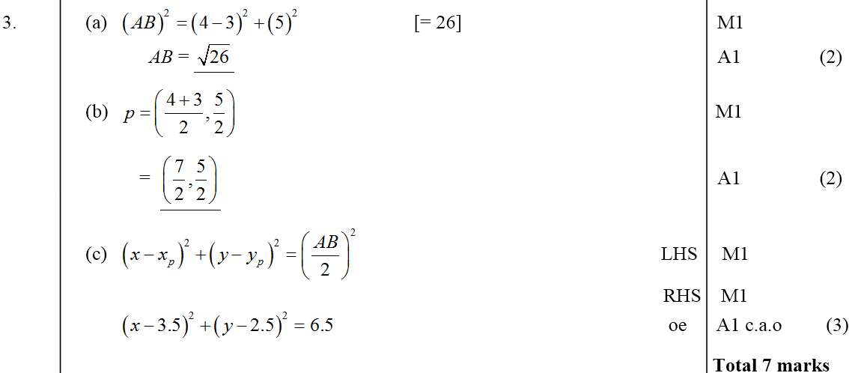
Jan 2006
A
B
C

Slide 49
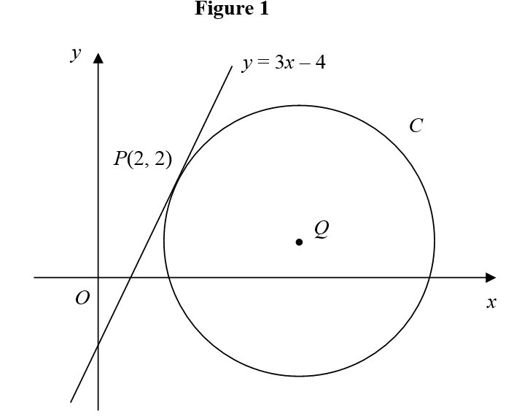
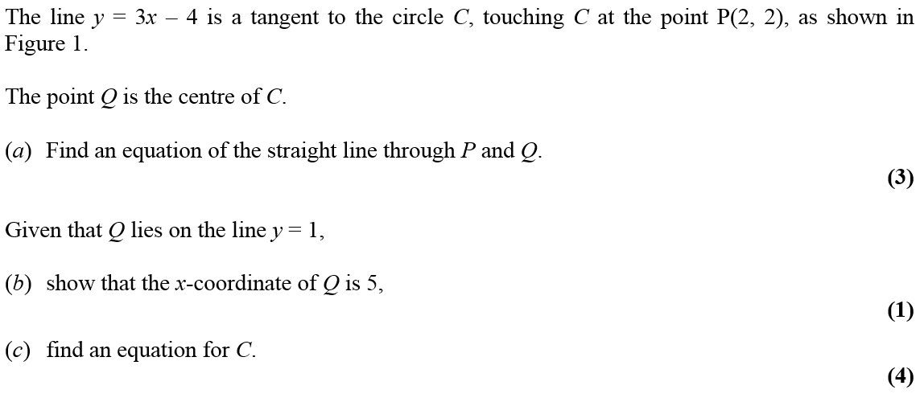
May 2006

Slide 50
May 2006
A
B
C

Slide 51
Jan 2007

Slide 52
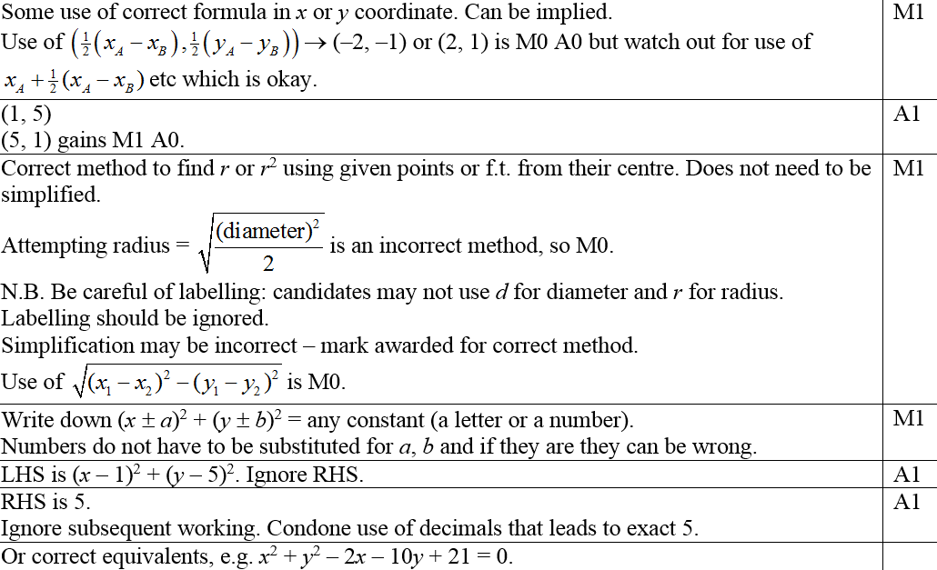
Jan 2007
A
Notes

Slide 53
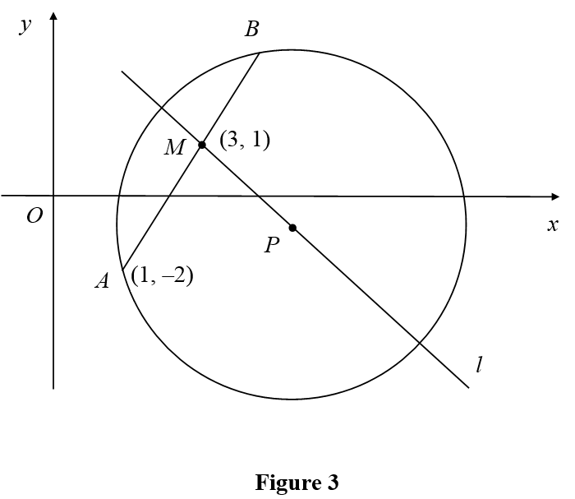
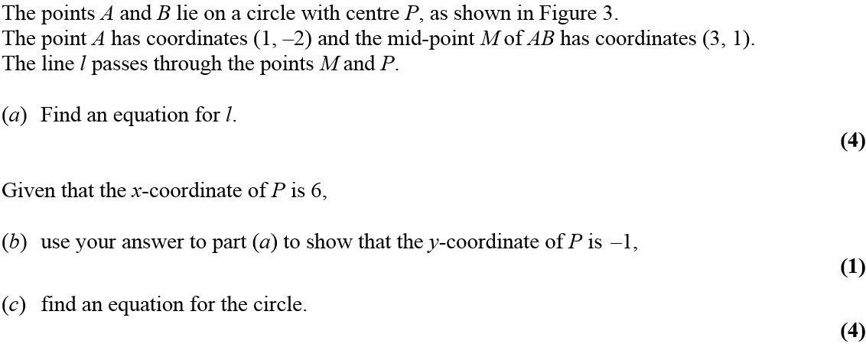
May 2007

Slide 54
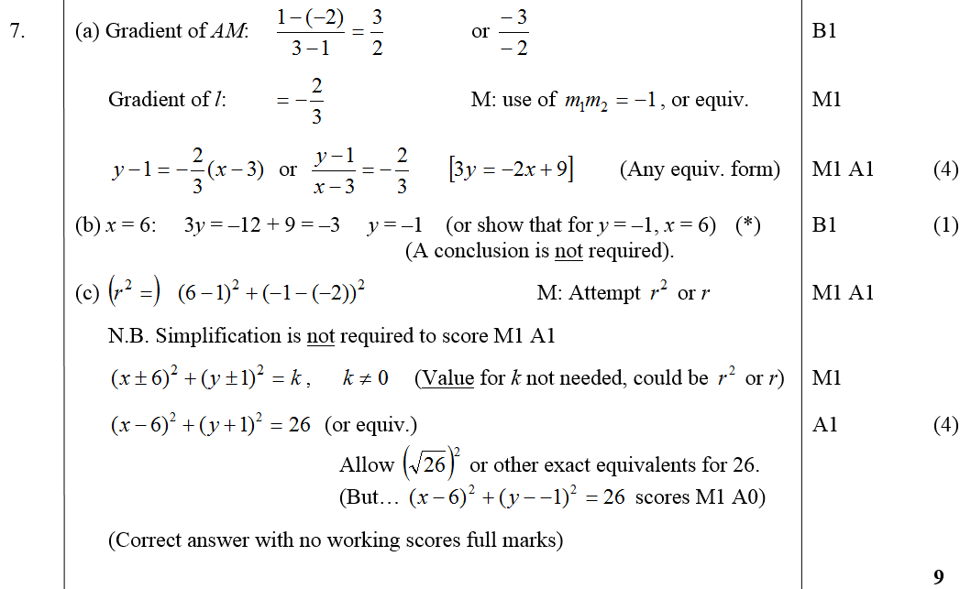
May 2007
A
B
C

Slide 55
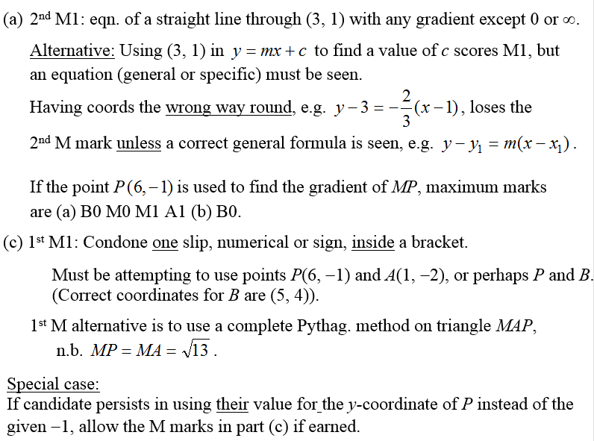
May 2007
A notes
C notes

Slide 56
June 2008

Slide 57
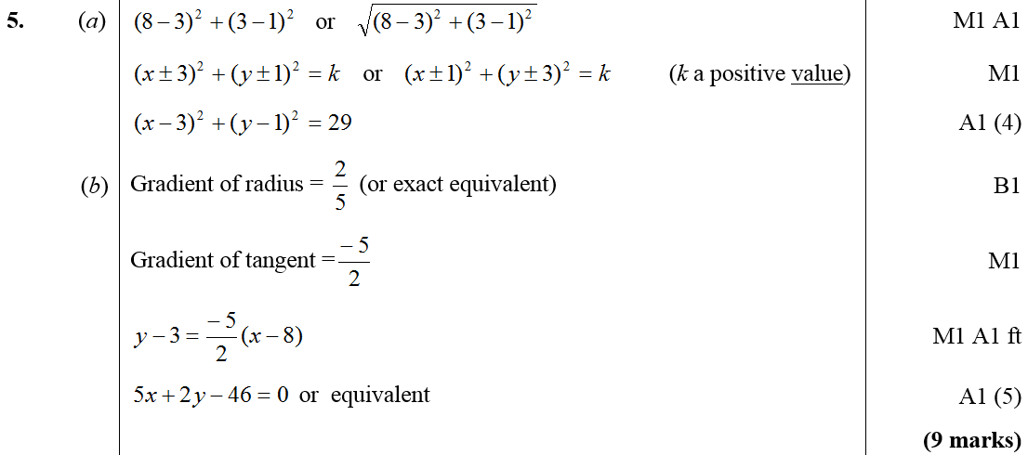
June 2008
A
B

Slide 58
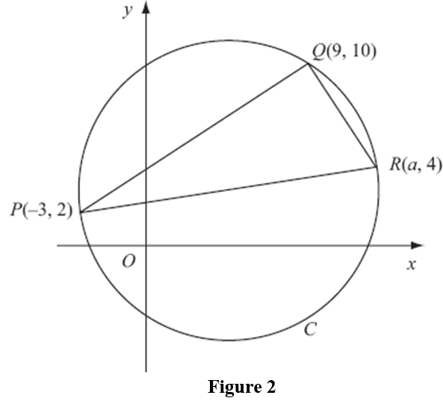
Jan 2009

Slide 59
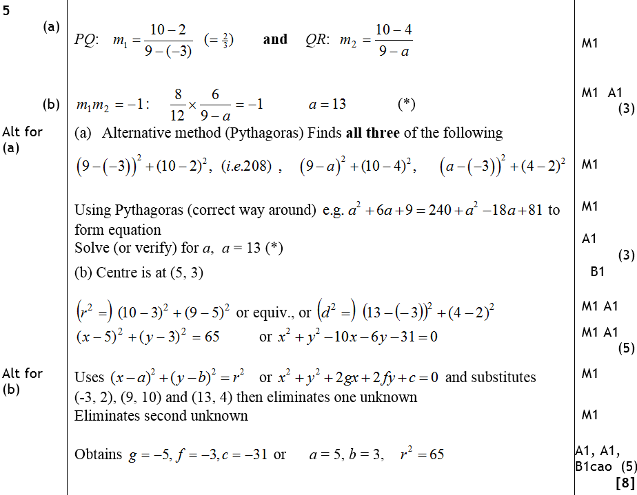
Jan 2009
A
B
Alternative A
Alternative B

Slide 60
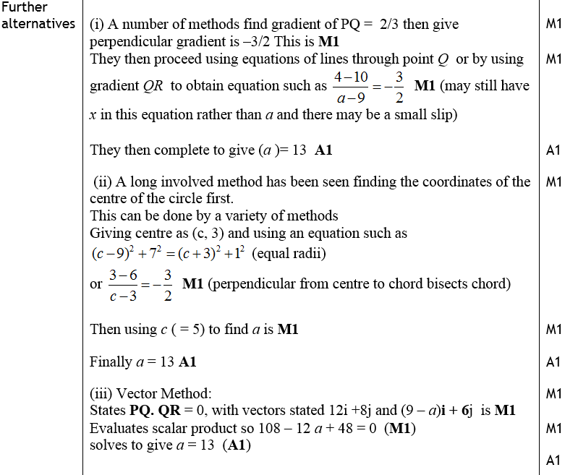
Jan 2009
Further Alternatives

Slide 61
Jan 2009
A notes
B notes

Slide 62
June 2009

Slide 63
June 2009
A
B
C

Slide 64
Jan 2010

Slide 65
Jan 2010
A
B
C
D
E

Slide 66
Jan 2010
A
B
C
D
E

Slide 67
Jan 2011

Slide 68
Jan 2011
A
B
C
D

Slide 69
Jan 2011
A
B
C
D

Slide 70
May 2011

Slide 71
May 2011
A
B
C

Slide 72
May 2011
A
B
C

Slide 73
Jan 2012

Slide 74
Jan 2012
A
Notes
Alternative Method

Slide 75
May 2012

Slide 76
May 2012
A
B
C
D

Slide 77
May 2012
A
B
C
A
B
D

Slide 78
Jan 2013

Slide 79
A (i)
Jan 2013
A (ii)
B
C

Slide 80
May 2013

Slide 81
May 2013
A
B

Slide 82
May 2014

Slide 83
May 2014
A
B

Slide 84
May 2014
Watch out for

Slide 85
May 2015

Slide 86
May 2015
A
B
B Alternative 1
B Alternative 2

Slide 87
May 2015
A notes
B notes
B Alternative 1 notes
B Alternative 2 notes

Slide 88
May 2016

Slide 89
May 2016
A
B
B Alternative
A notes
B notes

Slide 90
May 2016
C
C Alternative 1
C Alternative 2

Slide 91
May 2016
C notes

Slide 92
May 2017

Slide 93
May 2017
A
B
B Alternative

Slide 94
May 2017
C
C Alternative

Slide 95
May 2017
A notes
B notes
C notes

Slide 96
May 2018

Slide 97
May 2018
A
B
C
D

Slide 98
May 2018
A Alternative
B Alternative
D Alternative 1

Slide 99
May 2018
A notes
B notes
C notes

Slide 100
May 2018
D notes
D Alternative 1 notes
D Alternative 2 notes

Slide 101
Jan 2006

Slide 102
Jan 2006
A
B

Slide 103
May 2006

Slide 104
May 2006
A
B
C
D

Slide 105
May 2007

Slide 106
May 2007
A
B
C

Slide 107
May 2007
A notes
B notes
C notes

Slide 108
Jan 2008

Slide 109
Jan 2008
A
B

Slide 110
Jan 2008
A notes
B notes

Slide 111
June 2008

Slide 112
June 2008
A
B
C
D

Slide 113
Jan 2009

Slide 114
Jan 2009
A
B
C
D
A notes

Slide 115
Jan 2009
B notes
C notes
D notes

Slide 116
June 2009

Slide 117
June 2009
A
B
C

Slide 118
Jan 2010

Slide 119
Jan 2010
A
B

Slide 120
Jan 2010

Slide 121
Jan 2010
A
B
C
D

Slide 122
June 2010

Slide 123
June 2010
A
B
C
D

Slide 124
Jan 2011

Slide 125
Jan 2011
A
B
C
D
E

Slide 126
Jan 2011
B notes
C notes
D notes
E notes

Slide 127
May 2011

Slide 128
May 2011
A
A notes

Slide 129
Jan 2012

Slide 130
Jan 2012
A
B
C

Slide 131
May 2012

Slide 132
May 2012
A
B
C
D
E

Slide 133
May 2012
A notes
B notes
C notes

Slide 134
May 2012
D notes
E notes
Alternative E (i)

Slide 135
May 2012
Alternative E (ii)
Alternative E (iii)

Slide 136
Jan 2013

Slide 137
Jan 2013
A
B
C

Slide 138
May 2013

Slide 139
May 2013
A
B

Slide 140
May 2014

Slide 141
May 2014
A
B

Slide 142
May 2014
A Notes
B Notes

Slide 143
May 2014
Alternative Method (i)
Alternative Method (ii)
Alternative Method (iii)

Slide 144
May 2014
Alternative Method (i)
Alternative Method (ii)
Alternative Method (iii)

Slide 145
May 2014

Slide 146
May 2014
A
B

Slide 147
May 2014
A Notes
B Notes

Slide 148
May 2015

Slide 149
May 2015
A

Slide 150
May 2015
B

Slide 151
May 2015
C

Slide 152
May 2015

Slide 153
May 2015
A

Slide 154
May 2015
B

Slide 155
May 2016

Slide 156
May 2016
A
B

Slide 157
May 2016
C

Slide 158
May 2016
C Shapes

Slide 159
May 2016
C notes

Slide 160
May 2016
C Alternative 1 notes

Slide 161
May 2016
C Alternative 2 notes

Slide 162
May 2016
C Alternative 3 notes

Slide 163
May 2016
C Alternative 4 notes

Slide 164
May 2016
C Alternative 5 notes

Slide 165
May 2016
C Alternative 6 notes

Slide 166
May 2016
C Alternative 7 notes

Slide 167
May 2016
C further diagrams

Slide 168
May 2016

Slide 169
May 2016
A
B

Slide 170
May 2016
C
D

Slide 171
May 2017

Slide 172
May 2017
A

Slide 173
May 2017
B

Slide 174
May 2017
C

Slide 175
May 2017

Slide 176
May 2017
A

Slide 177
May 2017
B

Slide 178
May 2017

Slide 179
May 2017
A

Slide 180
May 2017
B

Slide 181
May 2017
B Alternatives

Slide 182
May 2018

Slide 183
May 2018
A
B

Slide 184
May 2018
C

Slide 185
May 2018
D
D Alternative 1
D Alternative 2
D Alternative 3

