Slide 1
Old Spec Q’s
Binomial Expansion
Practice A
Practice B (i)
Practice B (ii)
Practice C
SAM
2018

Slide 2
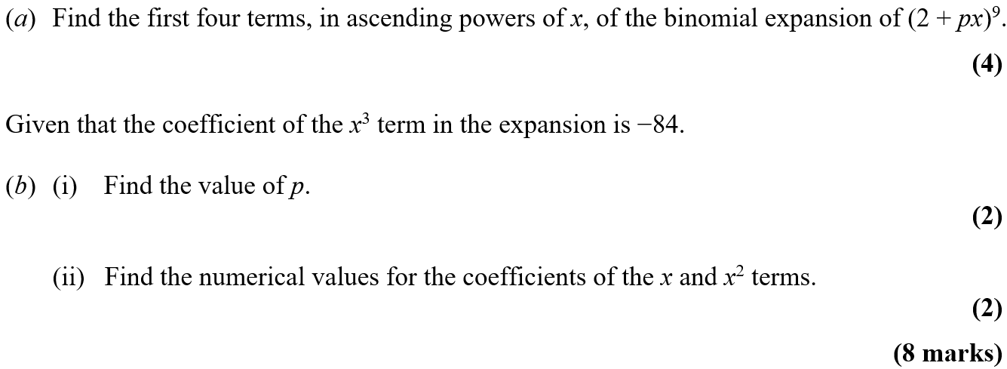
Practice A

Slide 3
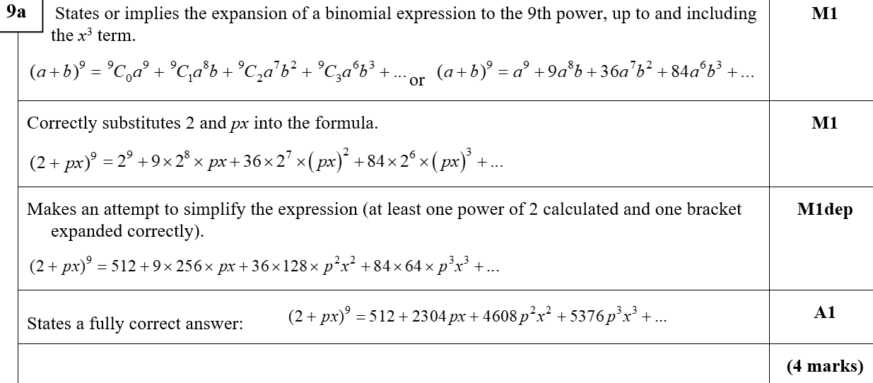
Practice A
A

Slide 4
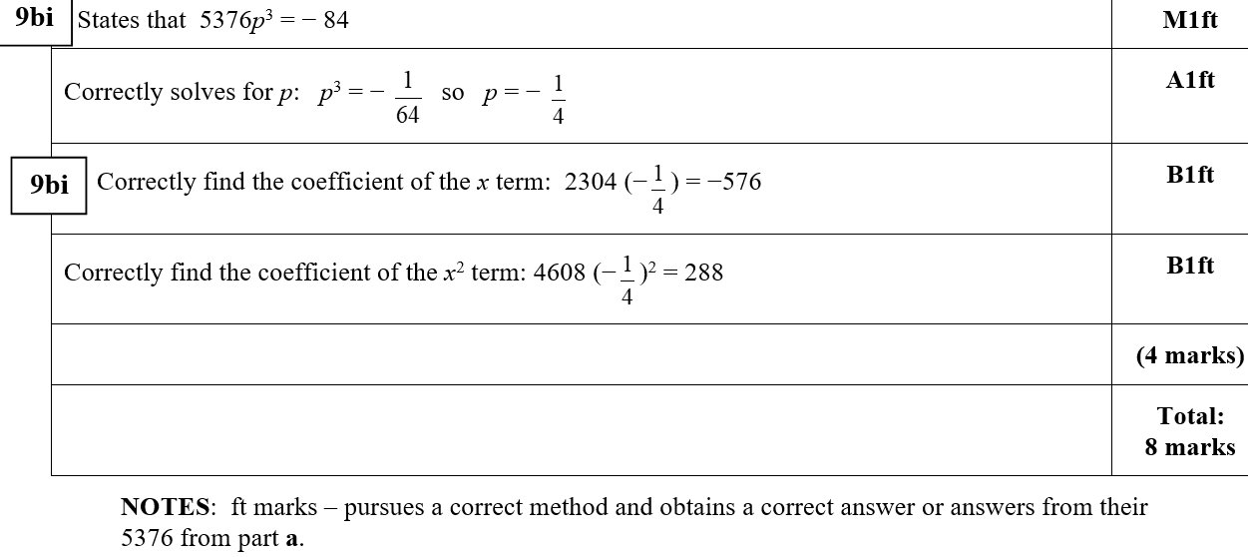
Practice A
B (i)
B (ii)
B notes

Slide 5
Practice B

Slide 6
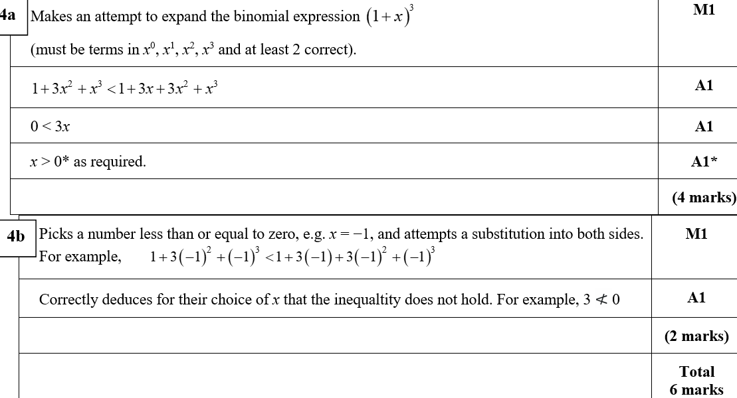
Practice B
A
B

Slide 7
Practice B

Slide 8
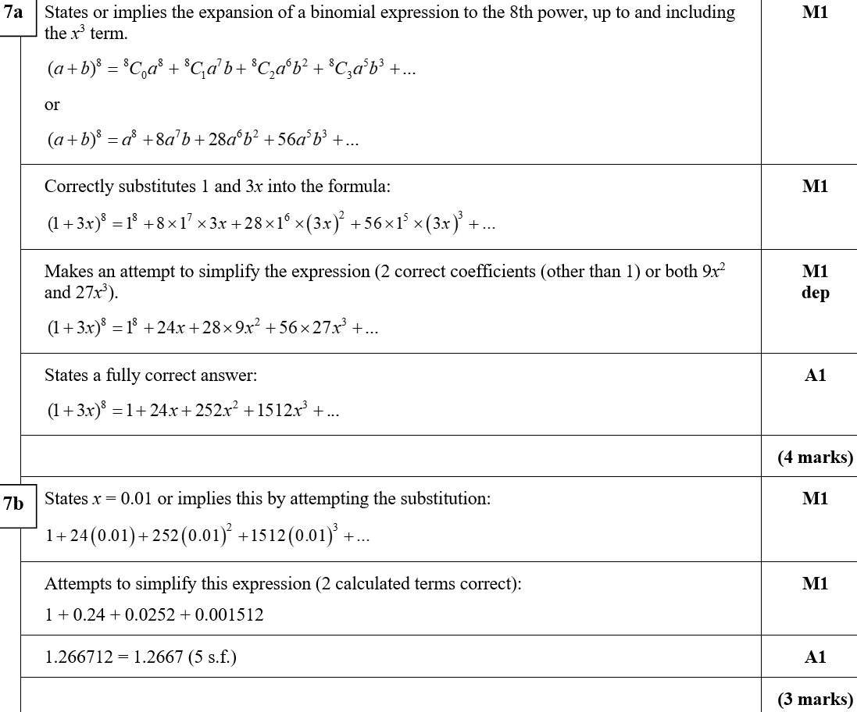
Practice B
A
B

Slide 9
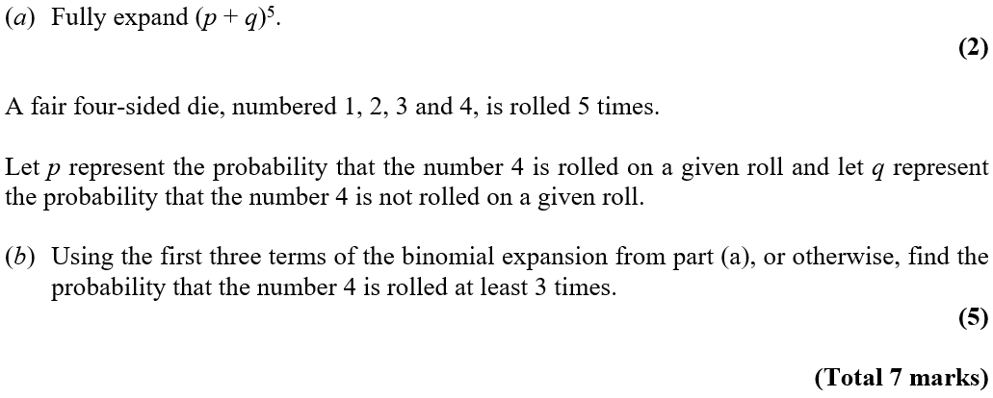
Practice C

Slide 10
Practice C
A

Slide 11
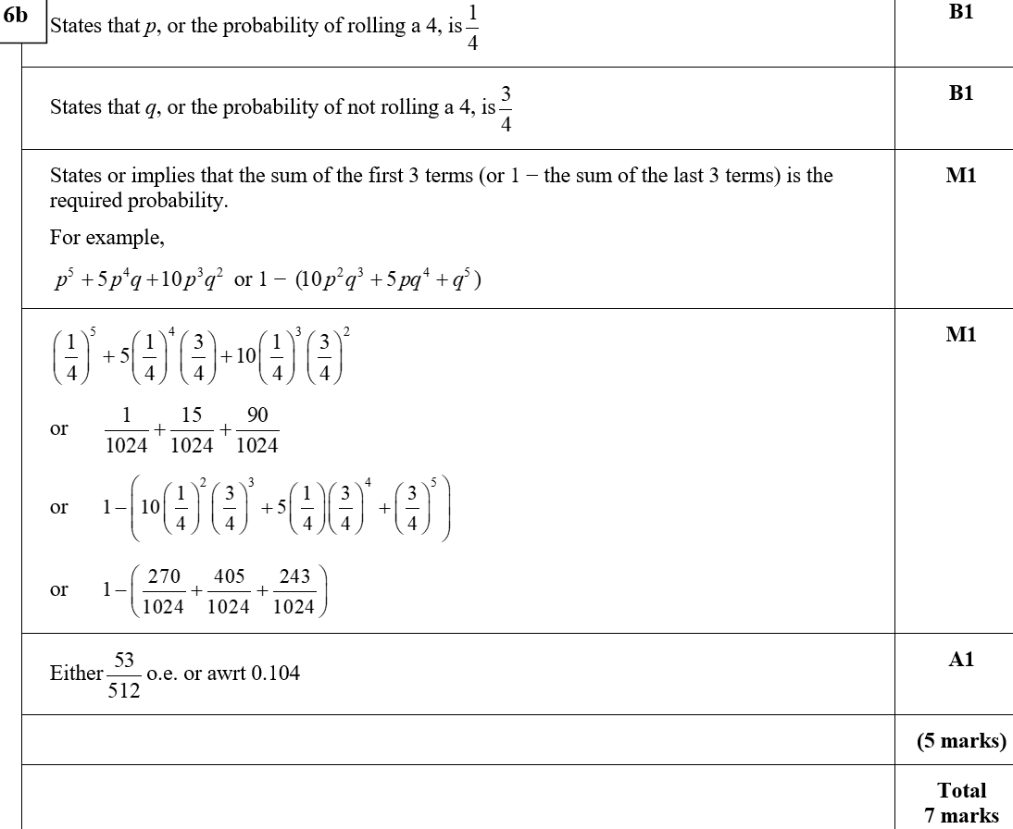
Practice C
B

Slide 12
SAM

Slide 13
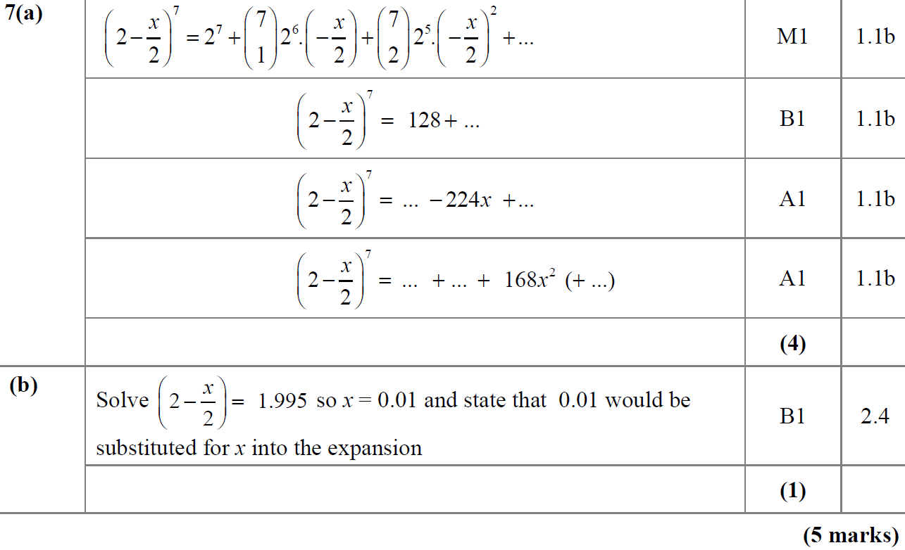
SAM
A
B

Slide 14
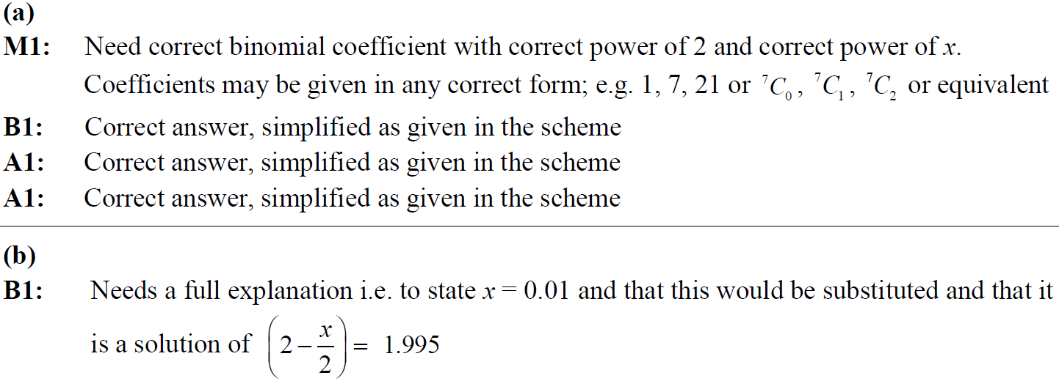
SAM
A notes
B notes

Slide 15
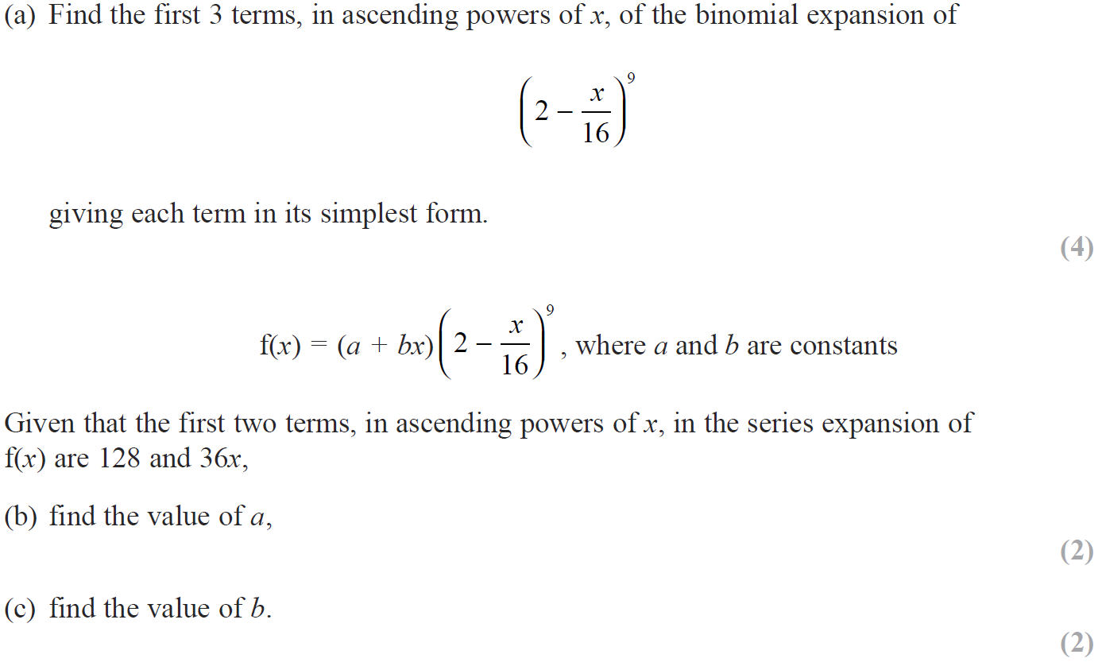
2018

Slide 16
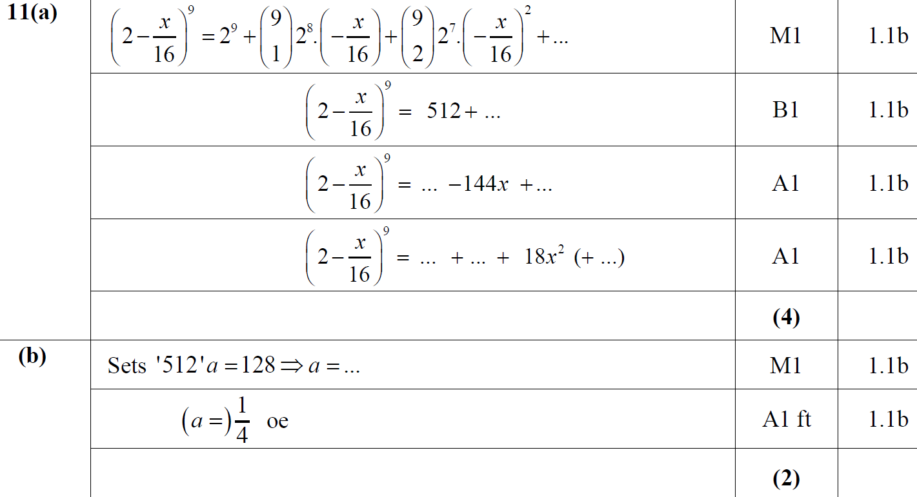
2018
A
B

Slide 17
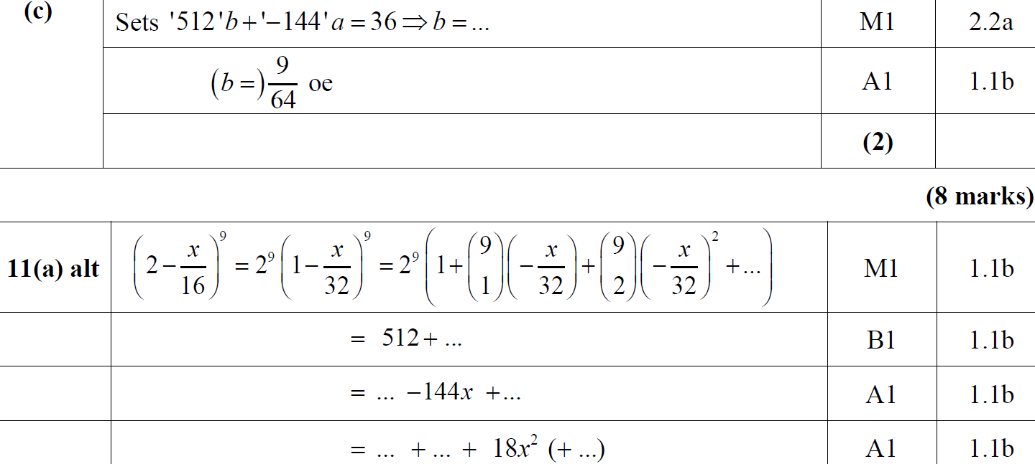
2018
C
A Alternative

Slide 18
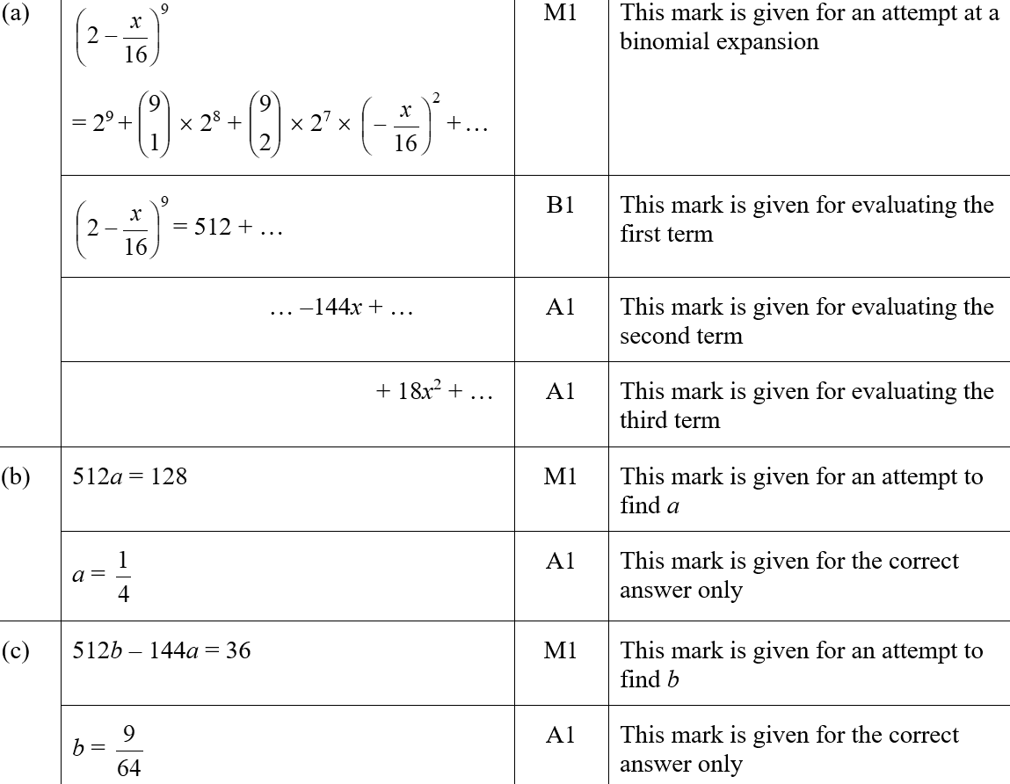
2018
A (SF)
B (SF)
C (SF)

Slide 19
2018
A notes

Slide 20
2018
B notes
C notes

Slide 21
New Spec Q’s
Old Spec Binomial Expansion
Jan 2006
June 2009
Jan 2013
May 2006
Jan 2010
May 2013
Jan 2007
June 2010
May 2014
May 2007
Jan 2011
May 2015
Jan 2008
May 2011
May 2016
June 2008
Jan 2012
May 2017
Jan 2009
May 2012
May 2018

Slide 22
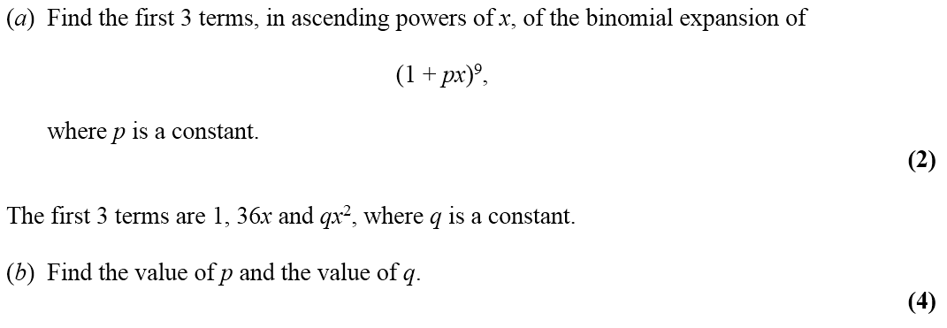
Jan 2006

Slide 23
Jan 2006
A
B

Slide 24
May 2006

Slide 25
May 2006
A

Slide 26
Jan 2007

Slide 27
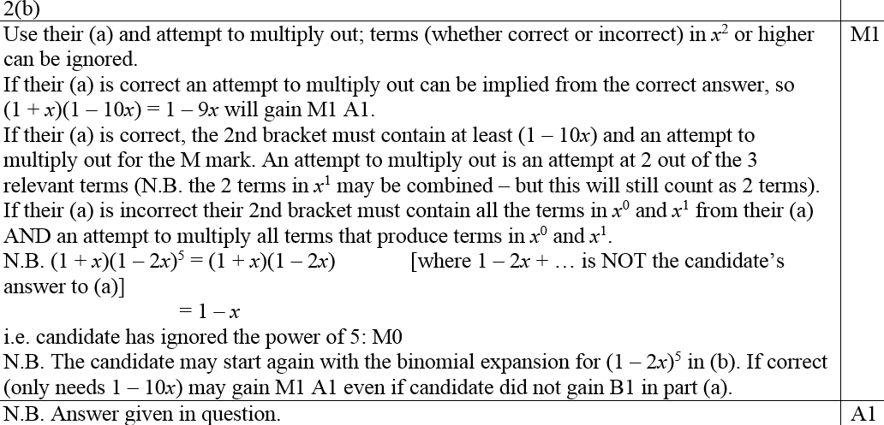
Jan 2007
A
B
B notes

Slide 28
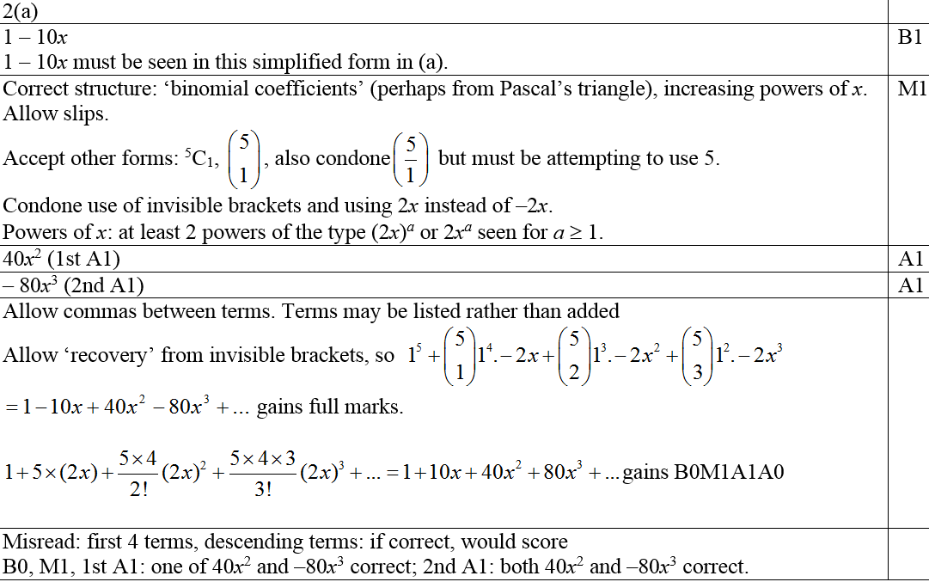
Jan 2007
A notes

Slide 29
May 2007

Slide 30
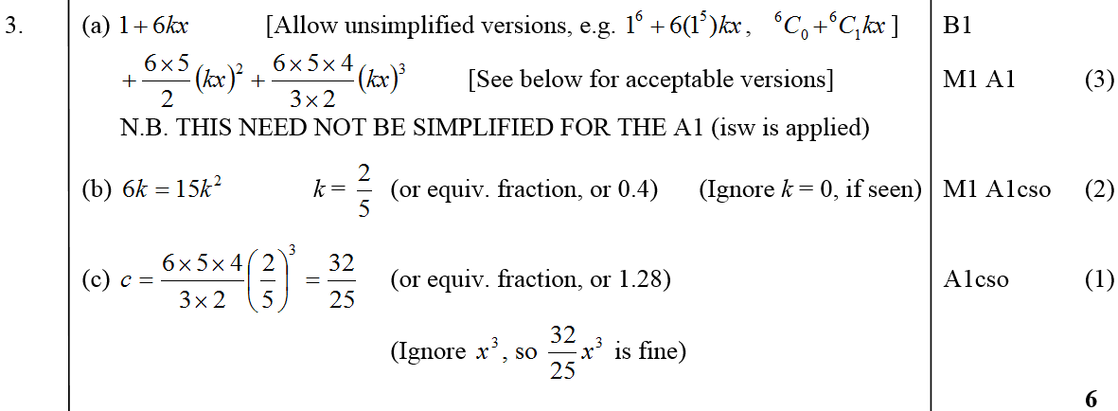
May 2007
A
B
C
B notes

Slide 31
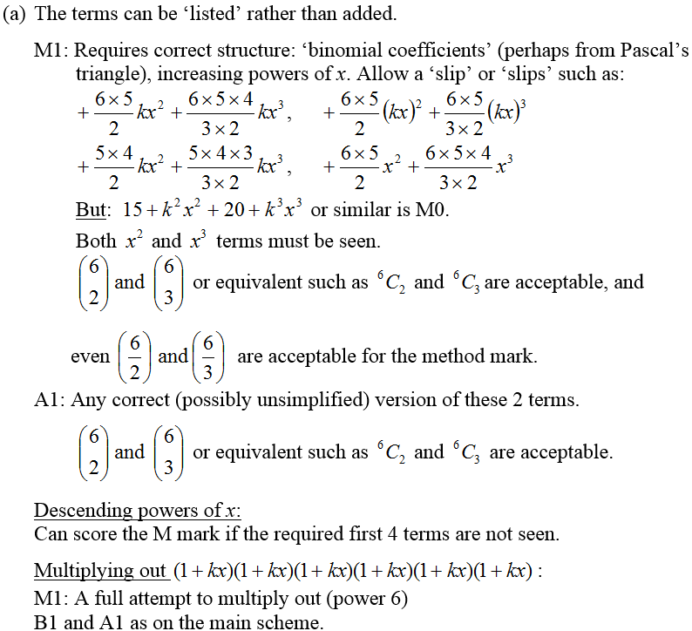
May 2007
A notes

Slide 32
Jan 2008

Slide 33
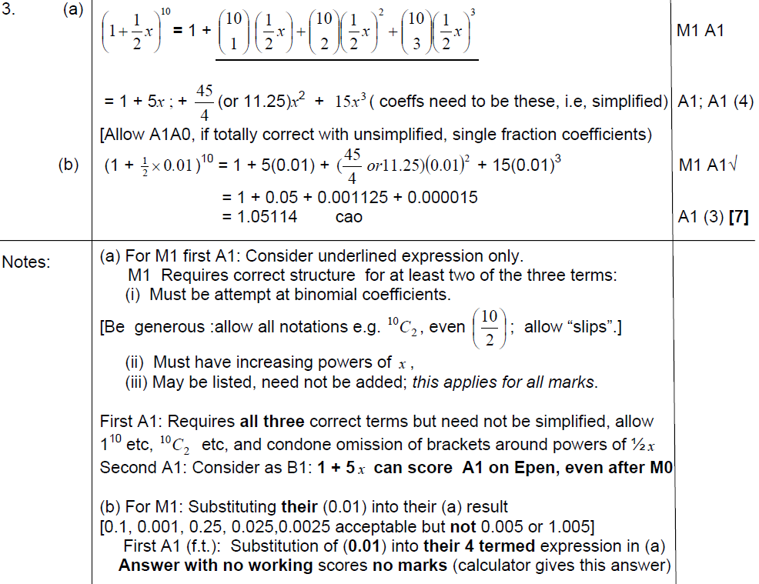
A
Jan 2008
B
A notes
B notes

Slide 34
June 2008

Slide 35
June 2008
A
B

Slide 36
Jan 2009

Slide 37
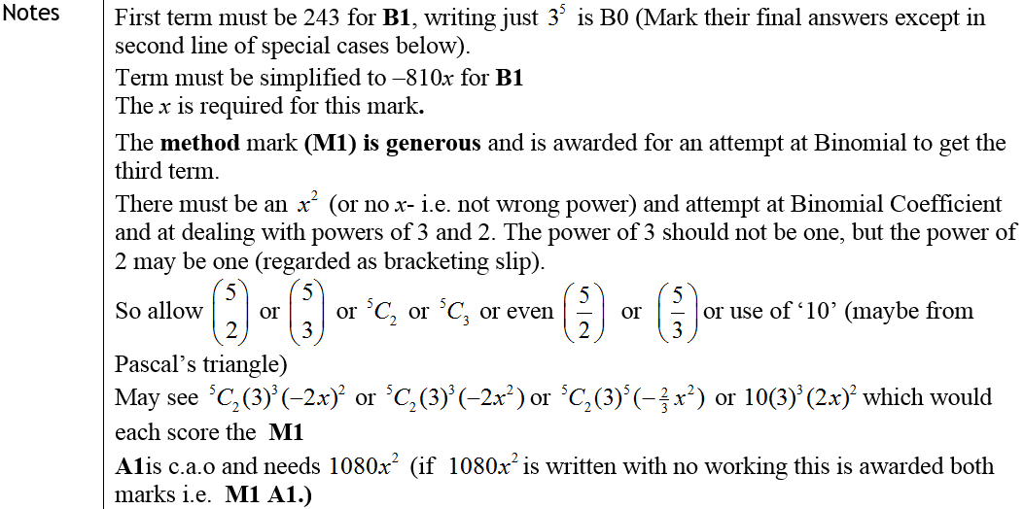
Jan 2009
A
Notes

Slide 38
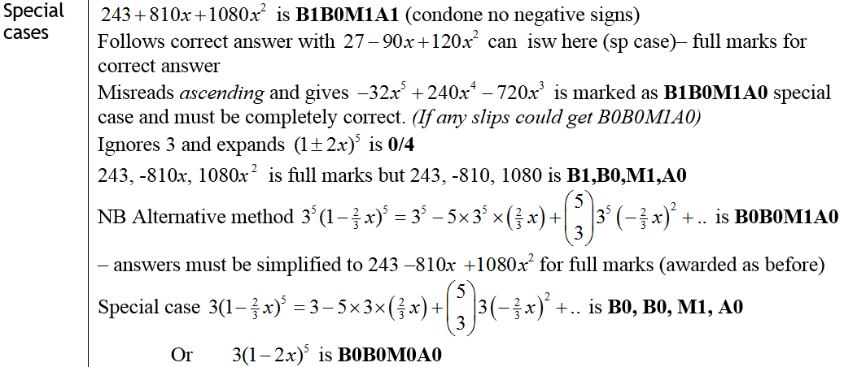
Jan 2009
Special Cases

Slide 39
June 2009

Slide 40
June 2009
A
B

Slide 41
Jan 2010

Slide 42
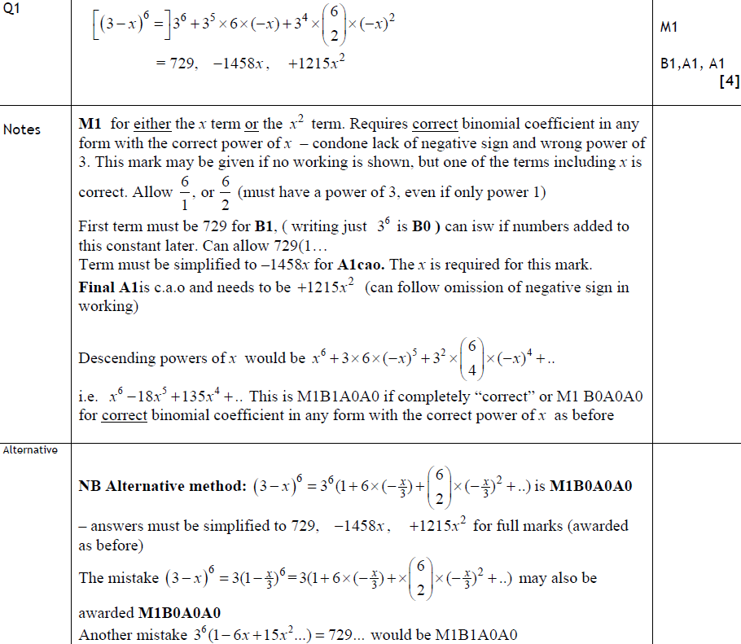
Jan 2010
A
Notes
Alternative Method

Slide 43
June 2010

Slide 44
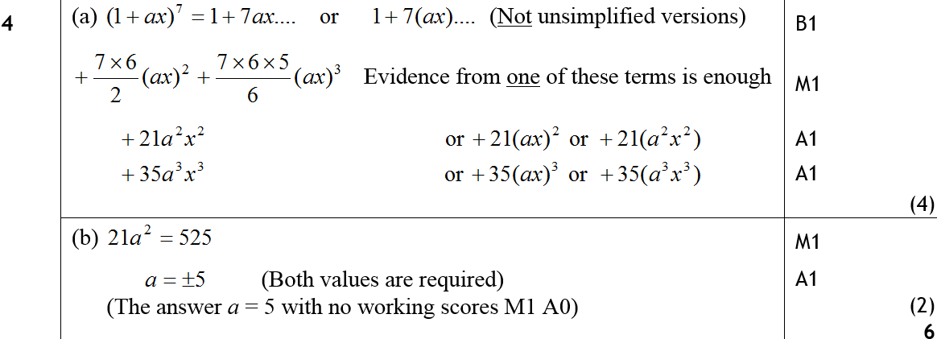
June 2010
A
B

Slide 45
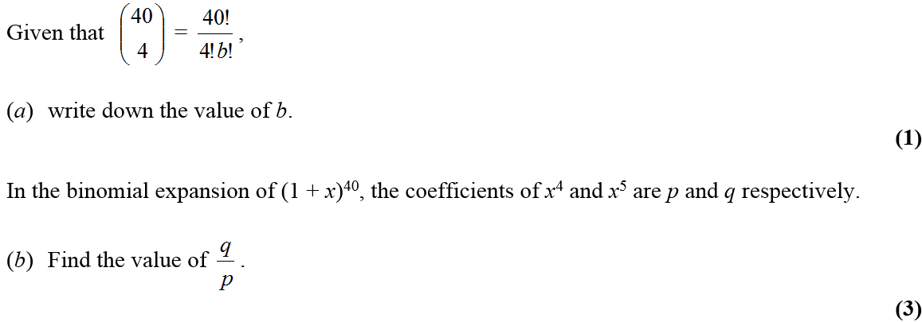
Jan 2011

Slide 46
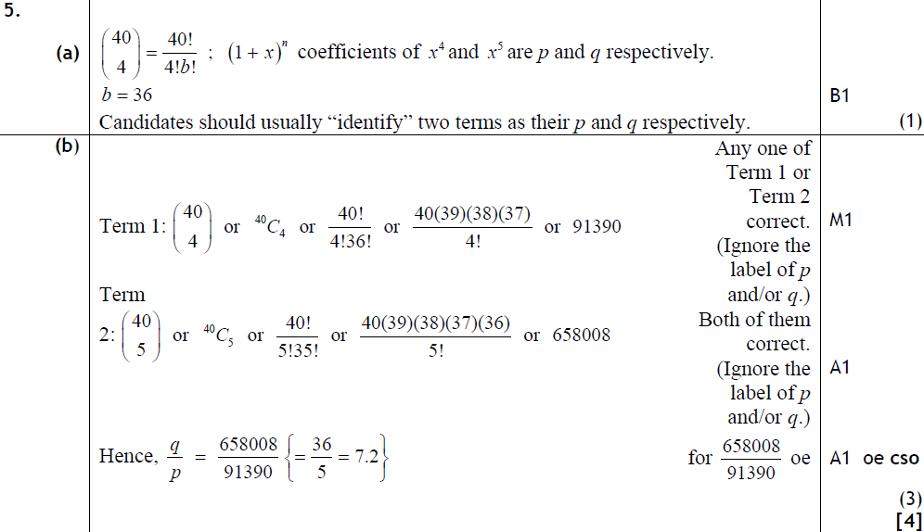
Jan 2011
A
B

Slide 47
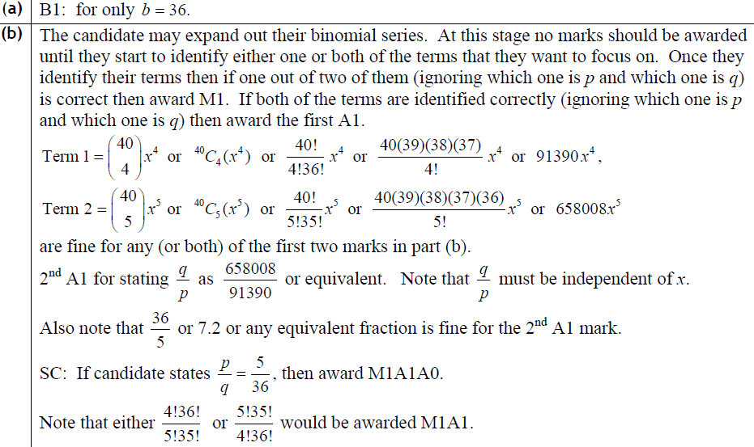
Jan 2011
A
B

Slide 48
May 2011

Slide 49
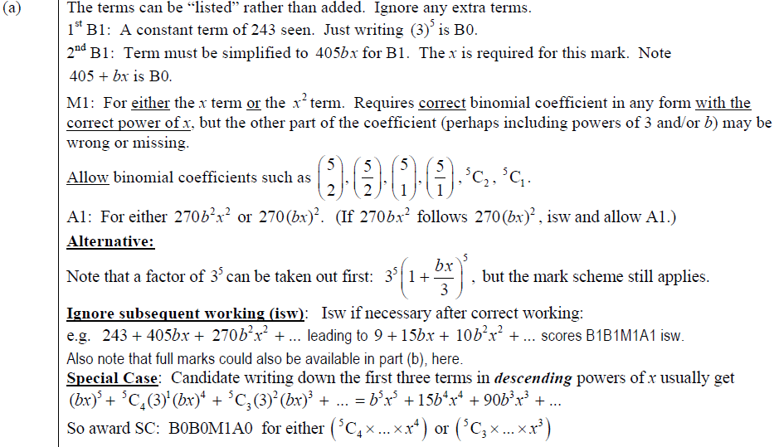
May 2011
A
B
A

Slide 50
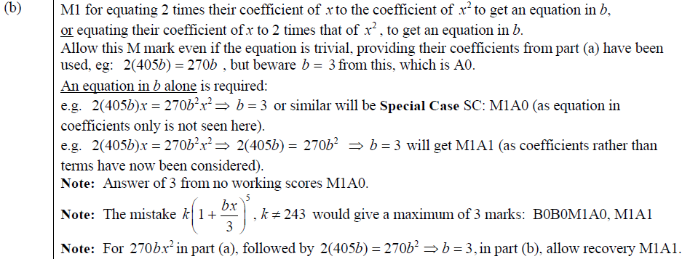
May 2011
B

Slide 51
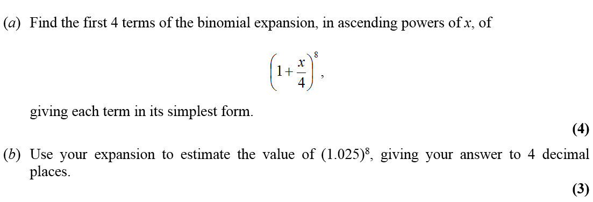
Jan 2012

Slide 52
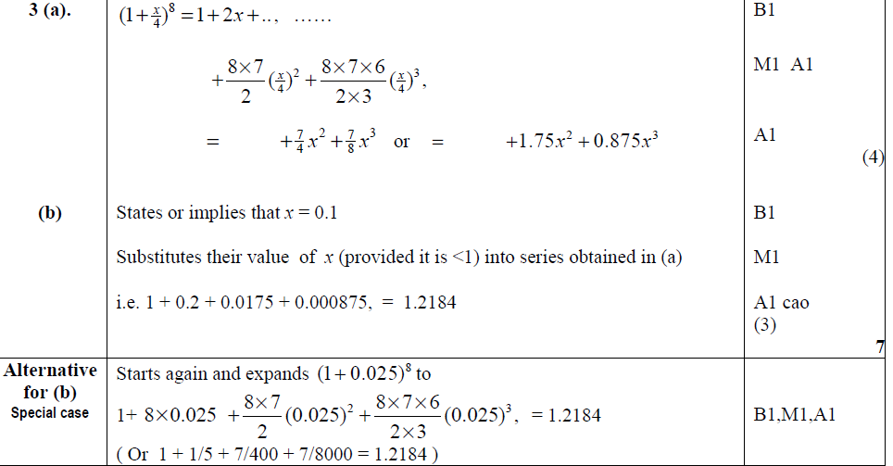
Jan 2012
A
B
Alternative B

Slide 53
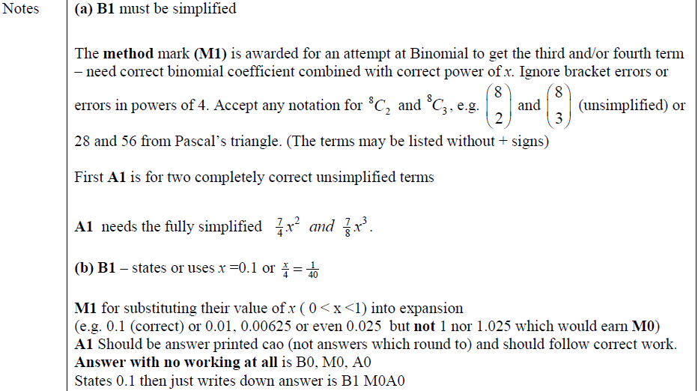
Jan 2012
A
B

Slide 54
May 2012

Slide 55
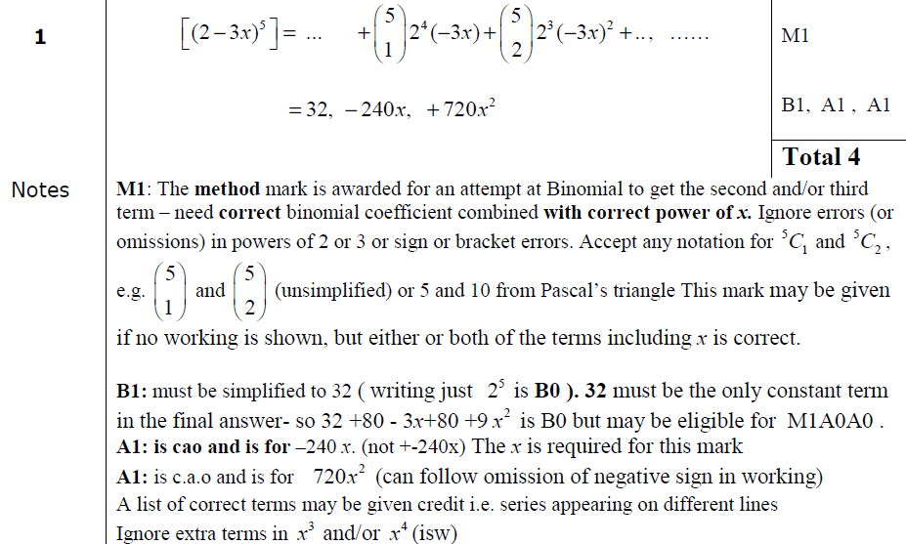
May 2012
A

Slide 56
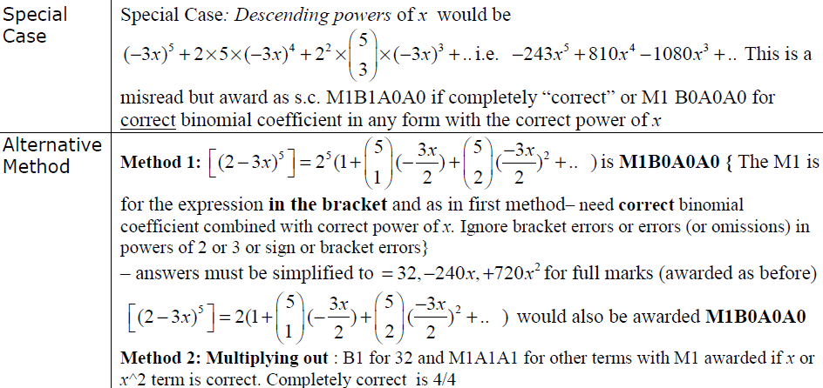
May 2012
Special Case
Alternative Methods

Slide 57
Jan 2013

Slide 58
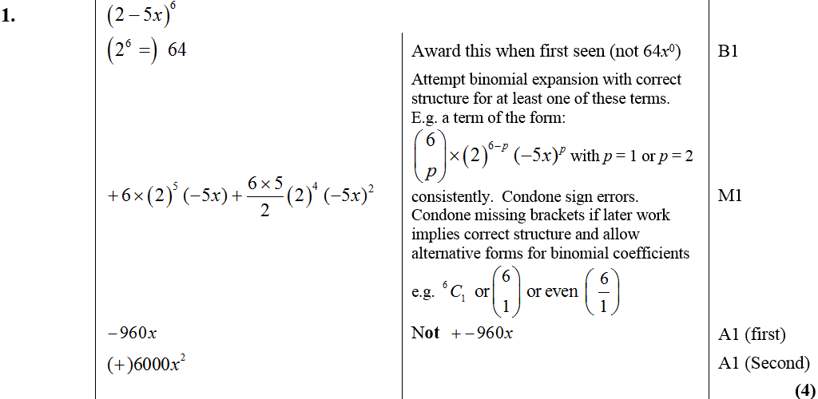
Jan 2013
A

Slide 59
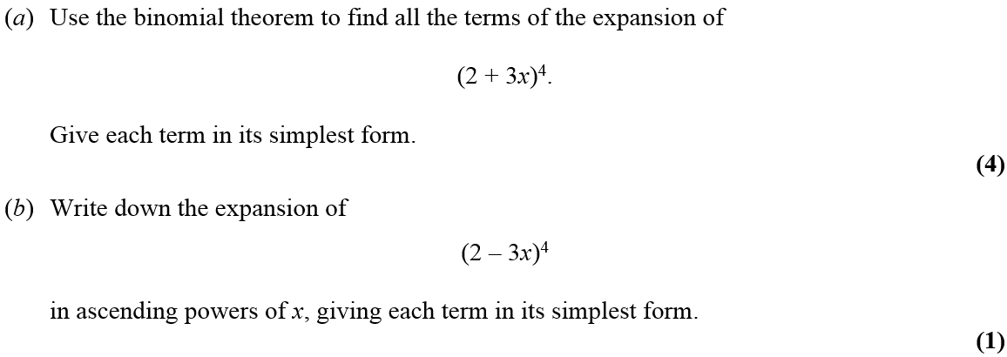
May 2013

Slide 60
May 2013
A
B

Slide 61
May 2014

Slide 62
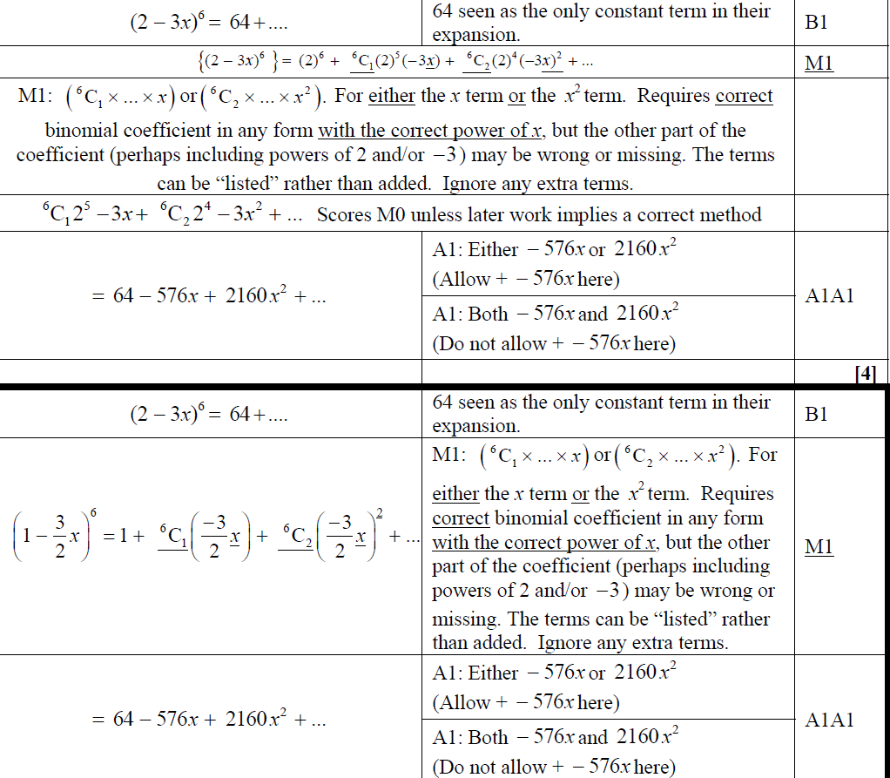
May 2014
A
Alternative A

Slide 63
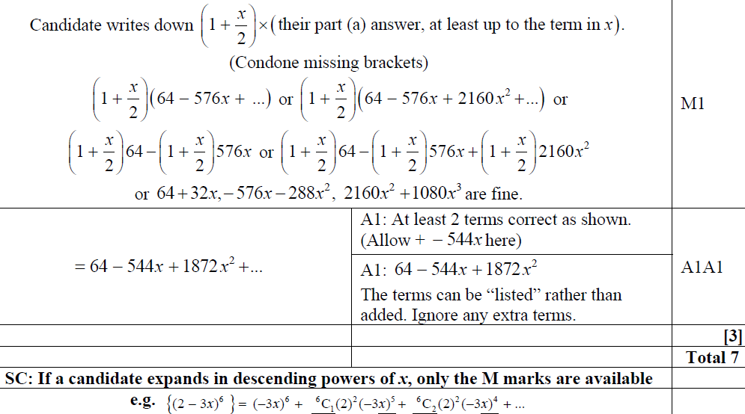
May 2014
B

Slide 64
May 2015

Slide 65
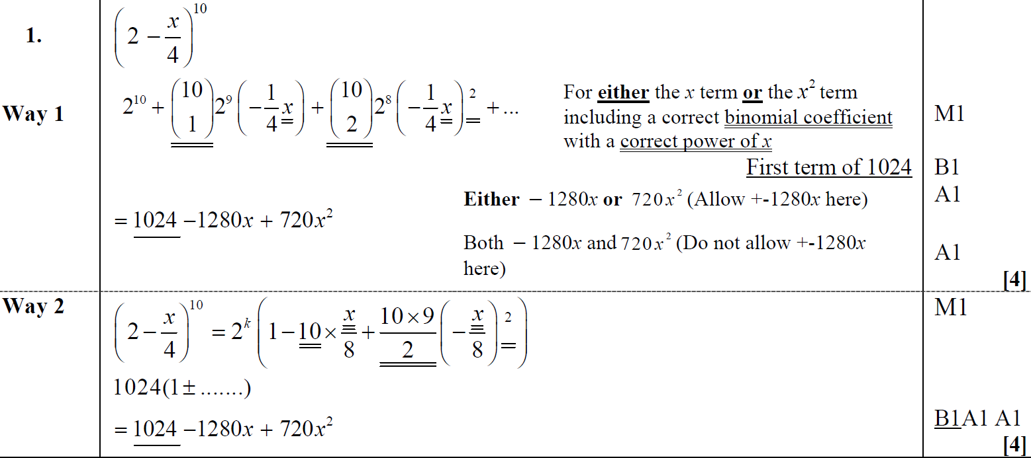
May 2015
A
A Alternative

Slide 66
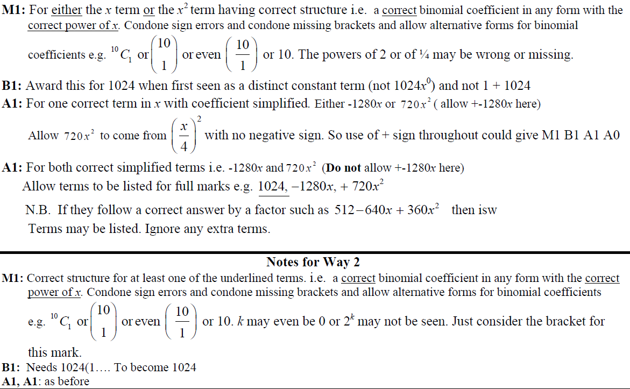
May 2015
A notes

Slide 67
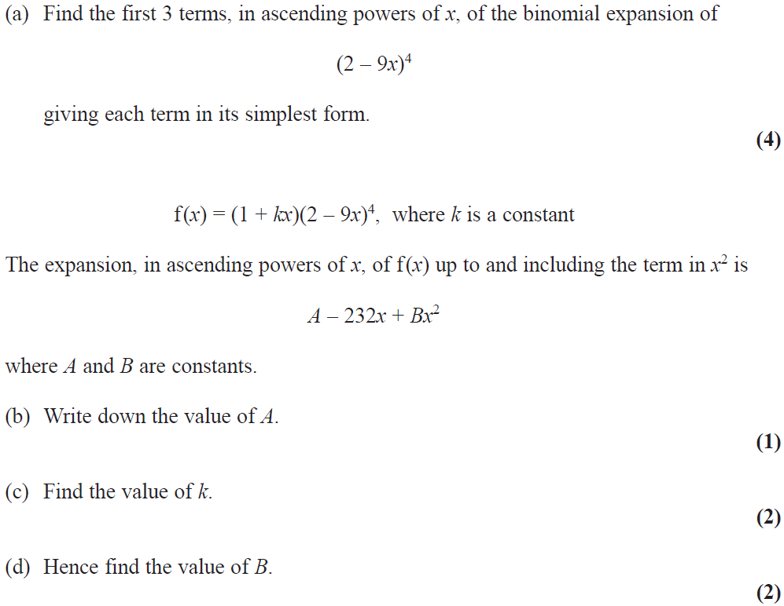
May 2016

Slide 68
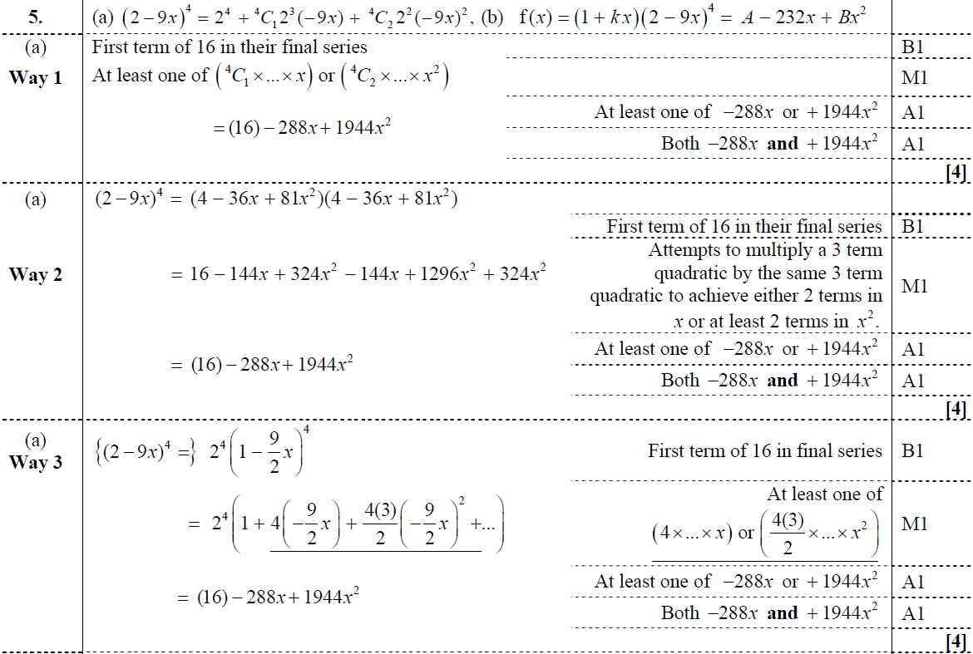
May 2016
A
A Alternative 1
A Alternative 2

Slide 69
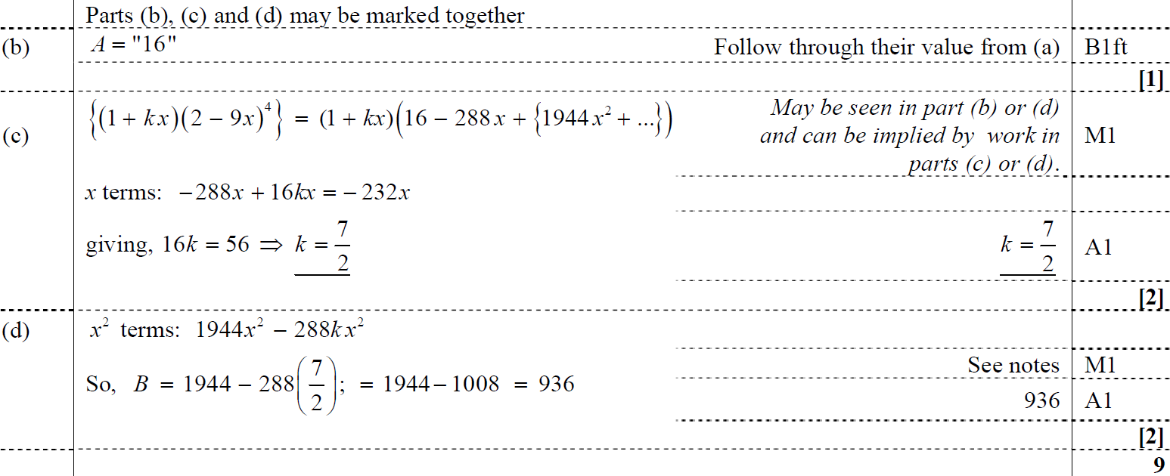
May 2016
B
C
D

Slide 70
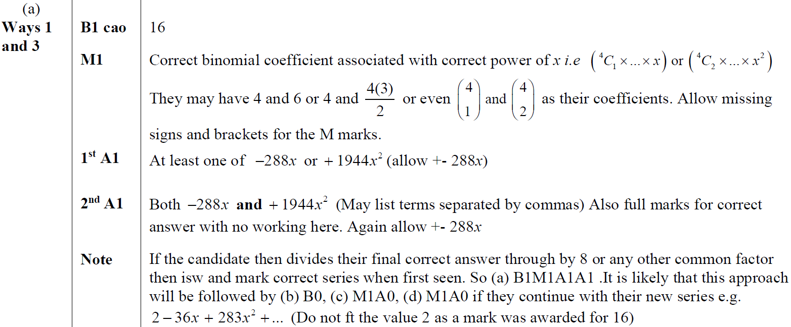
May 2016
A & A Alternative 2 notes

Slide 71
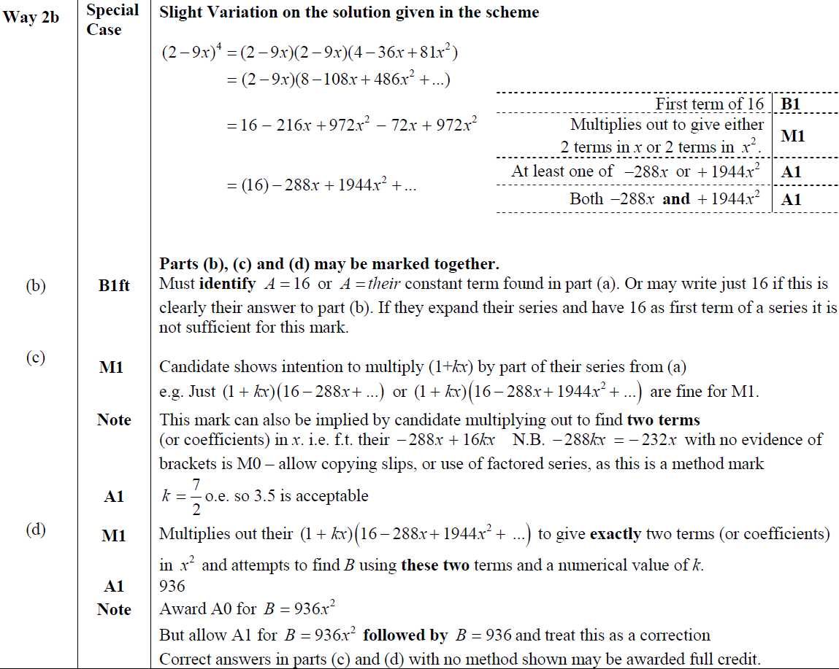
May 2016
A Alternative 1 notes
B notes
C notes
D notes

Slide 72
May 2017

Slide 73
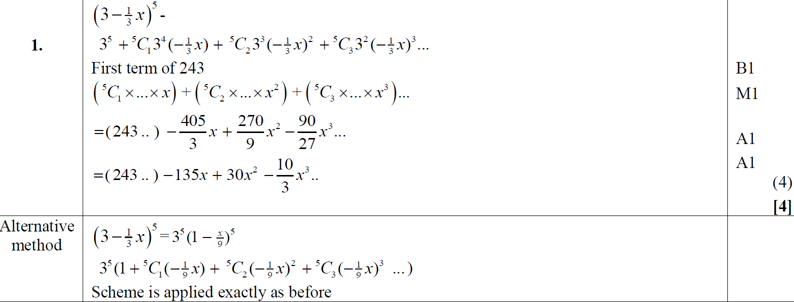
May 2017
A
A Alternative

Slide 74
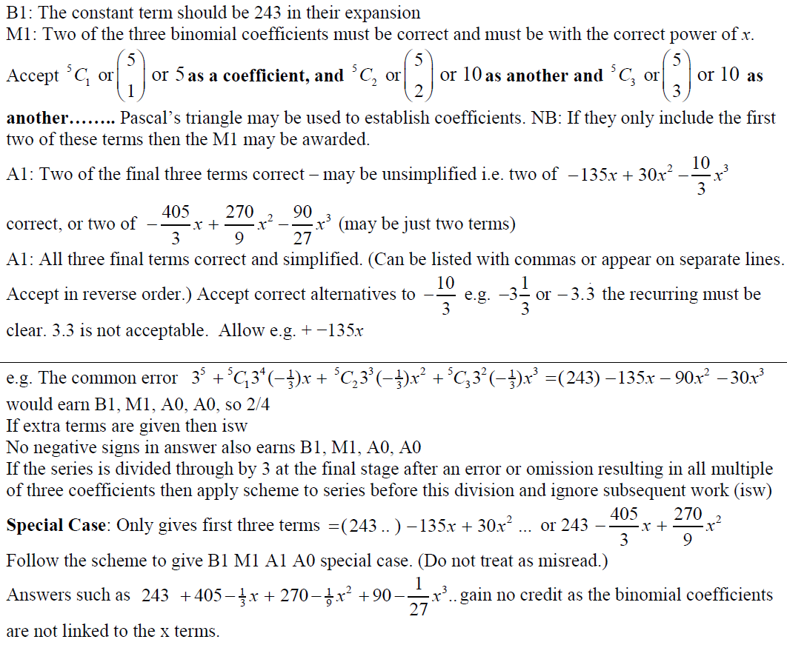
May 2017
A notes

Slide 75
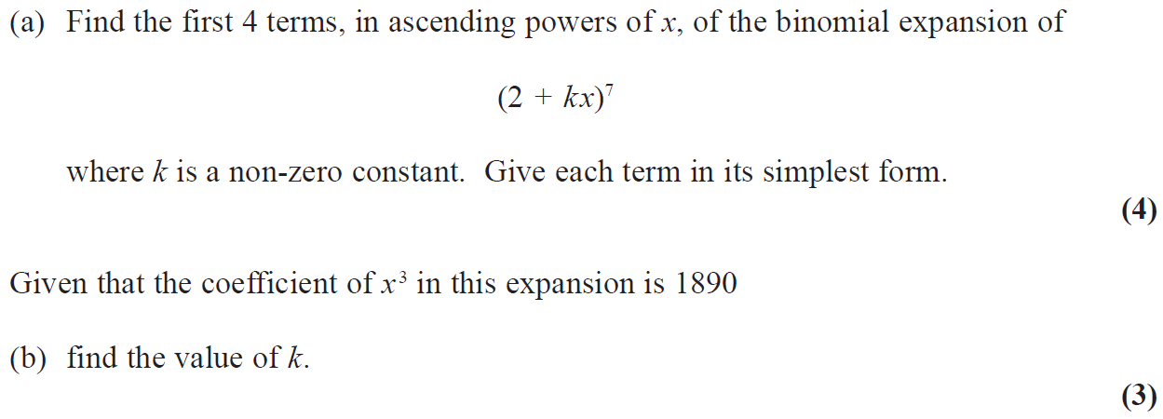
May 2018

Slide 76
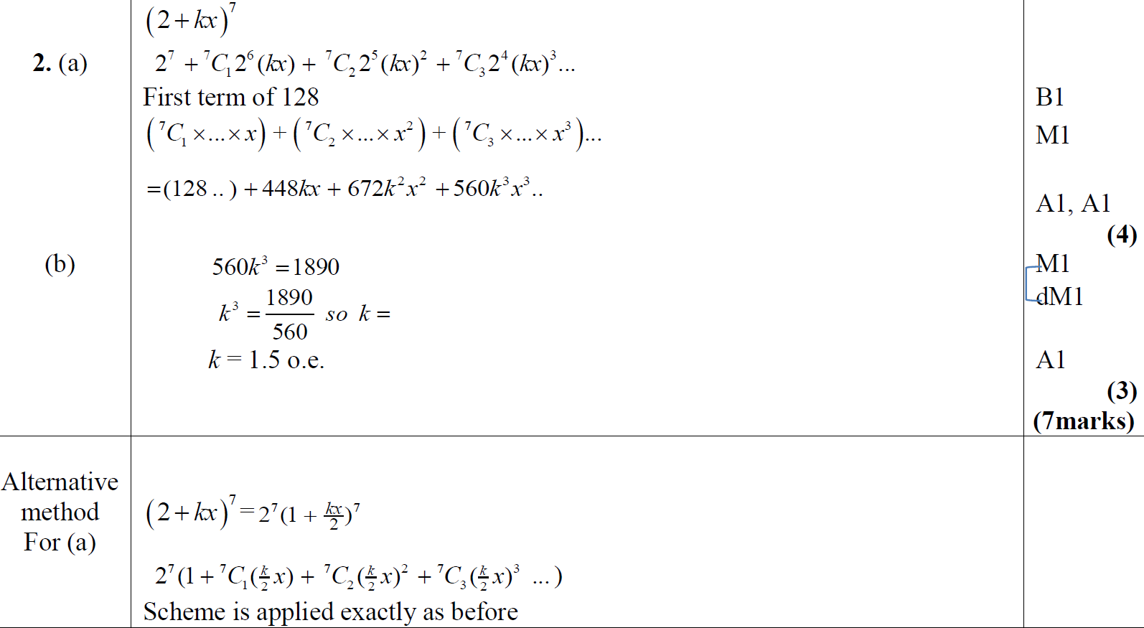
May 2018
A
B
A Alternative

Slide 77
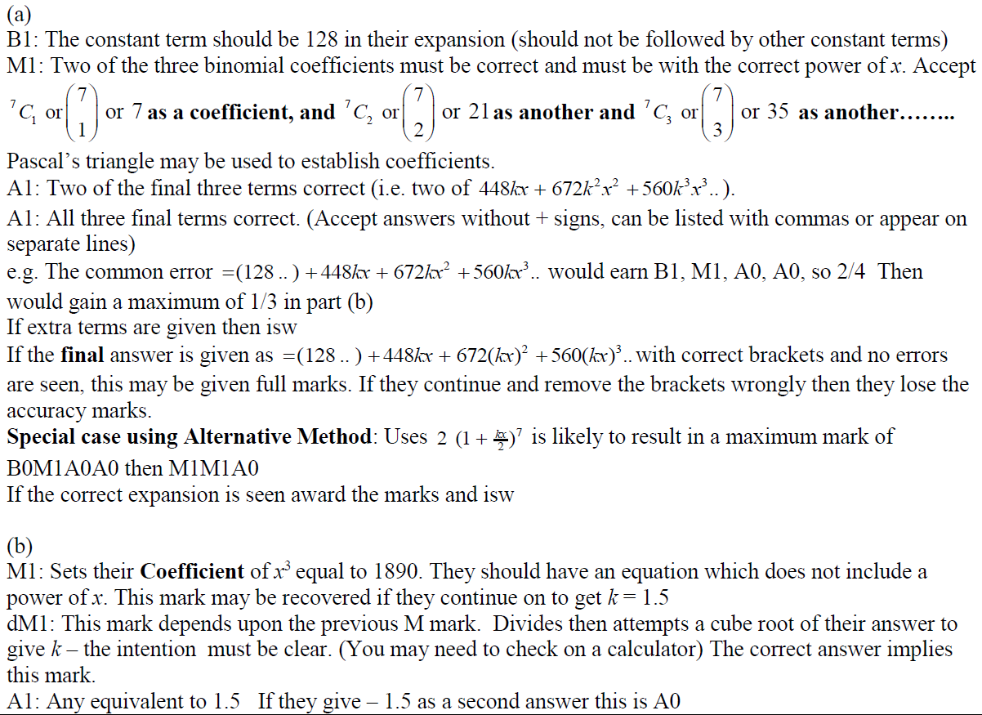
May 2018
A notes
B notes

