Slide 1
The Binomial Distribution
Through tree diagrams

Slide 2
Expand (a+b)²

Slide 3
Now let us consider the following:
We roll a fair dice and record the number of 6’s we roll
Represent this as a tree diagram

Slide 4












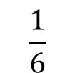






Now let us consider the following:
We roll a fair dice and record the number of 6’s we roll, and call this X
$${\left(\frac{1}{6}\right)}^{2}$$
$$\frac{1}{6}$$
Success
Find P(X=2)
$$\frac{1}{6}$$
Success
$$+$$
Find P(X=1)
$$\frac{5}{6}$$
$$\frac{1}{6}×\frac{5}{6}$$
Failure
$$+$$
Find P(X=0)
$$\frac{1}{6}$$
$$\frac{1}{6}×\frac{5}{6}$$
Success
$$\frac{5}{6}$$
Failure
$$+$$
$$\frac{5}{6}$$
$${\left(\frac{5}{6}\right)}^{2}$$
Failure
$${\left(\frac{1}{6}\right)}^{2}$$
$${\left(\frac{5}{6}\right)}^{2}$$
Note that these will sum to 1
$$2×\frac{1}{6}×\frac{5}{6}$$
$$+$$
$$+$$
$$1$$

Slide 5
Now let us consider the following:
We roll a fair dice twice and record the number of 6’s we roll, and call this X
Success 2 times
Success 1 time
Success 0 times
Does this look familiar?
(a+b)² = a² + 2 x a x b + b²
$${\left(\frac{1}{6}\right)}^{2}$$
$${\left(\frac{5}{6}\right)}^{2}$$
$$2×\frac{1}{6}×\frac{5}{6}$$
$$+$$
$$+$$

Slide 6
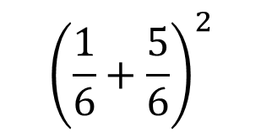
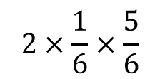
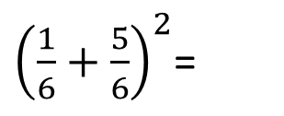
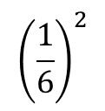


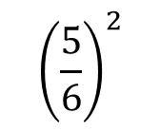
(a+b)² = a² + 2 x a x b + b²
$${\left(\frac{1}{6}\right)}^{2}$$
$${\left(\frac{5}{6}\right)}^{2}$$
What binomial would this have come from?
${\left(\frac{1}{6}+\frac{5}{6}\right)}^{2}$=
$$2×\frac{1}{6}×\frac{5}{6}$$
$$+$$
$$+$$
Success 2 times
Success 1 time
Success 0 times
$${\left(\frac{1}{6}+\frac{5}{6}\right)}^{2}$$
By writing probability outcomes as binomials we can quickly find probabilities for higher numbers of trials, rather than draw out huge tree diagrams
Success
Failure

Slide 7
Expand (a+b)³

Slide 8





























Now let us consider the following:
We roll a fair dice 3 times and record the number of 6’s we roll, and call this X
$${\left(\frac{1}{6}\right)}^{3}$$
Find P(X=3)
$$\frac{1}{6}$$
$$\frac{1}{6}$$
Success
Success
Failure
$${\left(\frac{1}{6}\right)}^{2}×\frac{5}{6}$$
$$\frac{1}{6}$$
Success
$$\frac{5}{6}$$
$$\frac{1}{6}$$
$${\left(\frac{1}{6}\right)}^{2}×\frac{5}{6}$$
Find P(X=2)
Failure
Success
$$\frac{5}{6}$$
$$\frac{1}{6}×{\left(\frac{5}{6}\right)}^{2}$$
$$\frac{5}{6}$$
Failure
$$\frac{1}{6}$$
$$\frac{1}{6}$$
$${\left(\frac{1}{6}\right)}^{2}×\frac{5}{6}$$
Success
Success
$$\frac{1}{6}×{\left(\frac{5}{6}\right)}^{2}$$
$$\frac{5}{6}$$
Failure
$$\frac{5}{6}$$
Failure
$$\frac{1}{6}$$
$$\frac{1}{6}×{\left(\frac{5}{6}\right)}^{2}$$
Find P(X=1)
Success
$$\frac{5}{6}$$
Failure
$${\left(\frac{5}{6}\right)}^{3}$$
$$\frac{5}{6}$$
Failure
Find P(X=0)
$${\left(\frac{1}{6}\right)}^{3}$$
$$3×{\left(\frac{1}{6}\right)}^{2}×\frac{5}{6}$$
$$3×\frac{1}{6}×{\left(\frac{5}{6}\right)}^{2}$$
$${\left(\frac{5}{6}\right)}^{3}$$
$$+$$
$$+$$
$$+$$
$$1$$

Slide 9
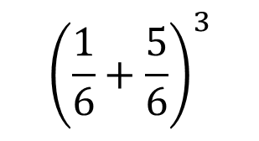
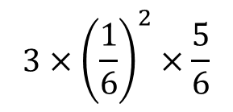
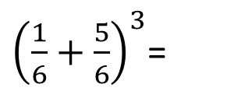




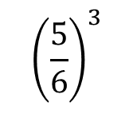
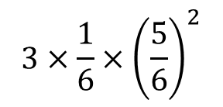
(a+b)³ = a³ + 3 x a² x b + 3 x a x b² + b³
${\left(\frac{1}{6}+\frac{5}{6}\right)}^{3}$=
$${\left(\frac{1}{6}\right)}^{3}$$
$$3×{\left(\frac{1}{6}\right)}^{2}×\frac{5}{6}$$
$$3×\frac{1}{6}×{\left(\frac{5}{6}\right)}^{2}$$
$${\left(\frac{5}{6}\right)}^{3}$$
What binomial would this have come from?
$$+$$
$$+$$
$$+$$
Success 3 times
Success 1 time
Success 2 times
Success 0 times
$${\left(\frac{1}{6}+\frac{5}{6}\right)}^{3}$$
By writing probability outcomes as binomials we can quickly find probabilities for higher numbers of trials, rather than draw out huge tree diagrams
Success
Failure

Slide 10
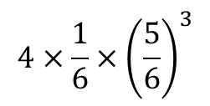

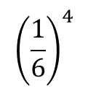
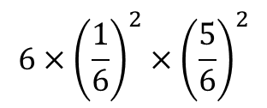

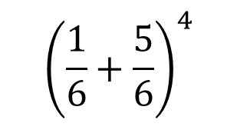

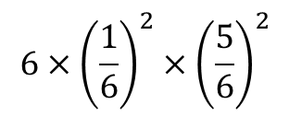
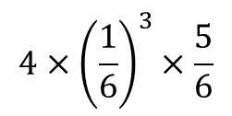
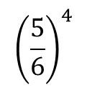


Now let us consider the following:
We roll a fair dice 4 times. By expanding (a + b)⁴, find the probability of rolling exactly two 6’s.
(a + b) ⁴ =
a⁴ + 4 x a³ x b + 6 x a² x b² + 4 x a x b³ + b⁴
So….
$${\left(\frac{1}{6}+\frac{5}{6}\right)}^{4}$$
$${\left(\frac{1}{6}\right)}^{4}$$
$$4×{\left(\frac{1}{6}\right)}^{3}×\frac{5}{6}$$
$$6×{\left(\frac{1}{6}\right)}^{2}×{\left(\frac{5}{6}\right)}^{2}$$
$$4×\frac{1}{6}×{\left(\frac{5}{6}\right)}^{3}$$
$${\left(\frac{5}{6}\right)}^{4}$$
=
$$+$$
$$+$$
$$+$$
$$+$$
Which probability represents rolling exactly two 6’s?
Success
Failure
$$6×{\left(\frac{1}{6}\right)}^{2}×{\left(\frac{5}{6}\right)}^{2}$$
So P (X = 2) =
$=$ 0.1157047047…
$=$ 0.116 (3SF)

Slide 11








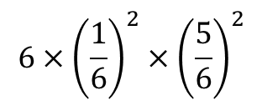













Still not convinced?
This is the last diagram, and furthest I will go with a tree diagram
$$\frac{1}{6}$$
Success
Find P(X=2)
$$\frac{1}{6}$$
Success
Success
$$\frac{5}{6}$$
Failure
$$\frac{1}{6}$$
Failure
$$\frac{1}{6}$$
Success
$$\frac{5}{6}$$
$${\left(\frac{1}{6}\right)}^{2}×{\left(\frac{5}{6}\right)}^{2}$$
Success
Failure
$$\frac{5}{6}$$
$$\frac{1}{6}$$
$$\frac{1}{6}$$
$$\frac{1}{6}$$
Success
Success
$${\left(\frac{1}{6}\right)}^{2}×{\left(\frac{5}{6}\right)}^{2}$$
$$\frac{5}{6}$$
Failure
Failure
$$\frac{5}{6}$$
$$\frac{1}{6}$$
$${\left(\frac{1}{6}\right)}^{2}×{\left(\frac{5}{6}\right)}^{2}$$
$$\frac{5}{6}$$
Failure
Success
Failure
$$\frac{5}{6}$$
$$\frac{1}{6}$$
Success
$$\frac{1}{6}$$
Success
$${\left(\frac{1}{6}\right)}^{2}×{\left(\frac{5}{6}\right)}^{2}$$
So P (X = 2)
Failure
$$\frac{1}{6}$$
Success
$$\frac{5}{6}$$
$$\frac{5}{6}$$
$$\frac{1}{6}$$
Success
$${\left(\frac{1}{6}\right)}^{2}×{\left(\frac{5}{6}\right)}^{2}$$
$$\frac{5}{6}$$
Failure
Failure
$$6×{\left(\frac{1}{6}\right)}^{2}×{\left(\frac{5}{6}\right)}^{2}$$
Failure
$$\frac{5}{6}$$
$${\left(\frac{1}{6}\right)}^{2}×{\left(\frac{5}{6}\right)}^{2}$$
$$\frac{1}{6}$$
$$\frac{1}{6}$$
Success
$$=$$
$$\frac{5}{6}$$
Success
Failure
Failure
$$\frac{5}{6}$$
$$\frac{5}{6}$$
$$\frac{1}{6}$$
Success
$=$ 0.1157407407…
Failure
Failure
$=$ 0.116 (3SF)
$$\frac{5}{6}$$

Slide 12



In General if P(Success) = p, then to find P(X = a) from n trials
P (X = a)
=
$$\left(\begin{matrix}n \\ a\end{matrix}\right)$$
$$×{\left(p\right)}^{a}×{\left(1−p\right)}^{n−a}$$
From the expansion where
$${\left(p+(1−p)\right)}^{n}$$
Success
Failure

