Slide 1
Algebraic fractions (7.1)

Slide 2
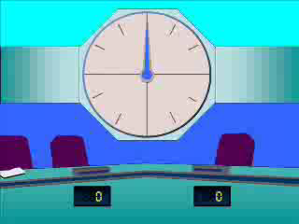
1
Simplify the following if possible:
$$\frac{t^{2}+t−2}{t−1}$$
a) $t+2$
b) $t−2$
c) $t−1$
d) Does not simplify

Slide 3
2
Simplify the following if possible:
$$\frac{4t^{2}−4t−48}{6t−24}$$
a) $2(t−4)$
b) $\frac{4\left(t+1\right)}{3}$
c) $\frac{2\left(t+3\right)}{3}$
d) Does not simplify

Slide 4
3
Simplify the following if possible:
$$\frac{5t−10}{t^{2}+3t+10}$$
a) $\frac{5}{t+3}$
b) $\frac{5t}{t^{2}+3t}$
c) $\frac{5}{t+5}$
d) Does not simplify

Slide 5
4
Simplify the following if possible:
$$\frac{t^{2}−5t+6}{t^{2}+2t−15}$$
a) $−\frac{2}{5}$
b) $\frac{−5t+2}{2t−5}$
c) $\frac{t+2}{t−5}$
d) $\frac{t−2}{t+5}$

Slide 6
5
Simplify the following if possible:
$$\frac{2t^{2}−8}{t^{2}−3t−10}$$
a) $\frac{2(x−2)(x−2)}{(x−5)(x+2)}$
b) $\frac{2(t^{2}−4)}{(t−5)(t+2)}$
c) $\frac{2(t−2)}{t−5}$
d) $2−\frac{8}{3t−10}$

