Slide 1
Inequalities on graphs and regions (3.6 & 3.7)

Slide 2
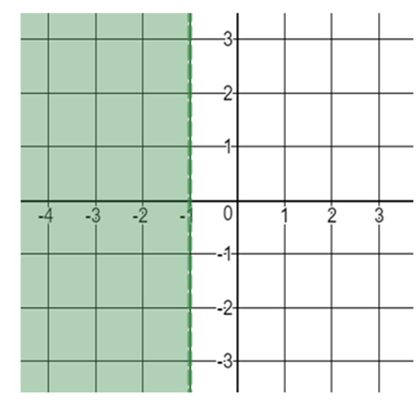
1
Which inequality is represented by the
shaded region?
a) $x<−1$
b) $y<−1$
c) $y<−1$
d) $x>−1$

Slide 3
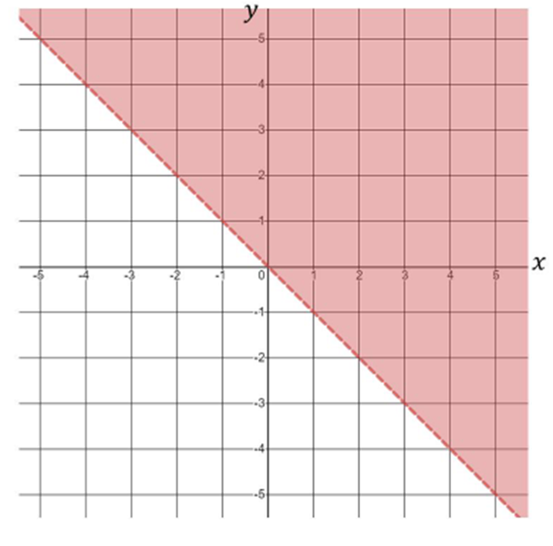
2
Which inequality is represented by the
shaded region?
a) $y>x$
b) $y<x$
c) $y>−x$
d) $y<−x$

Slide 4
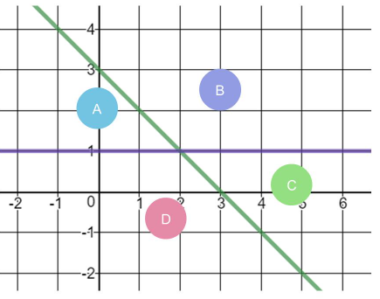
3
Which letter describes the region where
$x+y≤3$ and $y≤1$?
a)
b)
c)
d)

Slide 5
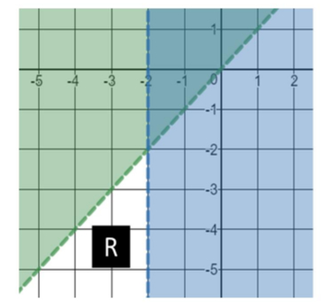
4
Which inequalities represent the
region R?
a) $y<x, x<−2$
b) $y>x, x<−2$
c) $y>x, x>−2$
d) $y<x, x>−2$

