Slide 1
Quadratic inequalities (3.5)

Slide 2
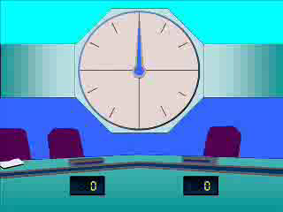
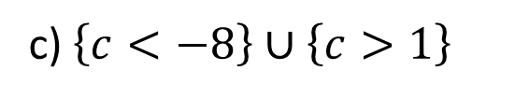
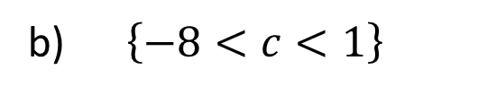
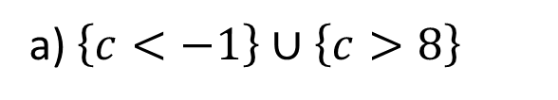

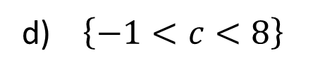
1
Solve:
$$\left(c+8\right)\left(c−1\right)>0$$
a) $\left\{c<−1\right\}∪\left\{c>8\right\}$
b) $\left\{−8<c<1\right\}$
c) $\left\{c<−8\right\}∪\left\{c>1\right\}$
d) $\left\{−1<c<8\right\}$

Slide 3
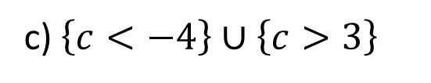
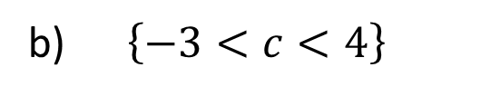
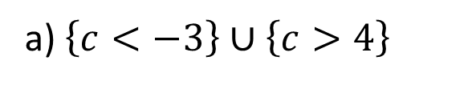

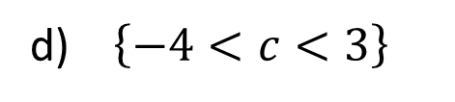
2
Solve:
$$\left(c+3\right)\left(c−4\right)<0$$
a) $\left\{c<−3\right\}∪\left\{c>4\right\}$
b) $\left\{−3<c<4\right\}$
c) $\left\{c<−4\right\}∪\left\{c>3\right\}$
d) $\left\{−4<c<3\right\}$

Slide 4
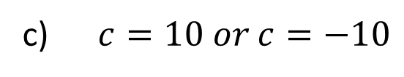
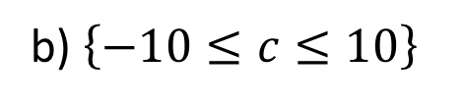
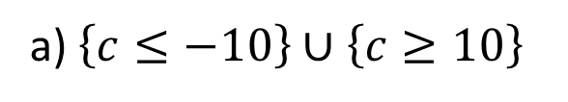

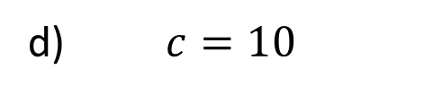
3
Solve:
$$c^{2}−100≤0$$
a) $\left\{c≤−10\right\}∪\left\{c≥10\right\}$
b) $\left\{−10≤c≤10\right\}$
c) $c=10 or c=−10$
d) $c=10$

Slide 5
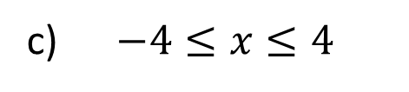
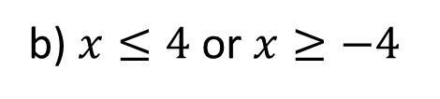
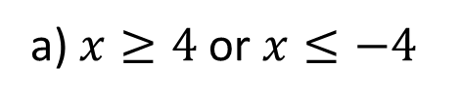

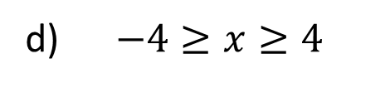
4
Solve:
$$x^{2}≥16$$
a) $x≥4$ or $x≤−4$
b) $x≤4$ or $x≥−4$
c) $−4≤x≤4$
d) $−4≥x≥4$

Slide 6
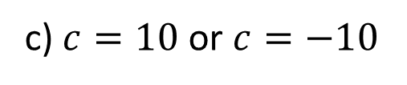
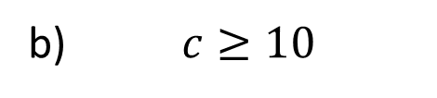
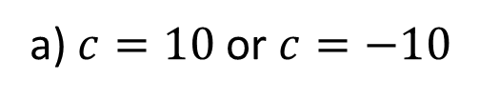

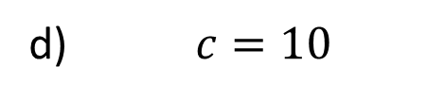
5
Solve:
$${\left(c−10\right)}^{2}≤0$$
a) $c=10$ or $c=−10$
b) $c≥10$
c) $c=10$ or $c=−10$
d) $c=10$

