Slide 1
Linear simultaneous equations (3.1)

Slide 2
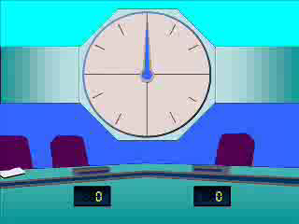

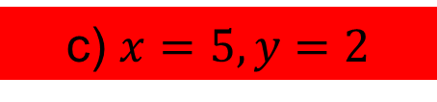
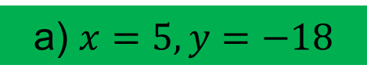
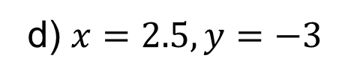
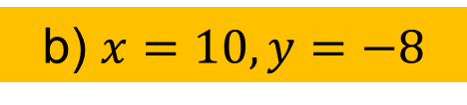
1
Solve the following:
$$\left\{\begin{aligned}4x−2y=16 \\ −2x−3y=4\end{aligned}\right.$$
a) $x=5, y=−18$
b) $x=10, y=−8$
c) $x=5, y=2$
d) $x=2.5, y=−3$

Slide 3

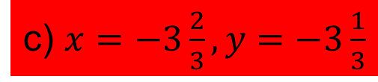
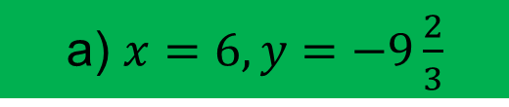
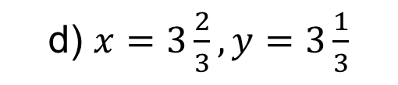
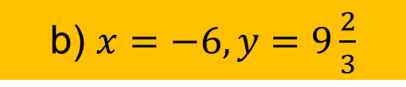
2
Solve the following:
$$\left\{\begin{aligned}2x+3y=17 \\ 4x+3y=5\end{aligned}\right.$$
a) $x=6, y=−9\frac{2}{3}$
b) $x=−6, y=9\frac{2}{3}$
c) $x=−3\frac{2}{3}, y=−3\frac{1}{3}$
d) $x=3\frac{2}{3}, y=3\frac{1}{3}$

Slide 4

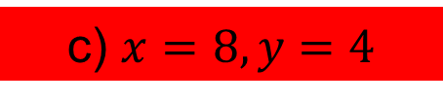
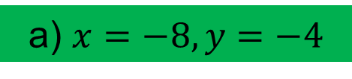
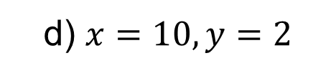
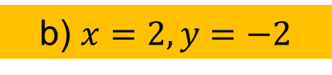
3
Solve the following:
$$\left\{\begin{aligned}x+y=12 \\ x−y=4\end{aligned}\right.$$
a) $x=−8, y=−4$
b) $x=2, y=−2$
c) $x=8, y=4$
d) $x=10, y=2$

Slide 5

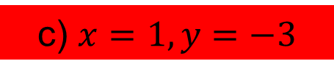
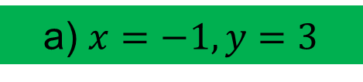
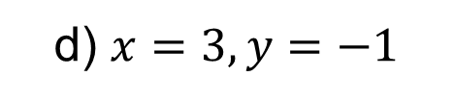
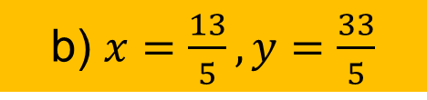
4
Solve the following:
$$\left\{\begin{aligned}2x+3y=7 \\ y=x+4\end{aligned}\right.$$
a) $x=−1, y=3$
b) $x=\frac{13}{5}, y=\frac{33}{5}$
c) $x=1, y=−3$
d) $x=3, y=−1$

Slide 6

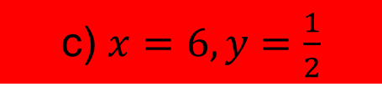
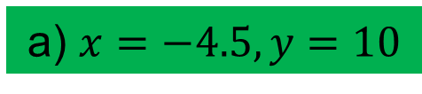
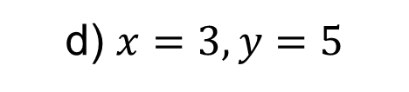
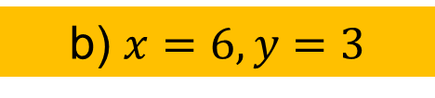
5
Solve the following:
$$\left\{\begin{aligned}3x+2y=19 \\ 2x+3y=21\end{aligned}\right.$$
a) $x=−4.5, y=10$
b) $x=6, y=3$
c) $x=6, y=\frac{1}{2}$
d) $x=3, y=5$

