Slide 1
The discriminant (2.5)

Slide 2
1
The function $f$ is given by $f\left(x\right)=4x^{2}−12x+9$
Which condition describes the nature of the roots
of $f\left(x\right)=0$?
a) Equal roots
b) Exactly three distinct roots
c) Exactly two distinct roots
d) No real roots

Slide 3
2
The equation $x^{2}+2x+p=0$ has no real roots.
What is the range of values of $p$?
a) $p<−1$
b) $p<0$
c) $p>0$
d) $p>1$

Slide 4
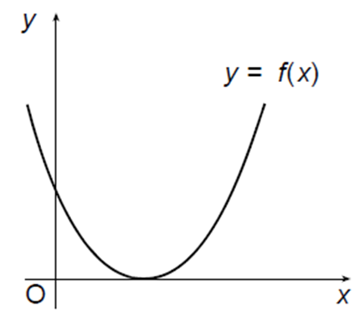
3
The diagram shows part of the graph of a parabola
with equation $y=px^{2}+qx+r$. The $x$-axis is a
tangent to the parabola. What is the relationship
between $p, q$ and $r$?
a) $q^{2}=4pr$
b) $q^{2}<4pr$
c) $q^{2}>4pr$
d) $q^{2}=−4pr$

Slide 5
4
The equation $px^{2}+6x+1=0$ has repeated roots.
What is the value of $p$?
a) $−9$
b) $9$
c) $0$
d) $\frac{1}{9}$

Slide 6
5
The equation $x^{2}−3px+1=0$ has no real roots.
What is the range of values of $p$?
a) $−\frac{2}{3}<p>\frac{2}{3}$
b) $−\frac{2}{3}>p>\frac{2}{3}$
c) $−\frac{2}{3}<p<\frac{2}{3}$
d) $−\frac{2}{3}>p<\frac{2}{3}$

