Slide 1
Quadratic graphs (2.4)

Slide 2
1
What are the coordinates of where the curve
$y=x^{2}−4x−11$ crosses the $y$-axis?
a) $(11,0)$
b) $(0,−11)$
c) $(0,11)$
d) $(−11,0)$

Slide 3
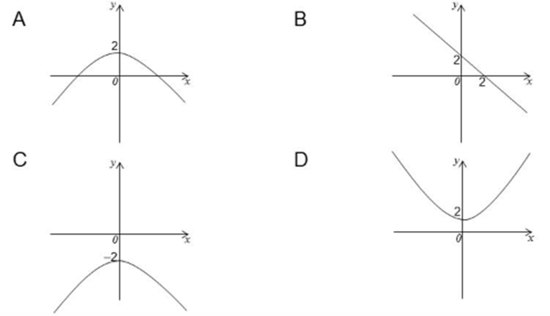
2
Which of the graphs shown below is the graph
$y=2−x^{2}$?
a) $A$
b) $B$
c) $C$
d) $D$

Slide 4
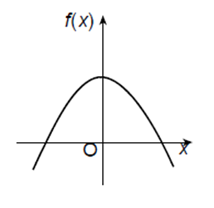
3
The diagram shows the graph of the function $f$
where $f\left(x\right)=p{\left(x−q\right)}^{2}+r$. The line $x=0$
is an axis of symmetry of the curve. Which of
the following is true about $p, q$ and $r$?
a) $p>0, q>0, r>0$
b) $p>0, q=0, r<0$
c) $p<0, q=0, r>0$
d) $p<0, q<0, r=0$

Slide 5
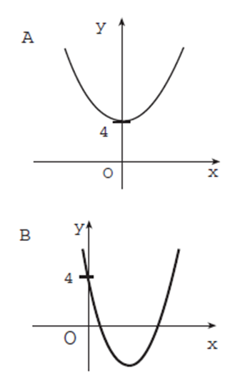
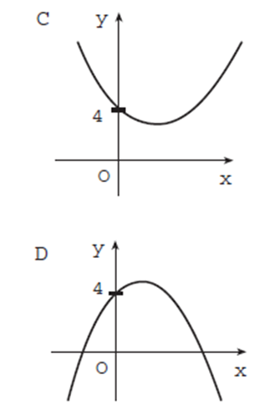
4
Which of the graphs shown below is most likely
to be the graph with equation $y=3x^{2}−2x+4$?
a) $A$
b) $B$
c) $C$
d) $D$

Slide 6
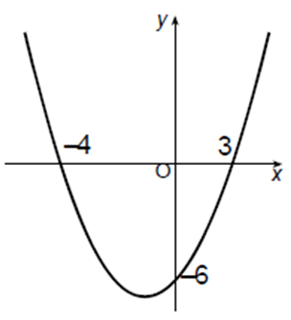
5
The diagram shows the graph of a parabola. What
is the equation of this graph?
a) $y=\frac{1}{2}x^{2}+\frac{1}{2}x−6$
b) $y=x^{2}+x−12$
c) $y=\frac{1}{2}x^{2}−\frac{1}{2}x−6$
d) $y=6x^{2}+6x−72$

Slide 7
6
The roots of a quadratic equation are $−1$ and $p$.
Which of the following could be the quadratic
equation?
a) $x^{2}+\left(1−p\right)x−p=0$
b) $x^{2}−\left(1+p\right)x+p=0$
c) $x^{2}+\left(1+p\right)x+p=0$
d) $x^{2}+\left(p−1\right)x−p=0$

