Slide 1
Functions (2.3)

Slide 2
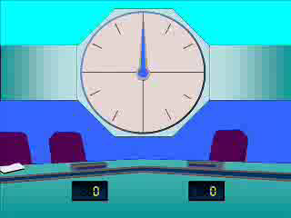
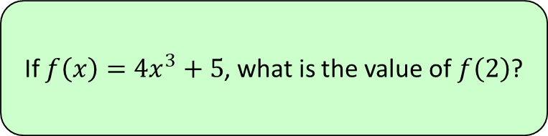




1
If $f\left(x\right)=4x^{3}+5$, what is the value of $f\left(2\right)$?
a) $22$
b) $26$
c) $37$
d) $48$

Slide 3
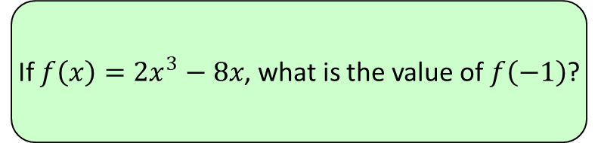




2
If $f\left(x\right)=2x^{3}−8x$, what is the value of $f\left(−1\right)$?
a) $−2$
b) $0$
c) $4.5$
d) $6$

Slide 4
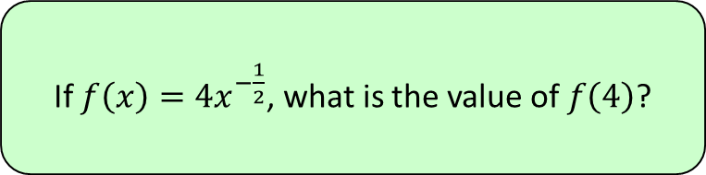




3
If $f\left(x\right)=4x^{−\frac{1}{2}}$, what is the value of $f\left(4\right)$?
a) $−\frac{1}{4}$
b) $\frac{1}{4}$
c) $2$
d) $4$

Slide 5
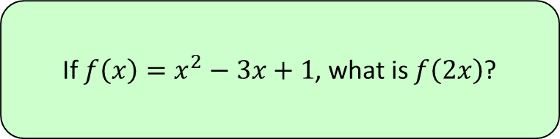
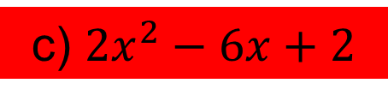
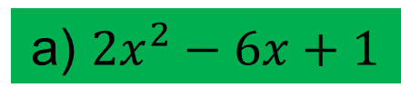
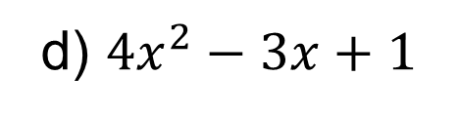
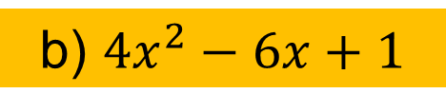
4
If $f\left(x\right)=x^{2}−3x+1$, what is $f\left(2x\right)$?
a) $2x^{2}−6x+1$
b) $4x^{2}−6x+1$
c) $2x^{2}−6x+2$
d) $4x^{2}−3x+1$

Slide 6
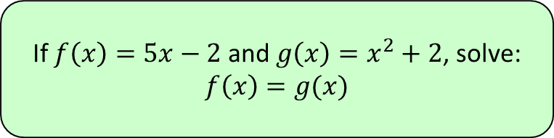
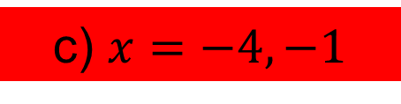

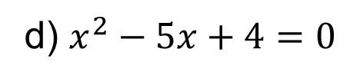

5
If $f\left(x\right)=5x−2$ and $g\left(x\right)=x^{2}+2$, solve:
$$f\left(x\right)=g(x)$$
a) $x=0, 5$
b) $x=4, 1$
c) $x=−4, −1$
d) $x^{2}−5x+4=0$

