Slide 1
Completing the square (2.2)

Slide 2
1
When $x^{2}+8x+5$ is expressed in the
form ${\left(x+a\right)}^{2}+b$, what is the value of $b$?
a) $−59$
b) $−11$
c) $0$
d) $5$

Slide 3
2
A parabola has equation $y=x^{2}+6x−8$.
At what value of $x$ does the minimum
point of the parabola occur?
a) $−8$
b) $−3$
c) $0$
d) $3$

Slide 4
3
Which of the following could be the
equation of this curve?
$$(2,1)$$
a) ${\left(x−2\right)}^{2}−1$
b) ${\left(x+1\right)}^{2}−2$
c) ${\left(x−2\right)}^{2}+1$
d) ${\left(x+2\right)}^{2}+1$

Slide 5
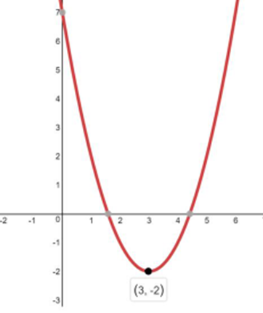
4
Which of the following could be the
equation of this curve?
$$(3,−2)$$
a) ${\left(x−3\right)}^{2}−2$
b) ${\left(x+3\right)}^{2}−2$
c) ${\left(x−2\right)}^{2}+3$
d) ${\left(x−2\right)}^{2}−3$

Slide 6
5
When $2x^{2}−12x+13$ is expressed in the
form $2{\left(x+q\right)}^{2}+r$, what is the value of $r$?
a) $13$
b) $1$
c) $−5$
d) $−13$

Slide 7
6
When $2x^{2}−8x+7$ is expressed in the
form $2{\left(x+q\right)}^{2}+r$, what is the value of $r$?
a) $−1$
b) $1$
c) $−5$
d) $5$

