Slide 1
Solving quadratics (2.1)

Slide 2
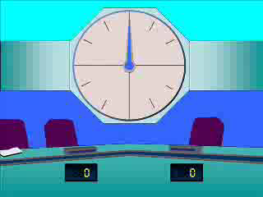
1
Find the solutions to the following
quadratic equation:
$$x^{2}+5x+6=0$$
a) $x=2, 3$
b) $x=2, −3$
c) $x=−2, 3$
d) $x=−2, −3$

Slide 3
2
Find the solutions to the following
quadratic equation:
$$4x^{2}−9=0$$
a) $x=\frac{3}{2}, −\frac{3}{2}$
b) $x=\frac{9}{4}$
c) $x=\frac{3}{2}$
d) $x=\frac{9}{4}, −\frac{9}{4}$

Slide 4
3
Find the solutions to the following
quadratic equation:
$$3x^{2}−18=9$$
a) $x=3$
b) $x=−3$
c) $x=3, −3$
d) $x=\sqrt{3}, −\sqrt{3}$

Slide 5
4
Find the solutions to the following
quadratic equation:
$$5x^{2}−39x−8=0$$
a) $x=−8, −\frac{1}{5}$
b) $x=8, −\frac{1}{5}$
c) $x=8,\frac{1}{5}$
d) $x=−8,\frac{1}{5}$

Slide 6
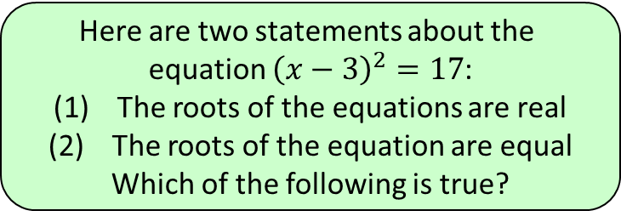
5
Here are two statements about the
equation ${\left(x−3\right)}^{2}=17$:
The roots of the equations are real
The roots of the equation are equal
Which of the following is true?
a) Neither statement is correct
b) Only statement (1) is correct
c) Only statement (2) is correct
d) Both statements are correct

